Slide 1
EGI Pay-per-use model

Slide 2
Outline
Status of the EGI Pay-per-use group
Resources allocation in 2021
6 projects (2 mins presentation)
Round-table discussion with the providers
AoB

Slide 3
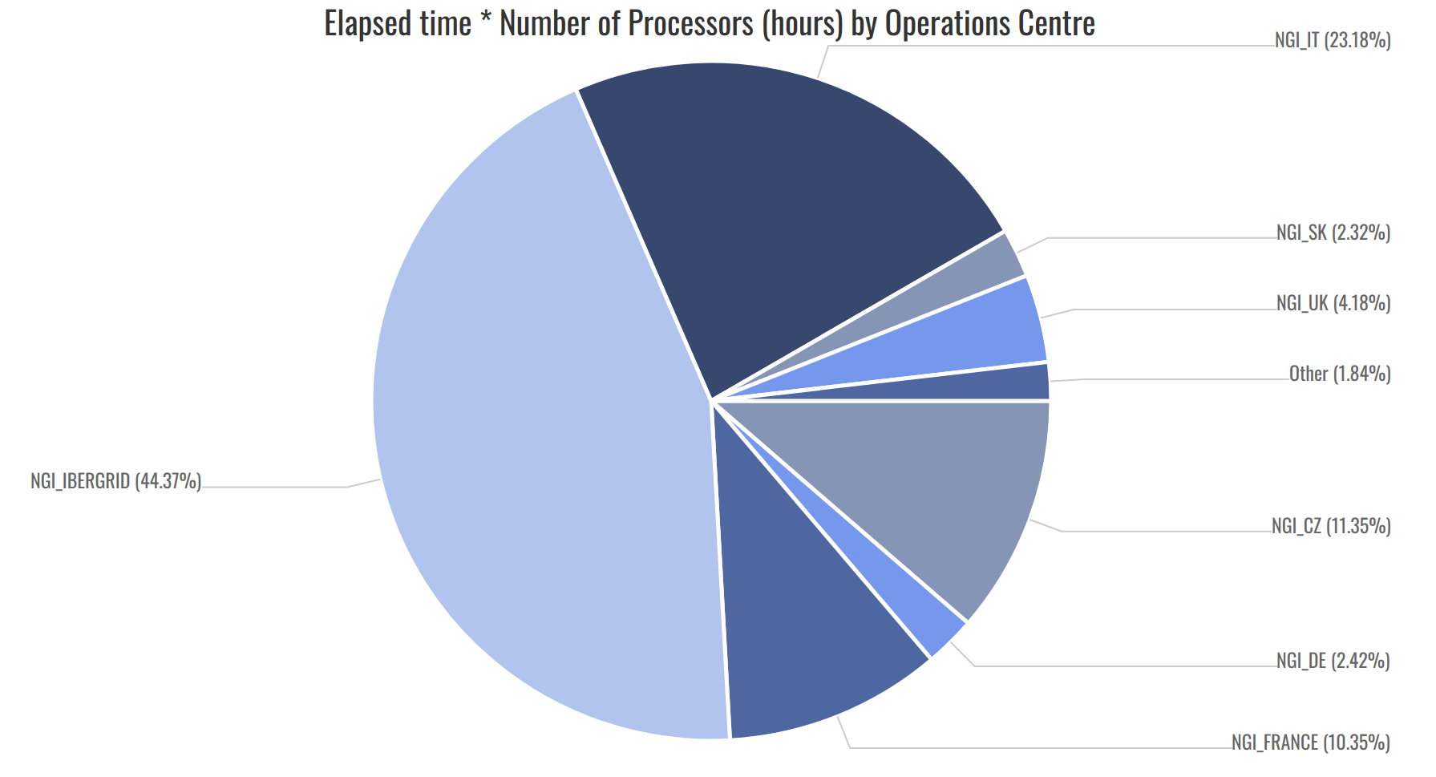
Status of the EGI Pay-per-use group
https://wiki.egi.eu/wiki/Pay-for-use
6/7 cloud providers from the EGI Federation:
CESGA and IFCA-LCG2 from NGI_IBERGRID
RECAS-BARI from NGI_IT
100%IT from NGI_UK
ULAKBIM from NGI_Turkey
IISAS from NGI_Slovakia
PSNC ??
How to join the group as service provider?
Provider must be a certified EGI provider and registered in the GOCDB
A Letter of Intent must be signed and sent to business@egi.eu along with all information outlined in the wiki table

Slide 4
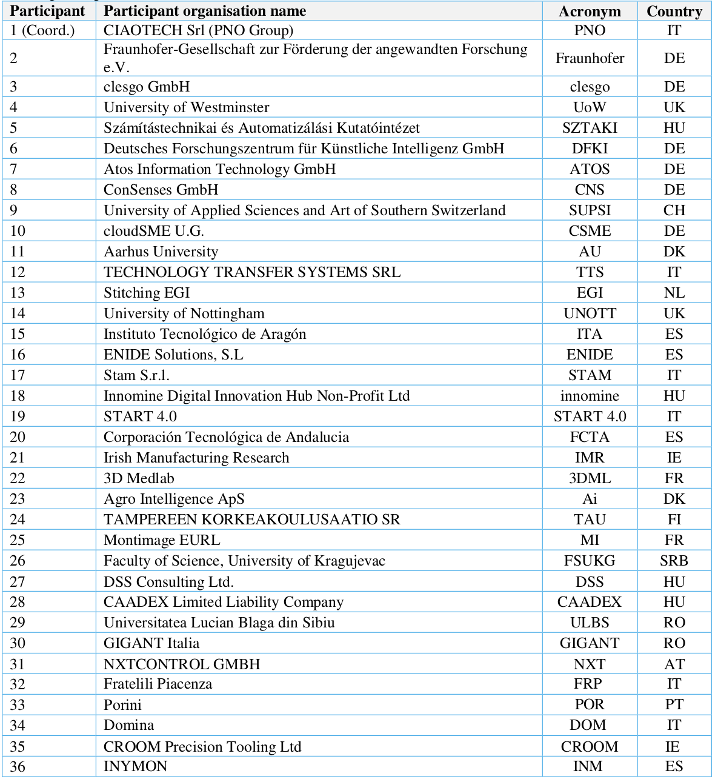
The DIGITBrain project
DIGITbrain has started on 1st July 2020 and is composed by a consortium of 36 partners
Goal: Enable small and medium-sized European manufacturing companies to benefit from AI-based Manufacturing-as-a-Service (MaaS) Duration: 42 months
6 DIHs with an overall European coverage:
START4.0 (IT), ITAINNOVA (ES), Innomine (HU), IMR (DE), DIGIT (DK), SMACC (FI)
4 Technology Providers:
SZTAKI (HU), UoW (UK), CloudSME (DE), Clesgo (DE)
2 Open Calls for experiments, mainly technology and manufacturing SMEs
Budget for HPC/cloud resources: 84,000 euros
Notes:
The added value provided by the DIHs in the DIGITbrain project will serve as well to attract new potential users for the DIGITbrain solution

Slide 5
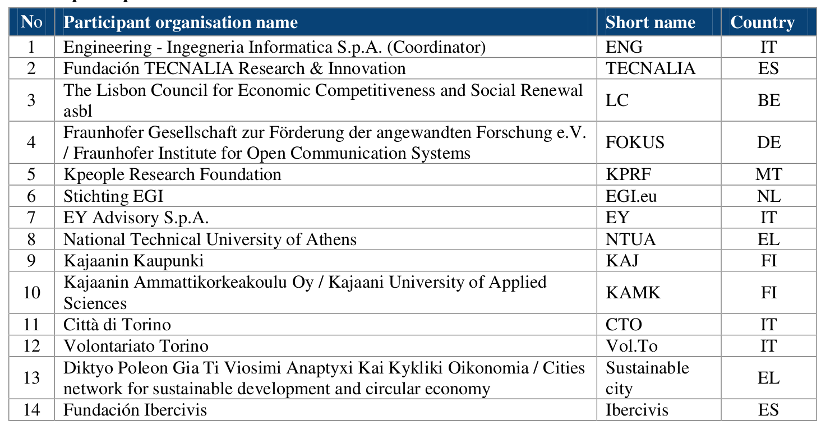
The DECIDO project
DECIDO will start in March 2021 and is composed by a consortium of 14 partners.
Goal: Demonstrate the groundbreaking impact of the adoption of innovative
methodologies, tools and data enabling the effective development of better evidence-based policies by public authorities.
Duration: 36 months
4 Pilots:
Pilot on Forest fires in Kajaani, Finland
Pilot on floods in Meisino Park, Italy
Pilot on power outage in Greek municipality, Greece
Pilot on wildfires in the Aragon region, Spain
Budget for HPC/cloud resources: 42,000 euros

Slide 6
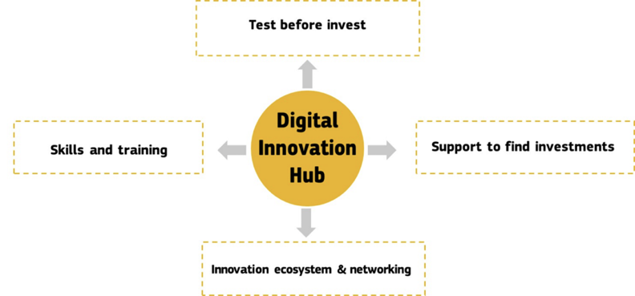
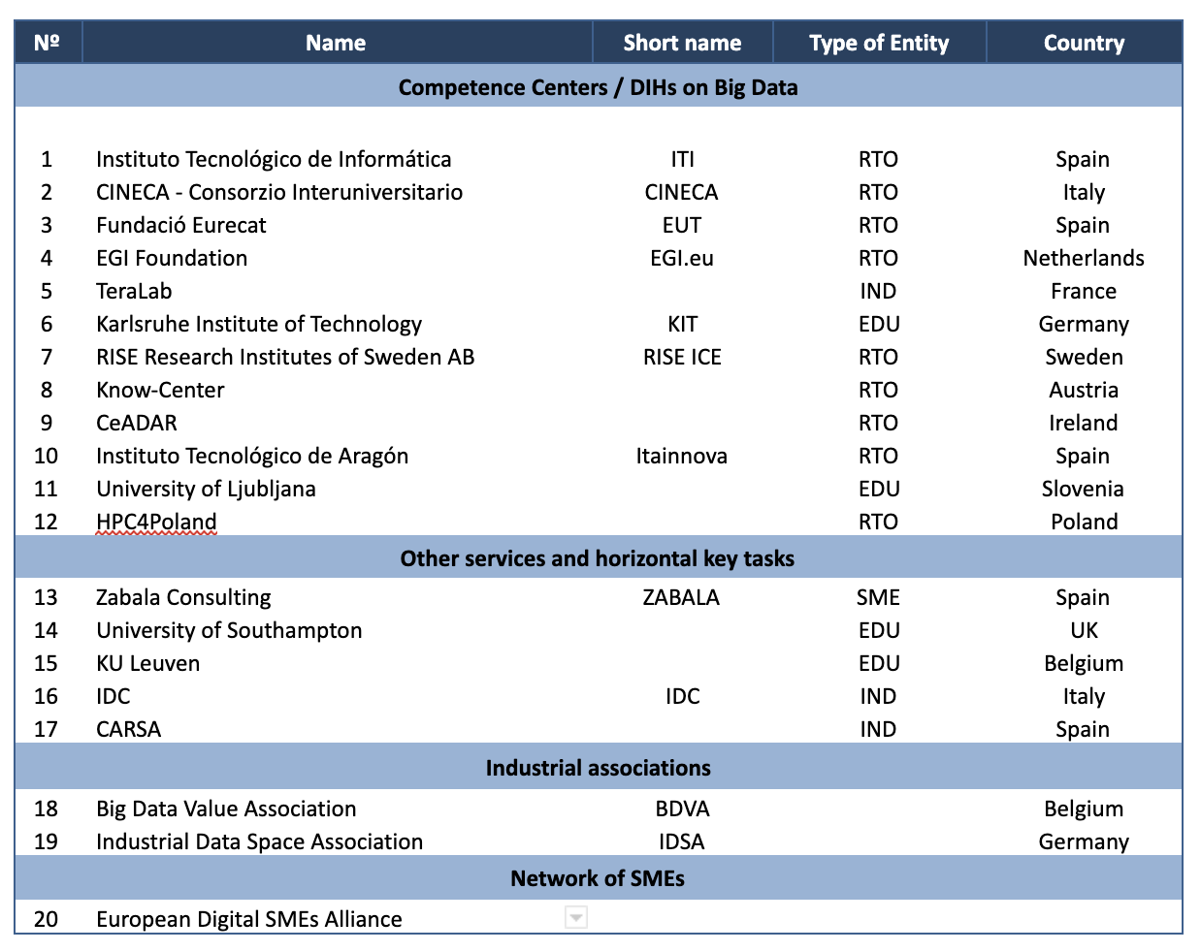
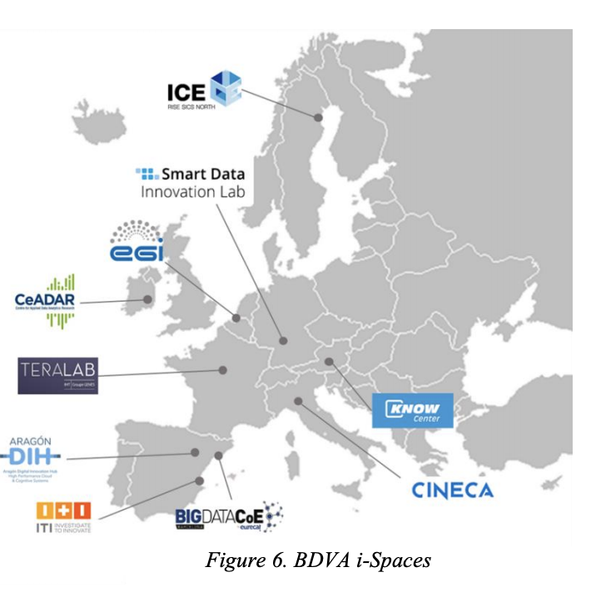
The EUHubs4Data project
EUHubs4Data has started on 1st September 2020 and is composed by a consortium of 20 partners
Goal: will set up a European federation of Big Data Digital Innovation Hubs (DIHs), with the ambition of becoming a reference instrument for data-driven cross-border experimentation and innovation, and support the growth of European SMEs and start-ups in a global Data Economy.
Duration: 36 months
Budget: 50,000 euros
An ecosystem of startups, SMEs, large industries, researchers, accelerators and investors that fosters the creation of partnerships to stimulate innovation.
WP5 - Federation of data sources and datasets:
Data federation, data sharing and data platforms
WP9 - Impact, outreach and dissemination:
Channels in action (on-line, media, events)

Slide 7
The LETHE project
LETHE will start on 1st February 2021 and is composed by a consortium of 15 partners
Goal: A personalized prediction and intervention model for early detection and reduction of risk factors causing dementia, based on AI and distributed Machine Learning
Duration: 48 months
Budget: 50,000 euros
Data Generation: Standardized protocols integrating werabales, Apps and mIoT
Data Lake & Data Warehouse: Collection and processing of RAW - Apache Hadoop, Spark and EGI/EOSC.
ISO27K certifications
AI core modules: Models development integrating ML and deep learning - Apache AirFlow
Report for users and professionals
Intervention interfaces for manager
Participant No. * | Participant organisation name | Short Name | Country
1 (Coordinator) | FH Joanneum | FHJ | AT
2 | Medical University of Vienna | MUW | AT
3 | University of Perugia | UPG | IT
4 | Karolinska Institutet | KI | SWE
5 | Finnish Institute for Health and Welfare | THL | FI
6 | Alzheimer Europe | AE | BE
7 | FORTH | FORTH | GR
8 | Maastricht University | MU | NL
9 | KAASA | KA | DE
10 | i2Grow S.r.l | i2G | IT
11 | Stichting EGI | EGI | NL
12 | ExtraRed | ER | IT
13 | Infotrend Innovations Co Ltd | Info | CY
14 | Combinostics | Comb | FI
15 | Lisbon Council | LC | BE

Slide 8
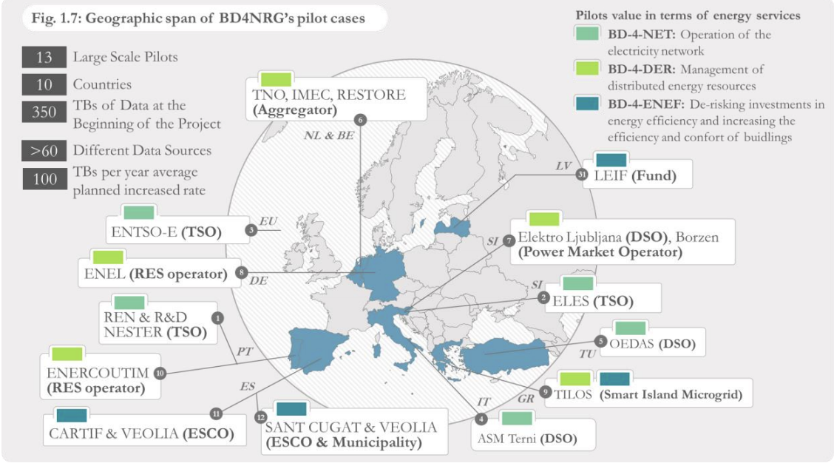
The BD4NRG project
BD4NRG will start on early 2021 and is composed by a consortium of 34 partners.
Goal: Apply Big Data & AI technologies to improve decision making in the energy sector
Duration: 36 months
Budget for resources: 50,000 euros
Coordinator: ENGINEERING (IT)
13 large-scale demo-sites across 10 countries:
BD-4-NET focus on predictive analytics that can forecast and increasing the efficiency and reliability of the electricity network
BD-4-DER focus on optimizing the management of assets connected to the grid
BD-4-ENEF focus on increasing the efficiency and comfort of buildings, and de-risking investments in energy efficiency, as both are interlinked
BD4NRG will federate 350 TB of data at the beginning an average increased rate of 100 TB/year (reaching 650TB at the end of project)

Slide 9
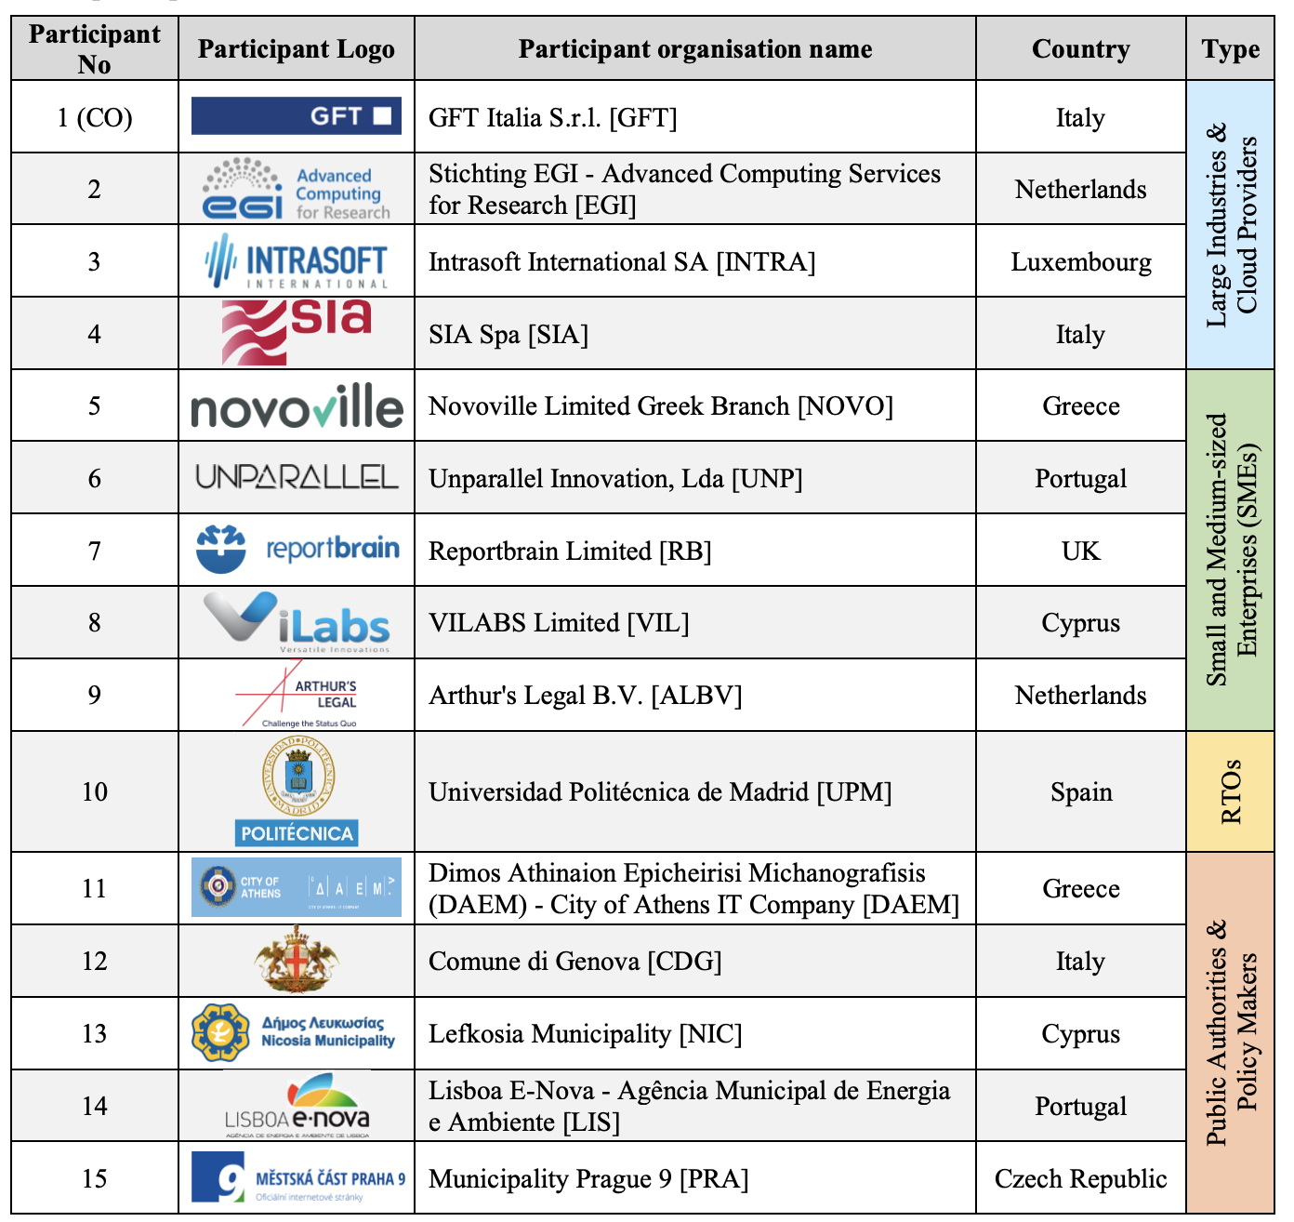
The AI4PublicPolicy project
AI4PublicPolicy will start on early 2021 and is composed by a consortium of 15 partners.
Goal: Unveil AI's potential for automated, transparent and citizen-centric development of public policies.
Duration: 36 months
Budget for resources: 50,000 euros
Project will allocate resources for policies, which will be dynamically updated during runtime based on emerging situations (e.g. through a local event that triggers the generation of additional datasets)
Orchestration mechanism (based on OpenShift and Kubernetes) to facilitate the management of containers for the execution of the AI models (and their chains / pipelines).

