Slide 1
Click here to add Title
CSIRT / EOSC-hub T4.4 F2F 2020-01-27
Dissemination level:INTERNALIf confidential, please define:
Disclosing Party: T4.4
Recipient Party: project consortium)

Slide 2
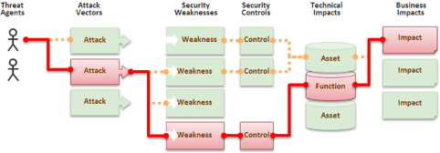
Information Security Risk Management
The definition of risk is ‘effect of uncertainty on objectives’
Information security risk management is a proactive approach to security
A framework for management accountability
A tool to connect business, services, service components and technical components

Slide 3
Risk Management
To avoid and and mitigate incidents you need security and risk management
We need to both technical and administrative security controls
To apply security controls we need both a plan and a process
It is not efficient nor comprehensive to apply security controls in random
The plan must be based on risk management

Slide 4
How can we do risk management together?
We should use joint tools and templates
Risk management should be a regular and recurring activity in EOSC
Required by the reviewers as well
We need a good flow between DevOps, security, and risk management

Slide 5
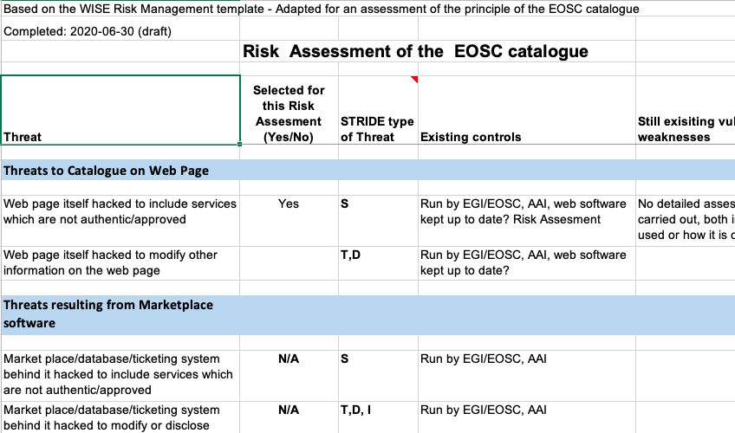
WISE Risk Management Template
https://wiki.geant.org/display/WISE/RAW-WG

Slide 6
Task for Information Security Risk Management in EOSC
Ensure that the asset inventory is complete and up-to-date
Ensure that the asset owners maintain the descriptions and classifications of the assets under their ownership and provide other information relevant for identifying and assessing information security risks
Perform a solid risk assessment periodically, based on available information on assets to be protected, as well as up-to-date information on vulnerabilities and threats
Update the risk assessment, whenever necessary – in particular, if a significant risk factor has changed
Together with other experts, identify, plan, implement and document information security controls to treat risks

Slide 7
Risk Assessment of the EOSC Marketplace and Catalogue/Information Security
See attached report and risk assessment sheet

Slide 8
ISM Security Controls and Risk
See:
https://confluence.egi.eu/pages/viewpage.action?spaceKey=EOSC&title=ISM+Security+Controls+and+Risk
https://confluence.egi.eu/display/EOSC/ISM6+Controls
Review of the procedure
https://rt.egi.eu/rt/ and click on ISM-controls in the box on the right.

Slide 9
Feedback from review workshop Dec 17, 2020 notes by David Kelsey
Move from use of RT for ISM-controls to Jira
Separate the handling of General Controls (ISO27000 Statements of Applicability?) and service-specific controls (Risk Assessment specific time-limited "actions").
Liaise with SVB and Owen to decide which two Core services should be risk assessed - and perform the assessments.
Complete the lists of controls from new assessments and all old ones. Agree and assign risk owners and control owners.
Review some controls from the old risk assessments.
Update ISM5 procedure to meet the hints/suggestions from the July 2020 audit
Work with Owen and Mal to design best location for storage of risk assessment spreadsheets and reports
Work with SPM and Onboarding procedure to check security requirements in the onboarding. Must consider Core services and perhaps also include Exchange services and a possible security "badge".
Start discussions on EOSC Future approach to risk management for Exchange services. Plans to produce Guidance and/or Training? Encourage services to do their own risk assessments?
Owen asked if one of us could attend the regular Onboarding Group meetings (once per month?).
Start to think about/plan what we can "offer" to Exchange services in future (Risk Assessment as a service?).

Slide 10
Questions for this F2F meeting
How to make the risk assessment template more efficient?
How to embed threat modelling and ’business impact’/management accountability to risk assessments?
How to manage security controls?
How to motivate and involve services to risk management?
How to motivate and involve EOSC management to risk management?
How to make risk management to scale?
Objectives for next few years?

