Slide 1
EGI-ACE & Security Coordn.
EGI CSIRT meeting – 27Jan21 Dave Kelsey (UKRI)

Slide 2
Slides from EGI-ACE InfoDay
EGI Advanced Computing for EOSC
26 November 2020

Slide 3
EGI-ACE objectives
Implement the Compute Platform of the European Open Science Cloud and contribute to the EOSC Data Commons by delivering integrated computing, platforms, data spaces and tools as an integrated solution that is aligned with major European cloud federation projects and HPC initiatives.

Slide 4
EGI-ACE specific objectives
Objective 1. Deliver the European Open Science Cloud Compute Platform and expand the supply-side
EOSC-Exchange
Objective 2: Contribute to the implementation of the EU Data Strategy and the EOSC Data Commons to support the Green Deal, Health and Fundamental Research
O4
O1
Federated Data
O5
O2
EGI-ACE
Objective 3: Integrate the EOSC Compute Platform with the EOSC Portal and the EOSC Core
O3
EOSC Core
Objective 4: Contribute to the realization of a global Open Science Cloud
Objective 5: Expand the demand-side of EOSC across sectors and disciplines

Slide 5
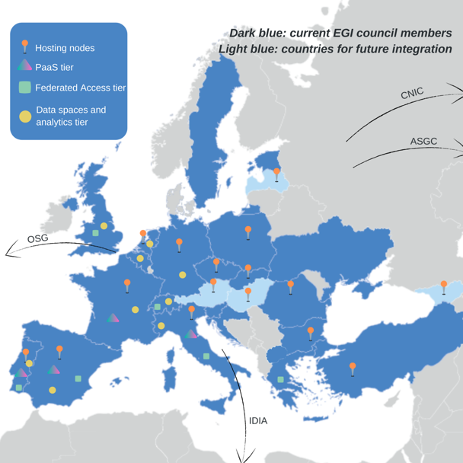
Consortium Overview and Service Providers
EGI Foundation as coordinator
33 participating partners, 23 third-parties
Consortium at a glance
16 partners to deliver cloud, HTC and HPC resources
12 user access and platform solution providers
21 providers from 13 communities to deliver data spaces
12 federation service providers
57% of the budget for service provisioning

Slide 6
Concept and methodology: Tier service architecture
Data Spaces
and Analytics
Data and thematic data analytics and processing tools
EOSC portal
Green Deal Data Space
Health Data Space
Fundamental Science Data Space
Humanities Data Space
Platforms
generic added-value platform level services
Interactive Computing
Automated Cluster deployment
Distributed AI training
Workload Management
EOSC
users
Service Management, Tools, Processes, Policies
Federated
Access
Federation-wide management of data and computing
Federated Compute
Federated Identity
Federated Data
Federated
Resources
Compute and storage facilities
Research Clouds
Public Clouds
HTC
HPC

Slide 7
Hosting nodes – Cloud & HTC
Allocation for communities within the project AND for new EOSC users
Increasing capacity (Cloud and HTC):
Phase 1 (month 1-10) ⇒ 13.8 Million CPU hours/41,300 GPU hours/7.5 PB/month
Phase 2 (month 11-20) ⇒ 27.6 Million CPU hours/83,000 GPU hours/15 PB/month
Phase 3 (month 21-30) ⇒ 41.4 Million CPU hours/124,000 GPU hours/23 PB/month
Mix of funding mechanisms
Virtual Access:
Local grants enabling policy-based access (EGI Cloud Federation + new partners):
Pay-for-use:
Pilot HPC sites:
Diverse locations AND compute flavors
Moldova
Latvia
Georgia
Hungary
Austria
USA
China
South Africa

Slide 8
Communication
Confluence: https://confluence.egi.eu/display/EGIACE
Other tools: Jira, mailing lists, Indico, Google drive
PMO: egi-ace-po@mailman.egi.eu (please contact to get access)
Mailing lists: https://confluence.egi.eu/display/EGIACE/EGI-ACE+mailing+lists
Communication package: in progress

Slide 9
Implementation structure
WP1 Project Management
WP2 Coordination and cooperation
Strategy, Service Portfolio Management, Continual Improvement
Align
Plan and delivery
Align
Service Provisioning
Service Management
WP3 Federated Access Services (VA)
AAI/Data/ Compute
WP7
Compute Services Delivery and Planning
Services Delivery
Service Planning Green Computing
Fed Services
WP4 [IaaS] Infrastructure Services (VA)
WP5 [PaaS] Platform Services (VA)
WP6 [SaaS] Data Spaces and Tools (VA)

Slide 10
WP1 - Project management and coordination
WP Leader: EGI.eu
Objectives
Overall project administration, finance and project management including definition and coordination of the quality and risk management.
Monitoring of resource and financial expenditures, contractual obligations, and reporting.
High-level supervision of work packages, internal review of deliverables and plans, monitoring of risk analysis, contingency plans, procedures, KPIs and metrics.
Managing project innovation, communication, and dissemination
Main outputs:
Project financial and administrative documentation
Plans (Quality, risk, dissemination and exploitation, data), procedures and reports

Slide 11
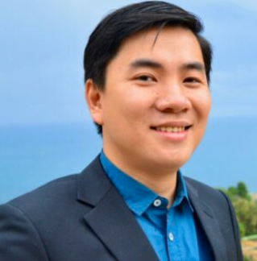
WP1 - Project management and coordination
WP leader: Hien Bui
Tasks
T1.1 Administration and finance management (Mandy Lin)
T1.2 Technical Coordination, activities, and governance management (Hien Bui)
T1.3 Quality and risk management (Małgorzata Krakowian)
T1.4 Innovation Management (Matti Heikkurinen)

Slide 12
WP2 - Coordination and Cooperation
WP Leader: EGI.eu
Objectives
Ensure strategic alignment of the project with EOSC Governance, policymakers, relevant projects and emerging national EOSC nodes
Liaison with EOSC including support the EOSC Governance, linking legal entities policies and EOSC projects, and portfolio management coordination
Provide training and consultancy activities for the main stakeholders
Providing communications and events organisation for the project and dissemination of results
Main outputs:
EGI-ACE Strategy Plan including alignment with EGI Federation strategy, EOSC SRIA and other key projects (KER5)
KER4: Technical specifications for IaaS/PaaS/SaaS and federated access services of the EOSC Compute Platform (KER4)
Technical, Policy and Service Management Integration Report (KER4)
Training material, EOSC Compute Platform handbook (KER2)
Contributions to improve the service management system (KER3)
Communications material (e.g. website, brochures), community building, raising awareness

Slide 13
WP2 - Coordination and Cooperation
WP leader: Sergio Andreozzi
Tasks
T2.1 Strategy and coordination with EOSC Projects and Legal Entity (Sergio Andreozzi)
Oversee coordination/planning of strategic activities
Alignment of the EGI Federation Strategy with the overall EOSC SRIA
T2.2 EOSC Portal alignment and coordination (Gergely Sipos)
SPM and onboarding to portal, FAIR maturity assessment, Technical alignment, Policy alignment, SMS Management, CSI
T2.3 Service promotion, user community support and coordination (Giuseppe La Rocca)
Promote services to new users, deliver consultancy, training and co-design
Support service providers and scientific users
Produce training materials and organize engagement events
T2.4 Communication and dissemination (Dimple Sokartara)
Coordinate communication and dissemination activities within the project and externally, support events organisation

Slide 14
WP3 - Infrastructure Services
WP Leader: EGI.eu
Objectives
Manage the Virtual Access to baseline computing and storage resources through the Cloud Compute (IaaS) + Cloud Compute service componentes and High Throughput Compute services of the EGI portfolio
AppDB
Dynamic DNS (Becoming production-ready)
Infrastructure Manager (IM) (New service)
Main outputs:
Delivery of compute services to EOSC users

Slide 15
WP3 - Infrastructure Services
WP leader: Enol Fernandez
Tasks:
T3.1 IaaS Federation Services Participants: IASA (21PM), IISAS (8.5PM), UPV (13.5PM)
T3.2 IaaS Services UC (unit costs) Participants: CESNET (18PM), IISAS (7PM), INFN (20PM), TUBITAK (10,5PM)
T3.3 IaaS Services
Deliverables D3.1, D3.2, D3.3, D3.4, D3.5
Six-Months periodical assessment of services (M6-M30)
Providers:
CESGA/CSIC, CESNET, CNRS, Cyfronet, DESY/SCAI/GSI, IFIN-HH, IICT-BAS, IISAS, INCD/LIP, INFN, SURF SARA, TUBITAK
IISAS, IASA, UPV

Slide 16
WP4 - Platform Services
WP Leader: EGI.eu
Objectives
Virtual Access to the Platform Services of EGI-ACE:
EGI Notebooks / Binder (CESNET)
EGI Workload Manager (CNRS)
DEEP training facility (CSIC, LIP) New Service!
DODAS (INFN) New Service!
Main outputs:
Expand the Notebooks service with more features with dedicated effort
Ensure DIRAC operations and support
Include support for ML / Big Data workloads in the EGI portfolio

Slide 17
WP4 - Platform Services
WP leader: Enol Fernandez
Tasks:
T4.1 EGI Notebooks / Binder (CESNET)
Transition from EGI.eu to CESNET, plan needs to start NOW
Better Binder integration
T4.2 EGI Workload Manager (CNRS)
No participation of CYFRONET (operating the existing DIRAC deployment so far)
T4.3 DEEP training facility (CSIC, LIP) New Service!
Distributed training facility for ML, AI, and Deep Learning models
Needs some initial adaptation to EGI (AAI)
T4.4 DODAS (INFN) New Service!
Centralized and automated deployment of distributed and federated clusters
Needs some initial adaptation to EGI (AAI)
Deliverables D4.1, D4.2, D4.3, D4.4, D4.5
Six-Months periodical assessment of services (M6-M30)

Slide 18
WP5 - Federated data space
WP Leader: EGI.eu
Objectives
Manage the Virtual Access of the EGI-ACE Federated data space
Main outputs:
Provide Data Spaces focused on Health, the Green Deal, fundamental research, and social sciences and humanities to support the execution of data-driven workloads in the federation
Increase the service offer with data spaces and analytics

Slide 19
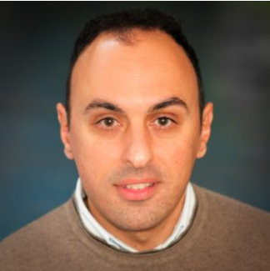
WP5 - Federated data space
WP leader: Giuseppe La Rocca
Tasks:
T5.1 Health and medicine - CIRMMP (5PM), CNRS CREATIS (15PM), EdelweissConnect (7,5PM), Univ of Freiburg (15PM), UoB (7,5PM), UU (10PM)
Continue to operate the WeNMR/VIP portals for serving structural biology and medical imaging communities
Operate/extend new federated data spaces (e.g.: OpenRiskNet, the European Galaxy server)
T5.2 Climate research - CMCC (8PM), IPSL (7PM), LNEC (15PM)
Extend already existing services with new functionalities (OpenCoastS)
Deliver a cloud-based data service environment for climate data analysis (ENES)
T5.3 Energy and physical sciences - NWO-I ASTRON (15PM), SURFSARA (3PM), UKAEA (15PM)
Develop a new service to generate science-ready data for radio astronomy (LOFAR) and cross-domain sciences
Develop a service to run HPC simulations and use AI to compare results (PROMINENCE)
T5.4 Environmental sciences - AS ASGC (30PM), CSIC (8PM), EMSO (15PM), ISA (6PM), LIP (1PM), MARIS (9PM)
Develop a new service for ocean researchers (MATRIS), provide access to ocean data (EMSO)
Expand data space with new biodiversity and geospatial data, and the portfolio of applications for hazards simulations (AS)
Expand the GBIF cloud data space with new biodiversity and geospatial data (GBIF)
T5.5 Social sciences and humanities - OPERAS AISBL (9PM)
Operate the service to increase the discoverability of OA books (OPERAS)
Deliverables D5.1, D5.2, D5.3, D5.4, D5.5 Six-Months periodical assessment of services (M6-M30)

Slide 20
WP6 - Federated Access Services
WP Leader: EGI.eu
Objectives
Management of the Virtual Access to the EGI-ACE Federated Access Services
Federated Access Services will provide secure access to the EGI-ACE services and enable large-data analysis workloads in the distributed infrastructure
Main outputs:
Enhancement of the AAI services
Enrichment of the data services offer with the integration of additional tools in the infrastructure
Enrichment of the compute services offer with the integration of additional tools in the infrastructure

Slide 21
WP6 - Federated Access Services
WP leader: Diego Scardaci
Tasks:
T6.1 Federated AAI
Check-in (GRNET), PERUN (CESNET), Master Portal (NOW-I Nikhef) New Service!
T6.2 Federated Data Access
RUCIO (UKRI) New Service!, FTS (UKRI), Data Hub (CYFRONET), CVMFS (UKRI), OpenRDM (Enhance-R) New Service!
T6.3 Federated Compute Access
Indigo-PaaS (INFN) New Service! , EC3: Elastic Cloud Compute Cluster (UPV)
Some of the services will need initial integration in the EGI Ecosystem
Deliverables D6.1, D6.2, D6.3, D6.4, D6.5
Six-Months periodical assessment of services (M6-M30)

Slide 22
WP7 Service Delivery and Planning
WP Leader: EGI.eu
Objectives
Ensuring that ACE services are provided in conformance with their Service Level Agreements
Maintenance of the Service Management System covering all processes related to service delivery and service planning
Coordination of Green Computing activities
Integration of HPC, HTC, and Cloud services
Expand the cloud infrastructure
Main outputs:
Technical roadmap of the service management tools
Best practice and training regarding Green Computing
Interoperability guidelines for HPC providers outside the project to assist with integration activities.

Slide 23
WP7 Service Delivery and Planning
WP leader: Alessandro Paolini
Tasks:
T7.1 Service Delivery (Lead: EGI.eu) (Participant: INFN)
Overall coordination, CHM, RDM, CRM, CONFM, software distribution (UMD/CMD)
T7.2 Service Planning and Green Computing (Lead: EGI.eu) (CNRS, CSIC, JISC)
SLM, SRM, SACM, CAPM
Coordination of Green Computing activity and related training
T7.3 HPC integration (lead: EGI) (CERN, CMCC, CESGA , IFIN-HH , IICT-BAS , INFN , LIP, TUBITAK, UKAEA)
provide interoperability guidelines for HPC systems with the EOSC Cloud Compute platform, exploring and identifying gaps for the execution of container-based workloads (involving four scientific pilot use cases)
T7.4 International cloud integration (Lead: EGI.eu) (CLOUDFERRO, CNIC, GRENA, IDIA, IMCS UL, OSG, RENAM, SZTAKI, T-SYSTEMS
expand the cloud infrastructure offered by the project by federating new infrastructure providers
Assistance to and collaboration with academic, industrial and commercial providers

Slide 24
WP7 Service Delivery and Planning
WP leader: Alessandro Paolini
Tasks:
T7.5 Security Coordination (Lead: UKRI) (CERN, CESNET, GRNET, IJS, NOW-I NIKHEF)
Policies, procedures, incidents, vulnerabilities
T7.6 Service Management Tools (Lead: EGI.eu) (CESNET, CNRS, CC-IN2P3, CESGA, CSIC, GRNET, INFN, KIT, LIP, SRCE, UKRI)
Coordination of technical plans and maintenance, requirements gathering, opportunities for improvement
Deliverables:
D7.1 Service Management Tools Technical Plan (M12)
D7.2, 7.5 Status of the SMS Processes (M15, M29)
D7.3 Final version of HPC integration handbook (M18)
D7.4 Green Computing progress and improvements within EGI-ACE (M24)

Slide 25
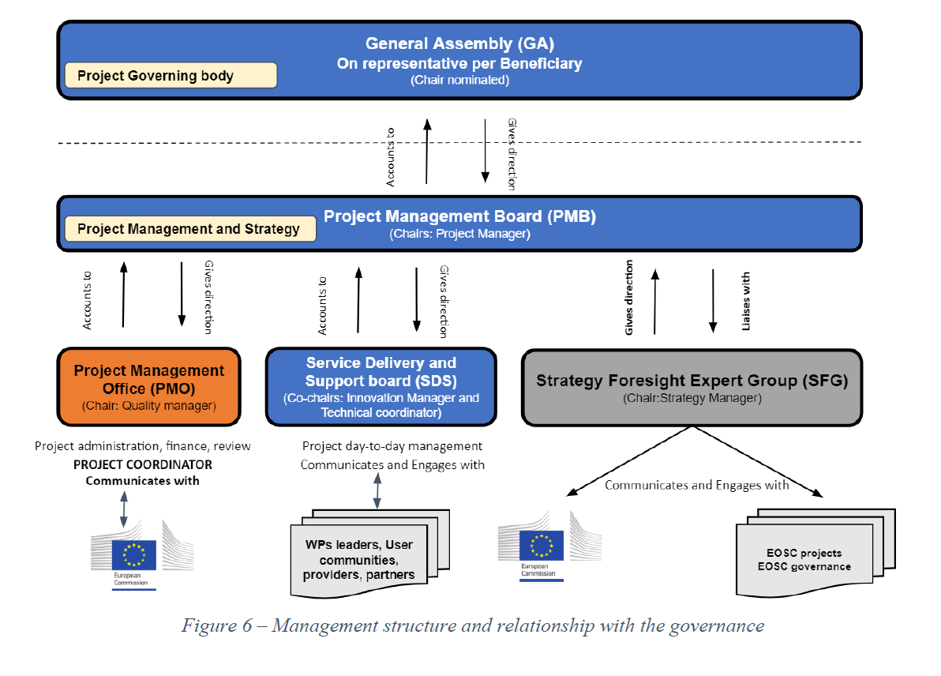
Management structure
Boards
General Assembly
Project Management Board (PMB)
Project Management Office (PMO)
Service Delivery and Support board (SDS)
Strategy Foresight expert Group (SFG)
More details: https://confluence.egi.eu/display/EGIACE/Project+Governance+and+management#ProjectGovernanceandmanagement-Boards

Slide 26
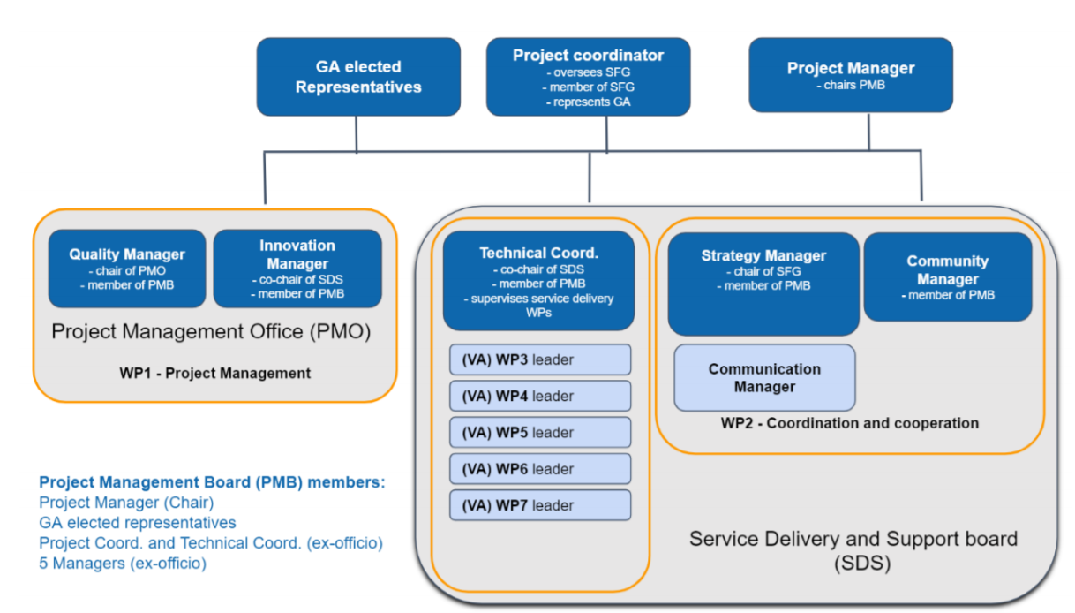
Management structure
Project Management Board

Slide 27
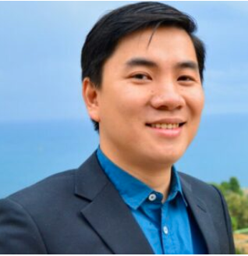
Roles
Project Coordinator (PC) Tiziana Ferrari Overall project management
Project Manager (PM) Hien Bui Project management, implementation of the plan of actions
Technical coordinator (TC) Gergely Sipos Overall technical coordination
Quality Manager (QM) Małgorzata Krakowian Project Management Office coordination

Slide 28
Roles
Innovation Manager (IM) Matti Heikkurinen Innovation and exploitation
Communication Manager (CM) Dimple Sokartara VA installation promotion, communication activities, events management, dissemination
Community Manager (CM) Giuseppe La Rocca VA services adoption, support and training to user community
Strategy Manager (SM) Sergio Andreozzi Strategy
More details: https://confluence.egi.eu/display/EGIACE/Project+Governance+and+management#ProjectGovernanceandmanagement-Roles

Slide 29
Now to DaveK slides ….

Slide 30
More information & Kick-Off
Introduction to EGI-ACE from EGI Conference (Nov 2020)
https://www.youtube.com/watch?v=F3Vk-KjkV74
Kick-off meeting of the project. Define how to work together and what the next steps are for each WP
4 & 5 Feb 2021
Includes a 0.5 day public launch event to promote the project to new users and providers
Consortium part: https://indico.egi.eu/event/5358/
Public part: https://indico.egi.eu/event/5359/
Registration required

Slide 31
EGI-ACE Task 7.5
Task 7.5 Security Coordination
The objective of the task is to provide and maintain Information Security Management (ISM) policies, procedures and coordination of ISM activities, to prevent security incidents where possible and to support the trust between EGI services and the wider EOSC environment. It also contributes to the protection of service integrity and to the management of risk and provides capabilities to support business continuity and disaster recovery in case of security incidents.
The task will coordinate a security vulnerability risk assessment team and an incident response task force to make sure that routine issues and security events are handled properly, and to provide specialised expertise in forensics and coordination for large scale incidents that threaten multiple providers.
The task also includes the development, maintenance and deployment of security operational tools, monitoring and the Security Service Challenge framework.
Security aspects of all services within the federation, including virtual access service providers within WP4, 5 and 6, are within scope of this task.

Slide 32
Task 7.5 - details
Partners: CERN, CESNET, GRNET, IJS, NIKHEF, UKRI(STFC)
Coordinator - David Kelsey (UKRI)
Funding mechanism (EGI Foundation & Partners – not EC)
75 PM over 30 months => 2.5 FTE
Task mailing list: egi-ace-wp7-t5@mailman.egi.eu
Answer email from Alessandro to be added to list (and the general lists)
All mail lists managed by EGI SSO
I propose that we only use the task email list for EGI-ACE specific issues
All ongoing general ISM work should take place on the usual lists
CSIRT, IRTF, SVG, SPG, etc …
As in EOSC-hub, continue division of tasks into Sub-Tasks (each with a named leader)
How often do we have a task meeting? Monthly?

Slide 33
Task 7.5 – Sub Tasks
CERN, CESNET, GRNET, IJS, NIKHEF, UKRI
Collaborating with EOSC, GN4-3, Research Infrastructures, National projects, Global activities
IRTF (Sven, DanielF, DanielK, Barbara, DavidC)
SVG (Linda, IRTF members, others)
Monitoring (DanielK, GRNET)
CSIRT Web Site, PR, Dissemination, Training, Best Practice, Guidance (Barbara, others)
SPG (DaveK, DavidG, Ian Neilson, others)
SSCs (Sven, others)
Risk management (?)
Trust & Identity (DavidG, DaveK, others)
International coordination and collaboration (note: coordination is not an aim of EOSC Future)
EOSC and Infrastructures, EUGridPMA, IGTF, TF-CSIRT, FIRST, TI, eduGAIN Security, FIM4R, WISE & SCI, REFEDS, SIG-ISM, GN4-3 EnCo, …

Slide 34
Discussion,
Q&A?

