Slide 1
Infrastructure services: highlights from the compute, security, data areas
Andrea Manzi (EGI.eu)
Diego Scardaci (EGI.eu)
Enol Fernandez (EGI.eu)

Slide 2
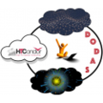
Compute Area
Enol Fernández

Slide 3
EGI Cloud Compute
Federated IaaS
Distributed Infrastructure as a Service (IaaS) powered by the EGI Federated Cloud
Execution of VM based workloads on a distributed infrastructure
Federated identity
Common VM image catalogue
GUI and CLI/API based access
Central accounting and monitoring
EGI Cloud Compute allows users to host data- and compute- intensive applications in a distributed infrastructure (move compute near the data) with complete control on the software and resources used

Slide 4
Expanding EGI Cloud with EGI-ACE
Federated Compute
Platforms
Federated Identity
AppDB VMOps
AppDB
VAs
EGI-ACE Clouds
International Clouds
Other EGI Clouds
Cloud Providers
Dynamic DNS
Federated Data

Slide 5
Bringing capacity for EOSC users
EC funded capacity (Virtual Access):
Phase 1 (month 1-10) ⇒ 13.8 M CPU hours - 41,300 GPU hours - 7.5 PB/month
Phase 2 (month 11-20) ⇒ 27.6 M CPU hours - 83,000 GPU hours - 15 PB/month
Phase 3 (month 21-30) ⇒ 41.4 M CPU hours - 124,000 GPU hours - 23 PB/month
Policy-based and pay-per-use access from members of EGI Federation, international partners and commercial clouds
Diverse locations AND compute flavors

Slide 6
Orchestration
IM deploys virtual infrastructures on Cloud resources
Infrastructure as Code (IaC) / RADL & TOSCA descriptions
Automates deployment, configuration, software installation, monitoring and update of virtual infrastructures
Wide variety of back-ends thus user applications become cloud agnostic
Provisioning of virtualized compute and storage on distributed infrastructure: cloud, HPC and container orchestration platforms
Automatic selection of providers
Federated Data integration: data orchestration, replication, trigger jobs on events
Automatic re-submission of deployments
Notes:
Coordinates the provisioning of virtualized compute and storage on distributed infrastructures, including cloud, HPC clusters and container orchestration platformsAutomatic selection of the best resource providers based on criteria like user’s SLAs, services availability and monitoring metrics and data location
Integrated with Federated Data services (Onedata, Dynafed and Rucio)
Automatic re-submission of the deployment request in case of failures or timeout (for a configurable number of retries)
Support for data orchestration workflow with Rucio (Cern)
Submission of data replication rules
Trigger processing jobs on data ingestion events

Slide 7
Automated Cluster Management
Elastic Cloud Computing Cluster (EC3) deploys virtual elastic clusters on IaaS providers
IM for deployment, CLUES for elasticity
Predefined ansible templates: Kubernetes, Mesos, SLURM, Torque, SGE, HTCondor, Nomad...
DODAS supports the deployment and configuration of distributed (possibly federated) clusters for executing experiment workflows (e.g. data processing, data analysis):
Batch System on demand
Big Data clusters on demand Interactive analysis service for local and remote data processing

Slide 8
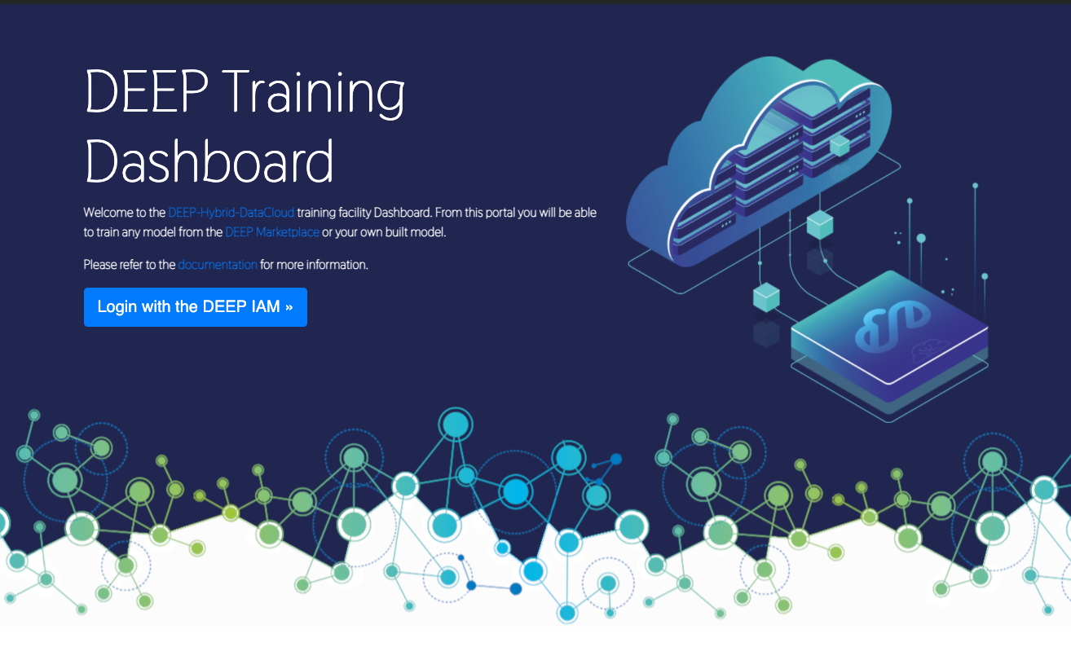
AI/ML: DEEP training facility
1-click development and training environment in cloud and HPC resources
Train, test and evaluate of models through the DEEPaaS API
Transparent access to infrastructure resources
Based on TOSCA templates submitted via INDIGO-DataCloud PaaS orchestrator and Infrastructure Manager

Slide 9
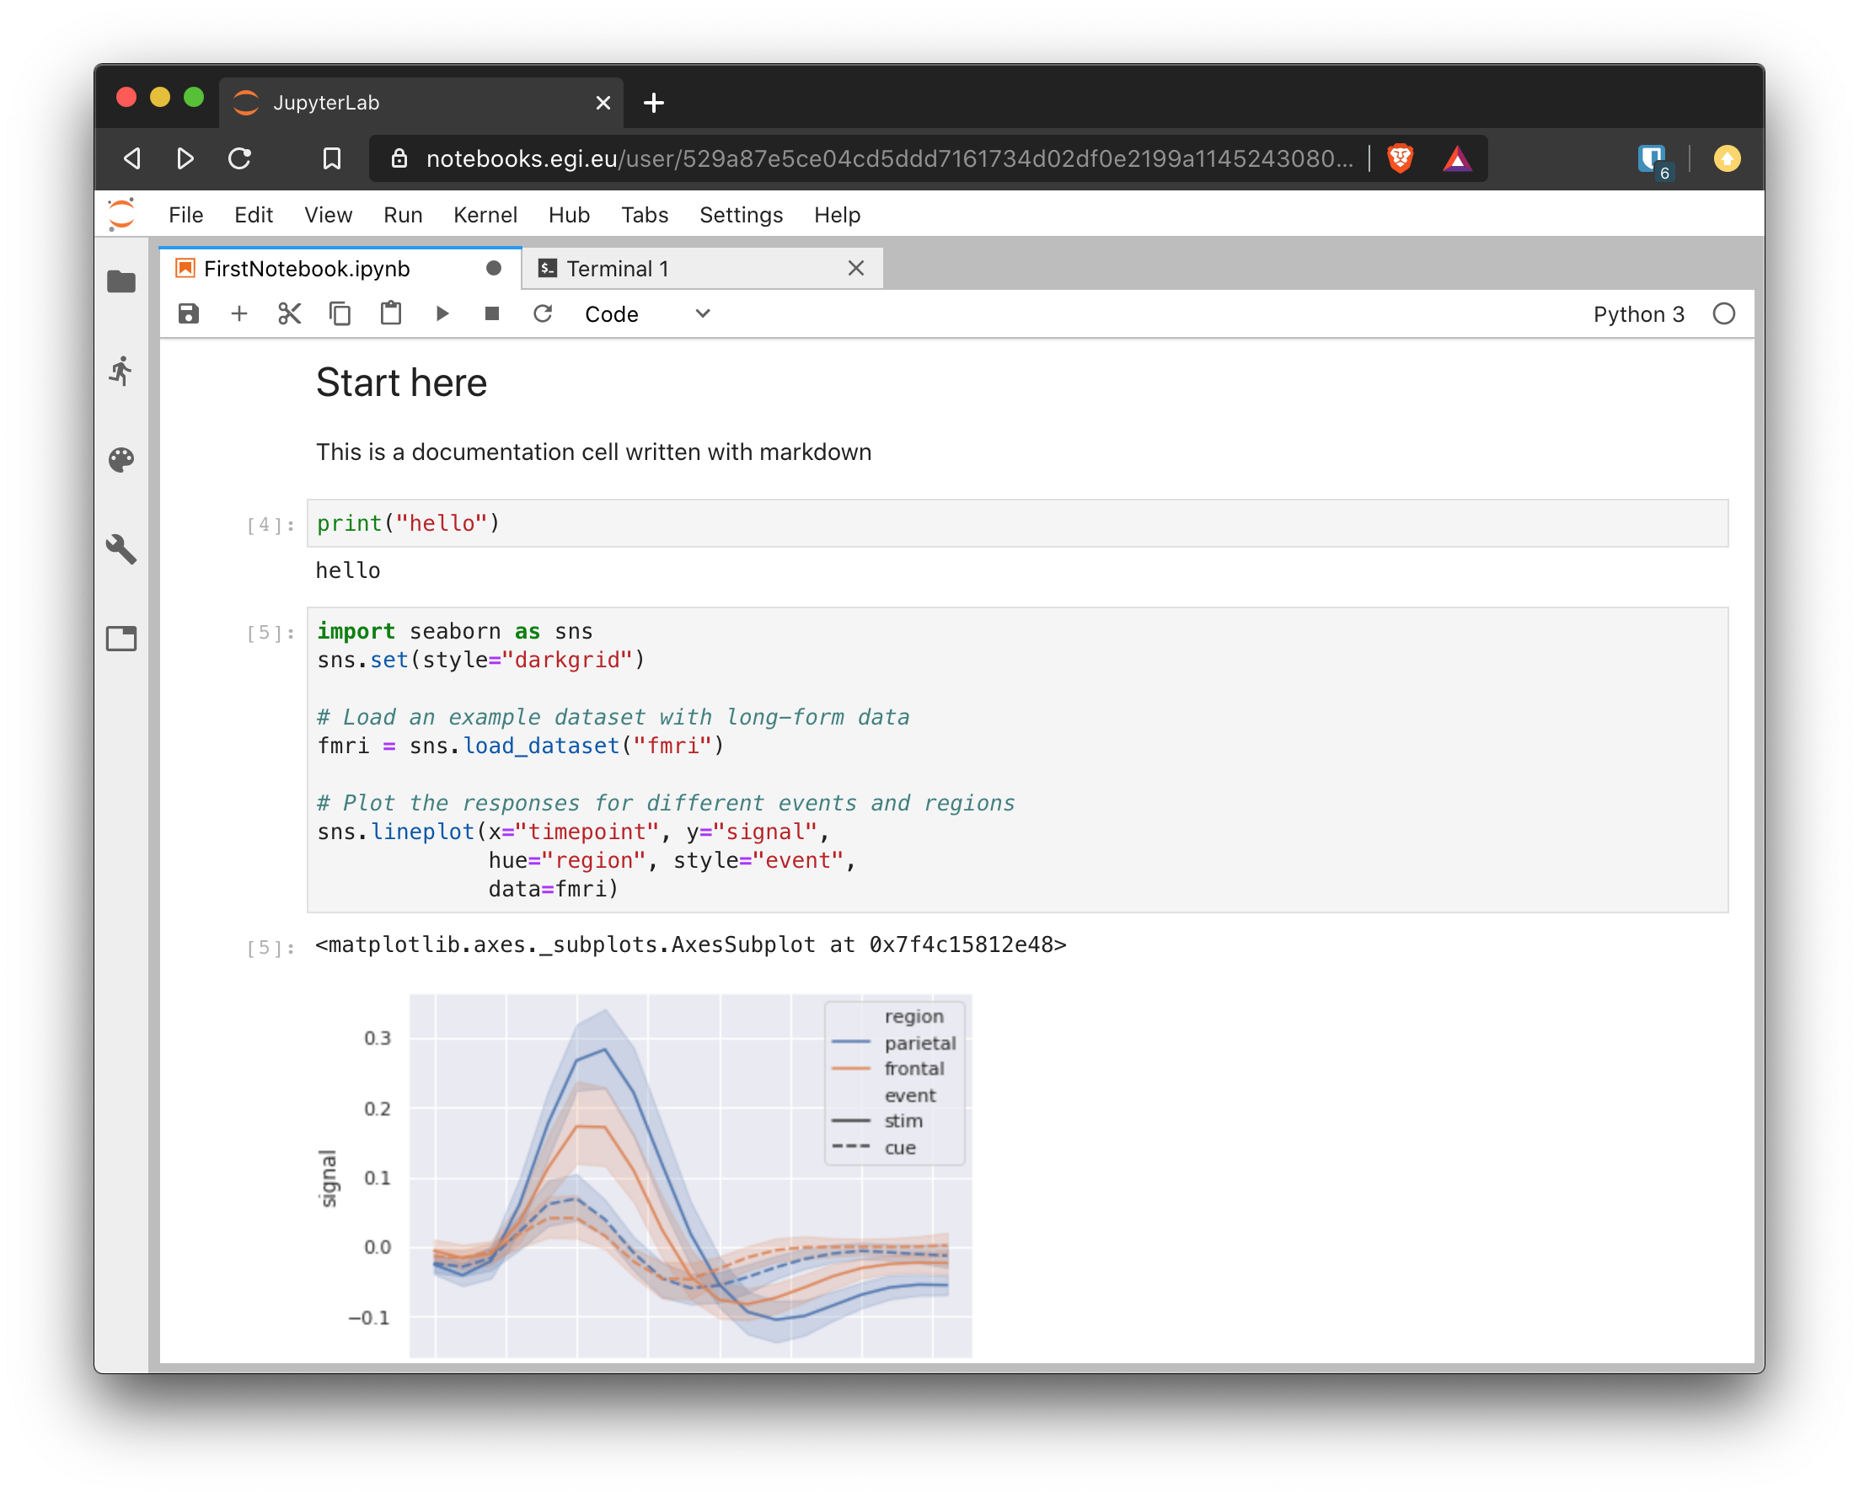
Interactive Computing: Notebooks
JupyterHub hosted in the EGI Cloud
Jupyter notebooks ‘as Service’
One-click solution: login and start using
EGI-ACE will bring:
Binder (reproducible notebooks) support
Better integration with Federated Data (e.g. onedata) and Federated Compute (DIRAC) services

Slide 10
Beyond IaaS Clouds: HTC and HPC
Orchestration
Federated Identity
CVMFS
EGI-ACE HTC
Other EGI HTC
HPC providers
Providers
Federated Data

Slide 11
High Throughput Compute
The EGI High-Throughput compute (HTC) provides users with the capability to access large amounts of computing resources, and to submit hundreds or thousands of computational tasks.
EGI-ACE brings one new option to the HTC service from SURF:
Spider, a versatile high-throughput data-processing platform aimed at processing large structured data sets.

Slide 12
Workload Manager
The Workload Manager helps users to exploit distributed resources in a transparent way.
Based on DIRAC, a framework shared by multiple experiments, both inside HEP, astronomy, and life sciences
Optimises workload placement
Support for massive workload and data operations
Aggregates multiple types of resources, e.g. Cloud / HTC providers, user community resources
User-friendly GUI, CLI and API access for advanced usage
Jupyter notebooks (prototype)
Services customizable for the needs of particular communities

Slide 13
Software Distribution
CernVM-File System (CVMFS) provides a POSIX read-only file system in user space
Scalable software distribution, recently extended to handle container images
Caching at providers for fast access to frequently used software
Mostly used in HTC, but useful also for IaaS
Application Database (AppDB) provides Virtual Appliance (VAs) Catalogue
Public registry of images with detailed metadata
Community-managed VA lists, fine control on what can be executed by users
Automatic distribution as VM images to the cloud providers

Slide 14
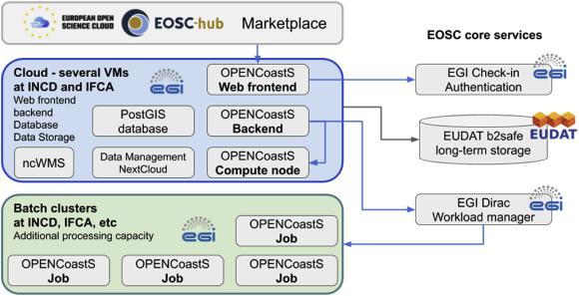
OPENCoastS: forecast systems for coastal sites
OPENCoastS brings together several EGI services to deliver on-demand coastal circulation forecast systems through a web platform with minimal user intervention
Hosting of web frontends / databases and permanent services on Cloud Compute
Dynamic workload managed by Workload Manager and executed on High Throughput Compute

Slide 15
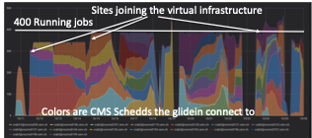
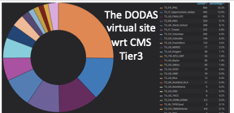
A distributed virtual CMS site powered by DODAS
DODAS used to build a lightweight ephemeral WLCG-Tier on demand distributed across four Cloud providers
Executing actual experiment workload
Dynamically distributing the load as providers join
Uses PaaS Orchestrator to deploy elastic Kubernetes that run HTCondor + CVMFS configured for integrating into CMS submission infrastructure

Slide 16
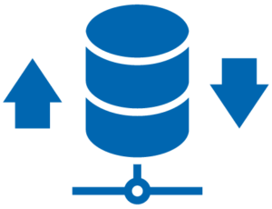
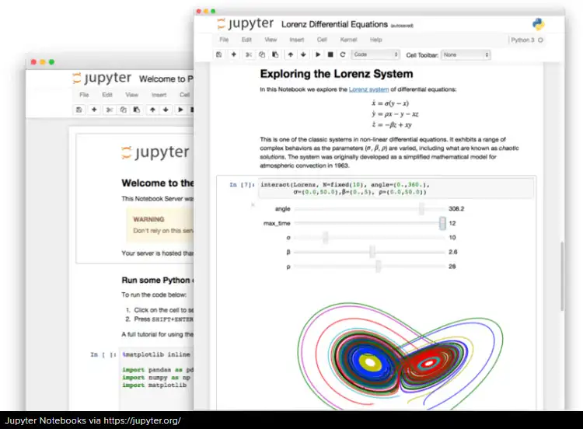
Reproducible big data analytics with notebooks
1
DataHub
Notebooks + Binder + DataHub provide the means to reproducible Open Science using big data
Integrates with zenodo for publishing and discovery of notebooks
Initial analysis on
EGI Notebooks
3
Reproduce notebook with binder
Publish notebook
2

Slide 17
Security Area
Diego Scardaci
RCAuth.eu & Master Portal
Check-in

Slide 18
EGI Check-in
Proxy service that operates as a central hub to connect federated Identity Providers (IdPs) with EGI service providers
Main characteristics:
Enables multiple federated authentication sources using different technologies
Federated in eduGAIN as a service provider (REFEDS RnS and Sirtfi compliance)
User registration portal to allow accounts-linking
Combines user attributes originating from various authoritative sources (IdPs and attribute provider services)
Integrated with PERUN
Compliant with the AARC Blueprint
Support non-web use cases & delegated access
Integrated with RCAuth.eu and Master Portal
RCAuth.eu & Master Portal

Slide 19
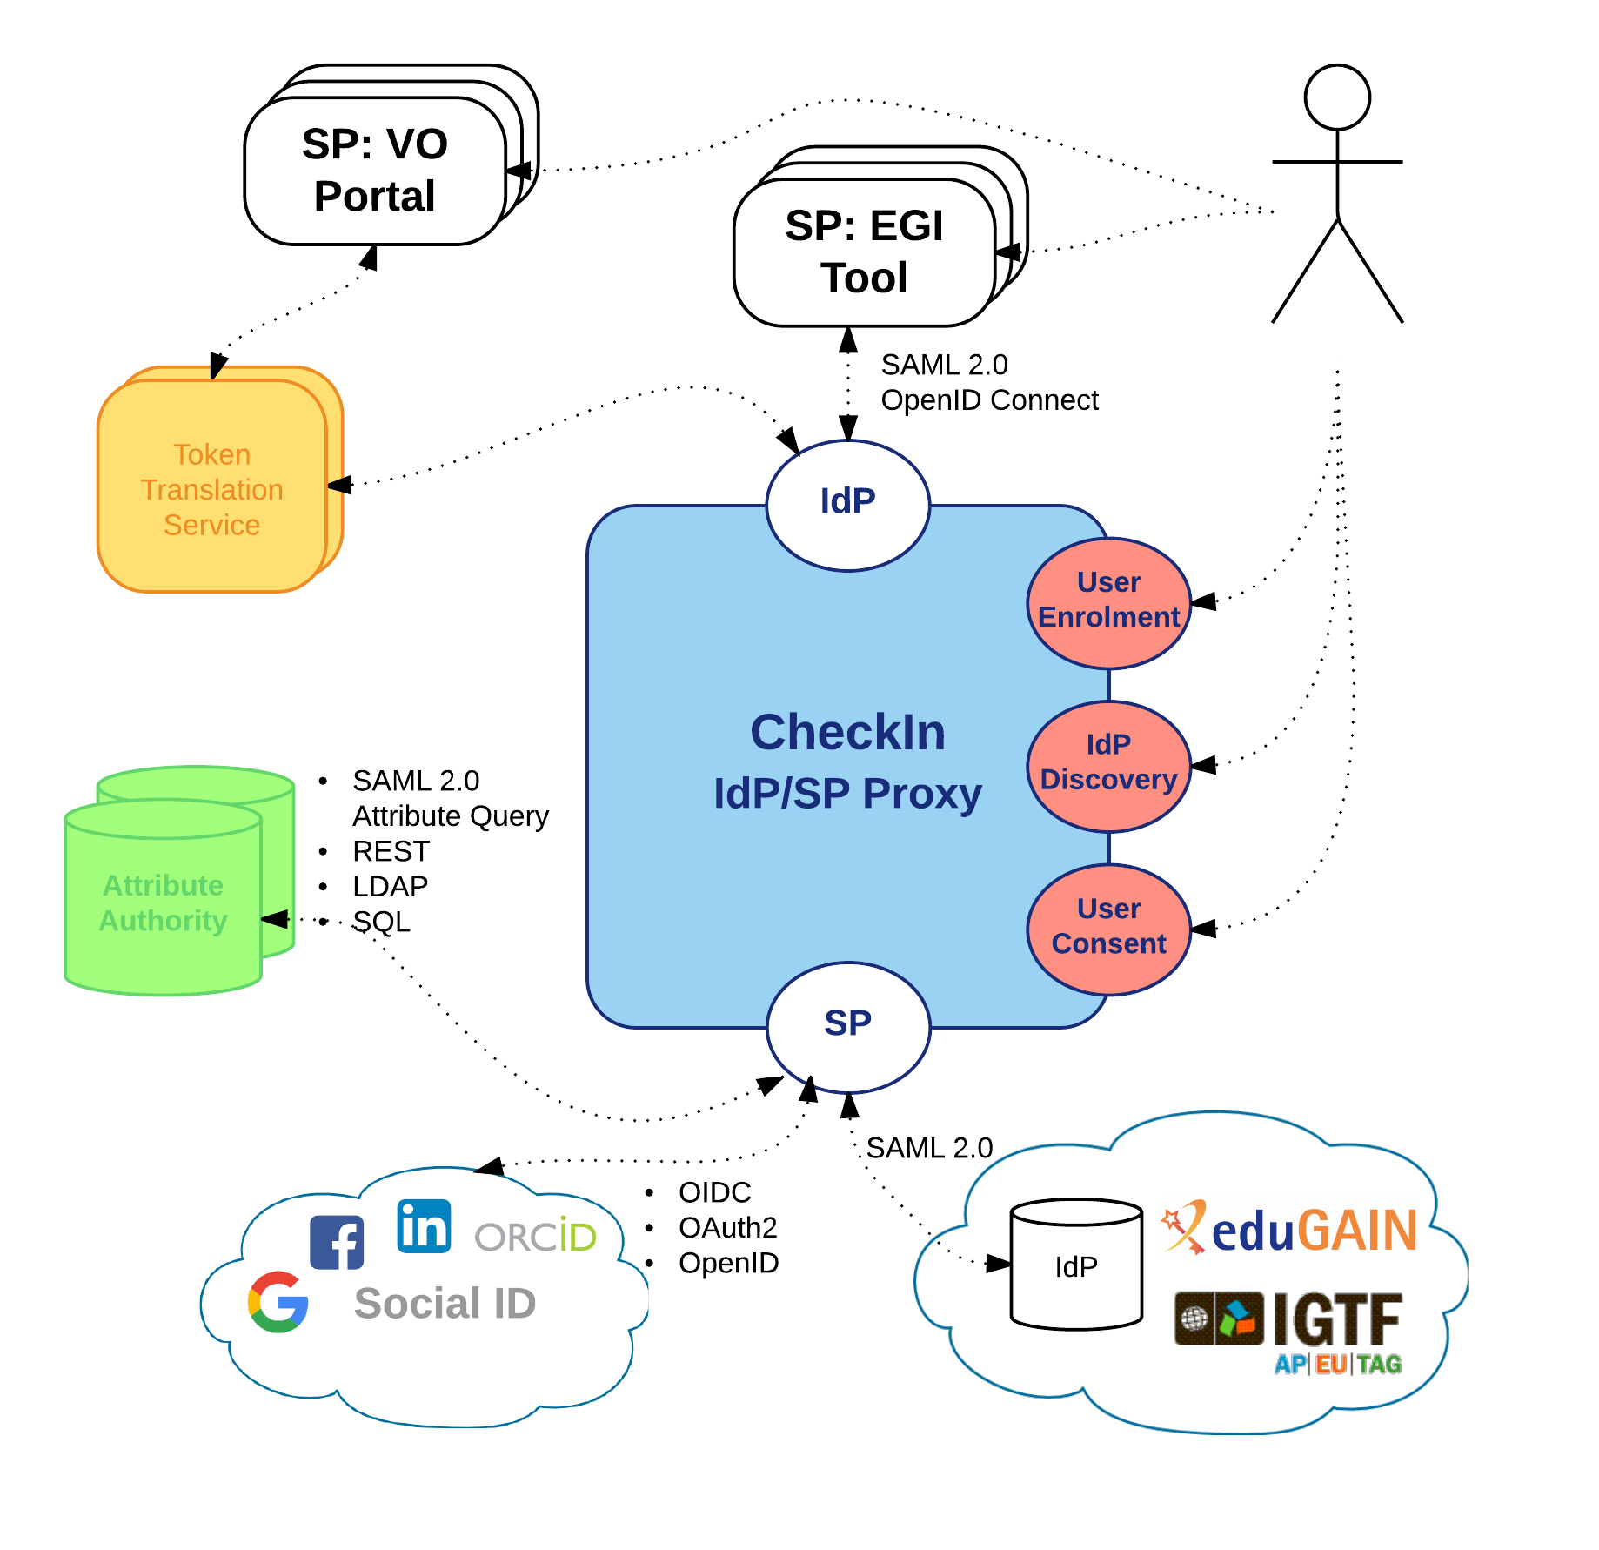
The EGI AAI Platform: Check-in
The IdP/SP Proxy
Identity Providers:
SAML2.0: eduGAIN
OIDC/OAuth2: Google, Facebook, LinkedIn, ORCID, WeChat, BitBucket
X.509: IGTF
Service Providers:
SAML2.0 & OIDC
Attribute Authorities
SAML2.0 Attr. Query, REST, LDAP, SQL
Token Translation Services
SAML2.0-to-X.509: Master Portal to RCauth.eu Online CA
Support for Levels of Assurance
User enrolment & account linking
IdP Discovery
User Consent

Slide 20
Use case: AAI as a Service
Check-in as an authentication proxy to allow user logins from institutional IdPs in eduGAIN and social media for non EGI services
Minimal overhead for the service development
Prerequisites:
Service provider must accept EGI policies on data protection
Social IDPs
eduGAIN
Institutional IdP
EGI CheckIn
EGI Infrastructure
SERVICE

Slide 21
Use case: AAI Integration
Social IDPs
eduGAIN
Institutional IdP
Community operating its own AAI connected as an IdP to Check-in to allow its users to access EGI services & resources
Users can access EGI services without changing their authentication workflow
AAI Proxy
EGI CheckIn
EGI Infrastructure
Service
Service

Slide 22
Use case: External Attribute Provider
eduGAIN
Community managing authorisation information about the users (VO/group memberships and roles) via their own group management service, which is connected to CheckIn as an external attribute authority
CheckIn will handle the configuration of the IdPs and the aggregation of the attributes for the SPs
No need to migrate the group information into an EGI specific attribute authority
Institutional IdP
Social IDPs
Virtual Organization
EGI CheckIn
EGI Infrastructure
Service
Service

Slide 23
Use Case Group Management as a Service
eduGAIN
Communities that do not operate their own group management service can leverage the group management capabilities of the CheckIn platform
Avoid overhead of deploying a dedicated group management service
Authorised VO admins will manage the information about their users independently
Can be used with EGI and non-EGI services
Institutional IdP
Social IDPs
EGI CheckIn
Service
Virtual Organization
Service
EGI Infrastructure
Service
Supported technologies:
CΟmanage
Perun

Slide 24
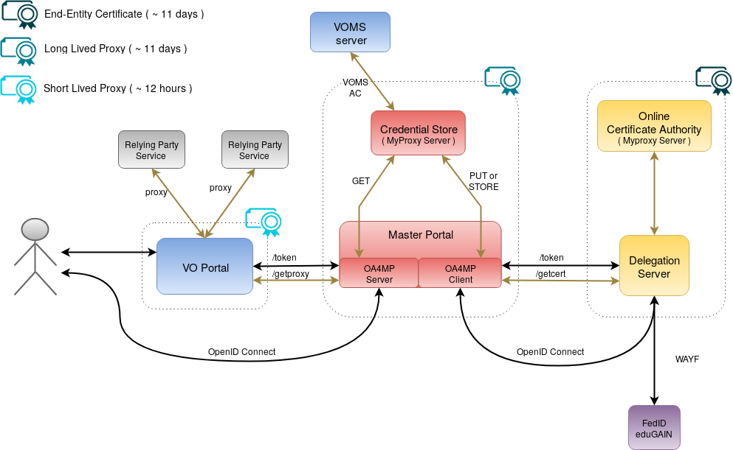
Non-web use cases & delegated access
RCauth.eu Online CA issued certificates
Check-in has been integrated with the production RCAuth.eu Online CA for allowing users to retrieve X.509 proxy certificates using their federated credentials
Master Portal retrieves end-entity certificate from RCauth.eu
Long-lived proxy certificate stored in backend MyProxy server
Short-lived proxies provided via:
Science Gateways via OIDC (so-called VO-portals)
users e.g. via SSH key authentication
EGI Check-in

Slide 25
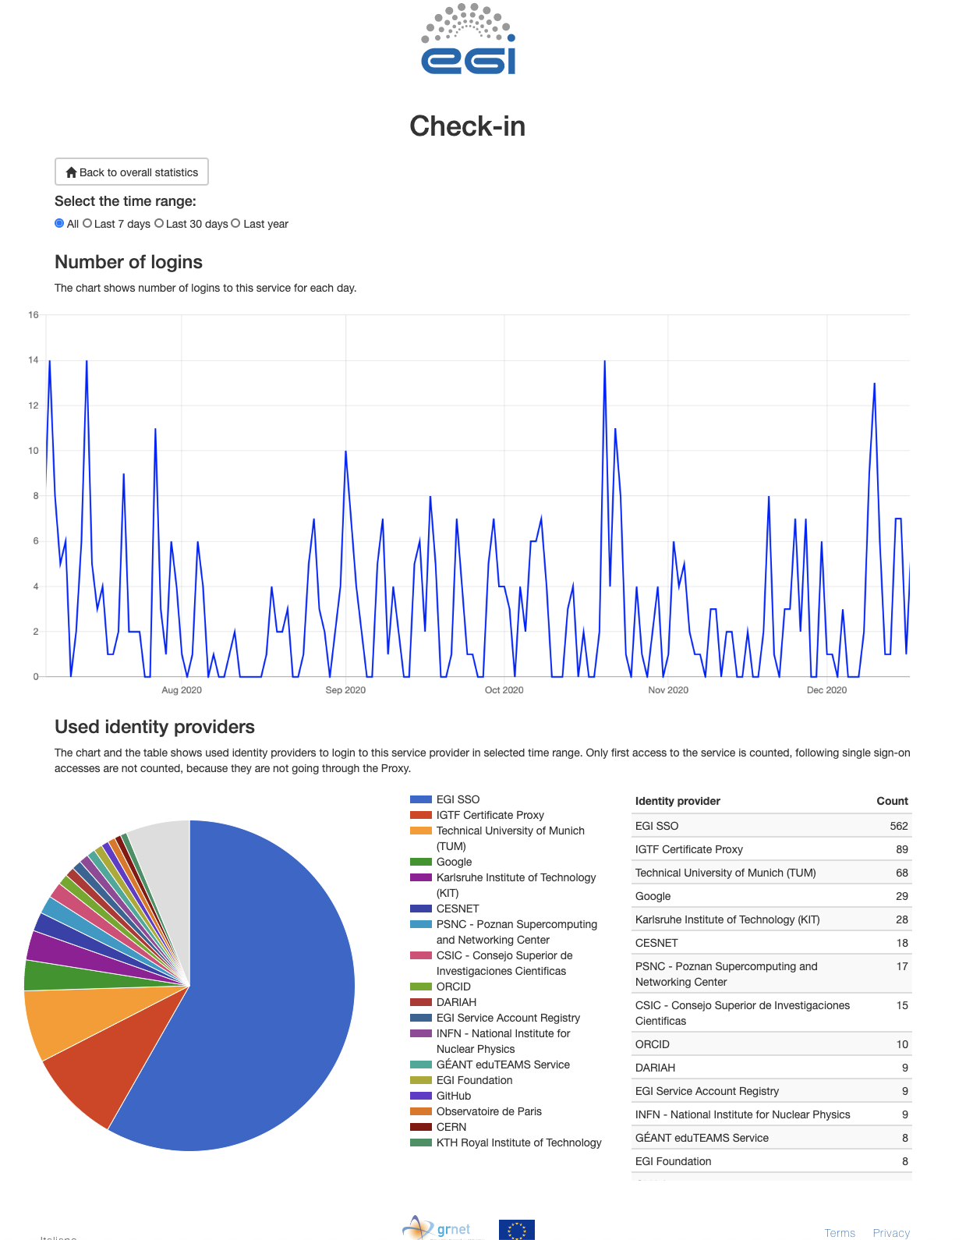
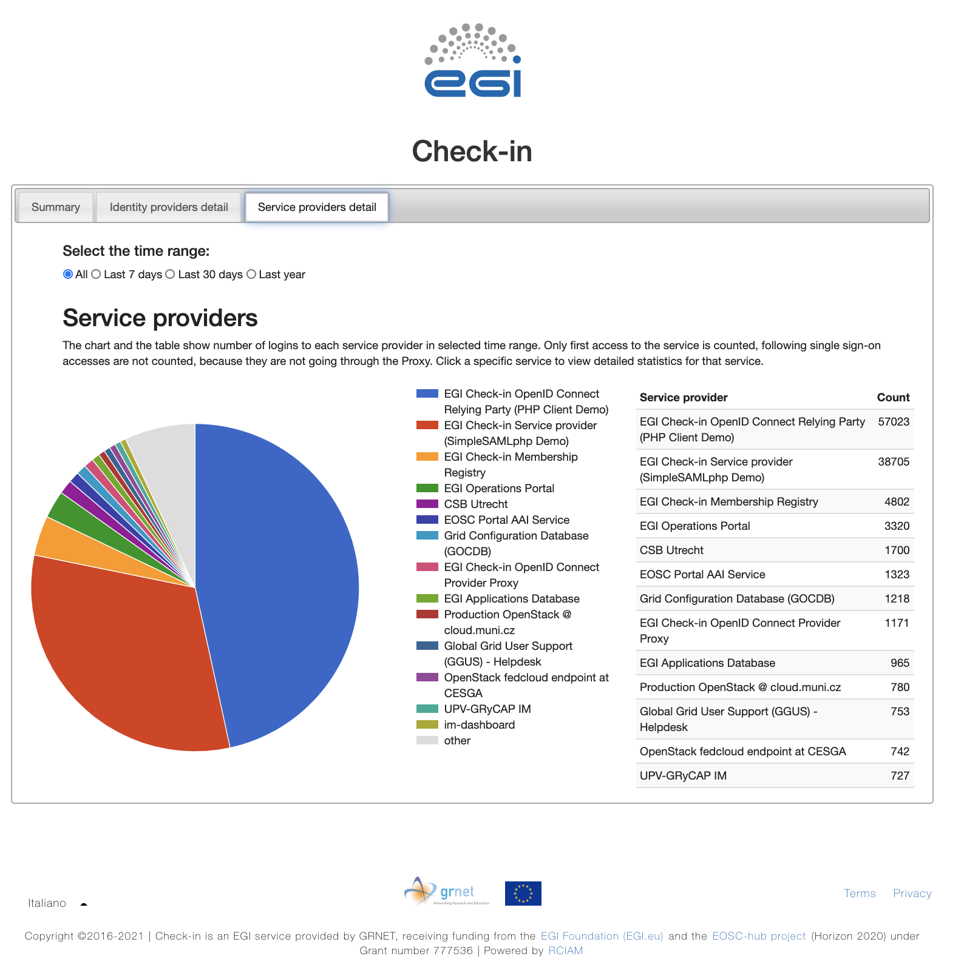
EGI Check-in Statistic viewer
Login statistics for services integrated
EGI Check-in statistics
General view of the login statistics (all services)
Dedicated service view for login statistics:
time trend of user logins
distribution of logins based on the IdPs used by users

Slide 26
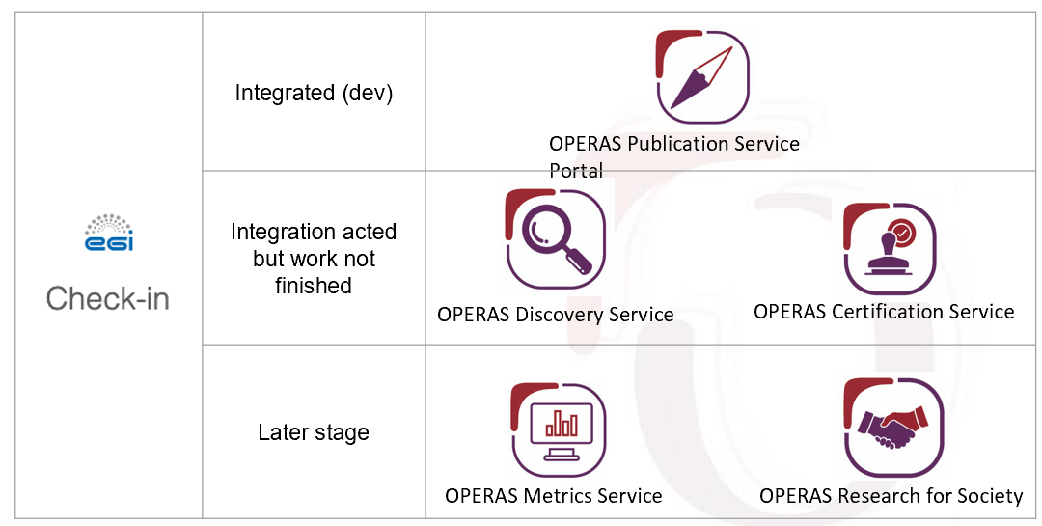
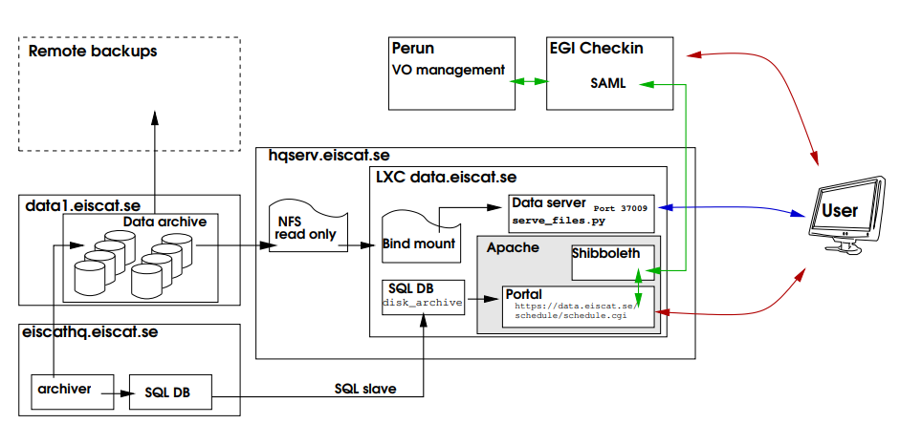
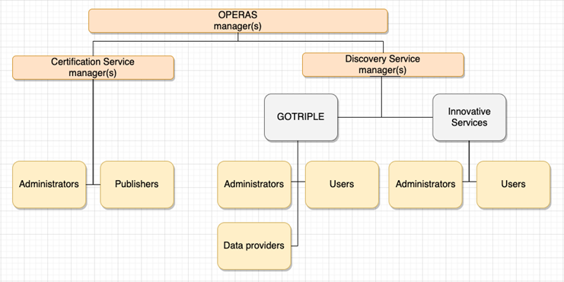
Some examples: EISCAT-3D and OPERAS
OPERAS
EISCAT-3D
Radars for the upper atmosphere and ionosphere
EISCAT-3D users managed in Perun
Access to EISCAT services through Check-in
Open Scholarly Communication in the ERA for Social Sciences and Humanities
OPERAS users managed in Comanage and structured in groups and roles

Slide 27
Check-in Documentation
Usage guide
Integration guide for service providers
Integration guide for identity providers
Getting Support

Slide 28
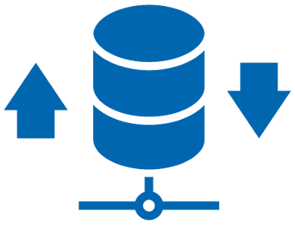
Data Area
Andrea Manzi

Slide 29
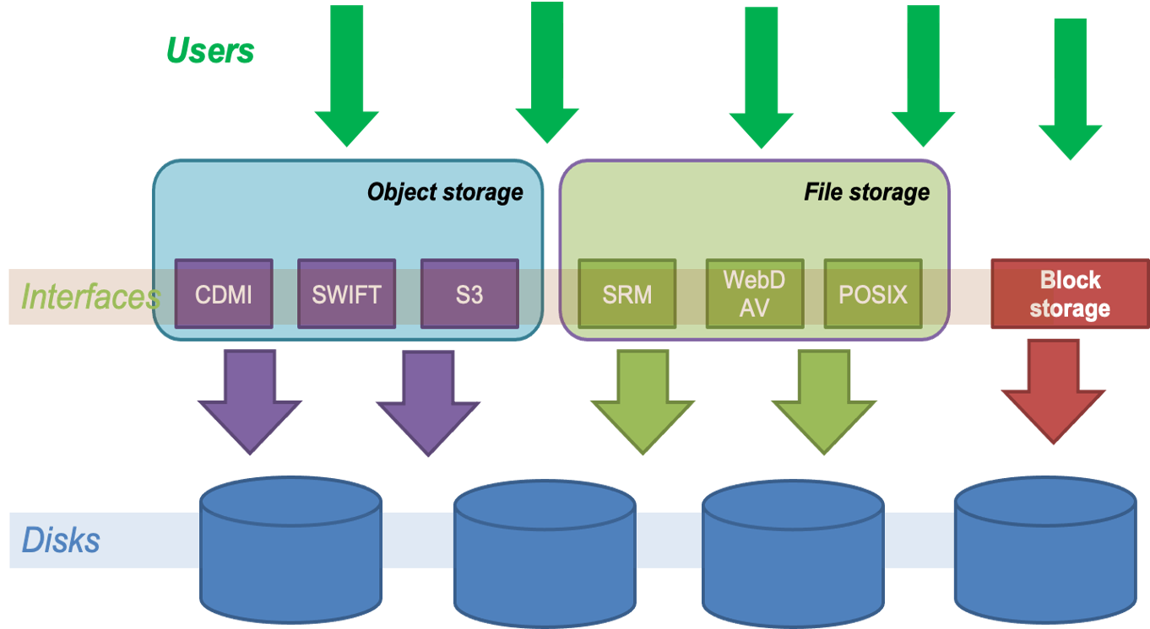
Online Storage
Includes 3 categories of storage services
File Storage
Block Storage
Object Storage

Slide 30
Online Storage
File storage
File storage can be used for storing and accessing files on the infrastructure as input/output to EGI HTC computations
The EGI Workload Management system (DIRAC) is able to access files stored in File Storage instances via different protocols, and schedule the computations in order to be executed close to where the input files are stored
Technologies: DPM, dCache, StoRM
Interfaces: SRM, HTTP/WebDAV, XRootD, gridftp, CDMI

Slide 31
Online Storage
Block storage
Block-level storage solution that allows to expand the storage capacity of instances in the EGI Federated Cloud, offering the lowest possible latency for applications
Increase storage without increasing the size or capacity of the instance or by provisioning new ones; delete servers, keeping data intact
Enhancing Technology: Openstack Cinder
Interfaces: POSIX for access, OCCI and Openstack CLI/GUI for management

Slide 32
Online Storage
Object storage
Manages data as objects. Each object includes the data itself, a variable amount of metadata, and a globally unique identifier.
Cloud object storage allows relatively inexpensive, scalable and self-healing retention of massive amounts of unstructured data
the main uses cases are:
Backups and Data Archive, AI and ML , Cloud Native applications
Technologies: OpenStack Swift, CEPH
Interfaces: S3, Swift, CDMI

Slide 33
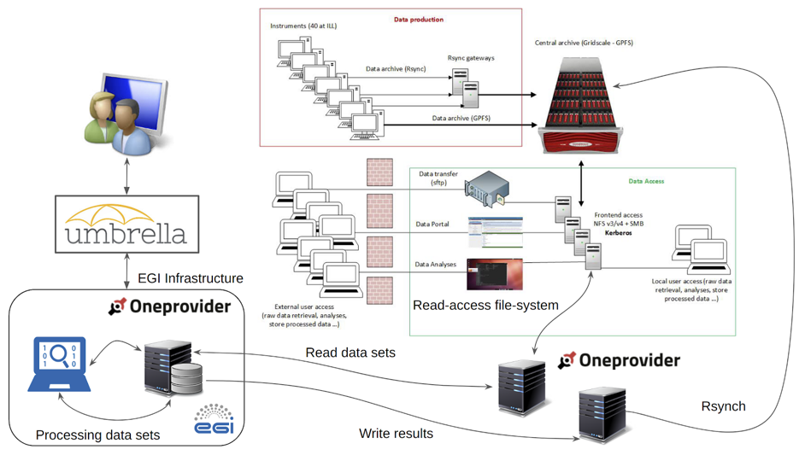
DataHub
Access key scientific datasets in a scalable way
Service based on Onedata technology
It allows transparent data access under a common namespace regardless of the location
Data can be accessed via a GUI or APIs
Developed in EOSC-hub project and
under integration by many communities
Central component and distributed
providers in EGI-ACE are going to be
operated by Cyfronet

Slide 34
DataHub
Main functionalities
Integrated with EGI-Checkin
File/Share Management
Shares can eventually be published via Handle services and have a PID assigned
Extensive backend support
Posix, S3, Swift, CEPH, GlusterFS
Data import
Allows exposing existing datasets
Metadata Management
Metadata associated to files (k-v pairs, json, rdf)
OAI-PMH interface
Harvester Management
Possibility to automatic extract metadata from files published to a space
Metadata updates are pushed to external indexes (e.g. Elastic Search) and automatically synchronized

Slide 35
Data Transfer
Transfer large datasets between storages
Easy users interaction for submitting transfers
Portal for end-users, Real Time monitoring and Web Admin
Checksums and retries are provided per transfer
Multiprotocol support
Different clients to access the service (RESTFul APIs, python bindings)
Transfers from/to different storages (including staging from tape)
Parallel transfers scheduling and optimization to get the most from network without burning the storages
Priorities/Activities support for transfers classification

Slide 36
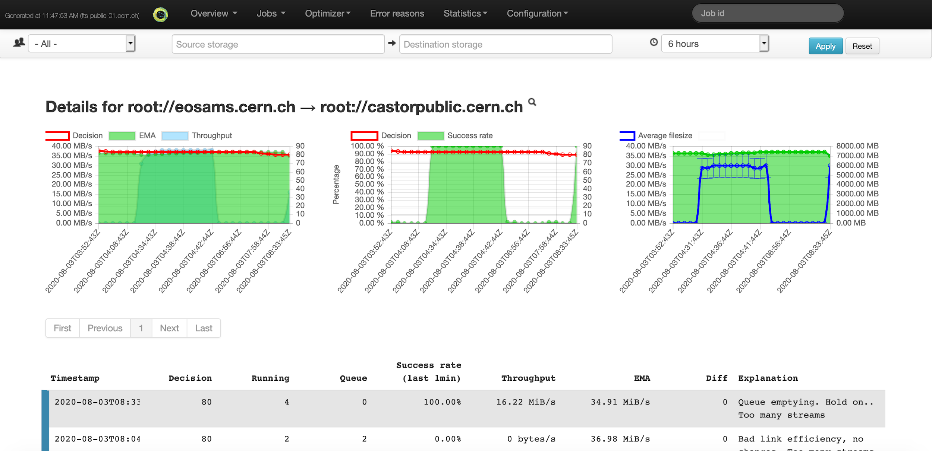
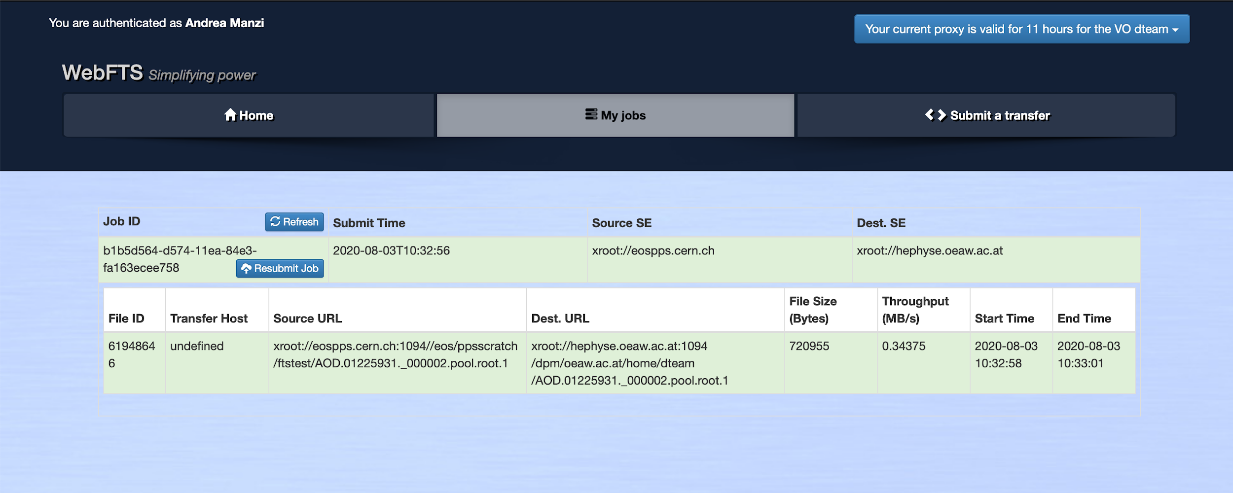
Data Transfer
Service operations
Orchestrates transfers between EGI Online storage instances and external storages using standard protocols ( e.g. HTTP/WebDAV, gridftp)
STFC-UKRI is providing the service and planning to operate the end user graphical interface (WebFTS)

Slide 37
Rucio
Scalable data management
Rucio is the software developed at CERN for the management of LHC experiments data
provides a complete and generic scientific data management service
Rucio manages multi-location data in a heterogeneous distributed environment
Creation, location, transfer, and deletion of replicas of data
Orchestration according to both low-level and high-level driven data management policies (usage policies, access control, and data lifetime)
Interfaces with workflow management systems
Large-scale and repetitive operational tasks can be automated

Slide 38
Rucio
Service operations
Under integration by many communities also outside HEP
Largest user (ATLAS) managing 500PB of data and 20GB/s transfers between 72 official sites
STFC-UKRI implemented extensions for Multi-VO support and will operate the service
Interfaced to FTS for transfer execution and possibly integrated with EGI Workload manager to implement data transfer orchestration linked to workflow executions

Slide 39
OpenRDM
Main functionalities
A complete solution for managing research data, based on the openBIS software. Targeting research labs working with quantitative research data
Inventory management
Keep track of all materials and samples used in a lab
Electronic lab notebook
Describe computational experiments and links to the materials, samples and protocols stored in the inventory
Data analysis integration
Jupyter notebook integration and access to external computing clusters
Data management
Store all data connected to experiments, export to data repos like Zenodo

Slide 40
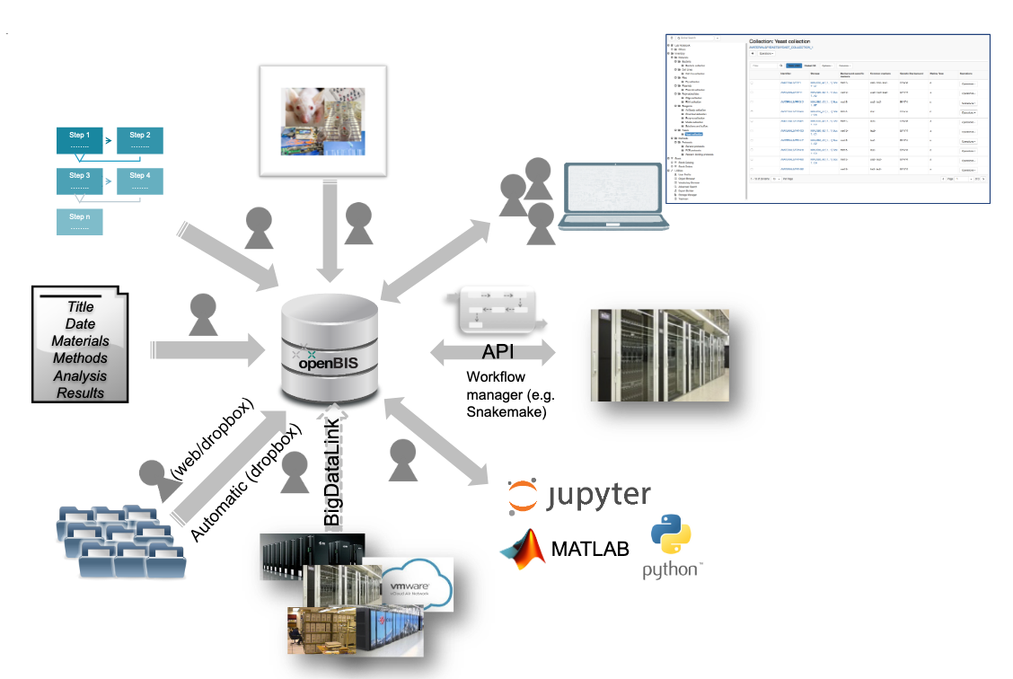
OpenRDM
Service Operations
The service will be provided by EnhanceR as a centrally managed instance (OpenRDM.eu) and will provide access to long-tail of science type use cases
Additionally dedicated instances for
specific communities will be setup on top
of EGI Federated resources

Slide 41
Documentation
Internal and External
Online Storage
DataHub ( user and provider guides )
Data Transfer
Rucio
OpenBIS user guide

