Slide 1
Data spaces: Services for online analytics
SeaDataNet WebODV analysis service
Dick M.A. Schaap
05th. February 2021

Slide 2
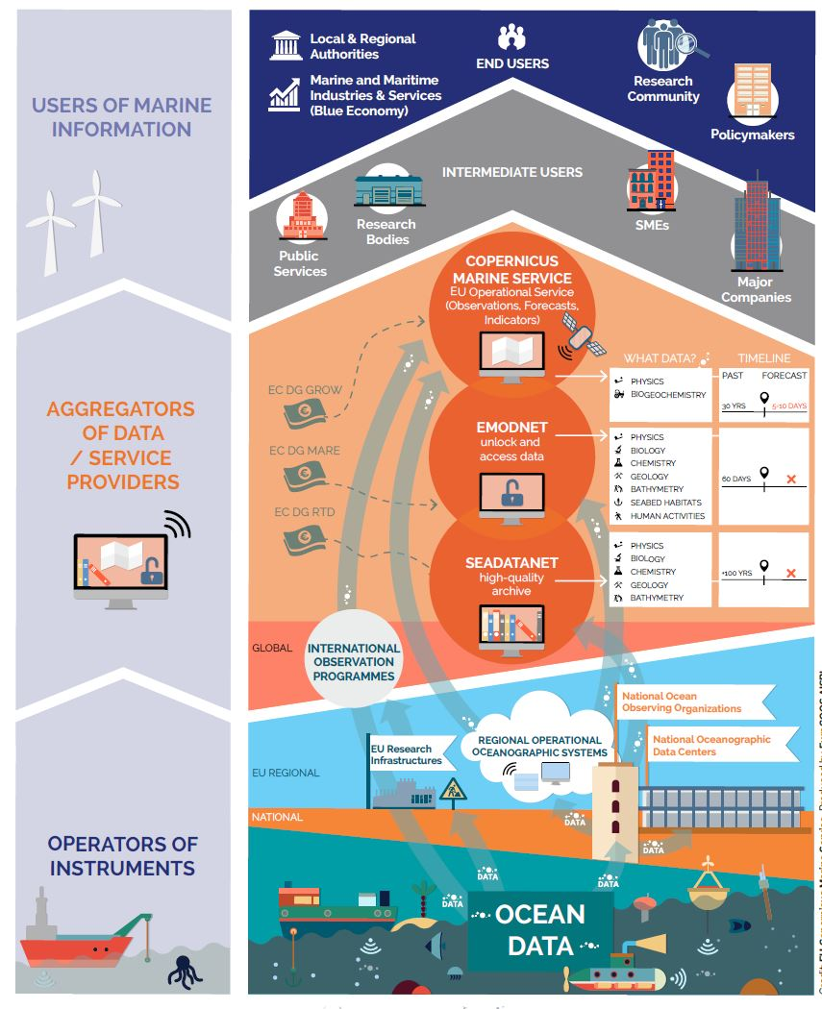
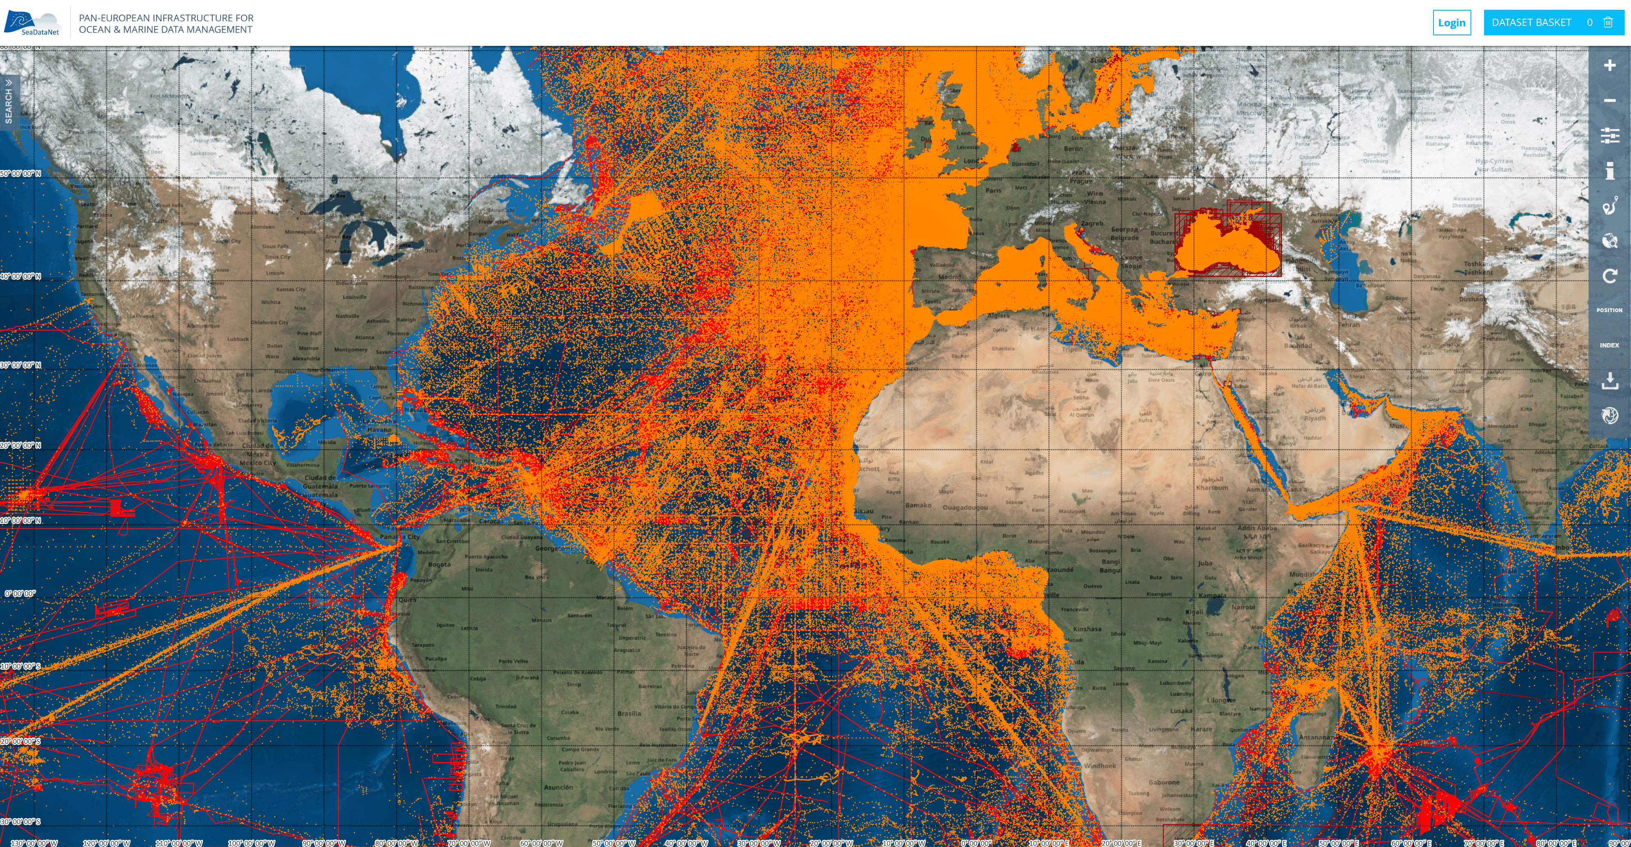

Short intro of the scientific communities
SeaDataNet - pan-European infrastructure for marine data management
Connecting > 110 data centres from 34 countries for discovery and access to marine data for physics, chemistry, geology, bathymetry, and biology from scientific and monitoring activities
Developing and promoting FAIR data management standards, services, and tools
Major contributor to EMODnet, Copernicus CMEMS, and Blue-Cloud
European marine data landscape

Slide 3
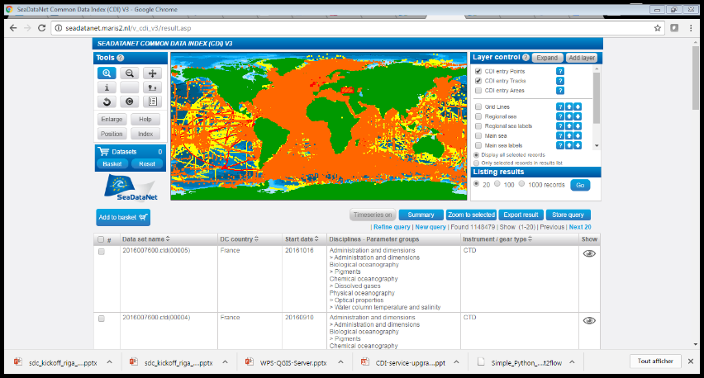
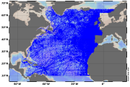
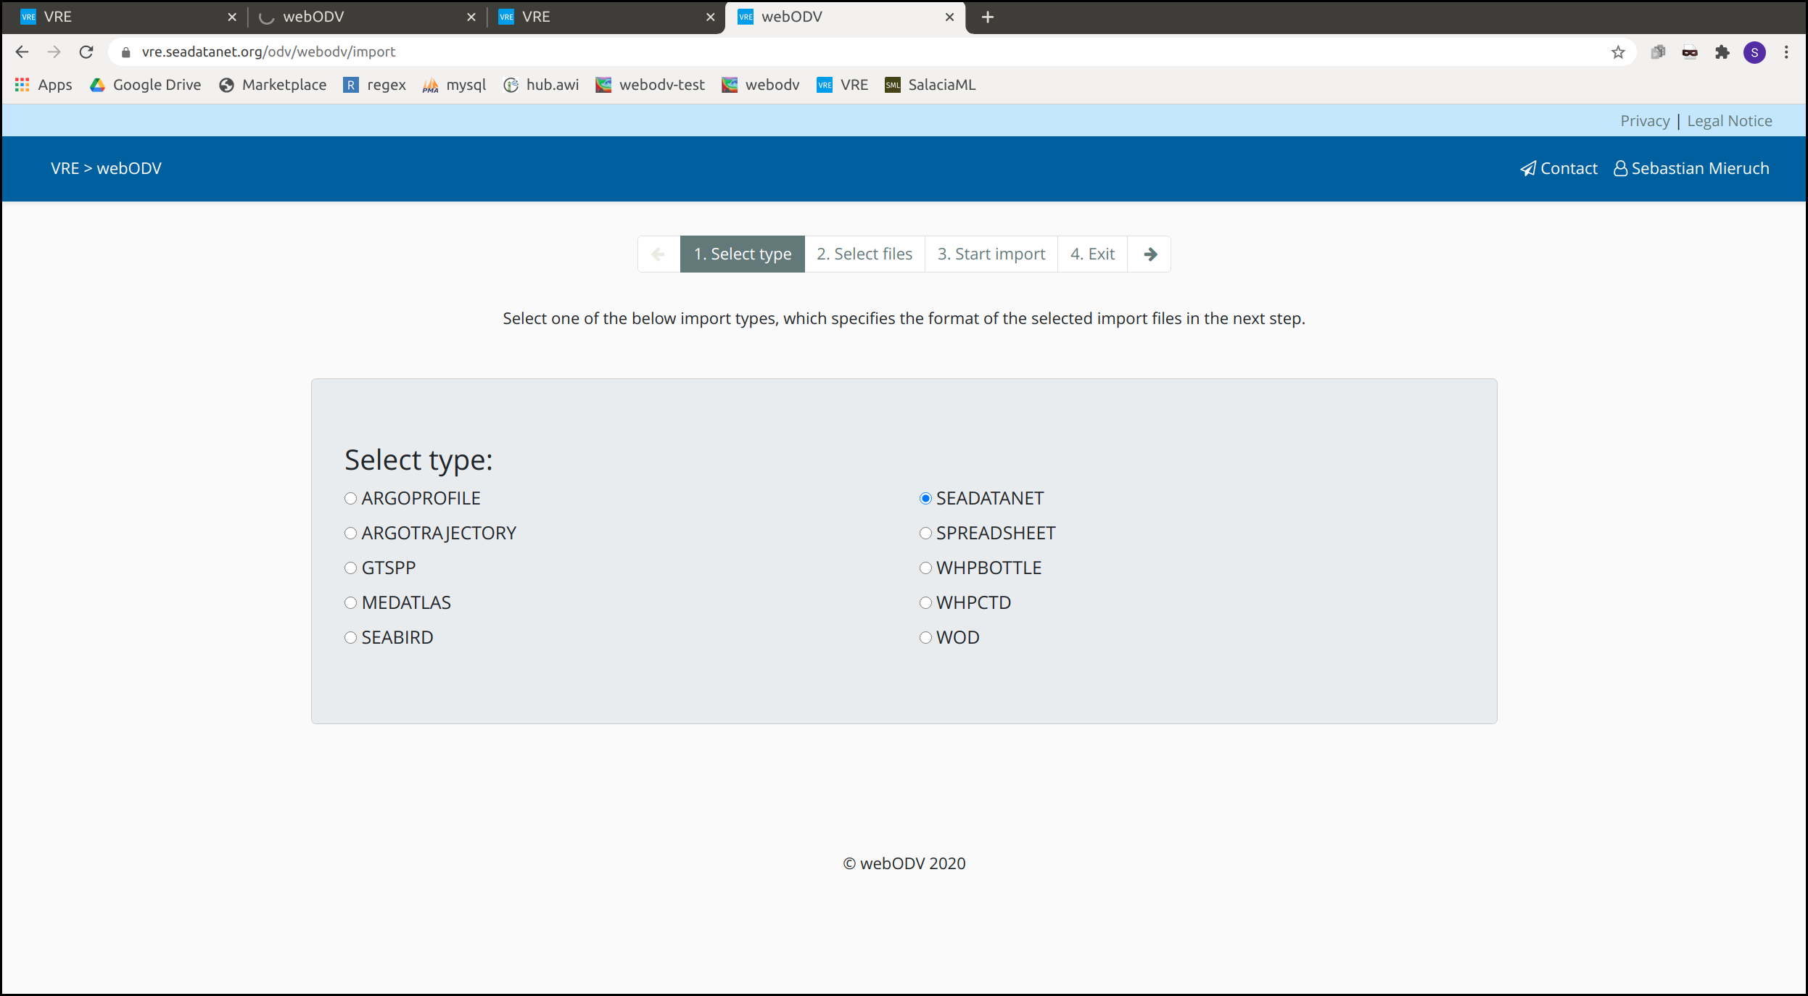
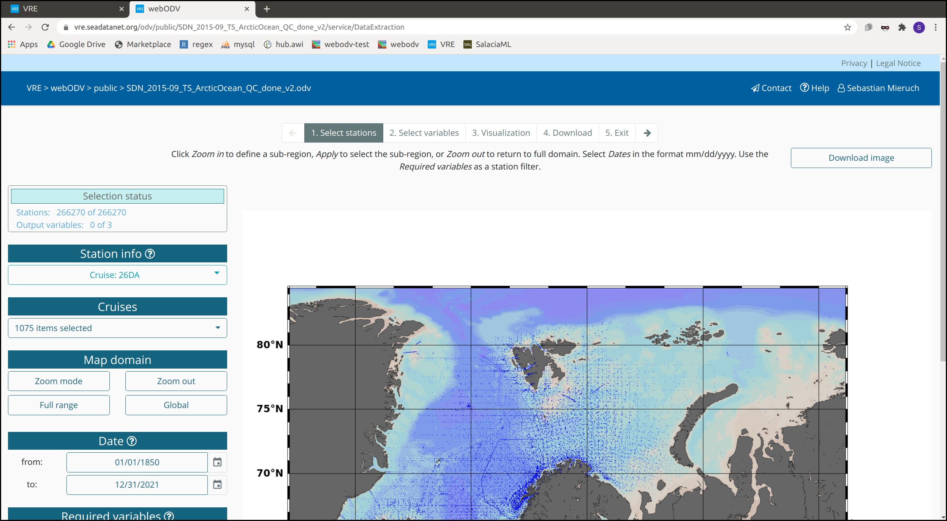
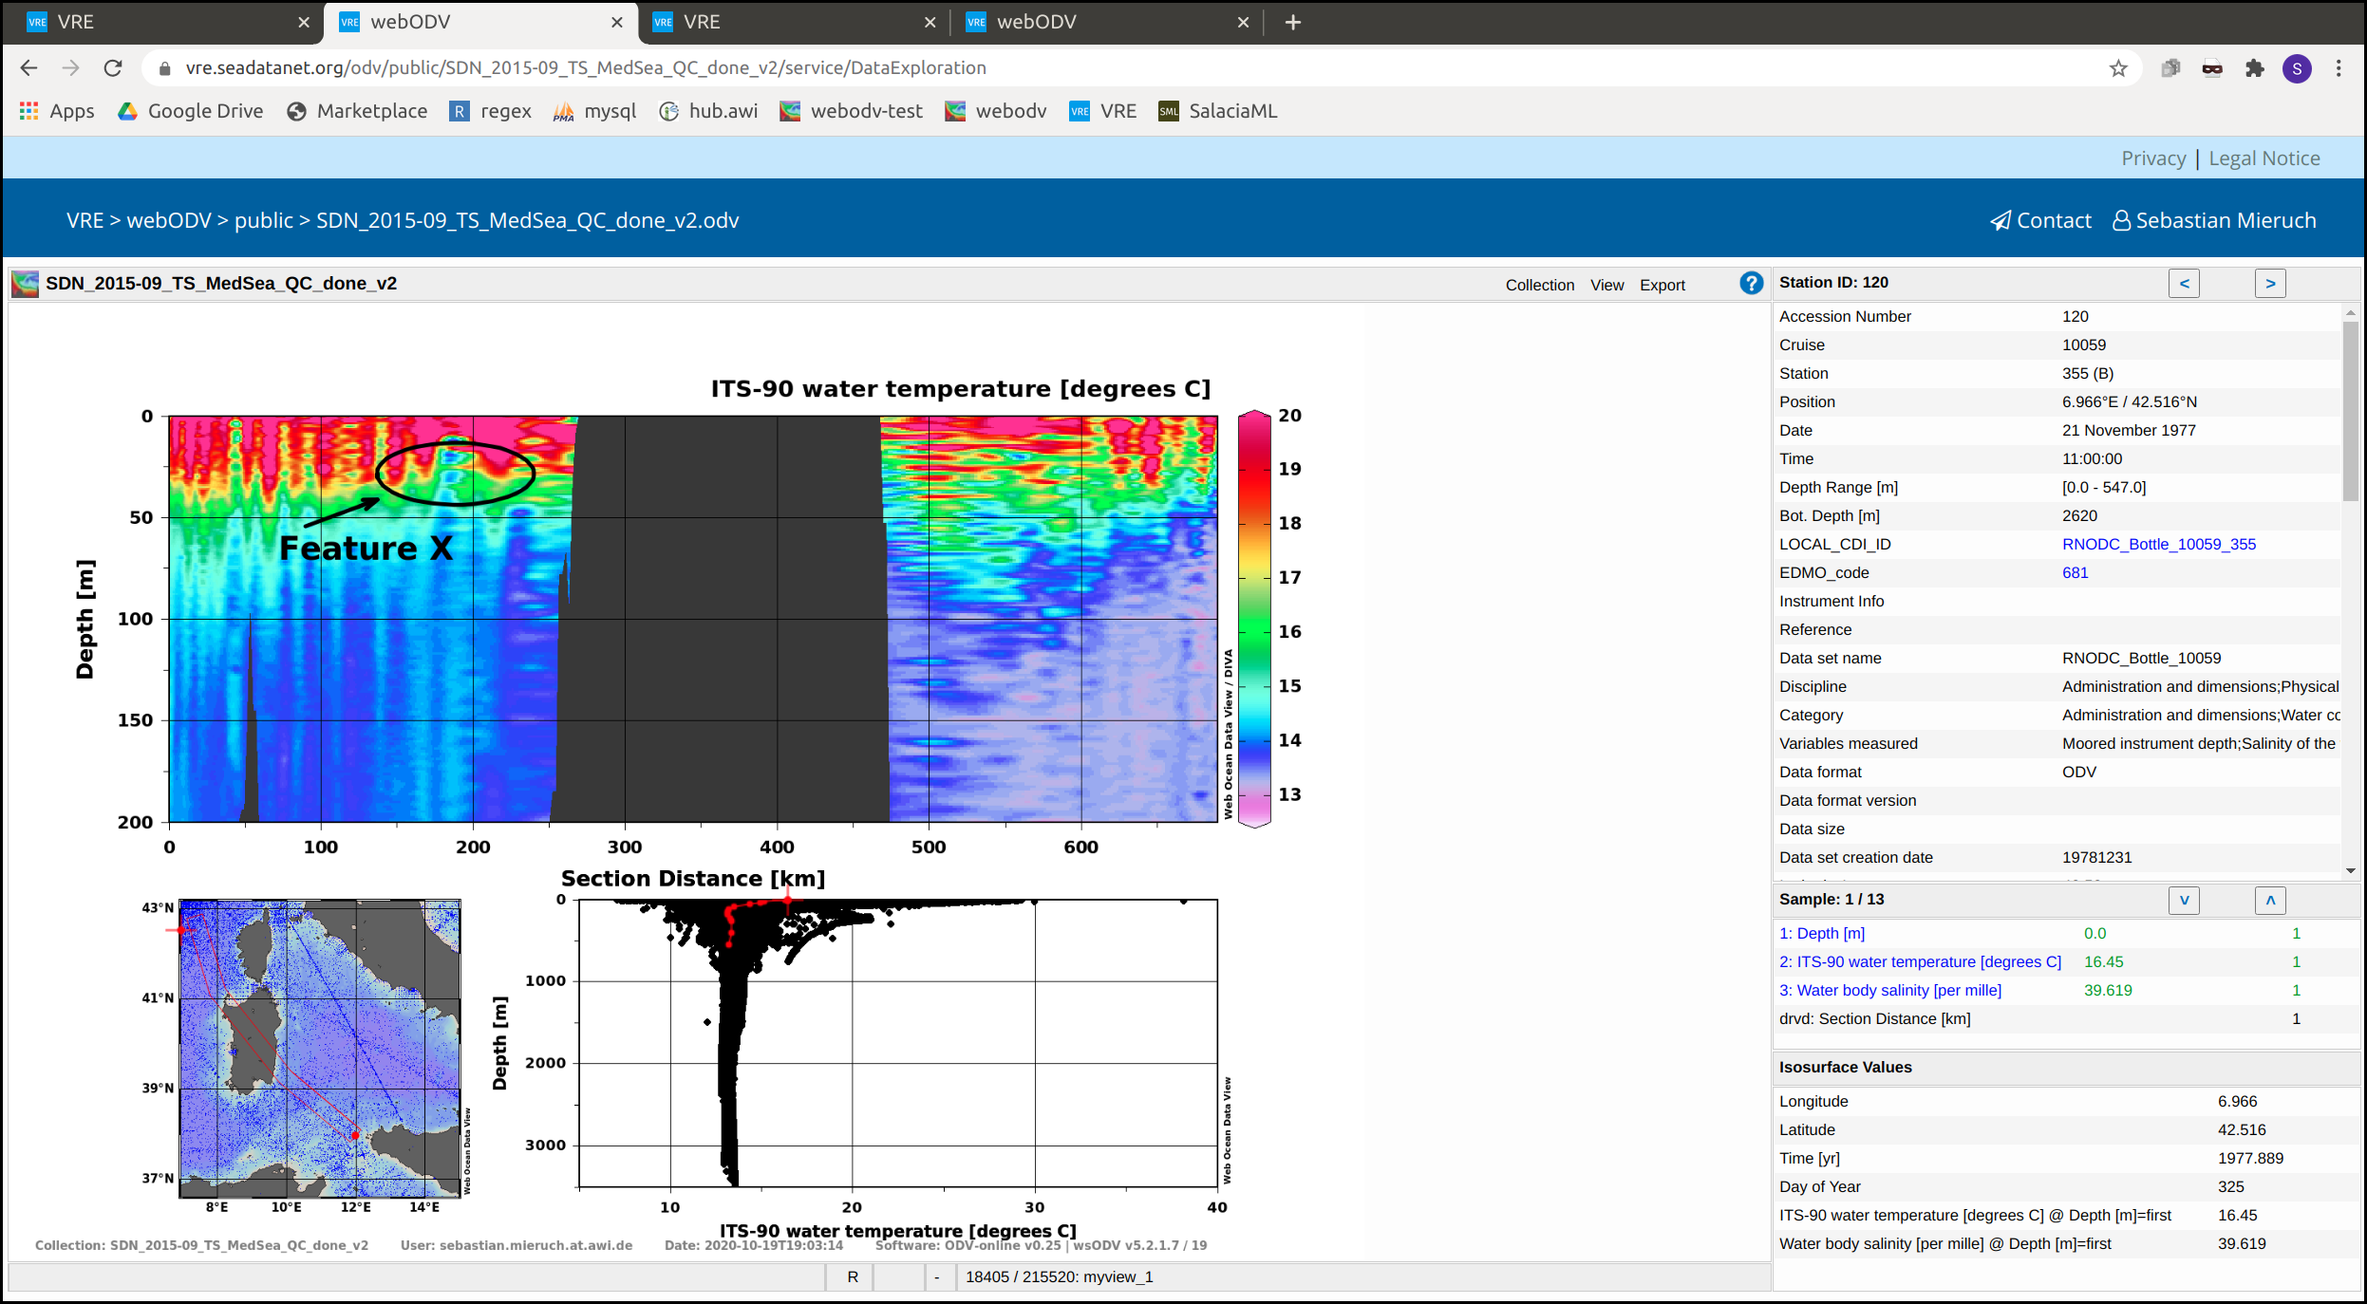
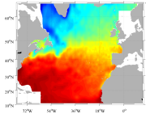
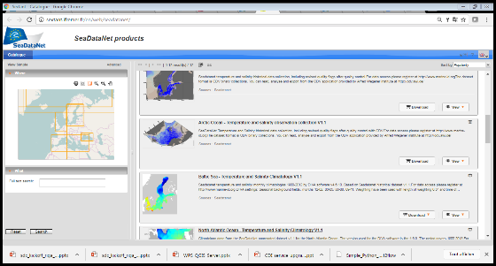
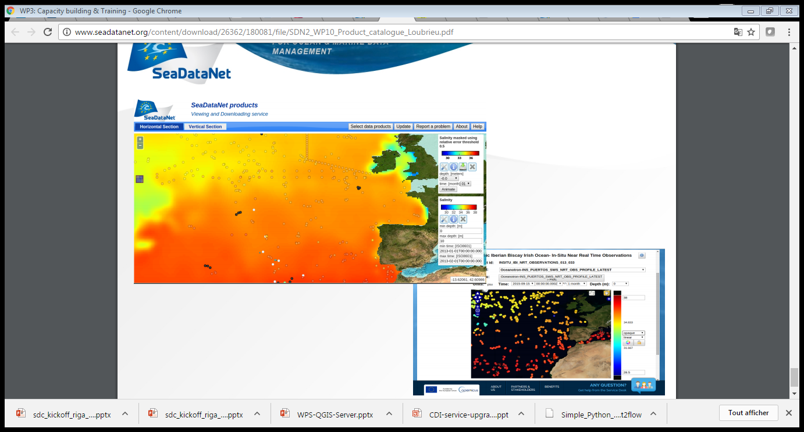
The computing/data challenges that will be addressed by the Data Space
Workflows for generating climatologies
WebODV for QA-QC, visualisation, subsetting, and export of large data collections
CDI
Qualified buffer
Publication
Geo interpolation

Slide 4
Planned work in EGI-ACE
Deploying, operating and exploiting WebODV
Activities to be undertaken by MARIS and AWI (WebODV developer)
Deploying and configuring WebODV at EGI-ACE service platform, including account management, and providing a set of large data collections
Onboarding WebODV service in the EOSC service catalogue
Promoting and mobilizing uptake by users communities, e.g. through SeaDataNet, EMODnet, existing ODV user base, and wider
Organising webinars
Providing support to users
Reviewing overall performance of services
Gathering and reporting KPIs

Slide 5
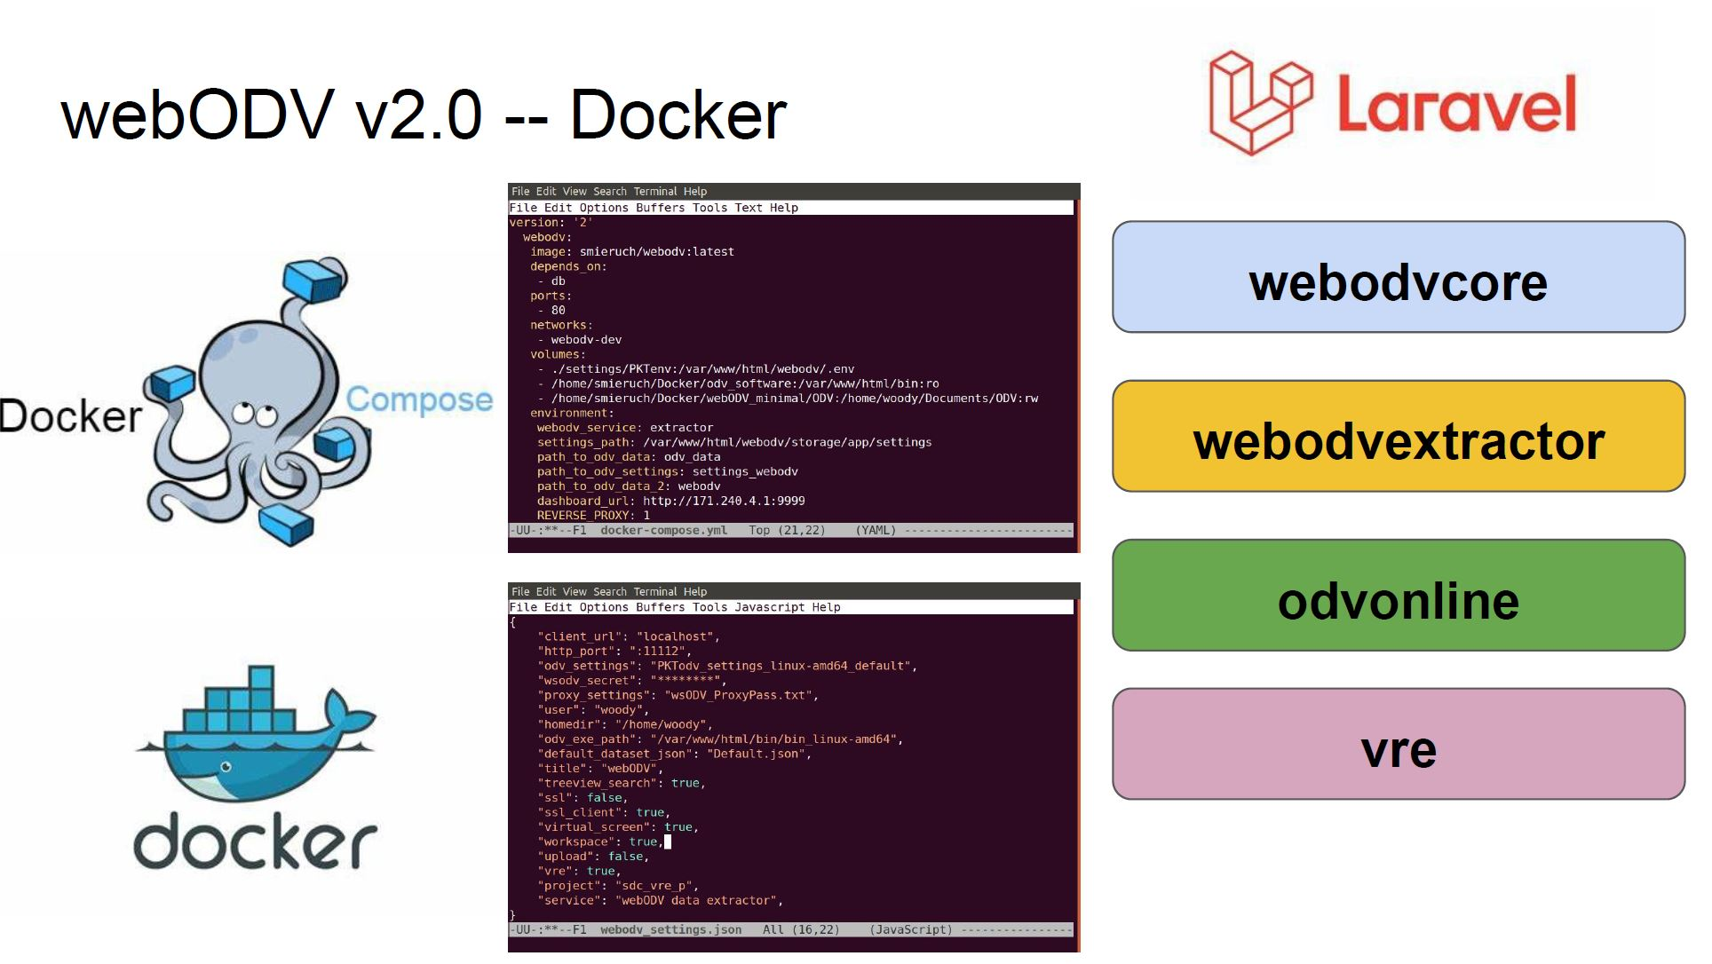
Which services will be used/requested
EGI-ACE to provide:
Technical support for the initial technical deployment of WebODV components as a number of Docker containers
Sufficient storage
Sufficient computing resources
AAI and account management
Tracking of use for KPIs
Co-promotion

Slide 6
Scale of resources needed
Targets and estimates
Aim is to reach out to several thousands of potential users, mostly oceanographers managing and studying marine physical and chemical data sets for various applications
Existing users of ODV and potential users of webODV can be found at all the major marine research institutes and universities, in Europe and beyond as oceanographic research has a global dimension.
Estimating scale of resources is difficult in this stage, but targets are 250 users in the 2nd project phase and 500 users in the 3rd project phase

Slide 7
Timeline for the implementation
3 project phases
Jan 2021 - Oct 2021: WebODV will be deployed, configured, and tested, after which it will be launched as part of EOSC offer
Nov 2021 - Aug 2022: Mobilising and supporting users to make use of the WebODV services in a productive and operational way, setting up user-accounts, providing technical and scientific support to users undertaking scientific analyses, monitoring performances and usage, and progress reporting
Sep 2022 - June 2023: See above, learning from the use experiences in several ways, and final reporting

Slide 8
Expected impacts
Potential users are oceanographers, working at all major marine research institutes and universities, in Europe and beyond as oceanographic research has a global dimension
webODV facilitates them to import large amounts of marine observations and to explore and analyse these as a group interactively by tables of numbers and by dedicated plots, performing quality control and giving quality flags, generating specific visualisations, and finally prepare output as ODV data collections, which can be shared for other webODV sessions.
These data outputs are important for studies on marine ecosystems and climate change related analyses, to support scientific papers, and marine environmental management and policies, such as the Marine Strategy Framework Directive (MSFD) of EU.
Expected impacts of EGI-ACE use case:
More users aware and adopting webODV
More users experiencing the benefits of web-based science
More experience with webODV performance with many parallel workflow runs
More insights in computing requirements for webODV operations
More feedback and suggestions for improving and/or expanding functionality of webODV
More interest from users in SeaDataNet, EGI, and EOSC

Slide 9
Thank you!

