Slide 1
UseGalaxy.eu
An accessible
and reproducible workbench
with an European-wide
distributed compute network
Björn Grüning
EGI-ACE Kickoff meeting, 05.02.2021
@bjoerngruening bgruening

Slide 2
Galaxy is an open, web-based platform for accessible, reproducible, and transparent computational research
https://galaxyproject.org

Slide 3
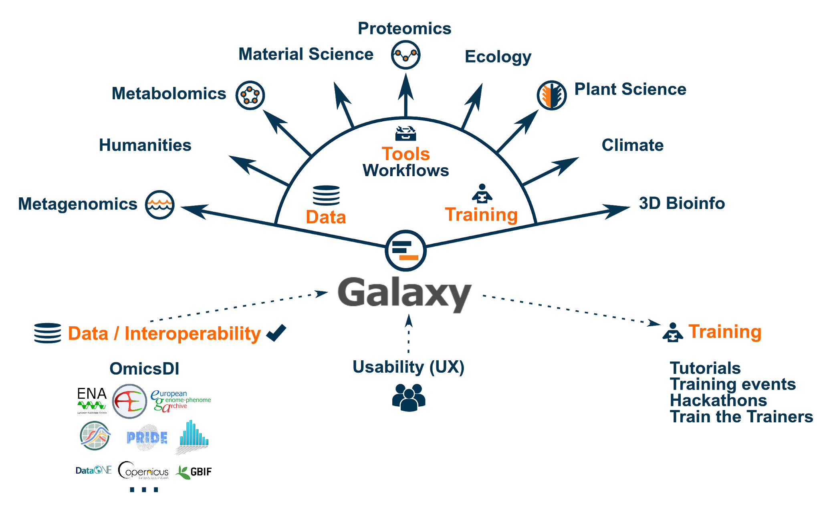
A Data Analysis Gateway for Everyone!

Slide 4
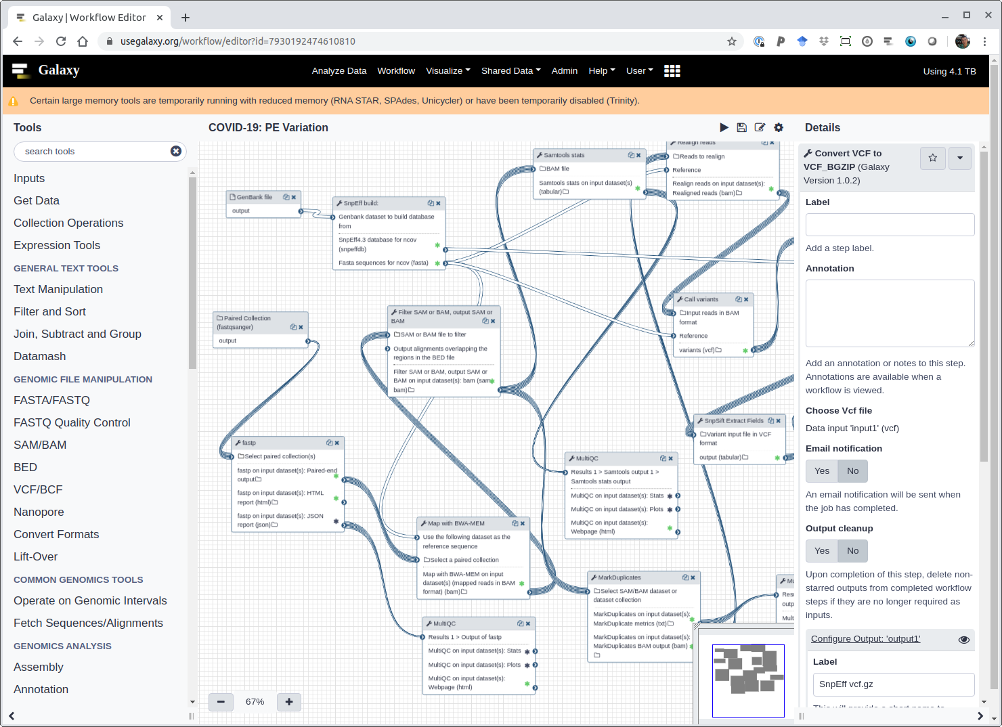
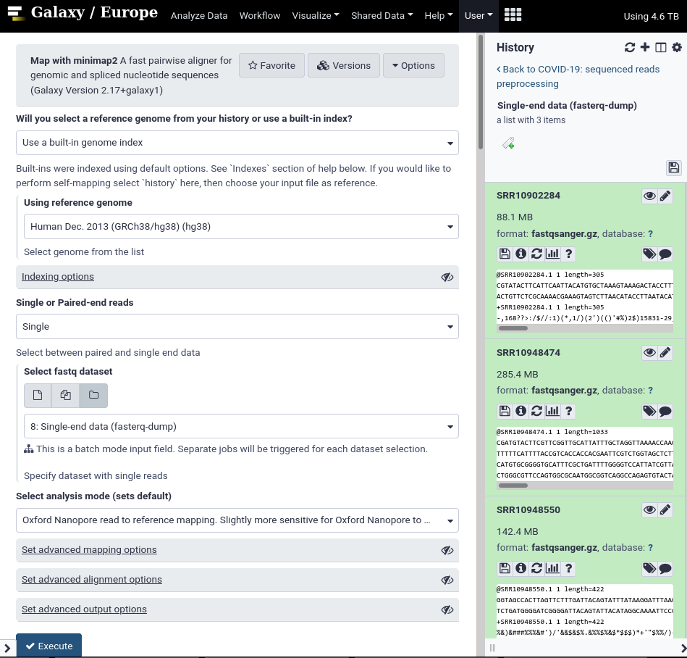
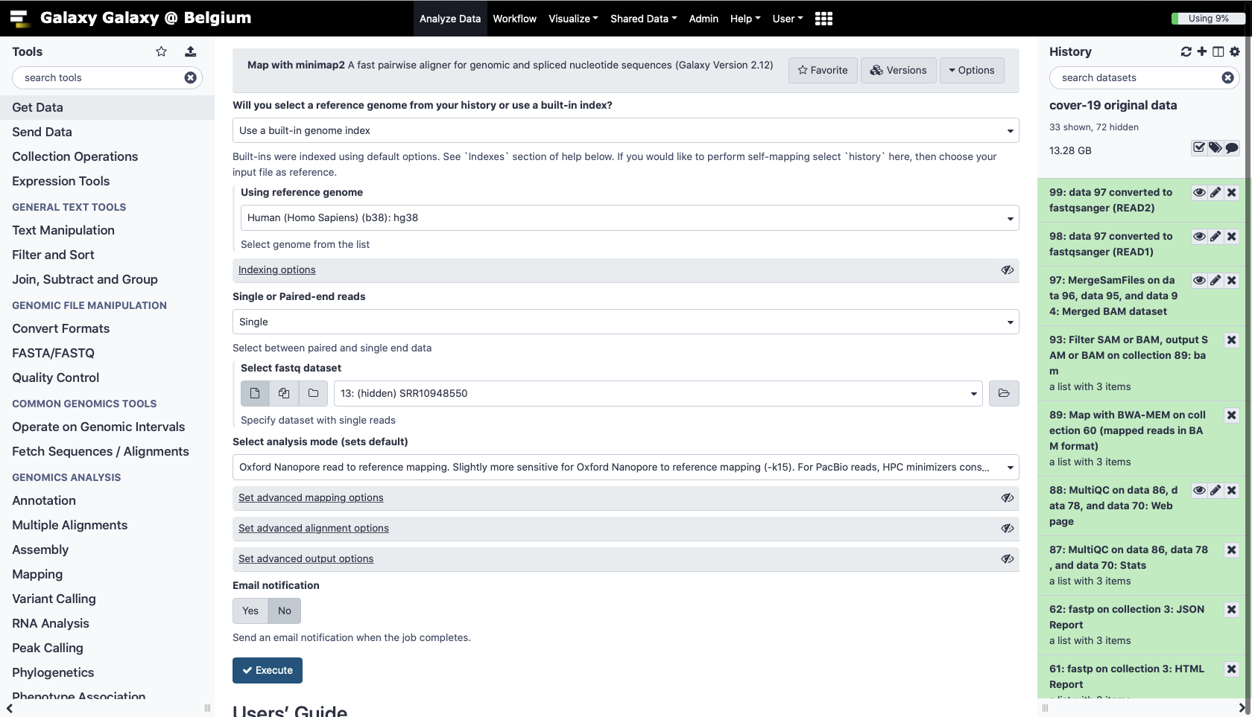
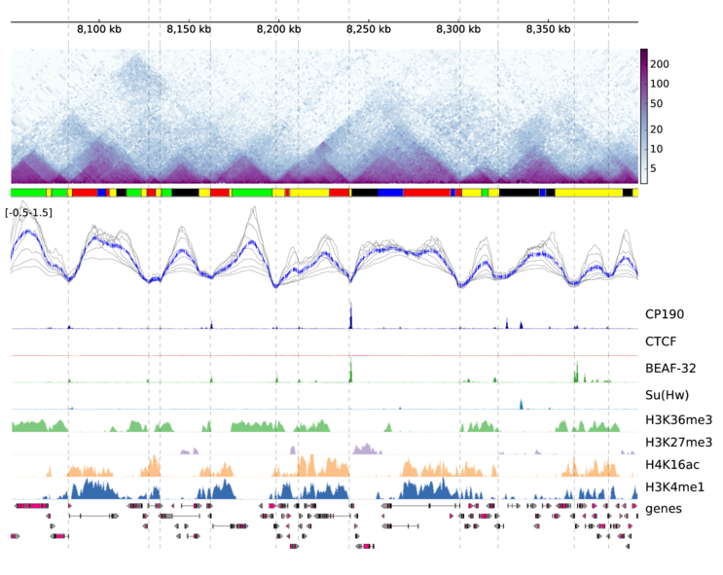
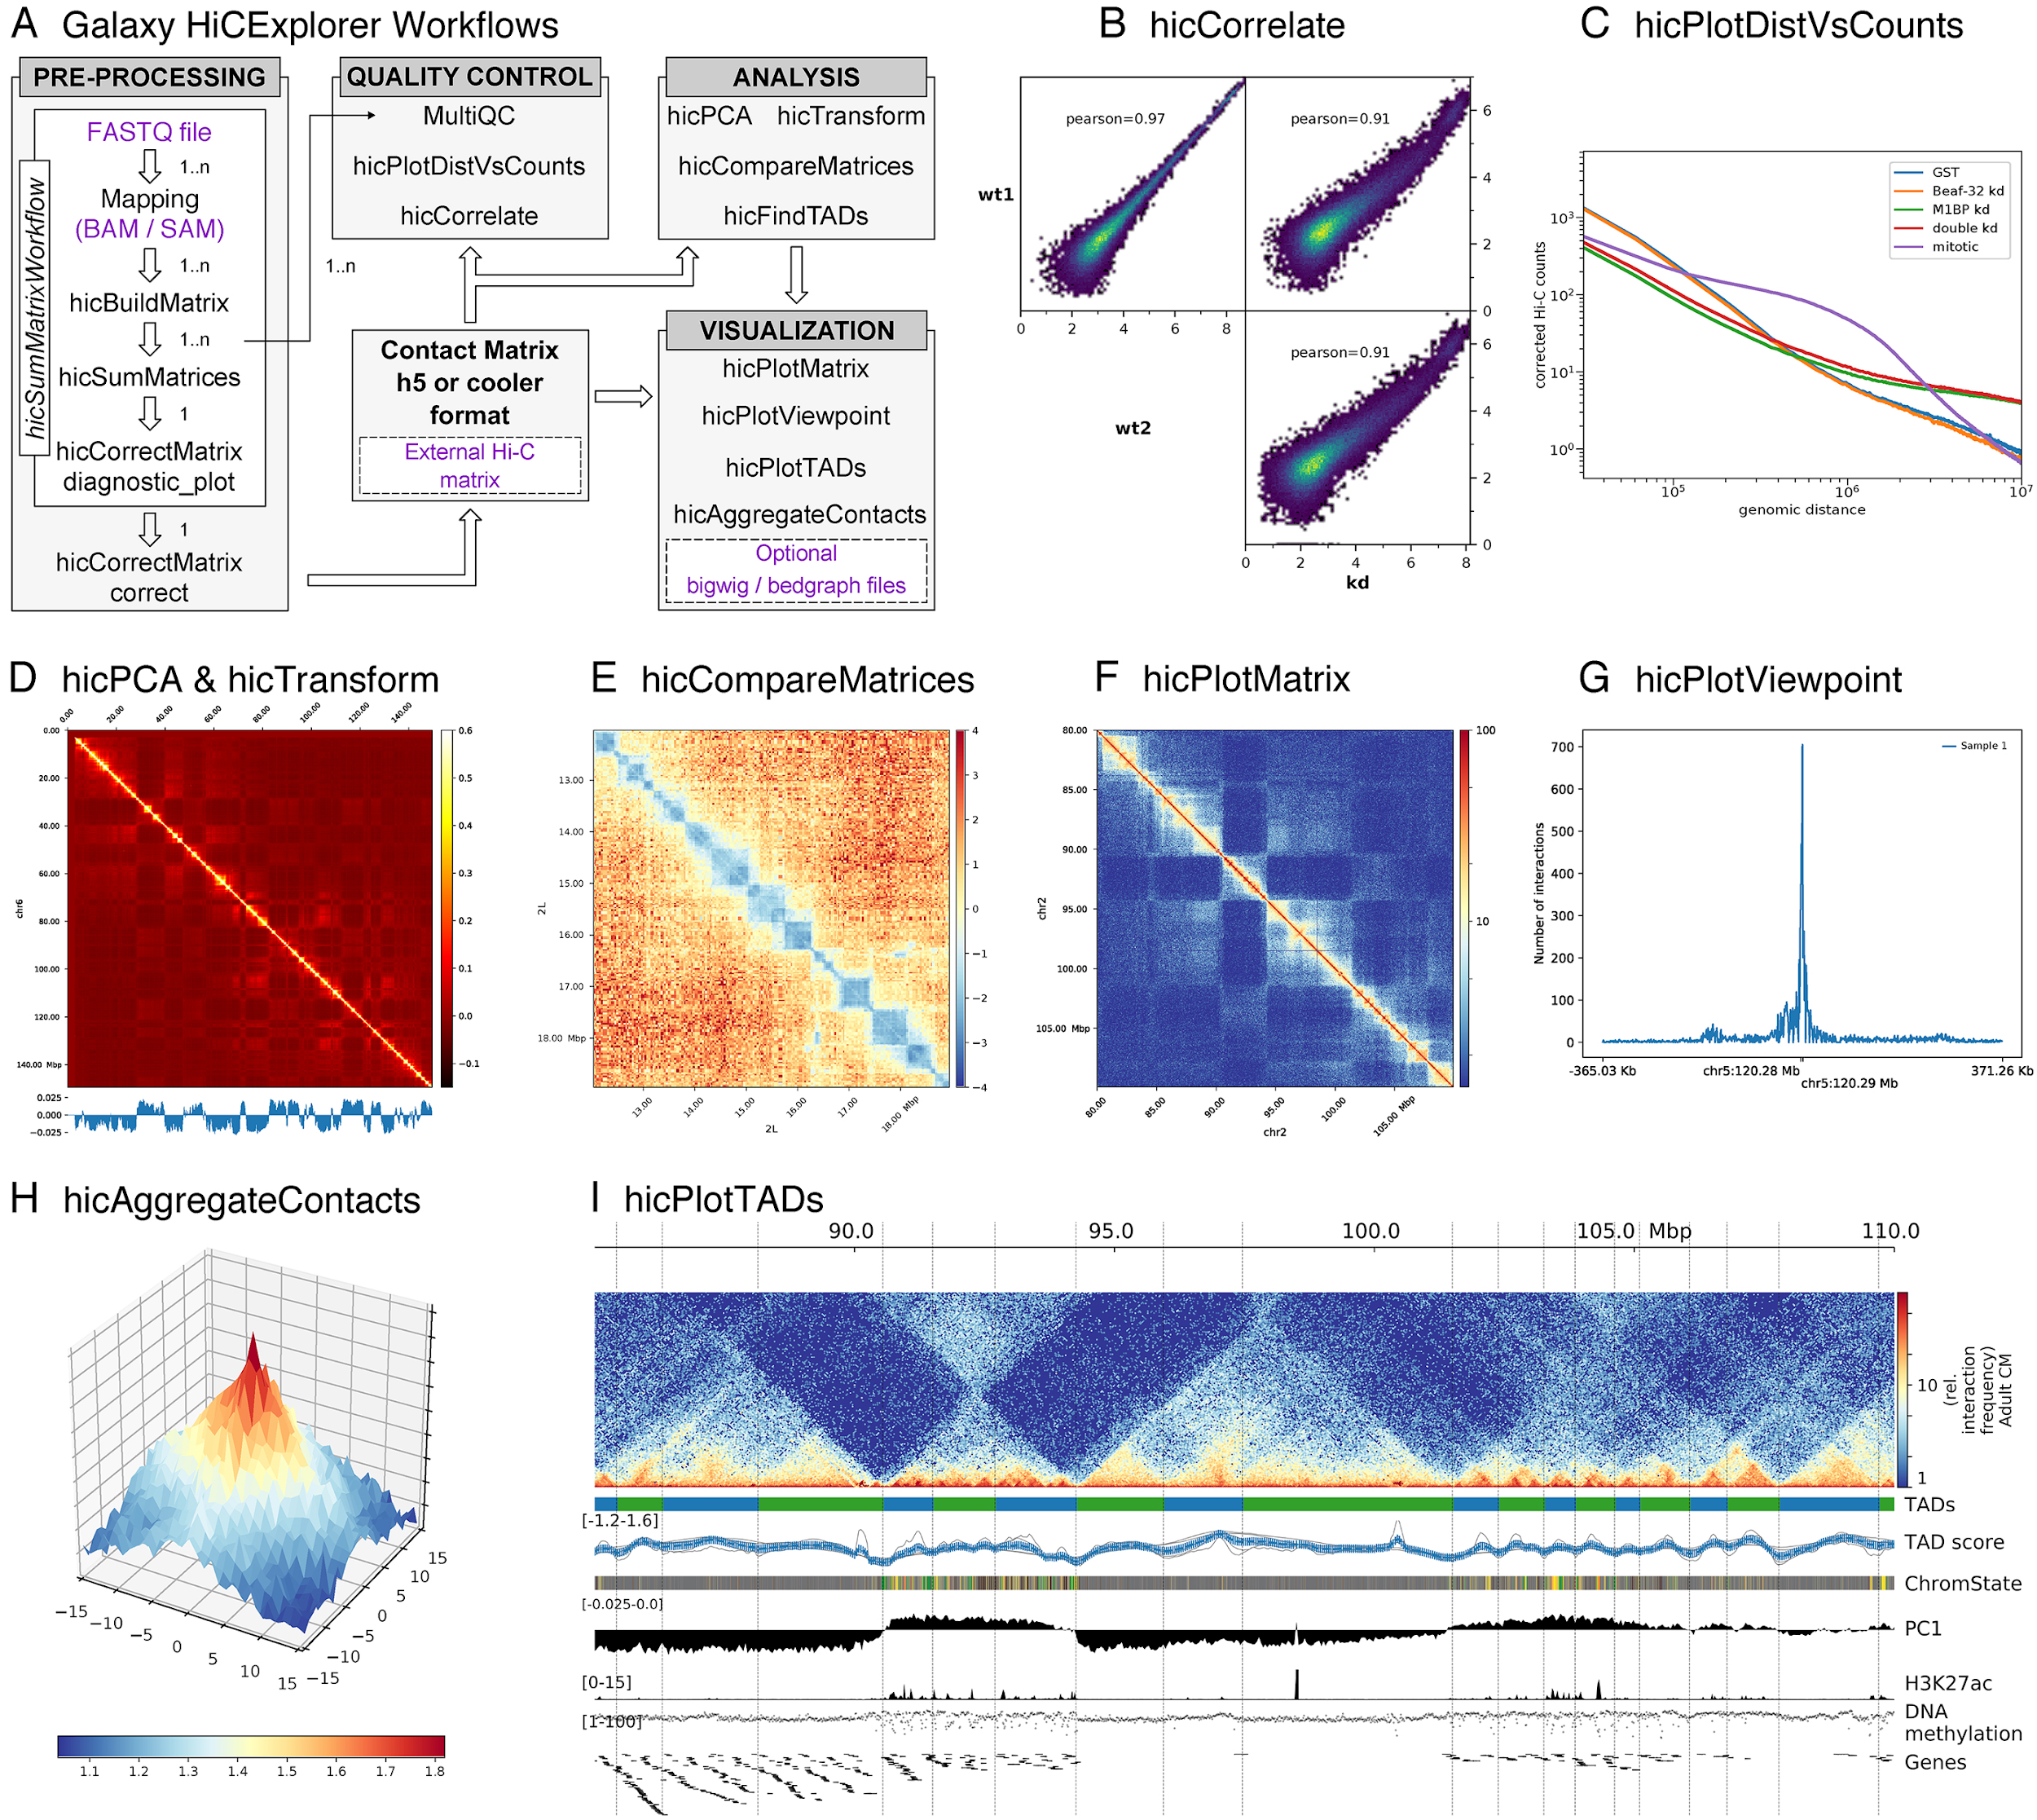
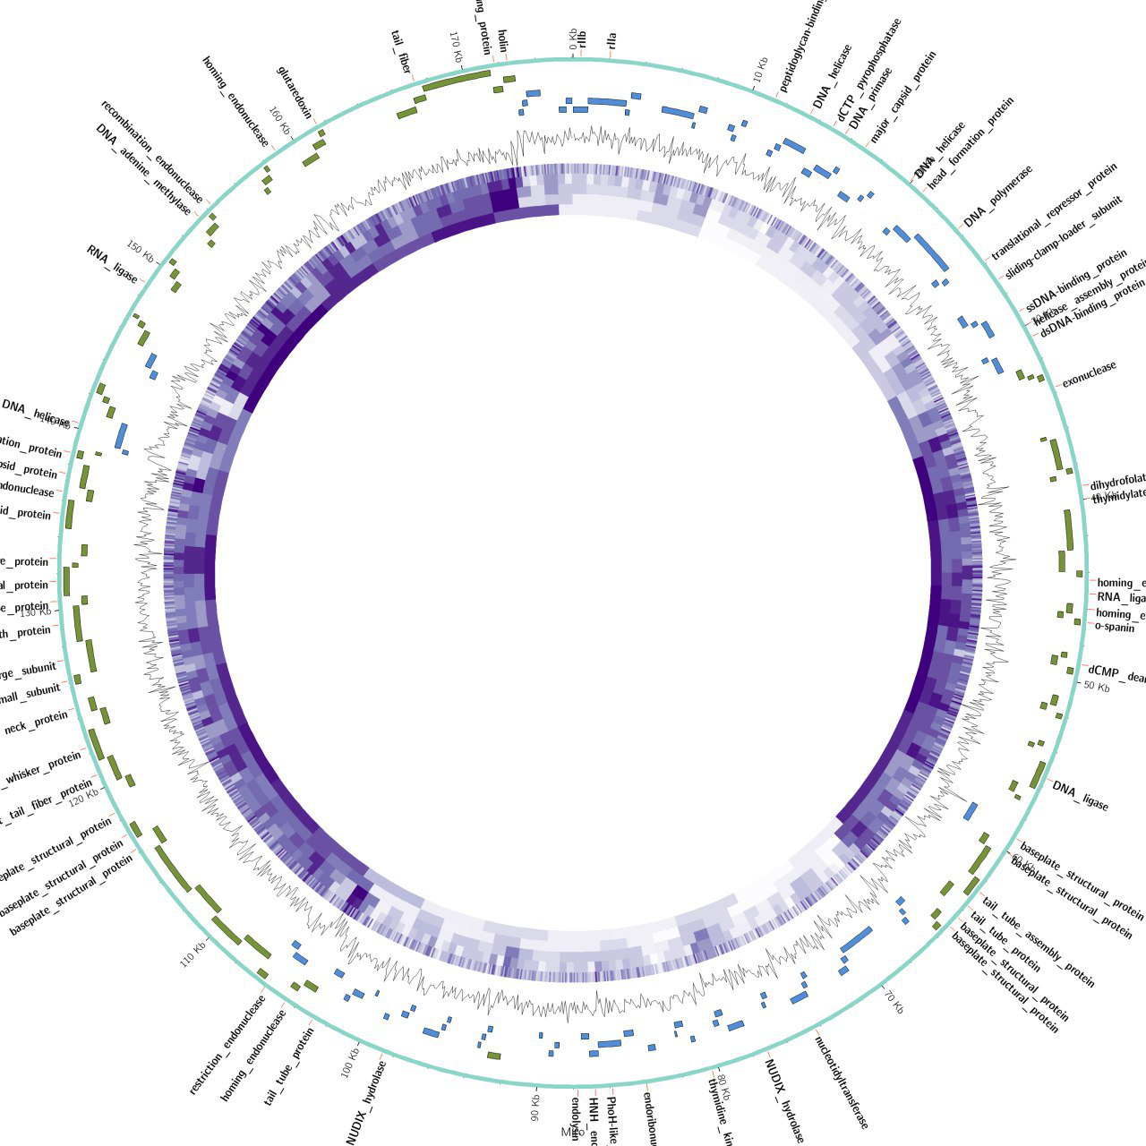
Web-based User Interface (+ API access)

Slide 5
Data Management
Rich, persistent metadata system
Histories
Data libraries
2-stage delete process
Access management control
Group/role model
Reference data / user data
User quota
Data importer and data exporter
LIMS integration (everything is scriptable)

Slide 6
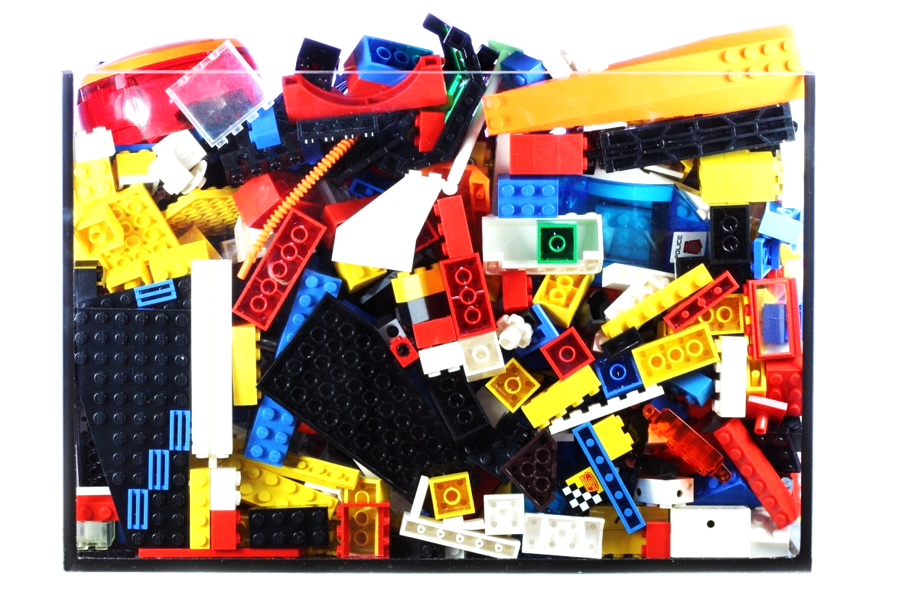
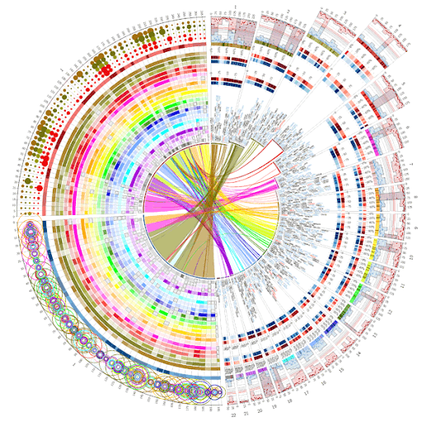
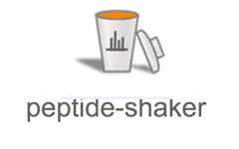
Tools: 2550 and counting
App Store-like distribution system
Can run in Conda, Containers, modules, etc.
DOTADIW philosophy

Slide 7
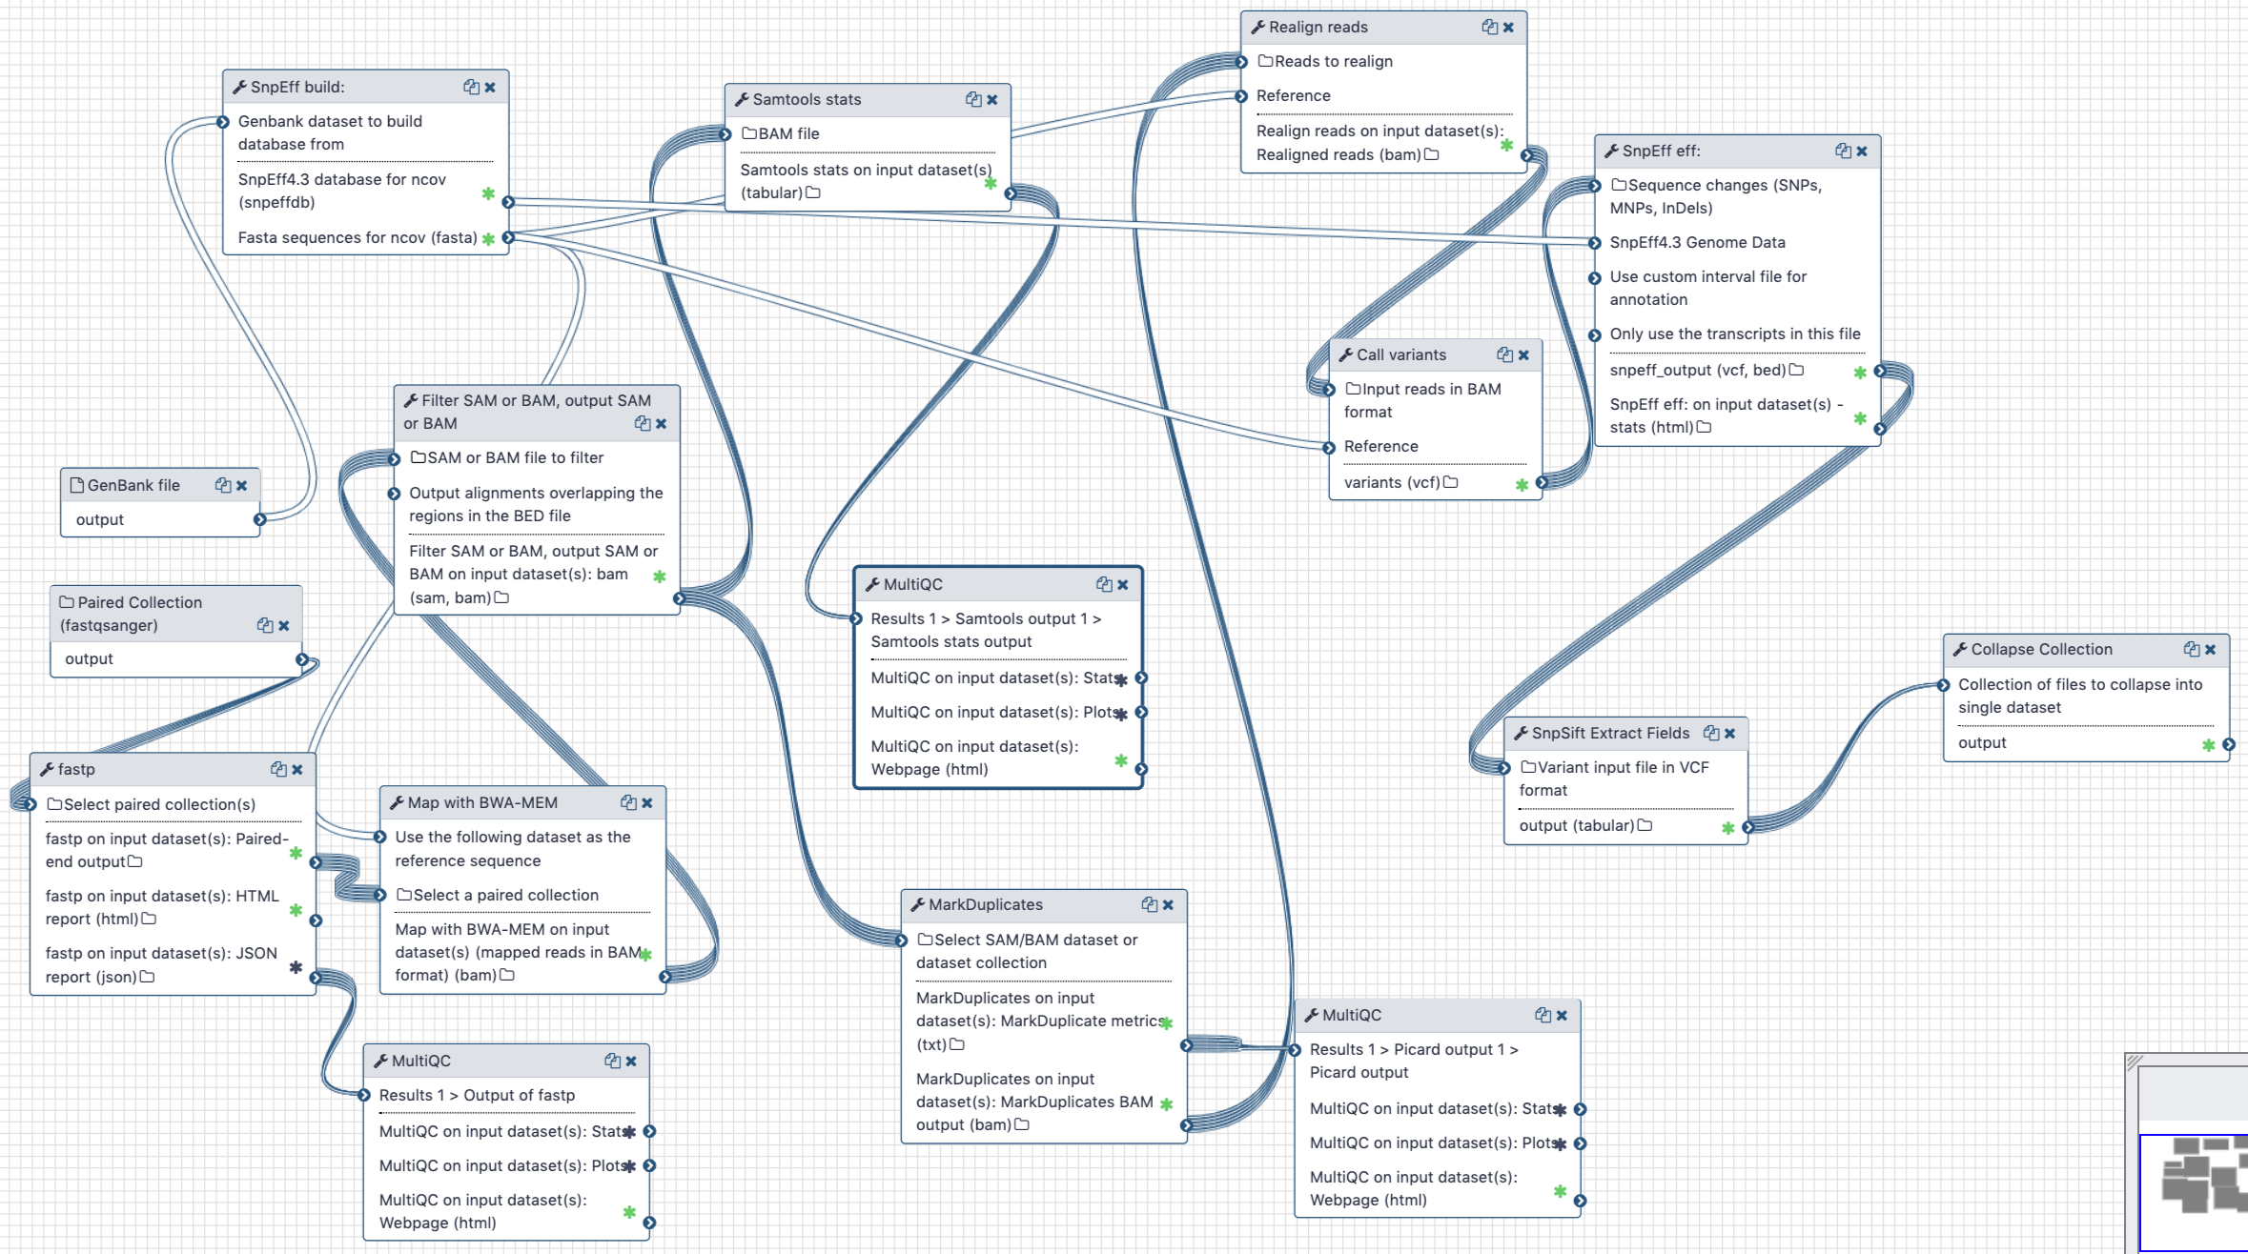
From Tools to (async) Workflows
Portable across Galaxy instances
Run in containers (Singularity, Docker ...)
Rich metadata annotation

Slide 8
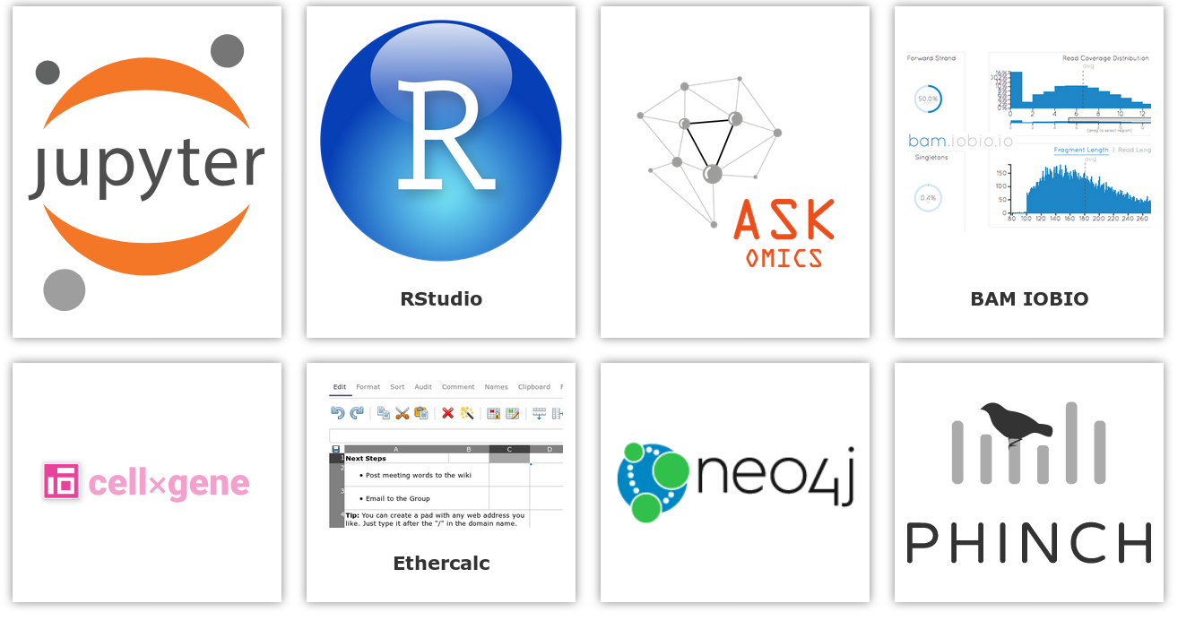
Synchronous Workflows

Slide 9
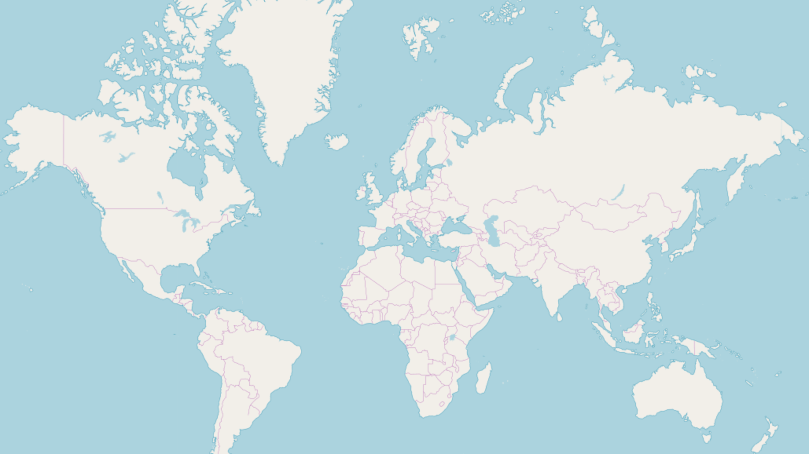

Slide 10
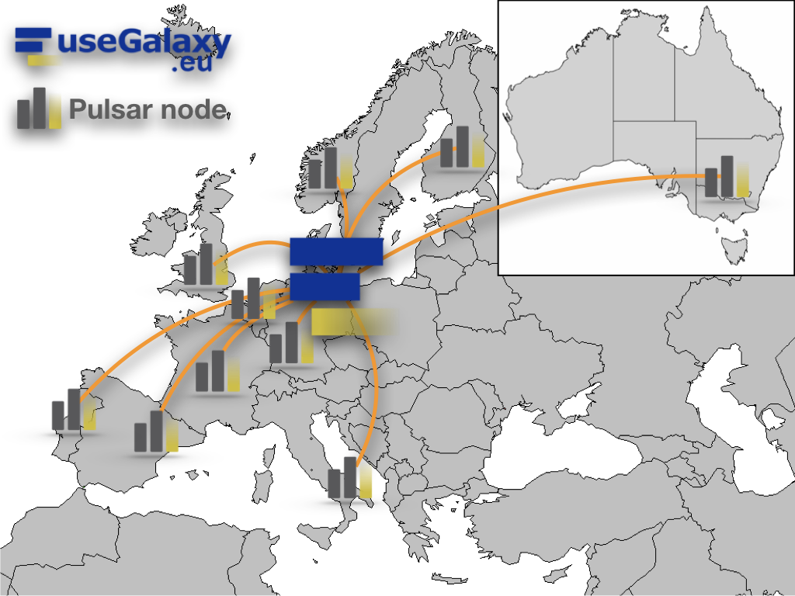
Distributed Computing across the Globe
https://pulsar-network.readthedocs.io

Slide 11
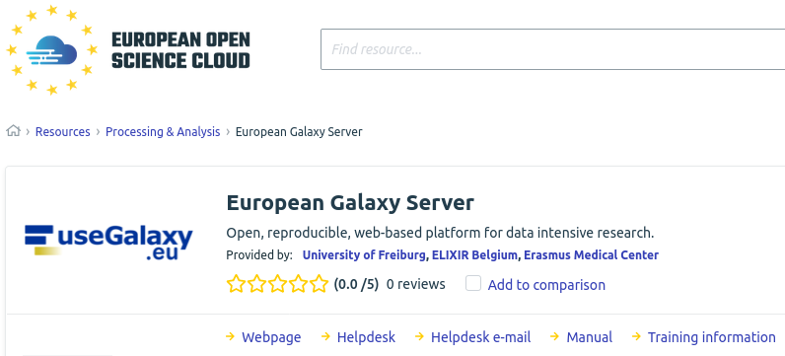
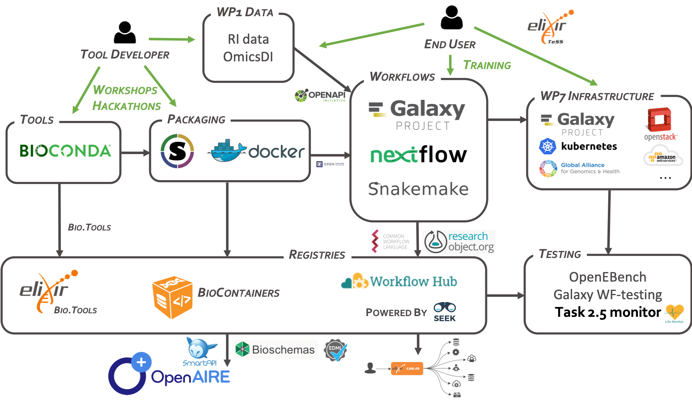
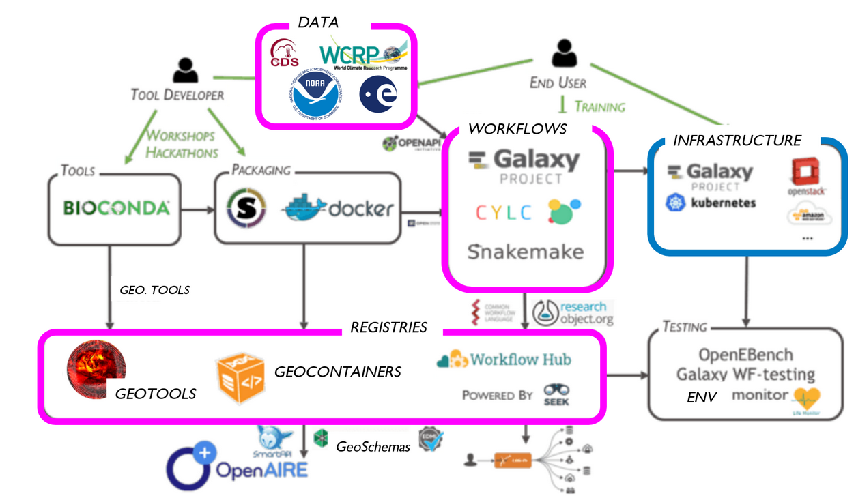
Cross-EOSC platform
EOSC Marketplace
EOSC-Life Tools Collaboratory Roadmap
EOSC-Nordic Roadmap

Slide 12
Domain-specific useGalaxy.eu Flavors
streetscience.usegalaxy.eu africa.usegalaxy.eu erasmusmc.usegalaxy.eu | climate.usegalaxy.eu virology.usegalaxy.eu cheminformatics.usegalaxy.eu covid19.usegalaxy.eu ecology.usegalaxy.eu graphclust.usegalaxy.eu imaging.usegalaxy.eu metabolomics.usegalaxy.eu metagenomics.usegalaxy.eu ml.usegalaxy.eu nanopore.usegalaxy.eu proteomics.usegalaxy.eu rna.usegalaxy.eu singlecell.usegalaxy.eu
Different entry point for communities
Different view of tools
Interface customizations
Same infrastructure
Same deployment

Slide 13
https://rna.usegalaxy.eu
https://hicexplorer.usegalaxy.eu
RNA structure analysis
RNA alignment
RNA annotation
RNA-protein interaction
Ribosome profiling
RNA target prediction
RNA-Seq analysis
single-cell RNA analysis
direct RNA-seq with Nanopore

Slide 14
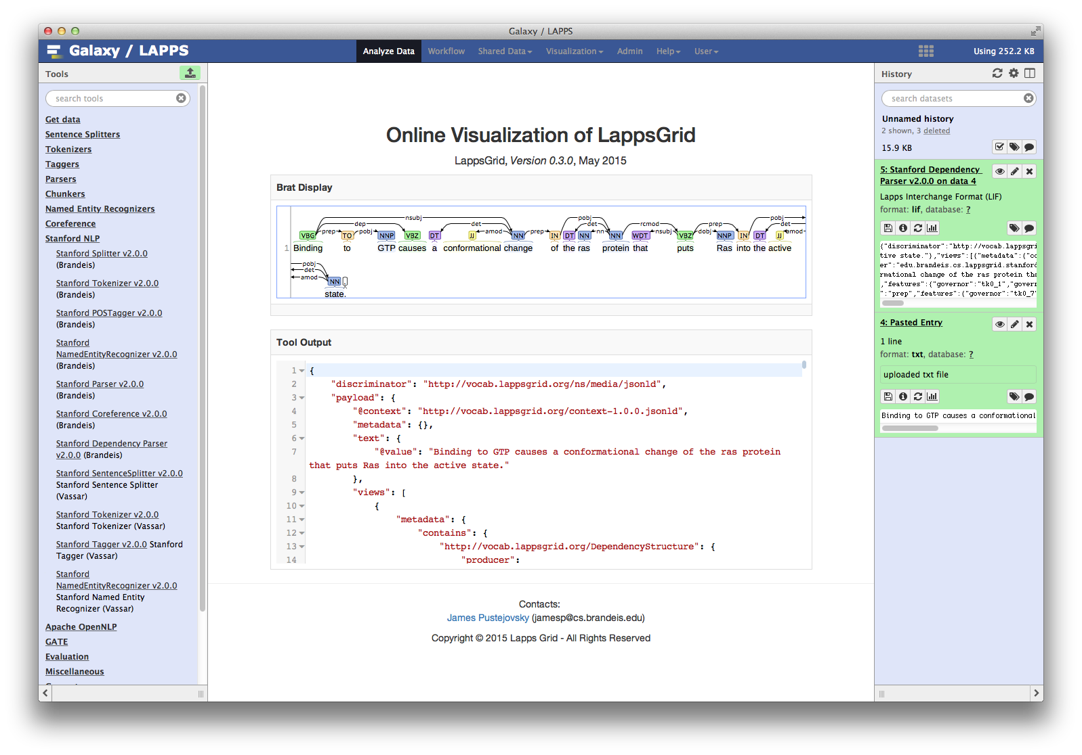
Natural Language Processing

Slide 15
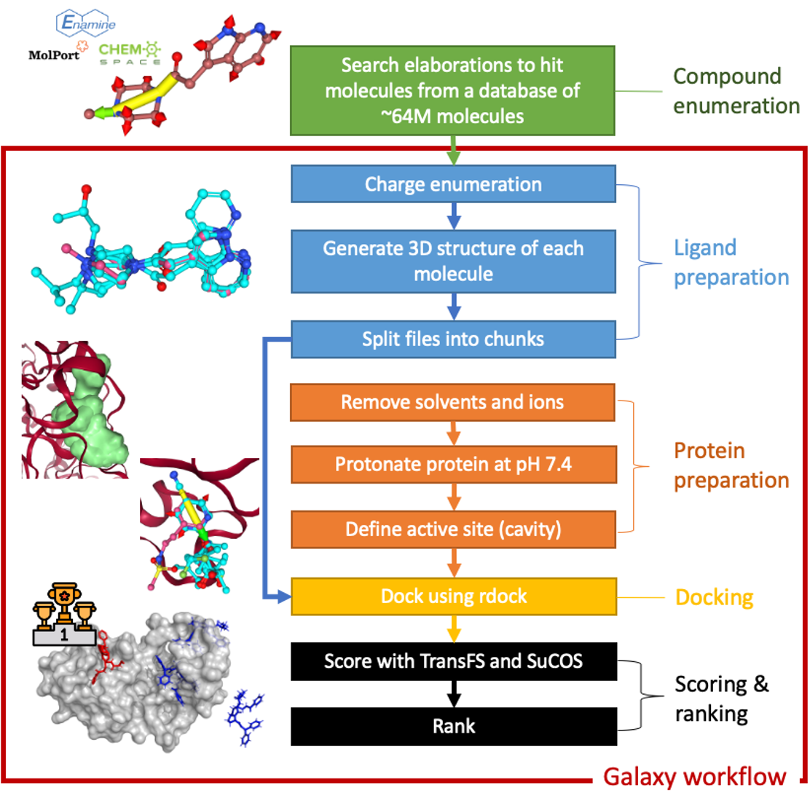
https://cheminformatics.usegalaxy.eu

Slide 16
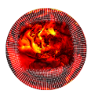
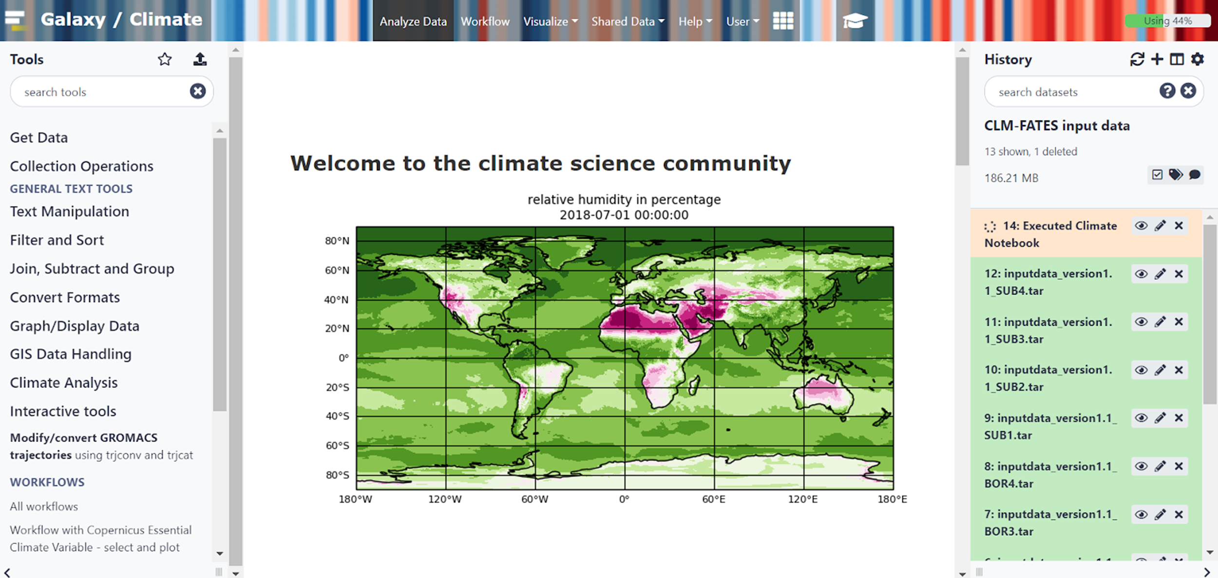
https://climate.usegalaxy.eu
Programming experience is not required; Users can repeat/understand a complete computational analysis and share/ publish histories, workflows, and visualisations via the web.The platform favors knowledge sharing still adopting separation of concerns principle.
INTERACTIVE TOOL: CLIMATE JUPYTERLAB WITH GALAXY
Researchers can visualize and analyze the results of their simulations, compare and combine with Copernicus data. All the PANGEO software stack is available.
Examples of Jupyter notebooks for climate analysis are available on Galaxy Europe as a Data Library “Earth System community Modeling”

Slide 17
Training Infrastructure as a Service (TIaaS)
+

Slide 18
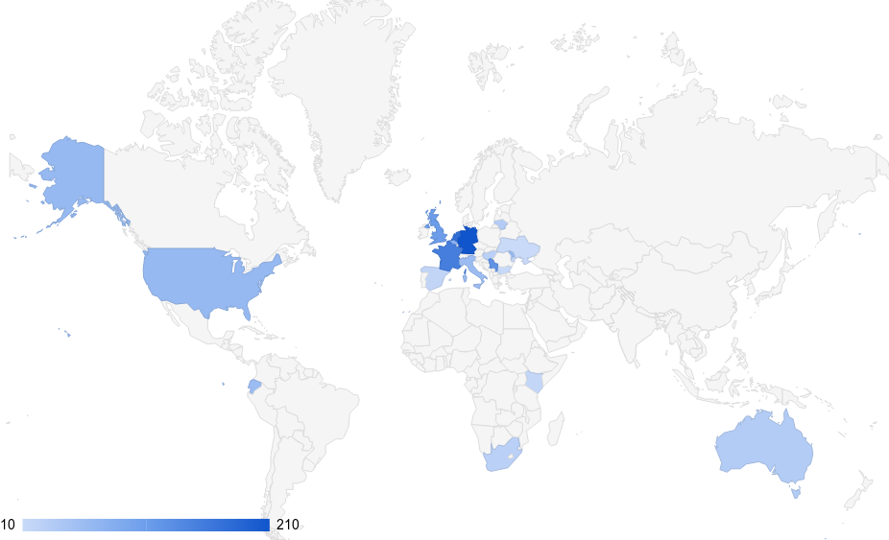
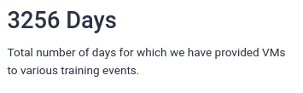
TIaaS Successes
https://usegalaxy.eu/tiaas/stats
https://usegalaxy.eu/tiaas/calendar

Slide 19
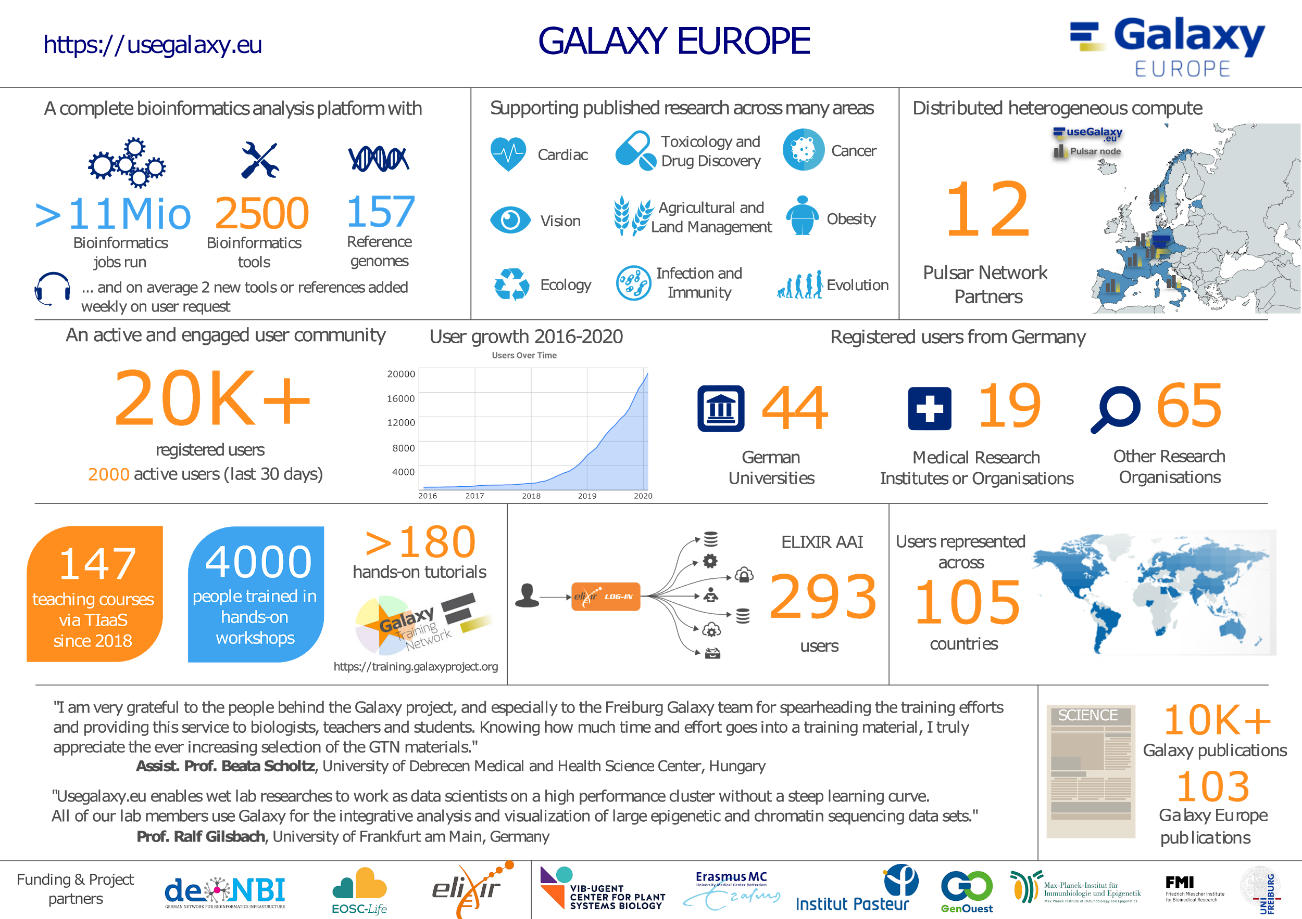
25

Slide 20
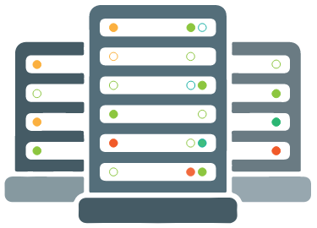
In Need of a Meta-scheduler!

Slide 21
Local Caching of Data

Slide 22
Sustainability

Slide 23
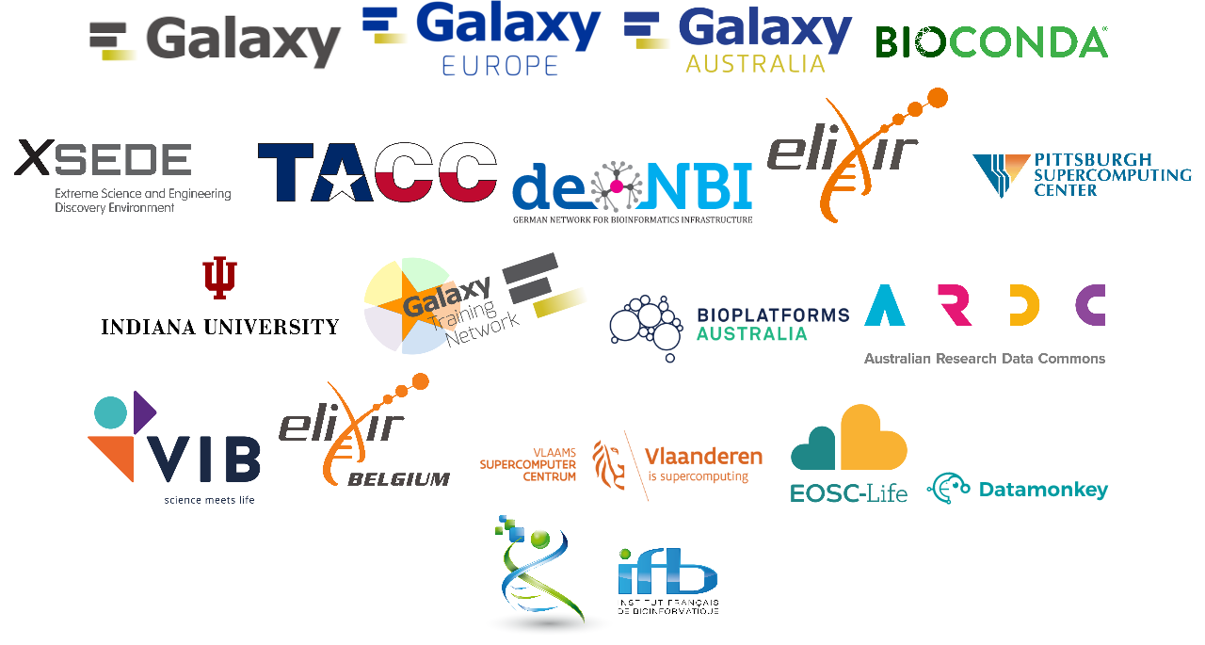
Acknowledgements

Slide 24
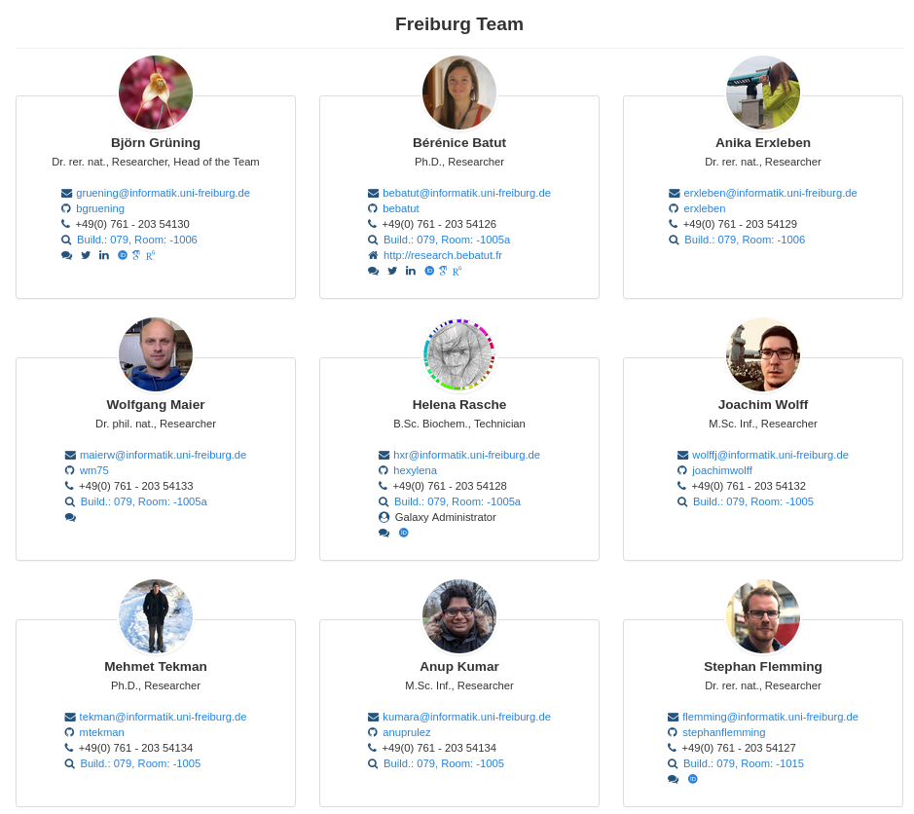
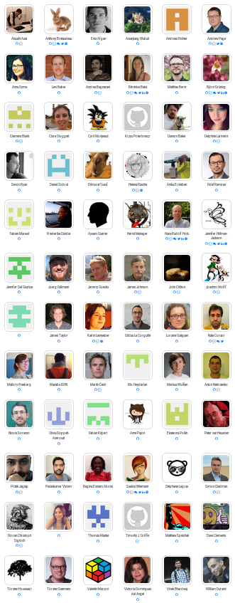
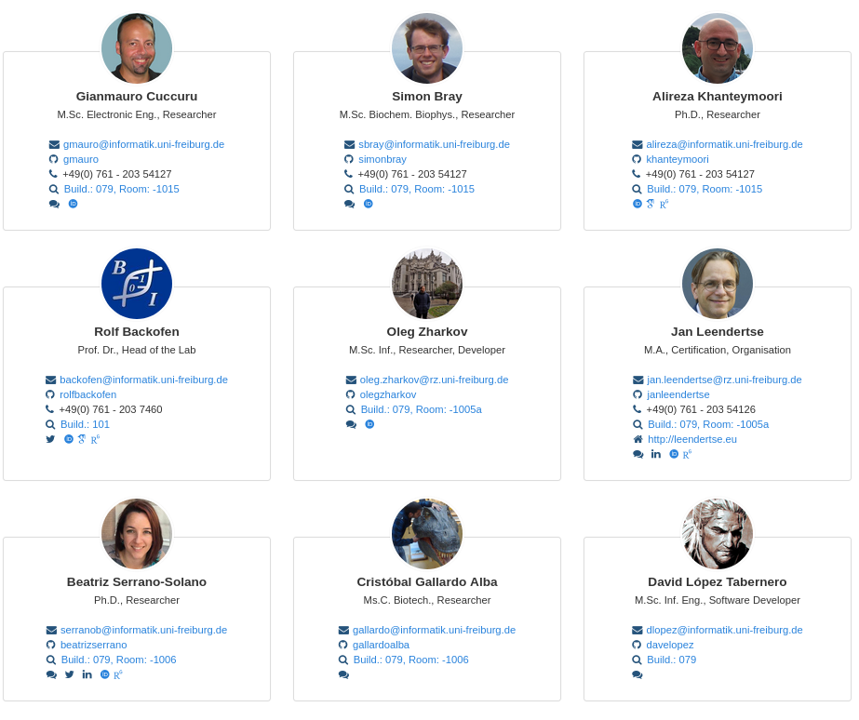
Thanks!

Slide 25
Ceterum censeo, magis luce nobis opus sunt!
freely adapted from Cato
More light we need!

Slide 26
A few words about scheduling & storage
Galaxy is known to work with destinations running:
TORQUE
PBS
Open Grid Engine
Univa Grid Engine
LSF
HTCondor
Slurm
Kubernetes
Chronos
Galaxy Pulsar
… anything supporting DRMAA
Galaxy can be configured to use any number of destinations and send jobs to them dynamically based on input parameters.
Container destinations, fast FS destination, or GPU destinations based on the version of a tool, the user/group or the OpenID profile.
Pulsar can avoid the need for a shared file system.
Storage: can use Amazon S3, iRODS, Swift, Azure, Google Compute, Dropbox, etc.

Slide 27
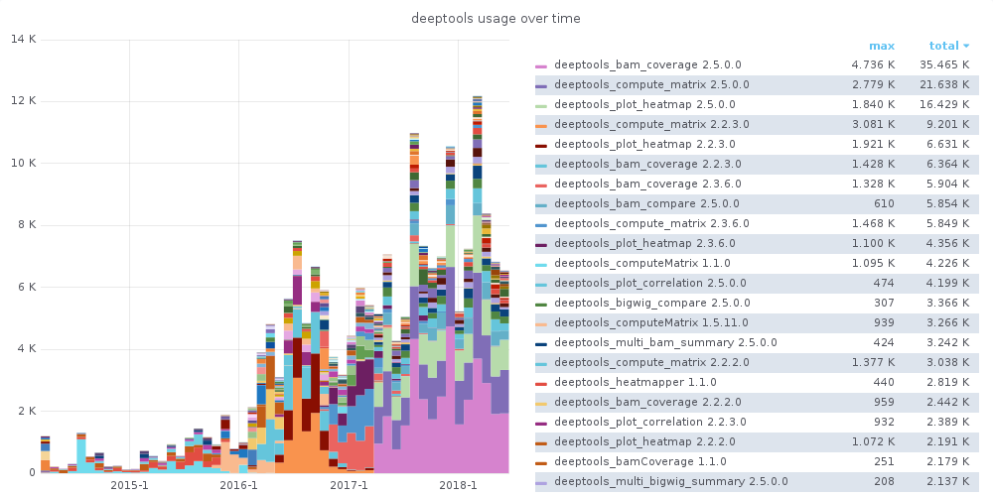
Developers - KPIs
Tool usage metrics
https://stats.galaxyproject.eu

