Slide 1
EGI-ACE Public Launch
EGI Advanced Computing for EOSC
5th February 2021

Slide 2
Agenda
10m
Welcome
09:00 → 09:10
01
Speaker: Hien Bui
40m
EGI-ACE overview
09:10 → 09:40
01
Speaker: Gergely Sipos
10m
60m
Infrastructure services: highlights from the compute, data, security areas
Speaker:
Enol Fernandez - Compute
Andrea Manzi - Data
Diego Scardaci - Federation and access services
09:50 → 10:50
02
10m
60m
Data spaces: Services for online analytics
11:00 → 12:00
03
Speakers:
Fabrizio Antonio (CCMC) Dick M. A. Schaap (MARIS) Agnes Mika (ASTRON) Björn Grüning (Uni Freiburg)
ENES Data Space
SeaDataNet WebOcean Data Analysis
LOFAR Science Products
UseGalaxy.eu
60m
Lunch break
60m
Partners presentation
13:00 → 14:00
04
Speakers: Debora Testi
Paolo Manghi
Raul Palma
Christian Briese
DICE (Data Infrastructure Capacity for EOSC)
OpenAIRE-Nexus (Scholarly Communication Services for EOSC users)
RELIANCE (REsearch LIfecycle mAnagemeNt for Earth Science Communities and CopErnicus users in EOSC)
C-SCALE (Copernicus - eoSC AnaLytics Engine)

Slide 3
EGI-ACE Overview
Gergely Sipos
EGI-ACE Technical Coordinator

Slide 4
EGI-ACE objective
Implement the Compute Platform of the European Open Science Cloud and contribute to the EOSC Data Commons by delivering integrated computing, platforms, data spaces and tools as an integrated solution that is aligned with major European cloud federation projects and HPC initiatives.

Slide 5
EGI-ACE specific objectives
Objective 1. Deliver the European Open Science Cloud Compute Platform and expand the supply-side
EOSC-Exchange
Objective 2: Contribute to the implementation of the EU Data Strategy and the EOSC Data Commons to support the Green Deal, Health and Fundamental Research
O4
O1
Federated Data
O5
O2
EGI-ACE
Objective 3: Integrate the EOSC Compute Platform with the EOSC Portal and the EOSC Core
O3
EOSC Core
Objective 4: Contribute to the realization of a global Open Science Cloud
Objective 5: Expand the demand-side of EOSC across sectors and disciplines
Solutions for a sustainable EOSC report from the EOSC Sustainability WG

Slide 6
How EGI-ACE responds to the EOSC mission?
“EOSC needs to provide a long-term open data archive with high-performance storage and computing services, to enable sustainable use of data beyond the life span of individual data infrastructures” (Feb 2020)
https://zenodo.org/record/3675081

Slide 7
EOSC Exchange Capacity Building
Project overviews from 1pm CET
Distributed Computing Services
RELIANCE (Research Lifecycle Management for Copernicus users)
INFRAEOSC-07 Increasing the service offer of the EOSC Portal
Data discovery, deposition, bit preservation storage
Collaboration agreements
C-SCALE (Copernicus EOSC data analytics engine)
Open scholarship services

Slide 8
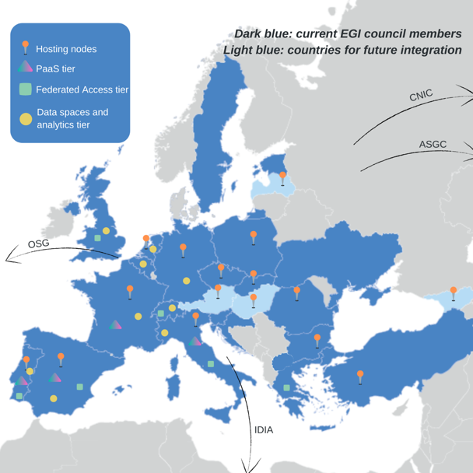
EGI-ACE Consortium Overview
EGI Foundation as coordinator
33 participating partners, 23 third-parties
Consortium at a glance
16 partners to deliver cloud, HTC and HPC resources
12 user access and platform solution providers
21 providers from 13 communities to deliver data spaces
12 federation service providers
Early adopters; Partner infrastructures
57% of the budget for service provisioning

Slide 9
EGI-ACE concept and methodology: Tier service architecture
Data Spaces
and Analytics
Data and thematic data analytics and processing tools
EOSC portal
Early adopters
Green Deal Data Space
Health Data Space
Fundamental Science Data Space
Humanities Data Space
Platforms
generic added-value platform level services
Interactive Computing
Automated Cluster deployment
Distributed AI training
Workload Management
EOSC
users
Service Management, Tools, Processes, Policies
Federated
Access
Federation-wide management of data and computing
Federated Compute
Federated Identity
Federated Data
Federated
Resources
Compute and storage facilities
Research Clouds
Public Clouds
HTC
HPC
Notes:
Expand how the federated compute platform comes together

Slide 10
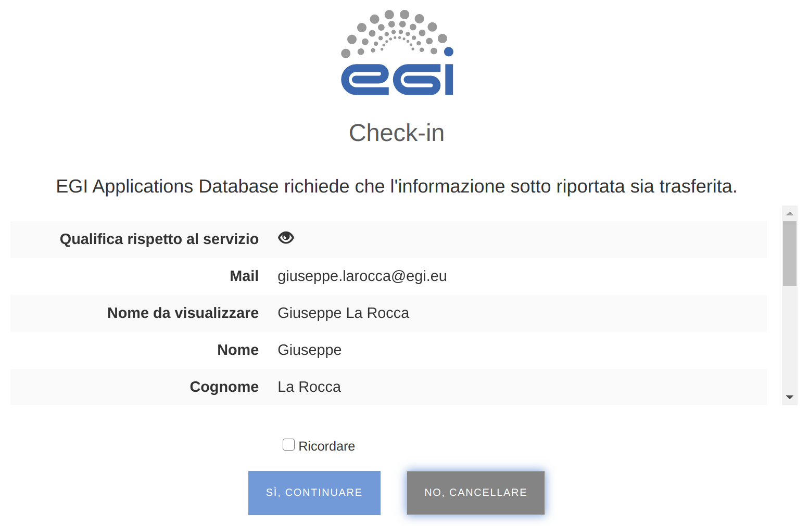
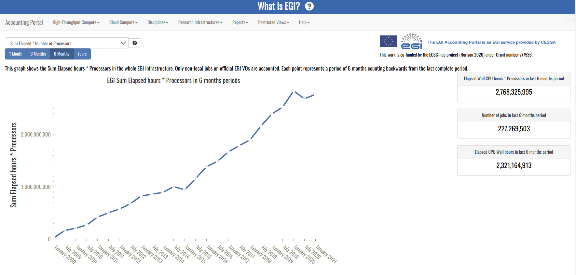
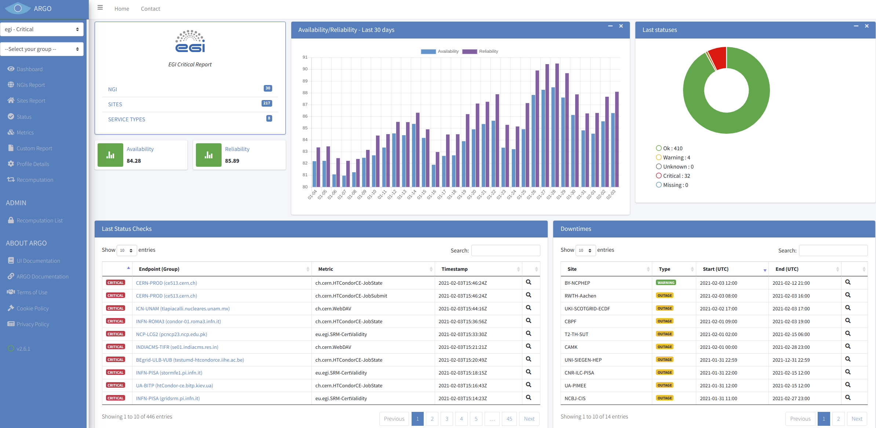
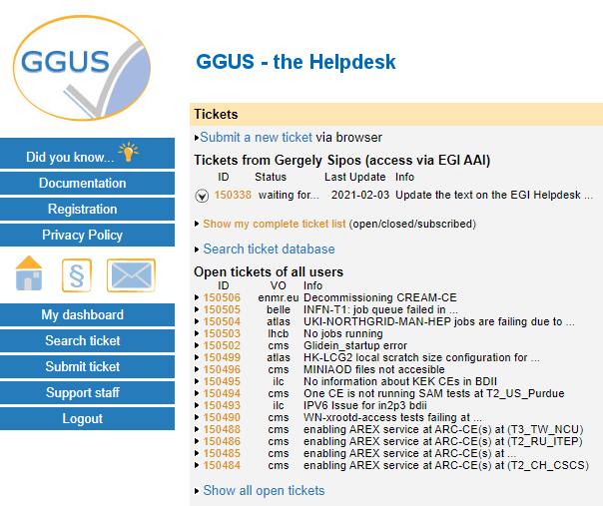
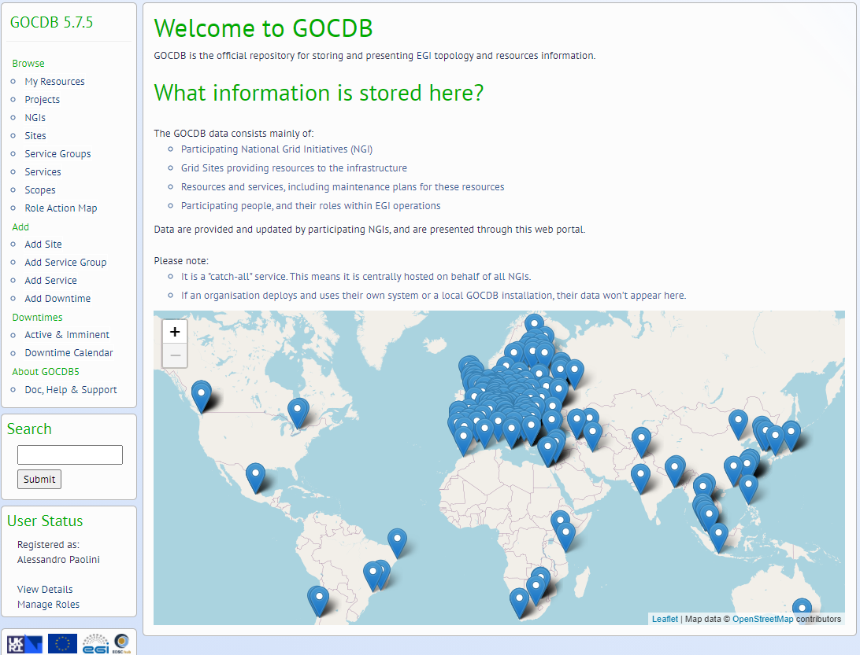
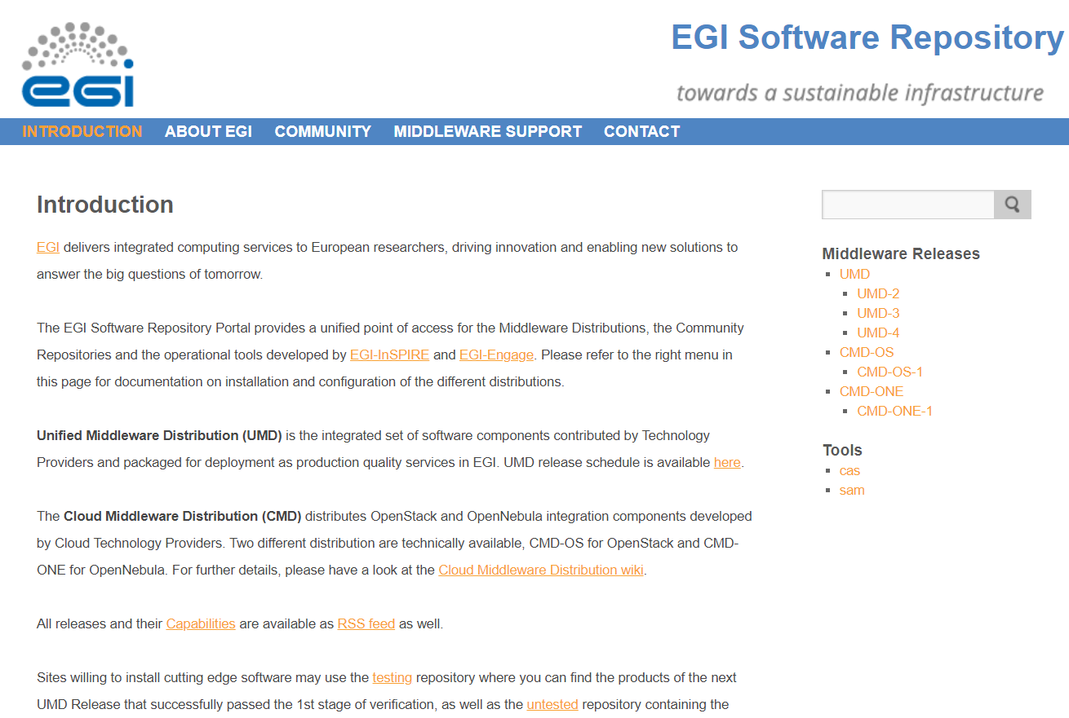
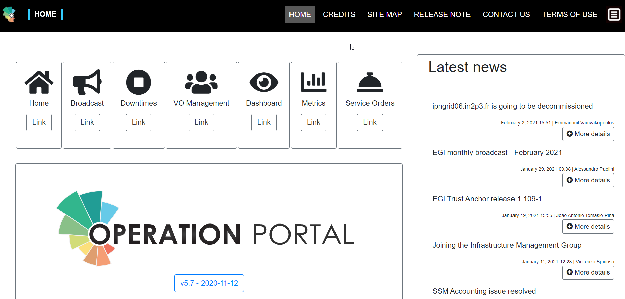
EGI federation - Core tools
Service Management, Tools, Processes, Policies
IT Service Management
Check-in
Early adopters
Green Deal Data Space
Health Data Space
Fundamental Science Data Space
Humanities Data Space
EOSC portal
Interactive Computing
Automated Cluster deployment
Distributed AI training
Workload Management
EOSC
users
Accounting
Monitoring
Helpdesk
Federated Compute
Federated Identity
Federated Data
Research Clouds
Public Clouds
HTC
HPC
Configuration DB
Operations portal
Unified middleware
Notes:
ITSM
Accounting
Monitoring
Helpdesk
Check-in

Slide 11
Compute services | Platform services | Data space services | Federation services (AAI, data, compute)
IM AppDB EGI HTC & Storage dCache Spider Storage Data Processing Compute EGI Cloud Compute AppDB DynDNS MetaCentrumCloud - CPU MetaCentrumCloud - GPU MetaCentrumCloud - Storage SCAI FedCloud v2 EGI - GSIOS IN2P3-IRES-CPU IN2P3-IRES-Storage TR-FC1-ULAKBIM - CPU TR-FC1-ULAKBIM - Storage INFN-BARI-CPU INFN-BARI-Storage INFN-CNAF-CPU INFN-CNAF-GPU INFN-CNAF-Storage INCD-Lisbon (NCG)-CPU INCD-Lisbon (NCG)-Storage EGI – IISAS DESY-FedCloud CESGA-CPU CESGA-Storage IFCA-LCG2-CPU IFCA-LCG2-Storage INCD-LIP-CPU INCD-LIP-Storage CYFRONET-CLOUD-CPU CYFRONET-CLOUD-Storage IICT-BAS-CPU IICT-BAS-Storage CLOUDIFIN-CPU CLOUDIFIN-Storage | EGI Notebooks & Binder EGI Workload Manager DIRAC DEEP training facility CSIC DEEP training facility LIP DEEP training facility DODAS | WeNMR portals UU WeNMR Portals UseGalaxy.eu Virtual Imaging Platform OpenRiskNet/NanoCommons Virtual Env. ENES Data Space OpenCoastS Prominence SURFSARA LOFAR Science Products NWO-I LOFAR Science Products Disaster mitigation and agriculture SeaDataNet WebOcean Data Analysis Iberian GBIF data space CSIC GBIF Cloud data space LIP GBIF Cloud data space EMSO ERIC data service OPERAS Metrics service OPERAS Certification service iop | EGI Check-in PERUN MasterPortal (EGI - Check-in) EC3 Indigo PaaS Orchestrator Rucio CVMFS OpenRDM EGI content distribution CVFMS EGI Data Transfer FTS EGI DataHub Onedata Rucio
31 different services from
61 providers

Slide 12
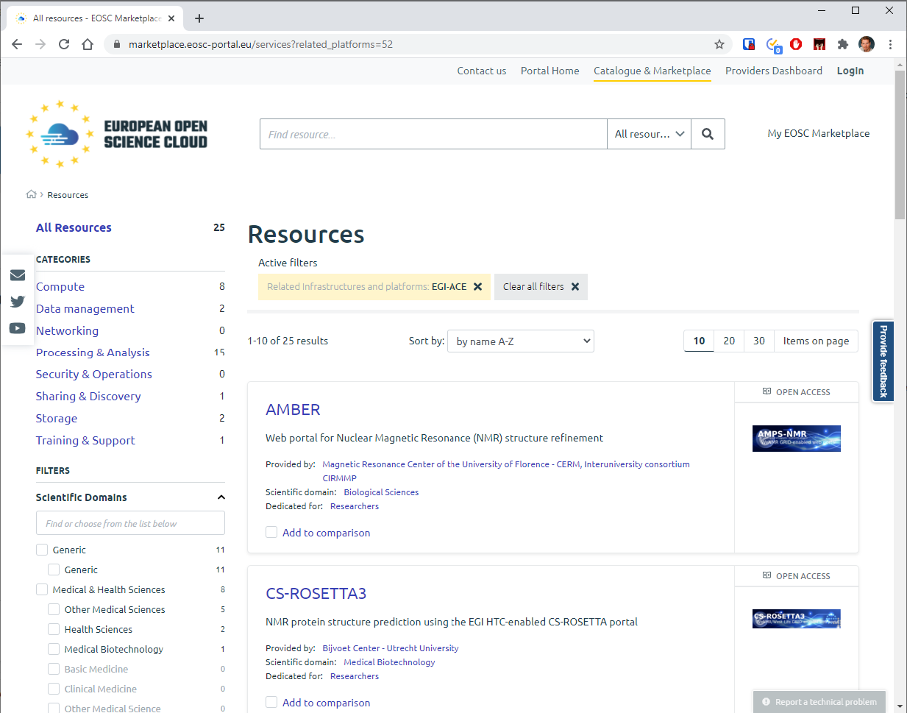
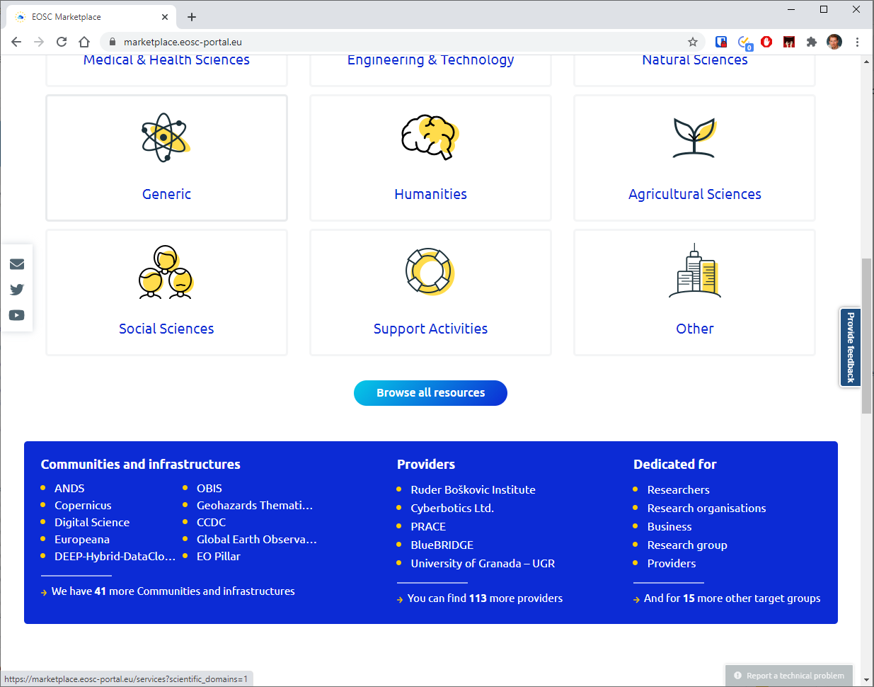
EGI-ACE portfolio in the EOSC Marketplace

Slide 13
Infrastructure layer – Cloud, HTC, HPC
For users and communities within the project AND for new EOSC users
Increasing capacity (Cloud and HTC):
Phase 1 (month 1-10) ⇒ 13.8 Million CPU hours/41,300 GPU hours/7.5 PB/month
Phase 2 (month 11-20) ⇒ 27.6 Million CPU hours/83,000 GPU hours/15 PB/month
Phase 3 (month 21-30) ⇒ 41.4 Million CPU hours/124,000 GPU hours/23 PB/month
Mix of funding mechanisms:
Virtual Access:
Local grants enabling policy-based access (EGI Cloud Federation + new partners):
Pay-for-use:
Pilot HPC sites:
Diverse locations AND compute flavors
Moldova
Latvia
Georgia
Hungary
Austria
USA
China
South Africa

Slide 14
Resource allocation, user support (2/1)
Single users
Small groups
Experimental users
International projects
Multi-national communities
EOSC USERS
Business-to-User
Business-to-Business
EOSC Portal
EGI-ACE Open calls (3x per year, 1st in March 2021)
Ready-to-use resources/services
Self-service configuration
Short term engagement
High capacity demand
Custom configurations
Long term engagement

Slide 15
Resource allocation, user support (2/2)
Single users
Small groups
Experimental users
International projects
Multi-national communities
User profiling
Call evaluation
National resources (more than EGI-ACE)
VMOps
Notebooks
OneData
EC3
Existing Virtual Organisations (more than EGI-ACE)
DEEP training
New community Virtual Organisations
DODAS
DIRAC
INDIGO PaaS
...
Bring the user to ‘fit for purpose’ services
Bring data to user (DataHub)
Bring application to user (AppDB)
Aligned customer relationship mgm.
Select suitable providers
Select suitable services
Deploy, configure, test
Support scale-up and uptake
Project focus on the providers
Project focus on the users

Slide 16
Joining the EGI-ACE Platform as a provider
Thematic service providers
RESPOND TO OUR USER CALLS
Receive infrastructure and platform services
Service Level Agreement
Infrastructure partners
CONTACT egi-ace-po@mailman.egi.eu
Partner in resource allocation
Aligned CRM
Memorandum of Understanding
EGI Participants
CONSULT WITH https://www.egi.eu/about/egi-council/joining-the-egi-council/
Integrate with Operation Tools
Membership agreement
Providers with Virtual access
Project Grant agreement

Slide 17
Humanities
OPERAS metrics and certification service
7 Early adopters
Disaster mitigation and agriculture
WeNMR (structural biology)
Health and medicine
EISCAT_3D Data Portal
(atmospheric physics)
GEOSS Portal and GEO DAB
Earthquake response and landslide analysis
Environmental sciences
GBIF Cloud data space
Virtual Imaging Platform (medical imaging)
13 Data spaces
EMSO ERIC data services
OpenRiskNet NanoCommons
VIRGO (gravitational waves)
MeerKAT workflows (astronomy)
E-RIHS (heritage object analytics)
JupyterLab
Enes libraries
EC3
Synda & DataHub
ESGF data archive
Cloud and HPC
SeaDataNet WebOcean Data Analysis
UseGalaxy.eu (bioinformatics)
PHIRI (population health)
LOFAR science products (astronomy)
OPENCoastS (circulation forecast)
PROMINENCE (fusion physics)
ENES (climate analytics)
Climate research
Energy and physical sciences

Slide 18
Summary
EGI-ACE delivers the Compute platform in EOSC
Compute continuum with HTC, Cloud and HPC
Online data analytics services
We are open for business !
Most of our services are already available in the EOSC Portal: https://marketplace.eosc-portal.eu/services?related_platforms=52
1st call for user communities to open in March
Providers can join via an MoU, with EGI Membership, or SLA (via user comm call)
Collaboration with INFRAOESC-07 projects starts today

Slide 19
Thank you. Questions?

