Slide 1
EGI-ACE WP6
Federated Access Services VA
Diego Scardaci
EGI Technical Solutions Team Lead

Slide 2
WP6 – Federated Services Access
Introduction
Manages the Virtual Access to the Federated Access Services of the EOSC Compute Platform
provide secure access to the services
enable large-data analysis workloads in the distributed infrastructure
effort for technical and scientific staff working on the provisioning of VA
preparation of detailed access activity information
periodic technical reports and assessment reports
Enable seamless transfer of workloads and data across sites.
Enable seamless transfer of user identities from EOSC Portal to sites.
VA sites (WP3)
Partner sites (T2.3, T7.4)

Slide 3
WP6 – Federated Services Access
Partners, effort & structure
WP Leader: Diego Scardaci (EGI F.)
T6.1: Valeria Ardizzone (EGI F.)
T6.2: Andrea Manzi (EGI F.)
T6.3: Enol Fernandez (EGI F.)
Partners: Cyfronet, CESNET, UPV, EnhanceR, GRNET, INFN, NOW-I Nikhef, UKRI STFC
Total effort: 190 PMs

Slide 4
WP6 – Collaboration tools & meetings
Confluence
EGI-ACE main page: https://confluence.egi.eu/pages/viewpage.action?spaceKey=EGIACE&title=EGI-ACE+Home
WP6: https://confluence.egi.eu/pages/viewpage.action?pageId=80872209
Mailing list: egi-ace-wp6@mailman.egi.eu
Indico: https://indico.egi.eu/category/305/
Monthly meeting
Need to agree on a slot, doodle? Last Wed at 11 AM ?

Slide 5
T6.1 Federated AAI
Installation | Provider | Description
Check-in | GRNET | Authenticates users with credentials from their home organisation and provides an intuitive interface for communities to manage their users and their respective groups, roles and access rights.
PERUN | CESNET | Provides an attribute management system for managing users, groups and access control
Master Portal | NIKHEF | Provides Token translation and credential management services to access services and resources that use PKIX, SSH, and OpenID credentials with federated login

Slide 6
T6.2 Federated Data Access
Installation | Provider | Description
Rucio/FTS | UKRI | RUCIO delivers large scale and policy-driven data management in a distributed infrastructure. FTS schedules and manages data transfers between facilities
DataHub | CYFRONET | Onedata provides an integrated platform for distributed data management
CVMFS | UKRI | CVMFS provides a scalable, reliable and low-maintenance software distribution service
OpenRDM | EnhanceR | OpenRDM delivers integrated data management services with interactive access via Notebooks

Slide 7
T6.3 Federated Compute Access
Installation | Provider | Description
Indigo-PaaS | INFN | The PaaS Orchestrator service allows users to deploy virtualised computing infrastructures with complex topologies using the TOSCA templating language and smart scheduling considering users’ SLAs, services availability and data location
EC3 - Elastic Cloud Compute Cluster | UPV | EC3 enables users to deploy self-managed clusters that are enlarged and shrunk automatically depending on the workload supporting Kubernetes, SLURM, TORQUE, Mesos and others

Slide 8
WP6 – Federated Services Access
Deliverables & Milestones
Deliverables | Description | Month
D6.1, 6.2, 6.3, 6.4, 6.5 Periodical assessment of Federated access services (R, PU) | The report provides assessment and statistics of all the Federated access services provided under virtual access | M6, M12, M18, M24, M30
Milestones | Description | Month
M5.1 | Service integration plan | M2
M5.2 | Service integration report | M5
M2.4 | Onboarding for EGI-ACE services has been initiated | M3
M2.10 | EGI-ACE service catalogue intermediate review and aligned with EOSC portal | M14
M2.13 | EGI-ACE service catalogue content final review and aligned with EOSC portal | M29

Slide 9
WP6 – Federated Services Access
Risks
Risk | Risk level | Description
Services fail to attract new users, beyond original target | High | To mitigate this risk usage of services will be monitored by SDS board every 6 months so that it will be possible to better tune the training and dissemination activities to support their adoption if needed. SDS board will meet bi-weekly to discuss potential service delivery issues and opportunities. As contingency plan dissemination and exploitation plan will be rediscussed and updated
There is no dedicated project funding for new development of EGI-ACE services, meaning new functionality requirements may not be met | High | To mitigate this risk users’ requirements will be monitored by Community coordinator with support from EGI UCB. As a contingency plan, other projects need to be identified to fund innovation of the services or SIF (Strategy and Innovation Fund) to fund needed development
Difficult to achieve sustainable collaboration between the service providers and the associated communities beyond the project life | High | The project will monitor external risk factors related to sustainability. Updating Sustainability Roadmap as living document. The project will also give specific attention to other initiatives for agreements on equitable principles and realistic planning for adoption

Slide 10
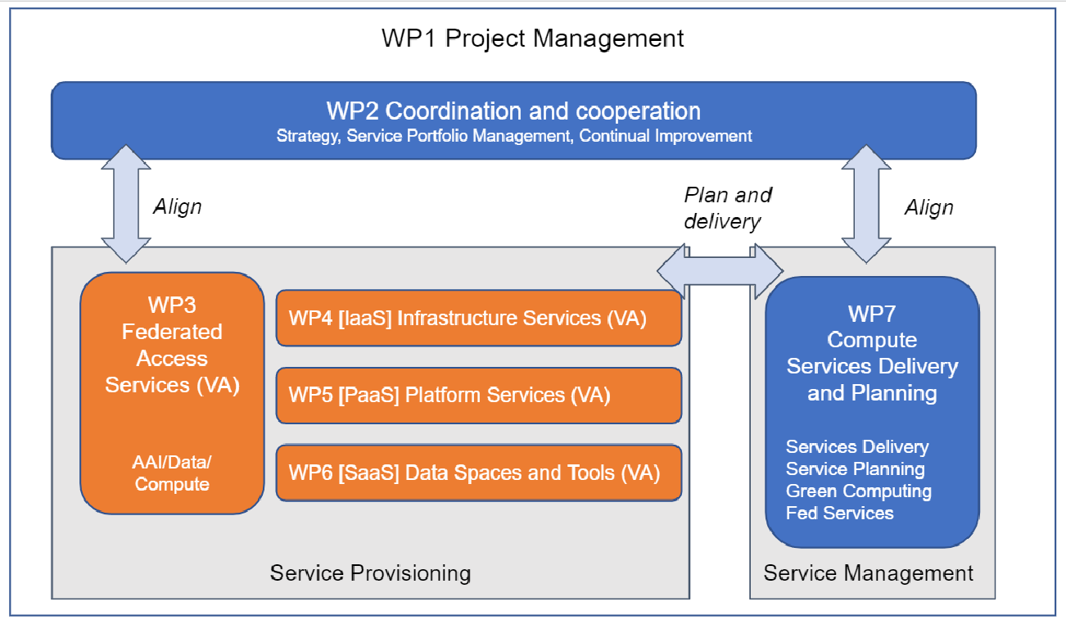
WP6 – Main activities and interactions with other WPs
Operation of the installations
Integration with the EGI-ACE EOSC Compute Platform (WP7)
AAI integration, monitoring, accounting, etc.
Define a roadmap for each installation
Technical support to project use cases (WP2, WP5)
More details later

Slide 11
Onboarding WP6 services in EOSC
All WP6 services have to be accessible via the EOSC Portal
will then be presented as part of the EGI-ACE portfolio
To be onboarded | Already onboarded
Rucio (as it is, or as an option of EGI DataHub or both?) | EGI Check-in + PERUN + Master Portal
EGI DataHub / OneData (ongoing) | EGI Data-Transfer/FTS
EGI Content Management/ CVMFS | Indigo-PaaS
OpenRDM | EC3
EOSC Portal provider page & documentation
to be done in collaboration with EGI-ACE

Slide 12
EGI-ACE Use Cases and WP6 services
EGI-ACE Use Cases (our first customers!)
Data Spaces from WP5 → 13
Early Adopter from WP2 (T2.3) → 7
More use cases from
EOSC Portal → to be managed with the project CRM
Providers’ contacts → requests for these cases should go through the EOSC Portal and ‘added’ to the project
Be ready to work closely with the use cases
Analyse requirements, attend technical meetings, provide tech support, etc.
EGI-ACE Community Workshop (16-17 February)
The opportunity to meet the users and advertise your services!
Please register: https://indico.egi.eu/event/5360/

Slide 13
Events
https://confluence.egi.eu/display/EGIACE/Project+key+events
Communities workshop (Feb 16-17 → M5.1 - Service integration plan)
Cloud and HTC Integration workshop (Doodle open for 2nd half of Feb)
HPC pilots workshop (March. Doodle to prepare)
Integration reporting workshop (May → M5.2 - Service integration report)

Slide 14
Questions?

