Slide 1
EGI-ACE T7.2
Service Planning and Green Computing
Catalin Condurache

Slide 2
WP7 – Service Delivery and Planning
Responsible for ensuring that ACE services are provided in conformance with their Service Level Agreements.
All activities relating to service delivery and service planning are covered, from the operations coordination to the maintenance of the Service Management System.
It also includes coordination of Green Computing activities within the project.

Slide 3
T7.2 – Service Planning and Green Computing
Objective of this task is to ensure that Service Delivery is adequately agreed and planned, by managing the following processes - Service Level Management (SLM), Service Reporting Management (SRM), Service Availability and Continuity Management (SACM) and Capacity Management (CAPM).
Also responsible for coordinating all aspects relating to Green Computing within the project, in particular the development and application of best practice and providing training regarding Green Computing and putting into place prerequisites in order to measure, monitor and improve energy usage and efficiency at data centres for the duration of the project.
This task involves Service Planning and Green Computing aspects of virtual access service providers within WP4, 5 and 6.

Slide 4
T7.2 – Collaboration tools & meetings
Confluence
EGI-ACE main page: https://confluence.egi.eu/display/EGIACE/EGI-ACE+Home
T7.2:https://confluence.egi.eu/display/EGIACE/WP7.2+Service+Planning+and+Green+Computing
Mailing list: egi-ace-wp7-t2 (at) mailman.egi.eu
Currently: 7 members - Isabel C., Josh F., Jerome P., Miguel N.-V., Aida P., Alessandro P., Catalin C.
New people?
Indico: https://indico.egi.eu/category/321/
Meeting frequency (?)

Slide 5
T7.2 – Service Planning and Green Computing
Structure
M1 – M30
Service Planning - business as usual regarding SMS processes (EGI)
Green Computing - new activity - training, best practice, KPIs and PUE (CSIC, CNRS, JISC)

Slide 6
T7.2 – Service Planning and Green Computing
Deliverables
D7.1 Service Management Tools Technical Plan (M12)
D7.2 Status of the SMS Processes (M15)
D7.3 Final version of HPC integration handbook (M18)
D7.4 Green Computing progress and improvements within EGI-ACE (M24)
D7.5 Status of the SMS Processes (M29)

Slide 7
T7.2 – Service Planning and Green Computing
Milestones
M7.1 Processes, policies and procedures are in place (M06)
M7.2 Green Computing taskforce has been formed (M09)
M7.3 First version of HPC integration handbook (M12)
M7.4 Capacity plans exist for all VA services (M18)

Slide 8
T7.2 – Service Planning and Green Computing
Green Computing
CSIC, CNRS, JISC to lead activities of this sub-task
Training
Best practices
KPIs
Power Usage Effectiveness
Liaison with other projects (C-SCALE, EOSC Future, …)
Dedicated (TF) meetings

Slide 9
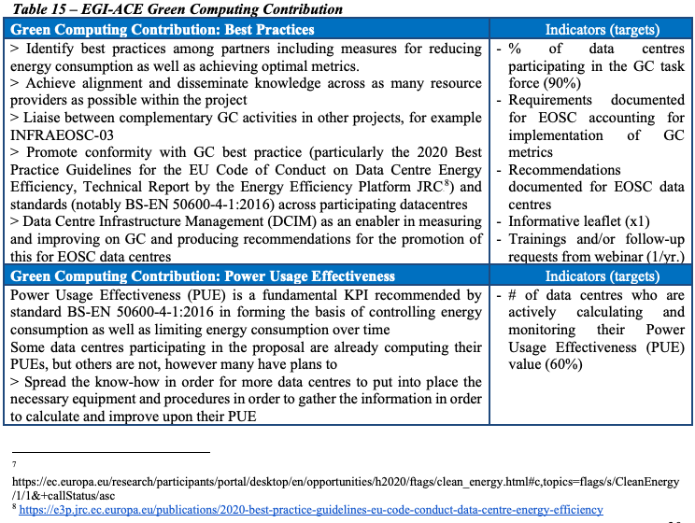
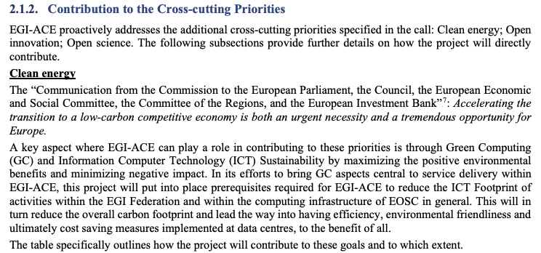
T7.2 – Service Planning and Green Computing
Green Computing
Project proposal -> Impact
“Accelerating Clean Energy Innovation”
https://eur-lex.europa.eu/legal-content/EN/TXT/HTML/?uri=CELEX:52016DC0763&from=EN

Slide 10
Discussions || Questions

