Slide 1
Data Transfer WG
3rd meeting
Andrea Manzi
EGI Foundation

Slide 2
Outline
Current Pilots status
Possible new activities
EGI-ACE intro and possible new pilots
Horizon Europe Destination 3 assessment
RDA BoF on Data Movement

Slide 3
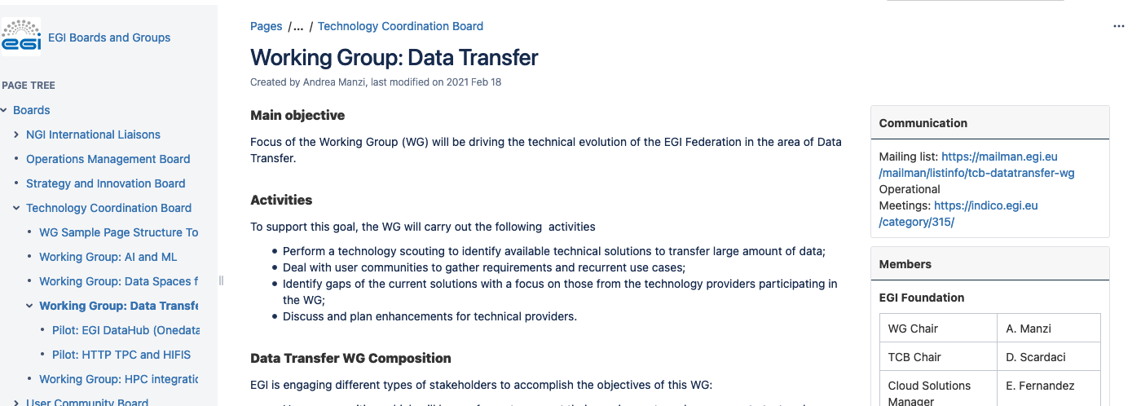
New Confluence page
https://confluence.egi.eu/display/EGIBG/Working+Group%3A+Data+Transfer

Slide 4
WG Initial Pilots
Rucio Multi-VO implementation at STFC: evaluation and testing by EGI and interested communities
STFC and EGI staff → DIDN’T START,
WAITING FOR STFC TO FIX SOME BUGS DISCOVERED
PANOSC Globus and OneData evaluation (for different use cases)
PaNOSC RIs + EGI for OneData pilot (supported by OneData Team) → ONGOING
ESRF + Globus → DONE
HIFIS testbed with FTS OpenID enabled
FTS team + EGI staff for the service setup and HIFIS + DESY for the storage setup → ONGOING

Slide 5
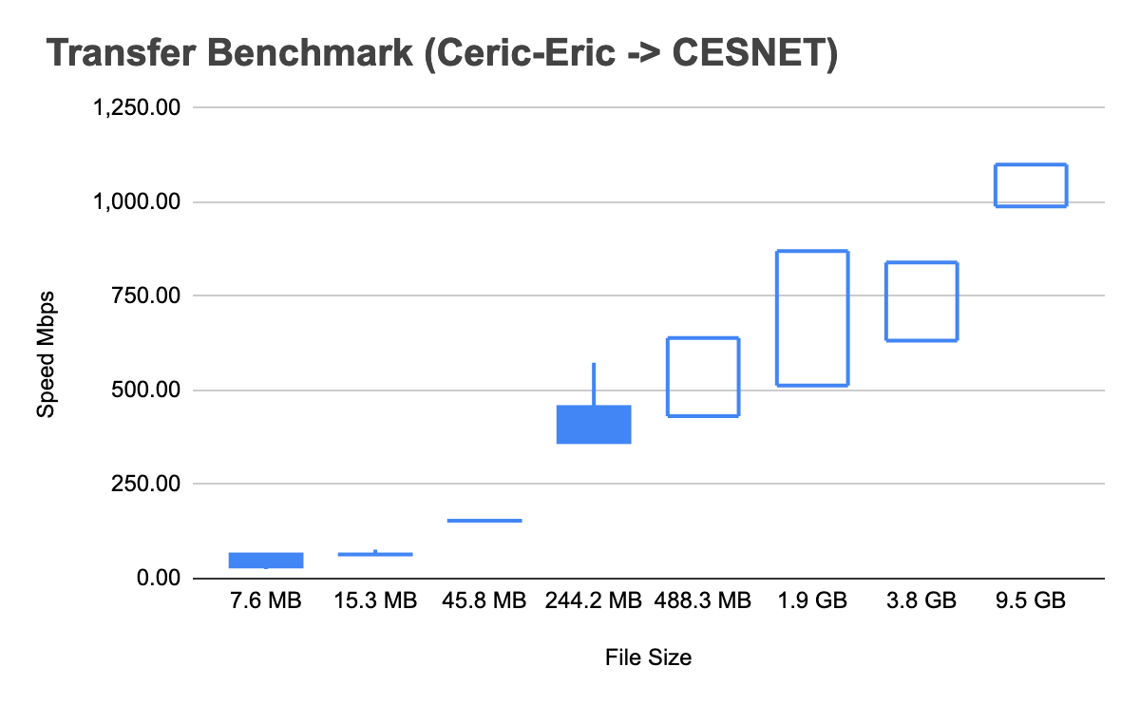
PaNOSC Onedata Pilot
Dedicated instance of Onedata Onezone
https://onezone-panosc.egi.eu/ozw/onezone/i
configured with UmbrellaID AAI
Initial setup includes 3 sites CERIC-ERIC, CESNET, ILL
1st test
CERIC-ERIC exporting data from NFS
No user mapping tested
Transfer test to CESNET
Data Access from Jupiter at CESNET
Python API to schedule transfers

Slide 6
PaNOSC Onedata Pilot
2nd test (ongoing)
ILL exporting data
Setup of the user mappings ( UmbrellaID to local ids)
Import of the NFSv4 ACLs
issues encountered
.snapshot folders imported
no access to folders in some cases
due the particular POSIX-like mappings in Onedata
No easy interface to setup the user and ACLs mapping ( REST API only)
to be completed in 1 month

Slide 7
EGI-ACE objective
H2020 Call INFRAEOSC-07-2020 - Increasing the service offer of the EOSC Portal Topic (a1) - Distributed and cloud computing resources
Implement the Compute Platform of the European Open Science Cloud and contribute to the EOSC Data Commons by delivering integrated computing, platforms, data spaces and tools as an integrated solution that is aligned with major European cloud federation projects and HPC initiatives.
8 Million Euro (EC Grant) + 2.4 Million Euro (EGI.eu countribution) 30 Months, started in Jan. 2021

Slide 8
EGI-ACE concept and methodology: Tier service architecture
Data Spaces
and Analytics
Data and thematic data analytics and processing tools
EOSC portal
Early Adopters
Data Space services
Platforms
generic added-value platform level services
Interactive Computing
Automated Cluster deployment
Distributed AI training
Workload Management
EOSC
users
Service Management, Tools, Processes, Policies
Federated
Access
Federation-wide management of data and computing
Federated Compute
Federated Identity
Federated Data
Federated
Resources
Compute and storage facilities
Research Clouds
Public Clouds
HTC
HPC

Slide 9
Community Engagement
Humanities
OPERAS metrics and certification service
7 Early Adopters
Disaster mitigation and agriculture
WeNMR (structural biology)
Health and Medicine
EISCAT_3D Data Portal
(atmospheric physics)
GEOSS Portal and GEO DAB
Earthquake response and landslide analysis
Environmental Sciences
GBIF Cloud data space
Virtual Imaging Platform (medical imaging)
13 Data Spaces
EMSO ERIC data services
OpenRiskNet NanoCommons
VIRGO (gravitational waves)
MeerKAT workflows (astronomy)
E-RIHS (heritage object analytics)
JupyterLab
Enes libraries
EC3
Synda & DataHub
ESGF data archive
Cloud and HPC
SeaDataNet WebOcean Data Analysis
UseGalaxy.eu (bioinformatics)
PHIRI (population health)
LOFAR science products (astronomy)
OPENCoastS (circulation forecast)
PROMINENCE (fusion physics)
ENES (climate analytics)
Climate research
Energy and Physical Sciences

Slide 10
Communities with data transfer needs
5 Early Adopters
Environmental Sciences
EISCAT_3D Data Portal
(atmospheric physics)
Earthquake response and landslide analysis
4 Data Spaces
VIRGO (gravitational waves)
MeerKAT workflows (astronomy)
PHIRI (population health)
LOFAR science products (astronomy)
OPENCoastS (circulation forecast)
Health and Medicine
PROMINENCE (fusion physics)
ENES (climate analytics)
Climate research
Energy and Physical Sciences

Slide 11
Data Spaces and Early adopters with Data transfer needs
Data spaces
OpenCoasts → improve data transfers between sites
ENES → Support for data sharing ( DataHub)
Prominence → Support for data sharing (DataHub)
LOFAR → Rucio/FTS
Early Adopters
EISCAT_3D → Rucio/FTS
Terradue → FTS
Virgo → Rucio/FTS
MeerKat → FTS
PHIRI
Experiments selected via Open Calls (3 per year)
Plan to include some of the communities in the WG

Slide 12
Rucio->FTS-> Storage and EGI-Checkin
Leverage the work coming from the WLCG DOMA WGs and WLCG Auhtz WG
Replacing gridftp transfers with HTTP TPC
Replacing X509 with JWT tokens with OAuth/OpenID connect flows in all the chain (Rucio->FTS-> Storages)
Similar to what is under piloting at HIFIS
“only” FTS + dCache
Follow up the integration of the components with EGI Checkin and identify missing steps
Activities already scheduled for the next EGI project (EGI-ACE), e.g. full EGI Checkin integration in Rucio and FTS

Slide 13
Horizon Europe Destination 3 assessment
Horizon Europe Destination 3 (2021 and 2022)
Data sharing in the common European data space
Strengthening Europe’s data analytics capacity
High-end computing for exascale performance and beyond
Actions in this heading will be entirely implemented in the Joint Undertaking EuroHPC.
From Cloud to Edge to IoT for European Data

Slide 14
Horizon Europe Destination 3 assessment
Possible interest for EGI
HORIZON-CL4-2021-DATA-01-03: Technologies for data management (IA)
provide new secure and energy-efficient data management tools improving the usability and discoverability of data in different contexts, covering data provenance, data quality management (such as data cleaning, validation, enrichment, co-creation, identification of bias and correlations), improving data interoperability, metadata management (automated ways of labelling and describing data, data linkage), and ensuring data security and integrity.
HORIZON-CL4-2021-DATA-01-04: Extreme data mining, aggregation and analytics technologies (RIA)
provide (technologies, tools and services for data mining (searching and processing) of large, constantly growing amounts and varieties of data, and/or extremely sparse/dispersed/heterogeneous/multilingual data (stored centrally or in distributed systems), in particular IoT and/or industrial/business/administrative/environmental/societal data.

