Slide 1
OpenBioMaps data management service for biological sciences and biodiversity conservation
PI: Dr. Miklós Bán
Shepherd: Miguel Caballer

Slide 2
Overview
The OpenBioMaps (OBM) is a free and open-source database platform for scientific and conservation purposes.
Science areas:
Biology, conservation biology, ecology, biodiversity
The OBM system is used for data management by nature conservation institutes, biodiversity research and citizen science projects.
OBM provides a number of services that make day-to-day work with data easier, but it does not yet provide tools for analyzing the data. Particularly for high computing tasks.
Current use cases:
https://openbiomaps.org/projects/

Slide 3
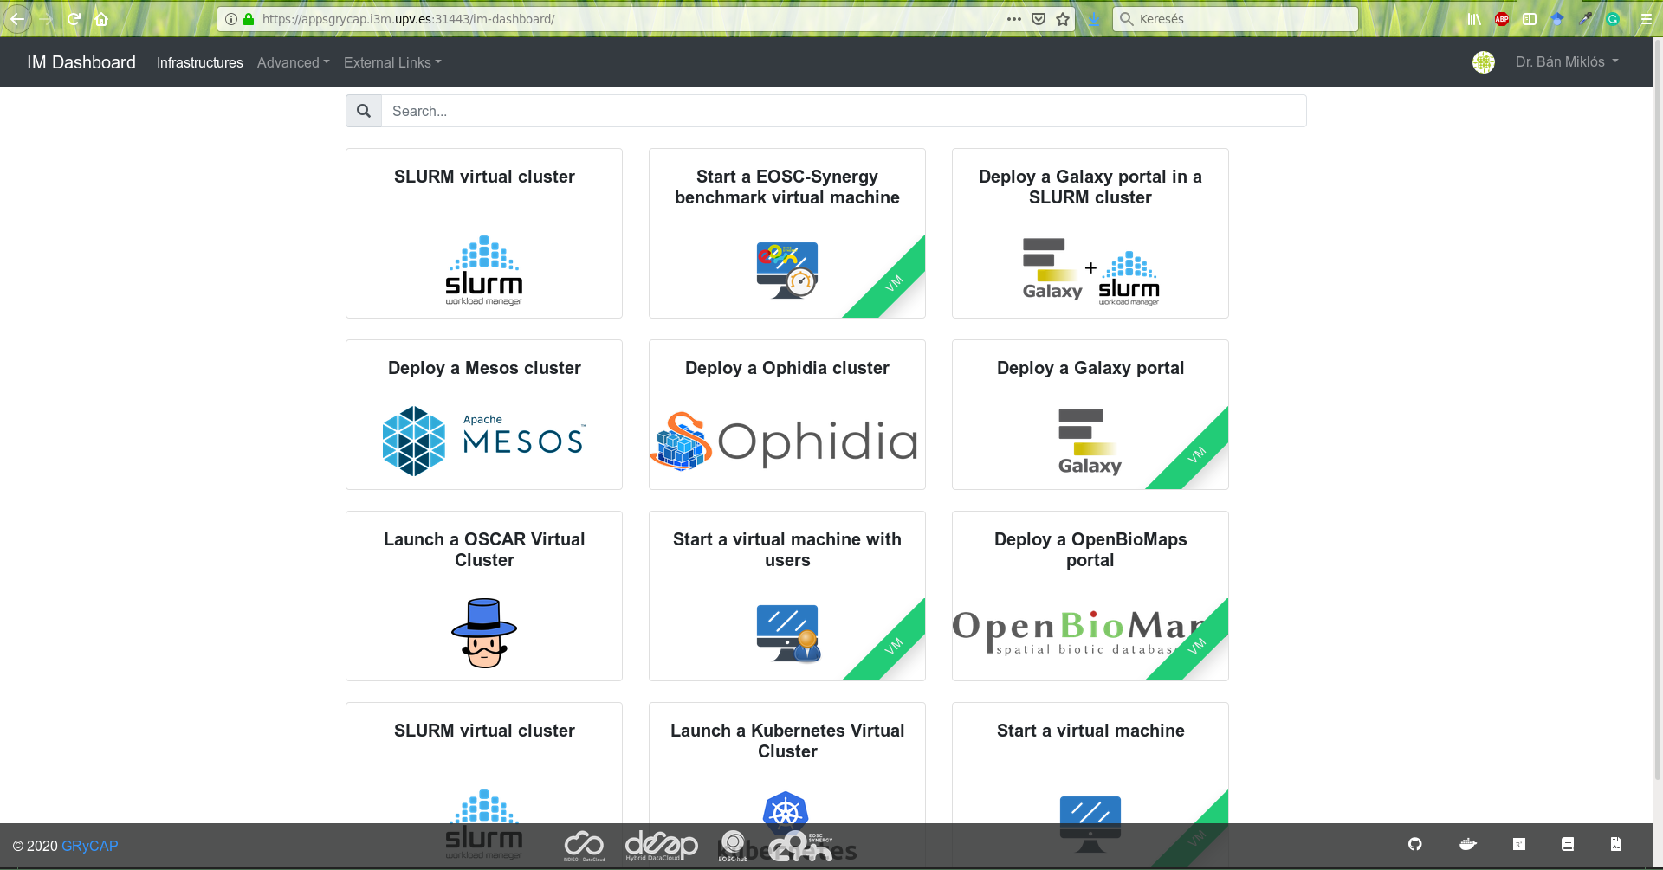
Current status
TOSCA template and Ansible recipes has been created (with Miguel) to launch OpenBioMaps portal from IM dashboard

Slide 4
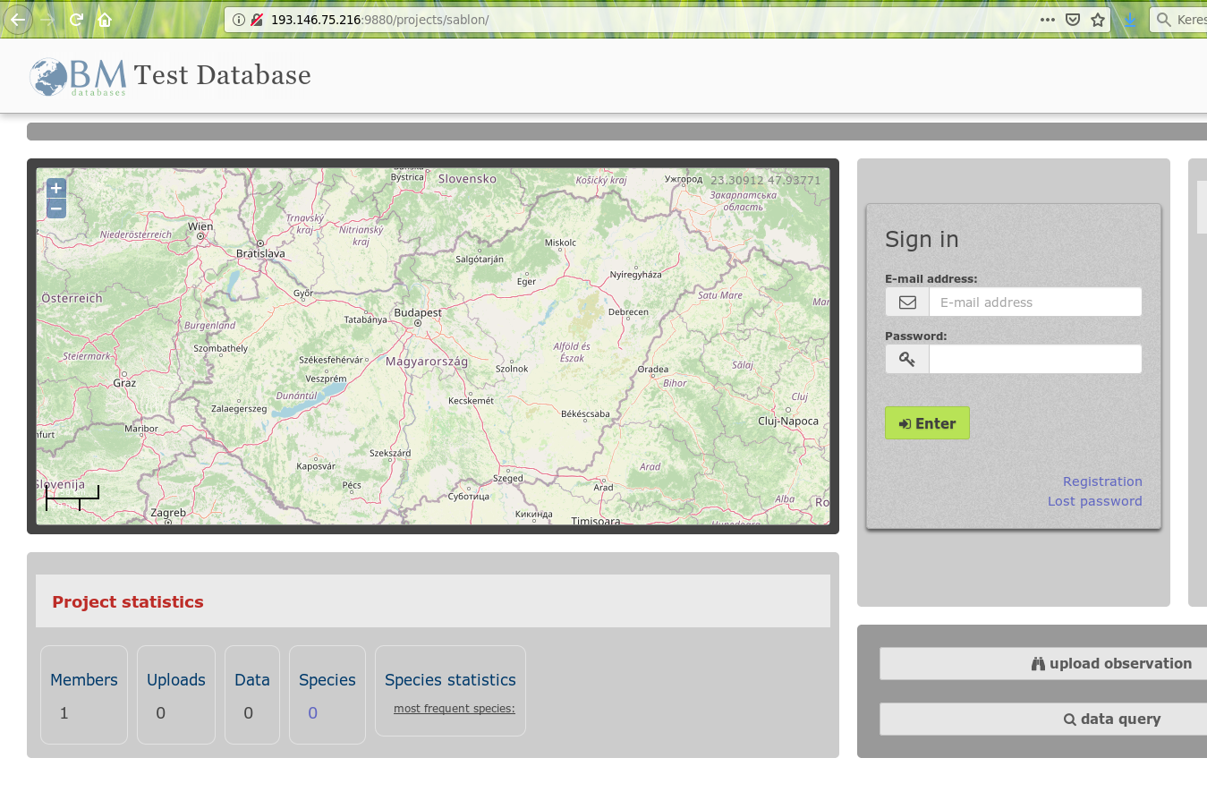
Current status
OpenBiomaps deployed successfully!

Slide 5
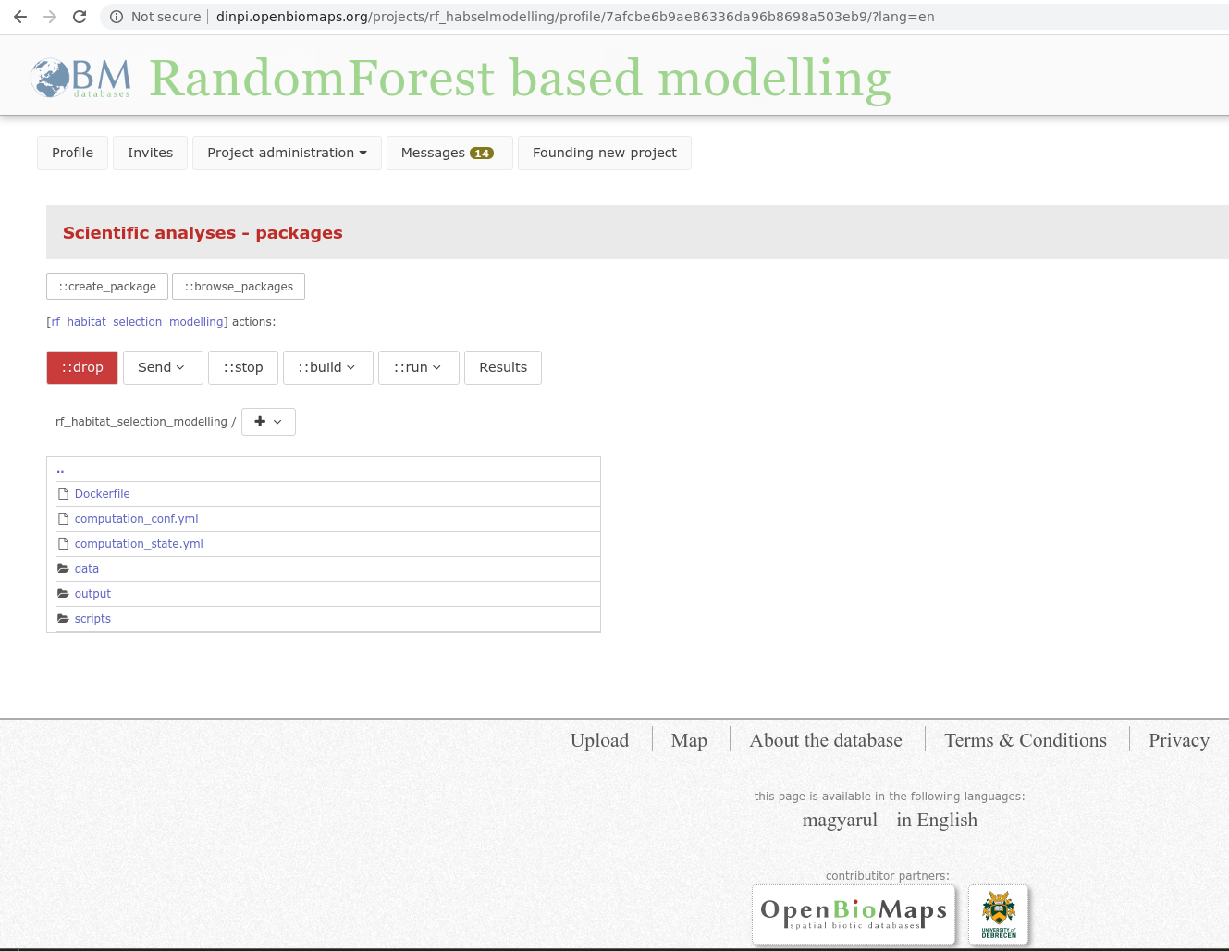
Computational node interface on an OpenBioMaps server

Slide 6
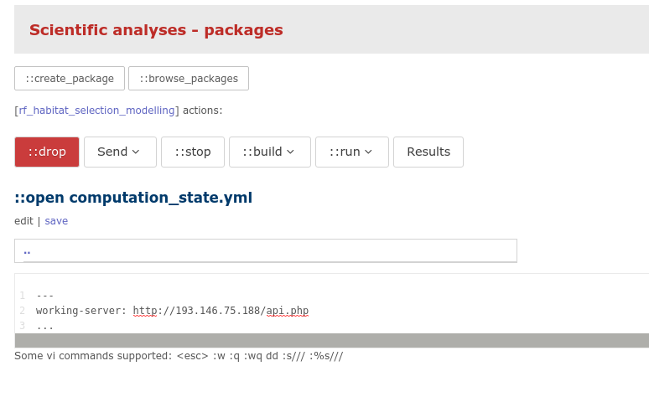
Computational service for OpenBioMaps
Creating computational service for OpenBioMaps projects to help researcher using OBM databases to apply particular computations.
This service accessible through OpenBioMaps servers for all users in the all projects
The computation scripts can be R scripts.
Computational servers are automatically chosen for computations (in this case it is our EOSC server)

Slide 7
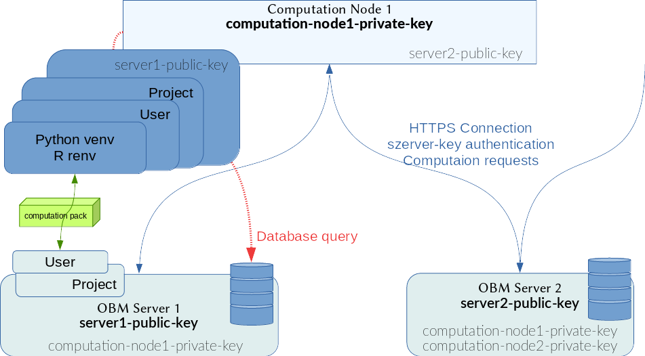
The new computation schema

Slide 8
Use cases
Behavior Ecology Research Groups at University of Debrecen (Hungary): species distribution modelling
Bükk National Park (Hungary): species distribution analysis of fish species
Milvus Group Association (Romania): species distribution analysis of birds

Slide 9
Missed things
Deploying Satellite Image (geoss) interface
B2Handle - Permanent Identifier Service - we have our own PID service, but we want to use B2Handle later when we will create common interfaces with external data repositories.
B2Share - we also plan to deploy this service later using its REST API. So far, we have come up with an internal interface for storing data objects in external repositories that can communicate with Dataverse and B2Share interfaces. These services are likely to be used in several research projects soon.
B2Drop, B2Find - We are not planning to integrate these services at the moment

Slide 10
Current status
Status of access to the services and SLAs agreed with the providers (Created):
SLA agreed with IFCA site (https://documents.egi.eu/public/ShowDocument?docid=3565)
1-8 VM, 48 CPUs, 130 GB RAM, 2.2 TB HD.
Progress of the application:
OBM computation layer: done. It is available for all OpenBioMaps users. 2VM in production.
OBM as EOSC service: done. An OpenBioMaps server successfully deployed using Infrastructure Manager Dashboard. It is not publicly available. 1VM demo.
Initial version of TOSCA Recipes and Ansible roles created to deploy the application automatically using IM.
Currently testing the automated deployment using Infrastructure Manager Dashboard:
https://appsgrycap.i3m.upv.es:31443/im-dashboard/

Slide 11
Further plans
B2Share, Dataverse data deposit interface
B2Handle - PID interface
Creating example computational packages
Image processing interface
Jupyter integration / using Jupyter API
GIT integration
Julia & Python support for computational packages
Satellite image downloading interface
ML support

Slide 12
banm@vocs.unideb.hu
micafer1@upv.es

