Slide 1
Towards a Global Federated Framework For Open Science Cloud: Three Use Cases
Hussein Sherief

Slide 2
Contents
TAIWAN TYPHOON
WRF-4DVAR Simulation
OpenCoasts Simulation
Sustainability

Slide 3
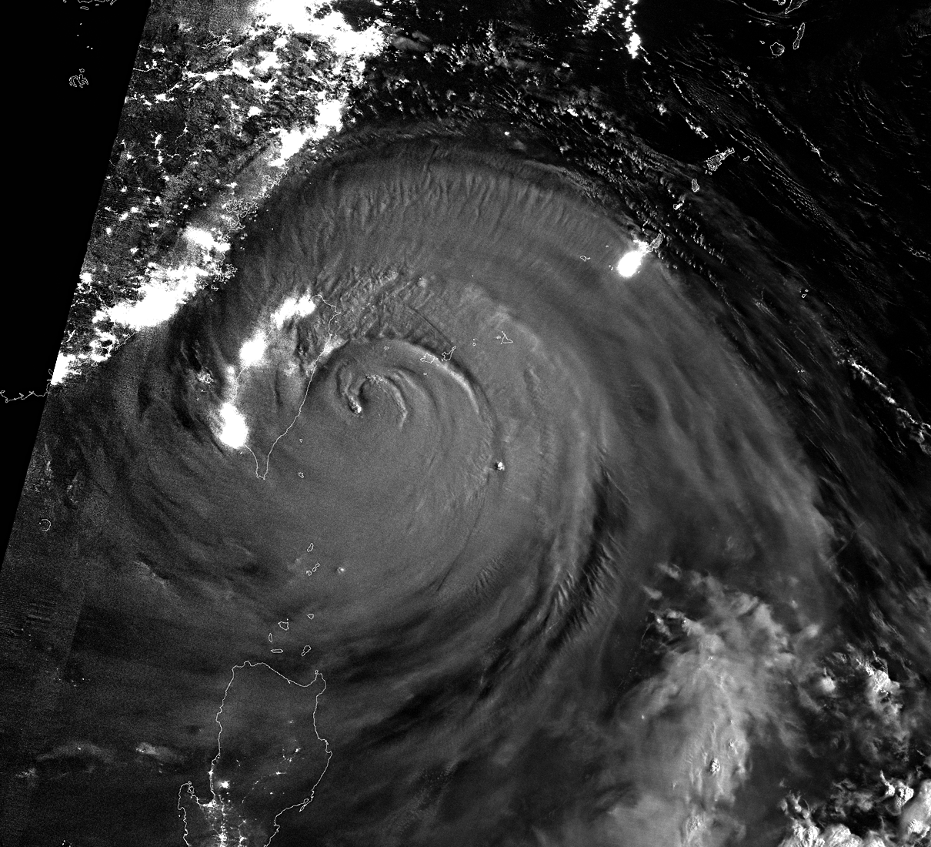
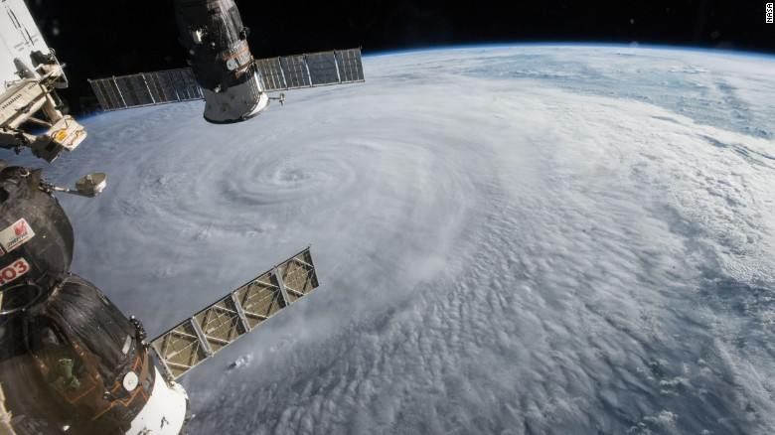
with peak winds at 180 mph (290 kph), according to the Joint Typhoon Warning Center.
The strongest storm on the planet so far this year: Typhoon Soudelor (2015)
The crew of the international space station spotted Typhoon Soudelor on August 5
8/8 00:55 LST
(source: Martin Setvak)

Slide 4
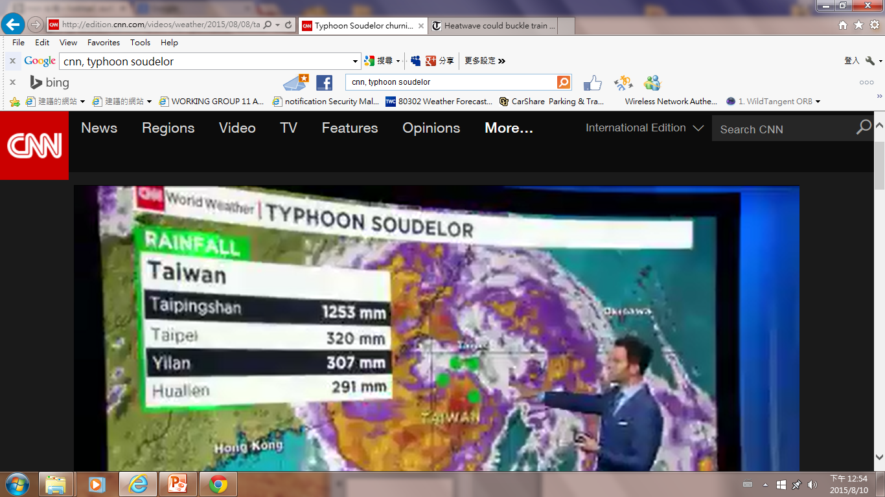
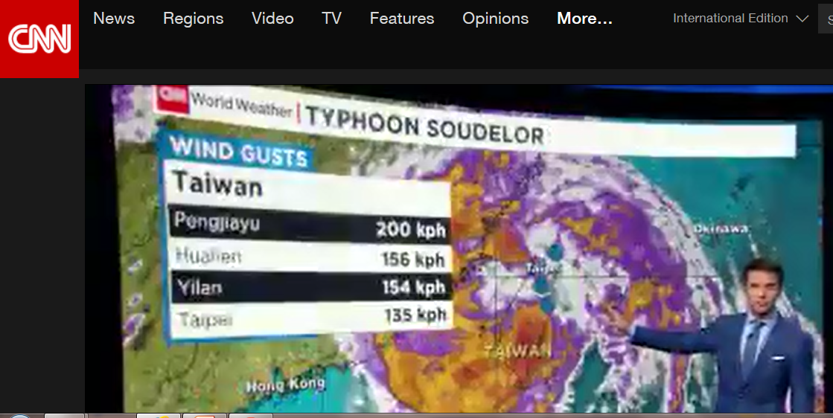

Slide 5
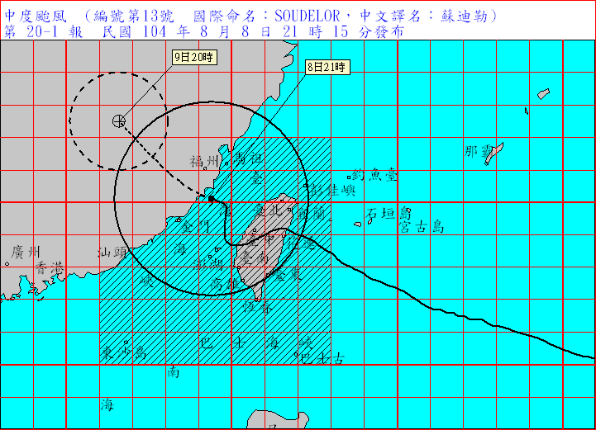
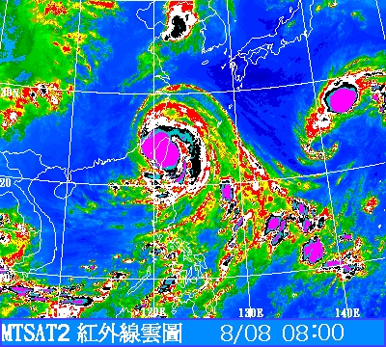
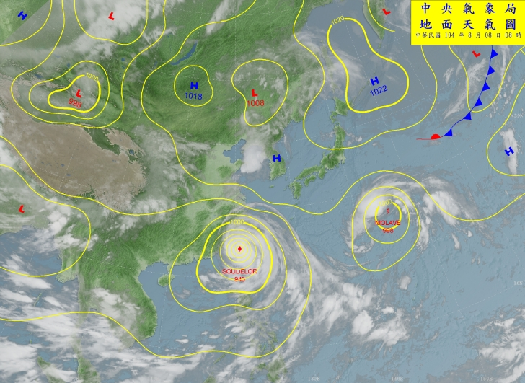
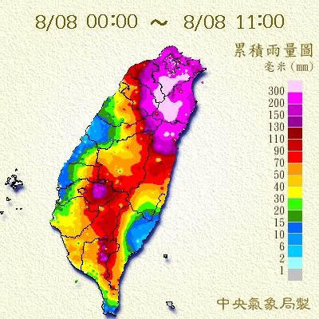
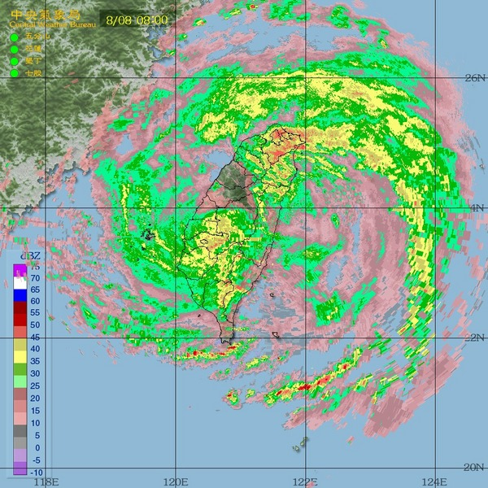
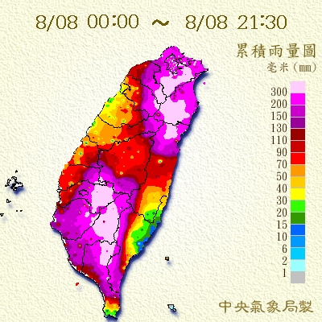

Slide 6
Observation
Simulation
JTWC BEST TRACK
Model

Slide 7
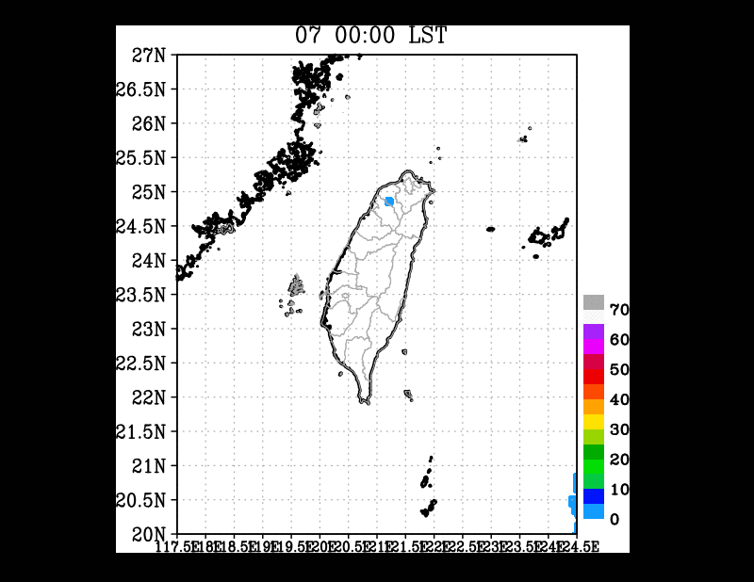
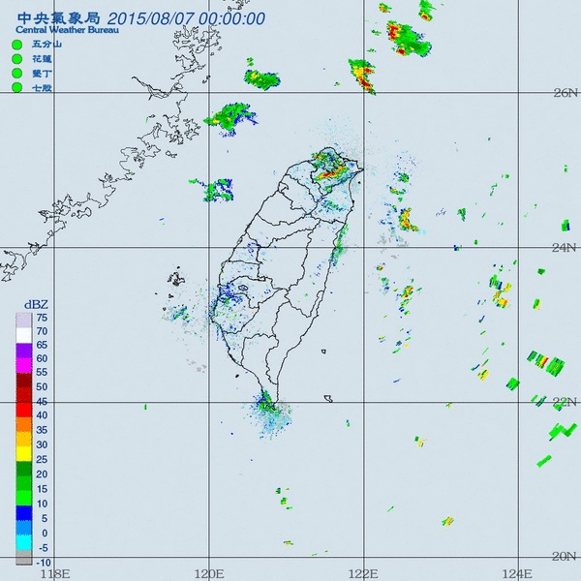
Cu:KSAS
Mp: WSM6
Bl: MYNN

Slide 8
OpenCoasts Simulation
The model SCHISM was run in depth-averaged barotropic mode without waves. Although waves can be important in the generation of storm surges in Taiwan (Liu and Huang, 2020), the present version of OPENCoastS only allows the simulation of waves in the North Atlantic Ocean. The model was forced by tides from FES2014 and the inverse barometer effect at the four open boundaries, and by wind and atmospheric pressure from NOAA/GFS at the surface. The time step was set to 240 s. The
1/3
Manning friction coefficient was set to 0.022 m /s, without any calibration. Considering the
exceptionally large depths in the Philippine Sea, the model results at the three available tide gauges are expected to be fairly insensitive to the friction coefficient.

Slide 9
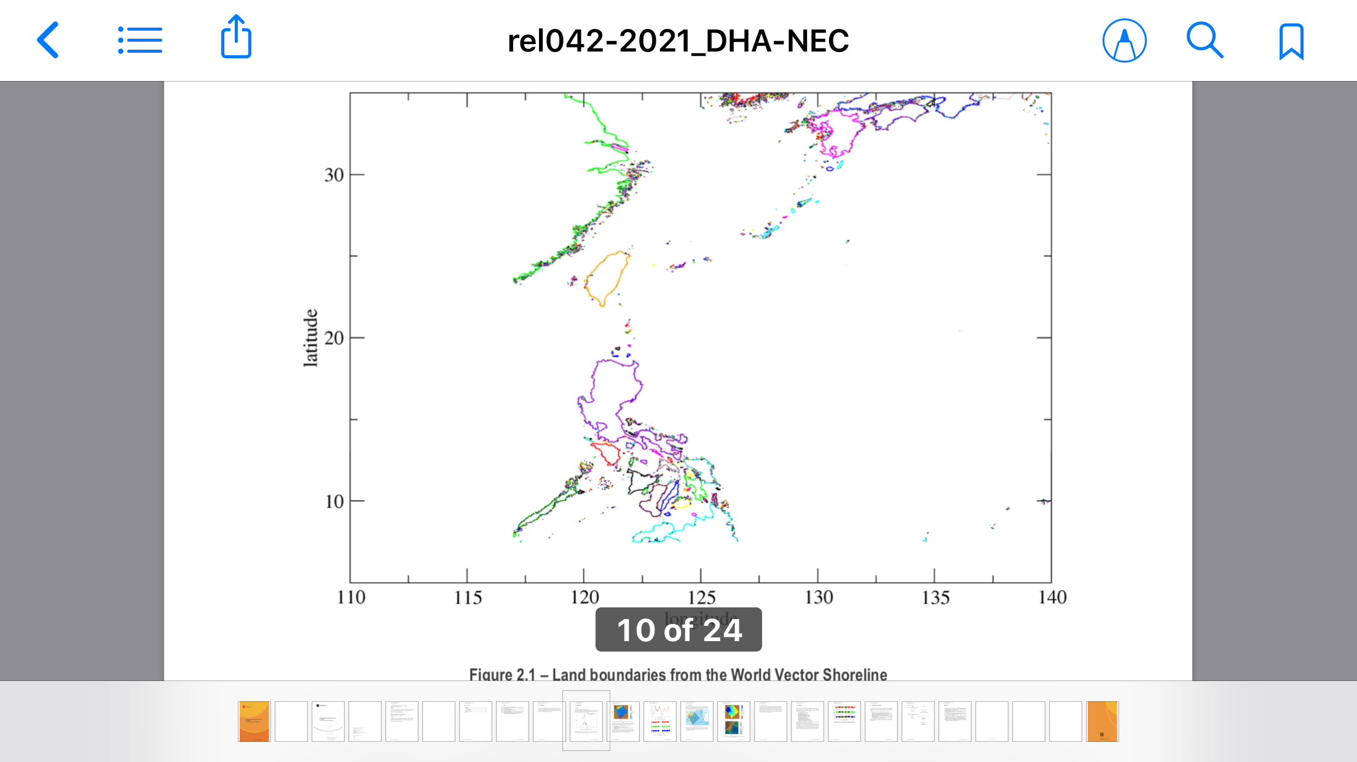

Slide 10
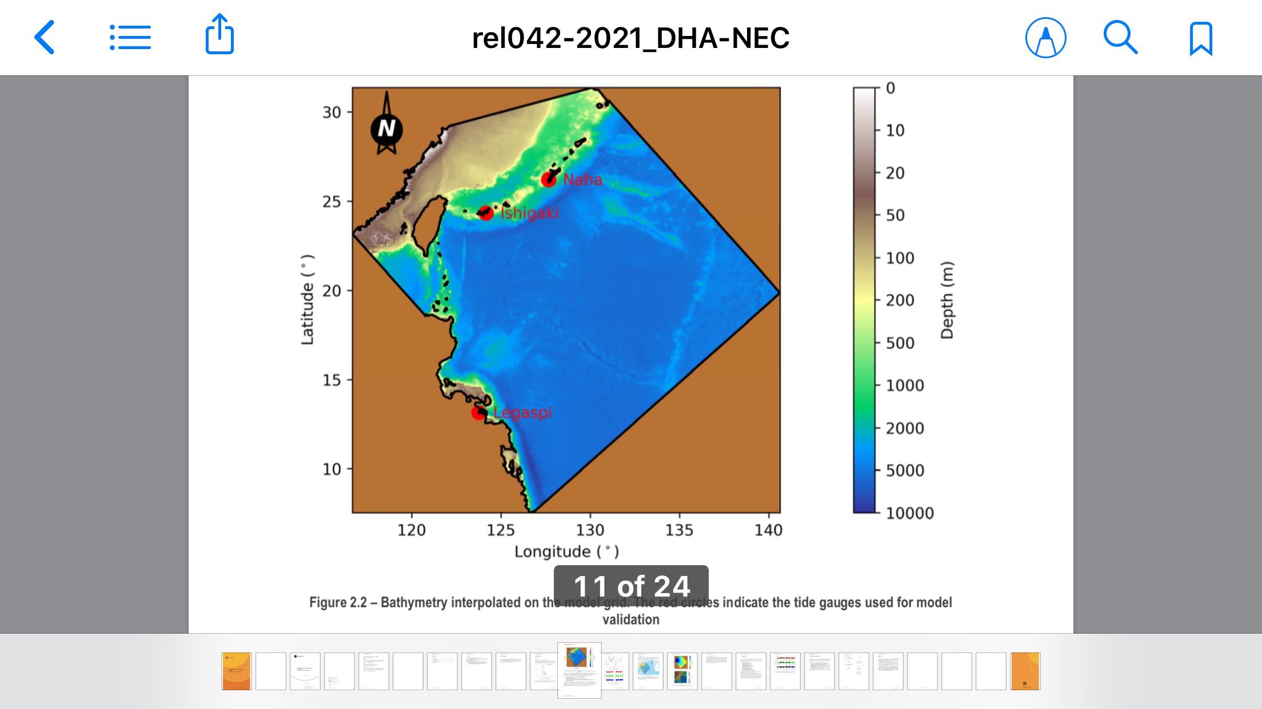

Slide 11
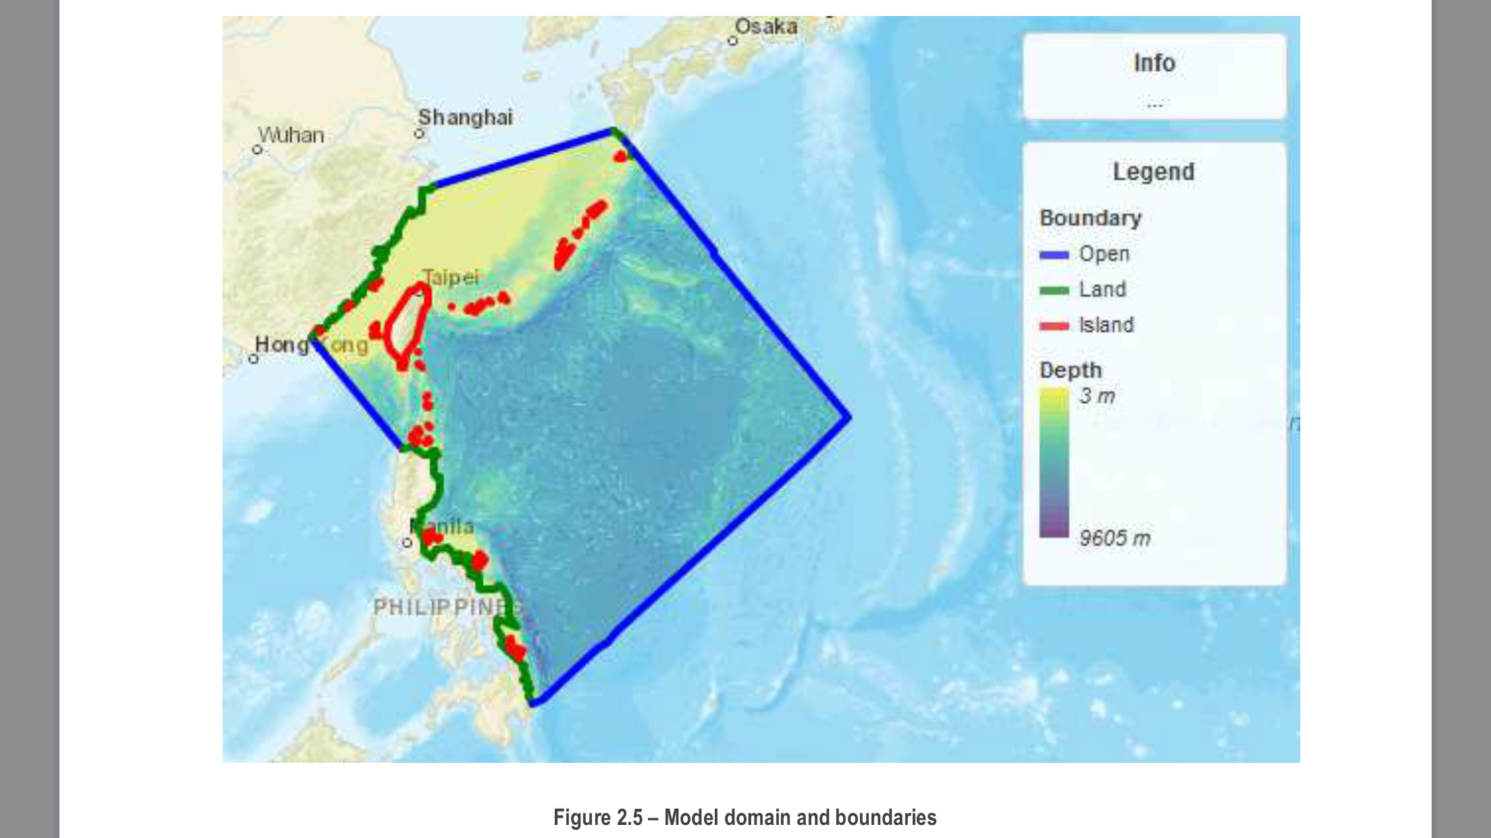

Slide 12
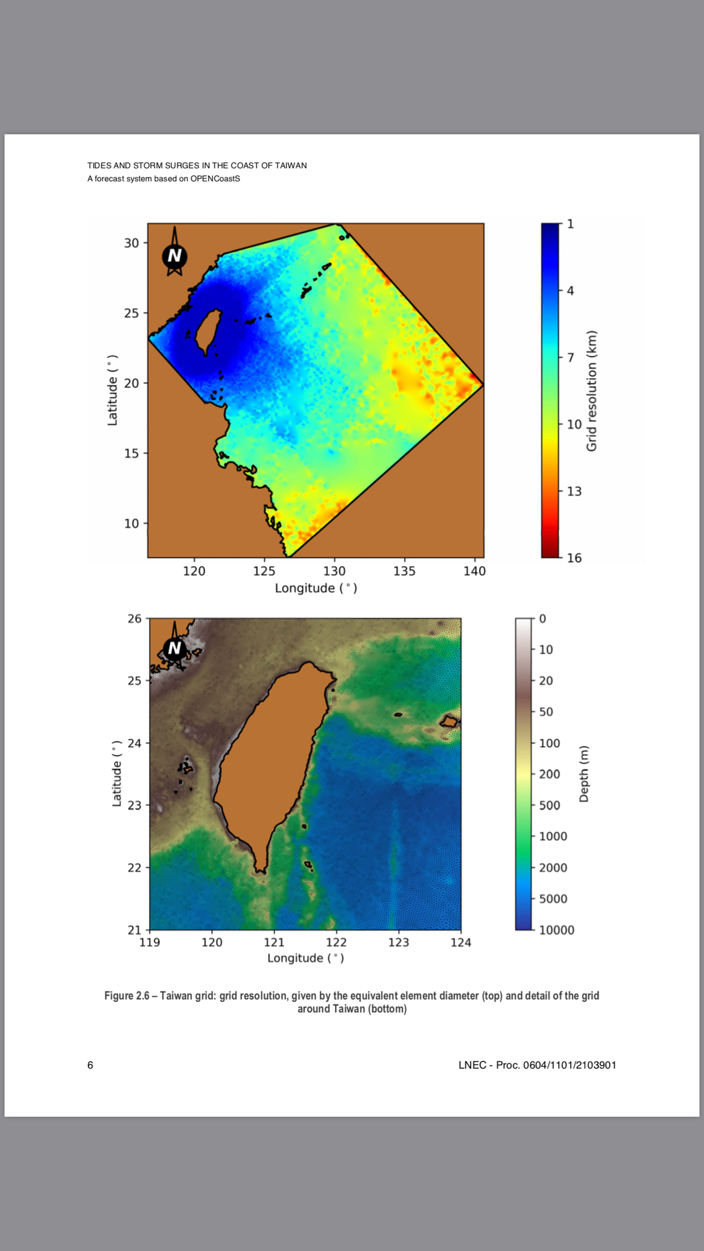

Slide 13
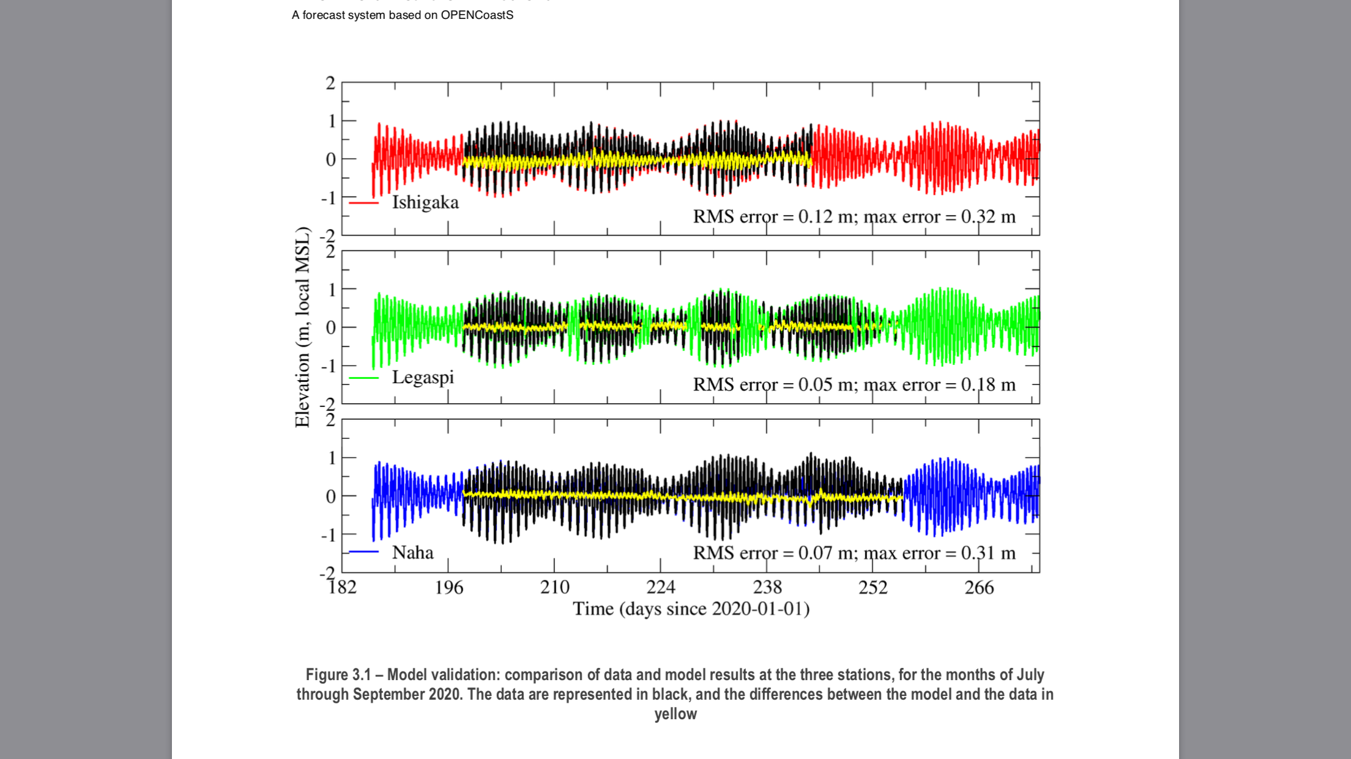

Slide 14
Conclusion
A forecast system for storm surges in Taiwan was generated with the OPENCoastS platform (Oliveira et al., 2020). Only open data available in the internet was used for both the model setup and the model validation. Validation results are considered very good, especially considering the absence of calibration.
In spite of the good results achieved, the forecasts could probably be improved through:

Slide 15
Sustainability
African Arab Science and Technology Cloud (AAScTCloud)
Linking EOSC , CSTCloud
forming GOSC

Slide 16
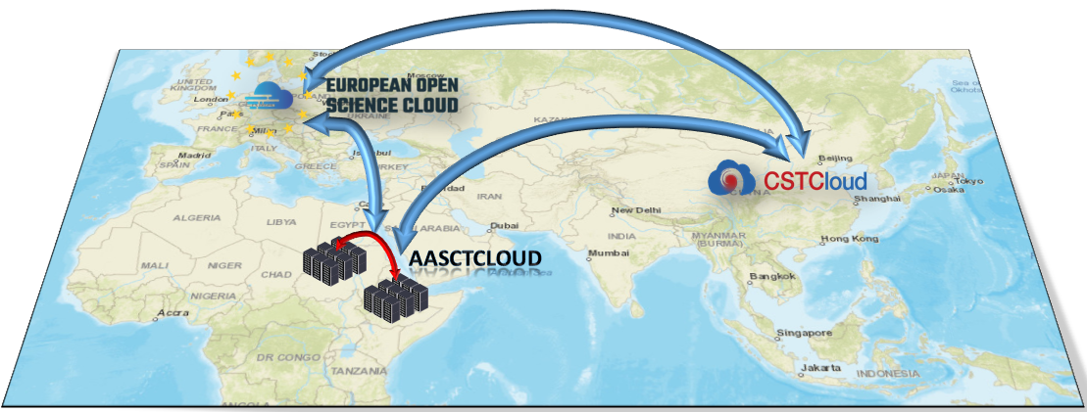
AAScTCloud Overall Architecture

Slide 17
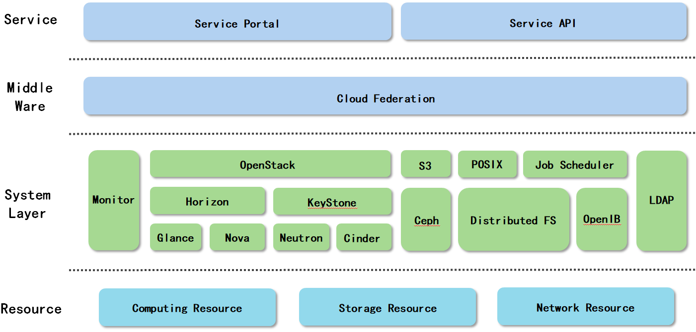
AAScTCloud Technology Architecture

Slide 18
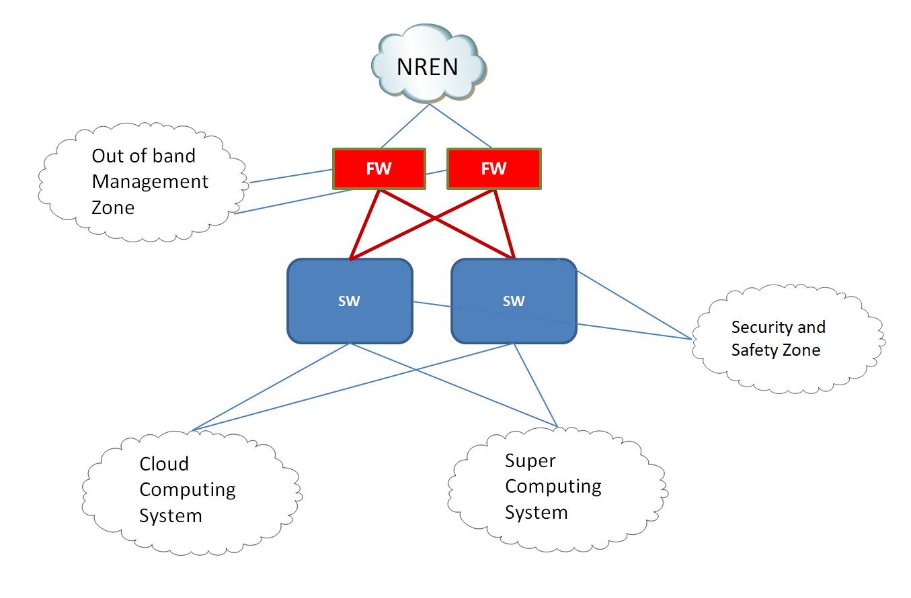
Schematic diagram of high-speed network architecture of data center

Slide 19
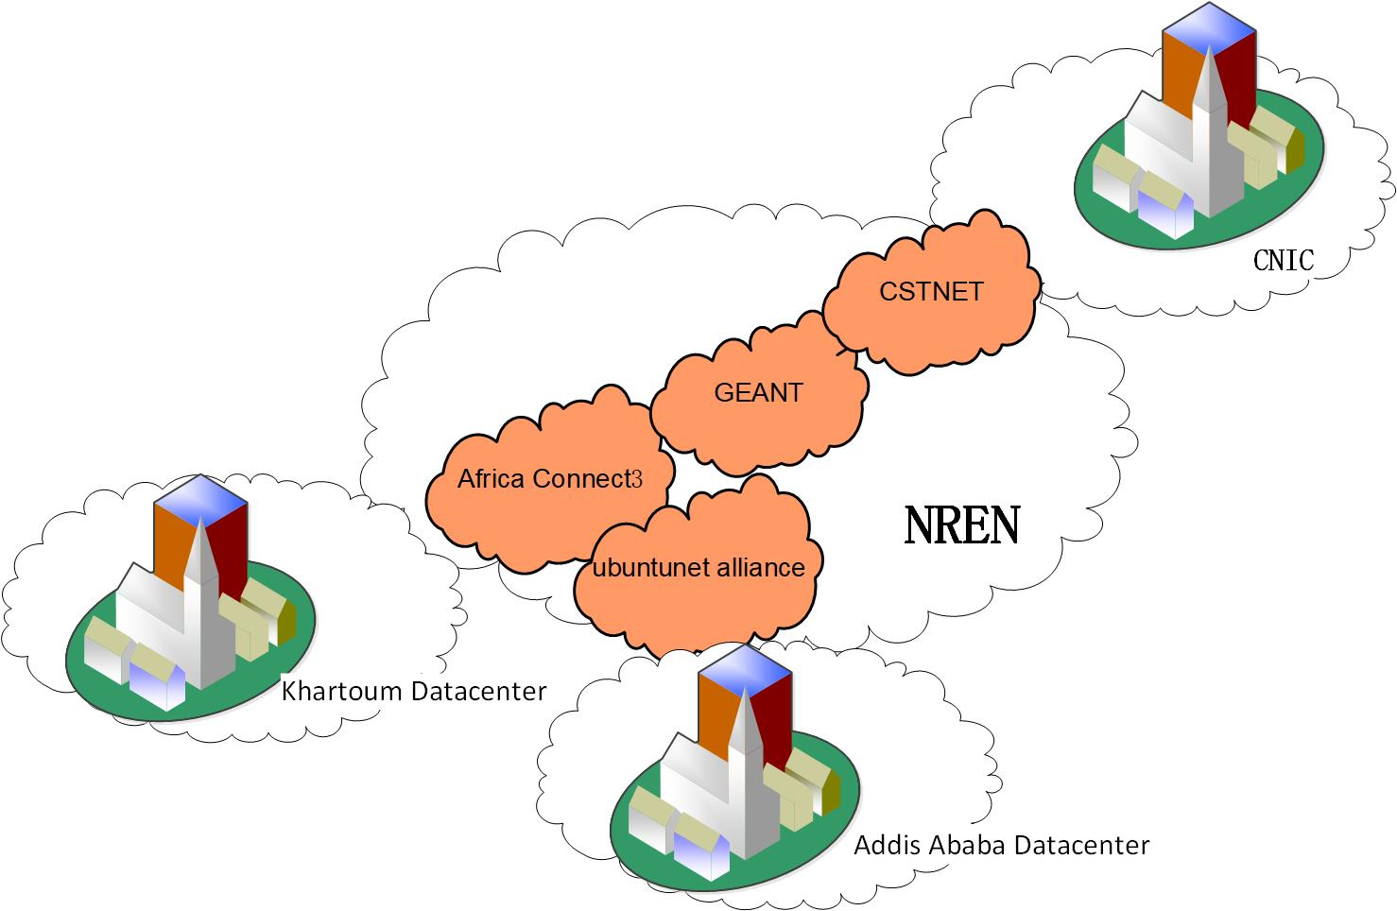
Schematic Diagram Of High-Speed Network For Scientific Research Collaboration

Slide 20
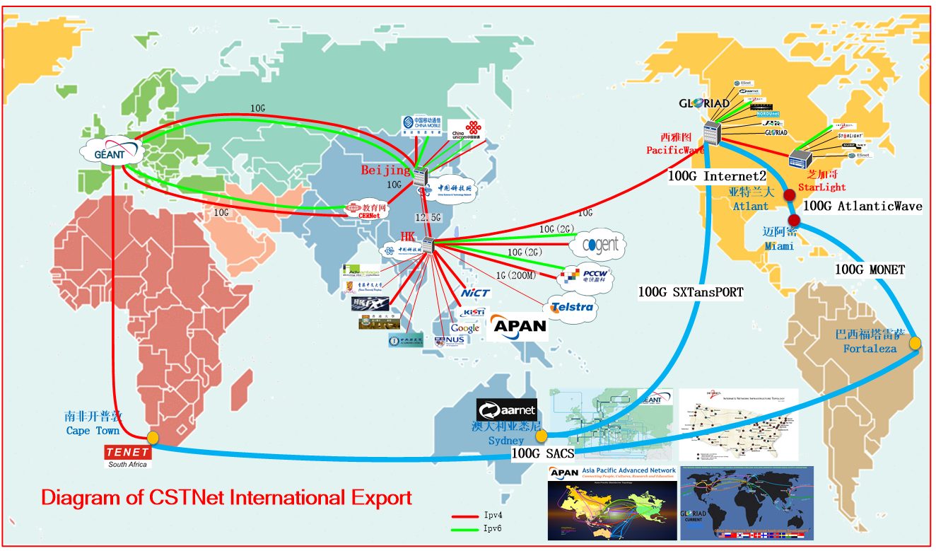
China Science and Technology Network (CSTNET) international link diagram

Slide 21
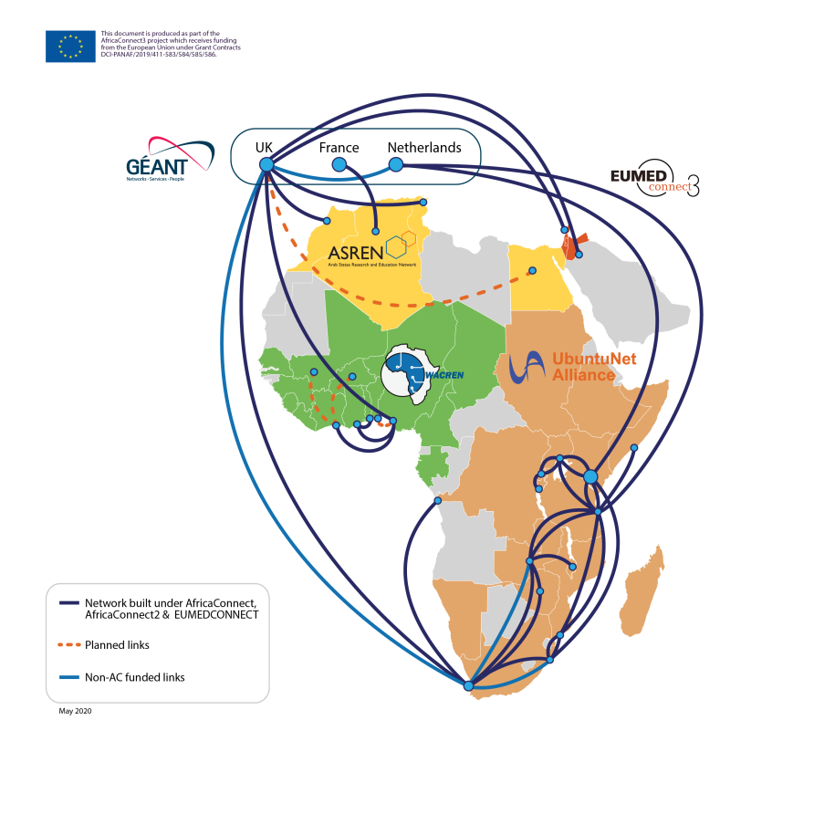
Schematic diagram of interconnected link of Africa Connect 3

Slide 22
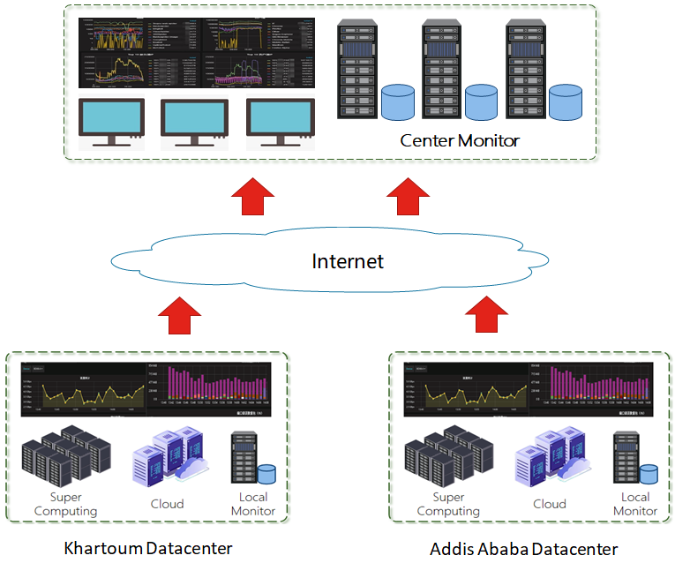
Schematic diagram of intelligent monitoring system

