Slide 1
Status update: Open AiiDAlab platform for cloud computing in Materials Science
Aliaksandr Yakutovich
Notes:
Widescreen 16:9 (as used by YouTube)

Slide 2
AiiDAlab: Quick reminder

Slide 3
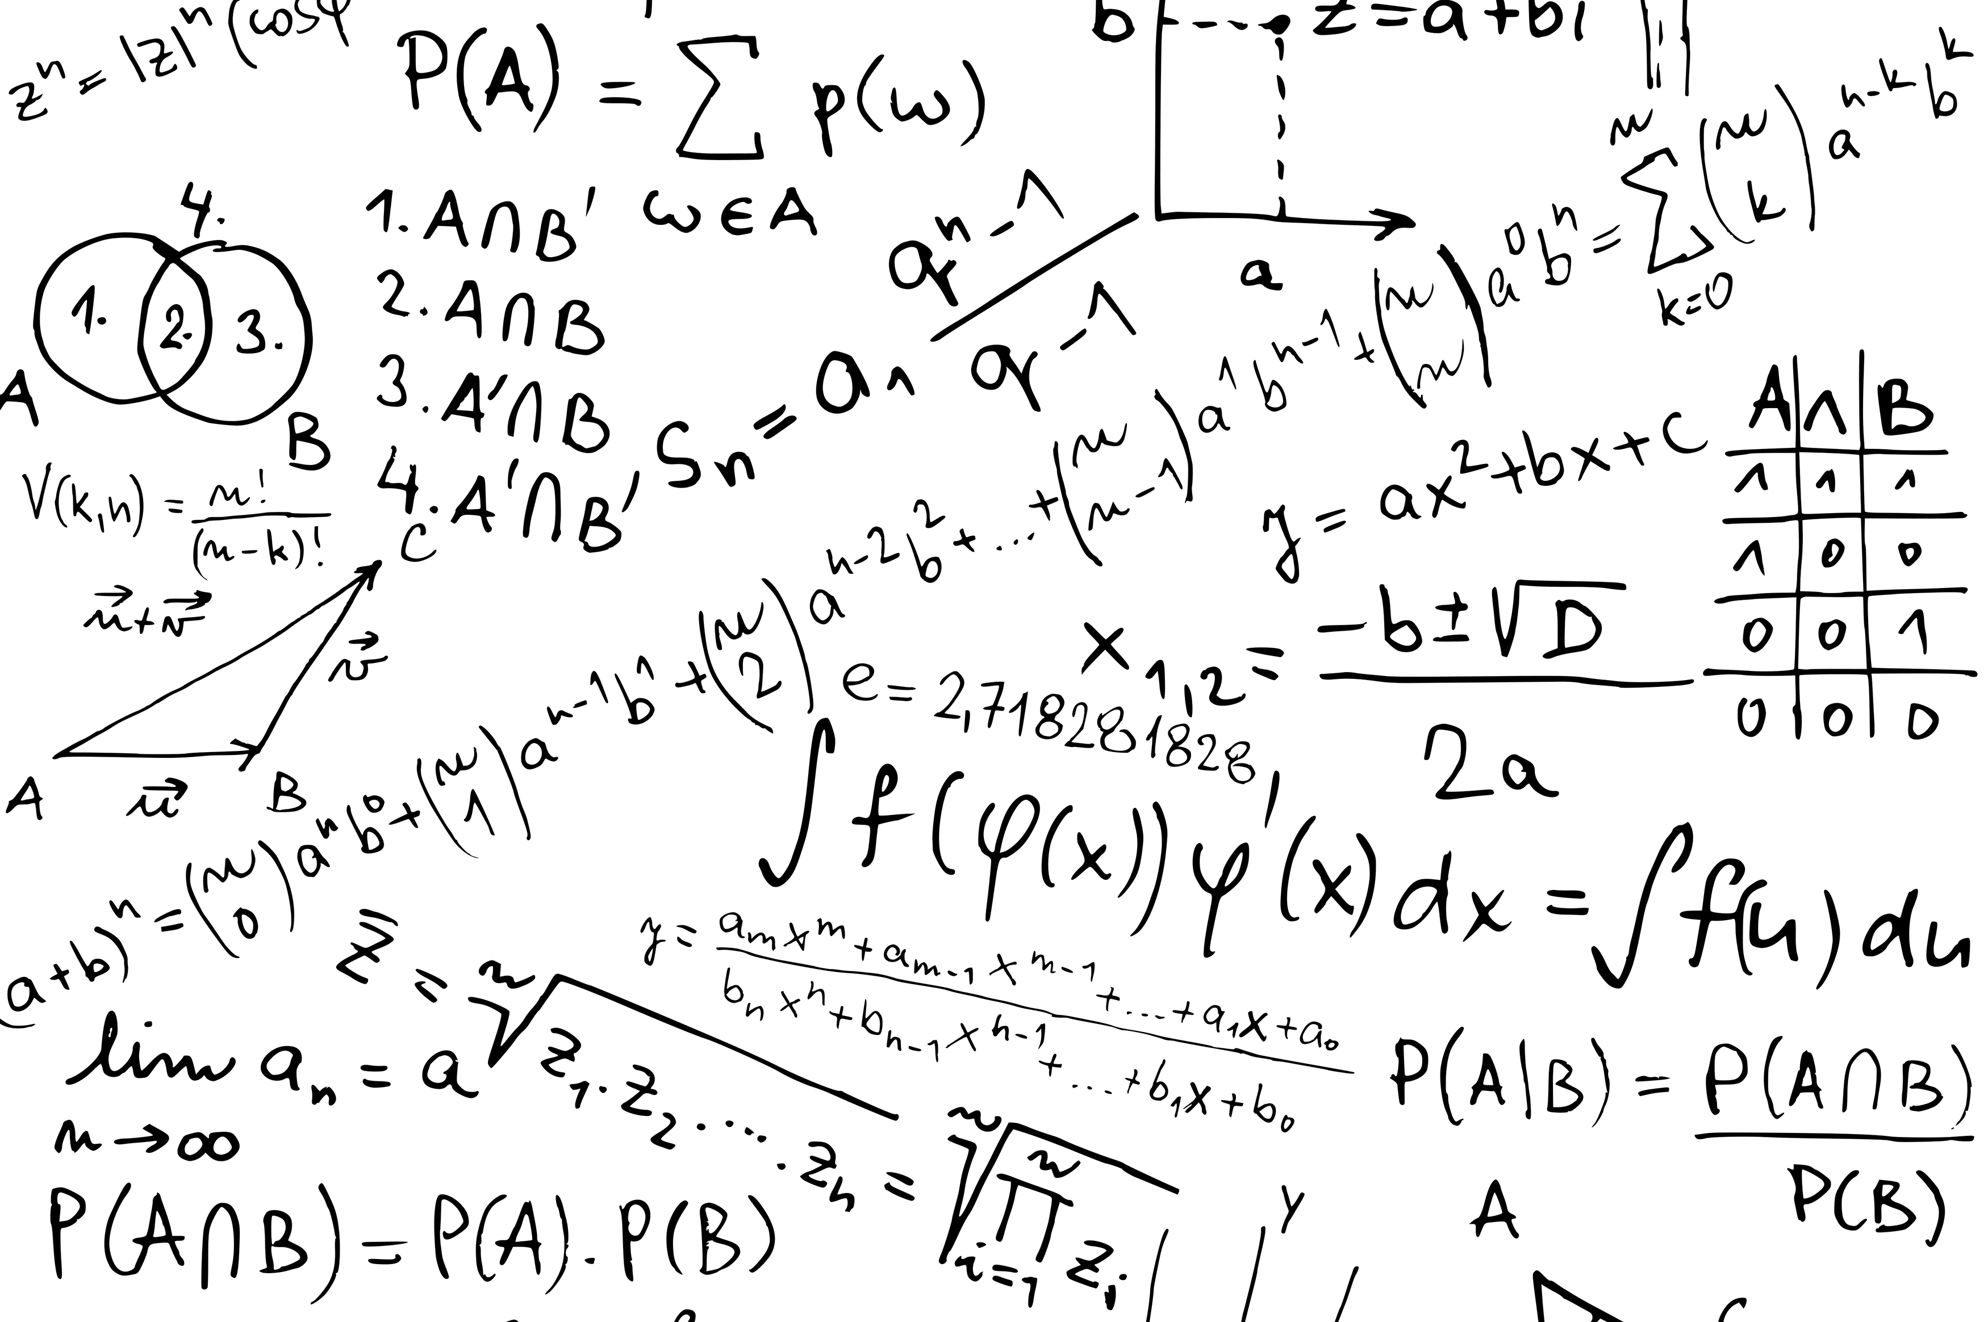
Three pillars of science
Pillar I: Experiment. Mostly done by experimentalists.
Pillar II: Theory. Mostly done by theoretical and computational scientists.
Pillar III: Simulation: Mostly done by computational scientists.
can be seen as a merging point between theory and experiment
Notes:
Don't forget to update your name on the right

Slide 4
Usage example

Slide 5
AiiDAlab@EOSC: status update

Slide 6
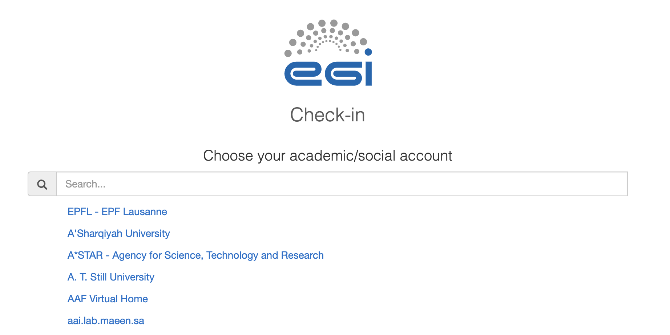
Q2: Apr-May-Jun
Increase capacity at CESNET to support at least 50 users (add: 50 CPUS, 150GB RAM, 1TB storage), setup k8s cluster with EC3. (Done)
Move to EGI Check-in production instance. (Done)
Deployment of an application to run Quantum ESPRESSO relaxation workflows in a fully automated fashion. (Done)
https://aiidalab-demo.materialscloud.org/

Slide 7
Q3: Jul-Aug-Sept
On-boarding of users (~50 expected) (Done)
Installation in the instance of updated apps, software stack and data as needed for tutorials. (Done)
Use of the EOSC AiiDAlab instance for a classroom/tutorial supporting at least 50 concurrent users. (Failed)

Slide 8
Kubernetes cluster problems
Changing folder access permissions: .ssh, .postgres (cinder). (Fixed)
K8s cluster node can’t have more than 6 volumes attached (cinder). (Fixed in November 2020)

Slide 9
Cluster resources to support 50 concurrent users
50 cores
200 GB RAM
1 TB of storage
200 volumes

Slide 10
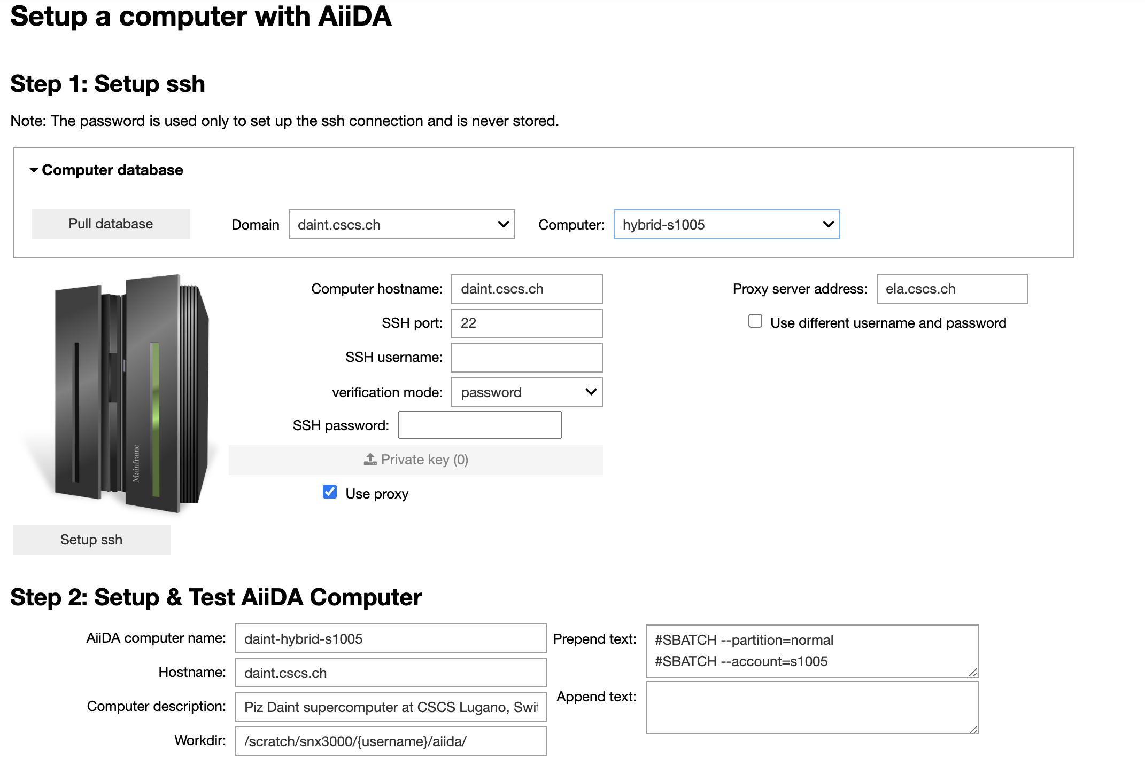
Q4: Oct-Nov-Dec
On boarding of more than 100 users. (To discuss)
Upgrade of the full software stack to the most recent available software. (Done)
Provide straightforward apps to connect to HPC resources. (Done)
Support of at least 6 different simulation codes and the corresponding AiiDA plugins. (In progress)

Slide 11
EGI registration
EGI registration procedure is rather convoluted. Can it be simplified?
Some users could not complete the registration process.
Some services didn’t work for me.
After completing the registration procedure, the user remains logged out. Is it really necessary?
Can EGI logout page redirect users back to the service login page? This is typically done through ‘next=‘ URL parameter.

Slide 12
General Questions
What is the final date when the EOSC Early adopter will finish?
What will happen when it's over - will the machines be shut down immediately?

Slide 13
Conclusion
AiiDAlab@EOSC is up and running.
To improve the EGI user experience, we suggest simplifying the registration procedure. We are happy to provide concrete suggestions.
To plan forward, we would like to understand how the EOSC-EAP will be finalised.

Slide 14
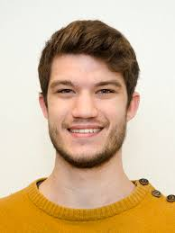
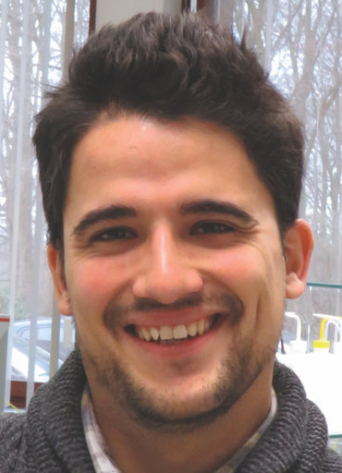
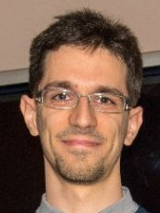
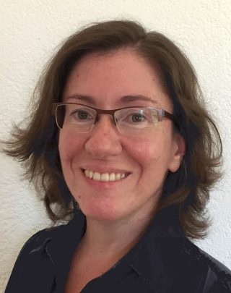
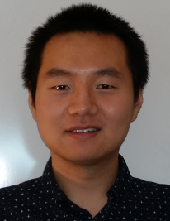
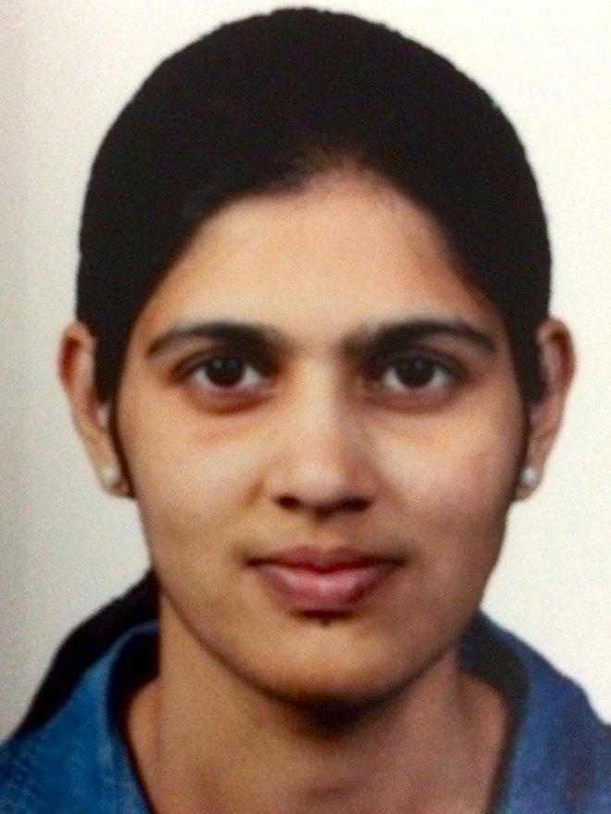
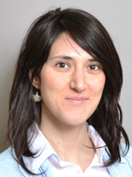
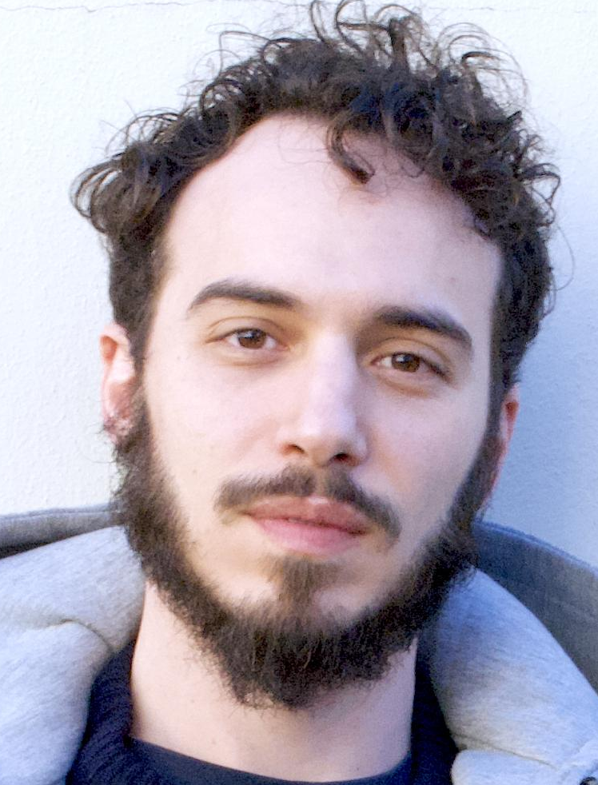
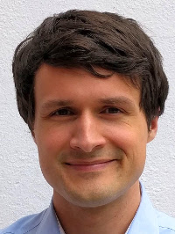
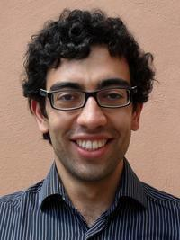
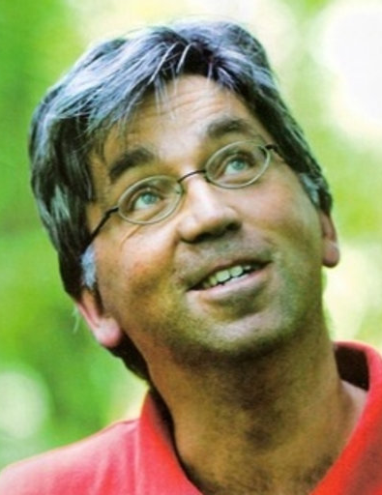
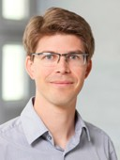
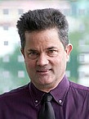
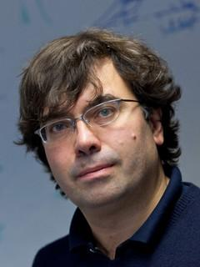
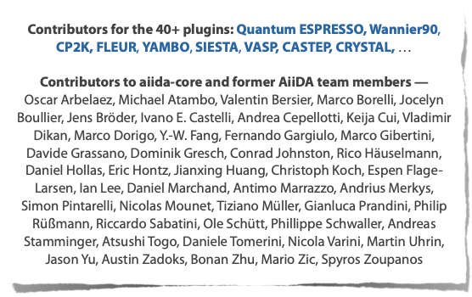
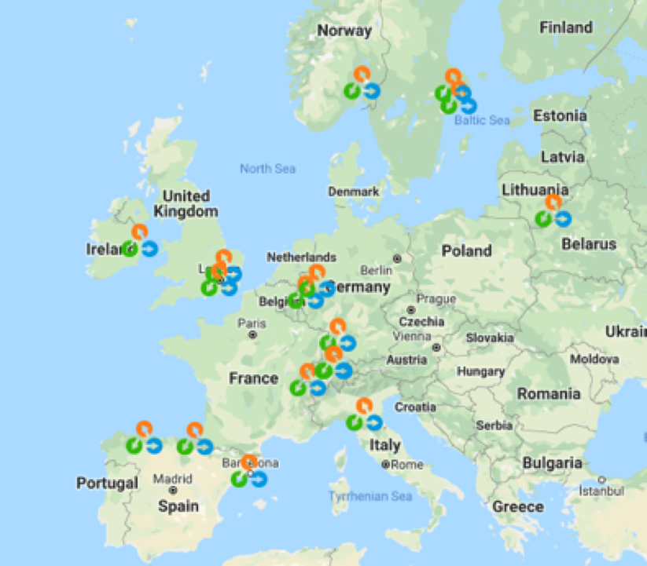
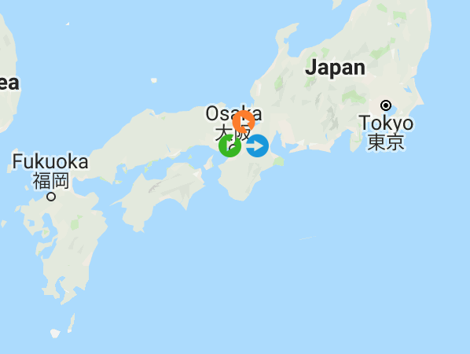
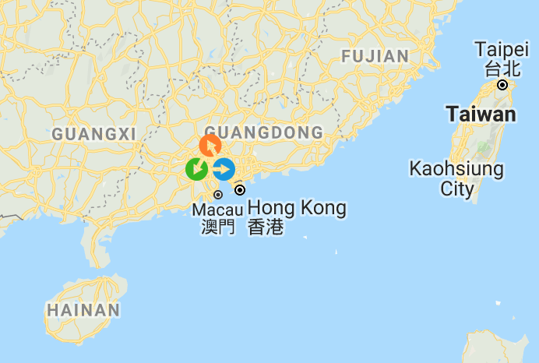
Developers
Carl Simon Adorf
(EPFL)
Casper W.
Andersen
(EPFL)
Marnik
Bercx
(EPFL)
Marco
Borelli
(EPFL)
Valeria Granata
(EPFL)
Sebastiaan P. Huber
(EPFL)
Dou Du
(EPFL)
Snehal P. Kumbhar
(EPFL)
Elsa
Passaro
(EPFL)
The Materials Cloud
And AiiDA teams
Francisco F. Ramirez
(EPFL)
Leopold
Talirz
(EPFL)
Aliaksandr
Yakutovich
(EPFL)
Chris
Sewell
(EPFL)
Giovanni Pizzi
(EPFL)
Berend Smit
(EPFL)
Joost
VandeVondele
(ETHZ,CSCS)
Thomas
Schulthess
(ETHZ,CSCS)
Nicola Marzari
(EPFL)
AiiDA contributors

Slide 15
Acknowledgements
MARVEL National Centre for Competency in Research
European Centre of Excellence MaX
École Polytechnique Fédérale de Lausanne
European Research Council
Platform for Advanced Scientific Computing
The European Materials Modelling Council

