Slide 1
Fostering DIHs for Embedding Interoperability in Cyber-Physical Systems of European SMEs

Slide 2
EOSC DIH Project Overview
UNINOVA – José Ferreira

Slide 3
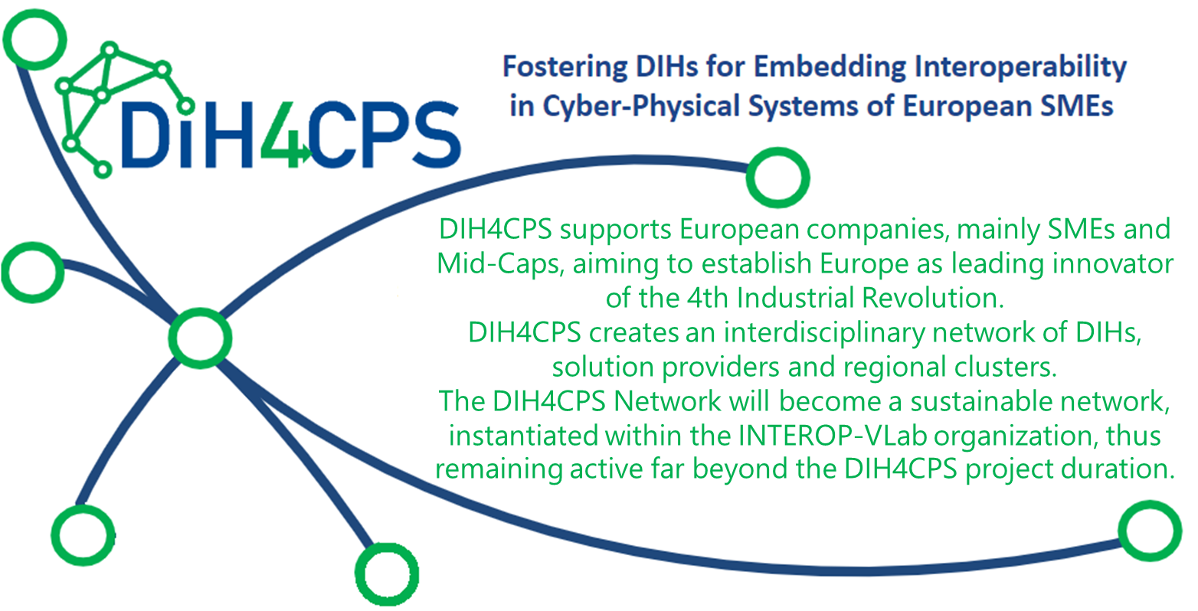
Project Overview
3 Years (2020-2022)
33 Partners from 15 EU Countries
66/26 Network/DIHs
11 + 12 Application Experiments
2M€ for Open Calls
(2nd Open Call for July 2022)

Slide 4
DIH4CPS Tools – DIHs Customers
Technology End-User
Technology Provider
Any company (SME / LE or start-up) that uses technology to best perform its business
Any company (SME/LE or start-up) whose business is to develop new technologies

Slide 5
DIH4CPS Network Collaboration
Administration of the DIH in the network
Adaptive, Multidimensional and user-friendly Network Navigation System
Network formalization
Multi-dimensional navigation tool
Access or propose to events
Disseminate, experiments results, or success stories
Collaboration with others communities, tools, …

