Slide 1
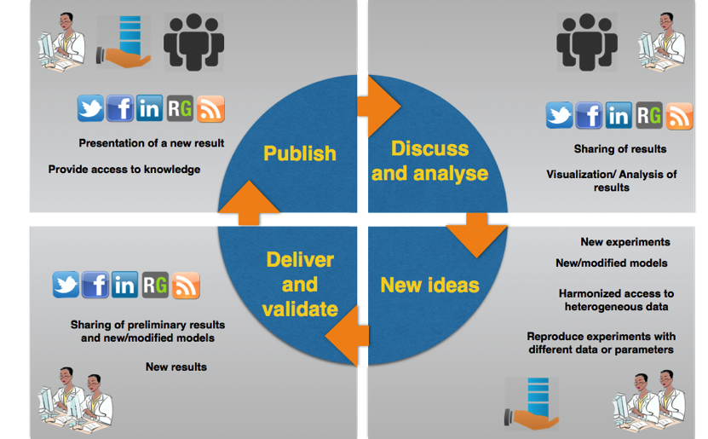
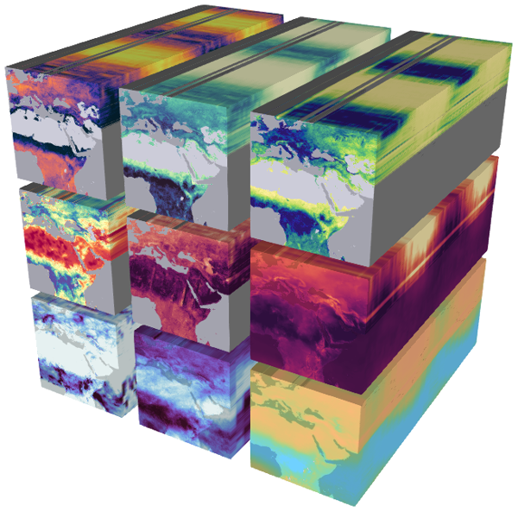
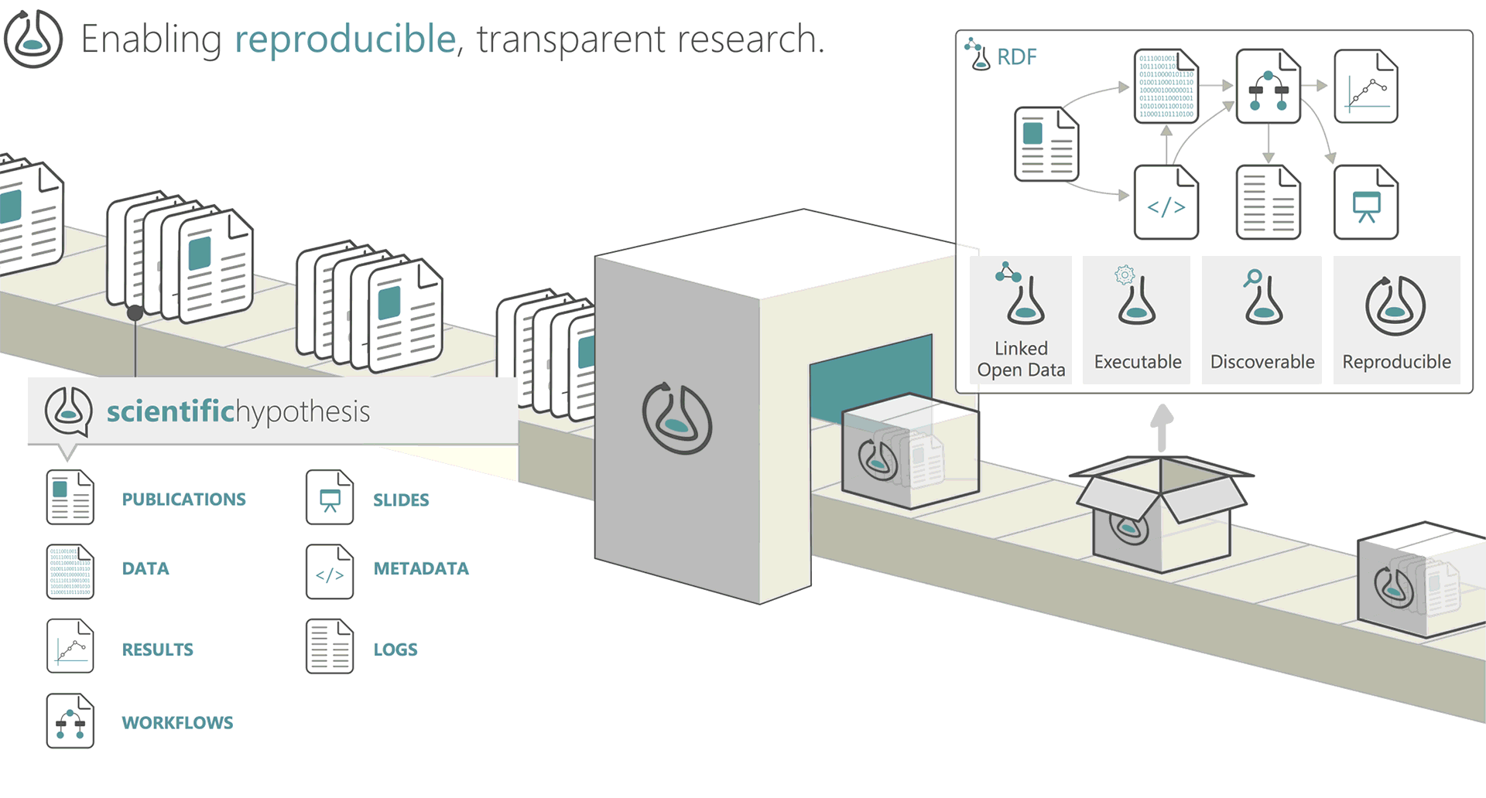
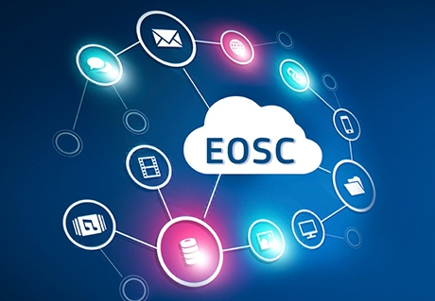
Research Lifecycle Management technologies for Earth Science Communities and Copernicus users in EOSC
Reliance will extend the EOSC service offering with a set of industry-strong, innovative, interconnected services for the open, efficient, and cross-disciplinary management of the research lifecycle
Reliance will adopt a holistic approach to address research activities in accordance with FAIR and Open Science principles
Reliance core service portfolio include
Research Objects as the information artefact to manage research,
Data Cubes for efficient and scalable structured data access and discovery, and
Text Mining for the extraction of information from scientific text as machine-readable metadata.
Reliance will pilot the services in three Earth Science communities, fostering the use of Copernicus data and demonstrating their efficacy in real-life scenarios, and it will launch an Open Call to engage other communities.
INFRAEOSC-07-2020 call
2 Million Euro (EC Grant)
24 Months
Kicked off in January 2021
Partners: PSNC (coordinator - PL), ESI (ES), CNR (IT), MEEO (IT), UiO (NO), INGV (IT), UPM (ES), Terradue (IT), Alpha (UK)

Slide 2
Opportunities for SMEs (collaboration, services, support, etc.)
RELIANCE services can support different stakeholders, with the primary focus on scientists, researchers, students and enthusiasts, allowing them
to manage and preserve their research work, to share it and make it available for publishing, to collaborate and to discover new knowledge.
Other user groups can be benefited by services like ROHub, e.g.,
Industry (SMEs) could externalize their research to a community of researchers worldwide in multiple scientific domains, and then follow and monitor the progress.
Investors can keep up to date and track scientific advances to fund and get involved in future breakthroughs.
Publishers can advertise their journals with researchers, have access to a pool of potential reviewers, and implement more interactive, review processes.
Industry can also leverage directly RELIANCE services and use/integrate in their services to deliver advanced research enabling services like text mining & semantic enrichment or access to EO data via Data Cubes
reliance_eosc
Visit us: https://www.reliance-project.eu/
Contact us: info@reliance-project.eu
reliance-project

