Slide 1
Copernicus - eoSC AnaLytics Engine
Christian Briese, EODC
christian.briese@eodc.eu
Shaping the future of the EOSC DIH: an industry showcase and path forward | 26.03.2021

Slide 2
Copernicus | Problem Statement
EU Copernicus programme has established itself globally as the predominant spatial data provider.
There is no single European processing back-end that serves (or will any time soon serve) all datasets of interest to the scientific community.
hampers the integration of these data sources in science and monitoring applications, particularly when expanding the applications to regional, continental and global scales.
Big (Copernicus) Data Analytics require a federated infrastructure with a core cloud computing and storage architecture optimised for very large data handling and fast user query response.

Slide 3
Copernicus – eoSC AnaLytics Engine
Vision
To empower European researchers, institutions and initiatives to easily discover, access, process, analyse and share Copernicus data, tools, resources and services in a way that can be seamlessly integrated into their processes and research practices.
Mission
The C-SCALE (Copernicus eoSC AnaLytics Engine) project will deliver a pan-European federated data and computing infrastructure for Copernicus to the EOSC Portal. The open platform will integrate cross-disciplinary EOSC services, ensuring interoperability between distributed data catalogs, computational tools and infrastructure. In doing so, the federation will increase the service offer of the EOSC Portal providing state-of-the-art research enabling services to its users.

Slide 4
High level objectives
The project will integrate EOSC services to federate pan-European computing and data resources for Copernicus, including resources from, inter alia, the Copernicus DIAS, the Collaborative Ground Segments and the European Open Science Cloud.
Users will contribute to the functional design of the federation by deploying mature services (TRL>8) and providing feedback on the user experience via the C-SCALE User Forum.
The project will provide an architecture blueprint and onboarding process, including training material, to scale the federation beyond the project partners.

Slide 5
The C-SCALE ambition
Federate European EO (DIASes, CollG nodes, etc.) and e-Infrastructure services to support Copernicus research and operations.
The C-SCALE consortium brings together expertise from:
EO sector:
EODC, Deltares, VITO, CloudFerro, TU Wien, CESNET, GRNET
e-Infrastructure:
EGI, CESNET, INFN, SURFsara, GRNET, INCD

Slide 6
C-SCALE services in EOSC
Suite of three services
C-SCALE EO Data Archive
provide access to a large C-SCALE EO data archive
C-SCALE Compute services
compute services integrated with the C-SCALE EO Data archive
C-SCALE EO Analytics platforms
set of analytics platforms that can be deployed on top of the C-SCALE EO data archive and compute services
C-SCALE federation services will be available in the EOSC Portal around mid 2022.

Slide 7
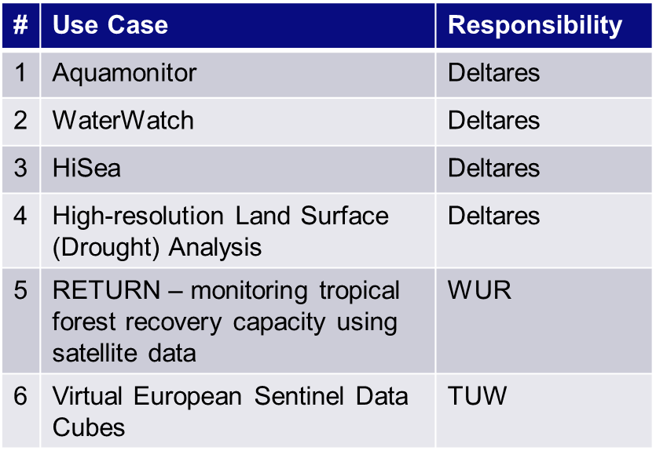
Use cases
Role:
Validate and optimise C-SCALE
Benefit for use cases:
Cloud agnostic
Independence from commercial, closed, non-EU providers
Cross- / inter-disciplinary exposure
FAIRer

Slide 8
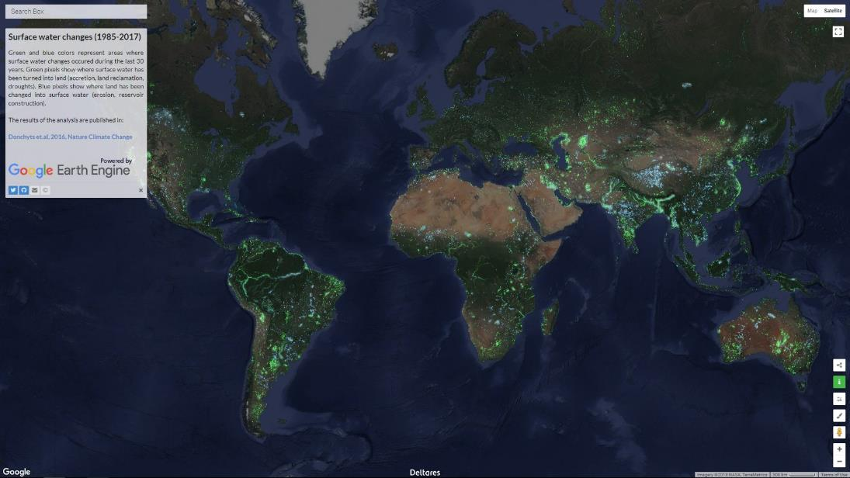
Use case #1: Aquamonitor
Objectives
Mapping of surface water changes globally
Web app to explore surface water mask and changes
Replicate functionality implemented using Google Earth Engine using EOSC infrastructure (or use hybrid approach)
https://aqua-monitor.appspot.com/

Slide 9
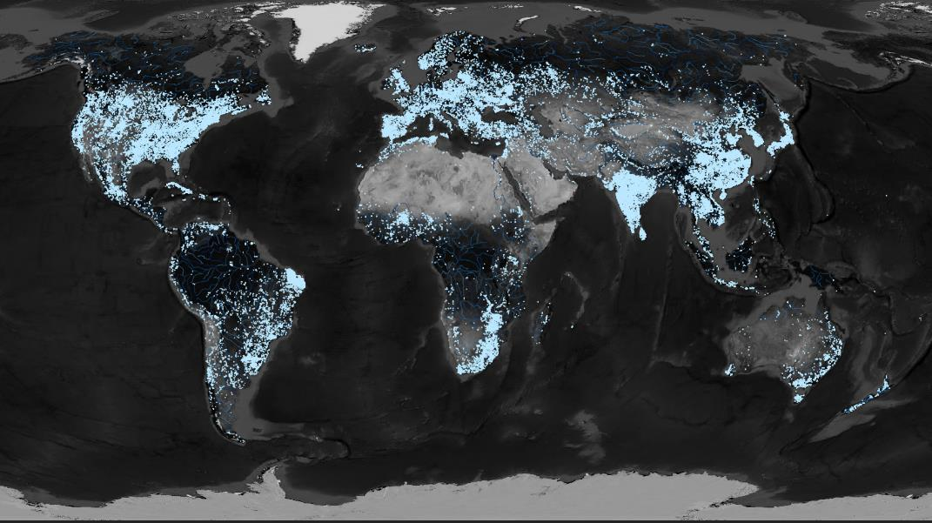
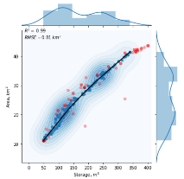
Use case #2: WaterWatch
Near-real-time updates of the availability of surface water resources foor 100k – 1M reservoirs (lakes, rivers, wetlands)
Users: water managers, agriculture, hydropower, droughts/floods, insurances

Slide 10
Use case #3: HiSea
Deliver accurate and reliable information, readily available, easily understandable and with high resolution
HiSea solution
Co-designed with users
Provides high resolution data of water quality at sea
Develops operational Copernicus-based downstream information services
Improves operation, planning and management of marine activities
HiSea Users
Targets port and the aquaculture sectors

Slide 11
Further use cases
Use case #4: High Resolution Land Surface (Drought) Analysis (HiResLSDA)
Use case #5: RETURN (Monitoring tropical forest recovery capacity using Multispectral and Radar satellite data)
Use case #6: Virtual European Sentinel Data Cubes

Slide 12
C-SCALE Virtual Access resources
Installations (short name) | Service Category | Unit of access | Units
EODC EO Storage | Storage Service | TB year | 150
EODC EO Cloud | Cloud Service | CPU year | 620
EODC HPC | HPC/HTC Service | CPU Hour | 600,000
CESNET MetaCentrumCloud - CPU | Cloud Service | CPU Month | 2,850
INFN Bari Storage | Storage Service | TB Month | 1,500
INFN Bari CPU | Cloud Service | CPU Month | 3,840
SURFsara dCache Front end Storage | Storage Service | TB Year | 154
SURFsara Spider (HTDP) storage | Storage Service | TB Year | 160
SURFsara Data Processing Compute | HPC/HTC Service | CPU Hour | 1,500,000
SURFsara MS4 Storage | Storage Service | TB Year | 10
SURFsara MS4 SSD Storage | Storage Service | TB Year | 96
SURFsara MS4 Compute | HPC/HTC Service | CPU Hour | 147,600
VITO CVB (Storage) | Storage Service | TB Month | 1,200
VITO CVB (Compute) | Cloud Service | CPU Hour | 876,000
GRNET KNS-Storage Cloud | Storage Service | TB Hour | 250,000
GRNET KNC Cloud | Cloud Service | CPU Hour | 1,650,000
GRNET ARIS-Storage HPC | Storage Service | TB Hour | 219,000
GRNET ARIS-Compute HPC | HPC/HTC Service | CPU Hour | 1,000,000
CREODIAS – Storage | Storage Service | TB Month | 2,762
CREODIAS - Compute | Cloud Service | vCore hour | 1,500,000
CREODIAS – GPU | GPU service | GPU hour | 6,000
INCD Lisbon (NCG) (Storage) | Storage Service | TB Month | 450
INCD Lisbon (NCG) (Compute) | Cloud Service | CPU Day | 4500
Total capacity of resources offered through VA:
Cloud: 1648 CPU core/year
HTC/HPC: 370 CPU core/year
Storage: 1104 TB/Year;

Slide 13
Conclusion
C-SCALE puts together EO and the e-infrastructure partners to:
Facilitate the exploitation of Copernicus data leveraging on large resources and advanced technologies from e-infras and EOSC
Make Copernicus resources easily accessible to new research areas and EOSC in general
C-SCALE will deliver a federation of EO and e-infrastructure services and resources
Create a very large distributed repository of EO data close to compute resources
EO data will be FAIR through the federation
Federation services accessible through the EOSC Portal
C-SCALE federation will be co-designed with researchers
Large amount of resources available through the Virtual Access mechanism

Slide 14
C-SCALE Contact information:
info@c-scale.eu | http://c-scale.eu/
C-SCALE Project coordinator:
Charis Chatzikyriakou, EODC, charis.chatzikyriakou@eodc.eu

