Slide 1
Guardomic – your Bot Mitigation Engine
Dissemination level: Public
Disclosing Party: Koma Nord, Idego, PSNC, Cineca
Recipient Party: Project consortium
Contact: adam.majewski@komanord.pl
Website: www.guardomic.eu

Slide 2
Parties involved in the project:
Koma Nord Sp. z o.o.
IT Integrator present on the market since 1994
Over 50 employees, each with unique skills and experience
The company is run on a principle successive, safe growth
Focused on innovation and new challenges
IDEGO
Present on the market since 2010
Custom software development company
Over 70 professionals
Ready to help clients to build and scale their products and project teams

Slide 3
Parties involved in the project:
PSNC
Internationally known node of the European Research Area in the field of IT infrastructure of science and an important R&D center
The biggest HPC center in Poland
CINECA
One of the Large Scale Facilities in Europe and a PRACE Tier-0 hosting site
Largest Italian computing centre, one of the most important worldwide

Slide 4
Guardomic - Your Bot Defense
what is Guardomic?
Crypto Web Mining
Digital Ad Fraud
Web Form Spam
Content Scraping
Incorrect Analytics
Unauthorized Access

Slide 5
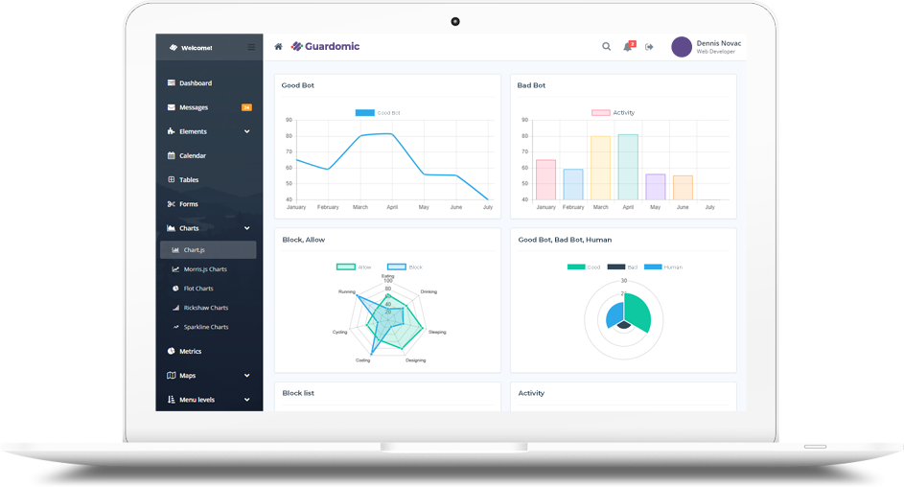
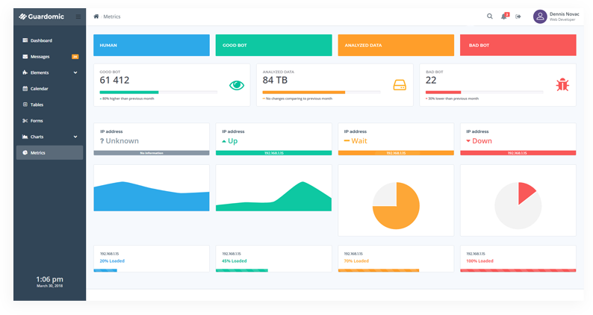
Guardomic – simple and effective
simple solution
automatic protection
without affecting user performance
improving the performance of the web server
scalability
analytics based on self-learning

Slide 6
Guardomic – the idea behind it
It came from the real needs of the market and the observation of the growth of major web-service providers like Cloudflare
The cooperation with DIH was a perfect opportunity at the right moment
The resources provided by DIH allowed us to develop the solution and implement it on safe and stable IT infrastructure

Slide 7
Guardomic – DIH integration
Consistent implementation of the solution
Two sites implementation – security and availability regardless of the customer's location
Resources used: services and infrastructure
PSNC: Openstack, 18 cores, 1670 GB RAM, 34 GB HDD, 1 IP
CINECA: Cloud BDW, 64 cores, 2000 GB RAM, 1000 GB HDD, 6 IP
Commercialisation support

Slide 8
Guardomic – impact
Cooperation in important international consortium and apparence in european research community
Knowledge of the methods and ways of operating within the european structures
Opening new areas of development for our company
Acquiring promising customers interested in our solution like SKM Szybka Kolej Miejska (mass transportation) and VERACOMP, a large nationwide IT distributor

