Slide 1
Global Open Science Cloud (GOSC) Initiative
Simon Hodson, Executive Director CODATA
21 October 2021
‘Update from the Global Commons’
Virtual SciDataCon 2021

Slide 2
CODATA’s mission and operation
The mission of CODATA is to “Connect data and people to advance science and improve our world”.
As the ‘Committee on Data of the International Science Council (ISC)’, CODATA supports the ISC’s mission of ‘advancing science as a global public good’ by promoting Open Science and FAIR data. CODATA convenes a global expert community and provides a forum for international consensus building and agreements around a range of data science and data policy issues, from the fundamental physical constants to cross-domain data specifications.
CODATA’s membership includes national data committees, scientific academies, International Scientific Unions and other organisations.

Slide 3
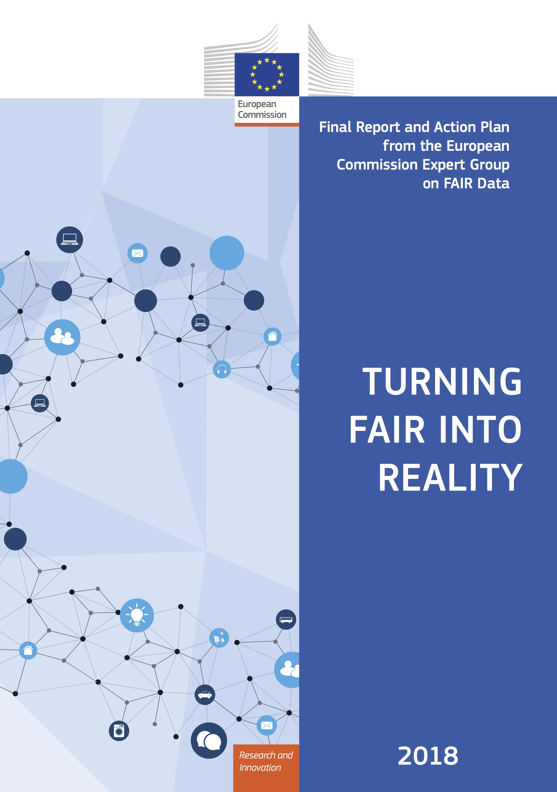
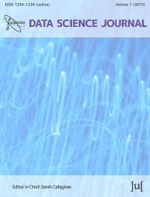
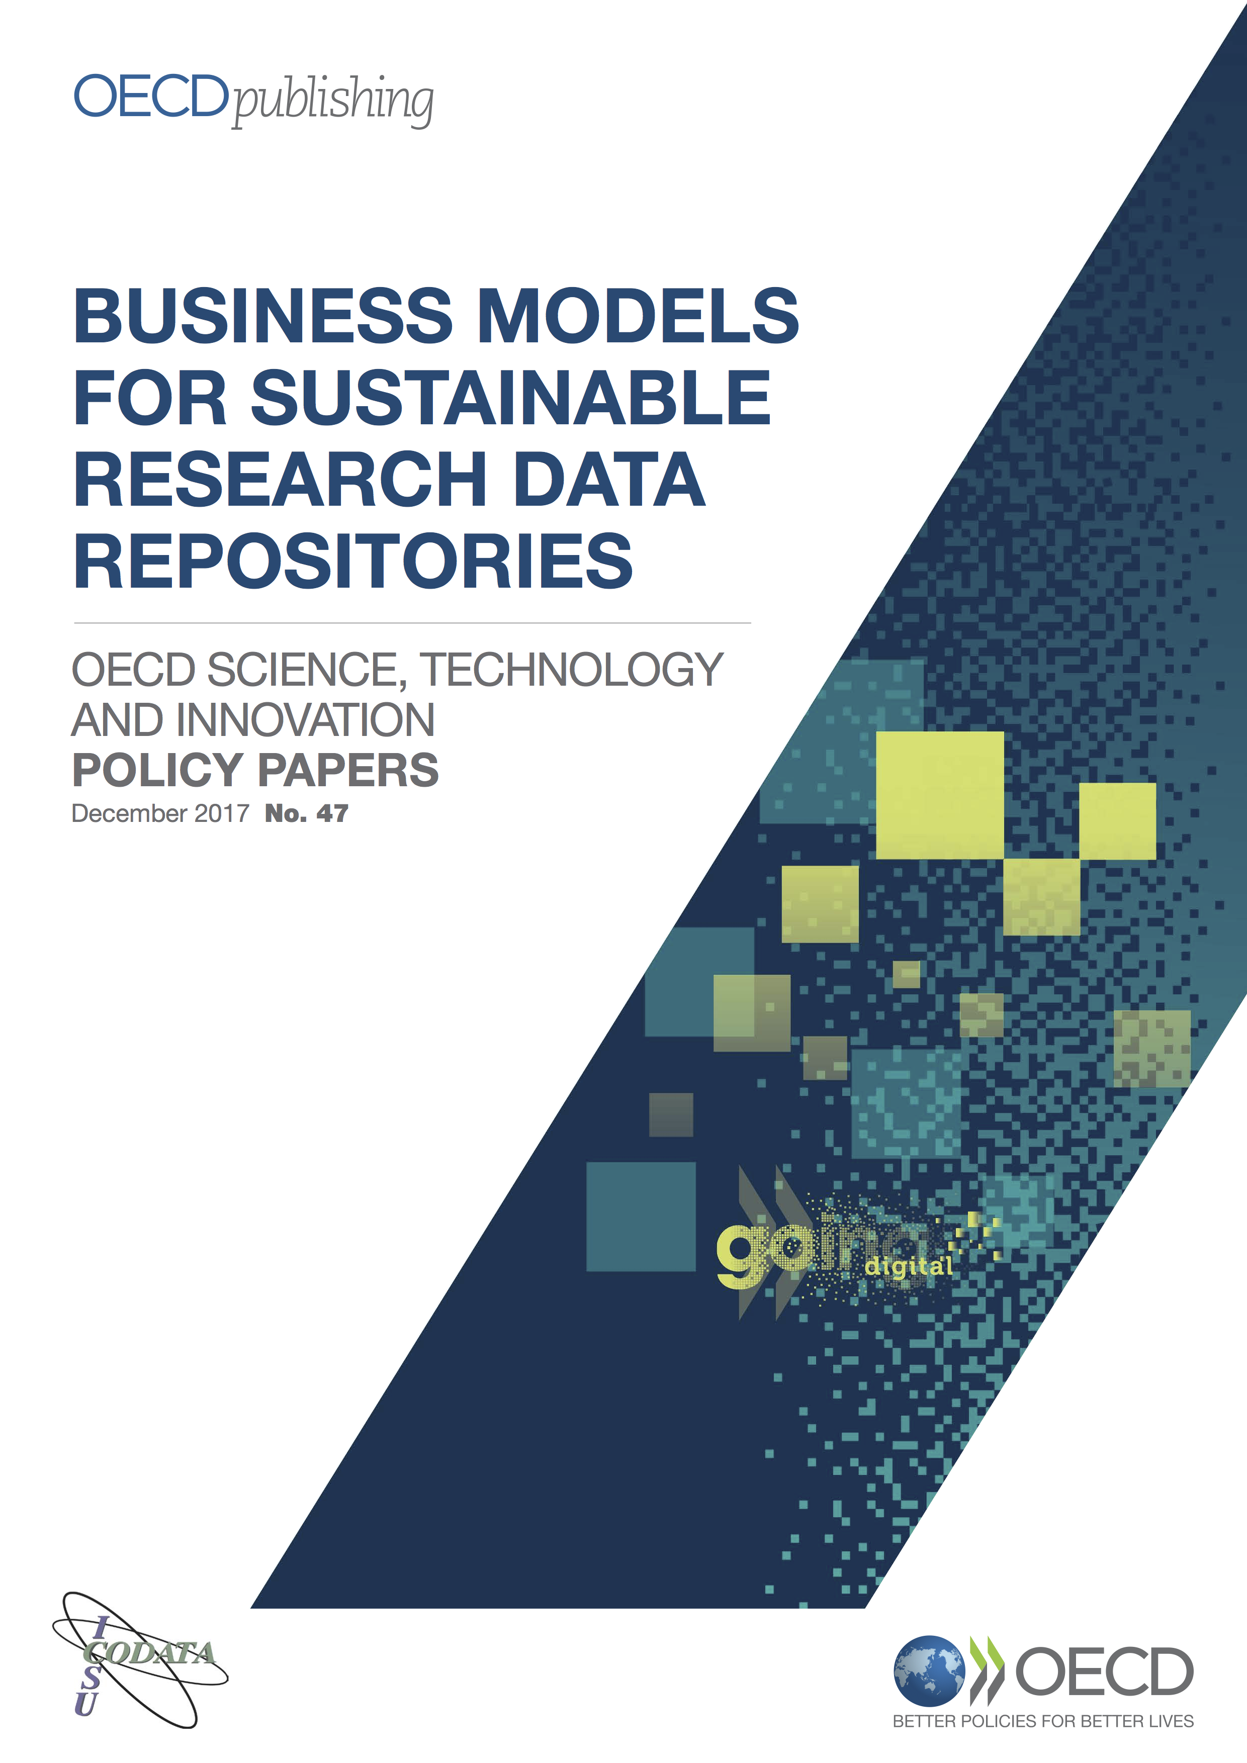
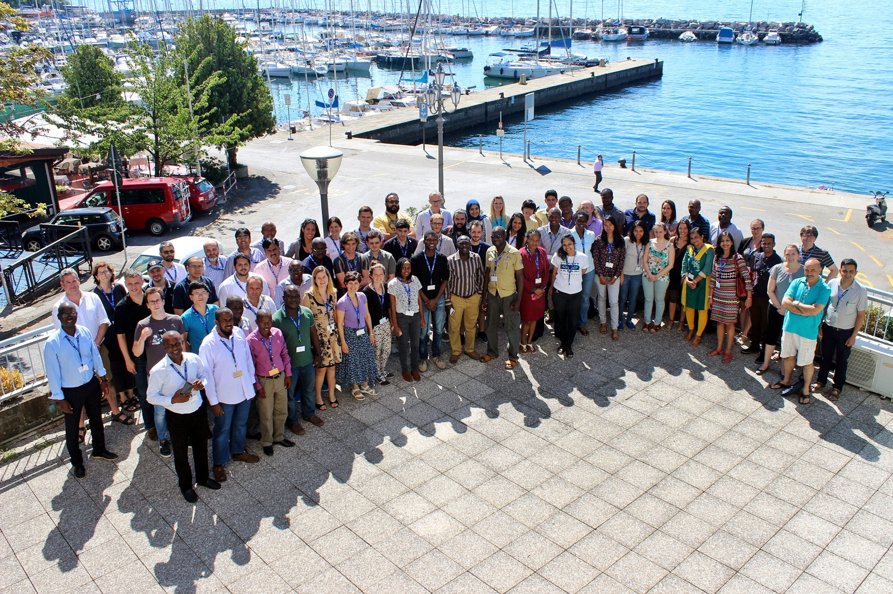
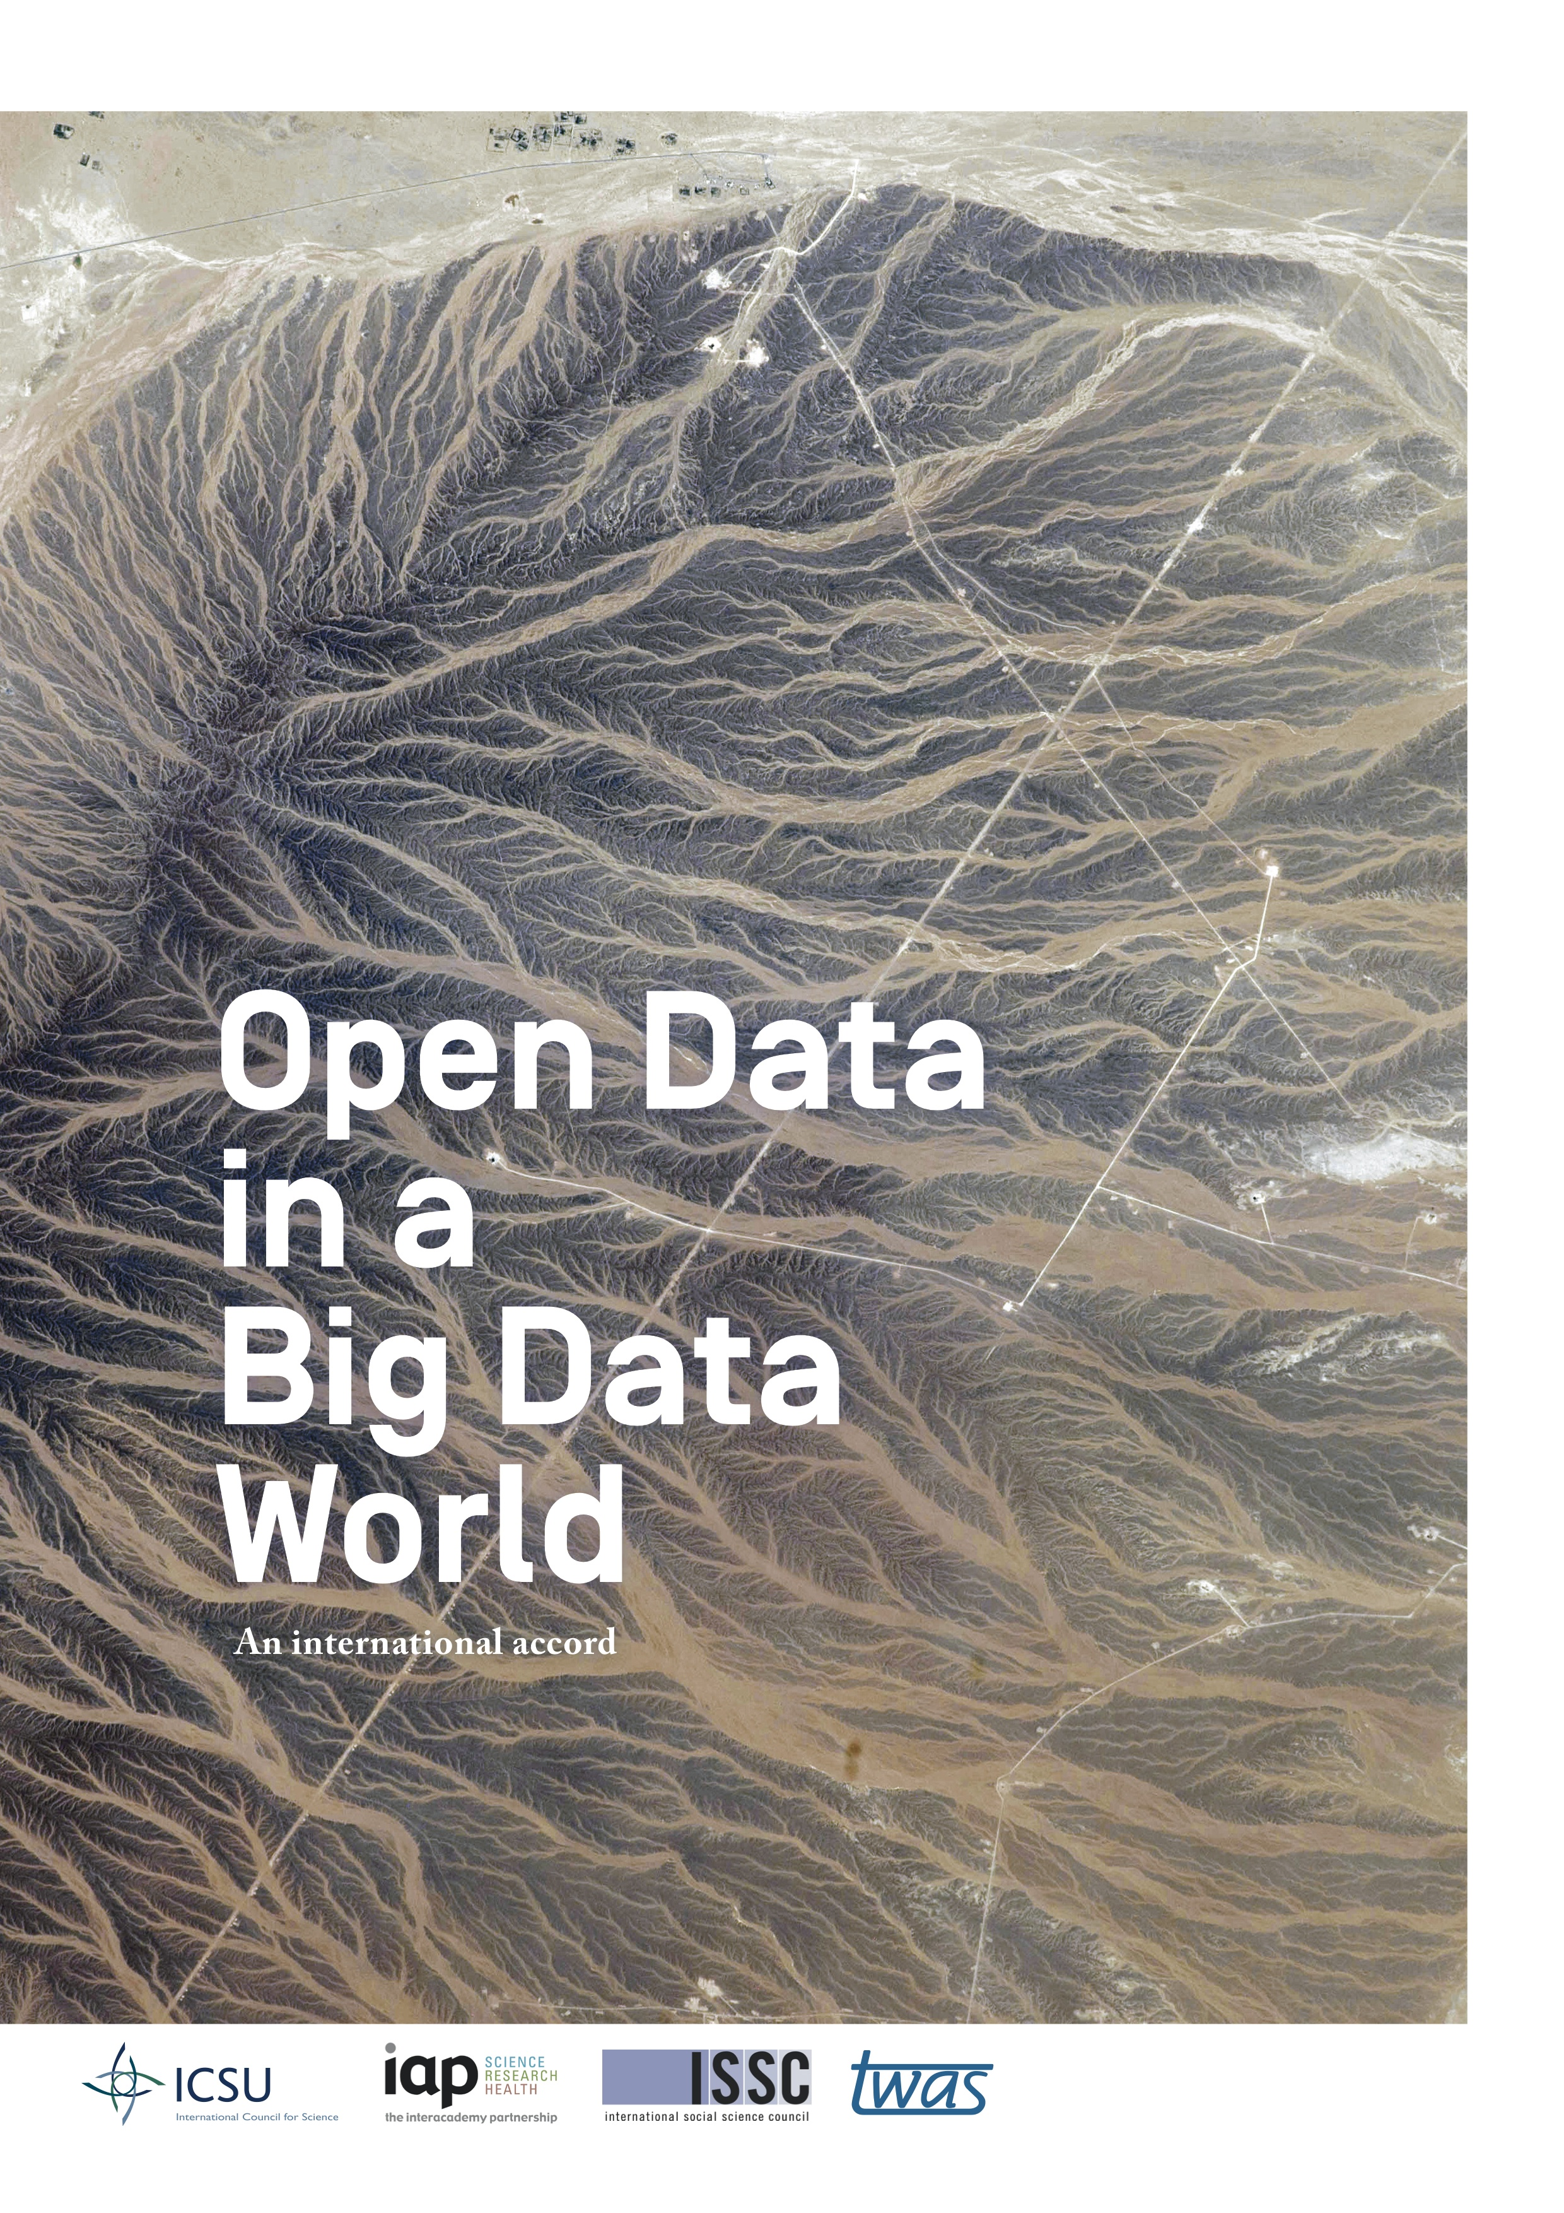
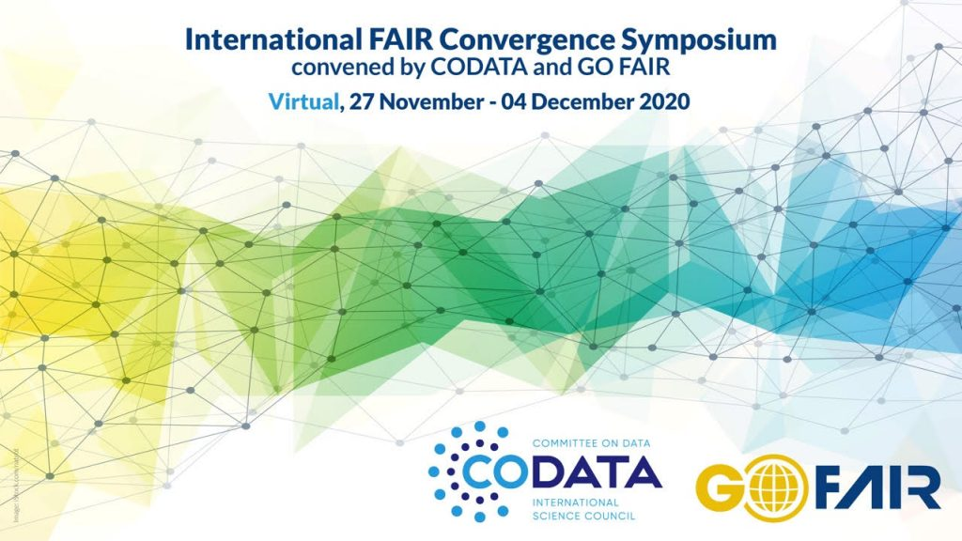
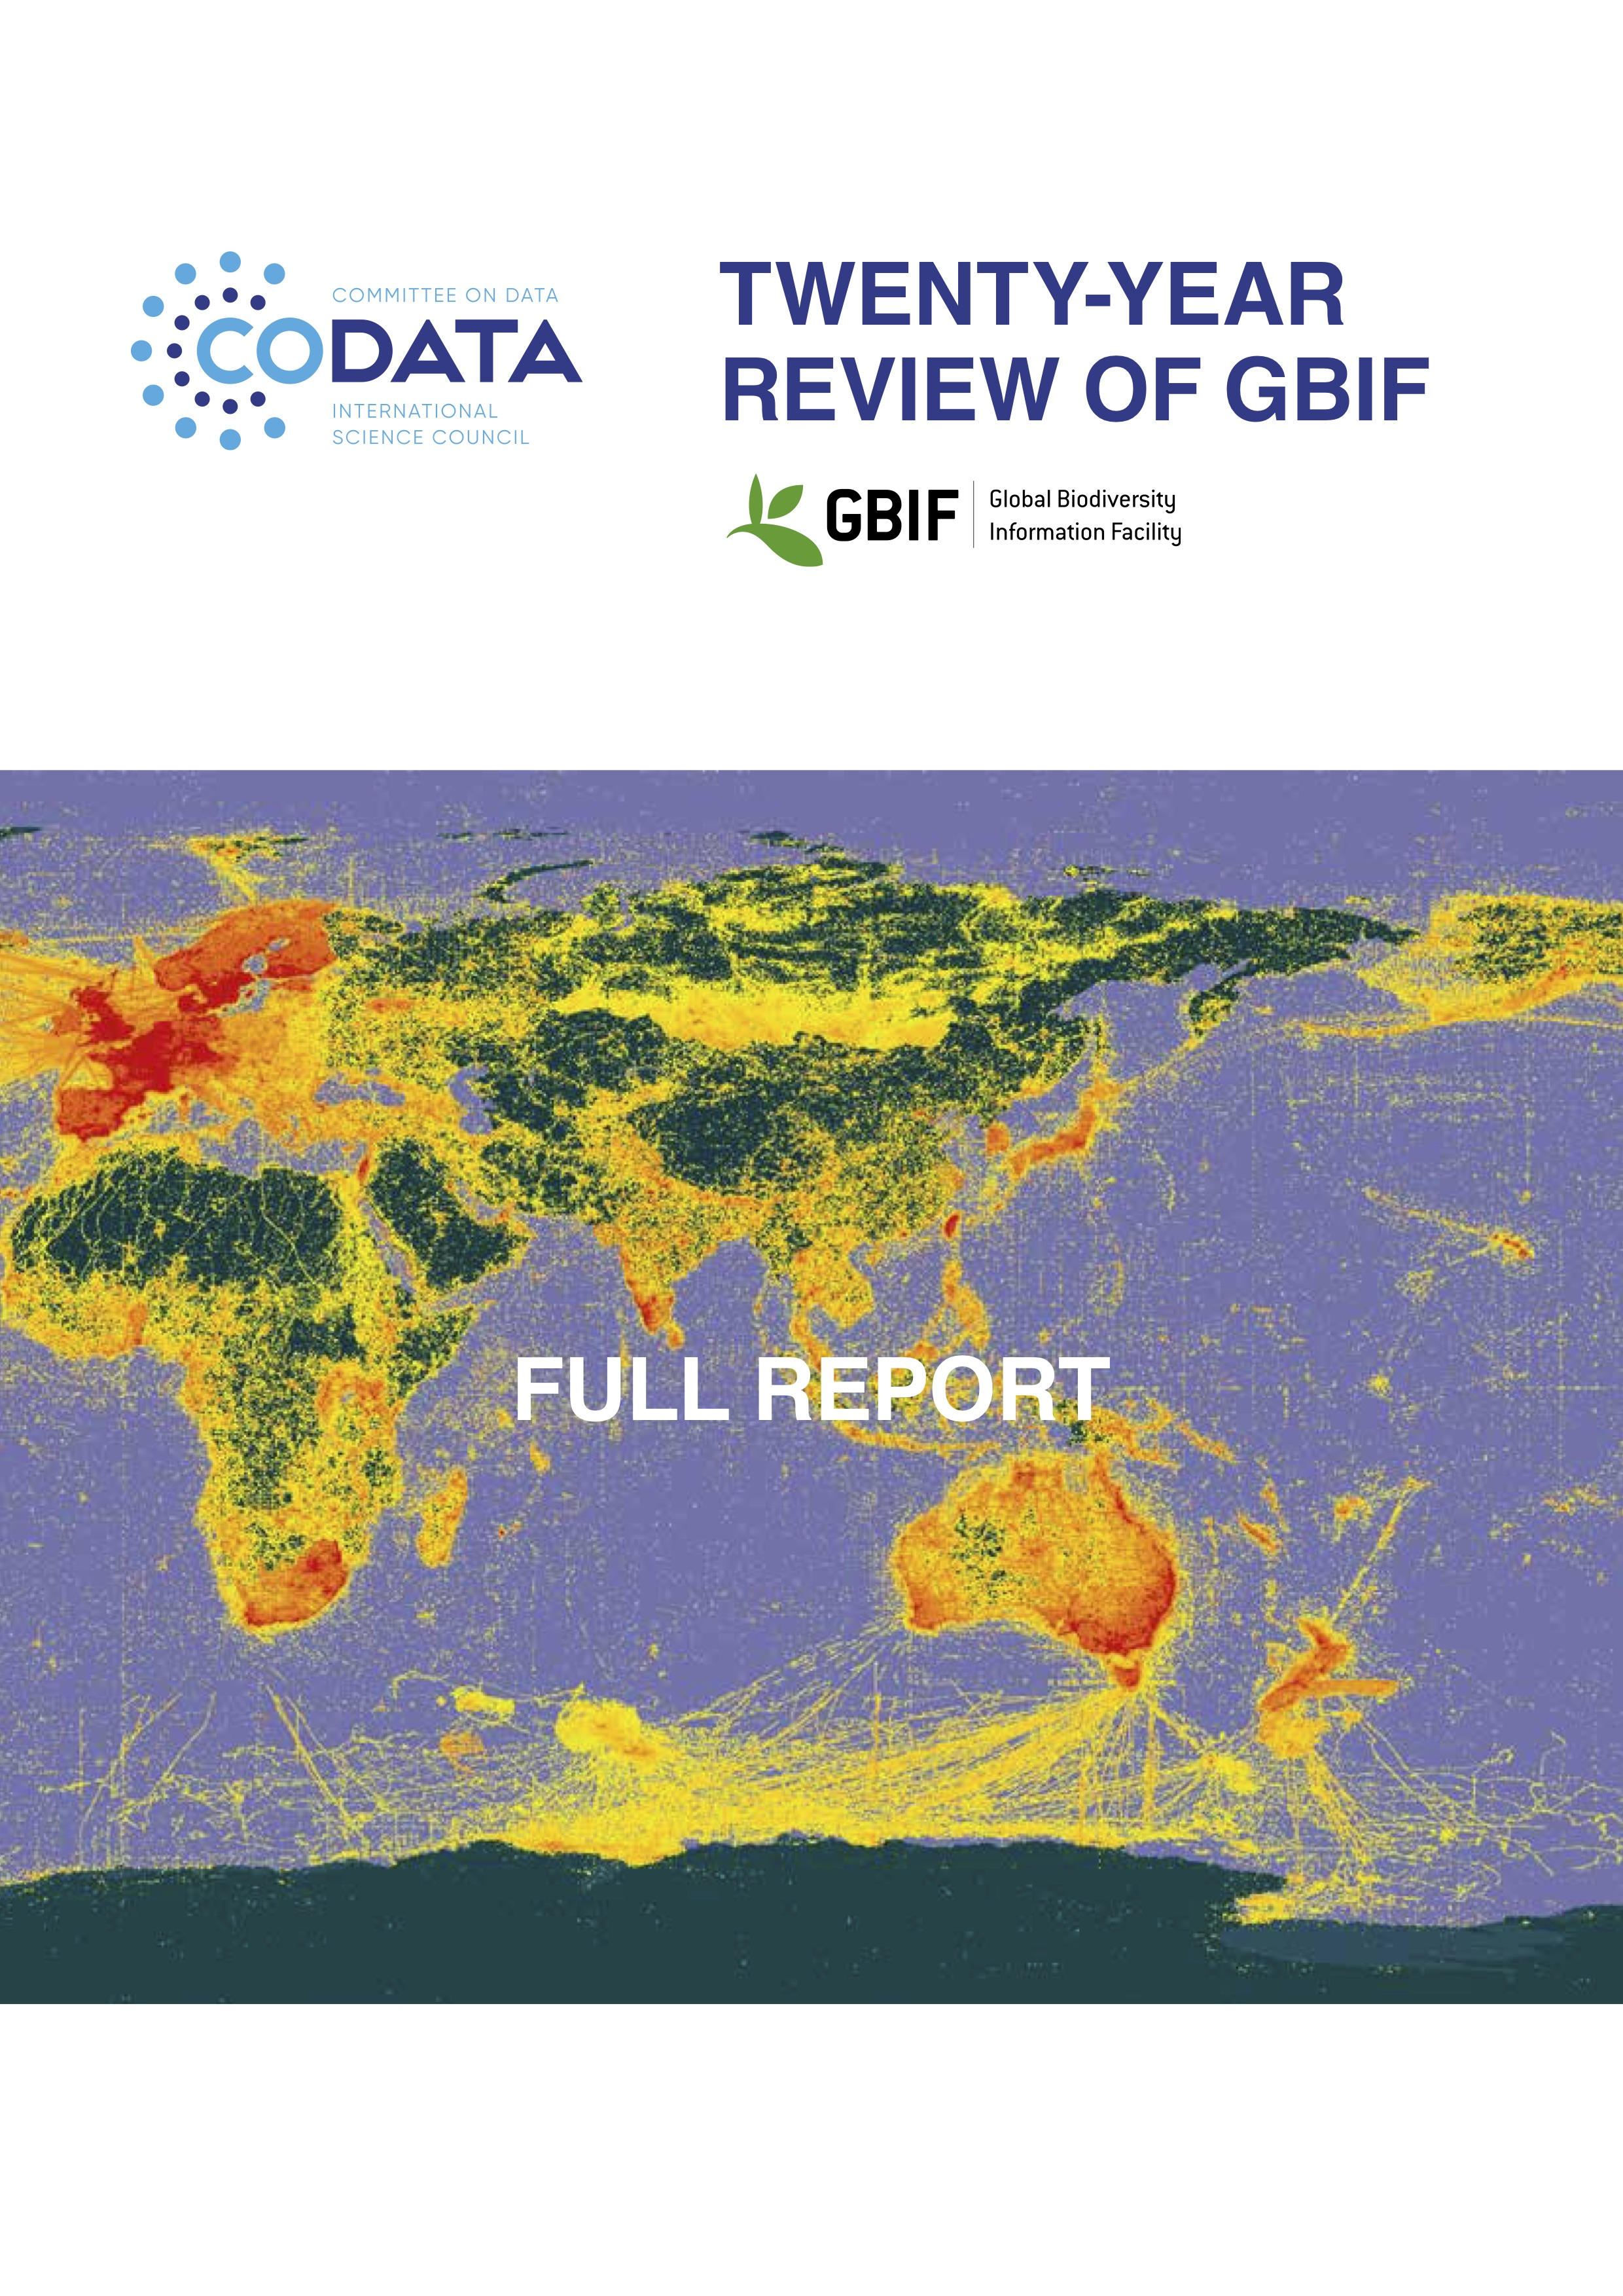
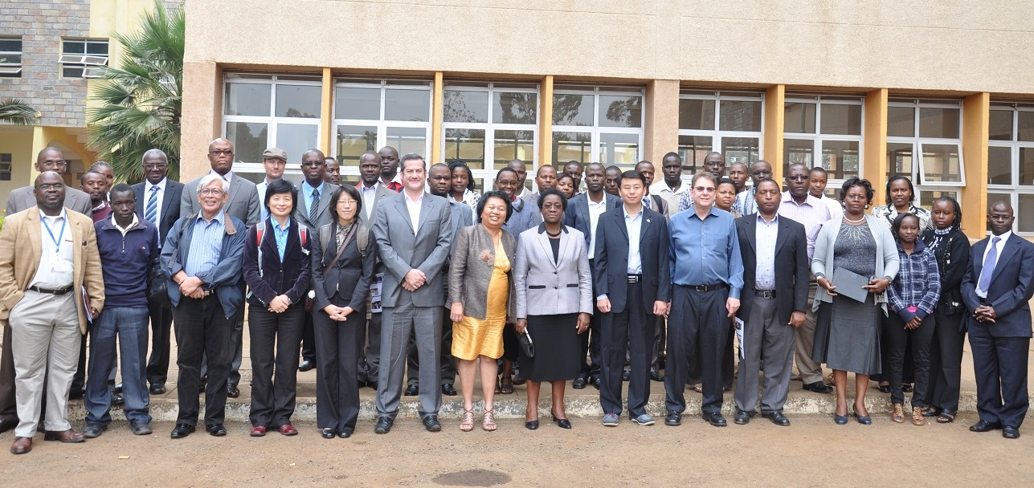
Data Policies
Data Science
Data Skills
Making Data Work…
Decadal Programme: Making Data Work for Cross Domain Grand Challenges
Promoting Good Data Practices
Interoperability and reusability within domains and across domains
Regional Open Science Platforms
CODATA Data Policy Committee http://bit.ly/data-policy-committee;
One major policy report per year.
20-Year Review of GBIF published in May 2020
Preparing Independent Review of CAS Earth data policy and practices
CODATA-RDA School of Research Data Science.
CODATA China, PASTD and other training activities.
#terms4FAIRskills and FAIRsFAIR Competence Centres.
Data Science Journal: https://datascience.codata.org/
International Data Week and CODATA Conference series.
Task Groups and Working Groups.

Slide 4
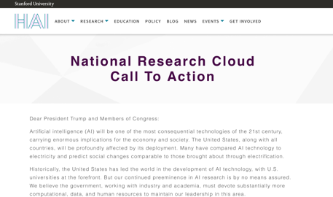
Global Open Science Cloud Initiative
A number of Open Science/Research Clouds/Platforms/Commons emerging globally.
Domain research infrastructures (WDCs, international and national domain data services and RIs, ESFRI process in Europe, Chinese data centres etc, Australian NCRIS… etc)
Open Science eInfrastructures (NRENs and eInfrastructures.
OSCs: infrastructures aligning vertically (full-stack) and across all domains.
Economies of scale, greater impact, greater interoperability, advancing and supporting Open Science
EOSC, CSTCloud, ARDC, NDRIO, MOSP, LA Referencia/Red Clara, AOSP…

Slide 5
ISC, UNESCO and CODATA
International Science Council Action Plan, 4.4: encourages the creation of national or regional Open Science platforms in the Global South, in order ‘to position scientists and science systems in the Global South at the cutting edge of data-intensive open science’: https://council.science/actionplan/open-science/
Includes ISC and CODATA engagement with the AOSP, MOSP; support for GOSC; and ISC and CODATA support for the UNESCO Recommendation.
African Open Science Platform: Pilot Project 2017-2019.
Strategy and Vision https://doi.org/10.5281/zenodo.2222418
2021, Executive Director appointed and Programme Office being established.
UNESCO Recommendation on Open Science: will be approved in November 2021.
Recommends: ‘North-South, North-South-South and South-South collaborations to optimize infrastructure use and joint strategies for shared, multinational, regional and national open science platforms, including through the promotion of research collaborations, sharing of open science infrastructures, technical assistance, transfer and coproduction of technology related to open science and exchange of good practices under mutually agreed terms’ (iii.g)
https://en.unesco.org/science-sustainable-future/open-science/recommendation

Slide 6
Global Open Science Cloud Initiative
The Global Open Science Cloud (GOSC) initiative will encourage cooperation, alignment, and ultimately interoperability, between existing and emerging Open Science Clouds (OSCs).
GOSC aims to do this through a combination of thematic Working Groups (building on existing experiences and addressing key areas of shared interest), and a set of detailed Case Studies that will demonstrate how international collaborative research communities and projects can be supported by Open Science Clouds.
CODATA providing coordination and secretariat support and partnerships to expand the initiative, efforts to obtain funding and contributions from other partners to achieve greater impact.
CNIC CAS Funded Project, providing secretariat support, project resource and (subject to agreement) an International Programme Office to support and extend the initiative.

Slide 7
Global Open Science Cloud (GOSC) Working Groups
Thematic Working Groups and Domain Case Studies
Mechanisms for encouraging communication, sharing of information, cooperation and ultimately alignment and interoperability (where needed).
Regular interactions between the WGs and Case Studies (propose quarterly AHMs).
Four initial WGs, exploring key topics of shared concern:
Strategy, governance and sustainability.
Policy and legal.
Technical infrastructure.
Data interoperability.
Case Studies
Working Groups
Steering Group

Slide 8
Global Open Science Cloud (GOSC) Case Studies
Five initial Case Studies, exploring key topics of shared concern:
Incoherent scatter radar data fusion and computation
Biodiversity and ecology information platform
SDG-13 climate change and natural disasters
Sensitive data federation analysis model in population health
Open reproducible raw diffraction data for access in pandemics (new)
Case Studies
Working Groups
Steering Group

Slide 9
Possible GOSC Working Group Activities
Understanding the landscape: information sharing, what are the various OSC initiatives doing in this space?
Identifying the challenges: what are the major issues and challenges from the perspectives of the various OSCs? Identify shared and different perspectives.
Output: Landscape report and presentation of challenges to be addressed?
Ideate possible solutions: Discuss and brainstorm possible solutions and outputs.
Test and refine solutions: Workshops, feedback on draft documents, recommendations.
Output: Recommendations to encourage cooperation and alignment?

Slide 10
Suggested GOSC Working Group Timeline
From 28 June 2021: WGs and Case Studies formed, co-chairs identified
From 2 Sept 2021, Co-Chairs Meeting: prepare WG and Case Study work plans.
22 Oct 2021: EGI Conference (fully virtual), WGs and Case Studies (where on appropriate topics) communicate activities to global e-Infrastructure community.
27 Oct 2021: GOSC Workshops as part of fully virtual SciDataCon 2021. WGs and Case Studies discuss their workplans: mission, objectives, planned outputs…
June 2022: GOSC Workshops as part of International Data Week 2022, Seoul, Republic of Korea. WGs and CSs report on progress and outputs.
Oct 2022: GOSC Workshops as part of 2nd FAIR Convergence Symposium, Leiden, Netherlands. WGs and CSs report on progress and outputs.
April 2022?: International Symposium on Open Science Cloud, Beijing, China (TBC). WGs and CSs report on progress and outputs.
Oct 2023: WG report on final outputs as part of International Data Week, Salzburg, Austria. WGs and CSs renewed, redirected or retired.

Slide 11
Key GOSC Information
GOSC Overview: https://bit.ly/GOSC-Overview
GOSC Introduction and Launch Event: https://bit.ly/GOSC-Intro-Launch
Includes presentations, recording, links to useful documents.
Join GOSC WGs, Case Studies: https://bit.ly/3jwZHNg
Propose New Case Studies: https://bit.ly/GOSC-Propose-New-Case-Study

Slide 12
Thank you for your attention Simon Hodson, CODATA www.codata.org simon@codata.org @simonhodson99 ; @CODATAnews

Slide 13
Strategy, Governance and Sustainability
OSCs have shared challenges of governance, funding, sustainability, rules of participation, inclusivity, making their value proposition, and engagement with researchers and existing research infrastructures and other e-infrastructures.
Exchange of information and experience.
Identify topics to explore in more detail.
Possible initial questions:
What are the governance and accountability structures?
What are the mechanisms for funding core OSC infrastructures?
How does the OSC present its value proposition in order to sustain operations?
What are the rules of engagement for public and private institutions?
Initial contacts: Yu CHEN, CNIC, cy@cnic.cn; Hana Pergl, CODATA, hana@codata.org

Slide 14
Policy and Legal
Building on many international policy and legal statements.
Interest among OSCs to share experiences in policy development, legal issues.
Potentially also to seek alignment of their policies, and even legal frameworks.
Exchange of information and experience.
Identify topics to explore in more detail.
Possible initial questions:
What are the key policy instruments adopted by the OSCs?
To what extent do these align and do they map well to major international statements of principle or policy?
Are there any areas of policy misalignment that could hamper cooperation among OSCs and projects supported by OSCs?
What are the most significant issues of legal interoperability to be addressed?
Initial contacts: Mark Leggott, CODATA Data Policy Committee, RDA Council, NDRIO mark.leggott@rdc-drc.ca; Lili ZHANG, CNIC, zhll@cnic.cn; Paul Uhlir, Consultant, pfuhlir@gmail.com

Slide 15
Technical Infrastructure
Open Science Clouds necessarily build on existing global e-infrastructures, including provision of high-speed academic networks, high performance computing, cloud computing, and so on.
Build on existing collaborations between these e-infrastructures.
Identify topics to explore in more detail.
Possible initial topics:
Network connectivity and protocols
Secure Authentication and Authorization Infrastructure (AAI)
Mechanisms for federation of computing and other services
Many others!
Initial co-chairs: LI Jianhui, CNIC, lijh@cnic.cn; Mark Dietrich, EGI, mark.dietrich@egi.eu
Initial contact: Yin CHEN, EGI, yin.chen@egi.eu

Slide 16
Data Interoperability
Among the objectives of OSC initiatives is to provide infrastructure to support interoperability within and across domains.
Building on existing RIs and supporting new cross-domain research areas.
Exchange of information and experience.
Identify topics to explore in more detail.
Possible initial topics:
The emerging FAIR Digital Object Framework
The use of structural and provenance metadata to facilitate machine-actionability across data
The alignment and development of good FAIR practice for semantic artefacts (including scientific vocabularies)
The need for systematic approaches that ensure reusability of cross-walks etc.
Initial contacts: Simon Hodson, CODATA, simon@codata.org; Lianglin HU, CNIC, hull@cnic.cn

