Slide 1
GOSC Initiative Policy and Legal WG
Presented by Dr. ZHANG Lili (CNIC,CAS)
On behalf of the CODATA GOSC Policy and Legal WG
22 Oct. 2021

Slide 2
GOSC challenges
Governance for global research resources
Global Research collaboration
Open science applications, open access, open collaboration,
UN SDGs，Big Science Programs, research collaborations.
Alliance for security, trusts and sustainability
Open science infrastructures should be federated, accessible, internationally interconnected, interoperable (UNESCO, 2021).
“The Global Open Science Cloud is a robust network of trusted research e-infrastructures among which different research resources are bridged and all stakeholders are connected for innovative science discovery in the evolving global open science environment.” (CODATA GOSC SG, 2021)
Possible policy issues
Resources layer
Services layer
Community layer
OSCs Overalls: trusts and interoperability
Applications
Social community for open research resources
SAAS level services and tools for different research resources, such as open access to journals
Soft.&T.
Global open data fabric
Data
Comp.
Cloud federation
Computing, storage and analysis.
Network
Global research & education network
CSTNET，CERNET，ESnet,，Internet2，
GÉANT，AARNet，RedCLARA，SANReN
https://www.cstcloud.net/gosc.htm

Slide 3
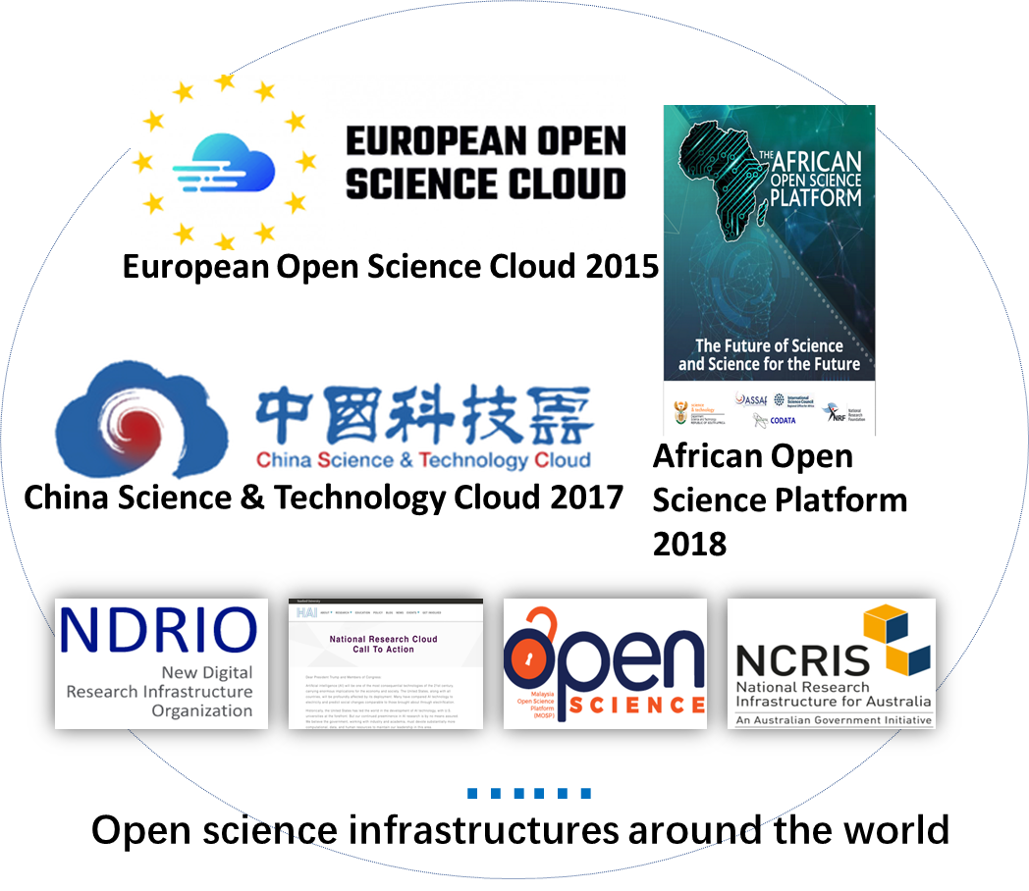
Mission & Approach
Steps by steps
Towards GOSC policy and legal co-development
Mission
To seek alignment of OSC policies;
To explore possible interoperability solutions between legal frameworks;
And get them implemented in the selected case studies.
OSCs review
Identify priorities & potentials
Gap analysis
Guidance CBC
Show case validation
General guidance
Partnership
Comm. Out.
Notes:
Solutions by WG & CS

Slide 4
To explore comprehensive policy gaps and solutions to facilitate the development and demonstration among different activities within the Global Open Science Cloud (GOSC) initiative.
OBJECTIVES
DELIVERABLES
Guiding principles to enable research facilities to collaborate and support data, services and resources to flow efficiently.
Policy framework based on the agreed principles for international alignment and mappings / crosswalks between policies that focuses on the GOSC testbed and case studies.
Interoperability assumptions that specify key standards or requirements in policy (in collaboration with other WGs).
Policy validation and adjustment in selected case studies.
Social network and community outreach co-building a trusted and inclusive environment for open science policy implementation.
Essential policy vocabulary and a list of prioritized policy issues;
Guiding principles facilitating collaboration on open science clouds;
Policy framework for international alignment;
Community outreach.

Slide 5
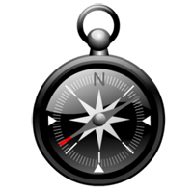
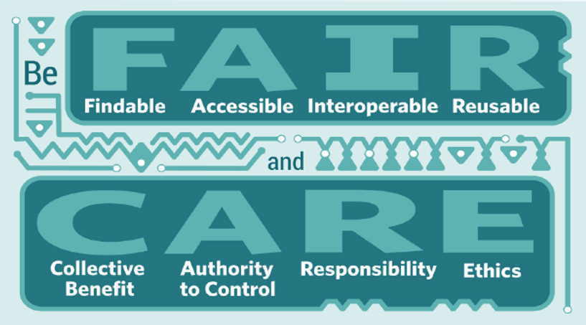
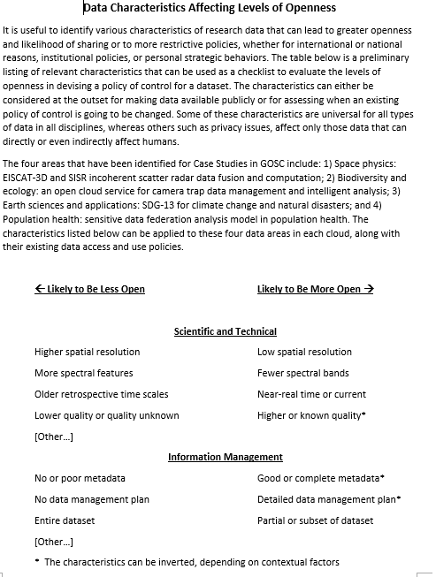
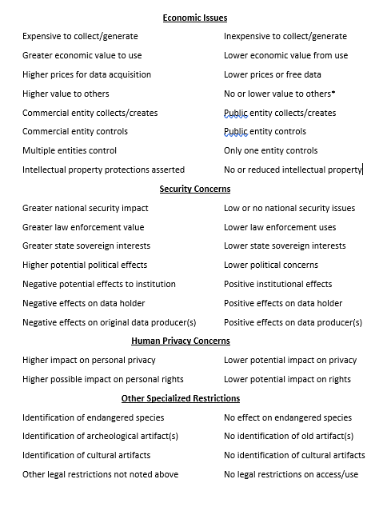
TASKS
Light-weight terminology review and summary
Develop guiding principles
Provide guidelines and a checklist
Engagement with case studies/WGs
https://www.amazon.com/Its-Christmas-David-Shannon/dp/054514311X
https://www.rd-alliance.org/trust-principles-rda-community-effort
https://www.gida-global.org/care
Carroll, S.R., Garba, I., Figueroa-Rodríguez, O.L., Holbrook, J., Lovett, R., Materechera, S., Parsons, M., Raseroka, K., Rodriguez-Lonebear, D., Rowe, R., Sara, R., Walker, J.D., Anderson, J. and Hudson, M., 2020. The CARE Principles for Indigenous Data Governance. Data Science Journal, 19(1), p.43. DOI: http://doi.org/10.5334/dsj-2020-043
Wilkinson, M., Dumontier, M., Aalbersberg, I. et al. The FAIR Guiding Principles for scientific data management and stewardship. Sci Data 3, 160018 (2016). https://doi.org/10.1038/sdata.2016.18
Lin, D., Crabtree, J., Dillo, I. et al. The TRUST Principles for digital repositories. Sci Data 7, 144 (2020). https://doi.org/10.1038/s41597-020-0486-7

Slide 6
Acknowledgement
CODATA, CNIC,CAS, and the GOSC Initiative Policy and Legal WG members
Co-chairs: Mark Leggott, Sarah Jones, Michelle Barker, Lili Zhang
37 members (updated by Sep.14)
1st member meeting (Nov.9/10, TBC)
Sign up to join us at:
https://codata.org/initiatives/decadal-programme2/global-open-science-cloud/sign-up-for-gosc-groups-and-studies/

Slide 7
Upcoming events
Co-chairs meeting/ Monthly member meeting
SciDataCon GOSC WG/CS (Oct. 27)
International Data Week 2022, 20 - 23 June 2022. Hybrid, online and in Seoul.
First International Symposium on Open Science Clouds, （2022, TBC).
FDO Conference and the FAIR Convergence Symposium, 24 - 28 October, 2022 (exact days TBC). Leiden.

Slide 8
Thanks for your attention！

