Slide 1
GOSC Initiative SDG-13 Case Study
Presented by Dr. ZHANG Lili (CNIC,CAS)
On Behalf of the SDG-13 CS
22 Oct. 2021

Slide 2
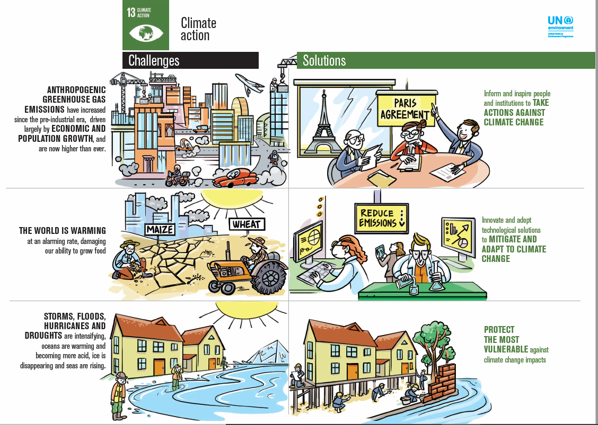
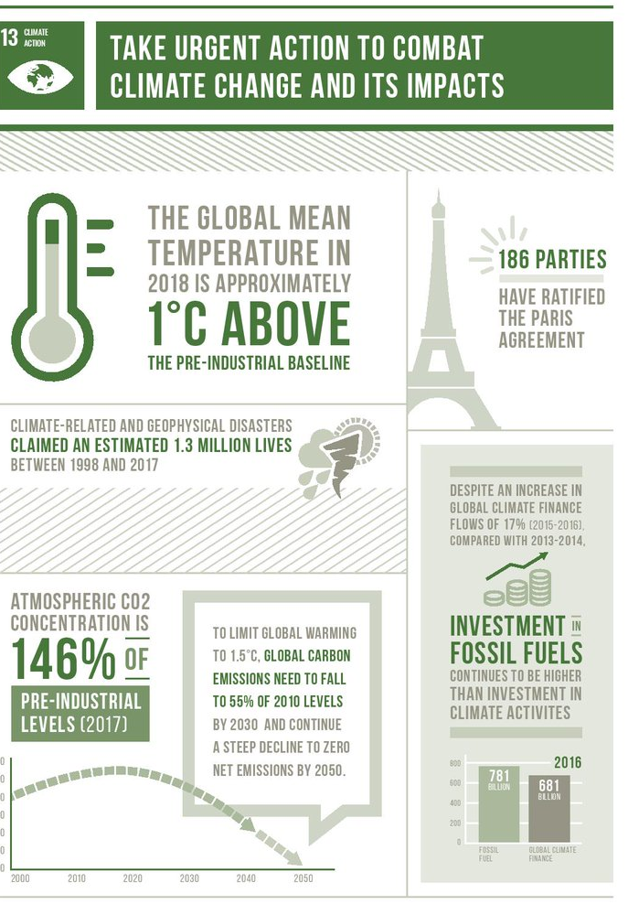
About the story
SDG-13 research challenges to tackle:
Data scale
Data quality - high precision& real-time
Distributed platforms with cloud services on demand
International alignment and effective ways to support decision making in disaster mitigation and long-term/short-term climate prediction.
UN Environmental Program
World Meteorological Organization
https://www.unep.org/es/node/2031
https://public.wmo.int/en/media/news/climate-action-central-sustainable-development-goals
Notes:
https://ec.europa.eu/eurostat/statistics-explained/index.php?title=SDG_13_-_Climate_action&oldid=439560

Slide 3
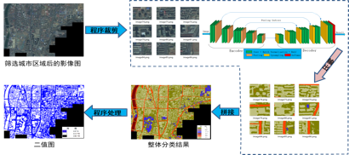
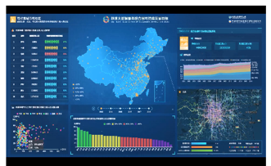
The landscape
SDG-13 for climate change and natural disasters
This Case Study concentrates on the UN Sustainable Development Goal, SDG-13, with focuses on climate change and natural disasters, especially temporal and spatial patterns of climate change; collection and sharing of research data on extreme climates and disasters; short-term forecasting and seasonal prediction of climate disasters, and monitoring and assessment of natural disasters.
We seek other SDG-13, climate change and disaster risk reduction related initiatives to join us.
Explore distributed research resources
Research & Decision making
Sharing of data and algorithm

Slide 4
Objective & deliverables
Objective
To study the large-scale patterns and heterogeneity of climate change and natural disasters, such as fire, drought, flooding, supported by the GOSC testbed;
To explore the causes and frequency of regional extreme climate and related natural disasters, providing science-based support for disaster mitigation.
To validate the maturity of cloud federation techniques provided by the GOSC testbed.
Deliverables
Metadata and database federation
Collaborative data computing and processing toolkits and a resources-centric platform
Exploration of cloud federation techniques supporting on-demand data processing and analysis for SDG-13.

Slide 5
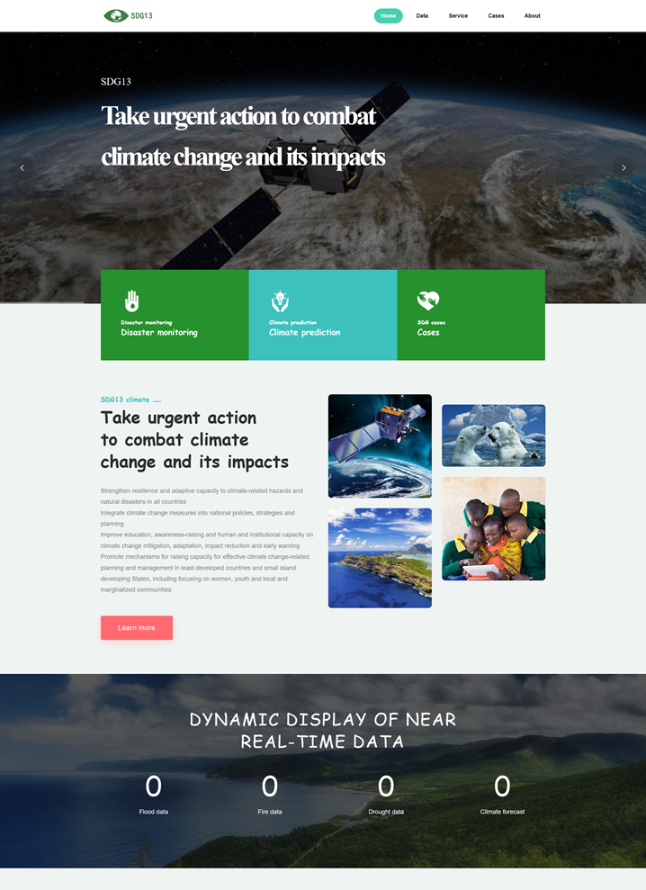
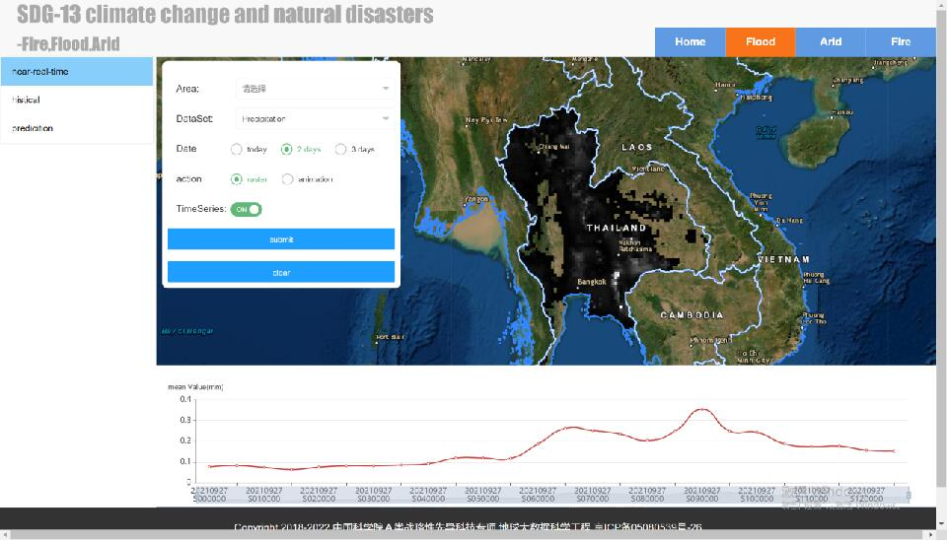
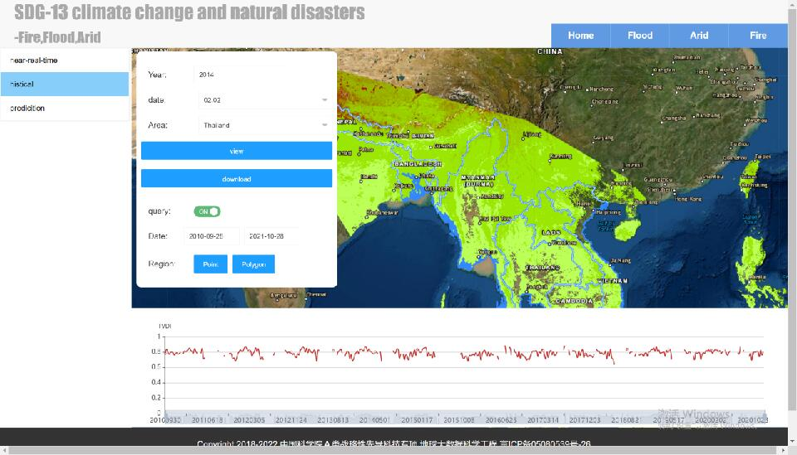
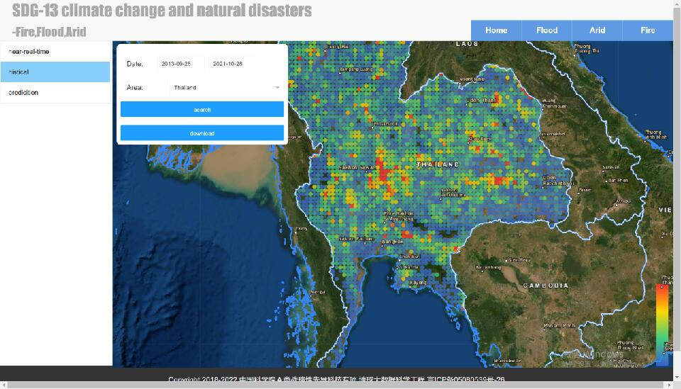
Key issues
Technical interoperability
Openness and connectivity between platforms/ systems/ research environments for cloud services.
Robust and sustained supports for research and decision making within institutional, regional, national and international scope.
SDG-13 Data and policy interoperability
Data may be collected from different sources (regions, themes, types, models, algorithms) .
Decision making calls for large-scale of data fusion.

Slide 6
Tasks
Establish (an) integrated professional database(s) of climate change, extreme climate, and natural disasters that demonstrates the feasibility of developing and using data focused on this area of research supported by the GOSC testbed;
Develop a dynamic monitoring and risk assessment model system in a GOSC context;
Achieve high-precision comprehensive assessment and seasonal prediction on the temporal changes and spatial patterns of extreme climate events and natural disasters in a GOSC platform;
Make international alignment with potential partners;
Monthly work meetings, regular science communication, training and other social activities for better impacts.

Slide 7
Schedule
2021.7-2022.3, Southeast Asian natural disaster screening and climate prediction platform demo.
2022.4-2022.9, detailed plan for international alignment for policy/data/technical interoperability.
2022.10-2023.3, Southeast Asian natural disaster screening and climate prediction platform v1.0
2023.4-2023.9
natural disaster screening and climate prediction platform v2.0
international alignment, with a specific focus on the Global South, in Africa as well as in other geographical areas.

Slide 8
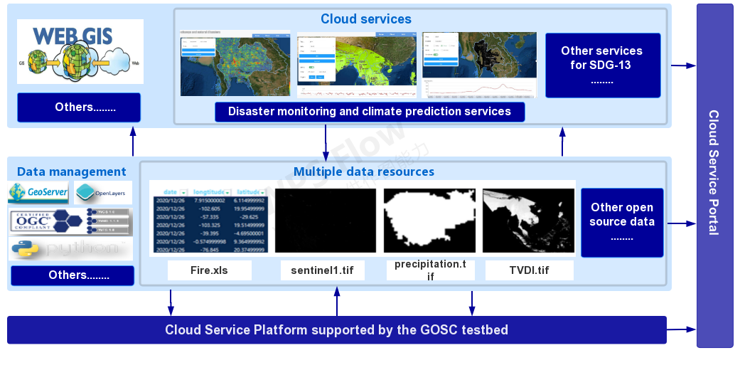
Preliminary Work
The Southeast Asian case in progress

Slide 9
Next steps
Further events
SciDataCon GOSC WG/CS (Oct. 27)
International Data Week 2022, 20 - 23 June 2022. Hybrid, online and in Seoul.
FDO Conference and the FAIR Convergence Symposium, 24 - 28 October, 2022 (exact days TBC). Leiden.
First International Symposium on Open Science Clouds, （2022, TBC).
Call for international alignment and community outreach
Sign up for SDG13 CS!
https://codata.org/initiatives/decadal-programme2/global-open-science-cloud/sign-up-for-gosc-groups-and-studies/

Slide 10
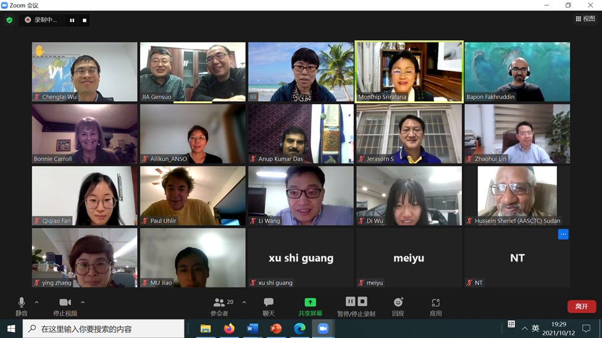
Acknowledgement
CODATA,CNIC,CAS, and the GOSC Initiative SDG-13 CS
Co-chairs: Prof JIA Gensuo, Monthip Sriratana and Bapon Fakhruddin
36 members (updated by Sep.1)
Welcome for more international alignment!

Slide 11
Thanks for your attention！

