Slide 1
Using MATLAB on EGI for Open Science
Shubo Chakrabarti & Yona Baskharoun
shuboc@mathworks.com, ybaskhar@mathworks.com
MathWorks

Slide 2
NEW! You can now Use MATLAB on the EGI!
There are two ways to use MATLAB on the EGI
Notebooks with MATLAB
Parallel Computing with MATLAB
Notes:
Here is the agenda for today
The brand new announcement : You can now use MATLAB on the EGI. There are 2 ways to do this
First, you can analyze cloud data directly via the browser using MATLAB on EGI notebooks and share your code with your community
Second, if you are looking to use parallel computing with MATLAB, HPC centers that are members of the EGI Council can now host MATLAB

Slide 3
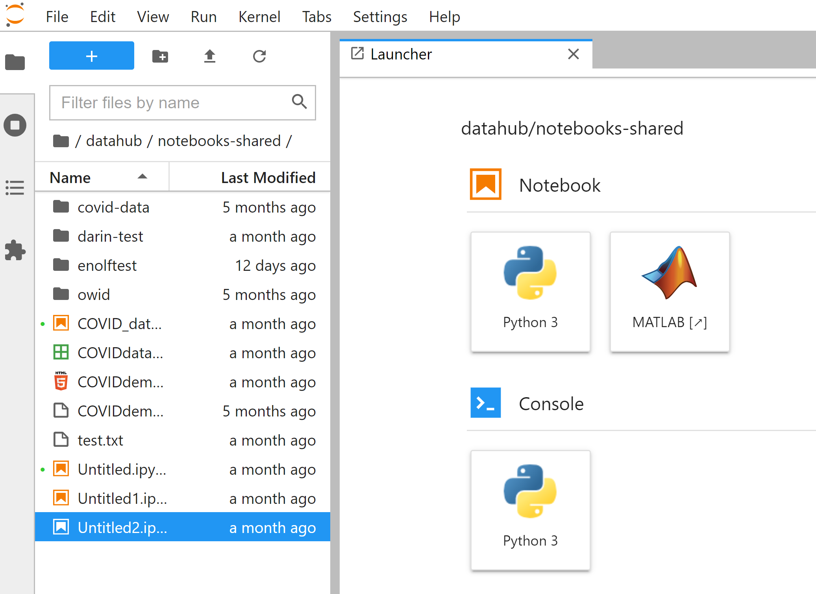
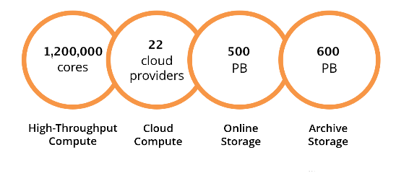
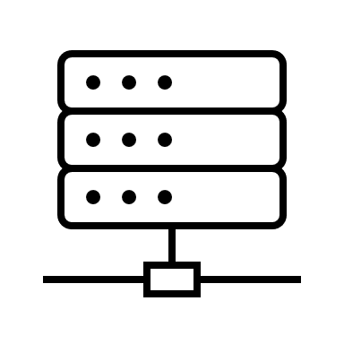
Analyze Cloud Data At Source Using MATLAB
cloud data
https://datahub.egi.eu/
www.egi.eu
Analyze directly on the EGI cloud
No downloads. Browser access
compute
cloud compute
https://www.egi.eu/services/notebooks/
MATLAB is now available on the EGI Notebooks Service.
Create computational notebooks
Share notebooks with your community
Access and analyze public data via the EGI cloud data portal
Make your data available to others
Notes:
The EGI Notebooks is a cloud computing interface so that users can access cloud data and analyze it directly via the browser.
The Notebooks service can be accessed via this link and clicking on Service User Manual button will allow you to access detailed help
Using MATLAB on the Notebooks Service, you can....

Slide 4
Bring Your Own License to Access EGI Notebooks
EGI Notebooks support all Toolboxes and Products (except Simulink)
A MATLAB license is required
Academic
MATLAB Campus Wide Licenses
(https://www.mathworks.com/academia/tah-support-program/eligibility.html)
MATLAB Individual Licenses
MATLAB Network Licenses
Standard
MATLAB Individual Licenses
MATLAB Network Licenses
Check if your school has a
Campus Wide License
https://www.egi.eu/use-cases/scientific-applications-tools/matlab/
Notes:
Lets first talk about MATLAB on EGI Notebooks Service
All MATLAB toolboxes and products, except Simulink, are enabled
To use this service, you need a MATLAB license
For academic users, Campus Wide Licenses, as well as Individual and Network Licenses are enabled for use with EGI Notebooks
To see if your school has access to a Campus Wide License use this link.
You can also use a Standard license to access MATLAB on the EGI

Slide 5
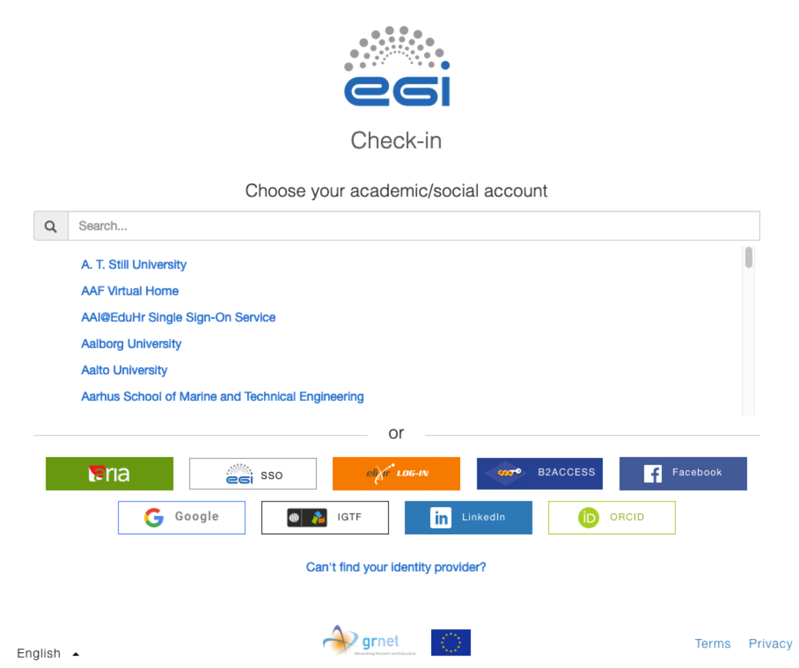
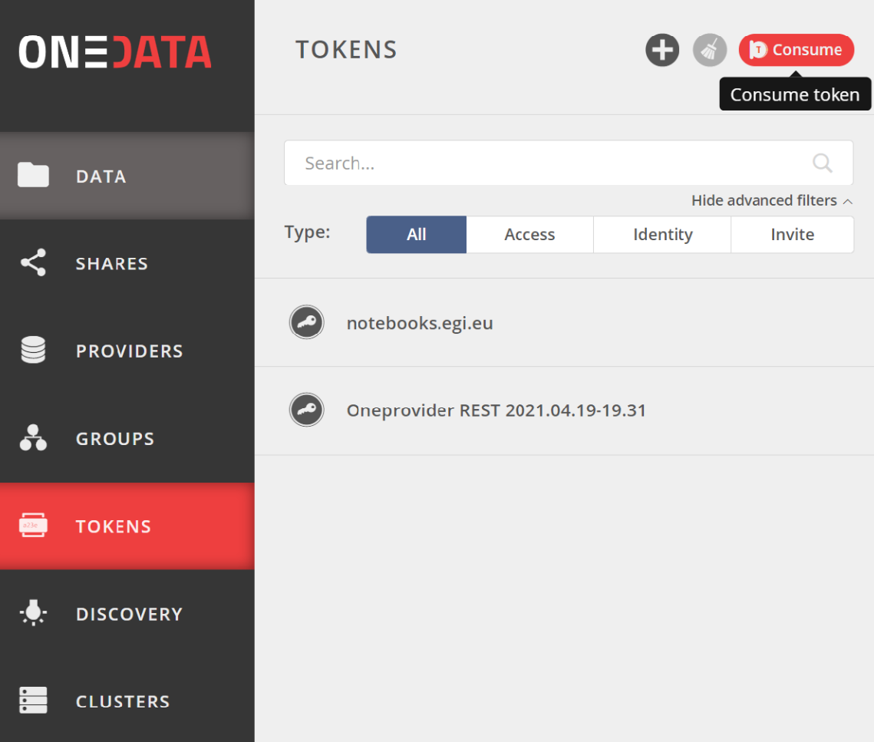
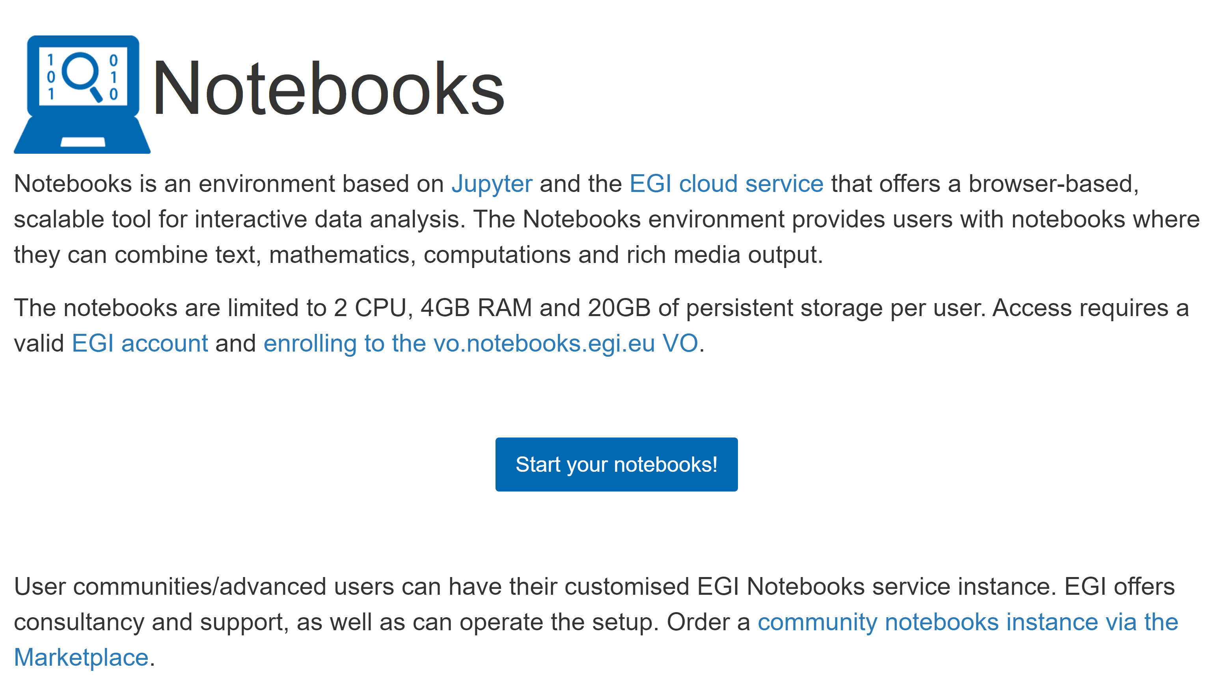
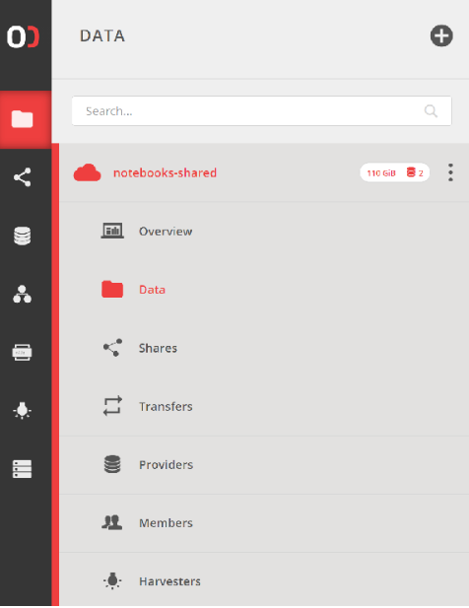
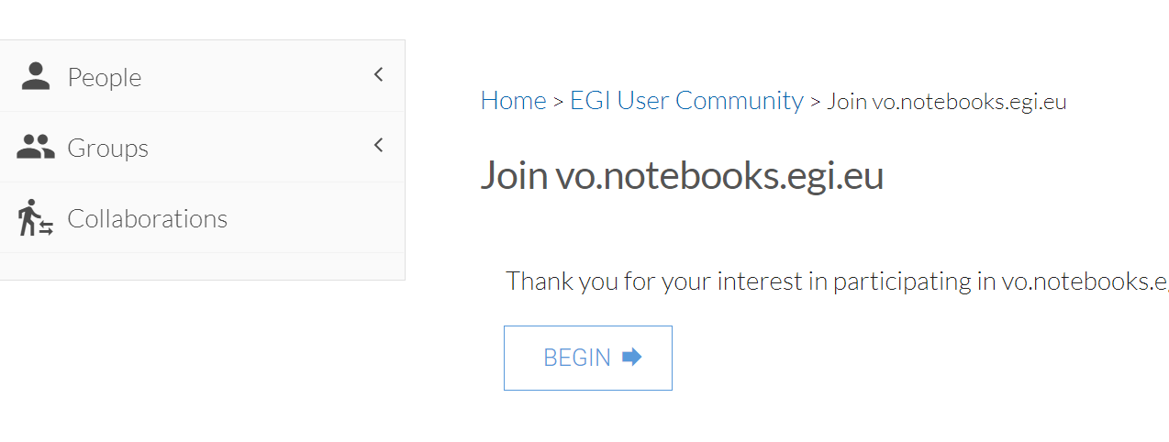
Steps Required to Access MATLAB on EGI Notebooks
Step 1 : Get an EGI account
Step 2 : Become a member of the Notebooks VO
Step 3 : Log into EGI DataHub and join the data center
Step 4 : Open Notebooks and login with your EGI account
Step 5 : Open MATLAB and login using your MathWorks account
Step 6 : Access, analyze, share
Steps 1 & 2
Step 3
Step 4
https://docs.egi.eu/users/notebooks/#service-modes
https://datahub.egi.eu/
https://notebooks.egi.eu/hub/login
Notes:
Here are the steps required to use MATLAB on the EGI Notebooks Service
For Steps 5&6, I will give you a hands-on demo

Slide 6
NEW! You can now Use MATLAB on the EGI!
There are two ways to use MATLAB on the EGI
Notebooks with MATLAB
Parallel Computing with MATLAB
Notes:
Here is the agenda for today
The brand new announcement : You can now use MATLAB on the EGI. There are 2 ways to do this
First, you can analyze cloud data directly via the browser using MATLAB on EGI notebooks and share your code with your community
Second, if you are looking to use parallel computing with MATLAB, HPC centers that are members of the EGI Council can now host MATLAB

Slide 7
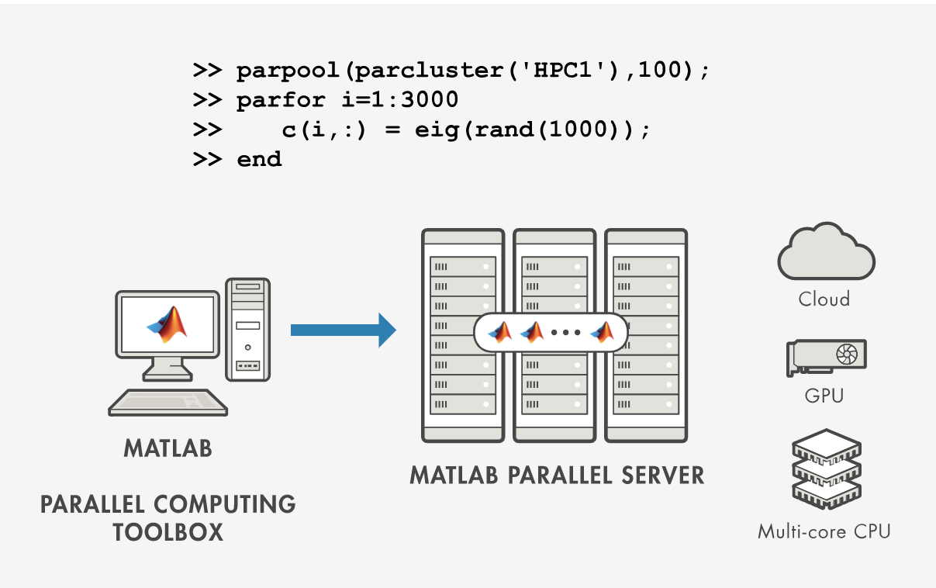
Parallel Computing with MATLAB – Scale to Clouds and Clusters
Minimal changes to code
Unlimited workers with Campus Wide Licenses
MATLAB Parallel Server scales your code to multiple cores, cluster and clouds
Notes:
Some of you might be particularly interested in Parallel Computing using MATLAB
The MATLAB Parallel Computing Workflow makes it possible to scale your code to clusters and clouds and does not require you to change your code every time.
Using the PCT and MPaS, you can now scale up your MATLAB code to use all computing resources available to you.
Users of CWLs can use all available cores they have access to

Slide 8
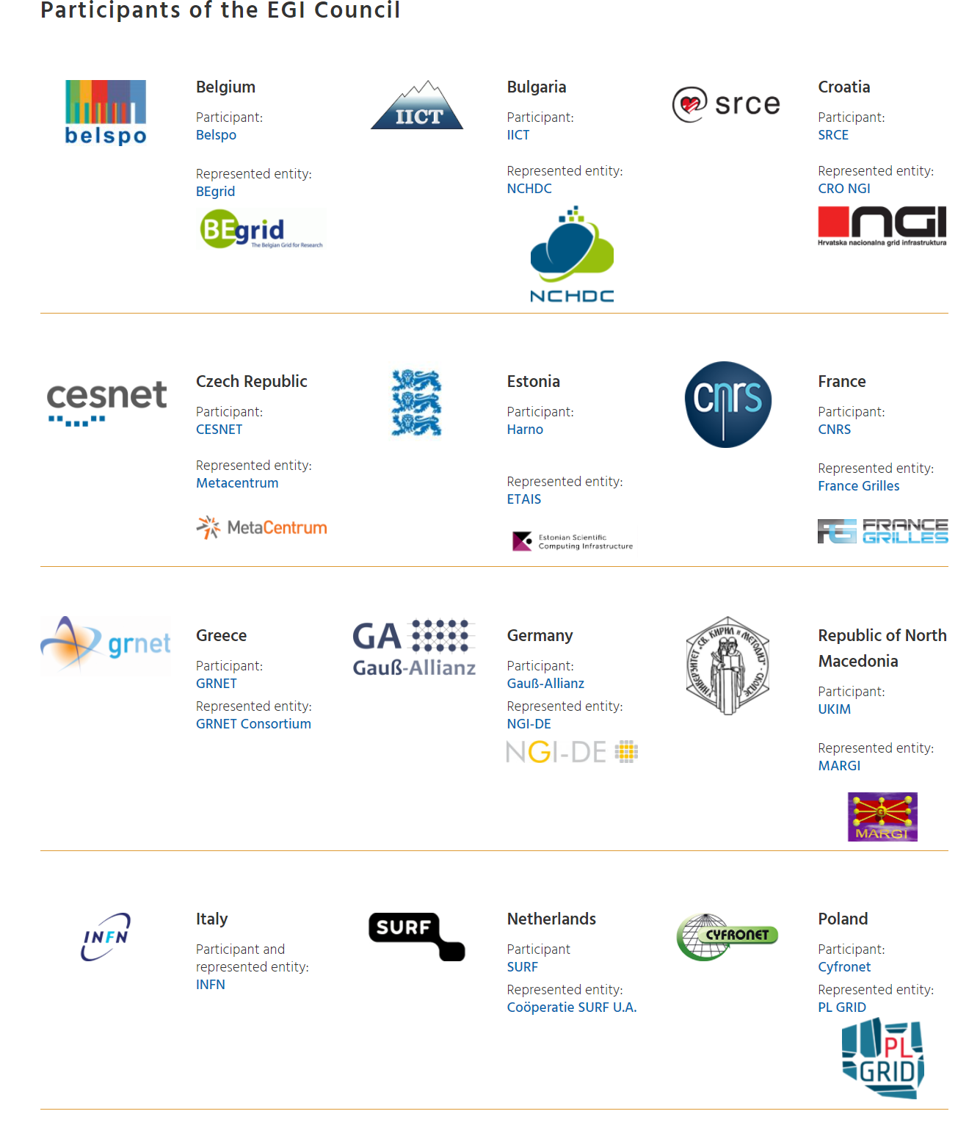
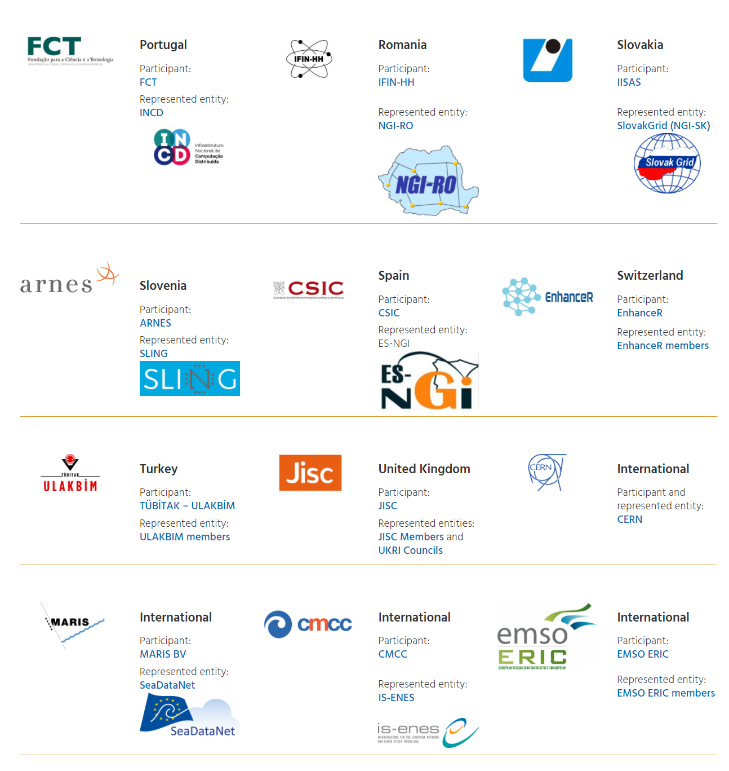
Using MATLAB on EGI Federation HPC Centers EGI Council Members Can Host MATLAB
EGI Council members can now host MATLAB
Users have to bring their own licenses for all products
https://www.egi.eu/about/egi-council/
Notes:
Any of the HPC centers that are part of the EGI Council, can now host MATLAB free of cost. You need to bring your own license with you as with the Notebooks Service
If interested in this option, please get in touch for more.

Slide 9
Using MATLAB on a EGI HPC Cluster One Researcher's Computational Workflow
Yona Baskharoun
ybaskhar@mathworks.com
MathWorks

Slide 10
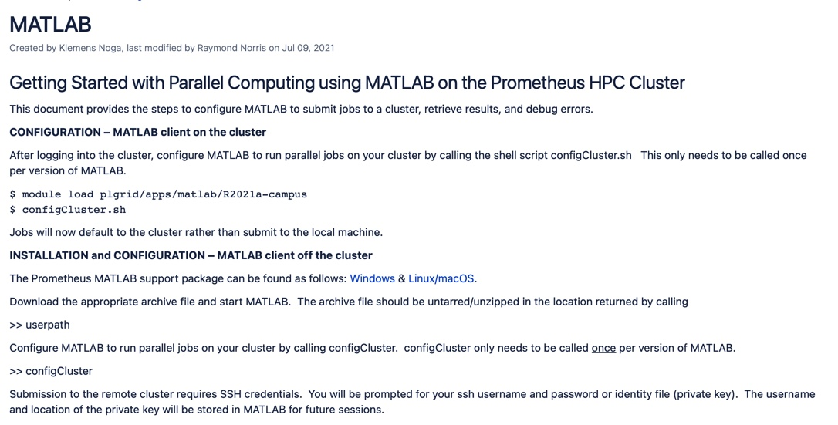
Using MATLAB on EGI Federation HPC Centers Cyfronet – A Case Study
Why Cyfronet?
Many academic institutions in Poland have Campus Wide licences but no HPC systems
Cyfronet is the leading HPC solutions provider in Poland and EGI Council member (Prometheus and Zeus provide more than 70k cores for scientific research)
Offering MATLAB as part of the EGI since July 2021 (BYOL)
User Story : Computing fast COVID-19 detection with MATLAB
Prof. Michal Inglot from Rzeszów University of Technology had a Campus Wide License (unlimited workers)
leveraged MATLAB on Cyfronet (enabled via the EGI)
ran many concurrent jobs using upto 288 cores with MATLAB
"Using MATLAB Parallel Server on Cyfronet reduced computation time by 80%. Thanks to this, determined the parameters of the COVID-detector (coronavirus), which analyzes the Raman spectrum of liquids, solids, and gases." – Dr. Michal Inglot, Rzeszów University of Technology
helpdesk@plgrid.pl

Slide 11
EGI Partners I Can Directly Support

Slide 12
Interested? Questions?
Talk to us at the EGI Virtual Conference 2021 or email us at
Shubo Chakrabarti : shuboc@mathworks.com
Yona Baskharoun : ybaskhar@mathworks.com
For more on Open Science with MATLAB
https://www.mathworks.com/discovery/open-science.html

Slide 13
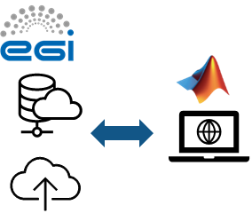
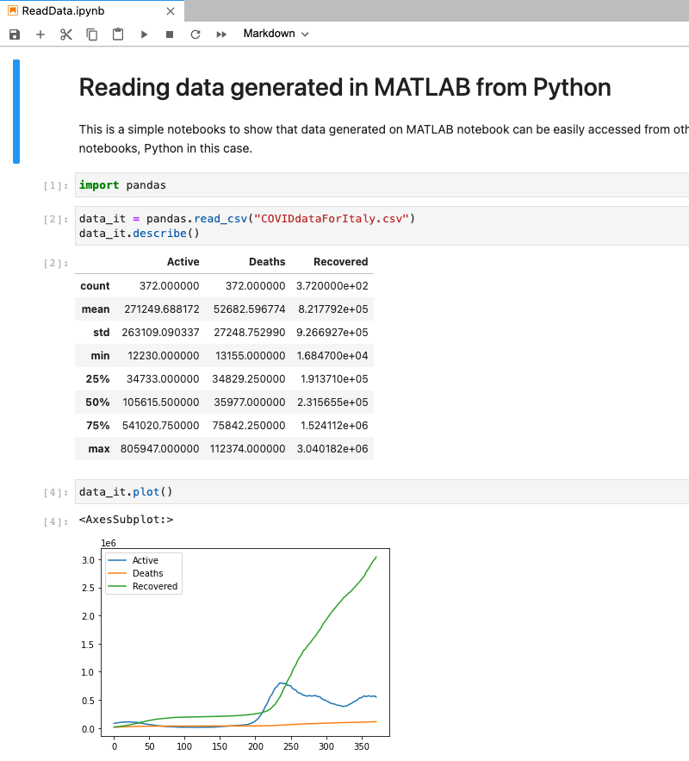
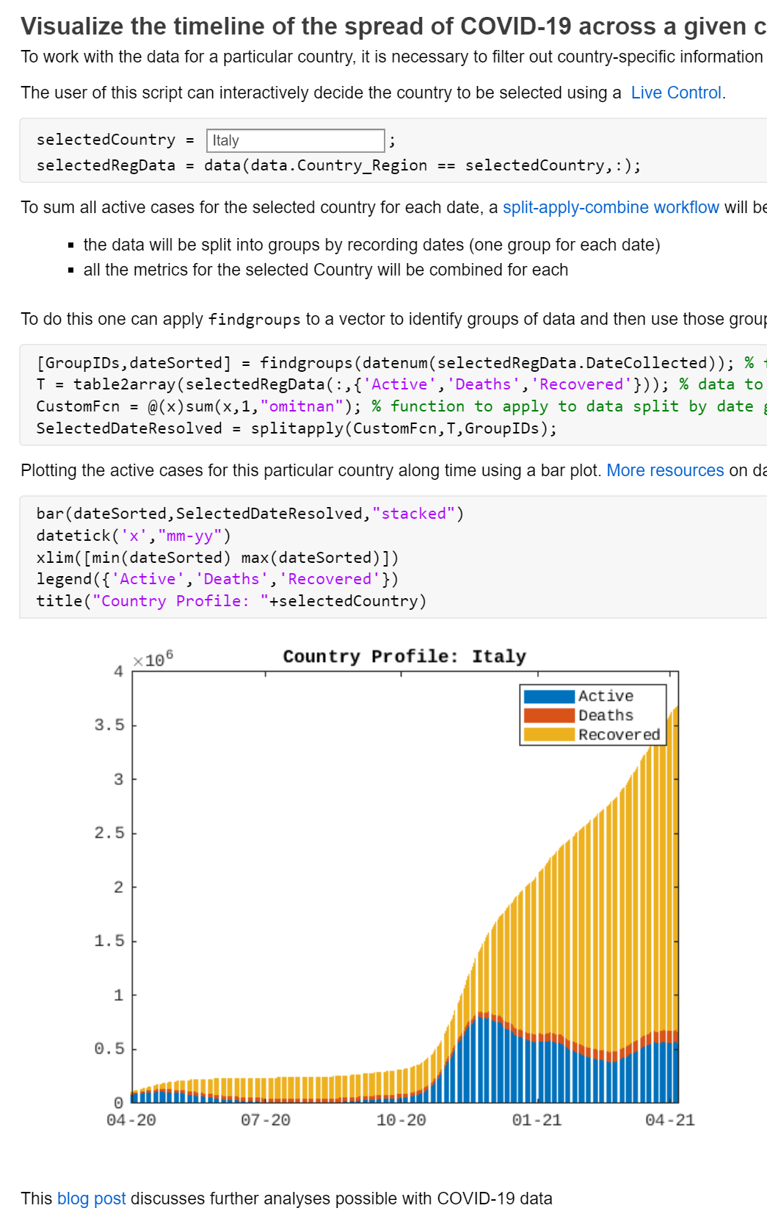
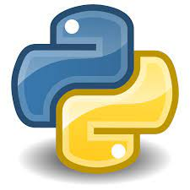
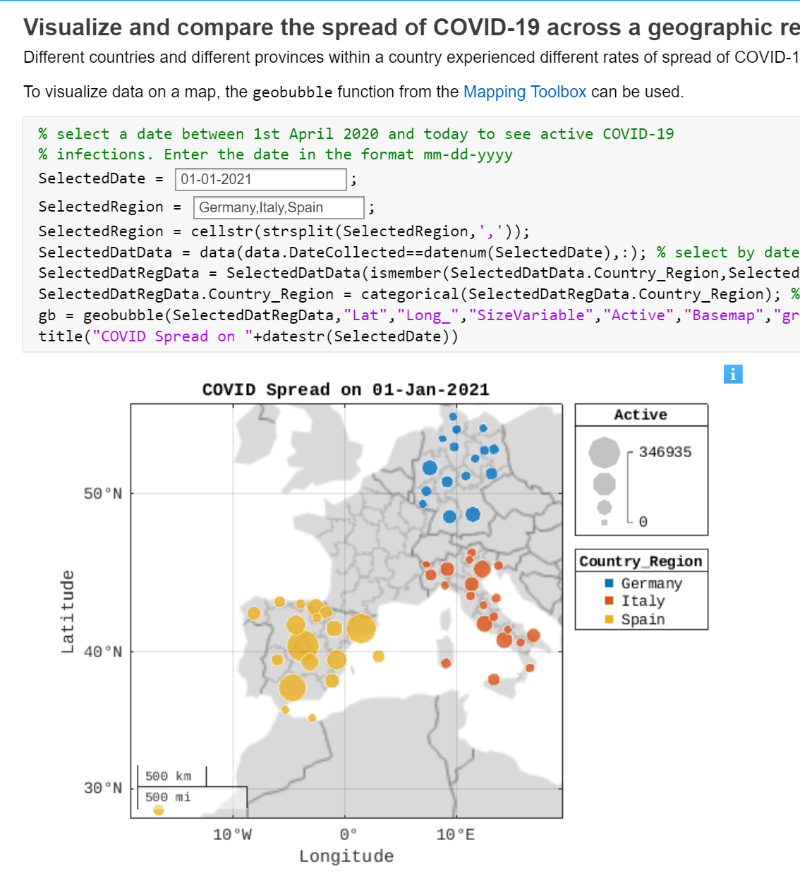
EGI Notebooks and MATLAB Sharing MATLAB Code using Notebooks
Read and Access Data
Produce Readable Code
Share and Collaborate
Connect and Contribute to Public Datasets
Explain Analysis in Readable Format
Make Research Output Discoverable
Analyze data at source
No downloads
Browser access
https://www.mathworks.com/discovery/open-science.html
Notes:
As I have shown you, with MATLAB on EGI Notebooks, you can
Connect and Contribute to Public Datasets via the DataHub without time consuming downloads
Explain your analysis in a readable format with user controls
Make your research output discoverable by sharing with others, including those non-MATLAB users

