Slide 1
AI4PublicPolicy
AI4PublicPolicy will bring AI to support decision making

Slide 2





Drivers and motivations

Slide 3





Automated, Transparent Citizen-Centric Public Policy Making based on Trusted Artificial Intelligence
Citizens centric
Evidence based
Interoperable
Secure

Slide 4
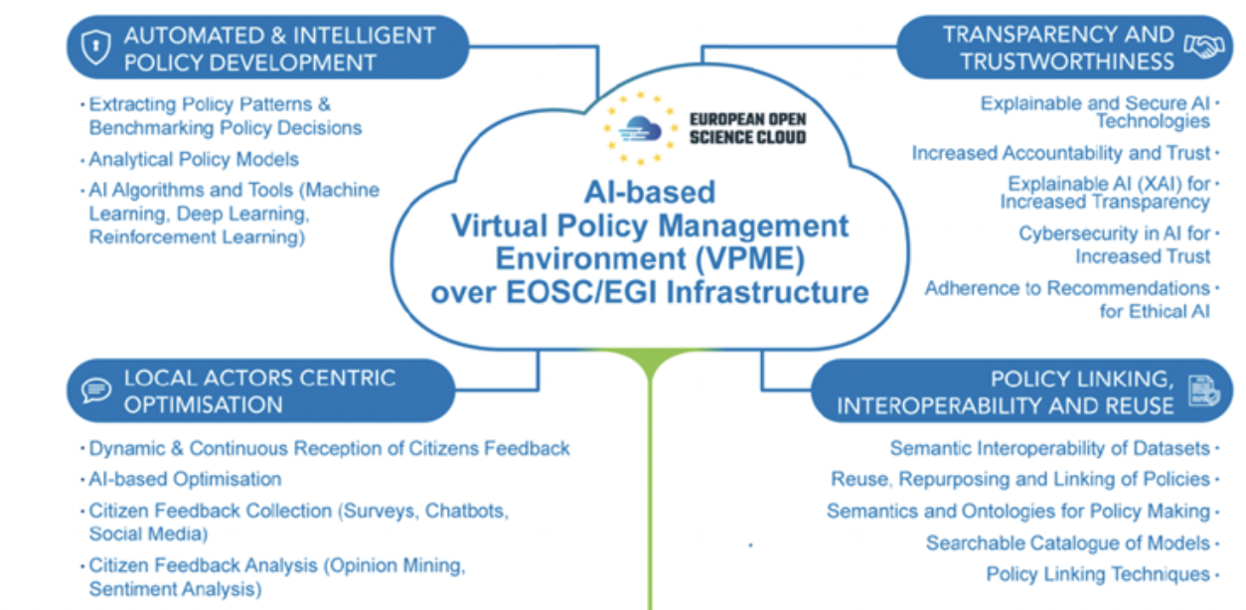
Key ideas and concept of the project

Slide 5
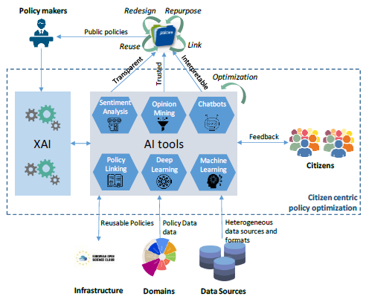
The Scenario

Slide 6
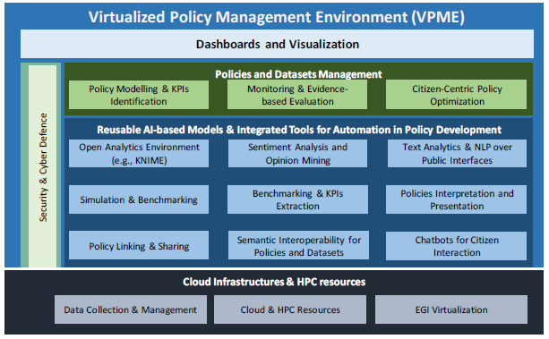
The Architecture

Slide 7
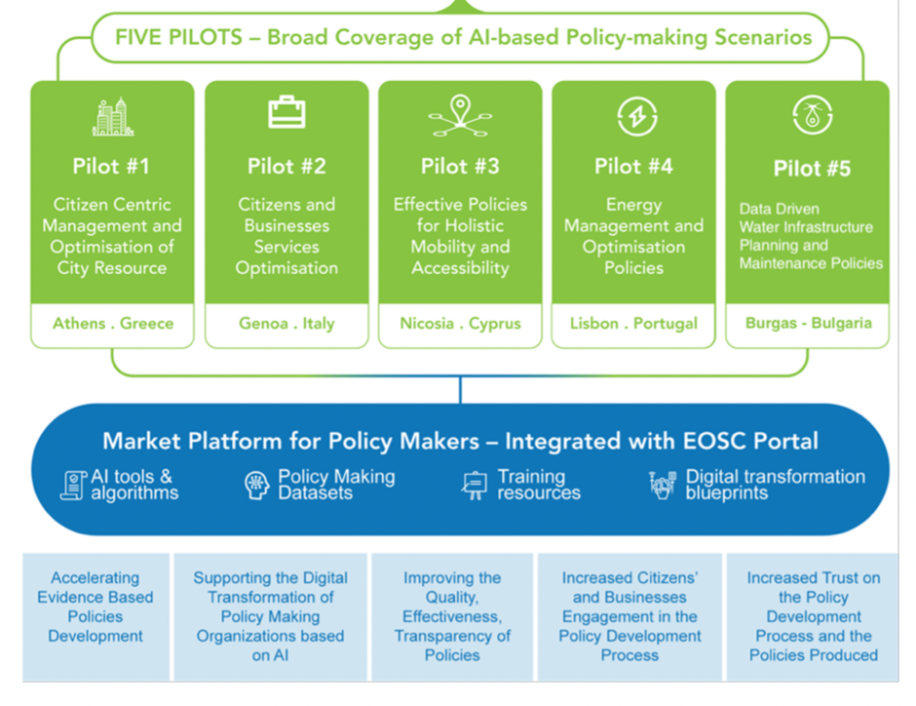
The Pilots

Slide 8
Contact us
Alessandro Amicone - GFT Italy
alessandro.amicone@gft.com
Online presence
https://ai4publicpolicy.eu
http://linkedin.com/company/ai4publicpolicy
https://twitter.com/ai4publicpolicy

