Slide 1






DIGITbrain a new approach to deliver Digital Twin technologies
Prof Tamas Kiss
University of Westminster
t.kiss@westminster.ac.uk
www.digitbrain.eu
www.linkedin.com/groups/12439191
www.twitter.com/digitbrain_eu
www.facebook.com/DIGITbrainProject

Slide 2
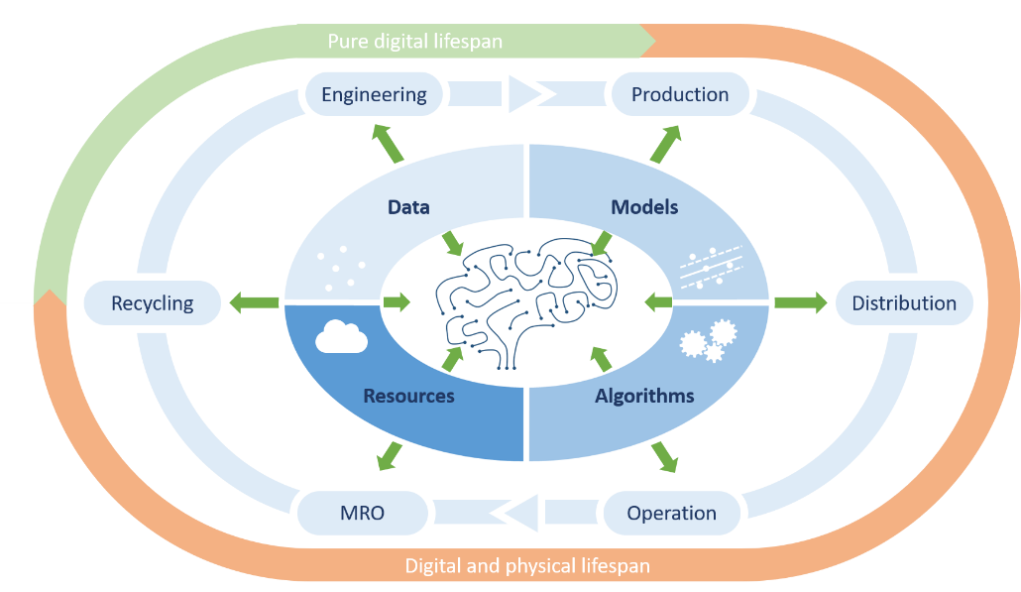
The DIGITbrain challenge
DIGITbrain main challenge
  “…to enable customised industrial products and to facilitate cost-effective distributed and localised production for manufacturing SMEs…”
How?
  “…by means of modelling, simulation, optimisation, analytics, and machine learning tools to augment the concept of digital twin with a memorising capacity…”

Slide 3



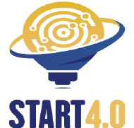
















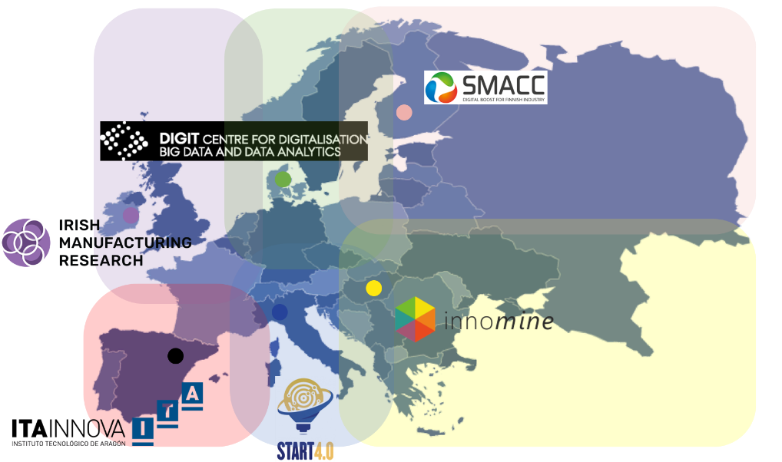















The DIGITbrain consortium
Core technical and administrative partners
Experiment partners
Network of DIHs

Slide 4
DIGITbrain timeline
Open Call
Open Call
Wave 1 Experiments
Wave 2 Experiments
Wave 3 Experiments
Advanced Technical and Business Support
Continuous implementation, integration, and validation
M01
M03
M06
M09
M12
M15
M18
M21
M24
M27
M30
M33
M36
M39
M42
July 2020
March 2021
March 2022
December 2023

Slide 5
Key concepts
Industrial Products: Mechatronic systems (or components) that are operated by manufacturing companies to support the production of other products (e.g. a manufacturing line).
Digital Twin: Represented by static and dynamic models that can evaluate historical and actual data to assess the condition and to simulate the behaviour of the industrial product.
Digital Product Brain: Guides the behaviour and performance of the industrial product by coalescing its physical and digital dimensions and by memorising the occurred (physical and digital) events over a significant part of its lifecycle.

Slide 6
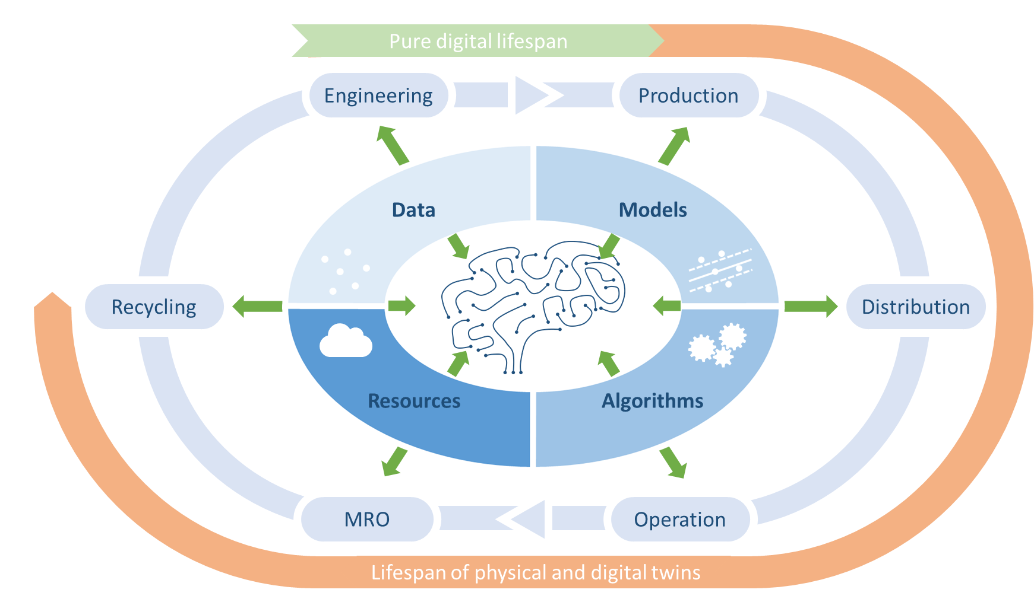
Concept of the Digital Product Brain

Slide 7
The high-level DIGITbrain concept

Slide 8
Data – Model – Algorithm - Microservices
…
  models and data,
  “computations” (algorithms)
  constitute a DMA Tuple in Db
  a Digital Twin in Db may consist of many DMA Tuples, e.g. each representing one type of behaviour
DMA Tuple
Model
Algorithm
Data
Microservices

Slide 9

Asset provisioning
IP Family
Autho-ring tools
MA Pair
Algorithm
Expert
user
Action:
- Notify user
- Execute DMA
- Adjust IPI
Db Asset
Provider
„create“
Asset:
Data
Model
Microservice
containerize Microservice, „upload“ Asset
to repository
Microservice(s)
Model(s)
data and
message
broker ??
Data source(s)
resource broker ??
Data source(s)
Model(s)
Microservice(s)
Algorithm(s)
Notes:
Db Asset Metadata Registry (metadata and references to Assets)

Slide 10
Asset publishing
IP Family
Db Asset Pub-lish-ing In-ter-face
Digital Agora
Autho-ring tools
MA Pair
Algorithm
Expert
user
Db Asset
Provider
„create“
Asset:
Data
Model
Microservice
publish
Asset
(provide
metadata,
reference
Asset)
Db Asset Metadata Registry
containerize Microservice, „upload“ Asset
to repository
Microservice(s)
Digital Brain
Solution
DIGITbrain Platform
Model(s)
references
Production site
Data source(s)
Local compute res.
Edge dev.
Data
…
IP Instances
Sensors
Data source(s)
Model(s)
Microservice(s)
Algorithm(s)
Notes:
Db Asset Metadata Registry (metadata and references to Assets)

Slide 11
DMA composing/ instantiation
compose
DMA tuple
DMA
Composer
IP Family
Db Asset Pub-lish-ing In-ter-face
DPB UI
Digital Agora
Autho-ring tools
MA Pair
Digital
(Product)
Brain
IP Instance
Inf. Eng.
Algorithm
DT
Sem. Net.
Expert
user
DTs
IPIs
etc.
Db Asset
Provider
„create“
Asset:
Data
Model
Microservice
publish
Asset
(provide
metadata,
reference
Asset)
Db Asset Metadata Registry
containerize Microservice, „upload“ Asset
to repository
Microservice(s)
Digital Brain
Solution
DIGITbrain Platform
Model(s)
references
Production site
Data source(s)
Local compute res.
Edge dev.
Data
…
IP Instances
Sensors
Data source(s)
Model(s)
Microservice(s)
Algorithm(s)
Notes:
Db Asset Metadata Registry (metadata and references to Assets)

Slide 12

DMA deployment/ execution
compose
DMA tuple
DMA
Composer
DPB/
IP Analyst
IP Family
Db Asset Pub-lish-ing In-ter-face
DPB UI
DMA LC Manager
Digital Agora
Autho-ring tools
MA Pair
Digital
(Product)
Brain
IP Instance
Inf. Eng.
Algorithm
DT
Sem. Net.
Expert
user
DTs
IPIs
etc.
Db Asset
Provider
„create“
Asset:
Data
Model
Microservice
publish
Asset
(provide
metadata,
reference
Asset)
Db Asset Metadata Registry
containerize Microservice, „upload“ Asset
to repository
Exec Eng./
Orchestrator
Microservice(s)
Digital Brain
Solution
DIGITbrain Platform
Model(s)
references
deployment,
execution
Production site
Data
Remote compute resources
Data source(s)
Local compute res.
Edge dev.
Data
…
IP Instances
Cloud
HPC
Sensors
Data source(s)
Model(s)
Microservice(s)
Algorithm(s)
Notes:
Db Asset Metadata Registry (metadata and references to Assets)

Slide 13
IP analysis
compose
DMA tuple
DMA
Composer
DPB/
IP Analyst
IP Family
Db Asset Pub-lish-ing In-ter-face
DPB UI
DMA LC Manager
Digital Agora
Autho-ring tools
MA Pair
Digital
(Product)
Brain
IP Instance
Inf. Eng.
Notification Action
Algorithm
DT
Sem. Net.
Expert
user
DTs
IPIs
etc.
User
Db Asset
Provider
Activity
„create“
Asset:
Data
Model
Microservice
publish
Asset
(provide
metadata,
reference
Asset)
Db Asset Metadata Registry
containerize Microservice, „upload“ Asset
to repository
Expert
user
Message handler
Message queue
Exec Eng./
Orchestrator
Microservice(s)
Digital Brain
Solution
DIGITbrain Platform
Model(s)
references
deployment,
execution
messages (triggered by Rules),
results (outputs)
Production site
Data
Remote compute resources
Data source(s)
Local compute res.
Edge dev.
Data
…
IP Instances
Cloud
HPC
Sensors
Data source(s)
Model(s)
Microservice(s)
Algorithm(s)
Notes:
Db Asset Metadata Registry (metadata and references to Assets)

Slide 14
High-level System Architecture Design for DIGITbrain V1
compose
DMA tuple
DMA
Composer
DPB/
IP Analyst
IP Family
Db Asset Pub-lish-ing In-ter-face
DPB UI
DMA LC Manager
Digital Agora
Autho-ring tools
MA Pair
Digital
(Product)
Brain
IP Instance
Inf. Eng.
Notification Action
Algorithm
DT
Sem. Net.
Expert
user
Db Platform Components Registry
DTs
IPIs
etc.
User
ADT Generator
Db Asset
Provider
Db Asset Metadata Registry
Activity
„create“
Asset:
Data
Model
Microservice
publish
Asset
(provide
metadata,
reference
Asset)
containerize Microservice, „upload“ Asset
to repository
CFG Platform
Expert
user
EMGREPO
EMGUM
EMGBC
Message handler
EMGWAM
Message queue
DIGITbrain Platform
Microservice(s)
Exec Eng./Orches-
trator: MiCADO
Digital Brain
Solution
Model(s)
references
deployment,
execution
messages (triggered by Rules),
results (outputs)
Production site
Data
Remote compute resources
Data source(s)
Local compute res.
Edge dev.
Data
…
IP Instances
Cloud
HPC
Sensors
Data source(s)
Model(s)
Microservice(s)
Algorithm(s)
Notes:
Db Asset Metadata Registry (metadata and references to Assets)

Slide 15
Zoom-in – first prototype (by Autumn 2021)
Db Asset Pub-lish-ing In-ter-face
DPB UI
Digital Agora
Digital
(Product)
Brain
IP Instance
DT
Db Platform Components Registry
DTs
IPIs
etc.
ADT Generator
Db Asset Metadata Registry
CFG Platform
EMGREPO
EMGUM
EMGWAM
DIGITbrain Platform
Exec Eng./
Orchestrator: MiCADO
DIGITBrain
Solution

Slide 16

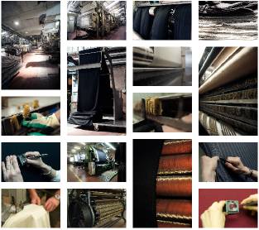
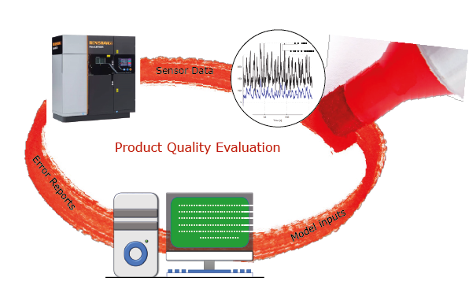
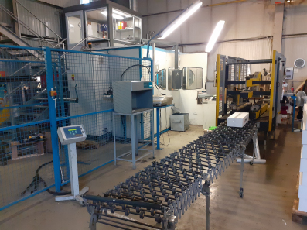
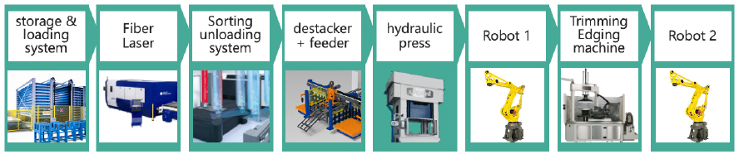
What is it used for? Experiments of the First Wave
Digital Style - Digital twin for fabric production optimization
Digital Brain for Injection Moulding
Digitization and optimization of snow guards manufacturing
Digital Twin for Additive Manufacturing (AM)
Digital Brain for Laser-Cutting and Forming of Aluminium
DIGITbrain in Agricultural Robots
Data-Driven Modelling Of Powder Bed Fusion Technology

Slide 17

Thank you for your attention!
Prof Tamas Kiss
University of Westminster
t.kiss@westminster.ac.uk
www.digitbrain.eu
www.linkedin.com/groups/12439191
www.twitter.com/digitbrain_eu
www.facebook.com/DIGITbrainProject

