Slide 1
WeNMR under EGI: a 10+ years happy symbiosis
Alexandre Bonvin
Utrecht University
The Netherlands
a.m.j.j.bonvin@uu.nl
@amjjbonvin

Slide 2
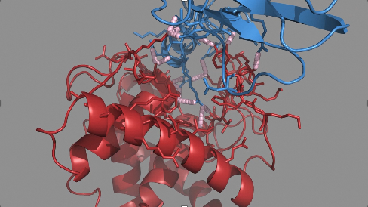
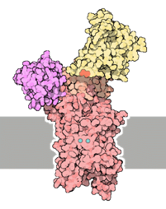
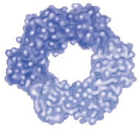
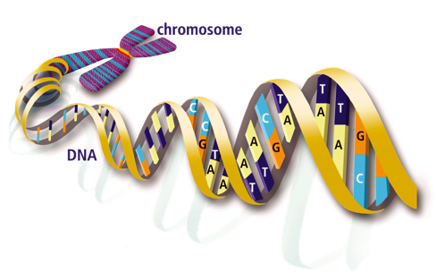
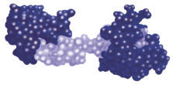
Domain: life sciences / structural biology
Understand life at a molecular level
Main use cases:
Disease-causing mutations
Engineer better molecules for material, health or food applications
Obtain a starting point for drug design to combat disease

Slide 3
www.wenmr.eu

Slide 4
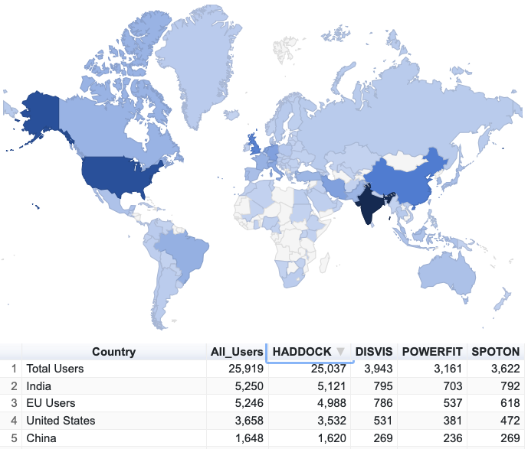
https://wenmr.science.uu.nl/user_map
Sustained growth of our user base

Slide 5
>10 years of serving the research community Made possible via HTC resources provided by FP7 and H2020 e-Infrastructure projects with the support of EGI over the years

Slide 6
The eInfrastructure landscape over the years
CC
Under EGI-Engage
European Open Science Cloud

Slide 7
Challenges and solutions

Slide 8
Challenges & e-Solutions
Attract users!
Offer them top of the line eScience solutions for their research ... which means top of the line software

Slide 9
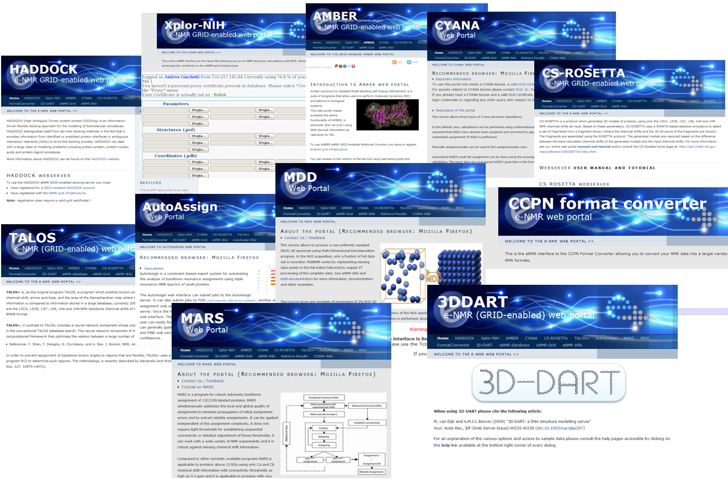
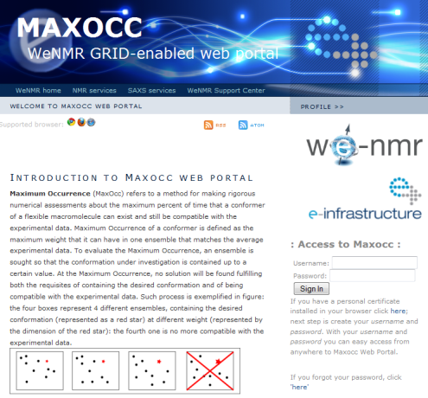
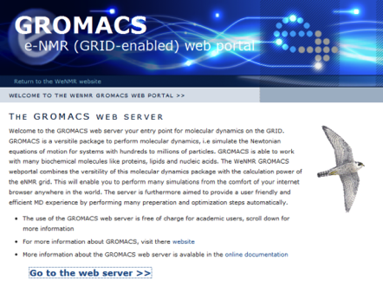
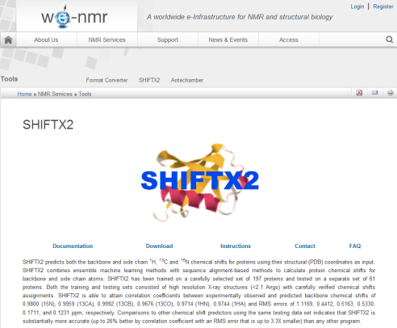
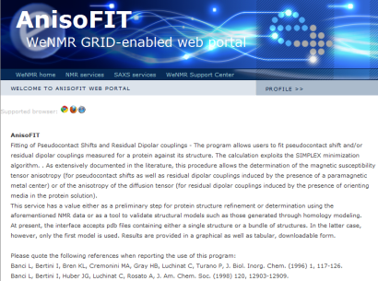
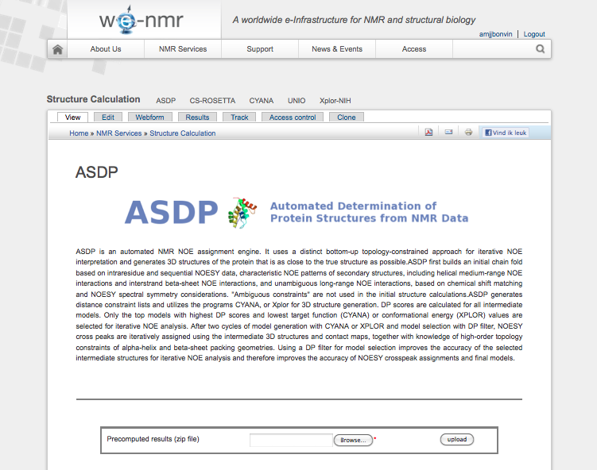
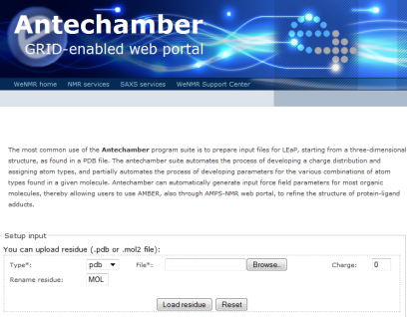
The WeNMR services portfolio over the years
Notes:
9
9

Slide 10
The WeNMR services in the EOSC
https://www.eosc-hub.eu
https://marketplace.eosc-portal.eu
Notes:
10
10

Slide 11
Challenges & e-Solutions
Attract users!
Offer them top of the line eScience solutions for their research ... which means top of the line software
Provide them training, tutorials and support

Slide 12
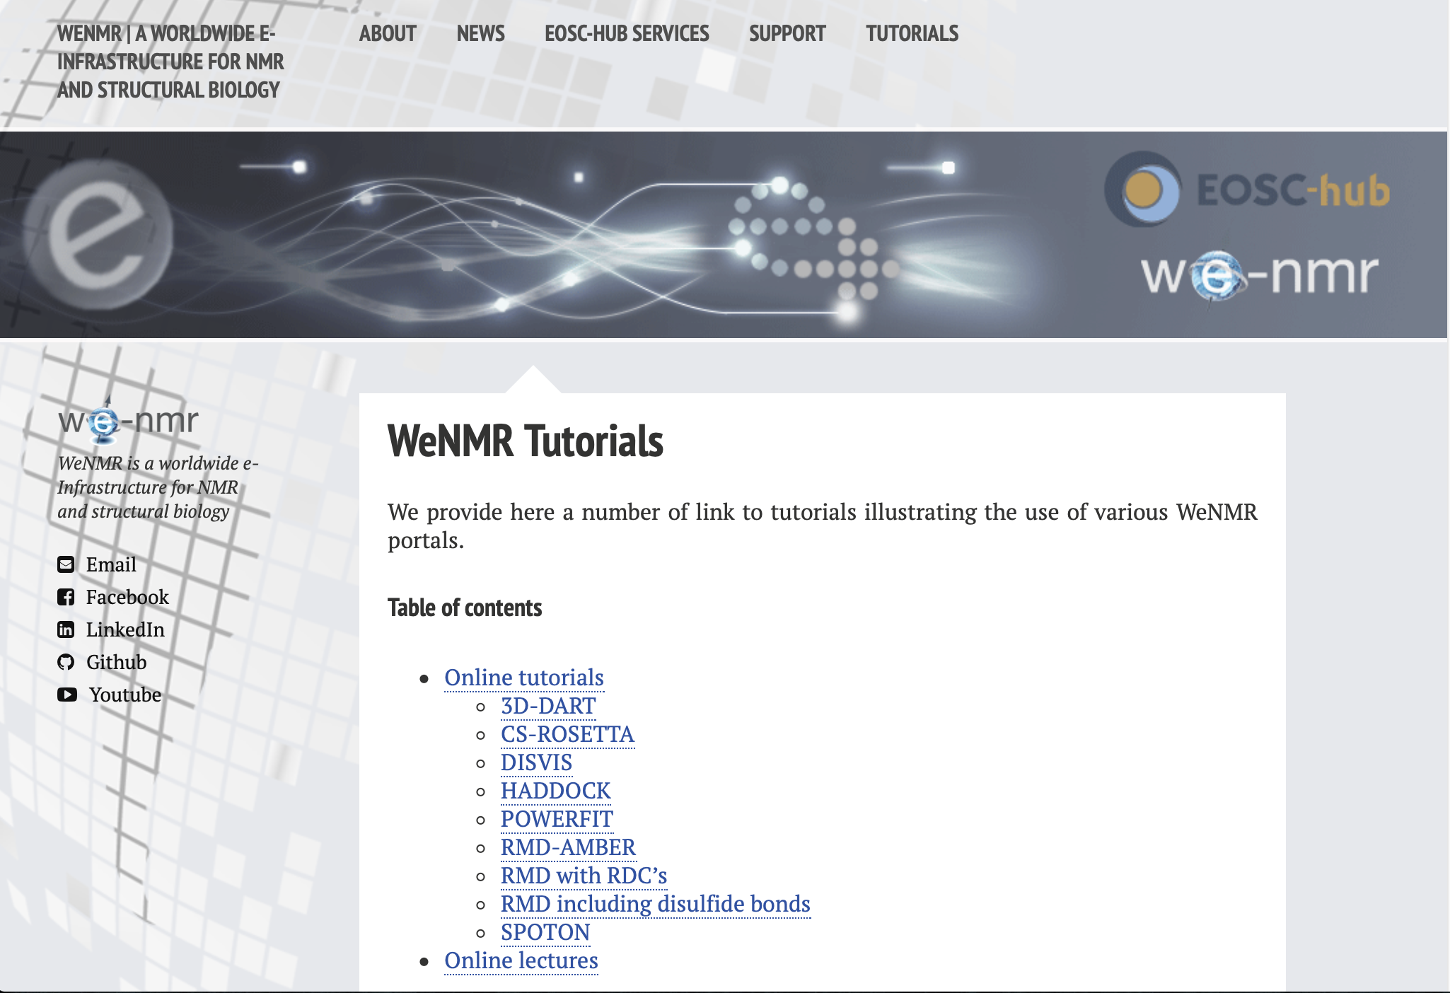
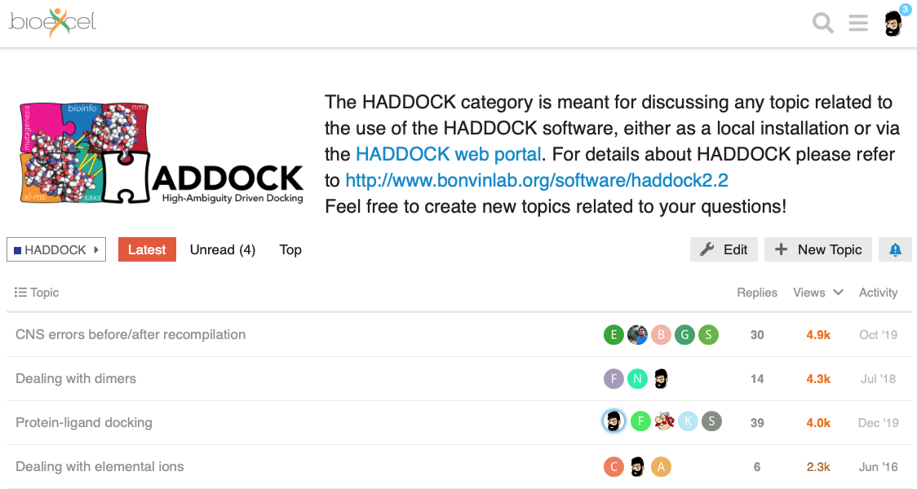
The WeNMR virtual research community
Support center
Tutorials
YouTube channel
Many workshops …
https://ask.bioexcel.eu

Slide 13
Challenges & e-Solutions
Attract users!
Offer them top of the line eScience solutions for their research ... which means top of the line software
Provide them training, tutorials and support
Make their life easier

Slide 14
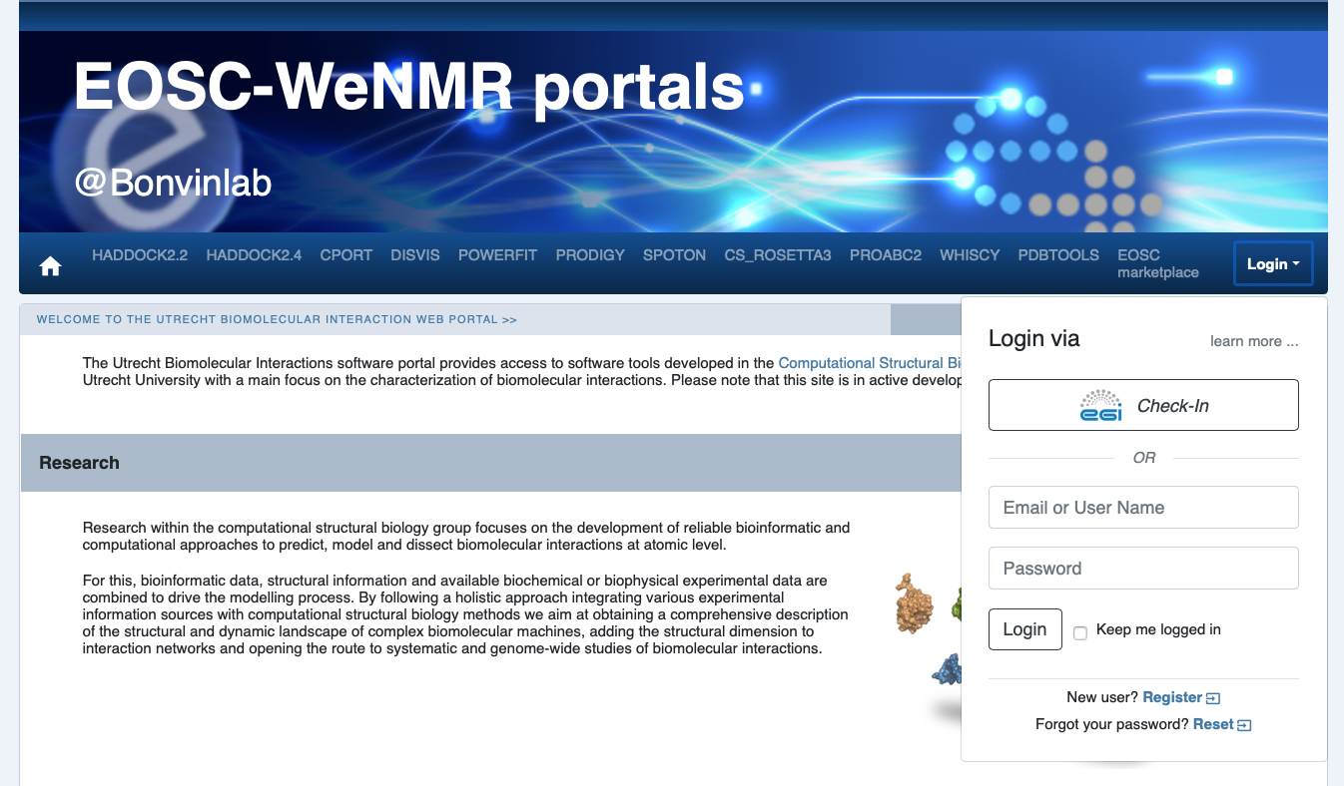
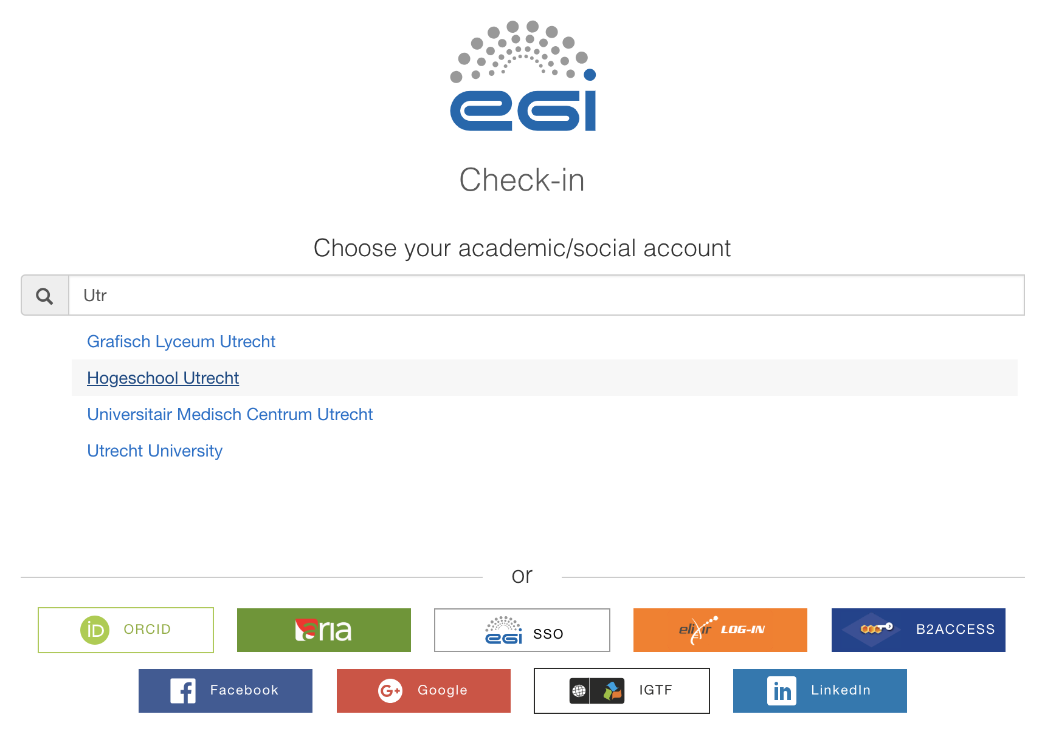
Single Sign On
SSO Integration with European Open Science Cloud EGI CheckIn

Slide 15
User satisfaction
Keep monitoring user satisfaction and get input from users
User satisfaction ratings
DISVIS: 4.76 (from 76 respondents)
HADDOCK: 4.87 (from 3978 respondents)
HADDOCK2.4: 4.89 (from 1515 respondents)
POWERFIT: 4.78 (from 18 respondents)
PRODIGY: 4.79 (from 2248 respondents)
SPOTON: 4.70 (from 82 respondents)

Slide 16
Challenges & e-Solutions
Attract users!
Access to e-Infrastructure

Slide 17
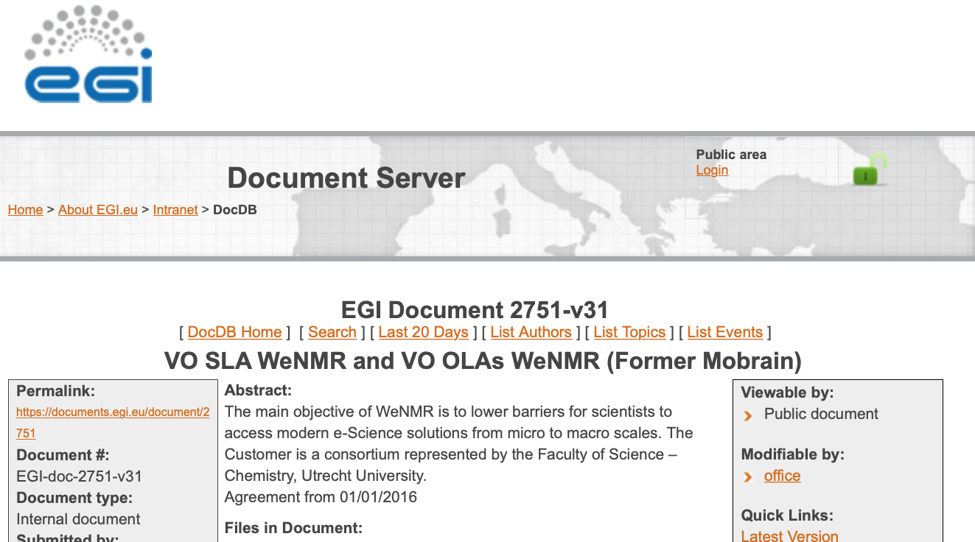
Resources
The WeNMR services have been in production since >10 years under various projects (eNMR, WeNMR, West-Life, EOSC-Hub, EGI-ACE)
Access to resources formalized via EGI through a SLA agreement valid until 06/2023
50+ million CPU hours (opportunistic access)
500+ cloud CPU cores
~60 TB storage

Slide 18
Resources usage
Efficient job handling via
EGI Workload Manager (DIRAC)

Slide 19
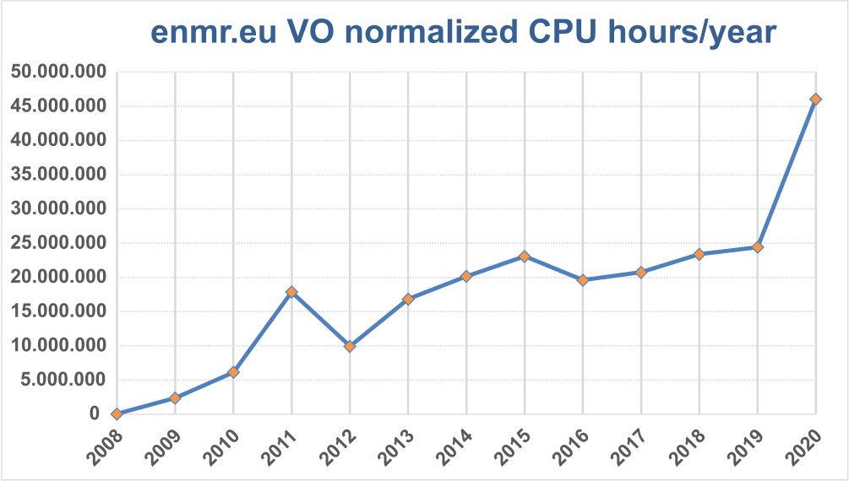
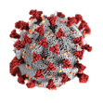
Resources usage

Slide 20
Challenges & e-Solutions
Attract users!
Access to e-Infrastructure
Develop software and maintain and operate a complex infrastructure

Slide 21
React fast! Supporting COVID-19 related research

Slide 22
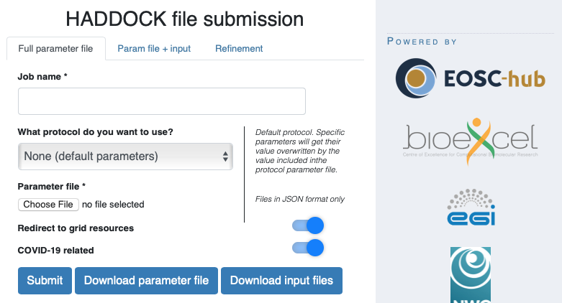
Meeting the demand
HADDOCK can be used to model interactions between virus and human proteins and for drug screening
Increased number of registrations since the lockdown measures in March 2020
We have tripled our processing capability by modifying the backend machinery managing the HADDOCK workflow
Via EGI additional HTC resources were allocated to us
Users can now tag their submissions as COVID-related

Slide 23
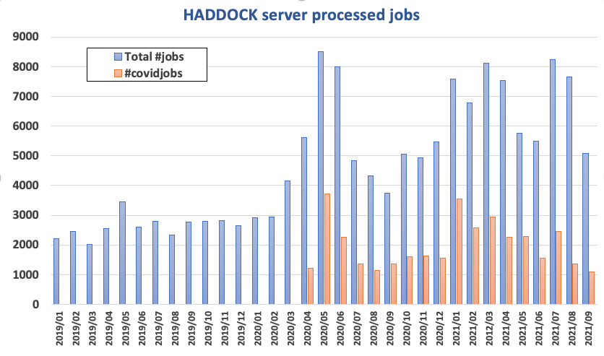
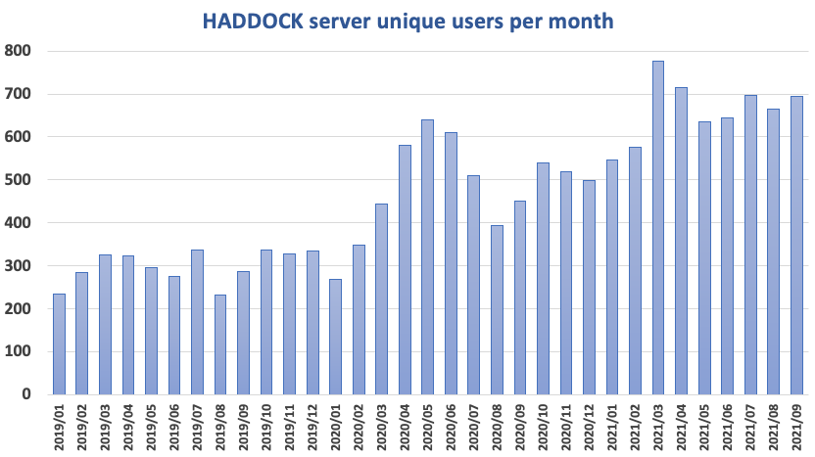
HADDOCK: Meeting the increased demand
The HADDOCK workflow machinery was modified to improve its efficiency and meet the increased demand (and more resources were allocated thanks to EGI/EOSC/OSG).
COVID19 effect

Slide 24
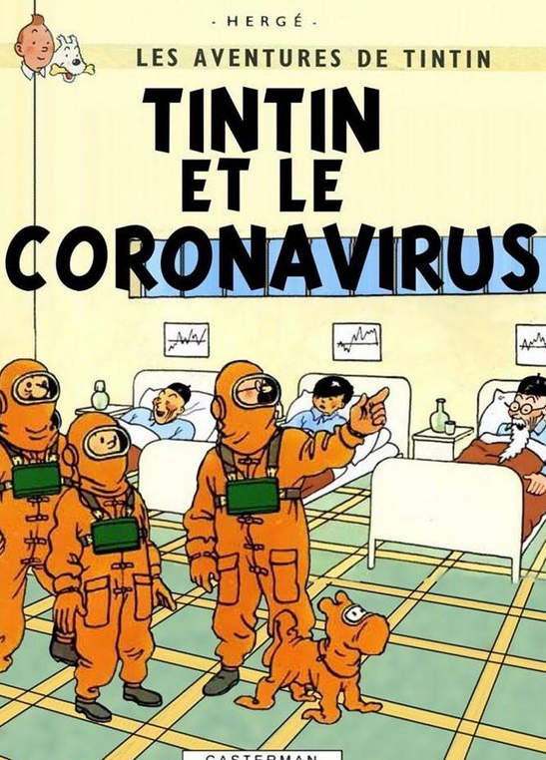
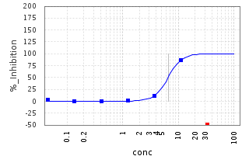
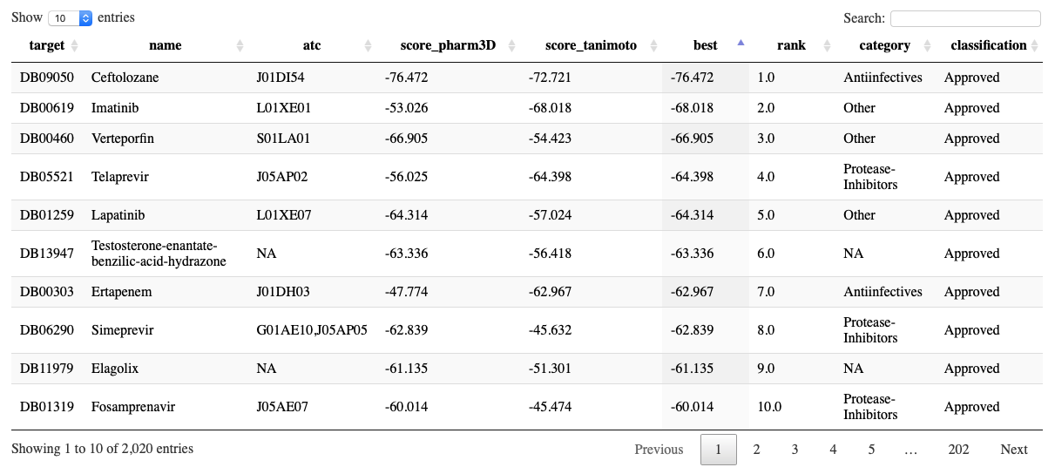
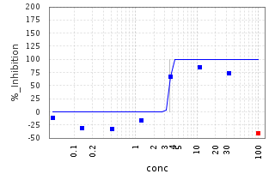
COVID19 drug repurposing
Efficient HADDOCK screen of ~2000 approved drugs against three COVID-19 related targets
30 selected compounds for Mpro currently being tested experimentally
First results for 10 of them reveal micromolar activity in infection assay … but cytotoxic to cells…
For details see: bonvinlab.ord/covid
Work ongoing under IMI CARE project
~7 µM
~3.6 µM
Drug repurposing using HADDOCK

Slide 25
Using HTC EGI/EOSC resources
Pharmacophore shape
Screening of ~2000 compounds was run on EGI/EOSC HTC resources in 3.5 days
www.eosc-hub.eu
www.egi.eu

Slide 26
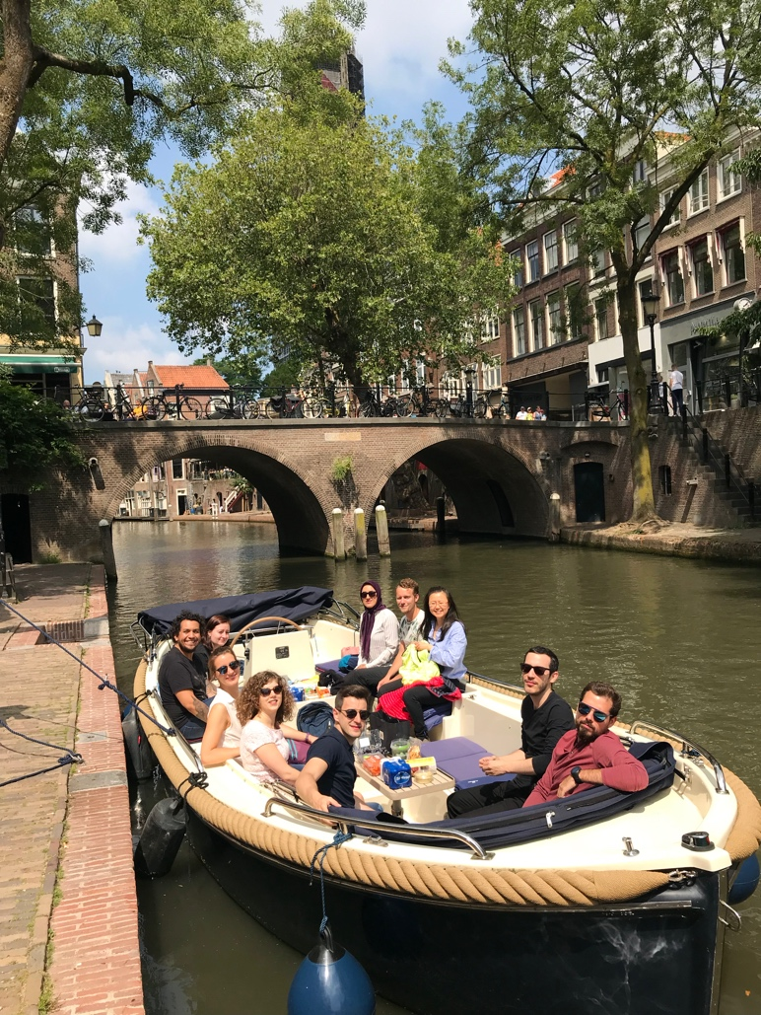
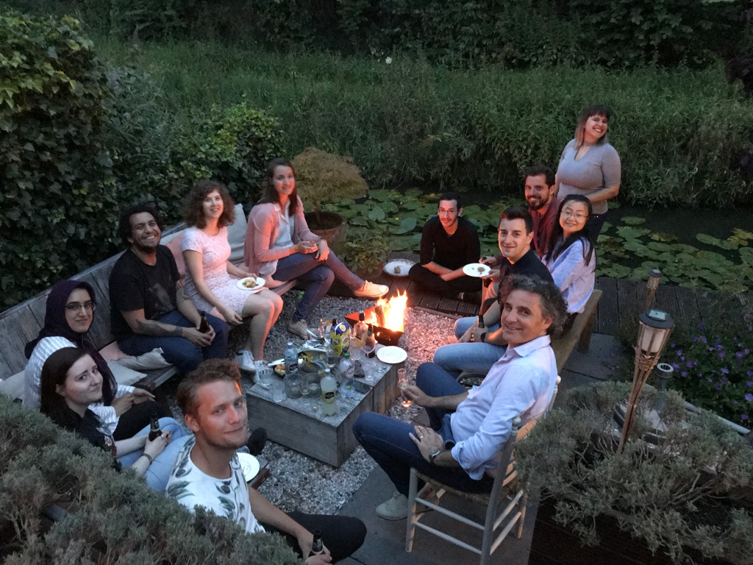
Acknowledgments: the CSB group@UU
€€
VICI
TOP-PUNT
WeNMR
West-Life
EGI-Engage
INDIGO-Datacloud
BioExcel CoE
EOSC-Hub
EGI-ACE
SURFSara

Slide 27
?

Slide 28
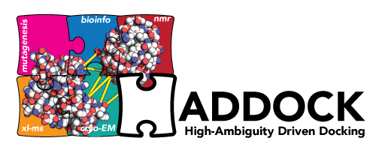
Haddock web portal
> 25000 registered users
> 375000 served runs since June 2008
> 55% on EOSC/EGI HTC resources
De Vries et al. Nature Prot. 2010
Van Zundert et al. J.Mol.Biol. 2016
https://wenmr.science.uu.nl

Slide 29
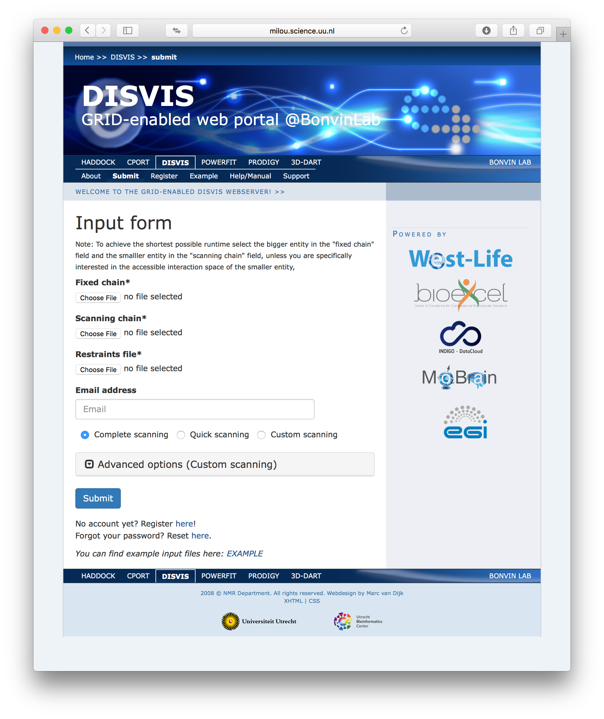
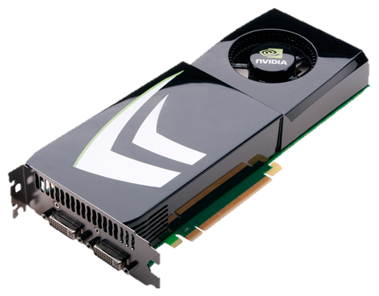
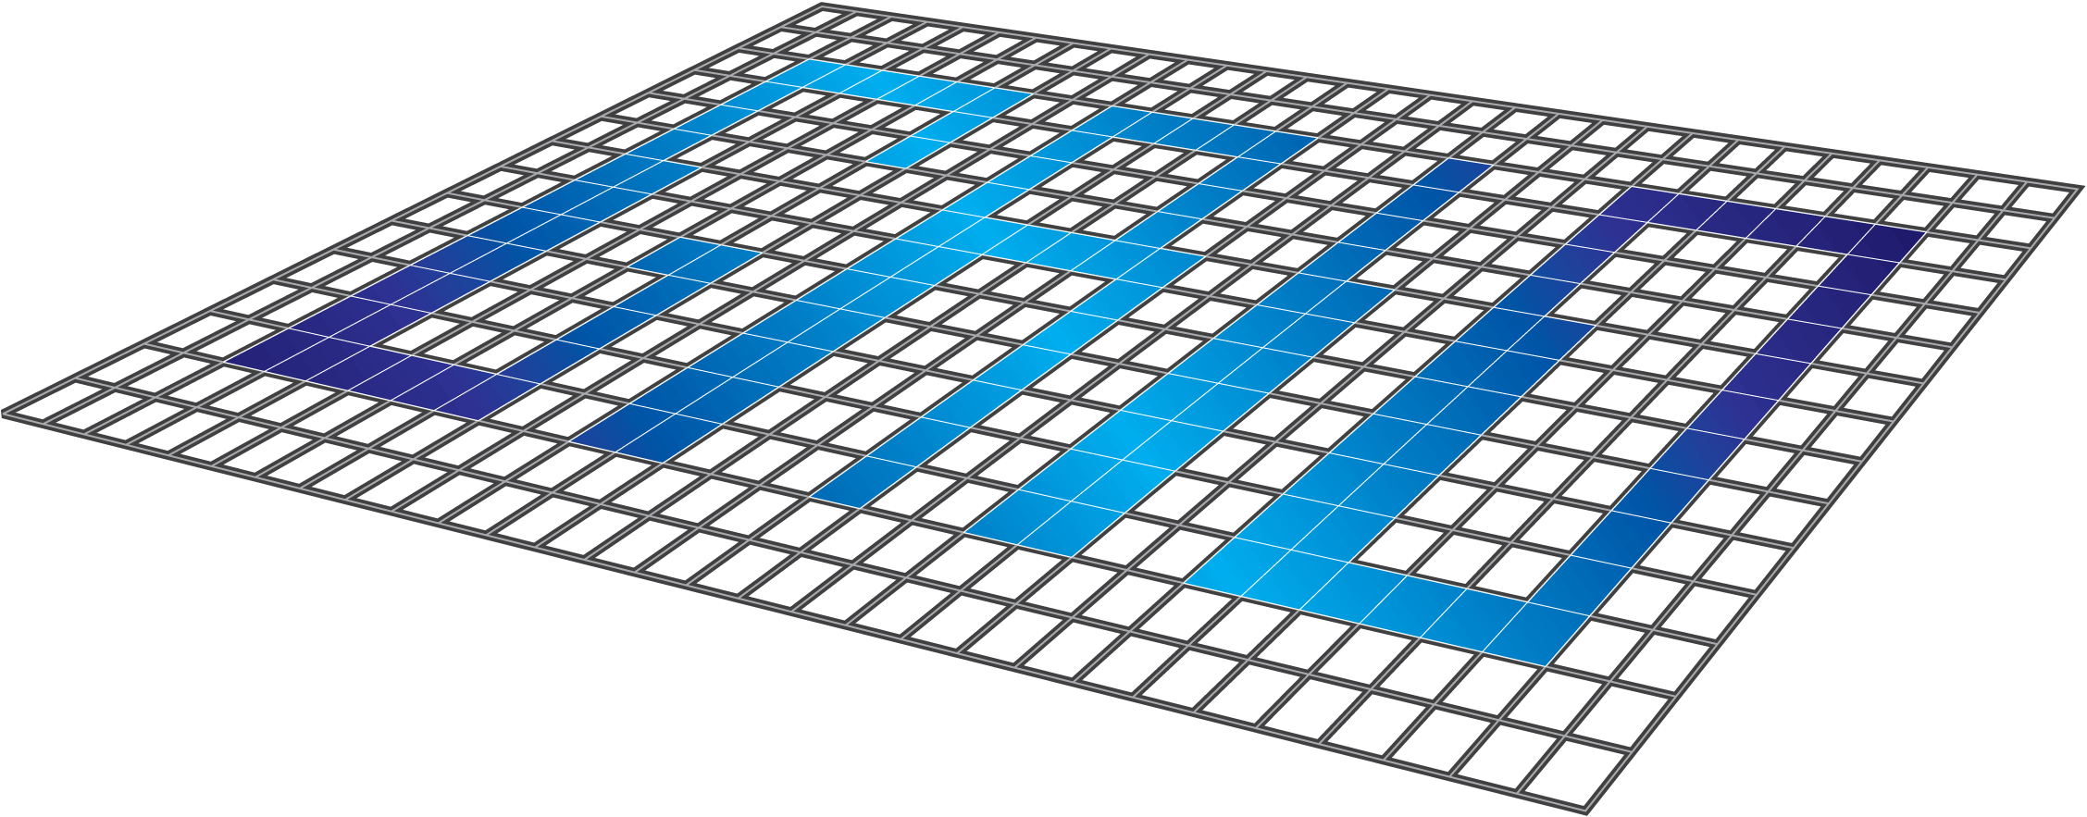
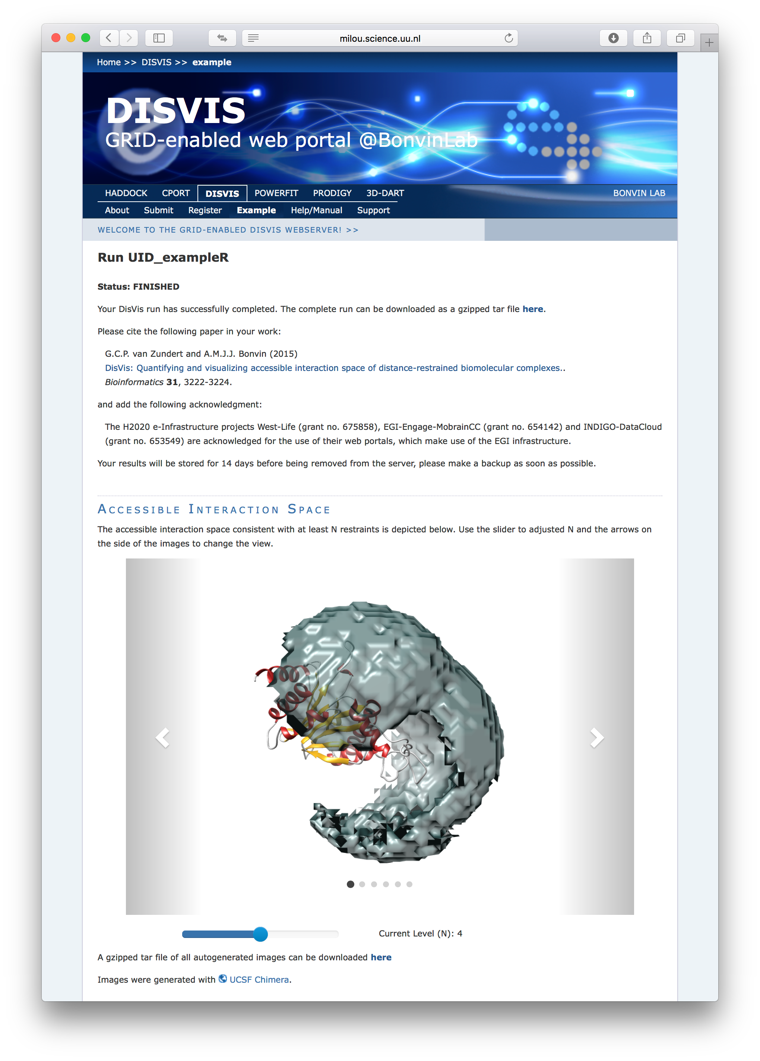
Architecture behind the portals
Submission to local nodes
CPU-calculation
User DB
User not found
Pre-processing + Input files packaging
OR
Input error
Submission to grid node
Validation
GPU-calculation
Output files packaging
+
submission of image generation
Post-processing + Results formatting
Chimera image generation
WEB CLIENT
WEB SERVER
MASTER NODE
WORKING NODE

