Slide 1
EGI Data Transfer WG session
Intro
Andrea Manzi (EGI Foundation)

Slide 2
General Housekeeping rules
Please make sure your microphone and video are deactivated unless the (co)host gives permission.
Use the “raise hand” function to ask to speak, you find the option in the “participants” list.
If you do not see all the Zoom buttons at the bottom of the Zoom window, move your mouse on that window and buttons will appear.
Share your impressions and experiences on Twitter using #EGI2021 and mention @EGI_eInfra.

Slide 3
The EGI Data Transfer WG
The Working Group (WG) is part of the EGI Technology Coordination Board (TCB) which provides the forum for EGI to coordinate the requirements, assessment, delivery and verification of software technology as it moves into the production infrastructure
Mandate: Drive the technical evolution of the EGI Federation in the area of Data Transfer.
To support this goal, the following activities are planned:
Deal with user communities to gather requirements and recurrent use cases;
Perform a technology scouting to identify available technical solutions in the area of data transfer
Identify gaps of the current solutions with a focus on those from the technology providers participating in the WG
Discuss and plan enhancements for technical providers

Slide 4
Participants
EGI is engaging different types of stakeholders:
User communities: which will have a forum to present their requirements and use cases; to test and validate transfer services
Technology providers: which can benefit of direct contacts with large communities to drive the evolution of their services
EGI infrastructure providers: which are hosting or planning to host the services/technologies part of the WG

Slide 5
Working Group details
Started in Sept 2020, already presented at the last EGI conference
Communication Channels
Mailing list : tcb-datatransfer-wg@mailman.egi.eu
Confluence page:
https://confluence.egi.eu/display/EGIBG/Working+Group%3A+Data+Transfer
Meetings & Minutes : https://indico.egi.eu/category/315/
ToR
https://documents.egi.eu/public/ShowDocument?docid=3659

Slide 6
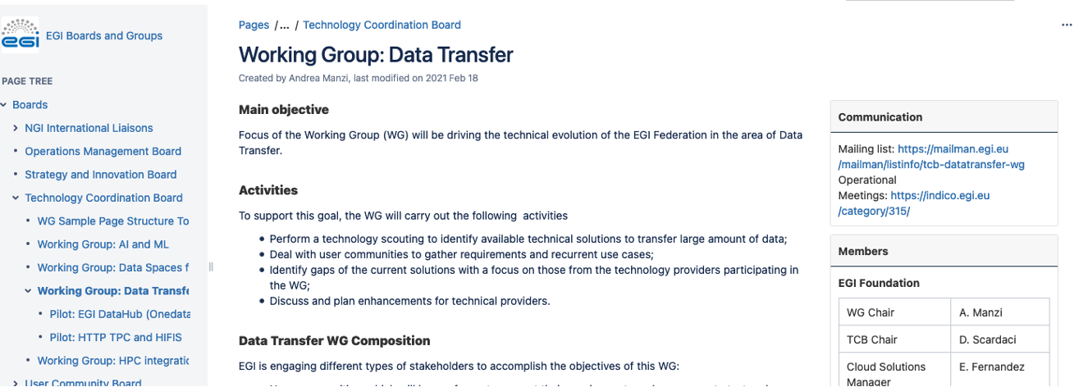
Confluence Page

Slide 7
Current participants
Technology providers:
Services already included in the EGI portfolio, e.g. FTS, Onedata
New services available via EGI-ACE project, e.g. Rucio
EGI possible collaborations, e.g. Globus
Communities with data transfer use cases
WLCG, PaNOSC, EMBL-EBI, HIFIS, INFN
Infrastructure providers
CERN, STFC, AARNET

Slide 8
WG Pilots
PaNOSC Globus and Onedata evaluation (for different use cases)
ESRF and Onedata team
Enhancements implemented by the Onedata team to accommodate the PaNOSC use case
Globus installation at ESRF
HIFIS transfer service
FTS dev team + EGI staff for the service setup and HIFIS + DESY for the component developments
Possible pilot with Rucio in the future

Slide 9
New activities
Leverage the work from the WLCG DOMA WGs and WLCG Auhtz WG
Replacing gridftp transfers with HTTP TPC
Replacing X509 with JWT tokens with OAuth/OpenID connect flows in all the chain ((Rucio->)FTS-> Storages)
Piloting with existing communities in collaboration with EGI Operations
We are welcoming any new user communities that would like to join a and start new pilots
Please contact me or the mailing list
tcb-datatransfer-wg@mailman.egi.eu

Slide 10
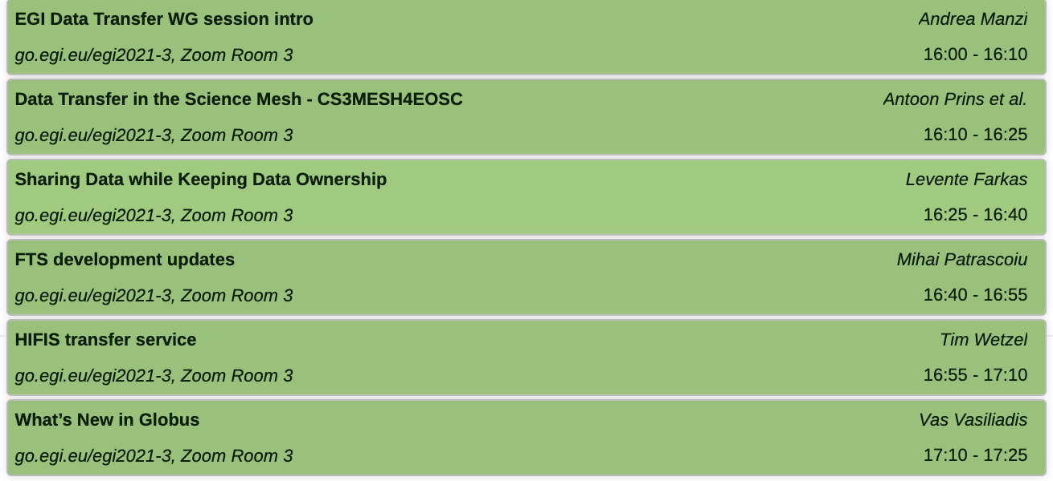
Today’s Agenda

