Slide 1
Federating national resources to process trans-national data
Enol Fernández, EGI Foundation
enol.fernandez@egi.eu
EGI Conference 2021 | 20th October 2021

Slide 2
Motivation
C-SCALE aims at providing an adequate IT infrastructure to allow researchers to easily discover, access and process the massive streams of high resolution EO data from Copernicus and related initiatives.
Avoid lock-in and and use a distributed infrastructure → federation
Flexible approach to computing → support Cloud, HTC/HPC, PaaS & interactive analysis
Free at point of use → Virtual Access

Slide 3
Copernicus Data Analytics Federation
C-SCALE
Compute
Federation

Slide 4
Compute federation – the high level picture
Batch Processing and interactive analysis
HTC/HPC Federation
Cloud Federation
PaaS Orchestrator
HPC/HTC
Container orchestrator
IaaS Cloud
SRAM
jobs
cont
VM
Check-in
C-SCALE Software repository
C-SCALE Data Federation

Slide 5
AAI
AAI (Authentication and Authorization Infrastructure) provides federated login into the distributed providers
Using mature products: Check-in and SRAM
Build on the existing work around EOSC AAI and AARC
Proven technology: OpenID Connect and LDAP
Clear responsibility model
Each community has a (set of) managers that decide who is entitled to be a member of the community
Providers take authorisation decisions locally based on membership to communities of users (and potentially other attributes)

Slide 6
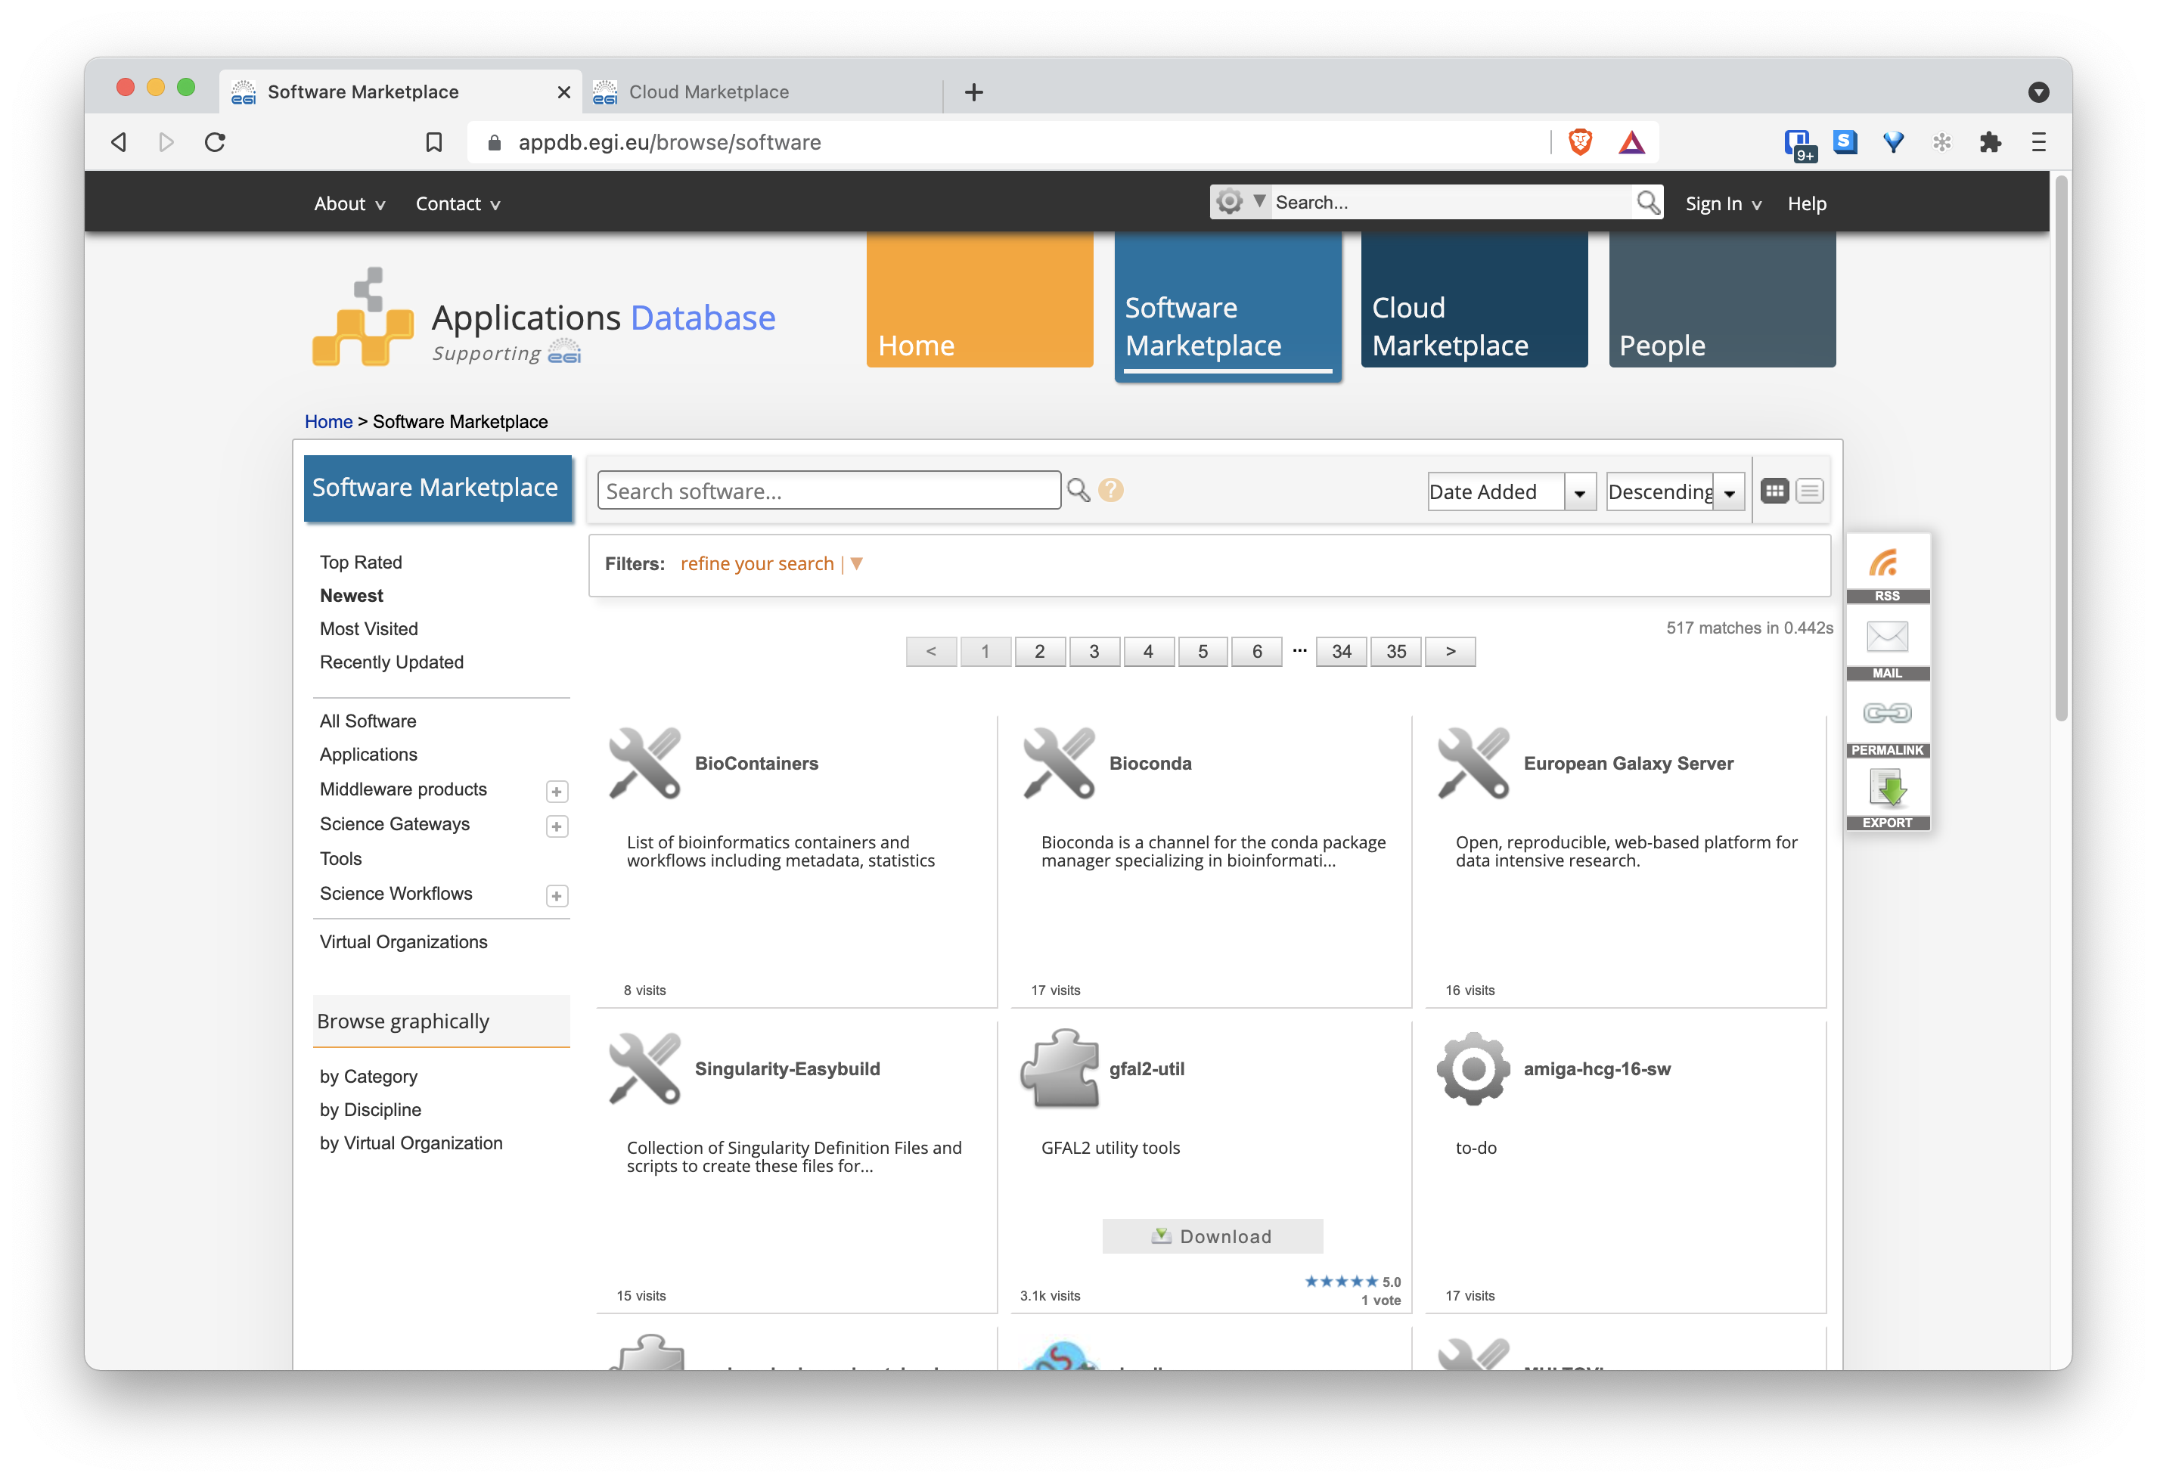
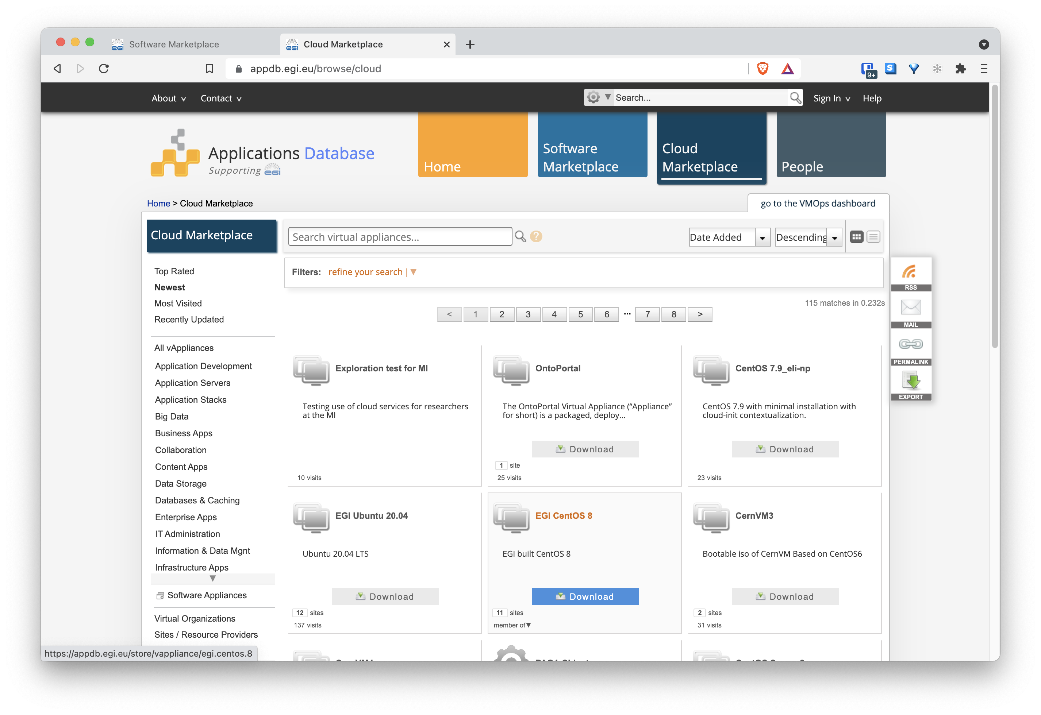
AppDB as a Software catalogue

Slide 7
Cloud Federation
VM-based IaaS
Flexible environment to run potentially any kind of workloads – but puts responsibility on the user to become VM admin
VM images catalogue in AppDB
Container Orchestration platform
Run containers on k8s – flexible and powerful platform – still complex to use
No providers directly supporting k8s right now, can be deployed on VMs automatically thanks to orchestrator or similar tools
Container registry in AppDB
PaaS Orchestration
Deploy applications across different infrastructures (VM + containers + potentially others) with data aware deployment
Templates for commonly used applications (e.g. k8s, spark, …)

Slide 8
HTC/HPC Federation
Access to large, shared computing systems for running computational jobs at scale
HTC is typically oriented towards the execution of many independent tasks over long times while HPC supports very optimised applications that need large amounts of parallel computing power over short periods of time
Managed: users do not need to care about infrastructure, just submit jobs to a queue
Tuned: highly available, scalable filesystems, accelerators (e.g. GPUs), low-latency network (e.g. Infiniband)

Slide 9
Batch processing and analytics
Provide higher level abstractions to facilitate access to computational resources
Managed: where the batch processing system is operated by a third party, and there is no need for the user to directly interact with the underlying infrastructure
Self-managed: where a user can choose a pre-packaged processing system and request deployment on his chosen compute infrastructure.

Slide 10
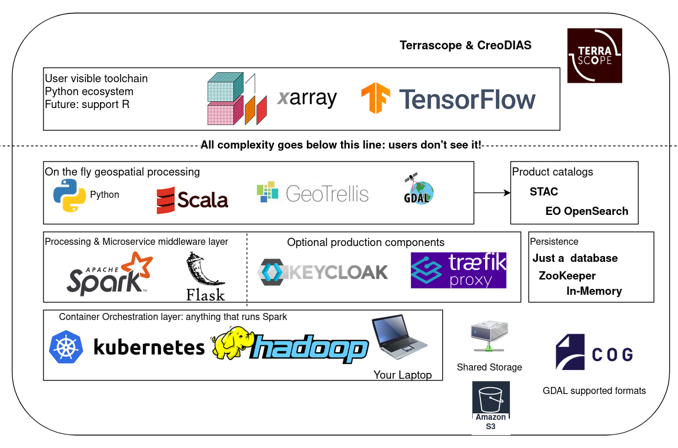
OpenEO deployment

Slide 11
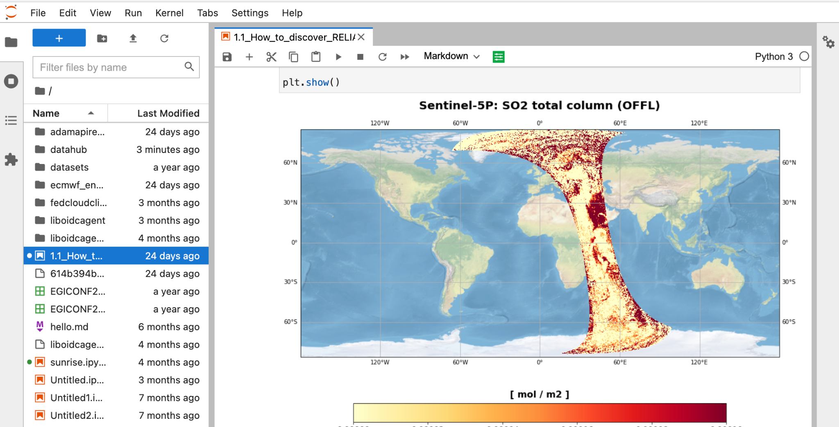
Interactive analysis
Jupyter Notebooks
Integrated with C-SCALE Federation
Ready-to-use data analytics on a interactive front-end
Leverage EGI Notebooks
multi-user setup - already integrated with AAI
customisable to meet the needs of EO users
integrated with other EOSC services from EGI / EUDAT and others

Slide 12
Interaction with Data Federation
Metadata queries to discover products via STAC-API
Dedicated clients or just HTTP client (e.g. curl)
No authentication needed
Data staging via HTTP-based endpoints
rclone or any HTTP client
Needs authentication (a valid Check-in access token)
Notes
Access tokens do expire (default 1 hour), tools like oidc-agent facilitate the refresh of these tokens in a secure and automated way
HTC/HPC providers may have limitations on outgoing/ingoing connectivity: discovery/staging may need to be done at the login nodes

Slide 13
VA installations
Partner | Cloud Compute | Storage | HPC/HTC and GPU
EODC | EODC EO Cloud | EODC EO Storage | EODC HPC
INFN | INFN-Bari-Cloud CPU | INFN-Bari-Cloud Storage
SURF |  | SURFsara dCache | SURFsara Data Processing Compute
 |  | SURFsara Spider Storage
 | SURFsara MS4 Cloud | SURFsara MS4 Storage
 |  | SURFsara MS4 Storage SSD
INCD | INCD-Lisbon (NCG) (Compute) – 4.5 CPU day | INCD-Lisbon (NCG) (Storage
CREODIAS | CREODIAS – Compute | CREODIAS – Storage | CREODIAS – GPU
GRNET | GRNET-KNC | GRNET-KNS-Storage
 |  | GRNET-ARIS (Storage) | GRNET-ARIS (Compute)
VITO | VITO - CVB (Compute) | VITO – CVB (Storage)
CESNET | CESNET - MetaCentrumCloud
Total capacity available:
12 PB months of storage
18 million Cloud CPU hours
3.1 million HPC/HTC CPU hours
6,000 GPU hours

Slide 15
Beyond (basic) cloud, HTC/HPC
WP3 so far focused on having a working foundation for accessing computing resources - this may be too low-level for some use cases!
Some ways of accessing higher-level abstractions
T3.3 Batch processing and interactive analysis will provide managed (e.g. OpenEO) and self-managed (i.e. recipes for deployment) tools
PaaS-Orchestrator facilitates the deployment of ready-to-use platforms, several already available
Ask for support! We may not be able to provide any platform but for sure can help on making it available

Slide 16
Copernicus Compute Federation - HTC/HPC – T3.2

Slide 17
AAI in Cloud Federation
Based on Check-in
AARC BP compliant IdP-SP proxy
OIDC as main technology / usable via browser and API/CLI flows
Users are managed within “VOs” (Virtual Organisations)
Perun as the VO management system
User enrolment with approval from VO manager
Authorisation handled locally at providers by checking assertions that state what VOs a given users belongs to
eduGAIN + social logins
Check-in
Perun
OIDC
Cloud Provider

Slide 18
Onboarding cloud providers
Rely on EGI cloud federation
Mature procedures for registration and technical integration
Ensure provider follows policies, contacts (admins, security), expected availability is met, etc.
Automated monitoring of providers to quickly detect, correlate, and analyse data for a fast reaction to anomalous behaviour
Common accounting reporting
Discovery information
Check-in
monitors
Argo
Monitoring
GOCDB
endpoint
topology
Provider
Cloud Management System
extract
infro
AppDB IS
Argo Messaging System
extract
usage
Accounting
sync
images
AppDB + VA repository

Slide 19
HPC/HTC Federation
SSH access to HPC/HTC (batch processing facilities) with common AAI
SRAM
LDAP
Batch processing farm
ssh
UI
slurm
storage

Slide 20
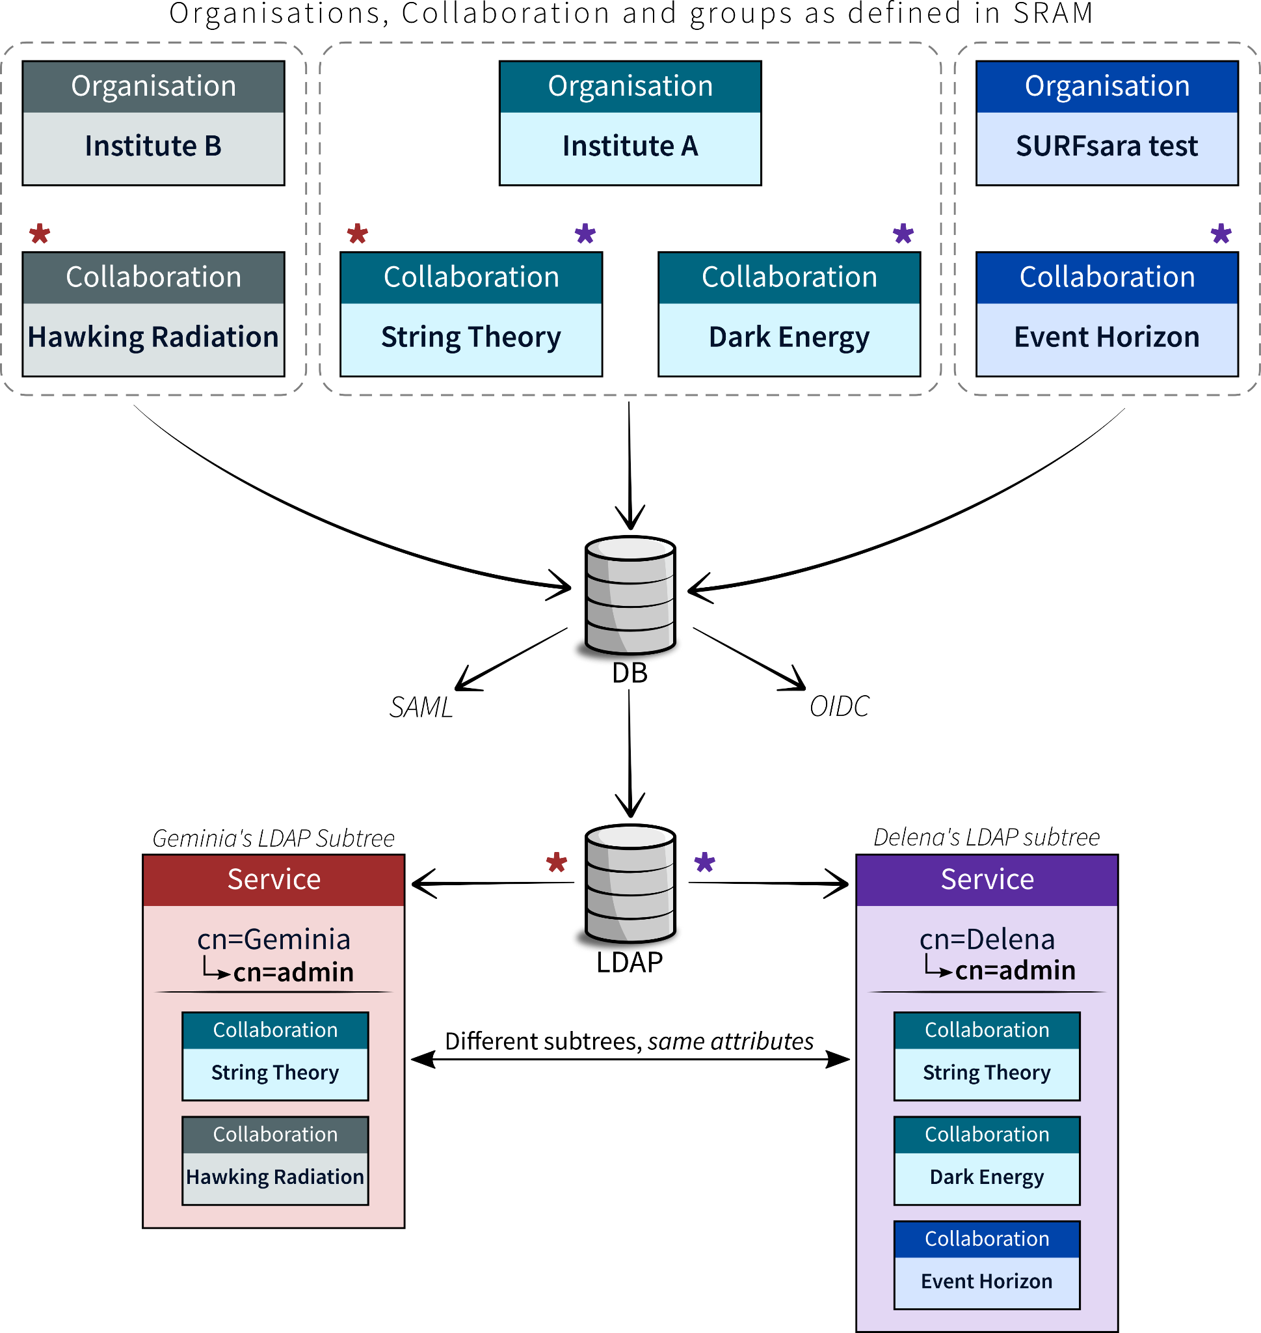
Onboarding HTC/HPC providers
SRAM registration
Established procedure to get provider information via a form (contacts, policies …)
Couple CO with provider
Configure LDAP synchronisation into the provider
Accounting and monitoring to be explored in 2022

Slide 21
Use case onboarding
Create supporting VO/CO in Perun/SRAM
Identify VO Manager/PI that will handle
Agree support with providers
SLA/OLA related procedures on EGI sites
Still to be properly defined for HTC/HPC, so far we have a collection of information required from each use case to be supported at the sites, but no common procedure
Configure providers
Configure VO in OpenStack/CO LDAP tree sync
Enrol users into VO/CO
Approval by VO Manager/PI
Access!

