Slide 1
EGI Data services Roadmap
Andrea Manzi
(EGI Foundation)

Slide 2
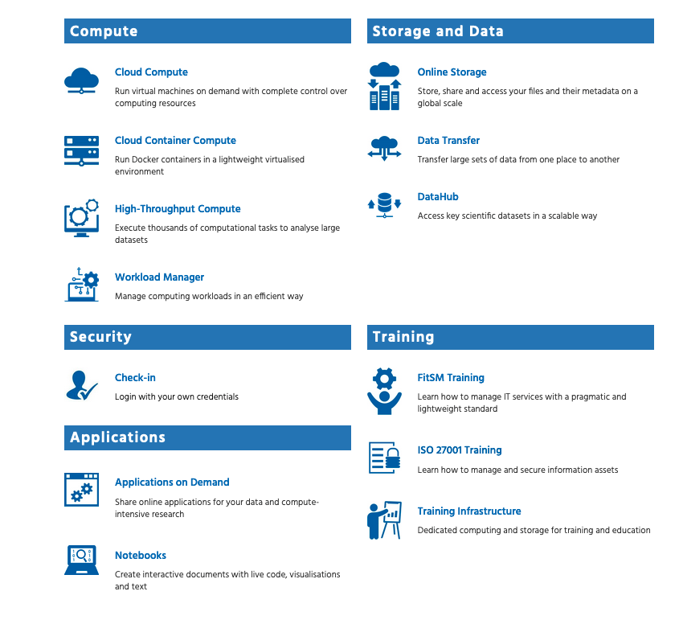
EGI Storage and data services
see: EGI-ACE Federated data access services
New EGI-ACE services
Rucio
openRDM
Services not yet in our catalogue
CVMFS
New area
Sensitive data management

Slide 3
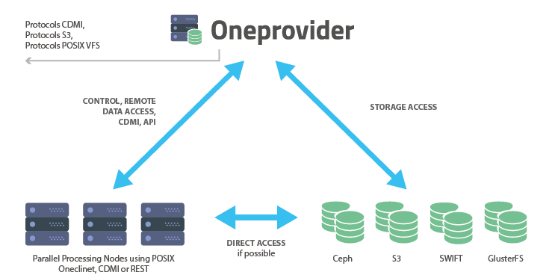
DataHub
Access key scientific datasets in a scalable way
Service based on Onedata technology
It allows transparent data access under a common namespace regardless of the location
Data can be accessed via a GUI or APIs
Central component and distributed
providers in EGI-ACE are operated by
Cyfronet

Slide 4
DataHub
Main functionalities
Integrated with EGI-Checkin
File/Share Management
Shares can eventually be published via Handle services and have a PID assigned
Extensive backend support
Posix, S3, Swift, CEPH, GlusterFS
Data import
Allows exposing existing datasets
Metadata Management
Metadata associated to files (k-v pairs, json, rdf)
OAI-PMH interface
Harvester Management
Possibility to automatic extract metadata from files published to a space
Metadata updates are pushed to external indexes (e.g. Elastic Search) and automatically synchronized

Slide 5
DataHub
Status and Roadmap
Transitioned to Beta in December 2020
added to the EGI catalogue and EOSC Portal
RoadMap
Integration with EGI Notebooks DONE
Accounting integration TODO
Transition to Production TODO
PoC integration with IDS Ecosystem DONE
Onedata new features in 2022
New storage drivers (Onedrive, gDrive, Dropbox,etc)
Archiving use case, supporting OAIS model for long term preservation
Automation based on workflow engine combined with FaaS platforms

Slide 6
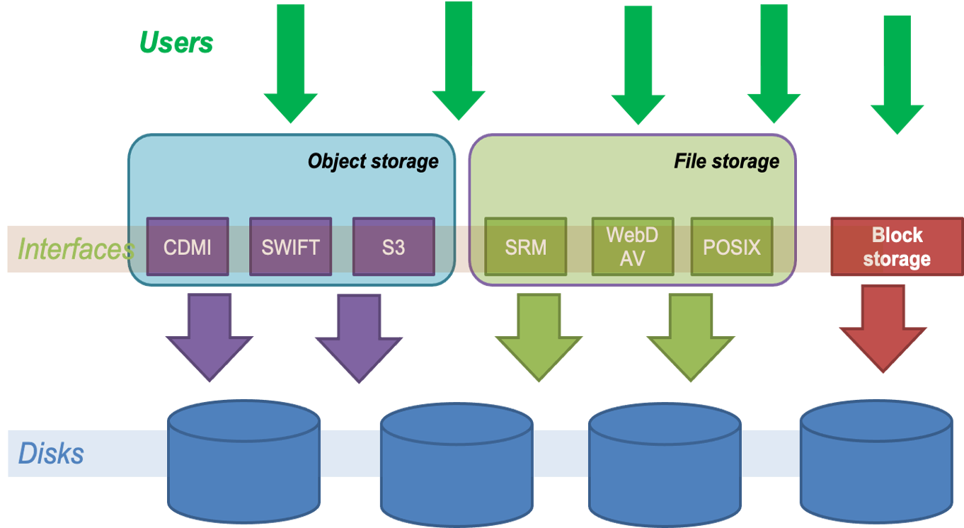
Online Storage
Includes 3 categories of storage services
File Storage
Block Storage
Object Storage

Slide 7
Online Storage
File storage
File storage can be used for storing and accessing files on the infrastructure as input/output to EGI HTC computations
The EGI Workload Management system (DIRAC) is able to access files stored in File Storage instances via different protocols, and schedule the computations in order to be executed close to where the input files are stored
Technologies: DPM, dCache, StoRM
Interfaces: SRM, HTTP/WebDAV, XRootD, gridftp, CDMI

Slide 8
Online Storage
Block storage
Block-level storage solution that allows to expand the storage capacity of instances in the EGI Federated Cloud, offering the lowest possible latency for applications
Increase storage without increasing the size or capacity of the instance or by provisioning new ones; delete servers, keeping data intact
Enhancing Technology: Openstack Cinder
Interfaces: POSIX for access, OCCI and Openstack CLI/GUI for management

Slide 9
Online Storage
Object storage
Manages data as objects. Each object includes the data itself, a variable amount of metadata, and a globally unique identifier.
Cloud object storage allows relatively inexpensive, scalable and self-healing retention of massive amounts of unstructured data
the main uses cases are:
Backups and Data Archive, AI and ML , Cloud Native applications
Technologies: OpenStack Swift, CEPH
Interfaces: S3, Swift, CDMI

Slide 10
Online Storage
Status and Roadmap
Production service in the EGI catalogue
Roadmap
File storage
DPM End of Support
EGI-ACE support till end of the project (June 2023)
Migration tools to dCache ONGOING
EOS in UMD ONGOING
Gridftp and GSI end of support coordination ( EGI operations ) ONGOING
Block Storage
Accounting ONGOING
Object Storage
Accounting TODO
Tutorial on data transfer TODO

Slide 11
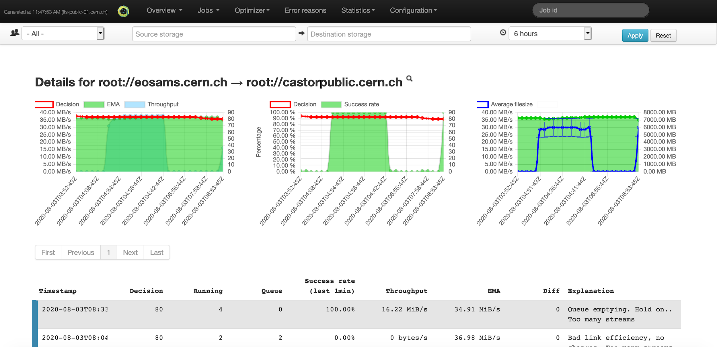
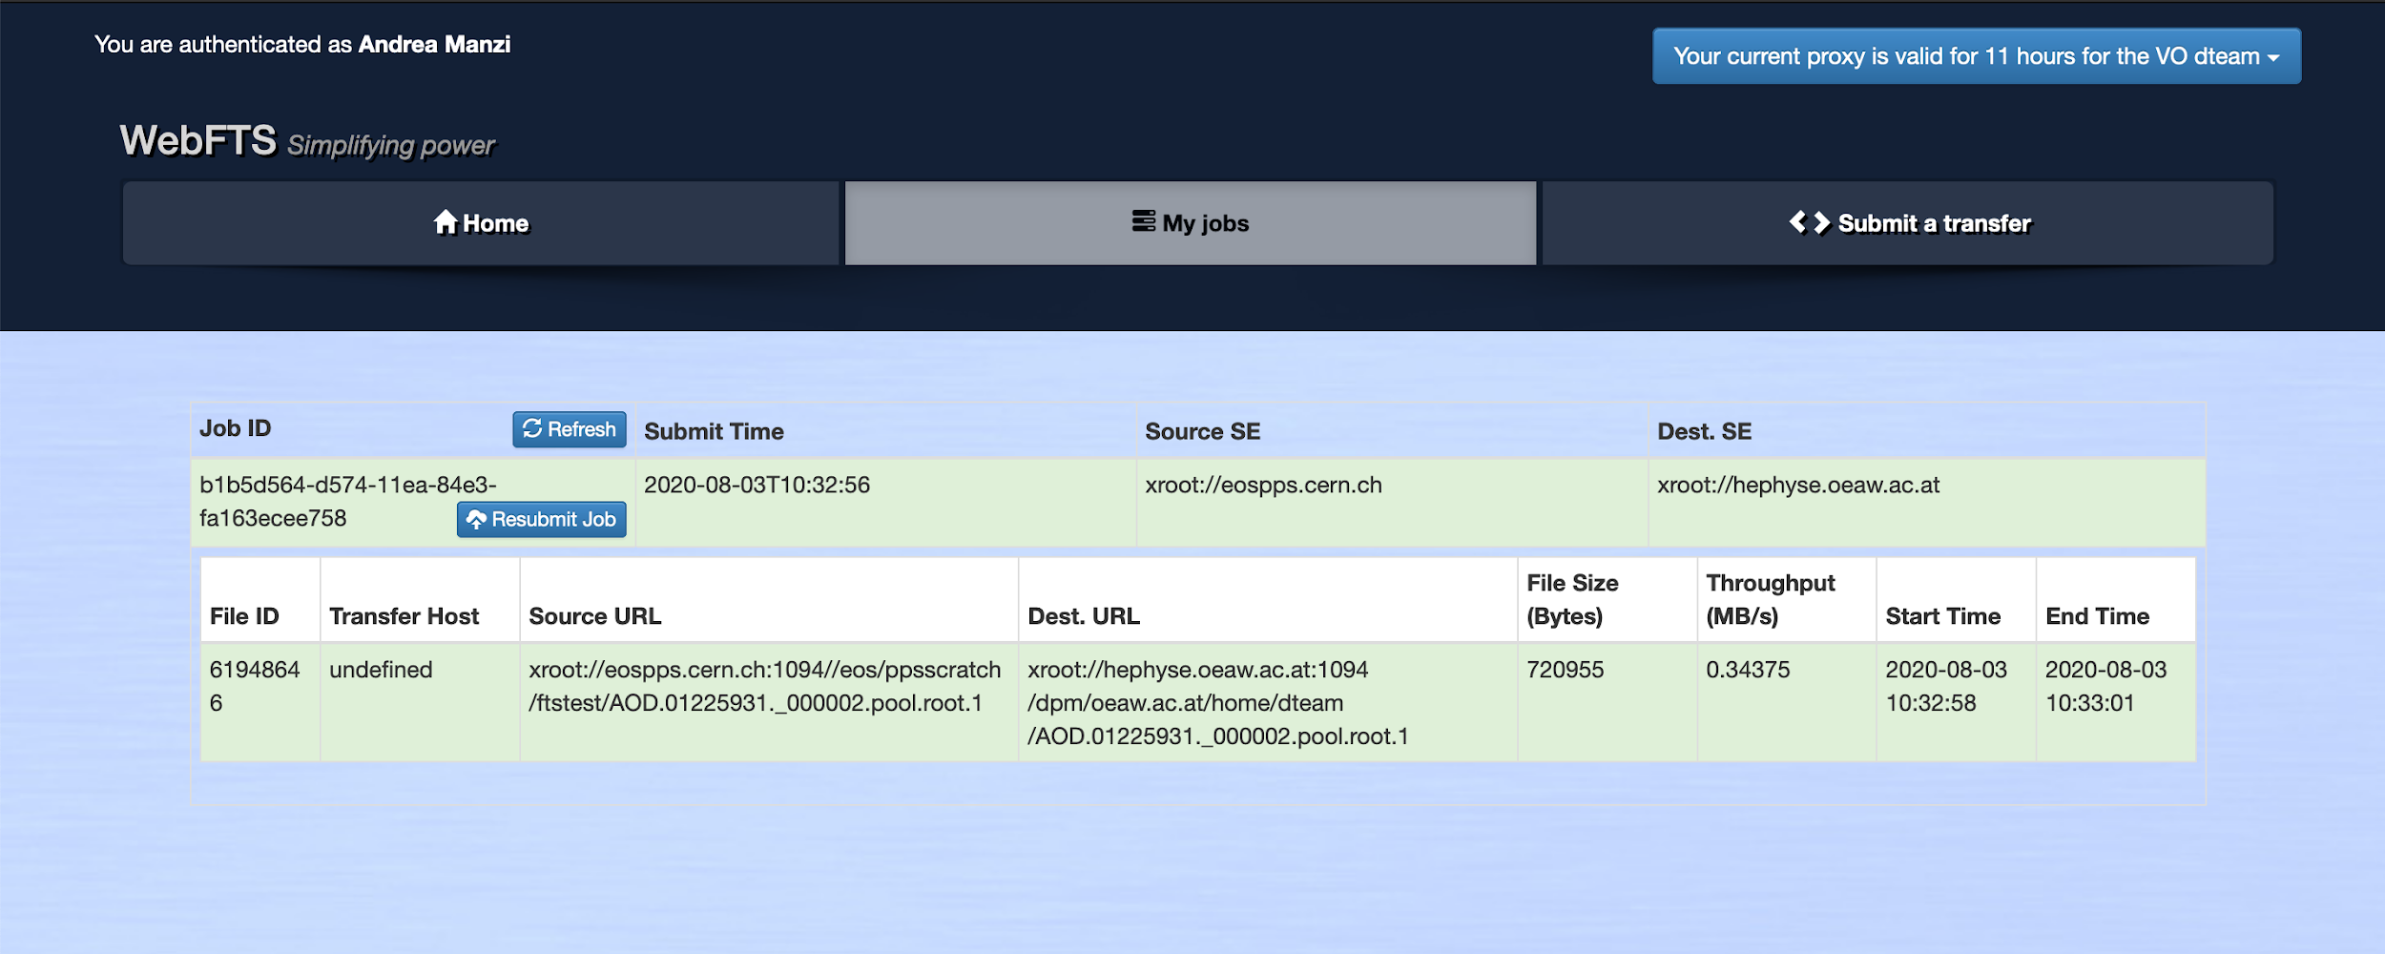
Data Transfer
Transfer large datasets between storages
Orchestrates transfers between EGI Online storage instances and external storages using standard protocols ( e.g. HTTP/WebDAV, gridftp)
UKRI-STFC is providing the service and planning to operate the end user graphical interface (WebFTS)

Slide 12
Data Transfer
Status and Roadmap
Production service in the EGI Catalogue
OLA for EGI-ACE ( both with CERN and UKRI- STFC) DONE
RoadMap
Deployment of EGI dedicated instance at UKRI-STFC ( both FTS and WebFTS) ONGOING
EGI-Checkin integration ONGOING
Data Transfer WG
Workshop organized at the conference
Understanding needs from communities, piloting new technologies
EOSC Future
Plans to provide the service as the EOSC Data Transfer service
Activity planned for 2022

Slide 13
Rucio
Scalable data management
Rucio is the software developed at CERN for the management of LHC experiments data
provides a complete and generic scientific data management service
Rucio manages multi-location data in a heterogeneous distributed environment
Creation, location, transfer, and deletion of replicas of data
Orchestration according to both low-level and high-level driven data management policies (usage policies, access control, and data lifetime)
Interfaces with workflow management systems
Large-scale and repetitive operational tasks can be automated

Slide 14
Rucio
Status and Roadmap
UKRI-STFC implemented extensions for Multi-VO support and is operating the service in EGI-ACE
Initial activities
Monitoring, Helpdesk and GOCDB DONE
OLA with UKRI-STFC DONE
EOSC registration ONGOING
RoadMap
New service in the catalogue
EGI Data orchestrator ONGOING
Integration activities
Documentation ONGOING
EGI-Checkin integration ONGOING
WebUI for Multi-VO TODO

Slide 15
openRDM
Main functionalities
A complete solution for managing research data, based on the openBIS software. Targeting research labs working with quantitative research data
Inventory management
Keep track of all materials and samples used in a lab
Electronic lab notebook
Describe computational experiments and links to the materials, samples and protocols stored in the inventory
Data analysis integration
Jupyter notebook integration and access to external computing clusters
Data management
Store all data connected to experiments, export to data repos like Zenodo

Slide 16
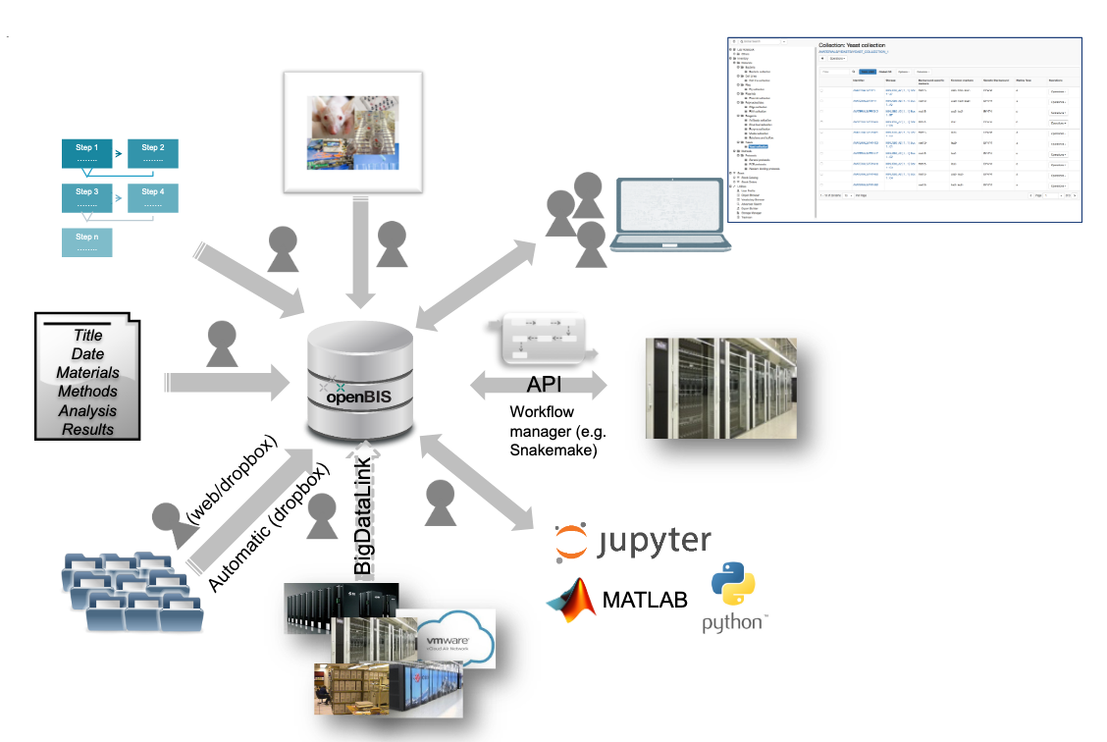
openRDM
Service Operations
The service is provided by EnhanceR as a managed instance on the EGI Cloud providing access to long-tail of science type use cases for evaluation
Additionally dedicated instances for
specific communities will be setup on top
of EGI Federated resources
Support for in house installations is also
provided

Slide 17
openRDM
Status and Roadmap
Initial Activities
Monitoring, Helpdesk and GOCDB DONE
OLA with Enhance-R DONE
Registration in EOSC DONE
RoadMap
EGI-Checkin integration ONGOING
Define the service in our catalogue TODO

Slide 18
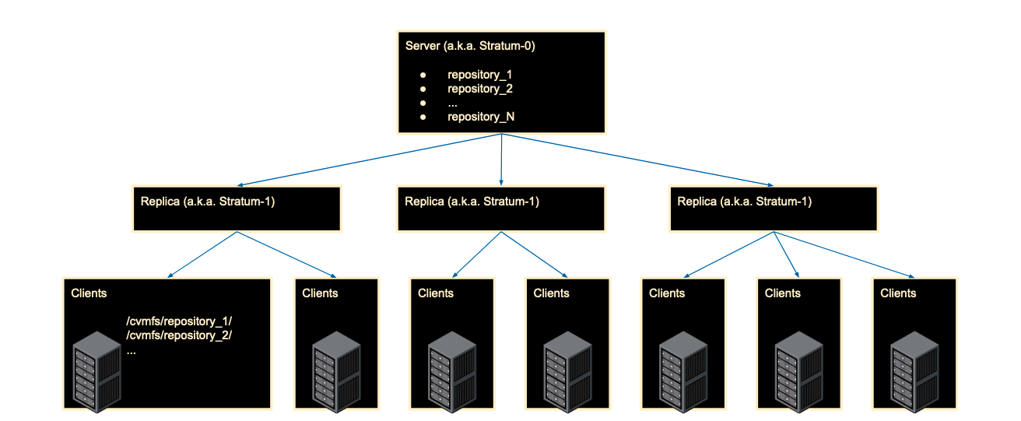
EGI Content Distribution (CVMFS)
Main functionalities
CernVM-File System (CVMFS) provides a POSIX read-only file system in user space
Scalable software and data distribution, extended to handle container images
Caching at providers for fast access to frequently used software/data
Mostly used in HTC, but useful also for IaaS

Slide 19
EGI Content Distribution (CVMFS)
Status and Roadmap
Already in use by production since years by several communities in EGI
Stratum-0 service operated by UKRI-STFC
OLA updated ( including OLA for Stratum 1 services)
RoadMap
Documentation revamp (to be migrated to docs.egi.eu) DONE
Still Alpha in EGI, Move to Beta ( and inclusion in the catalogue) ONGOING
Registration in EOSC Catalogue ONGOING
CVMFS uploader Check-in integration ONGOING
Better automation of uploading / unpacking container images TODO

Slide 20
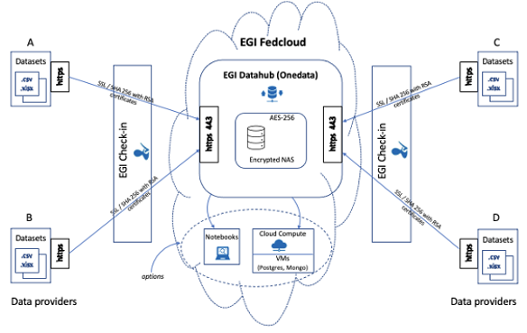
New area: Sensitive Data Management
First solution for sensitive data storage and processing just setup for the LETHE project
New technologies and solutions are under scouting and it will be one of the area of improvements in the near future
Technical solutions need to be complemented by regulatory and legal aspects
LETHE - A personalized prediction and intervention model for early detection and reduction of risk factors causing dementia, based on AI and distributed Machine Learning

Slide 21
Data management questionnaire
Data Management requirements questionnaire under preparation, to be shared with EGI Community
General data management requirement gatherings, i.e.
Specific services not available in their organizations
Storage and archival solutions preferred
It will help defining the directions for data management in EGI in the future
Already working on landscaping and testing technologies (also thanks to project where EGI is participating)
e.g. data catalogues (CKAN), File Sync and Sharing

