Slide 1
EOSC Future
Overview
Ron Dekker

Slide 2
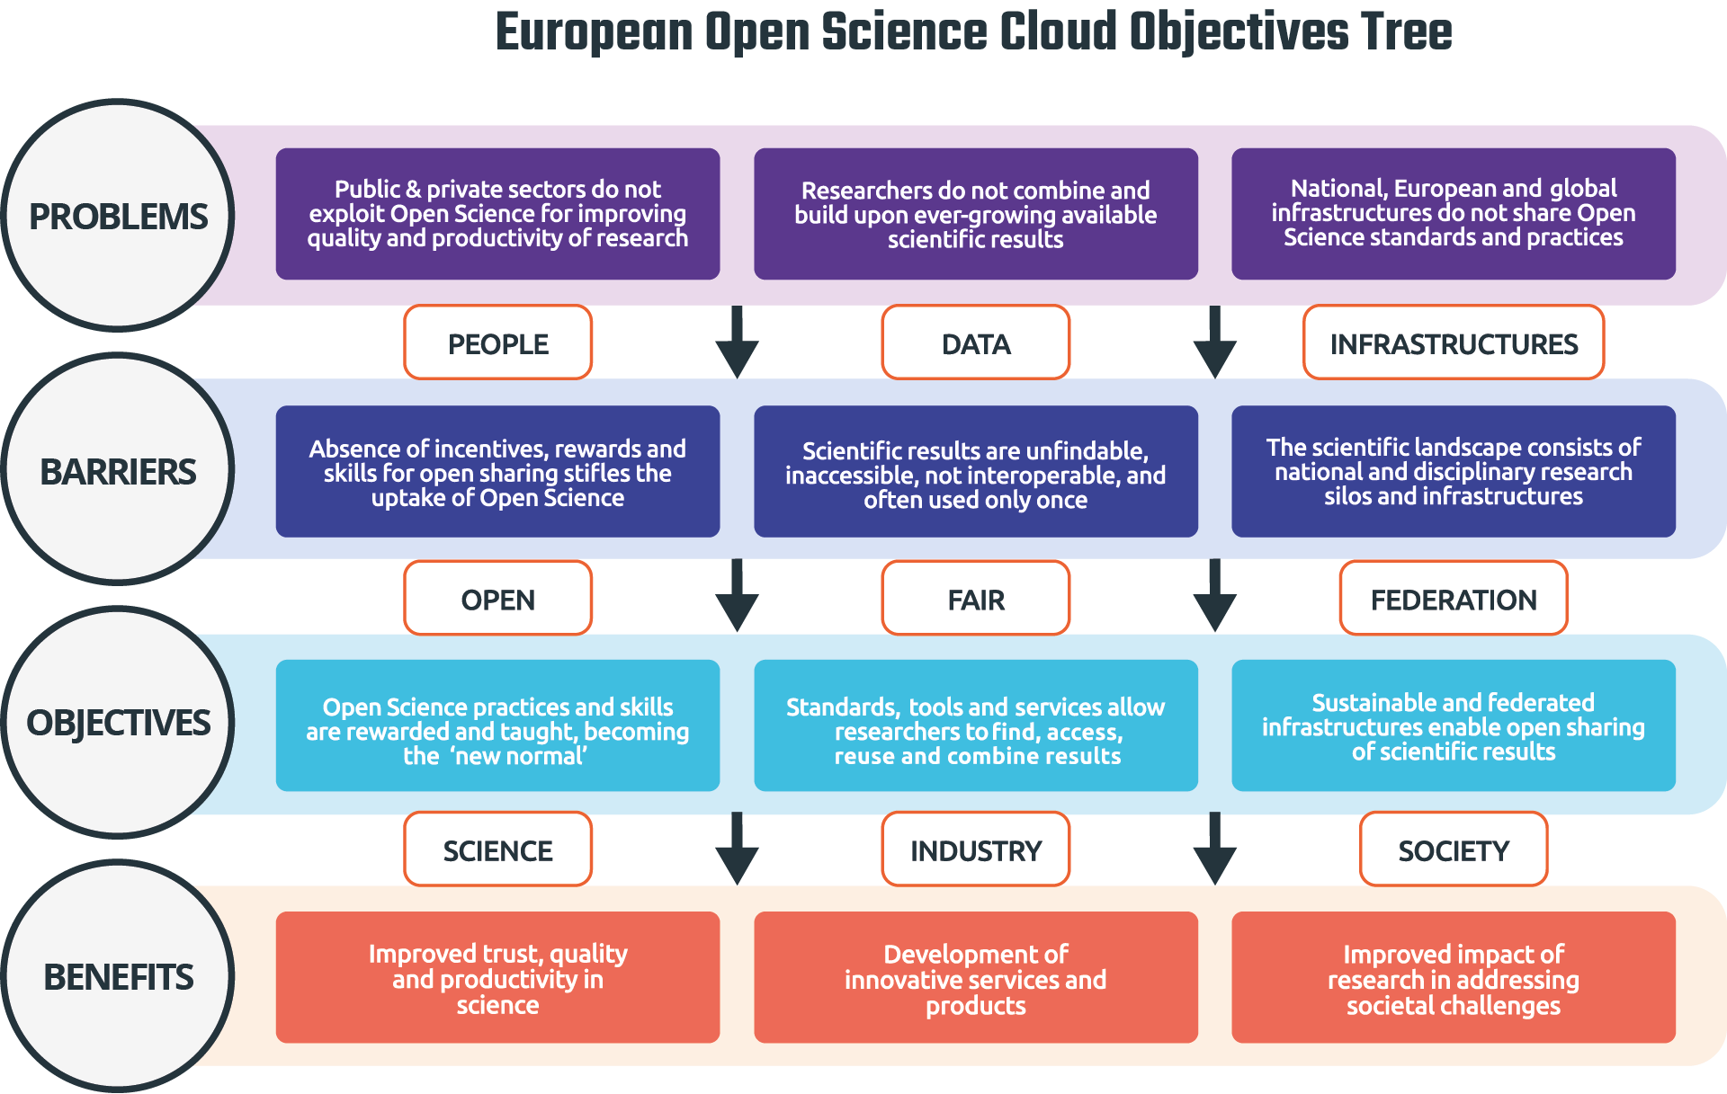
EOSC

Slide 3
Vision
EOSC Future
An operational platform with an integrated execution environment consisting of data, services, open research products, infrastructures
Mission
To bring the e-Infrastructures and Science Cluster communities together to implement an operational EOSC platform

Slide 4
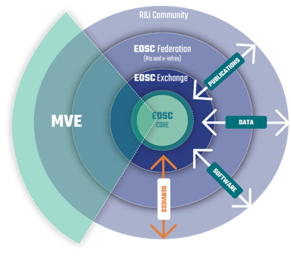
Tenets
EOSC Platform
EOSC Core & EOSC Exchange
Interoperability Framework [standards & guidelines]
Data Content & Services
Science Clusters
e-Infra Services [computing, storage, networks]
3rd party services
Communities
Engagement
Training & Skills

Slide 5
Consortium
41 M€, 30 Months
1 April 2021 – 30 September 2023
36 partners, 48 LTPs
e-Infra’s, Science Clusters, RDA, …
Alignment
EuroHPC
GAIA-X
EOSC Governance
European Commission
EOSC Partnership Board
EOSC Steering Board (MS / AC)
EOSC Association
EOSC Future
EOSC Projects
05 (Regional)
06 (Enhance)
07 (e-Infras)
12 (Hub, OpenAire)

Slide 6
Strategic goals
Policy & Strategy
(WP2)
Technology & Interoperability
(WP3, 4, 5, 7)
Excellent Science
(WP 6)
Co-development
& Procurement
(WP8)
Skills
& Training
(WP9)
User Engagement
(WP10)
Strategy and Oversight Board

Slide 7
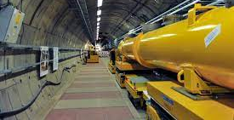
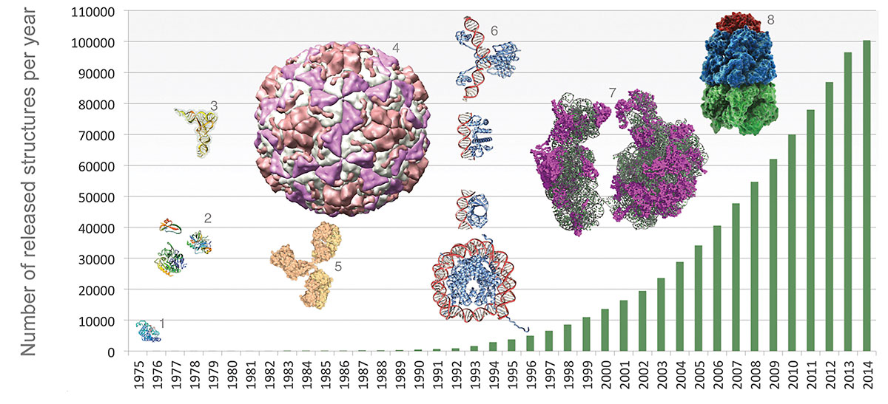
Young postdoc on cell membrane proteins
Data from And
Combining with existing data from other research group from synchrotron
RESULTS go into Protein Data Bank

Slide 8
Thank you
Ron Dekker

