Slide 1
EOSC Architecture
The EOSC Future Overview
Klaas Wierenga (GEANT) & Diego Scardaci (EGI)
Technology and Integration Pillar Leads
EOSC Future TCB Chairs

Slide 2
Guiding principles
The EOSC Future core platform federates existing and new infrastructures into a system of systems
EOSC Future delivers the ‘glue-layer’ that allows for the composition of resources across infrastructures by:
Providing APIs and metadata
Providing Interoperability Frameworks
Providing portal capabilities
Setup the EOSC-Core
Populating the EOSC-Exchange
Technical roadmap is driven by user requirements and implemented as an, over time increasing in complexity, set of user capabilities

Slide 3
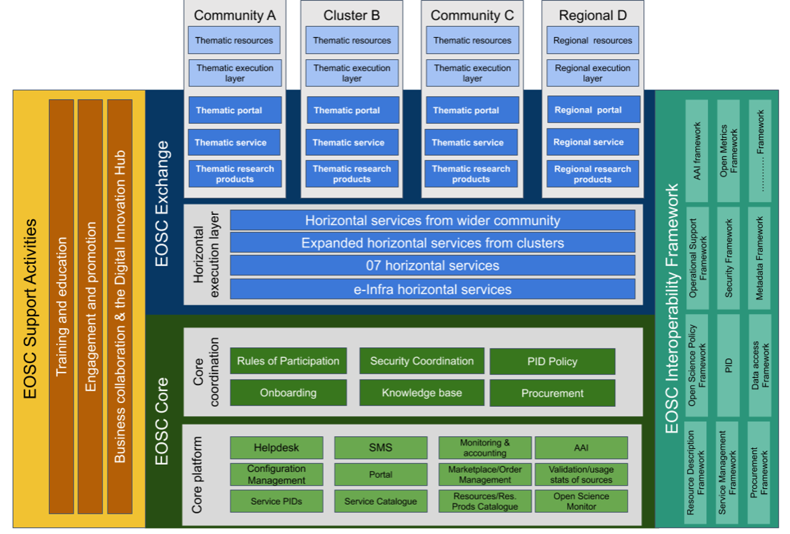
EOSC Architecture

Slide 4
EOSC Architecture - Core
Core platform
Portal
AAI
Config management
Service management
Helpdesk
Service catalogue
…
Coordination
Policies
Security
…

Slide 5
EOSC Architecture - Exchange
Community
Resources
Portal
Thematic services
Horizontal execution layer
07 Projects
e-Infra
Clusters
Community

Slide 6
EOSC Architecture - EIF
Resource Description Framework
(Persistent) Identifiers
AAI
Metadata and Ontologies
Accounting
Monitoring
Order management
Helpdesk

Slide 7
Researcher view: different benefits
Organised Community
Emerging community
Community
Researcher
Researcher
Researcher
Researcher
Researcher
Researcher
Researcher
Researcher
Researcher
Researcher
Researcher
Researcher
Researcher
Researcher
Researcher
Researcher
Community consensus tools, portals, workflows and resources.
Offer discovery of a comprehensive set of resources + experiments in resource composability
Offer a space for emerging research communities.
Access portals, tools and workflows from other communities a researcher is a member of - e.g. national
Community Platform
Community Platform
EOSC Portal
Tools
Workflows
Community Portal
Tools
Workflows
APIs
APIs
Comprehensive Resource Catalogue
EOSC Core Platform
Integrate:
-Resources from EOSC, making them available to community members: services, data, other research products
- Core services to add extra basic functionalities to community platforms
Composite resources
Thematic Provider A
Thematic Provider B

Slide 8
EOSC Future Technical Roadmap

Slide 9
EOSC Future Technical Roadmap
3 main milestones: M6 - M18 - M30
EOSC Interoperability Framework
EOSC Core
EOSC Exchange

Slide 10
EOSC Interoperability Framework
Technical Roadmap
Interoperability frameworks to enable the integration/composability of EOSC resources
Resource Description Framework
Identifiers
AAI
Metadata and Ontologies
Accounting
Monitoring
Order management
Helpdesk
Data Platforms for Processing
Data Publishing and Open Data
Cloud Compute Containerisation and Orchestration
HTC-HPC Compute
Machine Learning
INFRAEOSC-07
Thematic clusters
EOSC Exchange
EOSC Core
Regional clusters

Slide 11
Setup the EOSC-Core
EOSC Platform Central functions
Interfaces for (optional) integrations
Beta EOSC-Core
Production EOSC-Core

Slide 12
Populating the EOSC-Exchange
311 Resources onboarded through EOSC Future and prior projects (e.g. EOSC-hub, EOSC Enhance, eIC) (source EOSC Metrics Portal)
EOSC Exchange
Execution Framework
Cluster services onboarded
Thematic clusters
Community A
Cluster B
Community C
Regional D
Thematic resources
EOSC Core
Thematic service
Thematic resources
Thematic resources
Regional resources
Thematic service
Thematic service
Thematic service
Thematic service
Thematic service
Thematic service
Thematic service
Regional clusters
Thematic Resources
Thematic Resources
Thematic Resources
Regional Resources
Horizontal services
Horizontal services and resources from 07 projects and e-infras onboarded
EOSC Support Activities
EOSC Interoperability Framework
Core coordination functions
INFRAEOSC-07
EOSC provisioning / expansion
Core technical platform
EOSC Horizontal services are delivered (e.g. data transfer, container deployment and orchestration)
The onboarding process is extended to include validation of data sources
Ability to create thematic execution environments / VREs based on integration of compliant thematic, horizontal, and core resources
eInfrastructures

Slide 13
Thank you for your attention!
Diego Scardaci (EGI) <diego.scardaci@egi.eu>
Klaas Wierenga (GEANT) <klaas.wierenga@geant.org>

