Slide 1
ARDC Nectar Cloud & GOSC
Embedding Australian National Research Infrastructure globally
PRESENTED BY
Carmel Walsh
22/10/2021
Notes:
This is a title slide. Heading and Subtitle are on the right. Presenters name and date on the left.

Slide 2
ARDC Overview
Notes:
Use this slide as a section break.

Slide 3
Notes:
The ARDC’s purpose is to provide Australian researchers with competitive advantage through data. We accelerate research and innovation by driving excellence in the creation, analysis and retention of high-quality data assets.
This is the current ARDC strategy on a page. We operate a range of programs and services over four portfolios.
For the last two years, we have been running a range of open calls that have given us a unique insight into the digital research infrastructure needs of the Australian community.
Let’s look at some significant statistics
25 Universities are working together to collectively create a nationally agreed institutional research data management framework under the Institutional Underpinnings program
There are 15 Communities of Practice including areas like machine learning, research software, and sensitive data
There are 26 national research infrastructure and data platforms
Research Data Australia supports nearly 50,000 unique searches per year
The Nectar Research Cloud supported 1788 projects last year
These statistics show that the national data and research infrastructure capabilities are extensively utilised and they foster national collaborations to deliver research impact
But we can’t meet the demand and we need to transform the delivery of our national research infrastructure to take a strategic approach to ensure maximum benefit to the maximum number of researchers

Slide 4
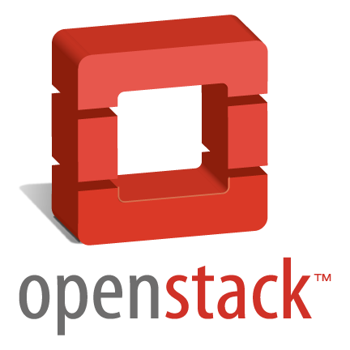
8,000
Virtual Machines
33,000
ARDC Nectar
Research Cloud
The University of Auckland
Auckland
Physical CPU Cores
Advancing research since 2012
QCIF
Brisbane
150,000+
Virtual CPU Cores
The University of Melbourne
Melbourne
Intersect
Sydney
2PB
Swinburne University of Technology
Melbourne
Object Storage
Monash University
Melbourne
5PB
TPAC
Hobart
File Storage
‹#›
AUSTRALIAN RESEARCH DATA COMMONS
ARDC Nectar Cloud & GOSC

Slide 5
Supporting Australian research since 2012
In 2020/2021 ARDC Nectar Research Cloud supported:
17
19
6
ARC Centres of Excellence
Cooperative Research Centres
ARC Industrial Transformation Research Hubs
4454
Active users
1935
15
4
35
Projects
NCRIS Capabilities
Medical Research Institutes
Australian Universities
320
ARC & NHMRC grants
27
4,605
50,000+
All
Platforms/Virtual Laboratories
Projects
Researchers supported
research fields
358
Collaborative multi-institutional projects
‹#›
AUSTRALIAN RESEARCH DATA COMMONS
ARDC Nectar Cloud & GOSC

Slide 6
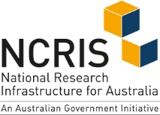
Enabling research collaboration
‹#›
AUSTRALIAN RESEARCH DATA COMMONS
ARDC Nectar Cloud & GOSC
Notes:
Existing Platforms hosted and developed on Nectar

Slide 7
ARDC Nectar Research Cloud & GOSC

Slide 8
ARDC Nectar & the Global Open Science Cloud
What can we bring to the Global Open Science Cloud...
An established national research cloud hosting significant national research platforms
OpenStack expertise and continual development to adapt to new technologies to evolving research needs
Significant experience in running a national Federation defining and implementing standards across multiple organisations and countries
A national and international community developing shared best practice, standards which leverage skill-sets to ensure we can give Australian researchers the competitive advantage through data
Innovation at scale
‹#›
AUSTRALIAN RESEARCH DATA COMMONS
ARDC Nectar Cloud & GOSC

Slide 9
ARDC Nectar - a testbed for the GOSC
Established
Evolving
Emerging
ARDC Nectar
Interoperability
Cyber Security for Research
27+ Platforms on ARDC Nectar
OpenStack Federation
Research infrastructure skill-sets
Multi-cloud integration
Seamless user experience
Bring compute to data
Micro-segmentation of security using new technology e.g. DPUs
Global authentication & access
‹#›
AUSTRALIAN RESEARCH DATA COMMONS
ARDC Nectar Cloud & GOSC
Notes:
ARDC Nectar can assist the GOSC in the following ways aligned to the work plan.
Share experience of running a Federation developing technical standards for interoperability
Develop and scale digital services for national/international use e.g. Jupyter Notebooks, VDI
Evolve and test innovative technologies for national and international use: GPUs, large memory machines in the cloud with national allocation
Innovate at scale: learnings and pitfalls of trailing technologies for research computing:
Tackling Cyber Security for research computing
Creating a responsive cloud for varied used cases: elastic compute (pre-emptive instances), multi-cloud integration (ARCOS, metadata tagging, multi-cloud integration)
Support international collaboration with global access to supported research platforms
From GOSC Technical Work Plan:
Identify different frameworks and sets of principles for interoperation (reference frameworks - RFs) that new infrastructures can consider and adopt to enable future interoperation
Define interoperability model, without focussing on technology. What are the key services that need to exist, that must be provided to users, and that must interoperate between different infrastructures?
Establish technical test beds to test specific interoperation between infrastructures, ideally using different combinations of platforms. Implement conceptual models, then test interoperation, proving that the model works. Expand testing from individual pairs of infrastructures to broader interoperability (many-to-many)
Expand from test beds to application tests (supporting international use cases) -- scaling up and out to support real science use cases.
Trial and test innovative technologies identified as potentially responding to unmet needs of the science community, for example:
evolve and design cyber security standards for research computing workloads
DPU
Cloud Vulnerability Testing
Multi-cloud (integrate commercial clouds)
Metadata tagging for data discovery

Slide 10
Established Research Cloud: Global Research Platforms
ARDC Platforms in development on ARDC Nectar
AgReFed: platform for transformation of agricultural research
Australian Characterisation Commons at Scale (ACCS)
Australian Digital Observatory
Australian Electrophysiology Data Analytics Platform (AEDAPT)
Australian Housing Data Analytics Platform (AHDAP)
Australian Imaging Service (AIS)
Australian Scalable Drone Cloud (ASDC)
Australian Transport Research Cloud (ATRC)
Biocommons - Galaxy Australia
Biosecurity Commons
EcoCommons (other projects use platform: AgReFed, Biosecurity Commons)
Environments to Accelerate Machine Learning Based Discovery
Fish ID (Transforming Australian aquatic ecosystem monitoring using AI)
Global Multi-Resolution Topography for Australian coastal & ocean models
Open EcoAcoustics
Secure eResearch Platform (SeRP)
Veterinary & Animal Research Data Commons (VARDC)
Investment in high-end infrastructure & services:
GPUs for machine learning & image processing
large memory machines for performance
new skill sets, training, multi-cloud & compute
containers and orchestration (Kubernetes on Nectar)
Big data analytics, sensitive data & integration:
data analytics platforms and software (Jupyter/VDI)
separate infrastructure for sensitive data havens
national coordination of containers for research (ARCOS)
Notes:
Australian BioCommons relies heavily on international collaboration and access to international genomics data sets
Sensitive Data Platforms - SeRP (UK to Australia?)
Tap into Global expertise in OpenStack Federations, ….
Leverage expertise and knowledge globally
Avoid reinventing the wheel
Build on expertise in global research ecosystem
Align standards and …
Move the compute and analysis to the data

Slide 11
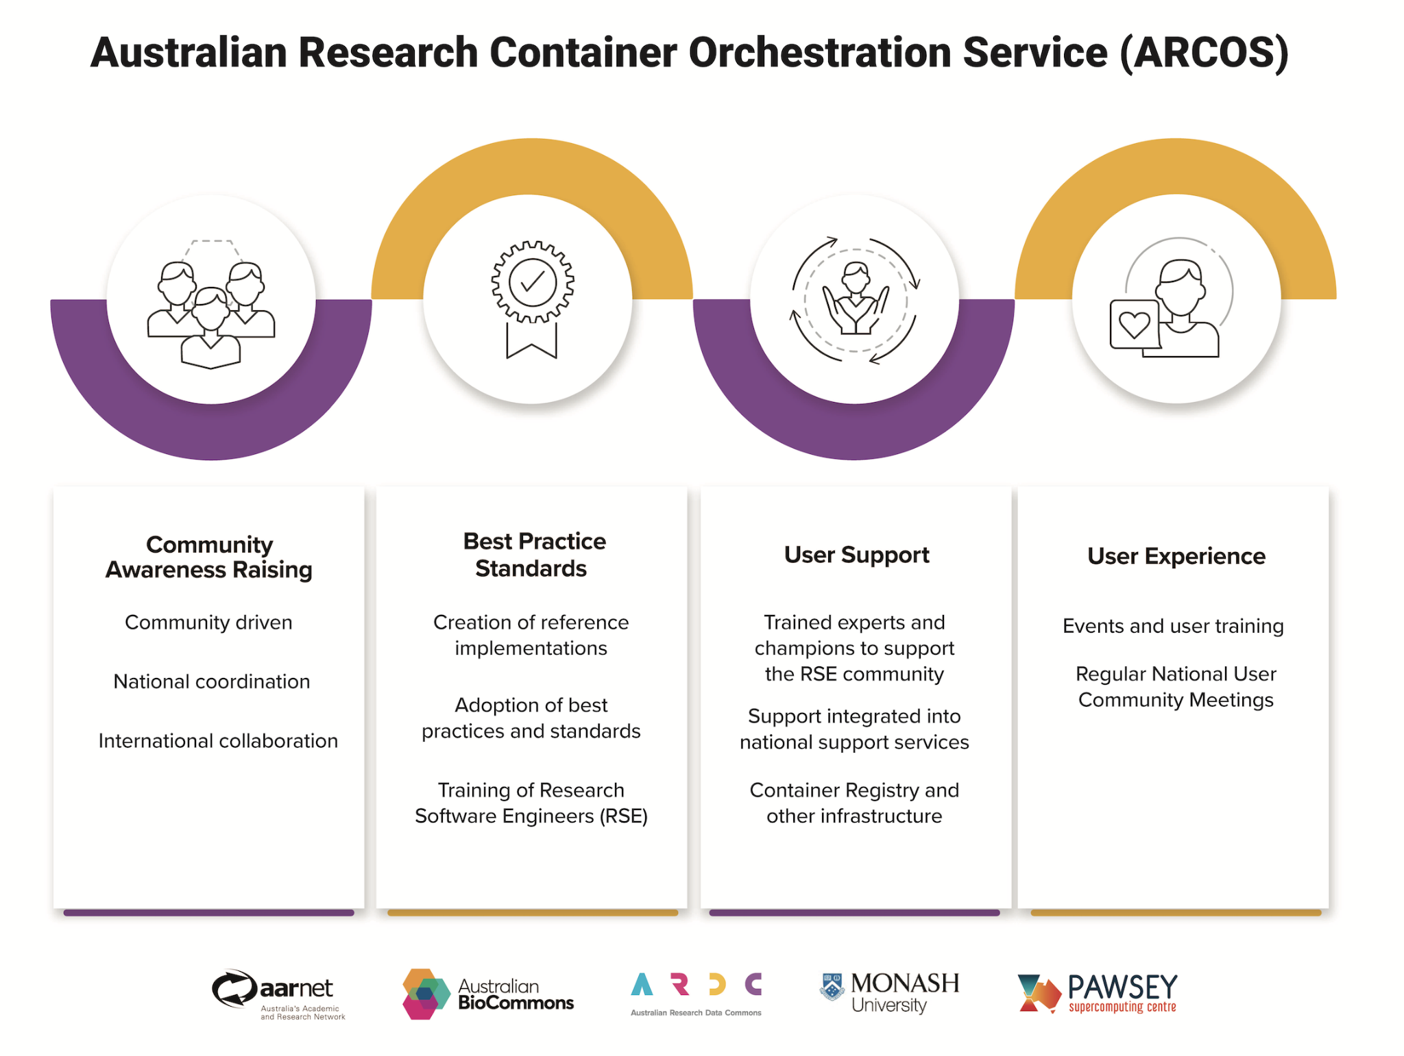
Evolving: Multi-cloud Integration
Containers & Orchestration:
Nectar Kubernetes services (Docker & Magnum)
Research institutions and programs using containers and orchestration across Australia
Lead national coordination of developing technology for research
National Cloud Computing & HPC
ARDC Nectar Research Cloud - cloud computing co-located with institutional HPC
ARDC is part of Digital Data eResearch Platforms (DDeRP) which provisions Peak HPC nationally
Growing demand for HTC
Interoperation with international open science clouds
Analysis and PoC of commercial cloud integration
Metadata tagging and microservices to define best compute for workload
National research commercial cloud use cases
Innovate & develop on Nectar - service on commercial
https://arcos.ardc.edu.au/
‹#›
AUSTRALIAN RESEARCH DATA COMMONS
ARDC Nectar Cloud & GOSC

Slide 12
Emerging: defining Cyber Security for Research
Use Cases testing DPUs for Monash University:
AI based security: fit for purpose
Palo Alto on DPU: enables integration with multiple institutions firewalls (test University & hospitals)
End to end encryption: enable sensitive data collaboration
BYO end-point protection - align with enterprise
Devolving responsibility to global collaborations,
To better enable collaborative research projects
https://www.nvidia.com/en-au/news/monash-university-nvidai-and-ardc-partner-to-explore-the-offloading-of-security-in-collaborative-research-applications
‹#›
AUSTRALIAN RESEARCH DATA COMMONS
ARDC Nectar Cloud & GOSC
Notes:
Security at research project level rather than at enterprise level - researchers self-organise and lead. Need to move away from enterprise approach to ensure we do not limit collaboration or compromise performance

Slide 13
Enabling innovation at scale - ARDC Nectar & GOSC?
Innovation
Investment
National Service
Adapt technology for research computing
Define & develop resources
Service Design & Provision
GPUs
Large Memory Machines
Burst capability/elastic compute
DPUs
Microservices
Containers & Orchestration
Jupyter R Studio
Vertical Desktop Interface
Knowledge share/develop GPUs & large memory machines for research in Nectar Federation
Enhance code developed by Nodes/Platform teams
Apply to use cases - ARDC Platforms
Develop and recruit new skill-sets
Evolve Openstack projects -Leverage national coordination
Partner with industry leaders to explore & test for research
Develop reservation system: Uni Auckland
Create new platforms & enhance existing (ARDC Platforms, Galaxy Aus)
Maximise use of free capacity with preemptible instances
Apply new technology to explore Cyber Security micro-segmentation
Magnum, Docker, National Registry
Create national standards and best practice for multi-cloud (ARCOS)
National Interactive Data Analytics Service
Notes:
Demand and feature forecast
Leverage
Interactive Data Analytics - storage questions
National cloud GPU service
$2M for GPU servers for national merit allocation
Large memory flavors
New Huge RAM flavors - up to 48 vcpus and 360GB RAM
Customised flavors for applications needing larger RAM
Reservation system for GPU and large memory flavors
Pre-emptible instances to provide additional short-term capacity
Jupyter notebook service
Virtual desktop-as-a-service
Expanding the application catalog
Exploring use of DPUs for improving cybersecurity without impacting network and compute performance

Slide 14
www.ardc.edu.au
australian-research-data-commons
ARDC_AU
Notes:
End slide

