Slide 1
A Pilot for GOSC Testbed
Federation CSTCloud with EGI FedCloud
Zuliang Guo, Haiming Zhang
Computer Network Information Center,
Chinese Academy of Sciences
Oct. 22, 2021

Slide 2
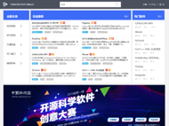



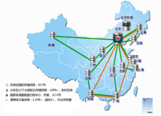
About CSTCloud
Pool of research software
Data & Information
CSTCloud
High-speed network connection
Algorithms & tools
Computing resources
Massive data storage

Slide 3


Missions of CSTCloud as a National Research e-Infrastructure
Define an open architecture to dynamically converge the data & computational infrastructures and research resources.
Co-design an integrated service model for science discovery.
Explore a win-win mechanism for sustainable operation and services.
Open architecture,
dynamic evolution
Fully supports for
disciplinary research activities
Distributed resources,
integrated services
Big data and artificial
intelligence driven
Public funding
& Non-profit services

Slide 4

Capacity of Resources and Services
Switching
Bandwidth
Sharing
Data
Storage
Capacity
Computing
Capacity
Research
Software
100
G
PB
Level
150
PB
300
PF
1000+
CSTCloud Portal
HPC
Resources
Pool
Cloud Computing &
Storage Resources Pool
Data & Information
Resources
Pool
Software
Resources
Pool
Network Resources Pool

Slide 5


















CSTCloud Services
NATIONAL/REGIONAL/INSTITUTIONAL DATA CENTERS
DISCIPLINARY SCIENCE CLOUDS
THEMATIC DEMOSTRATIONS
Intelligent operation and maintenance system
Safety control system
SAAS
New-Gen ARP
Website Group
Science Expo
CAS Email System
(152 institutes, 415,000 users)
CAS Cloud Conferencing (hosted 65,000 meetings 567,000 participants)
Geospatial Data Cloud Service (470,000 users 790TB storage)
Scientific Open Source Software Community (1,000+ software)
PAAS
CSTCloud Passport
(1.12 million users 845 applications)
Cloud Backup & Archive Platform
(respectively 60PB & 3PB storage)
Scientific Data of Chinese Academy of Sciences
(11 national centers, 3.2PB storage)
National Grid & CAS Grid (19 centers, 460PF computing power,310PB storage)
National Public Scientific Data Platform for Basic Discipline
Chinese Node of eduroam (covers 341 institutes and universities)
IAAS
China Science & Technology Network
(supports 295 institutes, provides 113G international bandwidth, 121G national bandwidth, 100G core network bandwidth
Advanced Computing System & Meta AI Platform (315PF computing power)
Cloud Computing & Storage Platform (both public and private, provides 12,000 cores CPU and 150PB storage)

Slide 6
Federation with EGI
Integration of CSTCloud Passport with EGI Check-In
CSTCloud’s deployment of EGI FedCloud

Slide 7
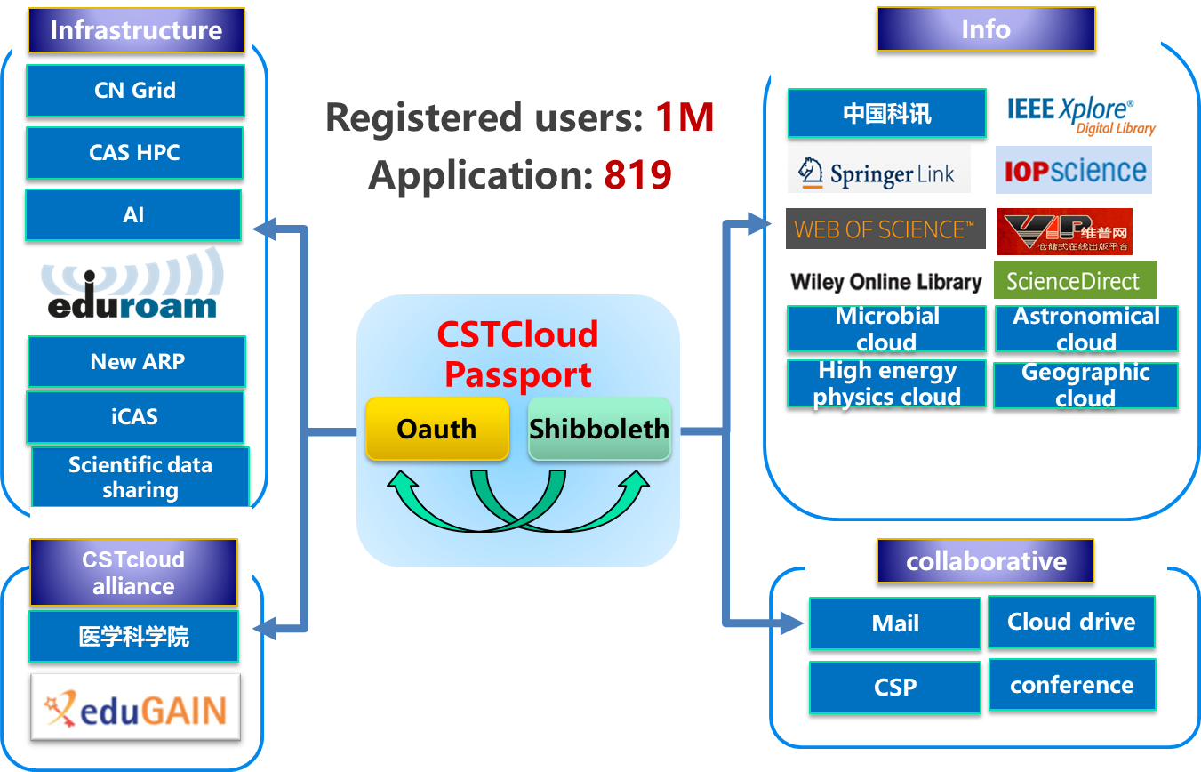
Federation with EGI - CSTCloud Passport
  >1 M registered users
  >95% CAS Institutions
  ≈ 270,000 visits per day
  >800 applications (OAuth 2.0)

Slide 8
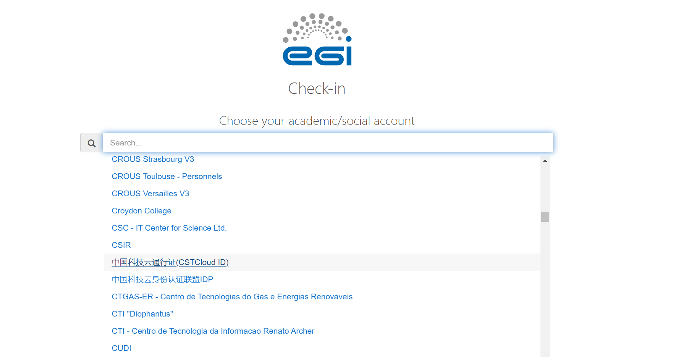
Federation with EGI - CSTCloud Passport

Slide 9
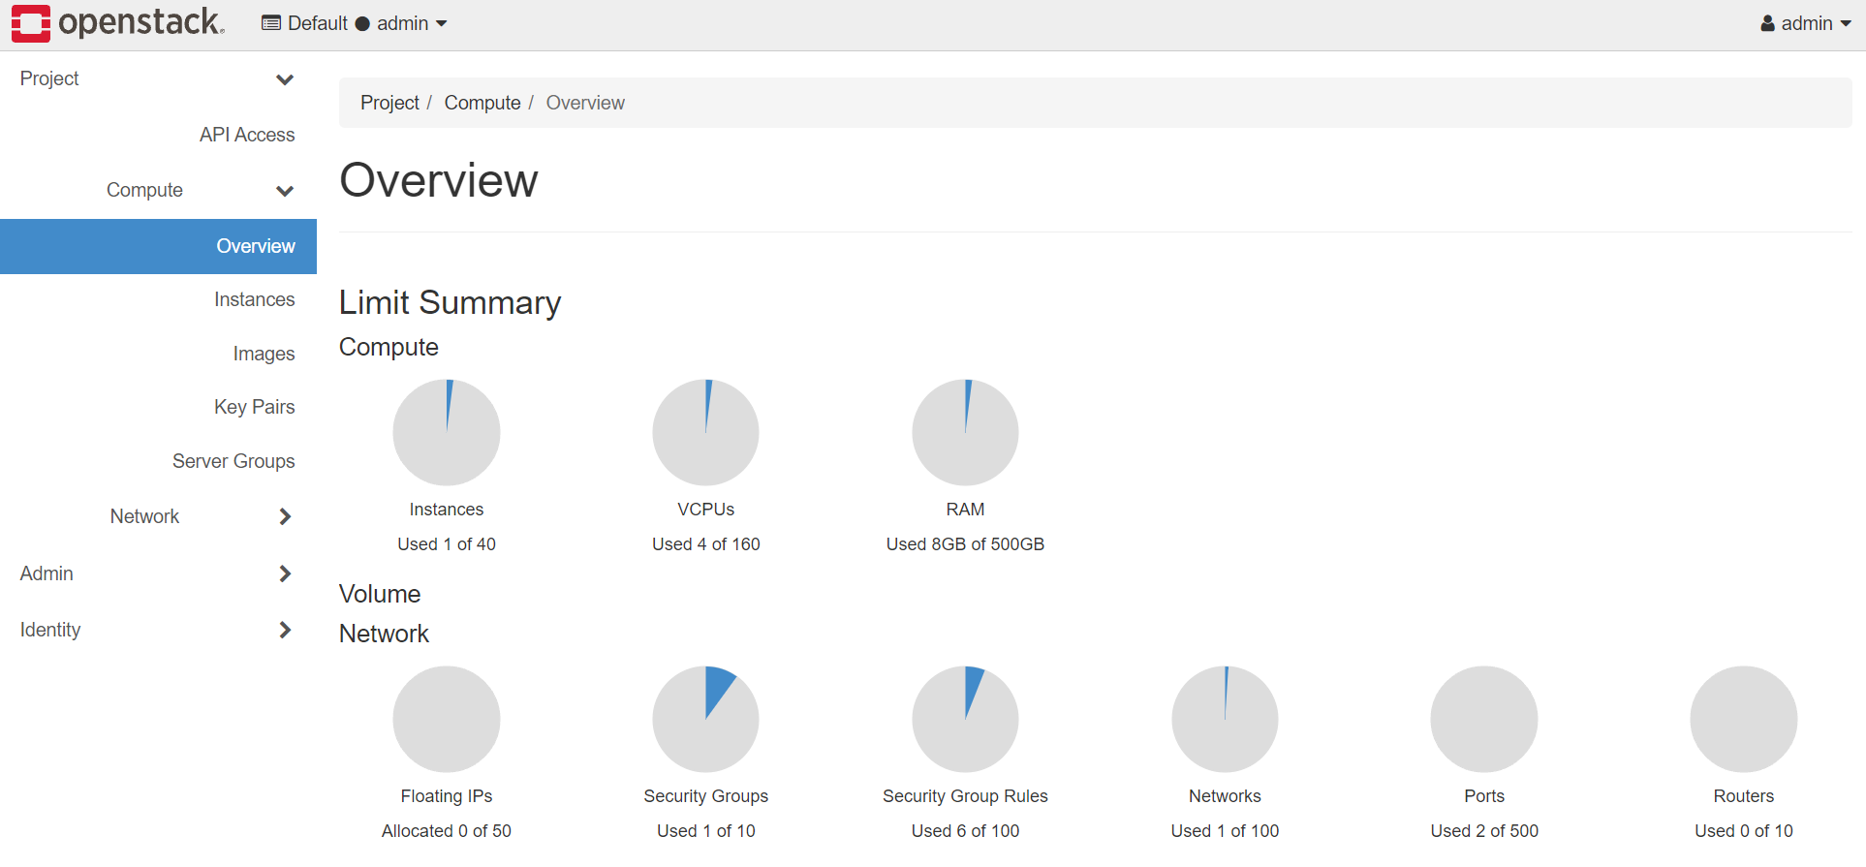
Federation with EGI - Testbed
1. Installation of OpenStack and EGI FedCloud Virtual Appliance
https://federation.cstcloud.cn/horizon/

Slide 10
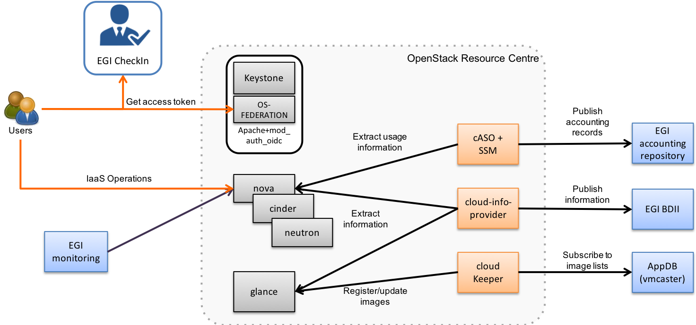
Federation with EGI
Installation procedure
1. OpenStack
2. EGI FedCloud Components
https://docs.egi.eu/providers/cloud-compute/openstack/

Slide 11
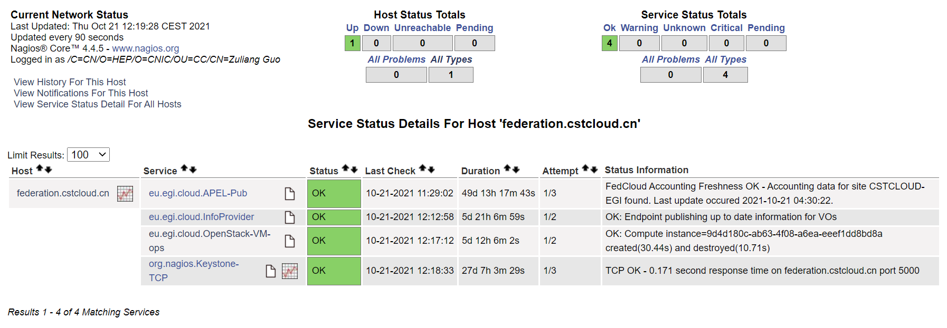
Federation with EGI
2. Capture by EGI Monitoring
https://argo-mon.egi.eu/nagios/cgi-bin/status.cgi?host=federation.cstcloud.cn

Slide 12
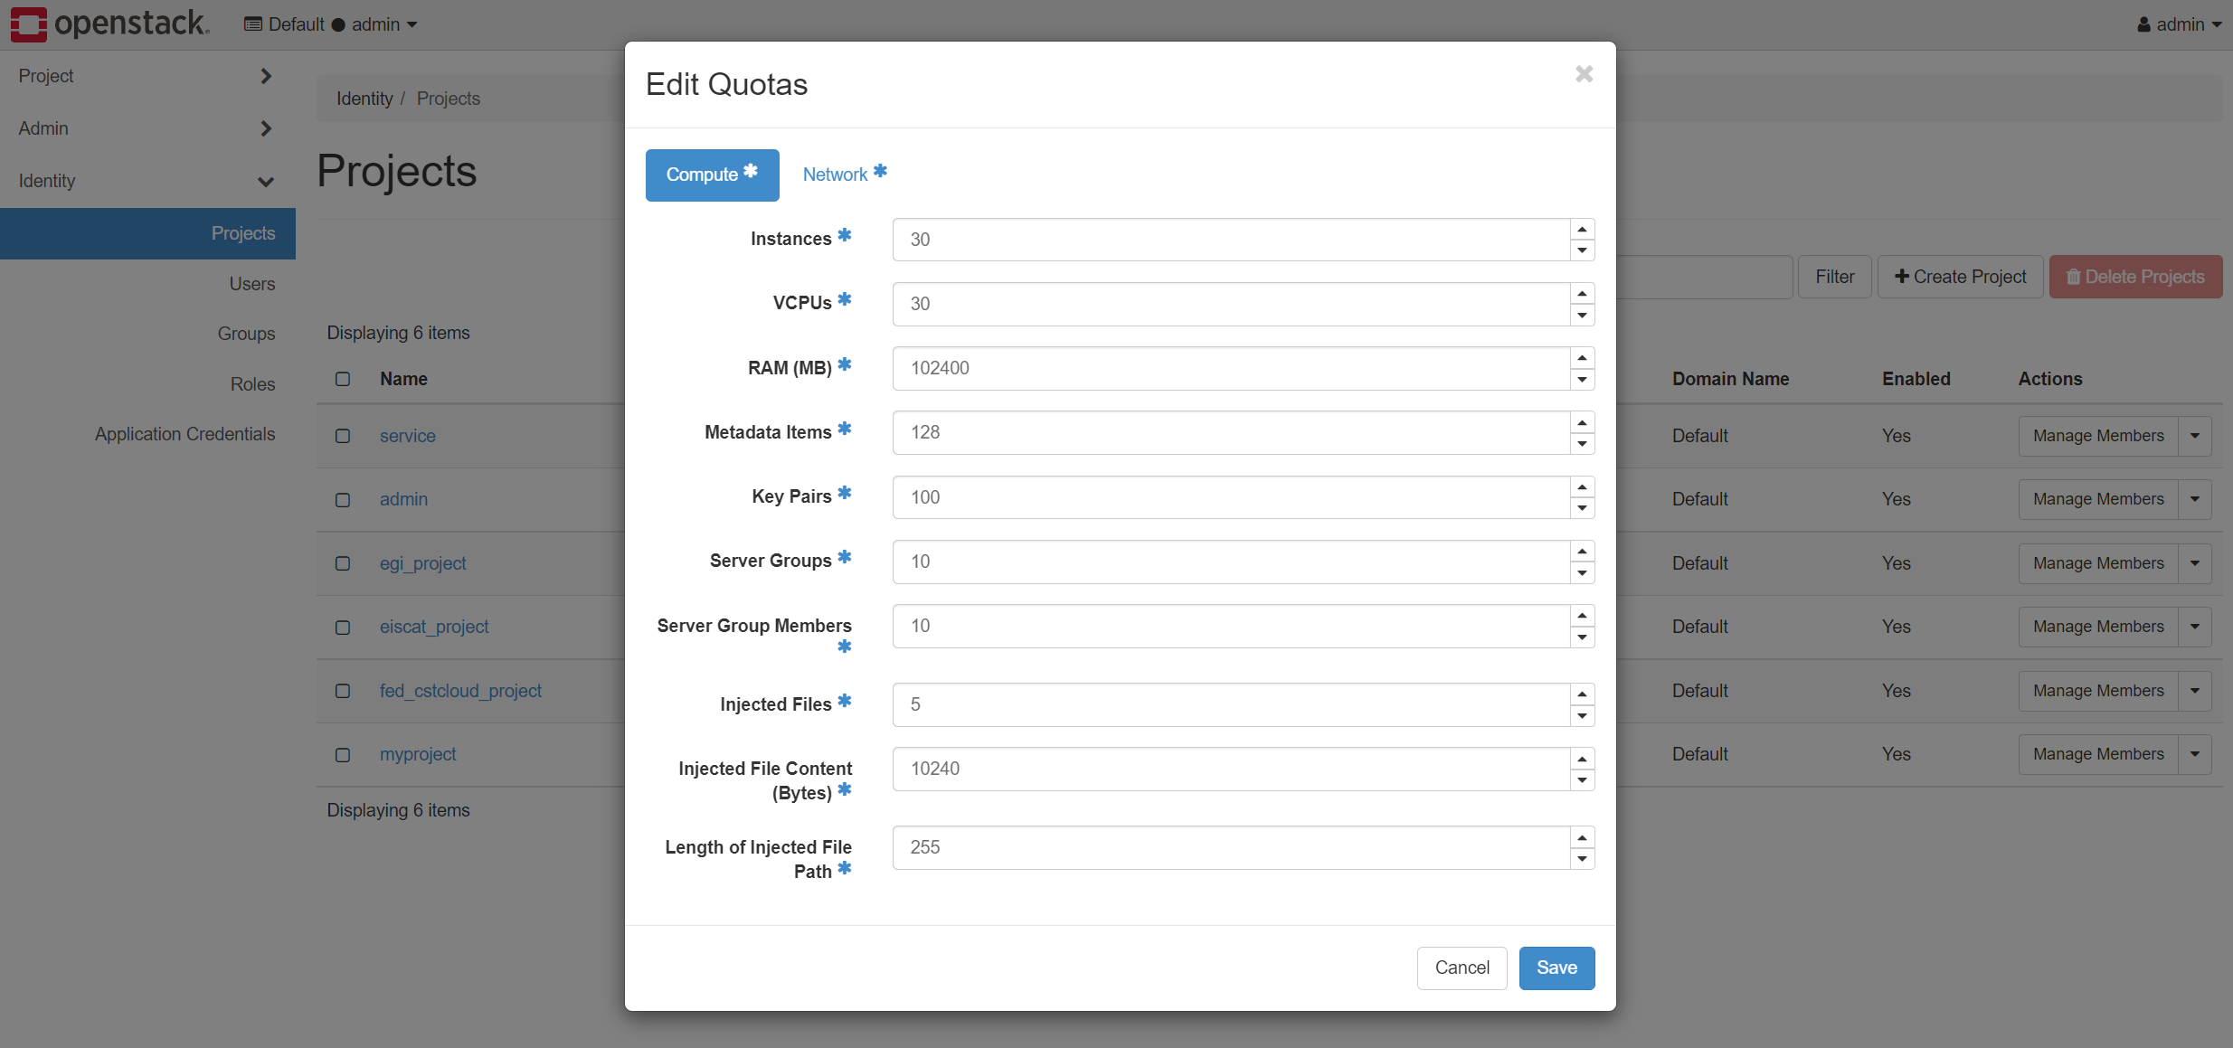
Federation with EGI
3. Configuration of VO: EISCAT.SE
30 Cores of vCPU
100GB of Memory
EISCAT.SE

Slide 13
Federation with EGI
Challenges while deploying:
Complexity of OpenStack
Rapid change of OpenStack
Overcome the challenges:
Read through EGI document
Support from EGI

Slide 14
Federation with EGI
Special thanks to:
Dr. Enol Fernández @ EGI
Dr. Yin Chen @ EGI

Slide 15
Future Plan
CSTCloud is also interested in becoming a VO in this federation.
CSTCloud hopes more providers, users and VOs will join this federation and share resources.
This testbed is consolidated step forward for the exploration of cross continental collaboration at infrastructure-level.

Slide 16
Thank you.
www.cstcloud.net

