Slide 1
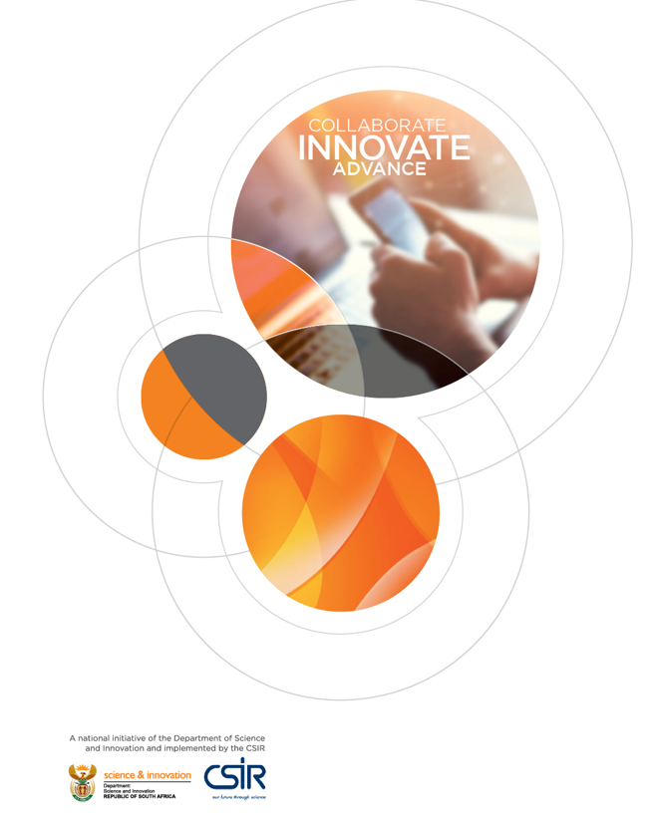
The African Open Science Platform (AOSP) and South African Open Science Cloud
Second Global Open Science Cloud (GOSC) Workshop
22 October 2021
Anwar Vahed
NICIS - DIRISA

Slide 2
African Open Science Platform
Launched December 2018 to “put African scientists at the cutting edge of contemporary data-intensive science”
Building blocks
Federated cyberinfrastructure, policies and enabling practices to support open science
Network of excellence in open science supporting scientists in using data resources to maximise scientific, social and economic benefit
https://zenodo.org/record/2222418#.YTs_-o4zbb0

Slide 3
Strands of activity
Enablers
A federated network of computational facilities and services
Software tools and advice on policies and practices of research data management
Applications
Data Science and AI Institute at the cutting edge of data analytics
Priority application programmes: e.g. cities, health, biosphere, agriculture.
Network for Education and Skills in data and information.
Network for Open Science Access and Dialogue.

Slide 4
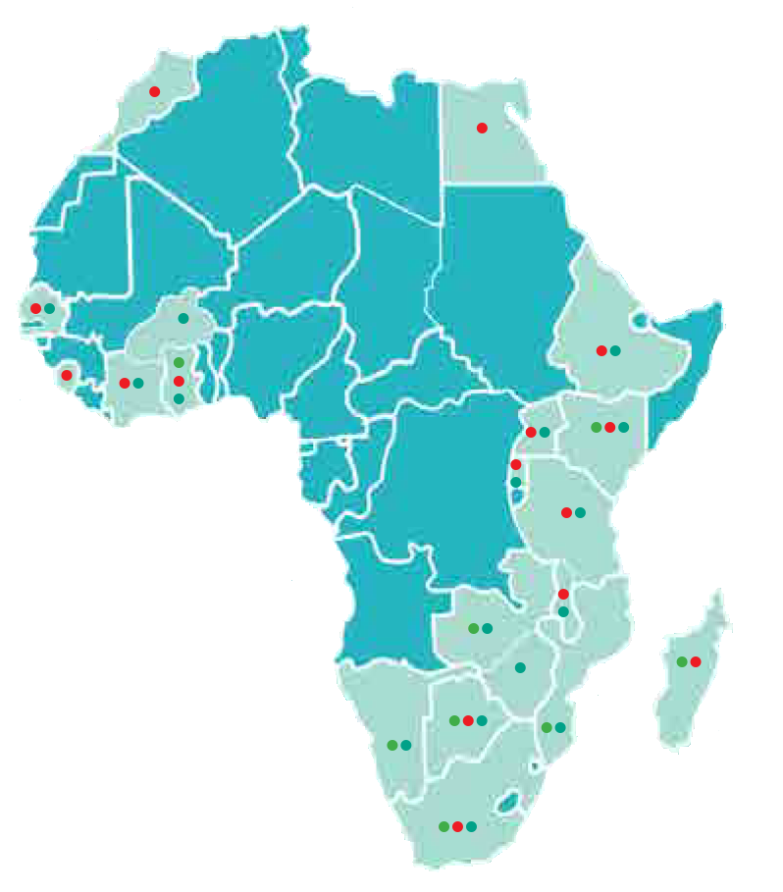
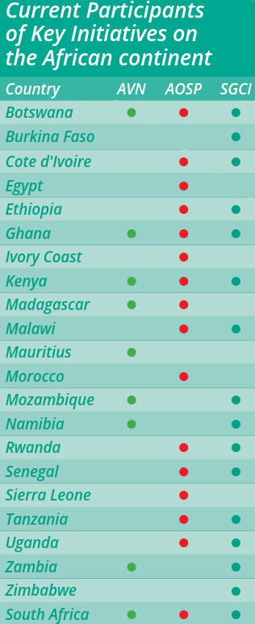
Pilot Phase
Map the current landscape of data and data science initiatives in Africa
Build a pan-African open science community and network
Develop frameworks for policy, incentives, training and technical requirements that will inform the operational platform.
https://www.nrf.ac.za/search/node/aosp

Slide 5
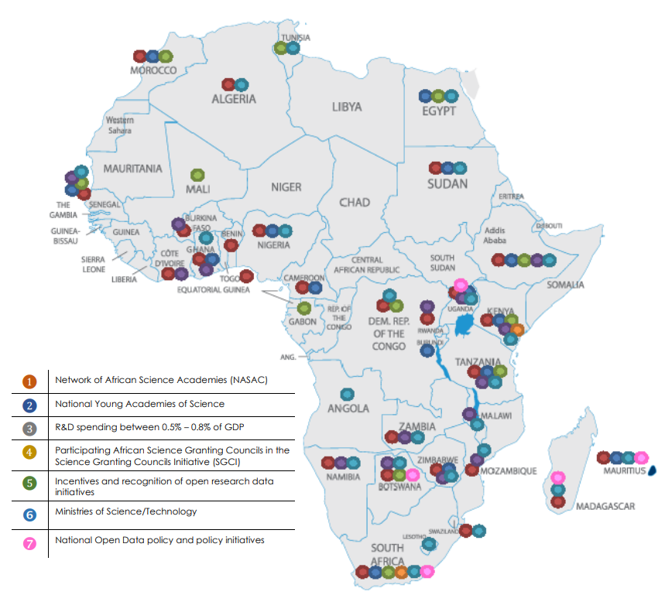
So far ...
AOSP Advisory Council
AOSP Technical Advisory Board
Roadmap for Open Science on Africa
NRF South Africa hosts the AOSP Project Office
AOSP Director
AOSP Summary of Frameworks
Policy Development
Incentives
Data Skills and Training
Data Infrastructure Roadmap
Map of political willingness on the African continent

Slide 6
Next Phase

Slide 7
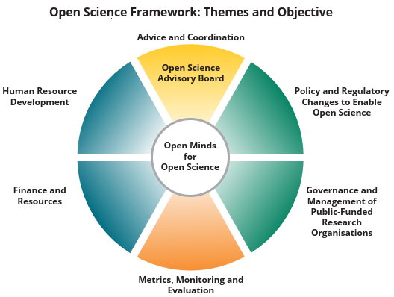
South African Open Science Framework

Slide 8
Open Science Framework Recommendations
Establish Open Science Advisory Board
Policy Actions
Open Science Policy
Ethical Code
Review IP policies
Acknowledge and Reward
HRD Actions
HRD Strategy and Training Platform
Advocate and Promote Adoption
Career Pathways
Financing and Resources
Repurpose existing funding
Resource DIRISA
Innovation Centres
Governance and Management
Targets and Implementation Plan
Metrics, Monitoring and Evaluation
50% Open by 2025
Open Data Archives

Slide 9
South African Open Science Cloud
Further SA-EU Dialogue: EOSC, on establishment of SAOSC
Local and Global Linkages (SANSA, ILIFU, H3BioNet SADC, EOSC, ARDC, GOSC,…)
NICIS the implementation agent
NICIS Platform: South African Research Cloud to be adapted
Policies and Regulations
Publicly Funded Research Organisations
Data Preservation
Recognition and Accreditation

Slide 10
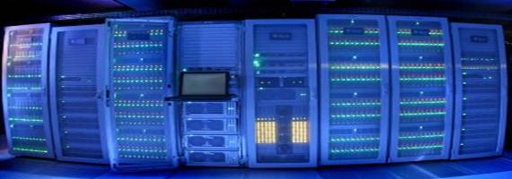
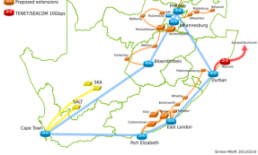
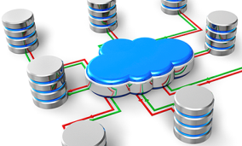
National Integrated Cyberinfrastructure System (NICIS)
Cyber platform for research
Close internal integration; federated globally and locally
Large scale science & cross-cutting projects (SKA, CERN, Bioinformatics, Climate Change, Astronomy, 4IR, SADC CI)
Phy Sci & Eng.
Health, Bio & Food
Energy
Earth & Environment
Humans & Society
Materials & Manuf.
Data intensive research environments (Cloud)
Skills & expertise
Computing Services (CHPC)
Networking Services (SANReN)
Data Services (DIRISA)
Core
services
Networked
resources

Slide 11
NICIS & South African Research Cloud
CERN, SKA
ARDC (Aust)
Nectar
JISC (UK)
EUDAT (EU)
Tier 0 (Global)
Tier 1 (National)
Tier 2 (Regional/Thematic)
ANDS
Tier 3 (Institutional)
NICIS (SA)
SANSA
SAEON
Ilifu
H3ABioNet
IDIA

Slide 12
SA Research Cloud → SA Open Science Cloud
Prototyping & Experimental
NICIS ACE Lab
Staging Area
NICIS Pilot Cloud
South African Research Cloud
StackNICIS
Research, experimental prototyping and development of bespoke services and modules for local conditions (Sandboxes for e.g., CEPH, iRODS, PoCs, Hypervisors, etc)
Verification, Alpha and Beta testing of services and applications
NICIS Local Cloud (Pre-production)
Self-developed cloud providing failover, to be moved into full production
Operational services supporting public sector
User cloud services for compute- and data- intensive research
COVID, Bioinformatics, Climate Change,…
Internal External

Slide 13
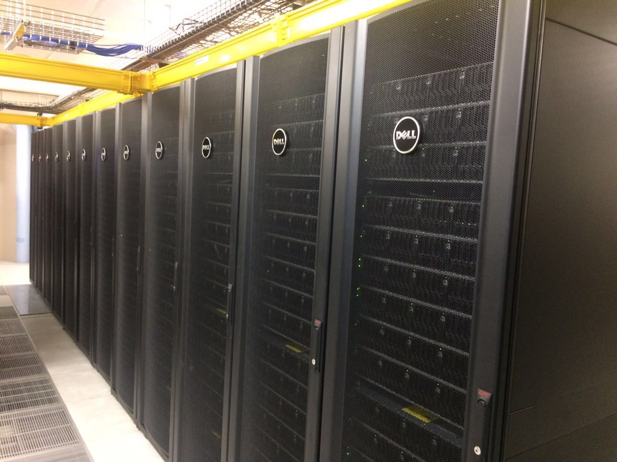
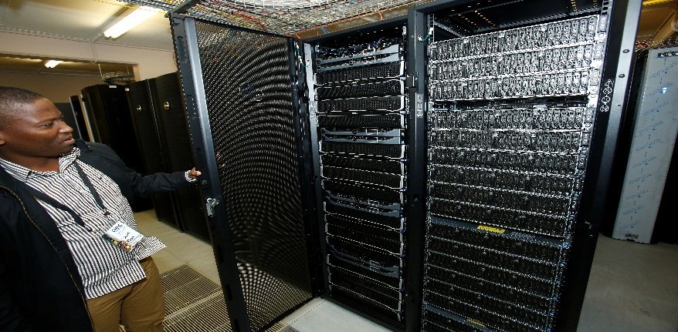
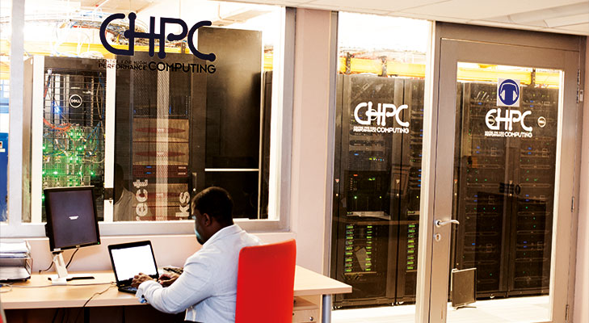
Centre for High Performance Computing (CHPC)
Lengau Cluster. 1+ PFLOP
1,039 PowerEdge servers, 24,192 Intel Xeon processors, 5 PB storage capacity; 56 GB/s Infiniband interconnect
335 registered Research Programmes; 1291 registered users [2018]
161 active research projects [2018]
GPU cluster: 24 V100’s
Big Data analytics and Machine Learning applications optimised – TensorFlow, MongoDB, SciDB, etc

Slide 14
Research Domain Usage
Percentage of research projects
Domain distribution – percentage core hours used

Slide 15
SANReN Services
Access to Global Network Architecture (GNA) for large science data transfers
Eduroam
perfSONAR
SA Federated Identities for Research and Education (SAFIRE) – Single sign-on to all eduGAIN services
SA_Grid computing services
Peering and transit (DTN) services locally and globally
Computer Security Incidence Response Team (CSIRT)
PoC Science Demilitarized Zone (DMZ) service
Security certificate issuing

Slide 17
DIRISA
Advocate and coordinate
Coordinate initiatives
Stakeholder engagement
National data infrastructure
Build and maintain Tier 1 nodes and services
Start Tier 2 domain nodes
Manage research data
Deploy RDM services
Develop user policies
Develop capacity and skills
Support e-Research programmes
Coordinate training workshops

Slide 18
South African Research Data Commons
Phase 1: Research Data Management
Phase 2: Collaborative Research Environments
My data management plans
My workflows
My data sets and outputs
My communities
Subscribe
DLogin
Mint DOI
Register at DIRISA
Authenticate DIRISA user
FindGet
DataDrop
DMPSA
DPreserve
Deposit and store data reliably
Develop data management plans
Store data for a long time

Slide 19
Data Access Model: Open by Default
FAIR: “As open as possible; as closed as necessary”
Closed Shared Open
Internal access
Private
Named access
Assigned by contract
Regulation authorised
Group based access
Project assigned
Selected membership
Sensitive
Confidential
Public access
Licence that limits use
Terms and conditions
Anyone
Open to public
No limits on use
Weather data
Geospatial data
Genomic data
Drivers licences
Surveillance data
Personal Private Public
Small Medium Big

Slide 20
DIRISA Activities
Data Infrastructure and Cloud Services: SAAS and IAAS
8PB data store with iRODS (Online/Active “Hot” storage)
40PB archive deployed in 2022 (Archival/Passive “Cold” repository)
Research Data Management
RDM policy recommendations
Data Management Planning Tool; DataCite DOI Minting service
HCD and Coordination
National MSc in eScience, training, workshops
Advocacy & Outreach
Local: DSI, DCDT, USAf, ASSAF, NRF. Global: RDA, DCC, CODATA, WDS, SKA
Thought Leadership
National Big Data strategy
Open Science Policy Framework

Slide 21
Thank you
avahed@csir.co.za

Slide 22
Extra

Slide 23
SARDaC Cloud Services (1)

Slide 24
SARDaC Cloud Services (2)

Slide 25
DMP Tool

Slide 26
NICIS Strategic Objectives
Establish and maintain a world class and relevant national integrated cyberinfrastructure system supporting research and teaching
Enable and promote e-Research. Promote new forms of research, including fostering of national and international collaboration, that address national development priorities by supporting research ecosystems and virtual communities
Position South Africa to take part in, host and lead large scale global research and science projects, with a specific focus on grand science, through continental leadership in cyberinfrastructure
Provide thought leadership to South Africa’s evolving cyberinfrastructure strategy and facilitate uptake of cyberinfrastructure
Foster the development of human capacity in cyberinfrastructure and the application of cyberinfrastructure and contribute to the transformation of this sector.

Slide 27
Lengau Cluster Usage

Slide 28
SANReN Status
Total available broadband capacity (TABC) provided by whole network 3.3 Gbps
Service more than 1.2 million users (students, researchers, lecturers, etc.) daily
All 26 public universities connected, most research councils, larger research initiatives (e.g. SKA, SALT)
Multiple 100 Gbps links make up the national backbone network
Several major metro networks (Johannesburg, Tshwane, Ethekwini, Cape Town, Bloemfontein, East London), new metros under way (e.g. Pietermaritzburg), upgrades to 100 Gbps for various
SANReN owns 7.3% of total available capacity on the West Africa Cable System (WACS) undersea cable
SANReN and TENET have jointly connected more than 300 beneficiary sites

Slide 29
South African Research Data Commons
DSubscribe
Subscribe as DIRISA user
DataDrop
Deposit and store data reliably
FindGet
Discover, download data sets
SafeShare
DataStage
Safely share data with users
Prepare data for HPC
User documentation
Help & support
Core services (DMP, PID)
(Benchmarks: EUDAT, ANDS, JISC, Escience, Data.gov,…)

Slide 30
Conceptual Architecture

Slide 31
Tiered data infrastructure

Slide 32
DIRISA
National research data integrator for data intensive research (discovery, access, (re)use, preservation,…)
Provides national research data infrastructure. Technologies and services also harvesting federated data nodes
Coordinates human capital development in data intensive research
Develops strategies, guidelines for research data management towards recommendations for data and open data.
Advocates and promotes data intensive research, recognising data contributions
Coordinates and provide strategic input for data intensive research

Slide 33
Activities
National data infrastructure
South African Open Science Cloud: Subscription/Registration, Data Deposit Tool,…
Ilifu
HCD
NEPTTP. Masters in eScience MAsters
Data Carpentry and other tutorial workshops
Research data management
Drafts of AUP (Acceptable Use Policy)
Services and products policy (FAIR and Open)
Outreach
National Data workshop
Strategic
Big data strategy
Open Science Framework

