Slide 1




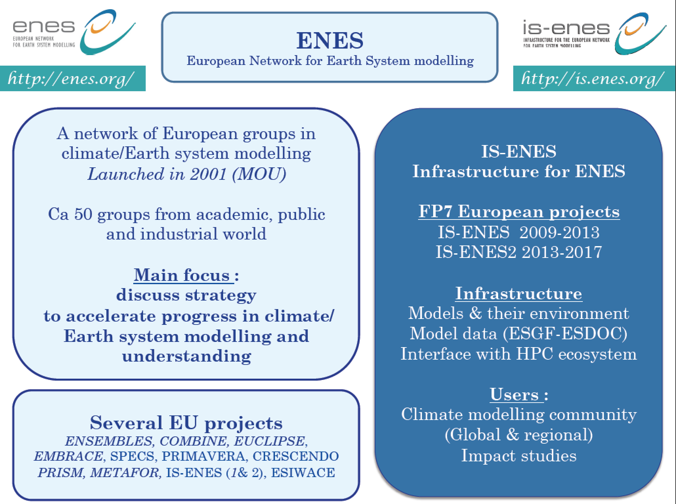

The IS-ENES use case
Sandro Fiore, University of Trento, Italy
Christian Pagé, CERFACS, France
Sylvie Joussaume, CNRS/IPSL, France
Fabrizio Antonio, CMCC, Italy
EGI Conference 2021 18-22 October 2021
EGI-ACE receives funding from the European Union’s Horizon 2020 research and innovation programme under grant agreement No. 101017567.
IS-ENES3 receives funding from the European Union’s Horizon 2020 research and innovation programme under grant agreement No 824084.

Slide 2
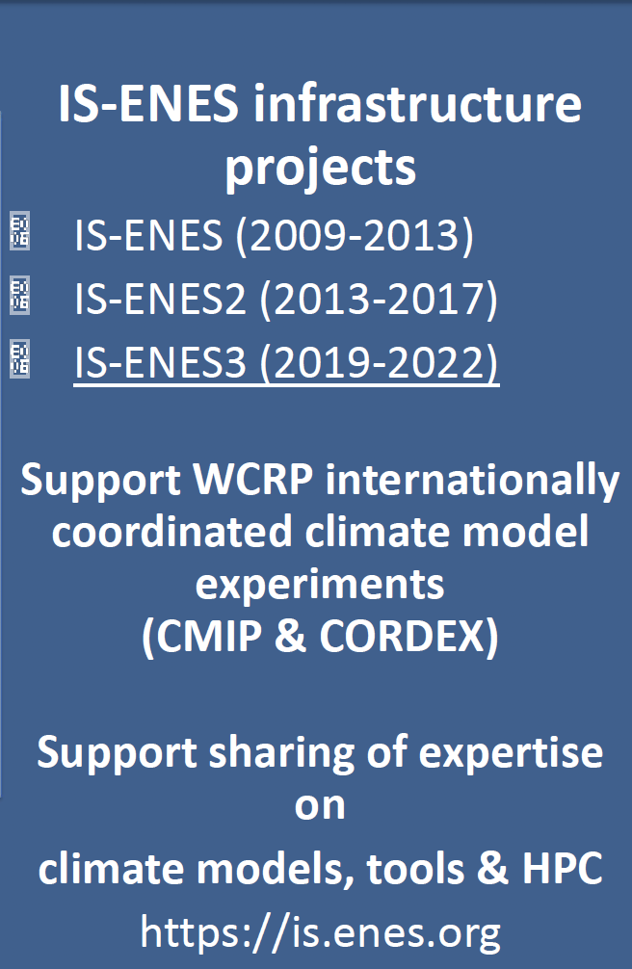
ENES & IS-ENES
European Network for Earth System Modelling

Slide 3
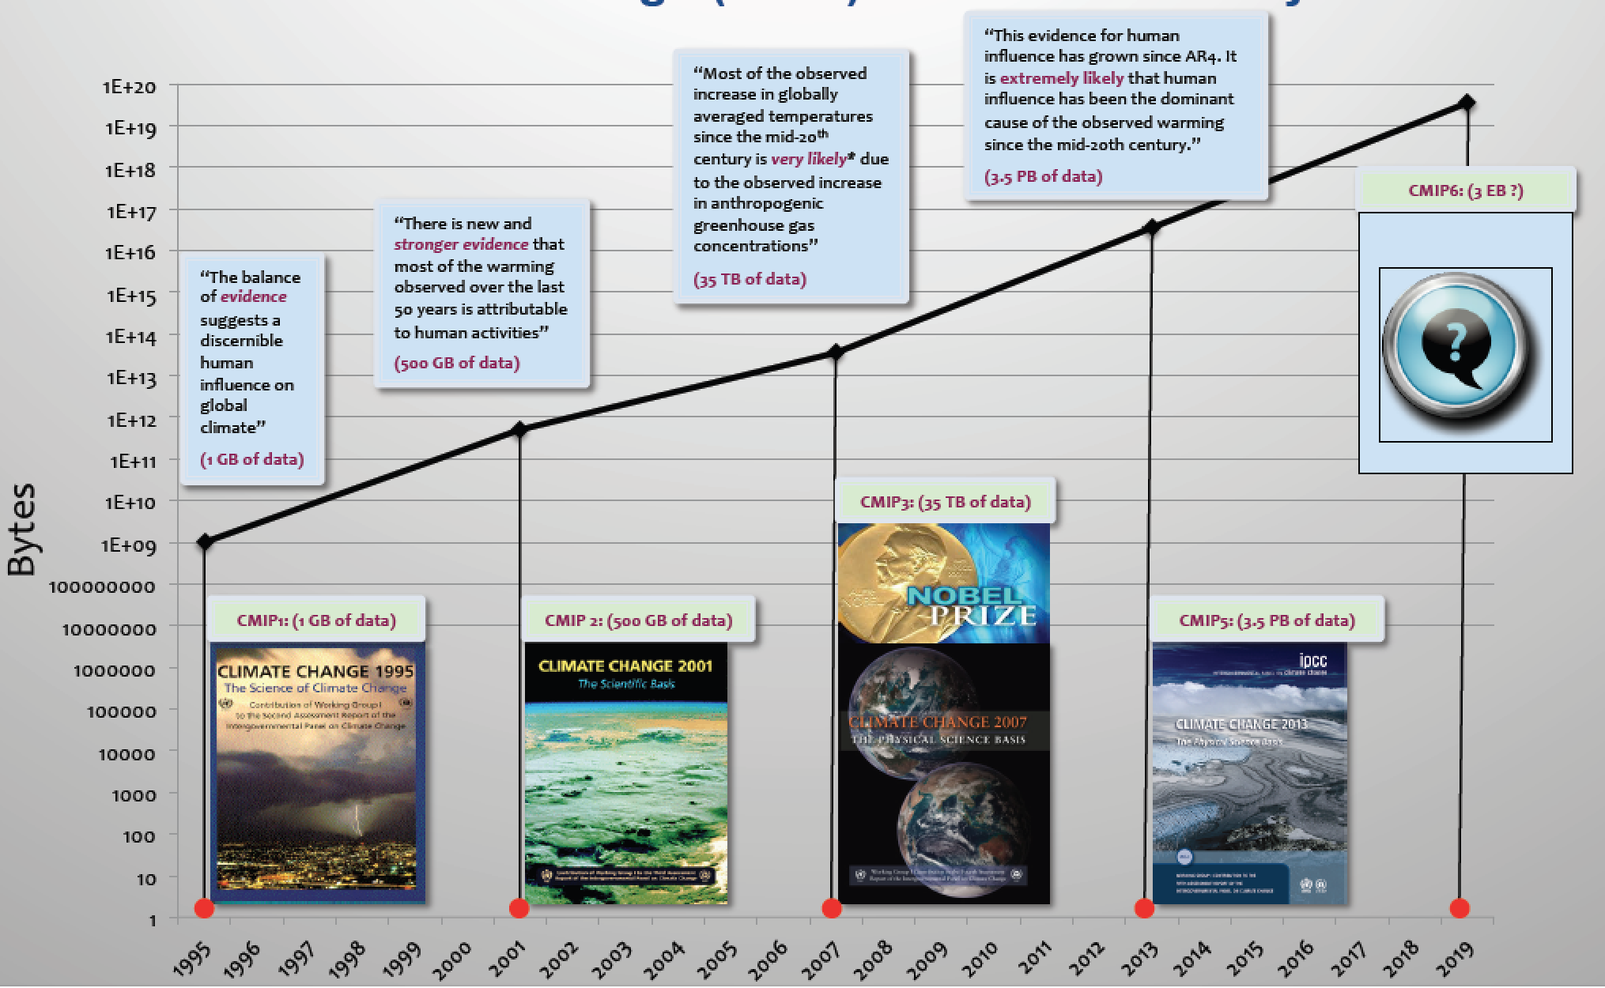
A (big) data perspective of the CMIP experiments
Image courtesy: Dean N. Williams (LLNL)
CMIP6
Ongoing effort
Expected data volume 10X CMIP5

Slide 4
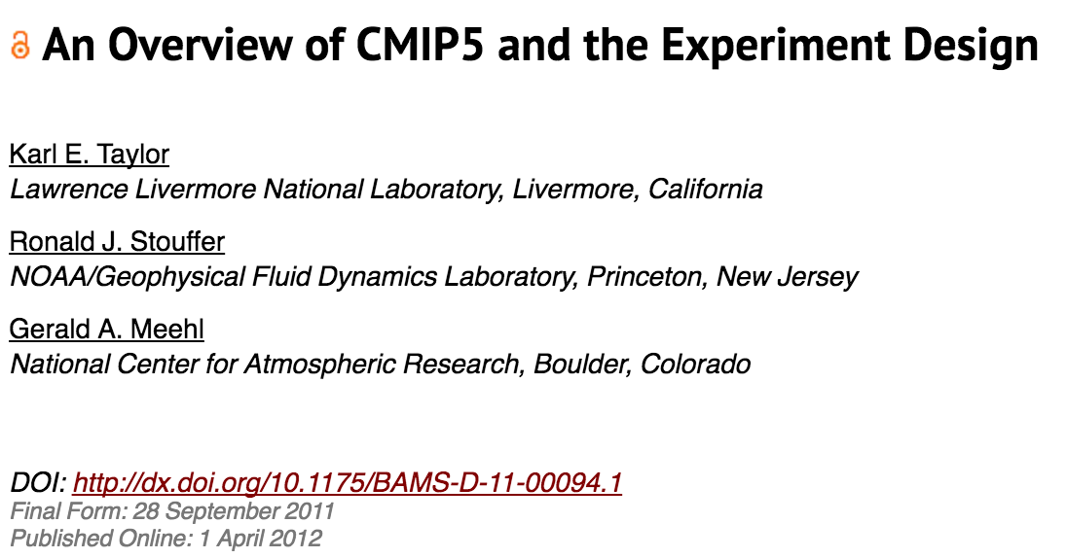
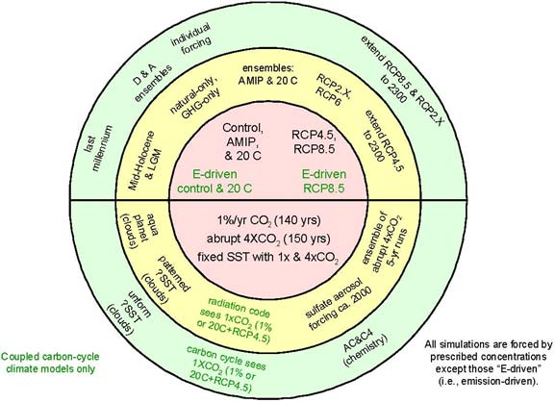
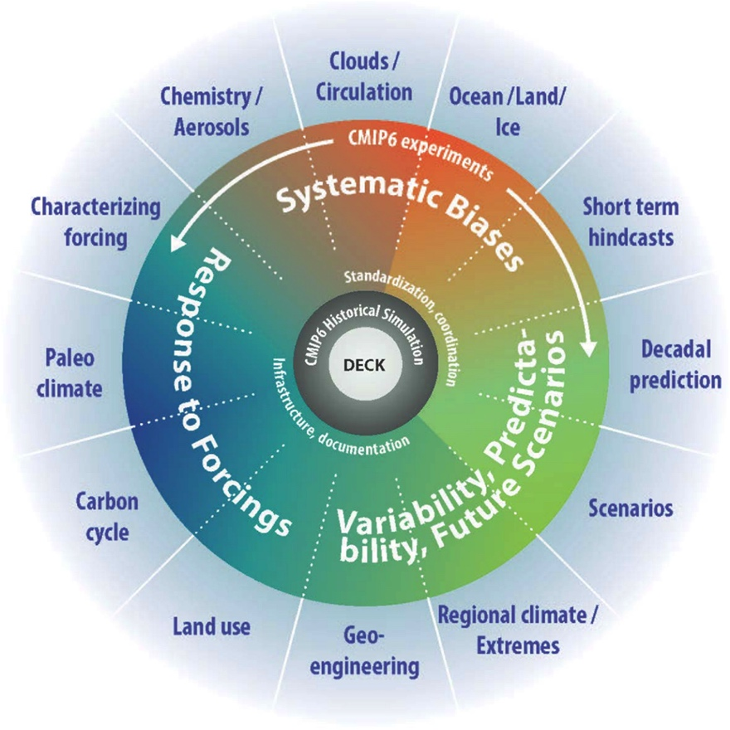
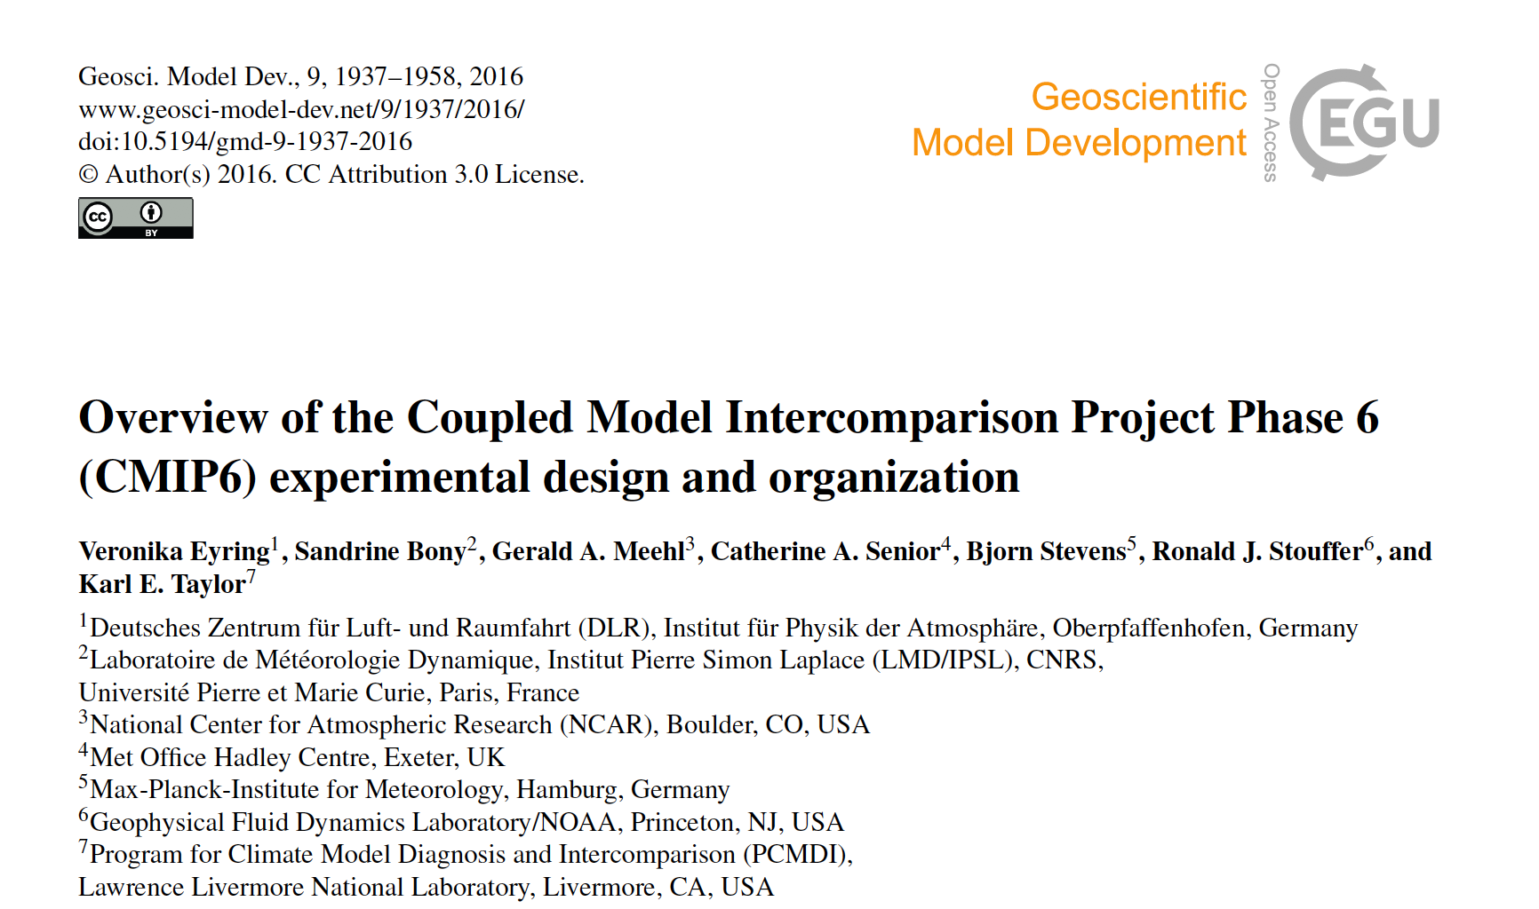
Large scale experiments: the CMIP case

Slide 5

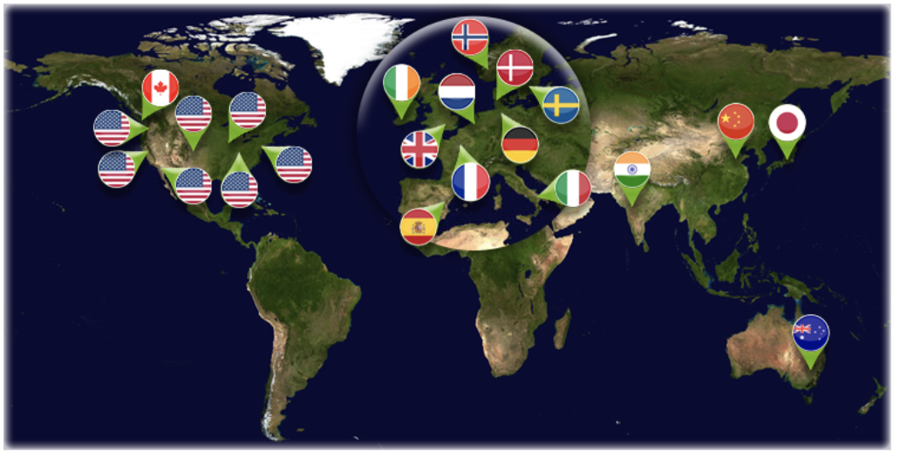
ESGF and the CMIP data archive
Image courtesy: Dean N. Williams (LLNL)

Slide 6
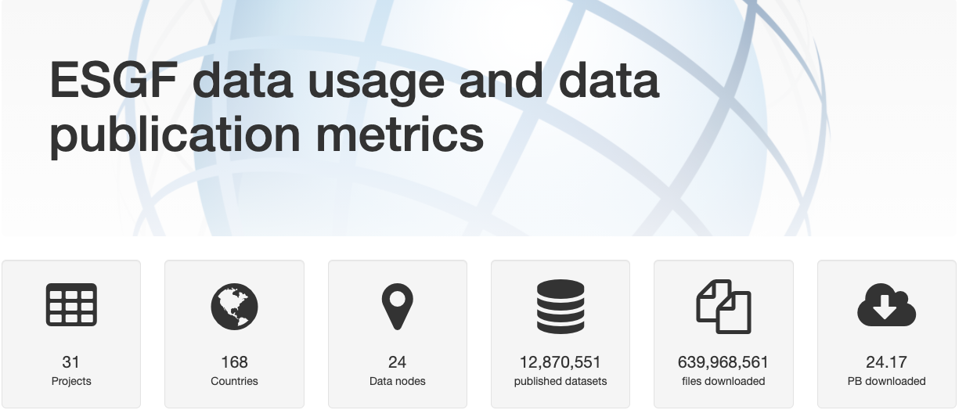
ESGF Metrics
Since 2018/01
Image courtesy: Dean N. Williams (LLNL)

Slide 7
ENES Data Space: goal and use cases
Goal: Deliver an entry point to an open, operational, scalable and cloud-enabled data science environment for climate data analysis (ENES Data Space) on top of the EOSC Compute Platform
Use cases: Data analysis on CMIP6 data
The “ENES data space” aims at providing an entry point to:
Datasets (e.g. CMIP6) -> Driven by users; Wide spectrum; Pre-staged (w.r.t. ESGF); Open
Storage & Compute resources -> Provided by EGI
Data Science Software Stack -> To address a wide spectrum of analysis needs;
IDE and Applications -> To devel/share/(re-)use apps, etc. FAIR principles
Cloud-Enabled -> SaaS for end-users applications; PaaS paradigm for data analysis service
Notes:
cloud-enabled provisioning of resources
PaaS approach for service deployment;

Slide 8
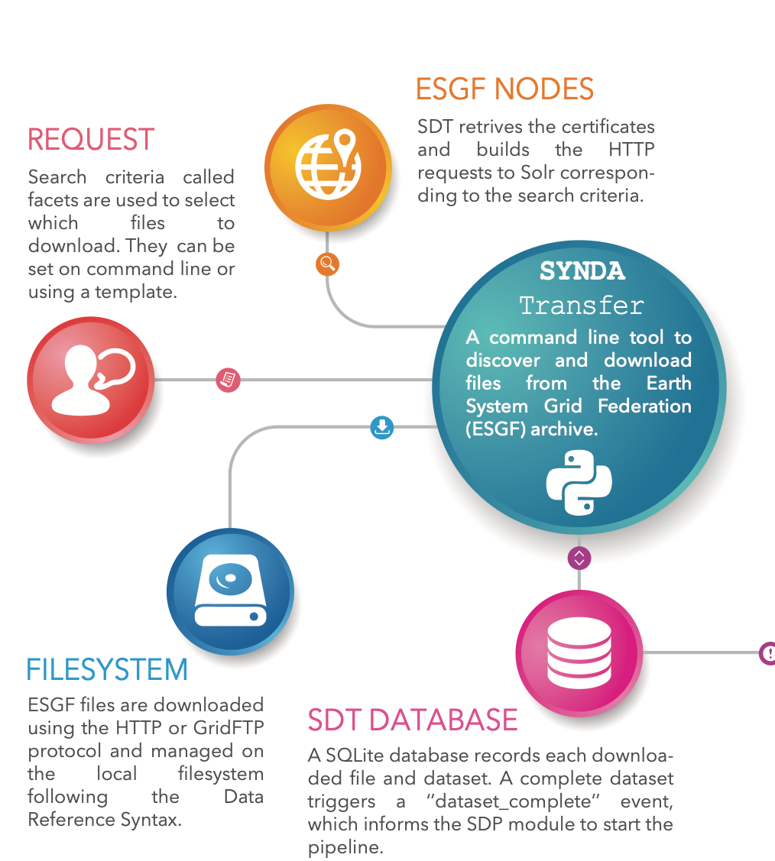


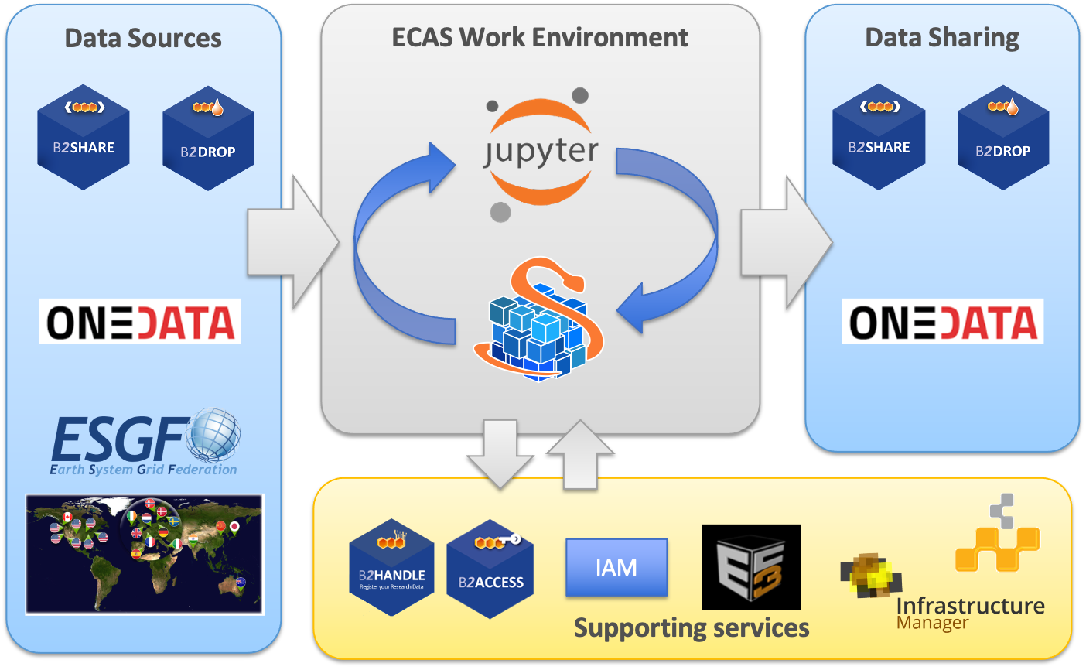
Core components from IS-ENES

Slide 9


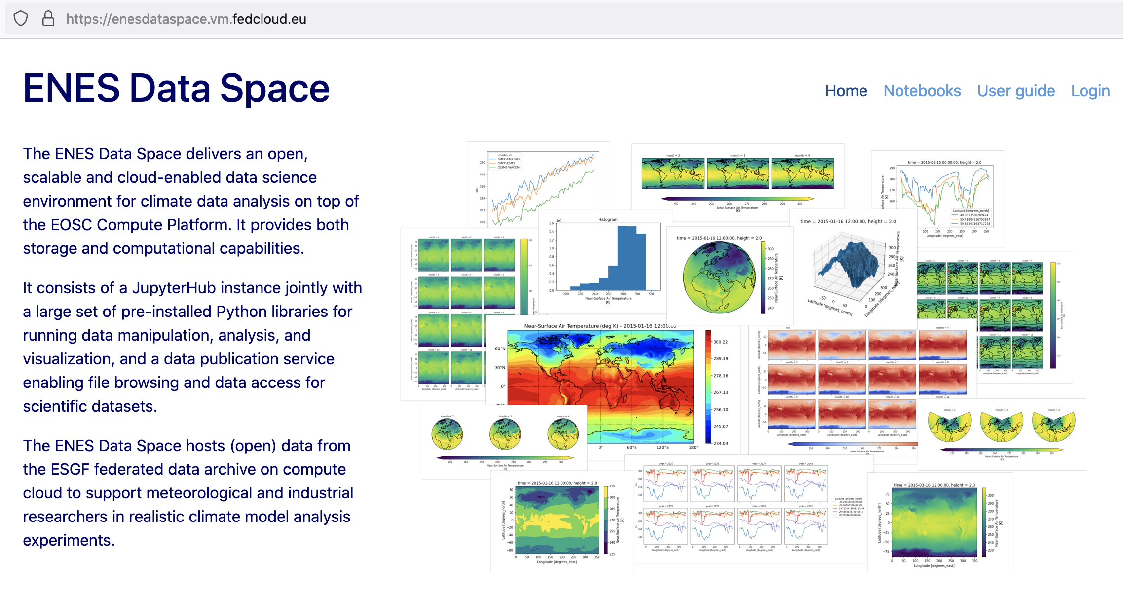







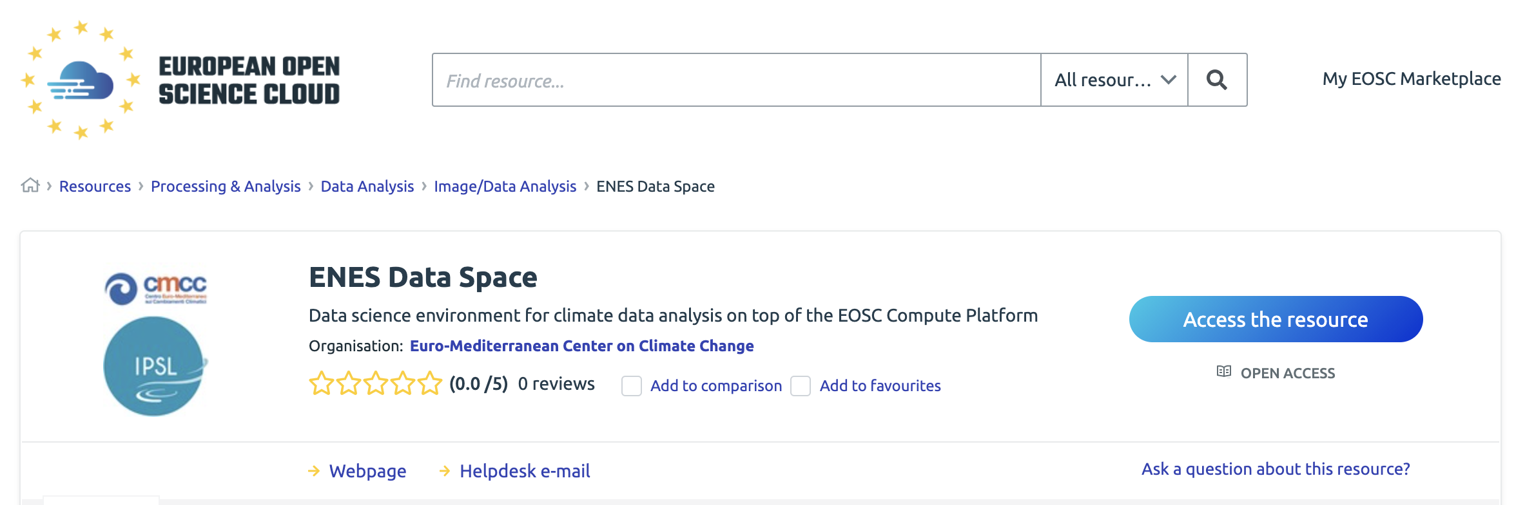

ENES Data Space
Data Space
environment
AAA & Monitoring
EOSC Data Access Service (DataHub/FTS)
Cache Manager
Collection DB
Data Transfer tools (clients)
Data Access & Compute Service
Data Access & Compute Service
Data Access & Compute Service
Community Database (SiteA)
Community Database (SiteB)
Community Database (Siten)
Notes:
TUBITAK hosting the Collection DB

Slide 10
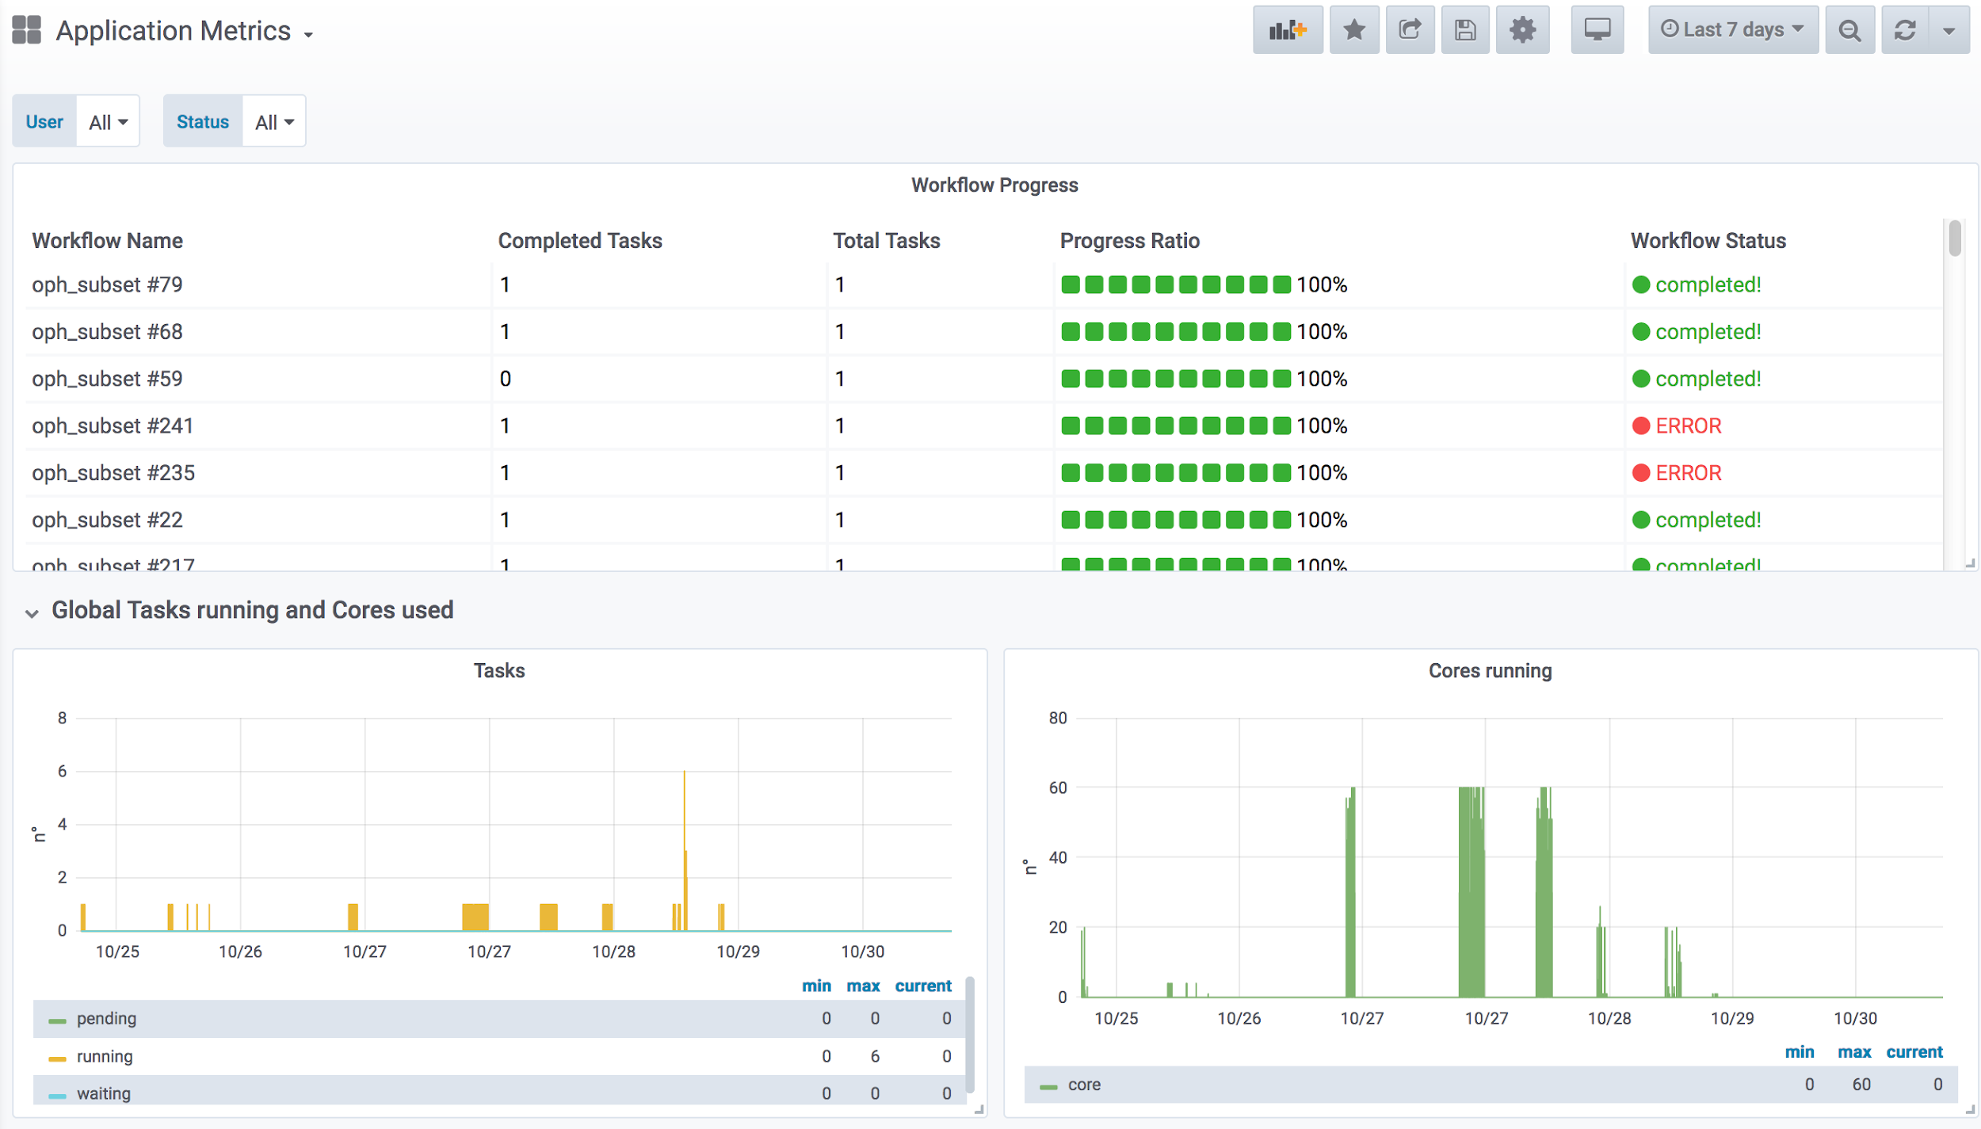
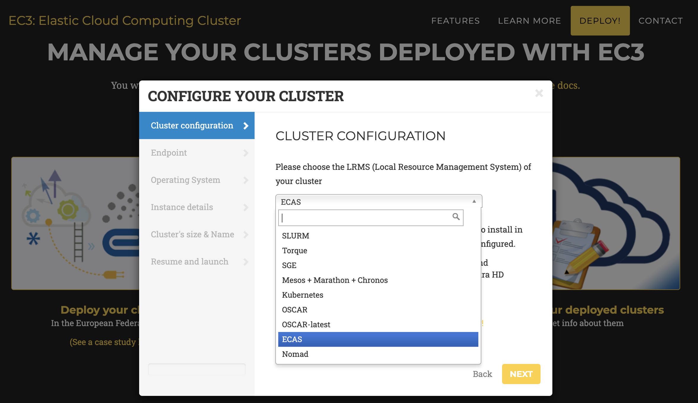
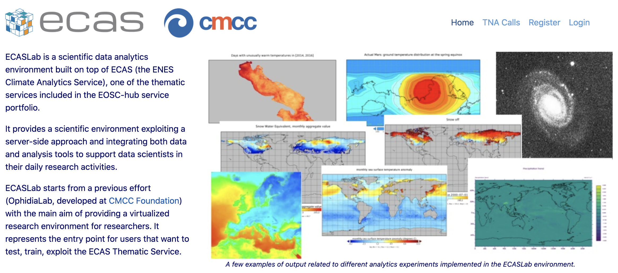
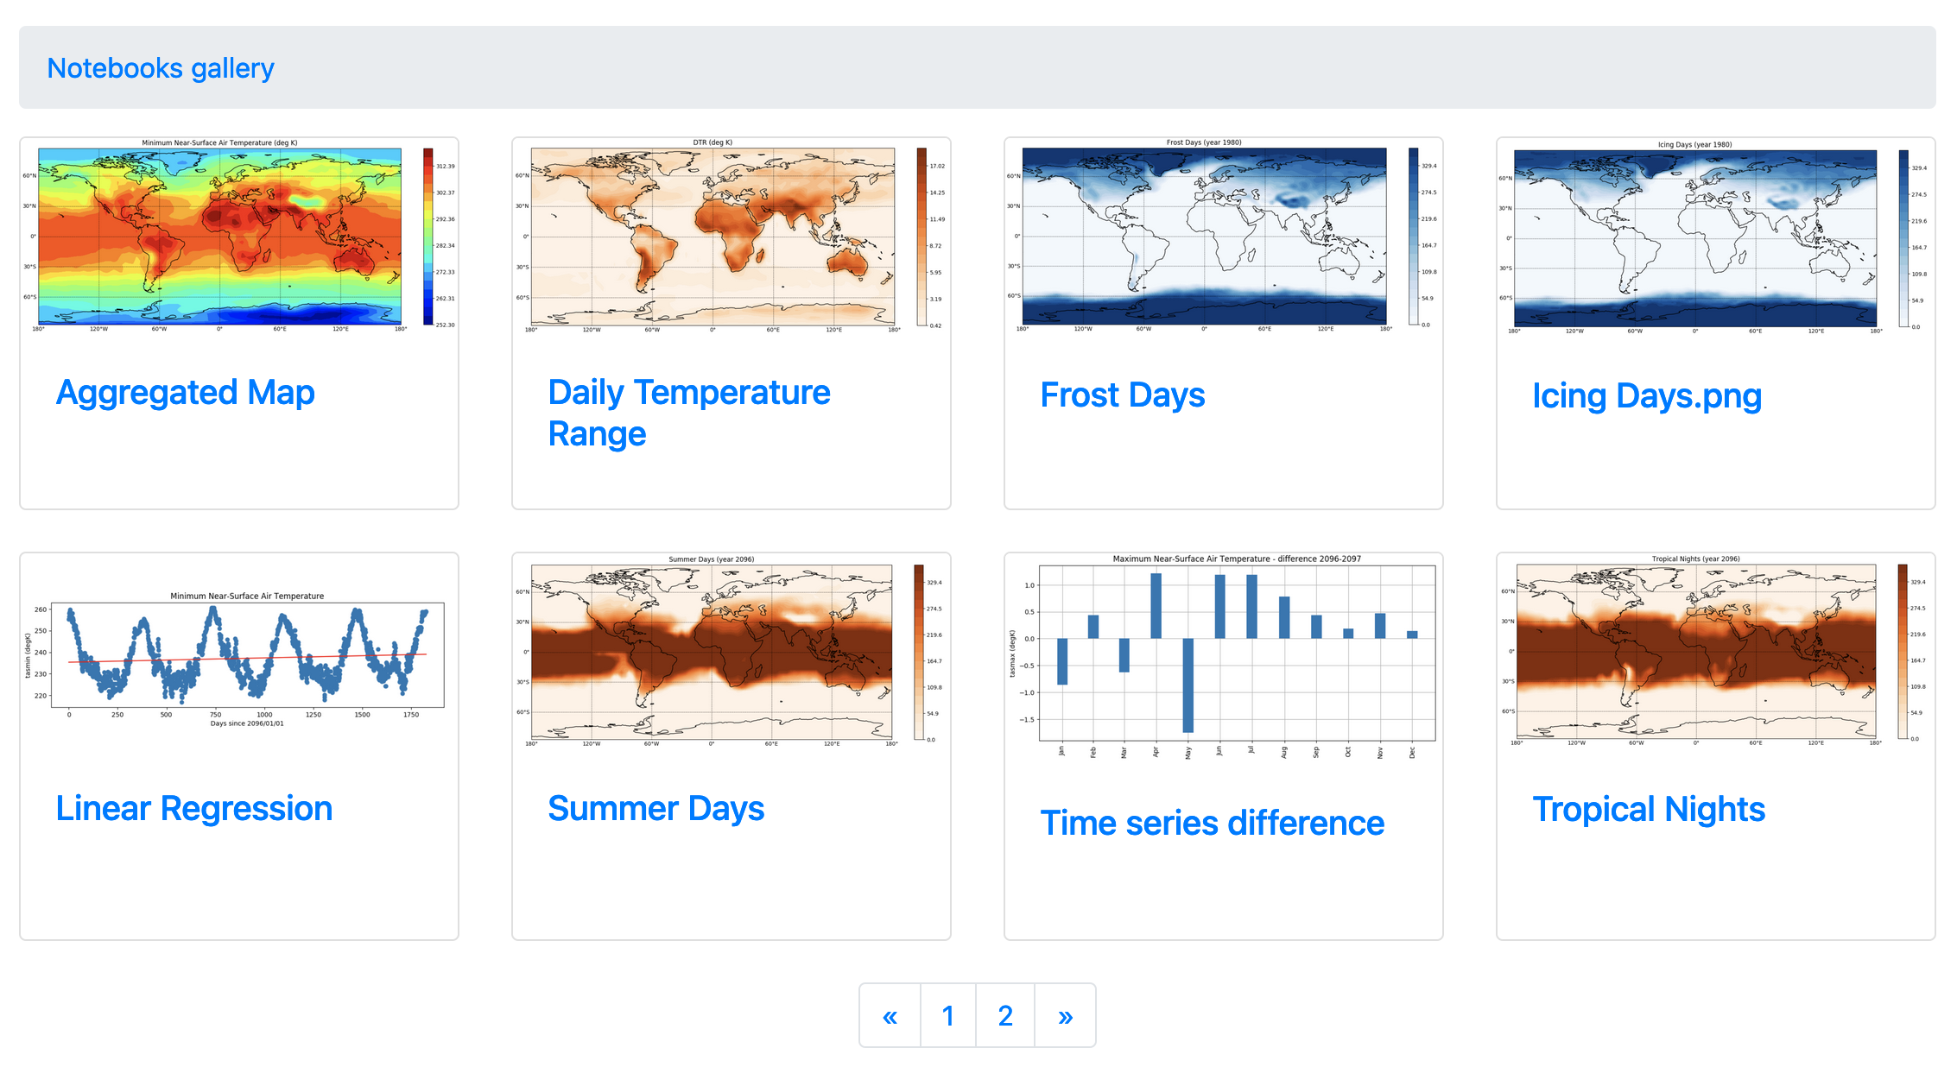
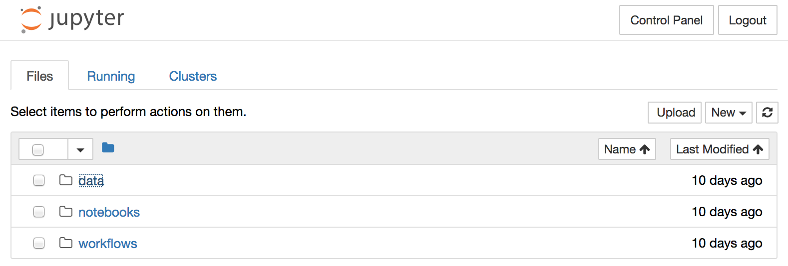
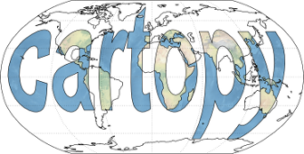


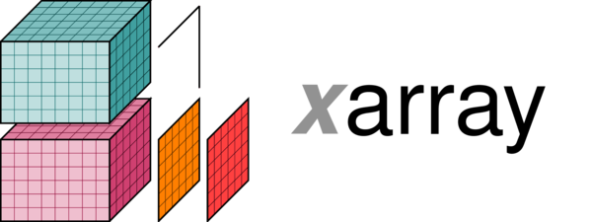


Services & Tools
System deployment, setup and monitoring
ECAS
Synda
EC3/IM
UDocker
EGI DataHub
Grafana
End-users experience and support
JupyterLab
A rich set of open source scientific Python libraries
Notebook Gallery
Data Request form
Notes:
https://enesdataspace.vm.fedcloud.eu/notebooks.html

Slide 11
Timeline
Service deployment and release
M7
M15
M20
M30
M10
  Initial deployment done! (end of Sept)
  Periodic releases
    One release every 5 months
  Scaling-up resources
  Env enrichment
  Data collections
M25

