Slide 1
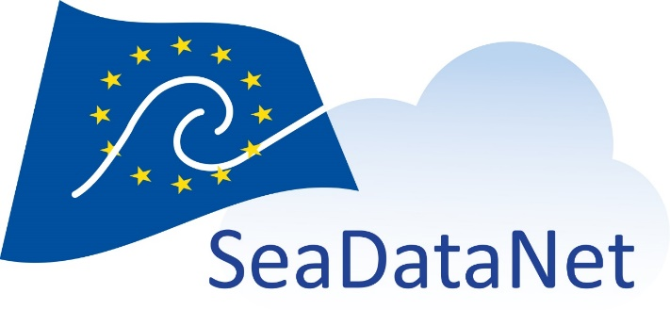
EGI Virtual Conference 2021
Collaboration across Boundaries - Workshop: Data Spaces and Data Ecosystems in Practice
20 October 2021
SeaDataNet use case
Dick M.A. Schaap – MARIS
Technical Coordinator SeaDataNet

Slide 2
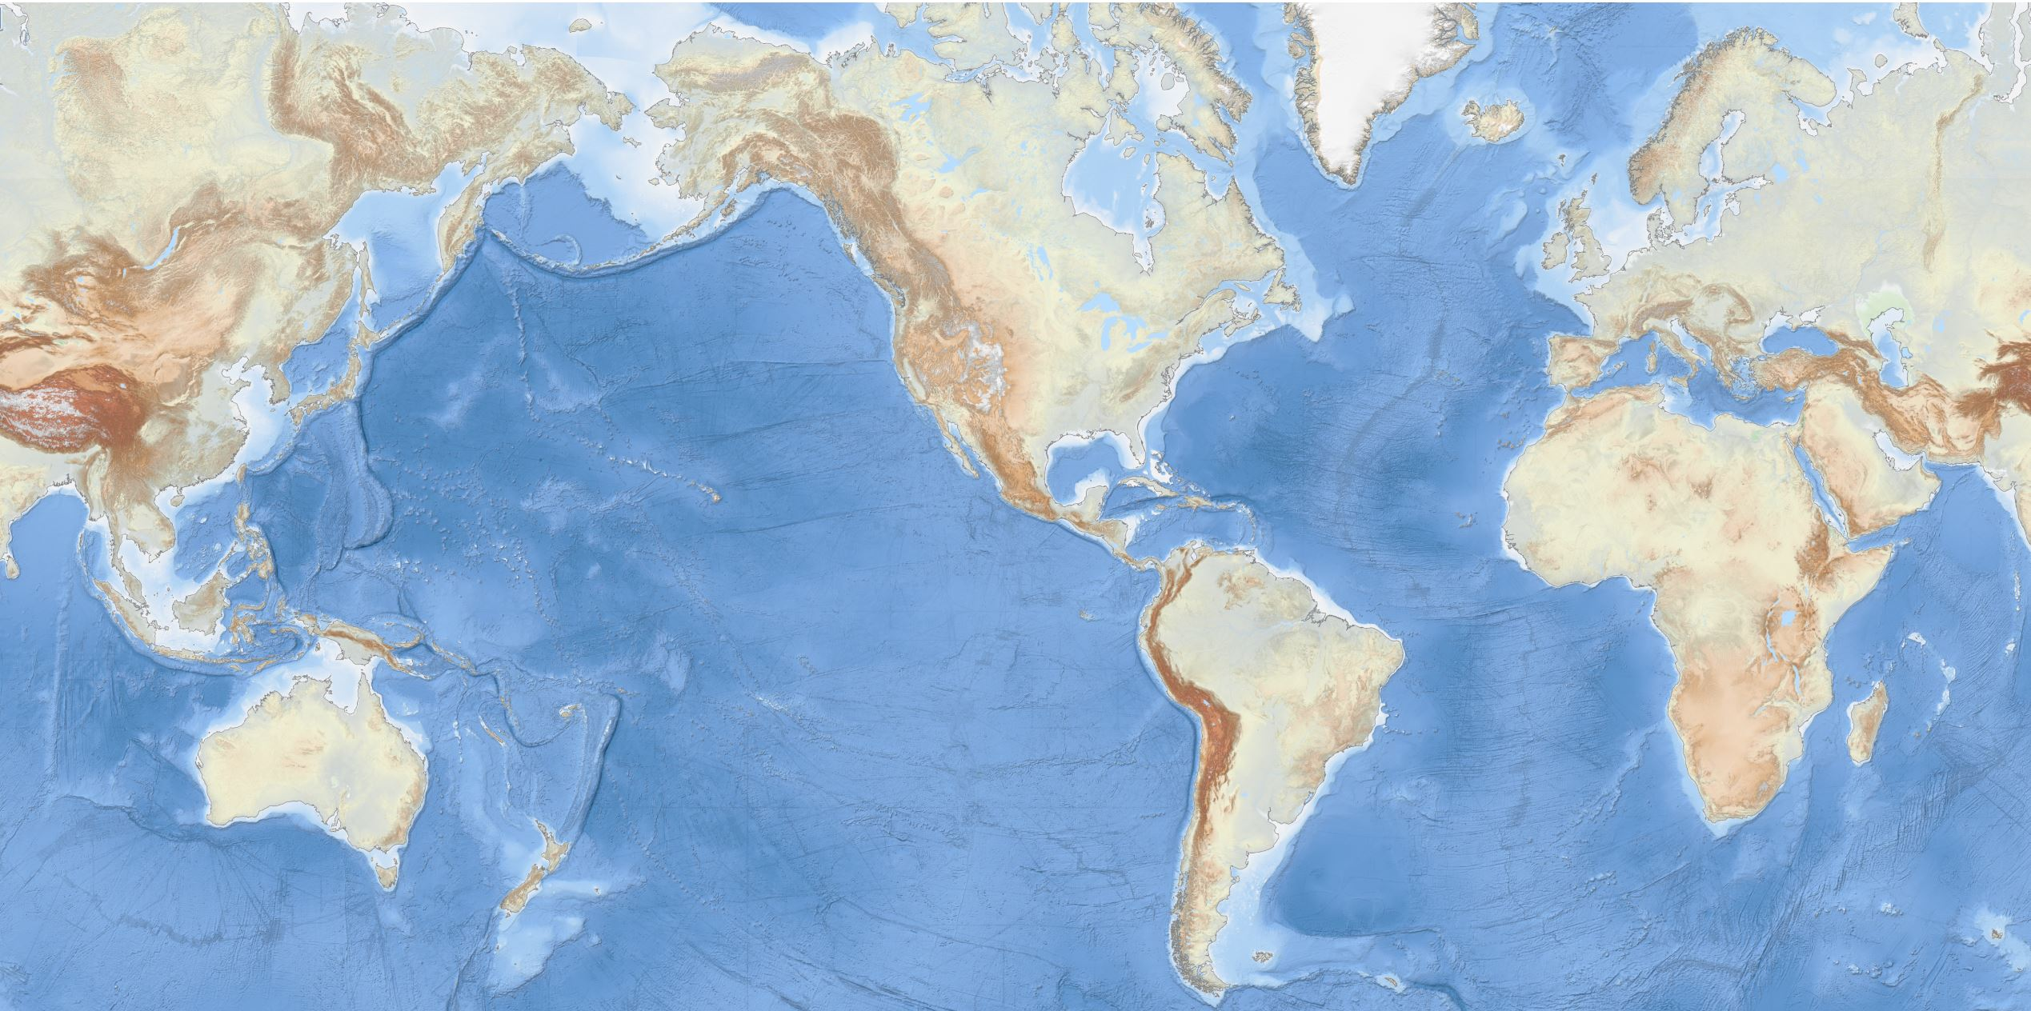
Oceans and seas are important
EMODnet Bathymetry
Climate, Energy, Food, Tourism, Trade, Health, ….

Slide 3
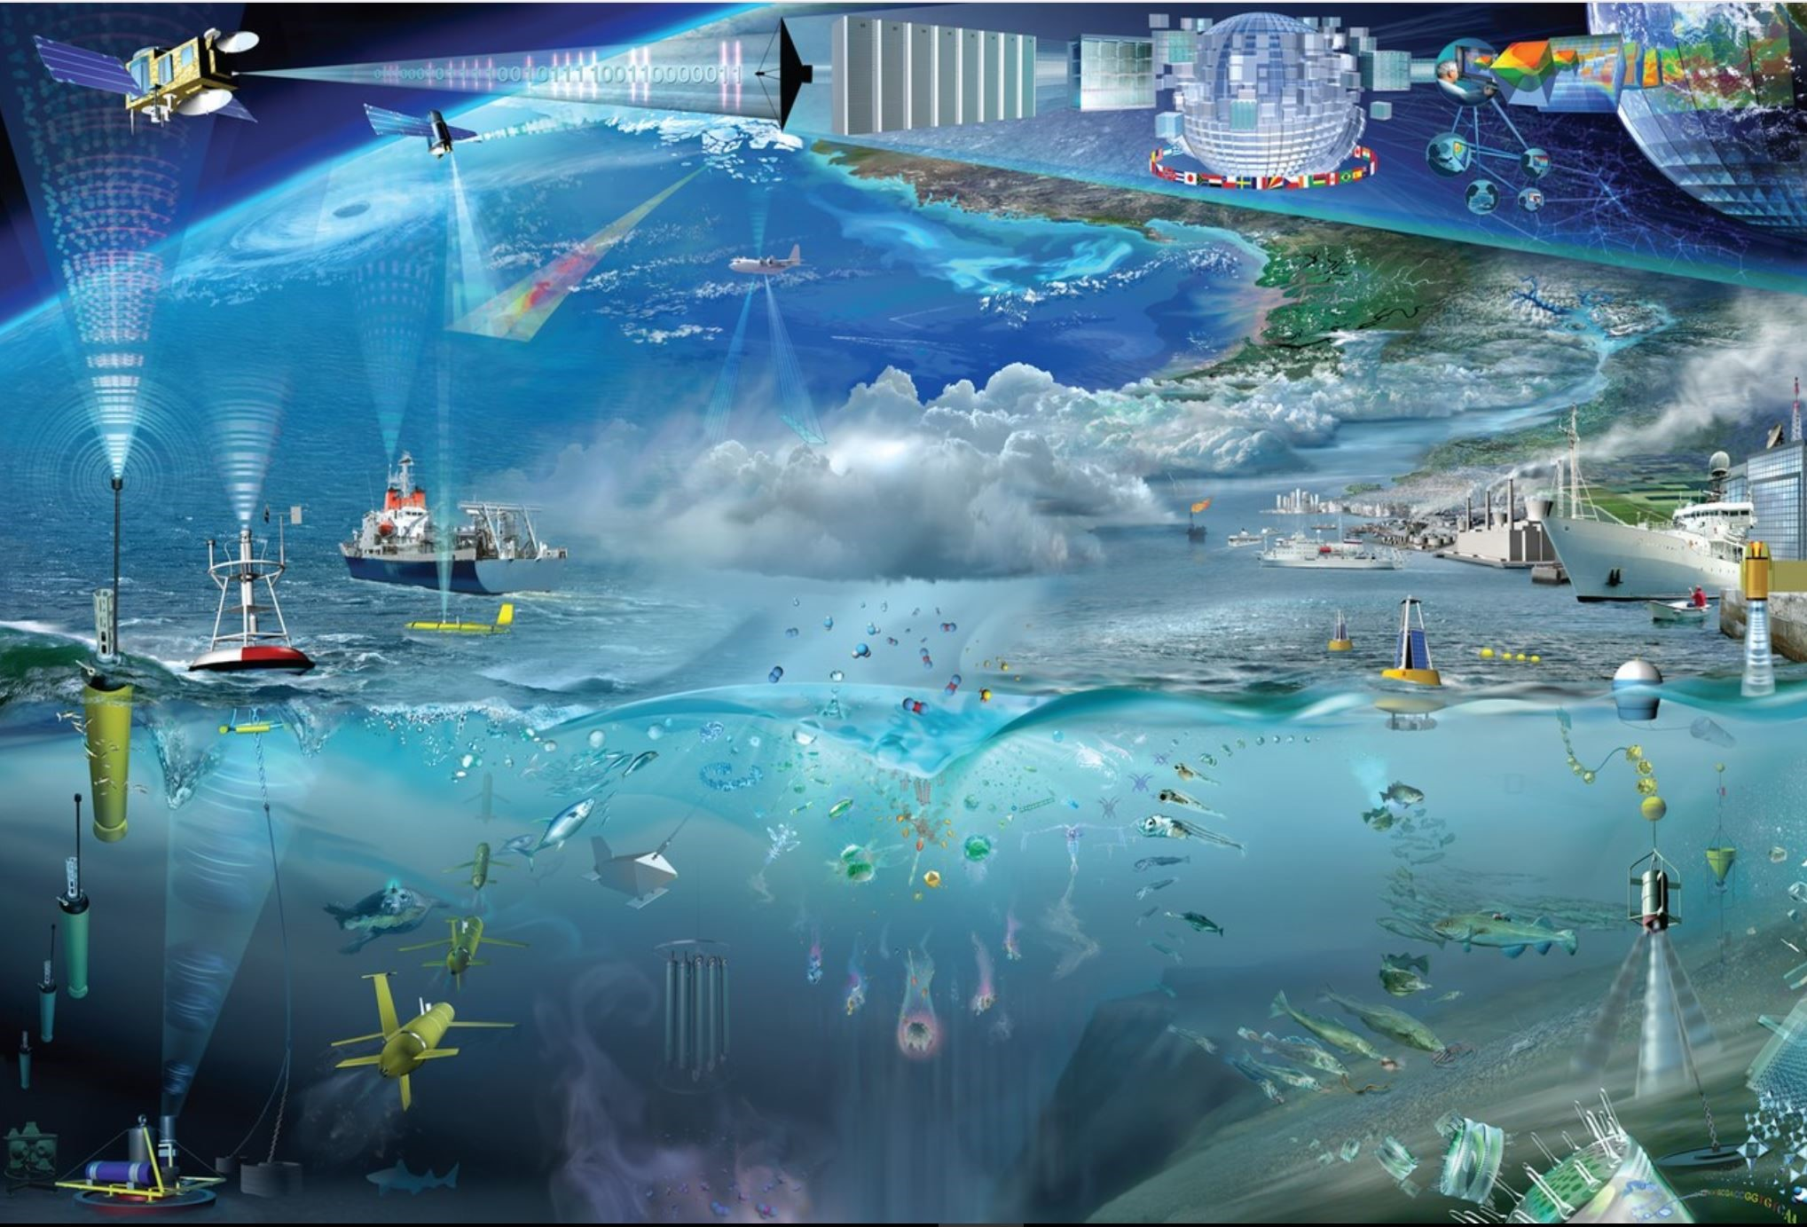
Acquisition of marine and ocean data
In Europe we spent circa 1.4 Billion Euro a year in marine data acquisition (1.0 BE in-situ; 0.4 BE remote sensing)
GOOS

Slide 4
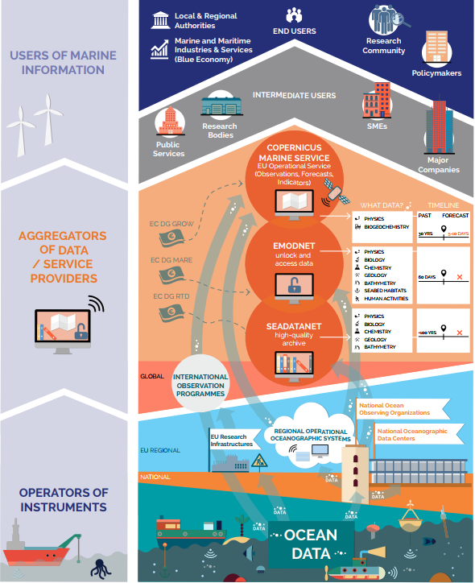
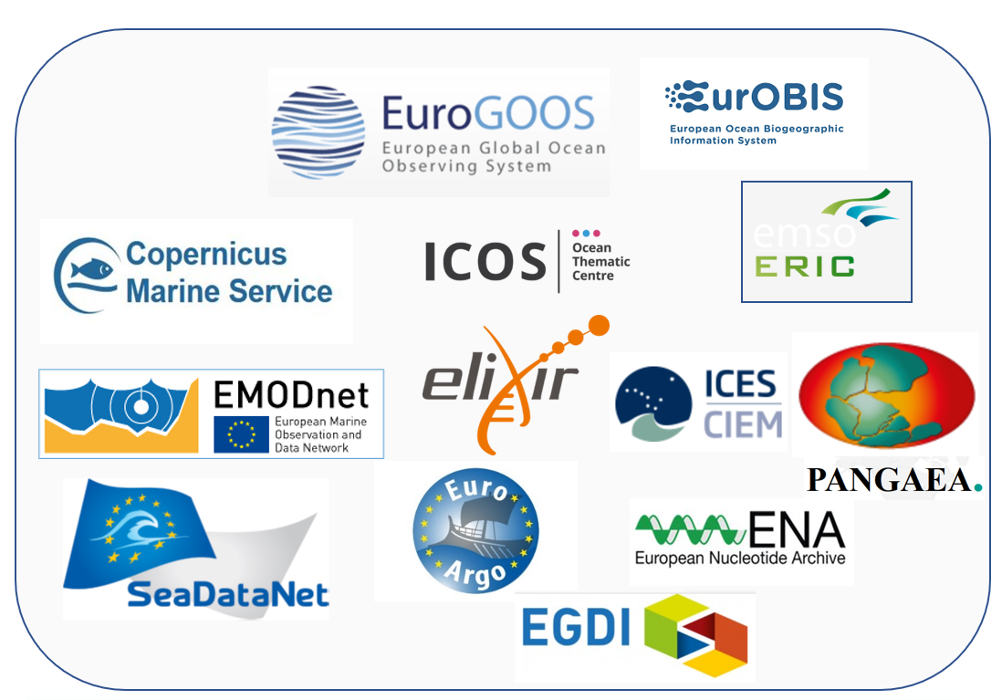
European landscape marine data management
Data aggregators and providers of data products and services

Slide 5
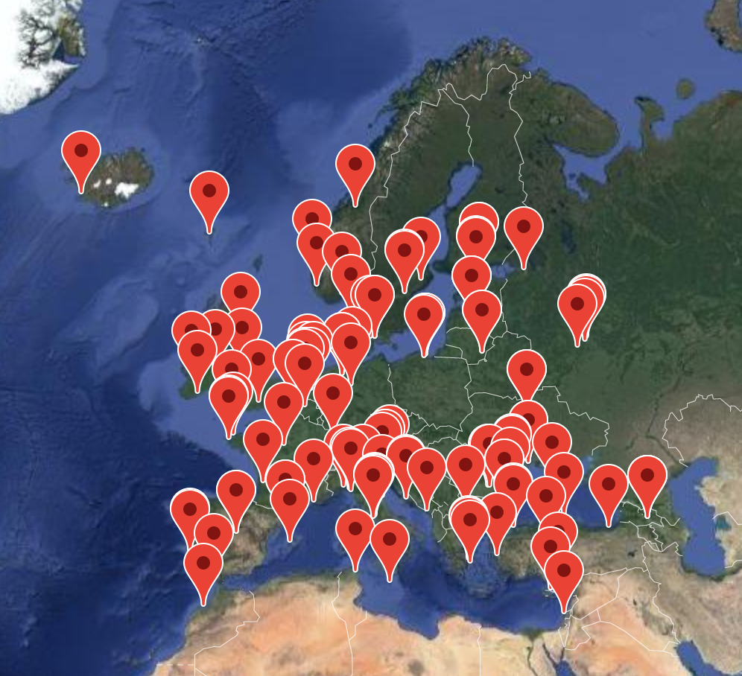
What is SeaDataNet?
A pan-European infrastructure, initiated and set up by the NODCs and marine data focal points of 34 countries bordering the European seas
90s | Metadata directories Medar/MedAtlas
1998-2001 | EuroNODIM (FP3)
2002-2005 | Sea-Search (FP5)
2006-2011 | SeaDataNet (FP6)
2011-2015 | SeaDataNet II (FP7)
2016-2021 | SeaDataCloud (H2020)

Slide 6
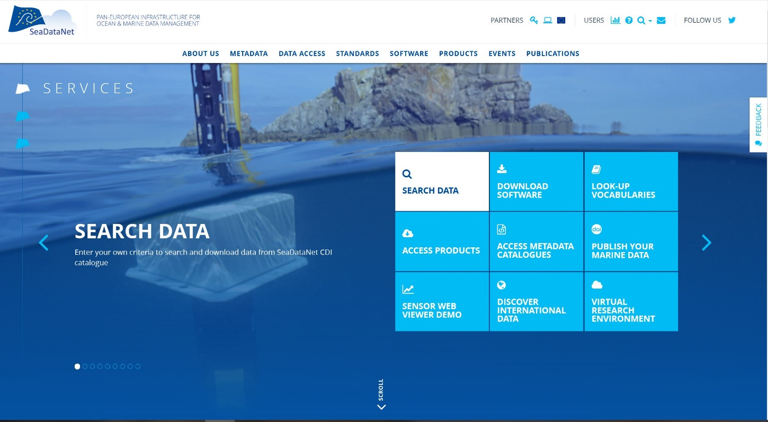
SeaDataNet portal and portfolio
Providing:
Data Management Standards and associated Tools for data centres
Data and metadata services
Products services
Applications for users
https://www.seadatanet.org

Slide 7
SeaDataNet standards
“Making Data and Services:
Findable
Accessible
Interoperable
Re-usable
for machines and people.”
Common standards for the marine domain, adapting ISO and OGC standards and achieving INSPIRE compliance:
Metadata formats for data sets, research cruises, monitoring networks, and research projects
Standard data exchange formats : ODV ASCII and NetCDF (CF) fully supported by controlled vocabularies
Controlled Vocabularies for the marine domain (>100.000 terms in 110+ lists), with international governance and web services
Maintenance and dissemination of standard QA-QC procedures, together with IOC/IODE and ICES

Slide 8
SeaDataNet fit for handling different data types
SeaDataNet metadata and data formats for:
Physical data sets, developed with NODCs
Chemistry datasets, developed with EMODnet Chemistry
Biological data sets, developed with EurOBIS
Geological and geophysical data sets, developed with EuroGeoSurveys
Bathymetry data sets, developed with EMODnet Bathymetry
HF-Radar data sets, developed with EuroGOOS and EMODnet Physics
Glider data sets, developed with Ocean Glider network
Flow Cytometry data together with CNRS and JERICO
Marine Litter data (beach, seafloor, and micro litter), developed with EMODnet Chemistry and TG Marine Litter
SeaDataNet Controlled Vocabularies:
Expanded with new lists and new terms
Available as Web Services, SparQL endpoint, User Interfaces, P01 Vocabulary builder and decomposer

Slide 9
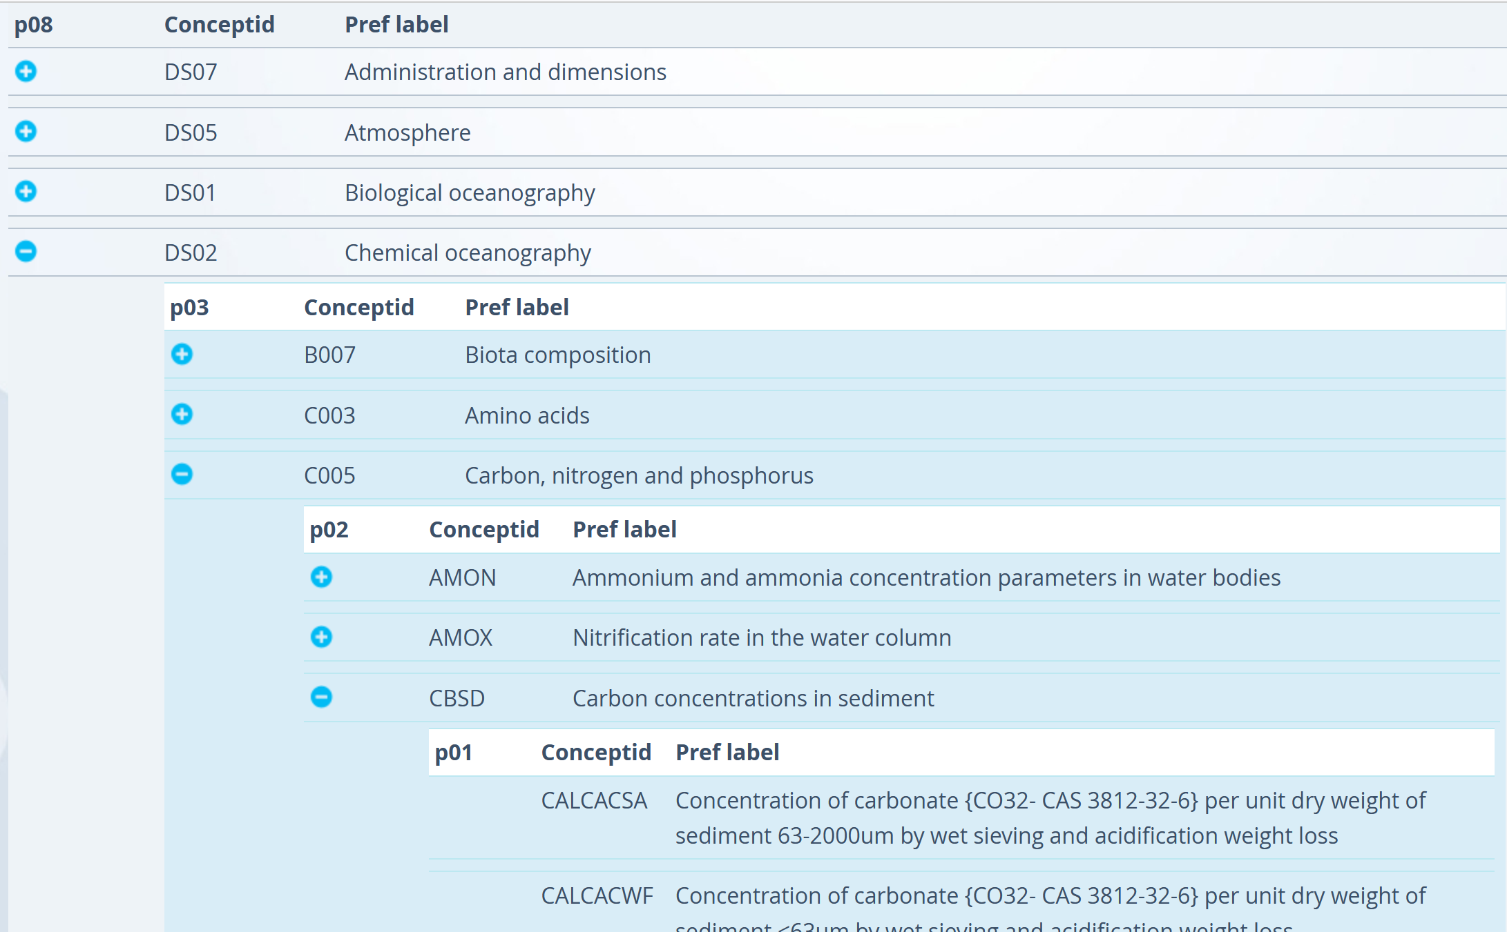
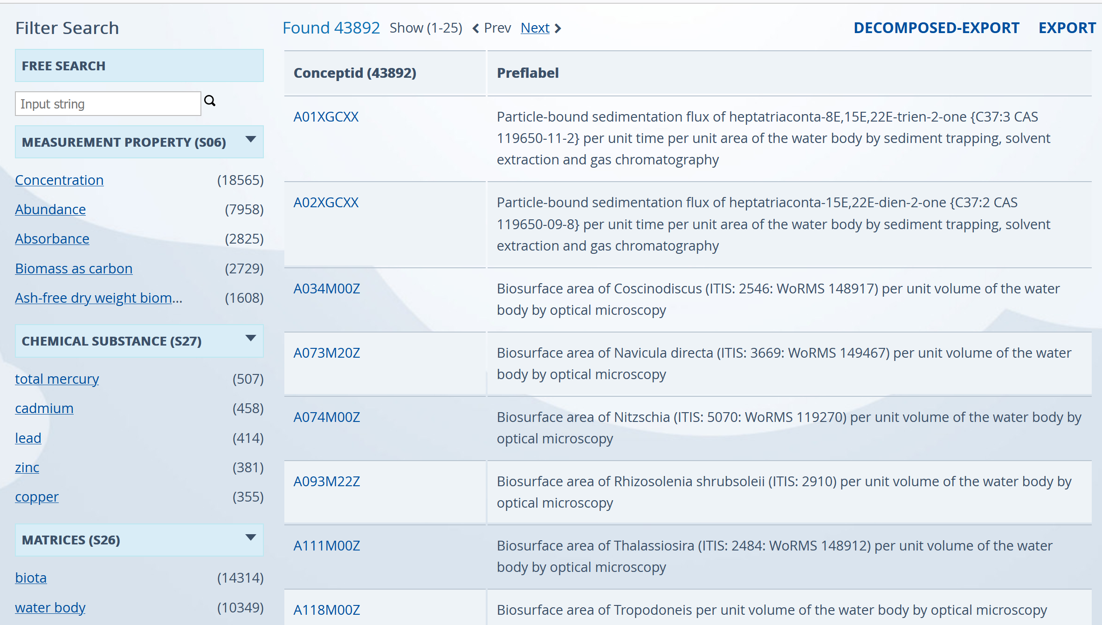
SeaDataNet vocabularies

Slide 10
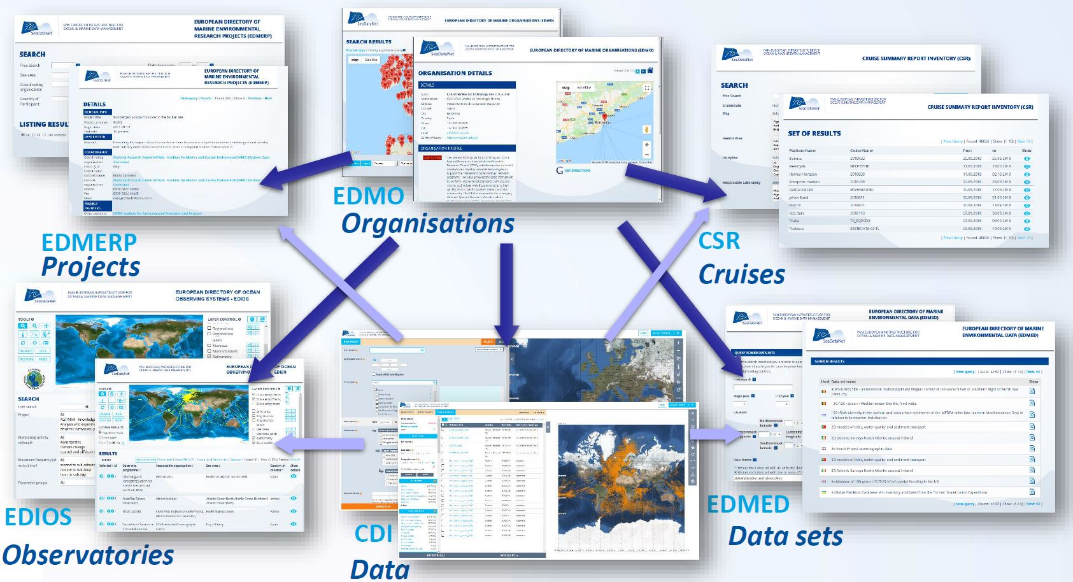
European metadata directories
User Interfaces
Machine-to-Machine services:
SparQL
SOAP web services
API’s
Linked Data Principle
Organisations and their engagements in projects, cruises, monitoring networks and programmes, data collections, data observations, and data management

Slide 11
CDI Data Discovery & Access Service
Cooperation with EUDAT, European e-infrastructure of academic computing centres
As part of:
https://cdi.seadatanet.org/search

Slide 12
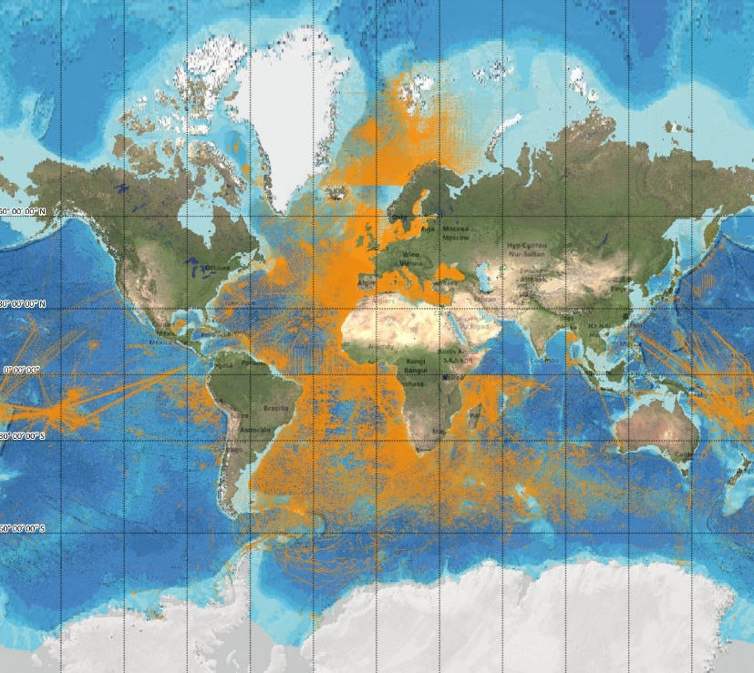
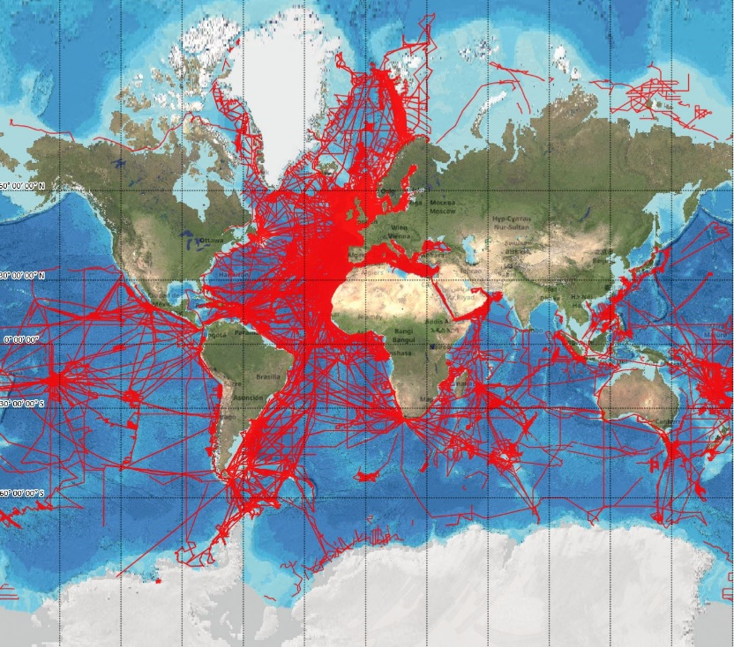
CDI Data Discovery and Access service
Currently, more than 2.65 million data set entries for physics, geology,
chemistry, geophysics, and biology from 114 data centres from 34
countries and > 850 data originators
https://cdi.seadatanet.org/search

Slide 13
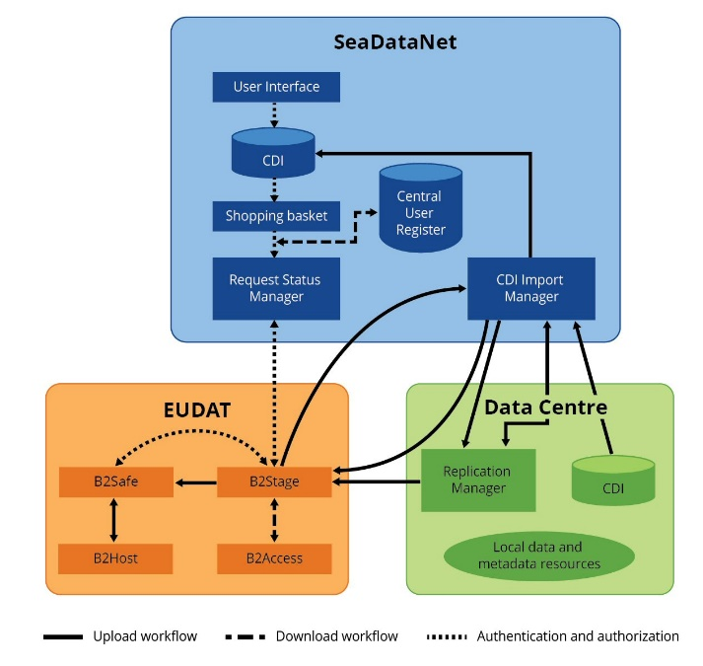
CDI service set-up
Local software tools at data centres to prepare metadata and data ingestions
Replication Manager (RM) at data centres for exchanging to Import Manager and Data cloud
Data cloud for CC-BY data with adapted EUDAT services
CDI Metadata Catalogue, GUIs & APIs, shopping facility with AAA, MySeaDataNet dashboard, order ledger, and downloading service at SeaDataNet
Staging set-up with test, import, and production

Slide 14
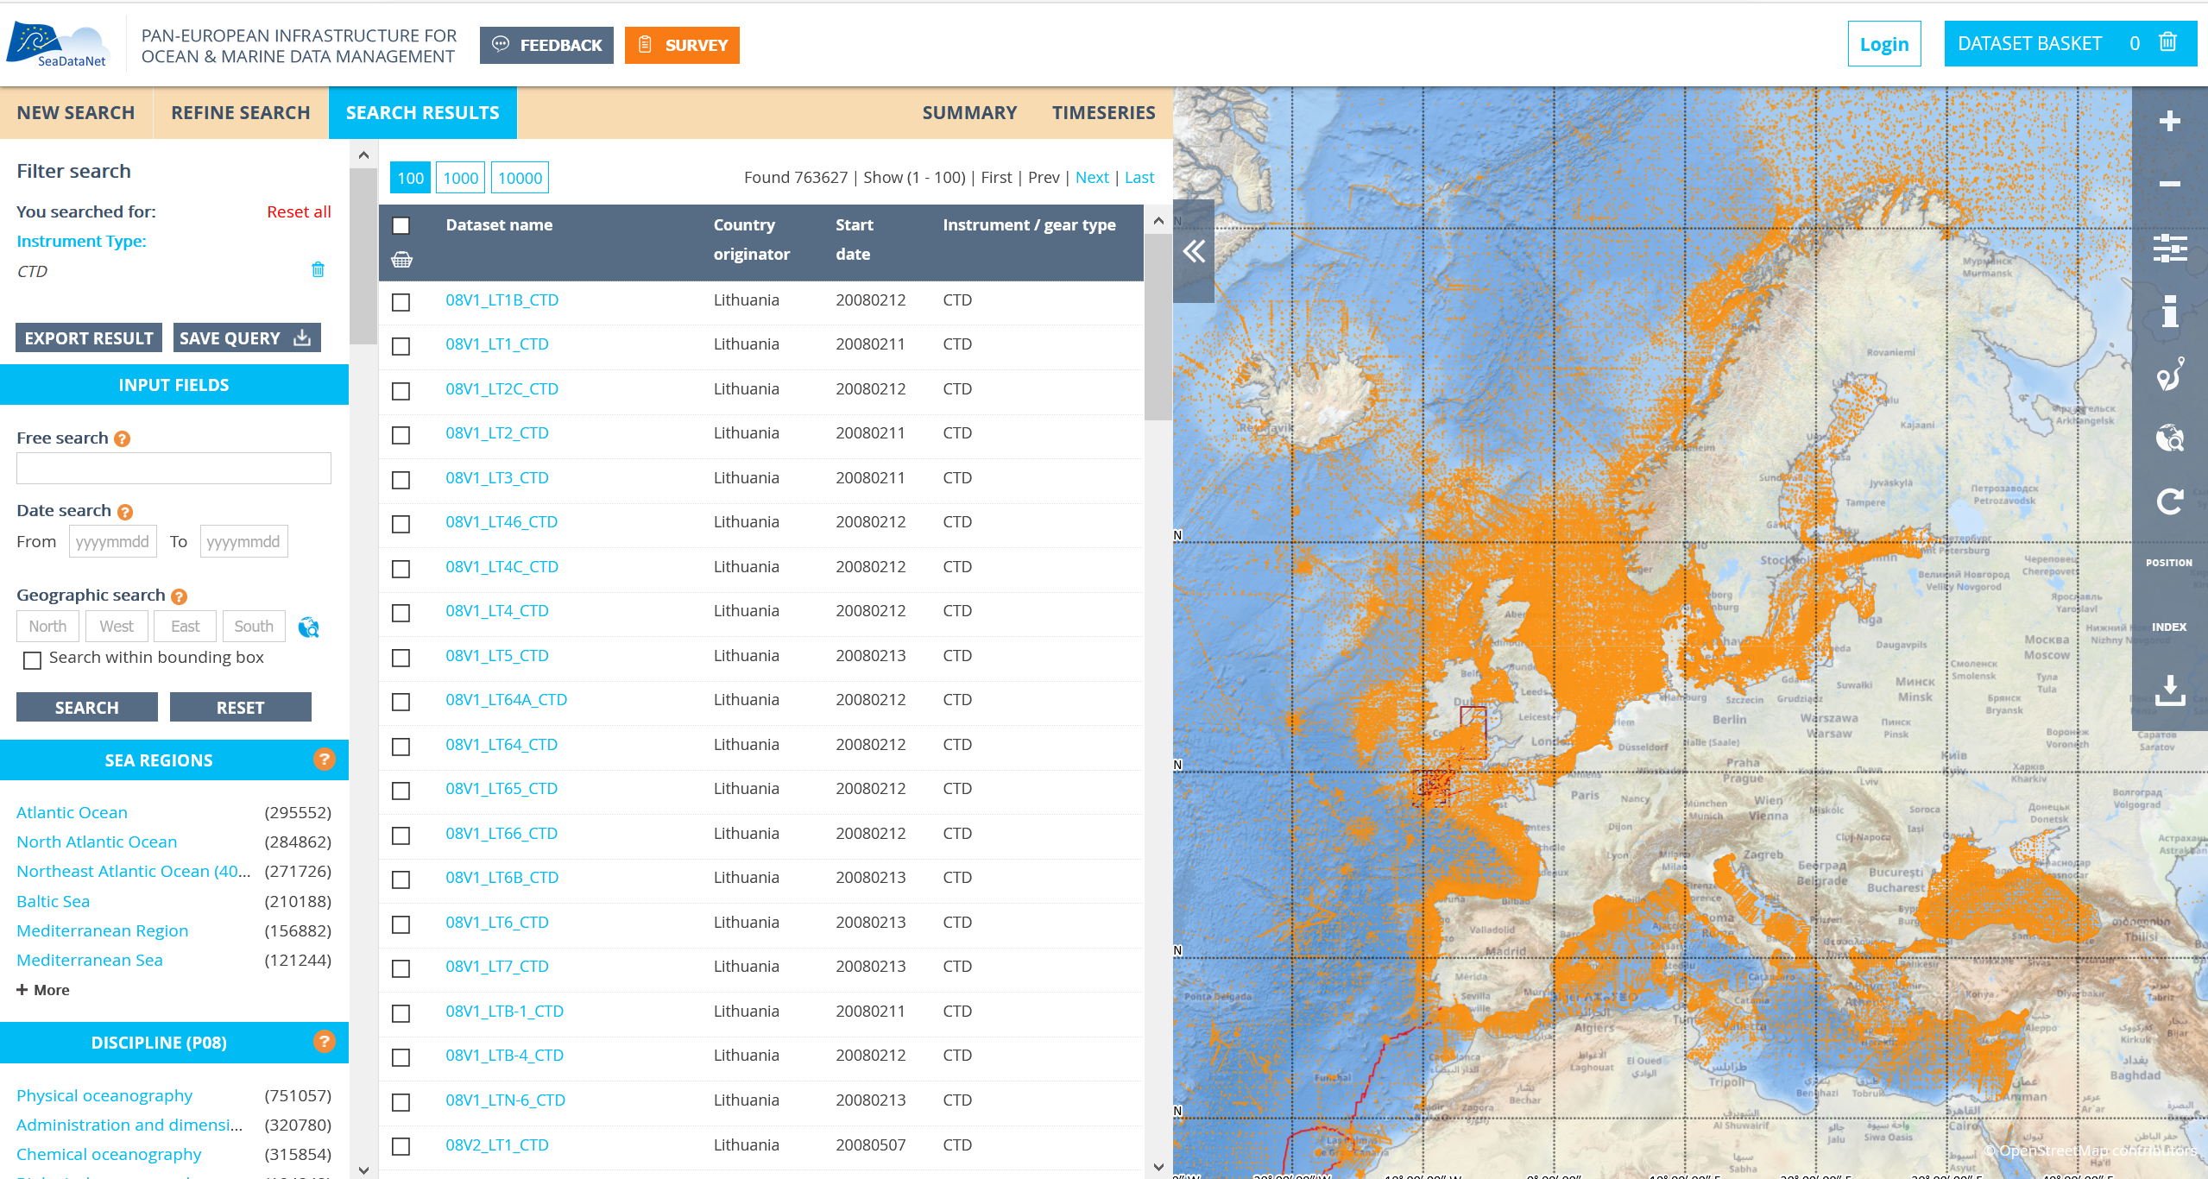
CDI service user interface

Slide 15
Various tools & services developed and made available
Software tool for generating XML entries (MIKADO), format conversions and format checking (NEMO and OCTOPUS)
Software tools for analyses (ODV) and interpolations (DIVA)
Online versions of ODV (WebODV) and DIVA (DIVAnd) as part of SeaDataNet Virtual Research Environment (VRE)
Sensor Web Enablement (SWE) toolkit for operational data streams
SEANOE data publishing and DOI minting service
Vocabulary and Directories web services

Slide 16
SeaDataNet cooperation
Many research projects: ENVRI-FAIR, MARINET2, PHIDIAS, E-Shape, EOSC-EGI-ACE, EOSC-Future, Blue-Cloud, …, adopting and adapting SeaDataNet standards and services, and use cases
Large ocean monitoring systems: EuroGOOS, JERICO-S3, EuroFleets+, ...: adopting standards and services for validation + long-term archiving
GEOSS - EuroGEOSS: populating the GEOSS portal with SeaDataNet in-situ data collections for global sharing
UNESCO IOC – IODE network and Ocean Data Portal: global data exchange and interoperability solutions
Copernicus Marine Environmental Monitoring Services (CMEMS): providing standards, data collections, and cooperation in T&S climatologies
European Marine Observation and Data Network (EMODNet): building added-value products and services
Data management solutions and long term stewardship
Engaging new thematic communities
Adopting and adapting SeaDataNet standards

Slide 17
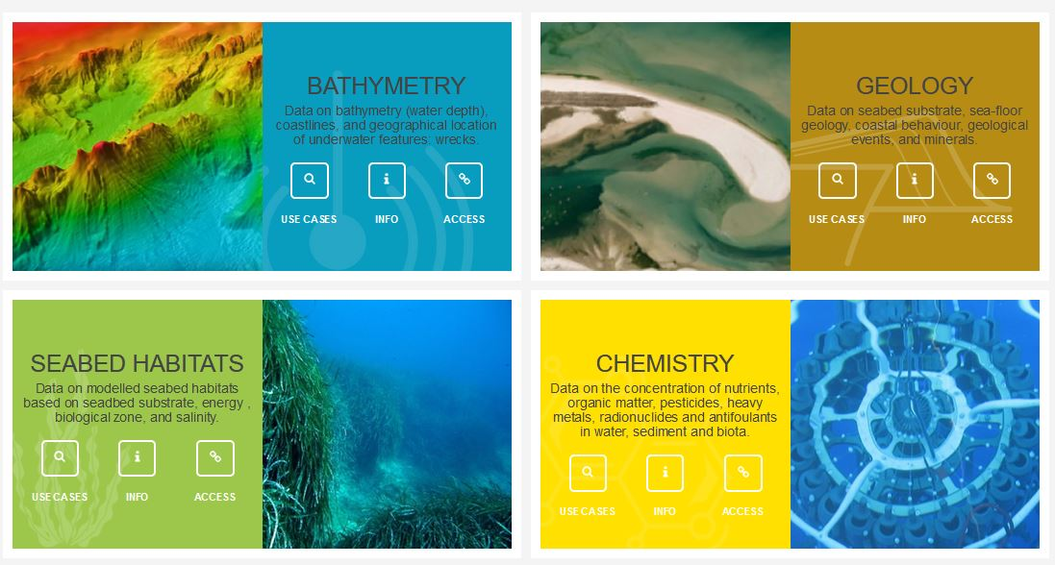
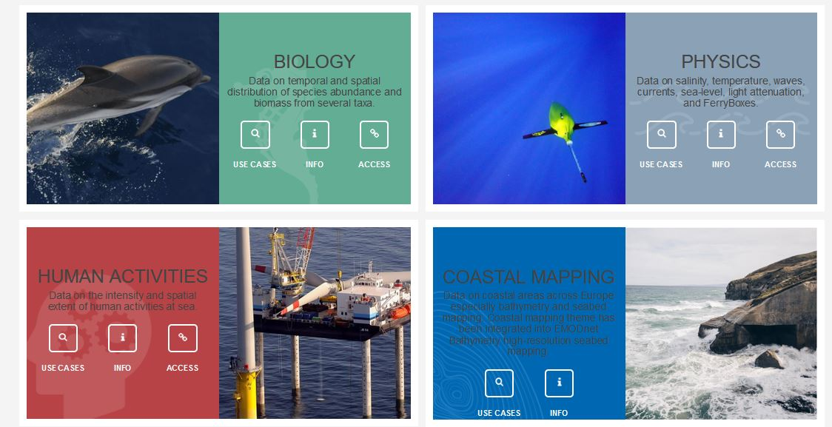
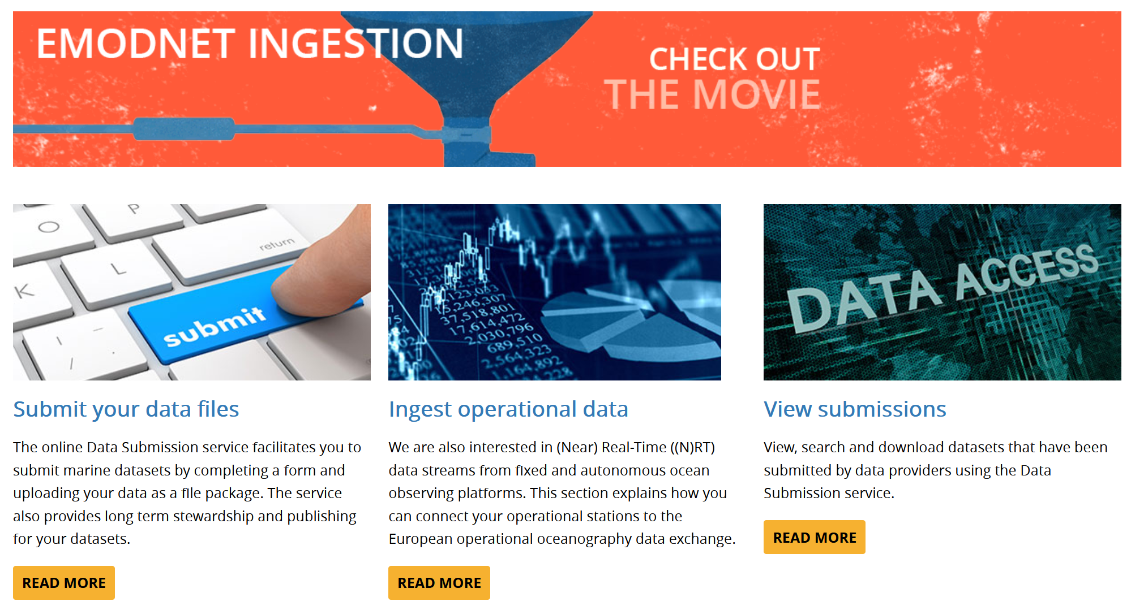
Pillar under EMODnet
EU DG MARE initiative, started in 2008, for an overarching European Marine Observation and Data Network (EMODnet)
SeaDataNet qualified as major supporting infrastructure, driving several thematic portals from the start
EMODnet has focus on European data products and services in support of Blue Economy, Blue Environment and Marine Knowledge 2020

Slide 18
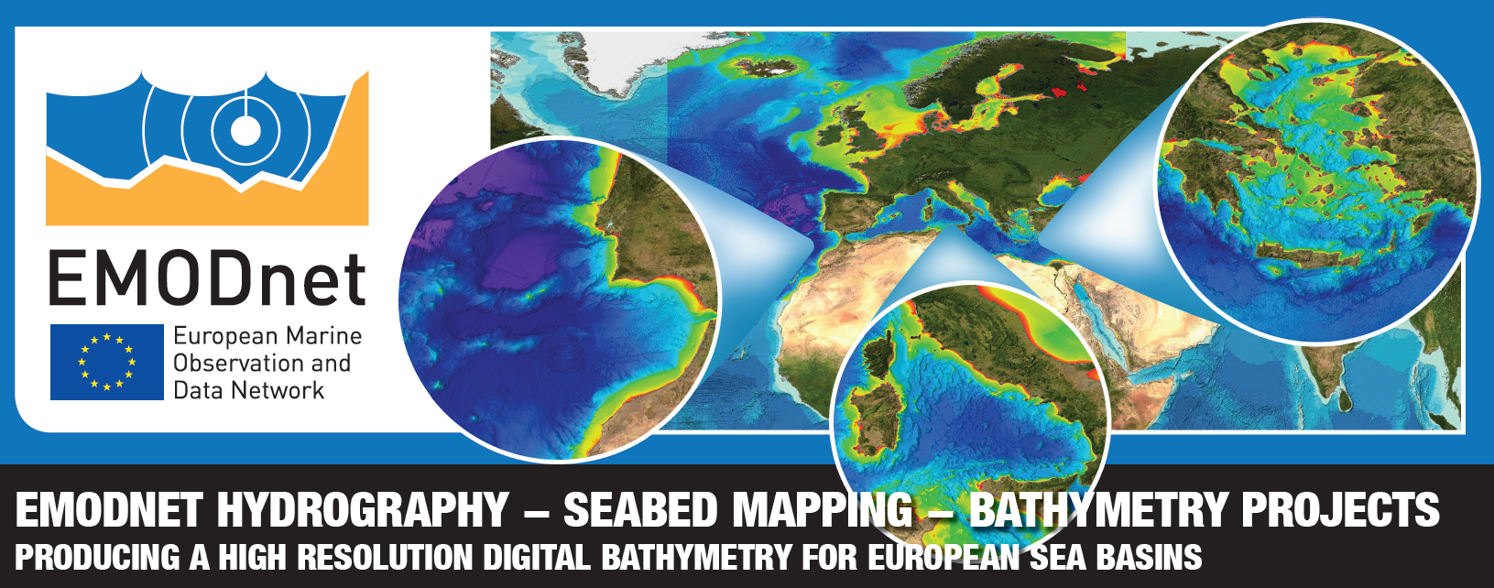
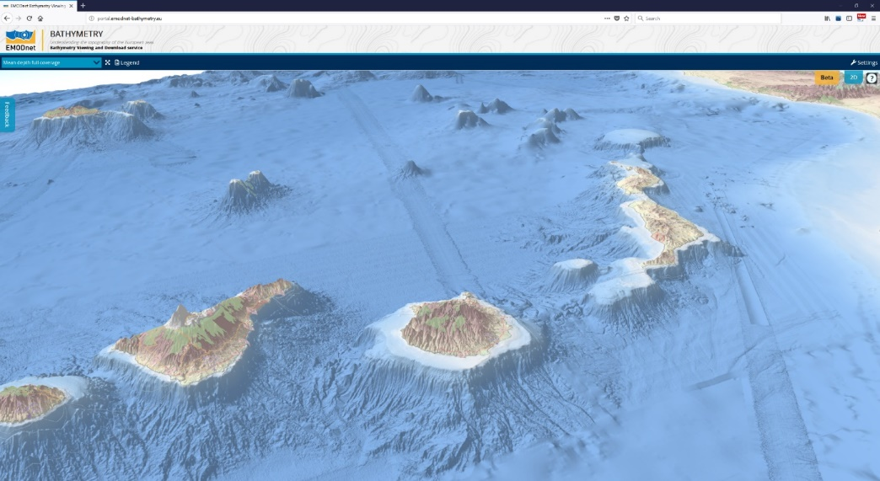
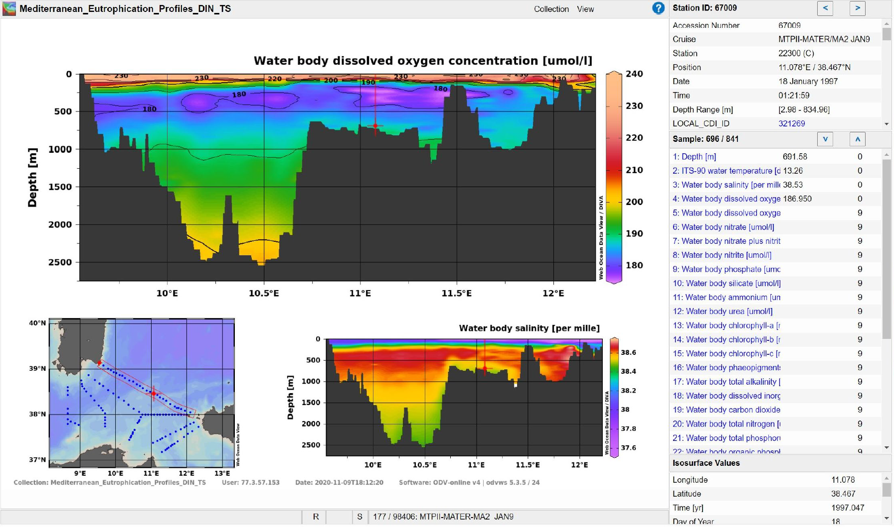
EMODnet examples for Bathymetry and Chemistry

Slide 19
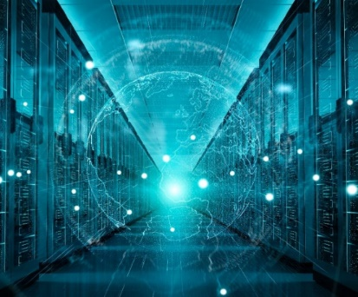
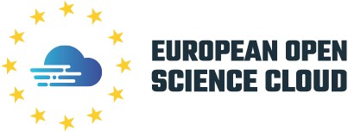
Blue-Cloud initiative
To explore and demonstrate the potential of cloud based open science supporting research for ocean sustainability, and UN Decade of the Oceans and G7 Future of the Oceans
To deploy a cyber platform with smart federation of multidisciplinary data repositories, analytical tools, and computing facilities
To develop a blue print for a thematic EOSC

Slide 20
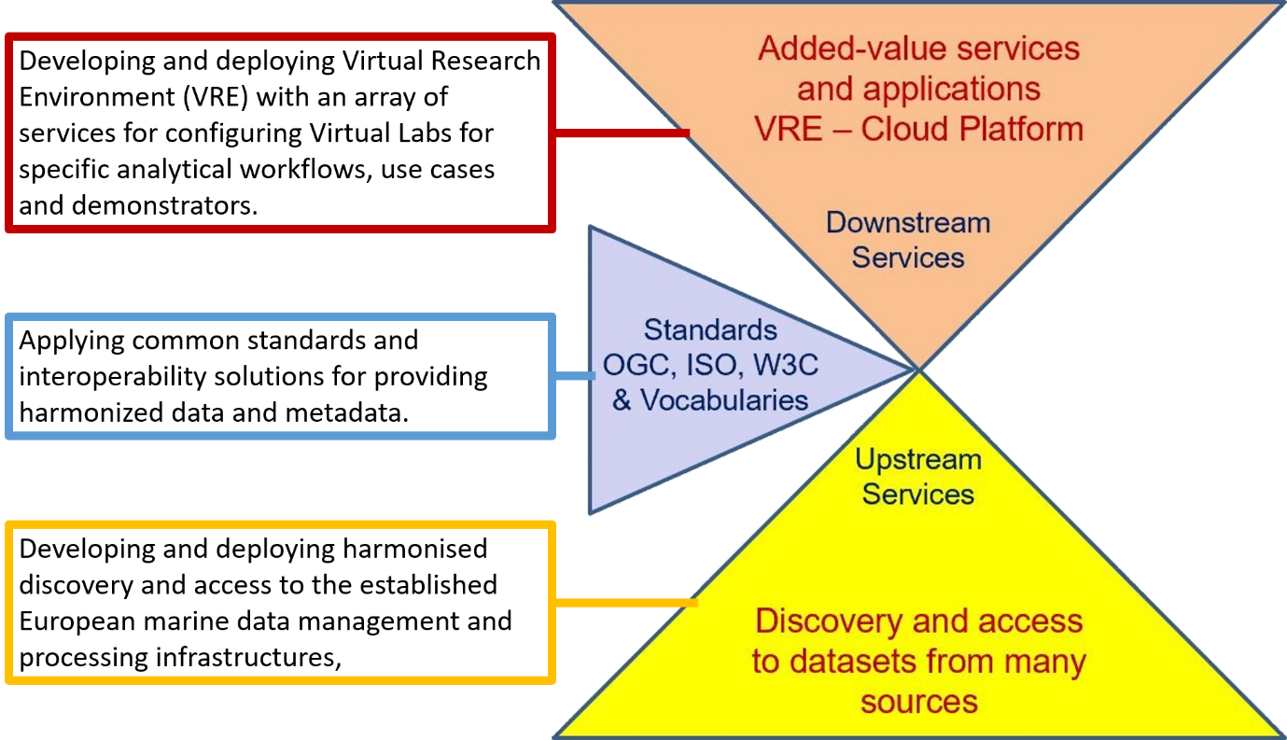
Blue-Cloud overarching concept

Slide 21
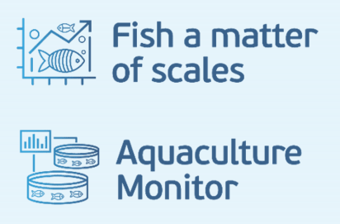
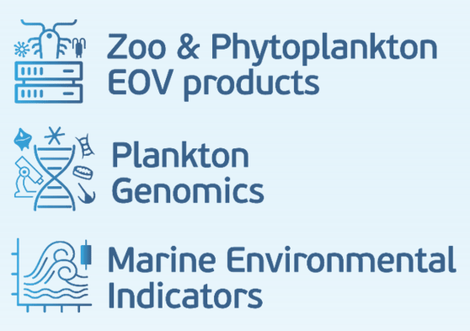
Blue-Cloud key products and services
Blue-Cloud Data Discovery & Access service, federating key European data management infrastructures, to facilitate users in finding and retrieving multi-disciplinary datasets from multiple repositories
Blue-Cloud Virtual Research Environment infrastructure to provide a range of services and to facilitate orchestration of computing and analytical services for constructing, hosting and operating Virtual Labs for specific applications
Blue-Cloud Virtual Labs, configured with specific analytical workflows to serve as Demonstrators, which can be adopted and adapted for other inputs and analyses

Slide 22
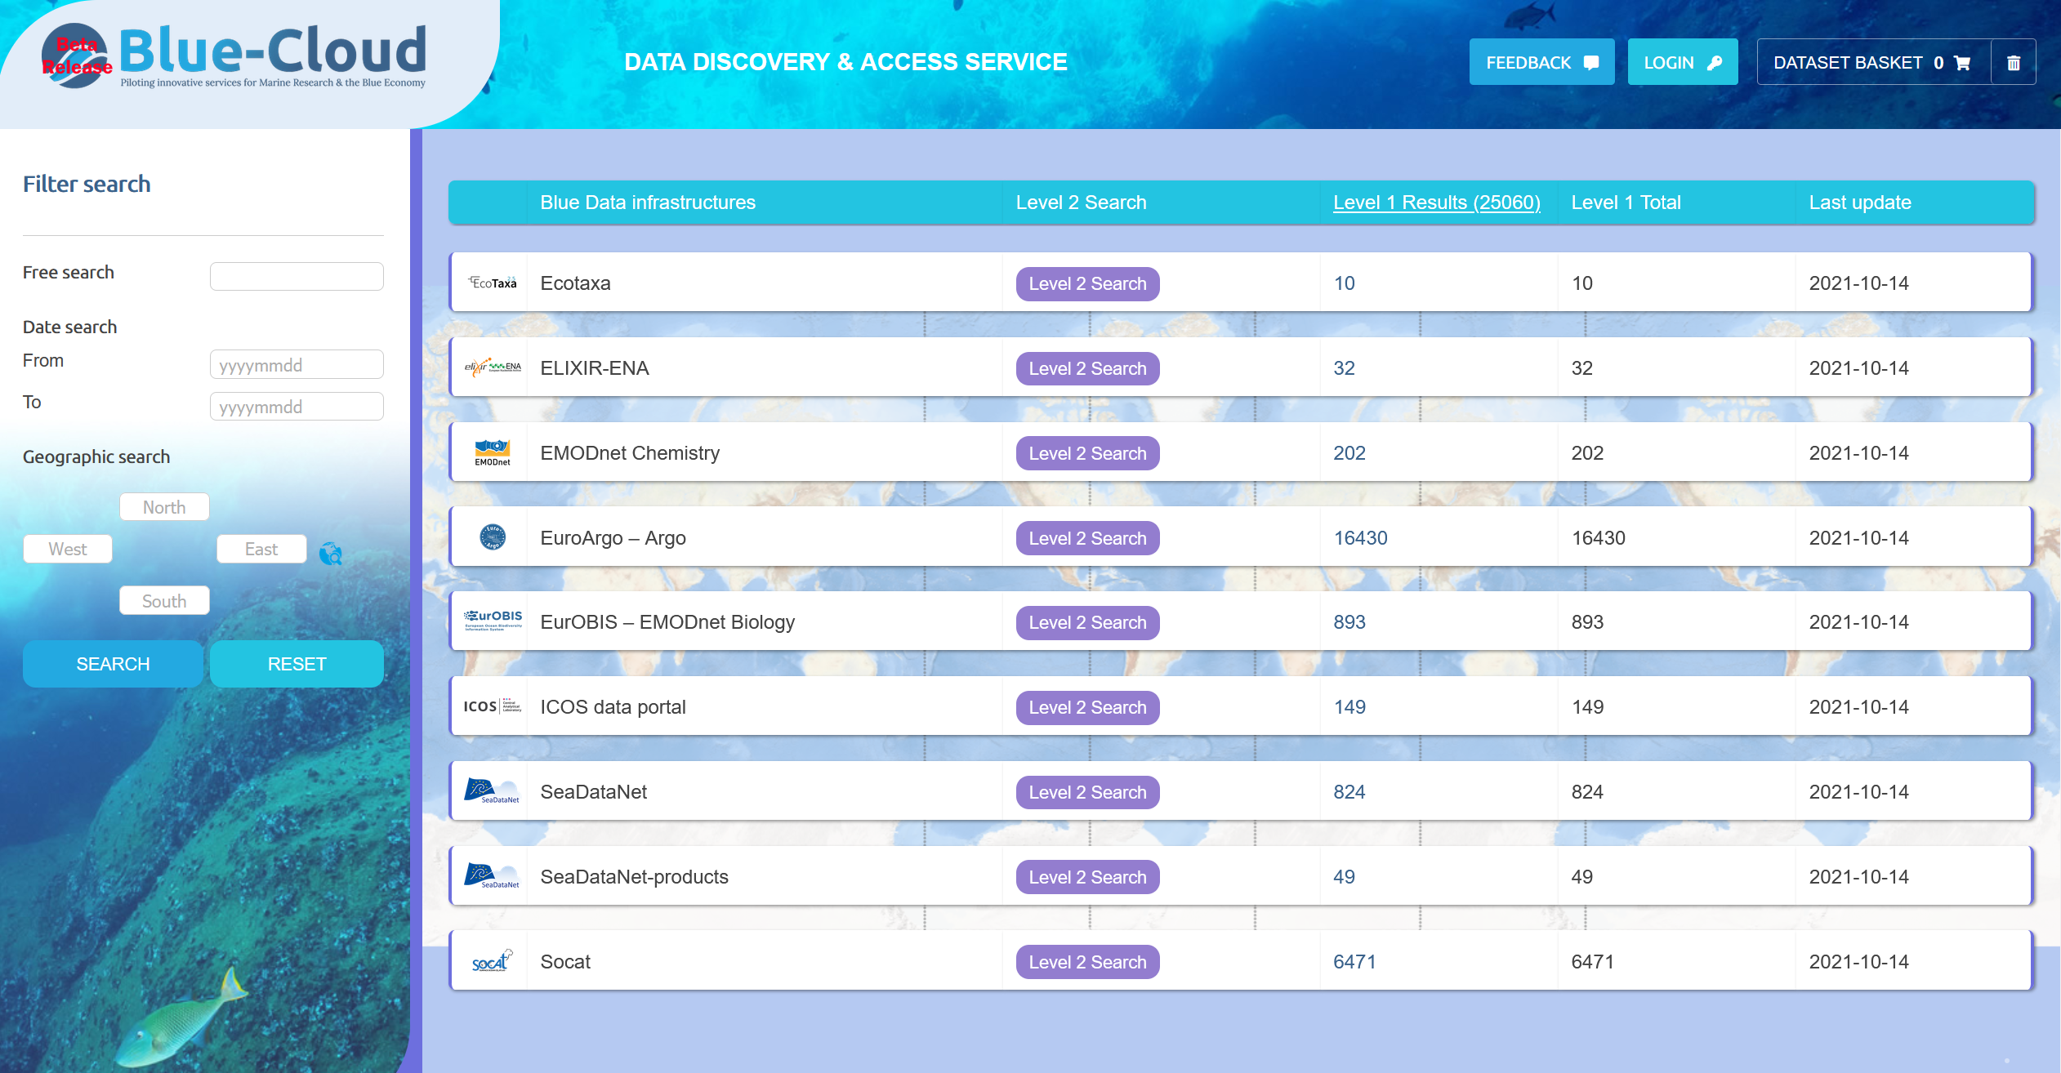
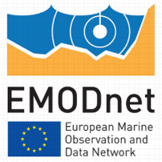
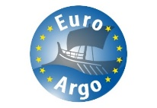
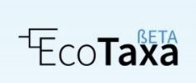
Blue-Cloud Data Discovery & Access service
Built upon DAB metadata broker technique as also used for GEOSS portal to power search at collection level
Built upon CDI Data Discovery and Access service technique to power interactive searches at data level and to submit and process shopping baskets for downloading data sets from 9 major Blue Data Infrastructures
https://data.blue-cloud.org

Slide 23
Conclusions
SeaDataNet develops and maintains standards and services for marine data management which are widely adopted, and which have a major impact on the functioning of the marine data landscape in Europe and beyond
SeaDataNet has a large network of data centres which have direct contacts with hundreds of in-situ data collectors, providing them services for validation, long term stewardship, and wider dissemination of data sets
SeaDataNet data collections are input for many derived products, for instance for several European data products as generated and published by EMODnet and CMEMS
SeaDataNet is a major inspirator and contributor for the Blue-Cloud project and is one of the many building blocks for EOSC, representing a large network of marine data providers and users.

