Slide 1
Community Engagement: The Competence Centres and the EOSC Early Adopter Programme (WP8)
Gergely Sipos/EGI Foundation
WP8 coordinator
Dissemination level: Public

Slide 2
Outline
Role of Competence Centres (CCs) and Early Adopter Pilots (EaPs)
CCs and EaPs compared
A launchpad for communities
Lessons learnt with examples
The Future

Slide 3
CCs and EaPs in EOSC-hub
Federation and common services
Thematic services
DIH Business Pilots
WP5
WP6
WP5
WP7
Federation Services
Auth-Authorization, Accounting, Monitoring
Added value services
Compute platforms, data & software management, curation & preservation
Open Collaboration Services
Application/software repository, Configuration management, Marketplace
integration
WP9
WP6
Basic infrastructure
Compute and storage
integration
WP10
Competence Centres (8)
Early Adopter Pilots (5+8)
New thematic services
E-infrastructure studies
Data processing use cases
WP11
Outreach and training
WP8

Slide 4
Engaging with research communities
CCs (8)
Selection during proposal preparation
Defined set of providers (mini-projects within the project)
Funding for users and providers (232 PMs for 36 = ~30PM/CC)
Run for 36 months
EaPs (5+8)
Selection during project time (2018)
Providers and shepherds were identified based on the use case
Funding for providers (80 PMs for 17 = ~6PM/EaP)
Run for 15 or 12 months
Common support
Horizontal and Thematic services
Email lists, Confluence, JIRA, WP10 technical support
Teleconferences, Webinars, Trainings

Slide 5
A launch pad for communities
RI infrastructure pilots/studies,
Community platforms,
Processing cases
Project accelerators
Open AiiDA lab for material science
Towards a Global Open Science Cloud
Toxicology risk assessment
OpenBioMaps for biodiversity
DevOps for ENVRI-FAIR
ESFRI cluster
ESFRI landmark
T8.9 Early Adopter Pilots
AGINFRA+ VRE for agri and food
Virtual Solar and Planetary Access
T8.1 ELIXIR
T8.8 Disaster mitigation
T8.2 Fusion
STARS4ALL
Data discoverability for clinical research
ESFRI landmark
Competence Centres
ESFRI landmark
T8.7 Carbon cycle
T8.3 Marine
EMSO data mgm platform
Agriculture monitoring with Copernicus
ESFRI landmark
Towards plant phenotyping platform
Global energy system
ESFRI project
ESFRI landmark
T8.6 Radio astronomy
T8.4 Ionosphere studies
T8.5 EPOS-ORFEUS
ESFRI landmark
ESFRI project
ESFRI landmark
ESFRI landmark
D8.2 – Final report on CC key results and exploitation status and plans
EaP final report

Slide 6
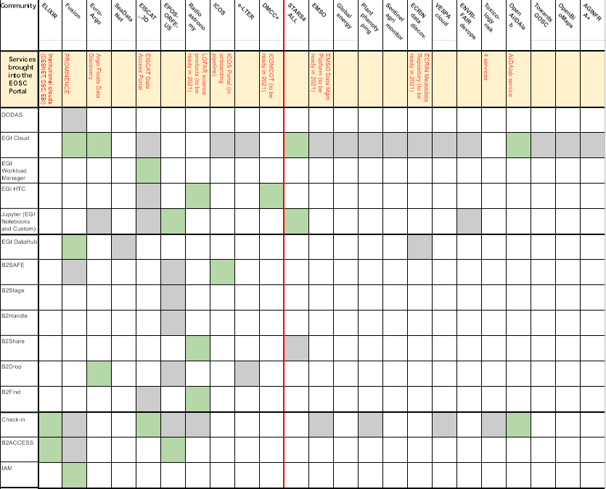
Matchmaking communities and opportunities
Compute
“This CC has allowed us to gain much experience in fields which are generally not familiar to scientists.” (Carl-Fredrik Enell, EISCAT Association, EISCAT_3D CC)
Data mgm.
“The EaP program allowed us to understand better how the EOSC infrastructure works and to identify useful services for our community.
The exchanges and feedback from other projects involved in the EaP program were also very enriching.” (Vincent Nègre, INRAE, Plant phenotyping EaP)
Auth.-Auth.
Notes:
Talking points:
There is immerse set of opportunities given by the EOSC-hub generic services
These are shown in three areas. The assessment and integration is indicated within the matrix. Red separates CCs from EaPs
The main outputs were:
Identify opportunities, learn about EOSC
11 services onboarded, 5 more to come in 2021
Assess suitability of e-infrastructure services for RIs, projects → ‘Infrastructure study’
Could be also used:
“The EAP pilot was an excellent opportunity to understand how EOSC services can be used to provide core functionality to the individual community-specific infrastructure” (Thomas Exner, Edelweiss Connect, Risk assessment EaP)

Slide 7
An example – Euro-Argo CC
Internet
EOSC-hub services area
EGI Cloud Compute (site at IN2P3)
Argo RI area
metadata
elasticsearch
data discovery import
EGI Cloud Compute (site at IN2P3)
EGI Cloud Compute (site at IN2P3)
Data Discovery
API
data
cassandra client
Argo discovery
http://bluecloud.odatis-ocean.fr
cassandra
Datacharts
API
subsetting daemon
Subsetting
API
SSTables
tomcat
RabbitMQ
csv
data
json
metadata
B2DROP
Data store
or FTP
NetCDF - csv
scala
spark
Argo GDAC
EGI Notebooks
Interactive computing

Slide 8
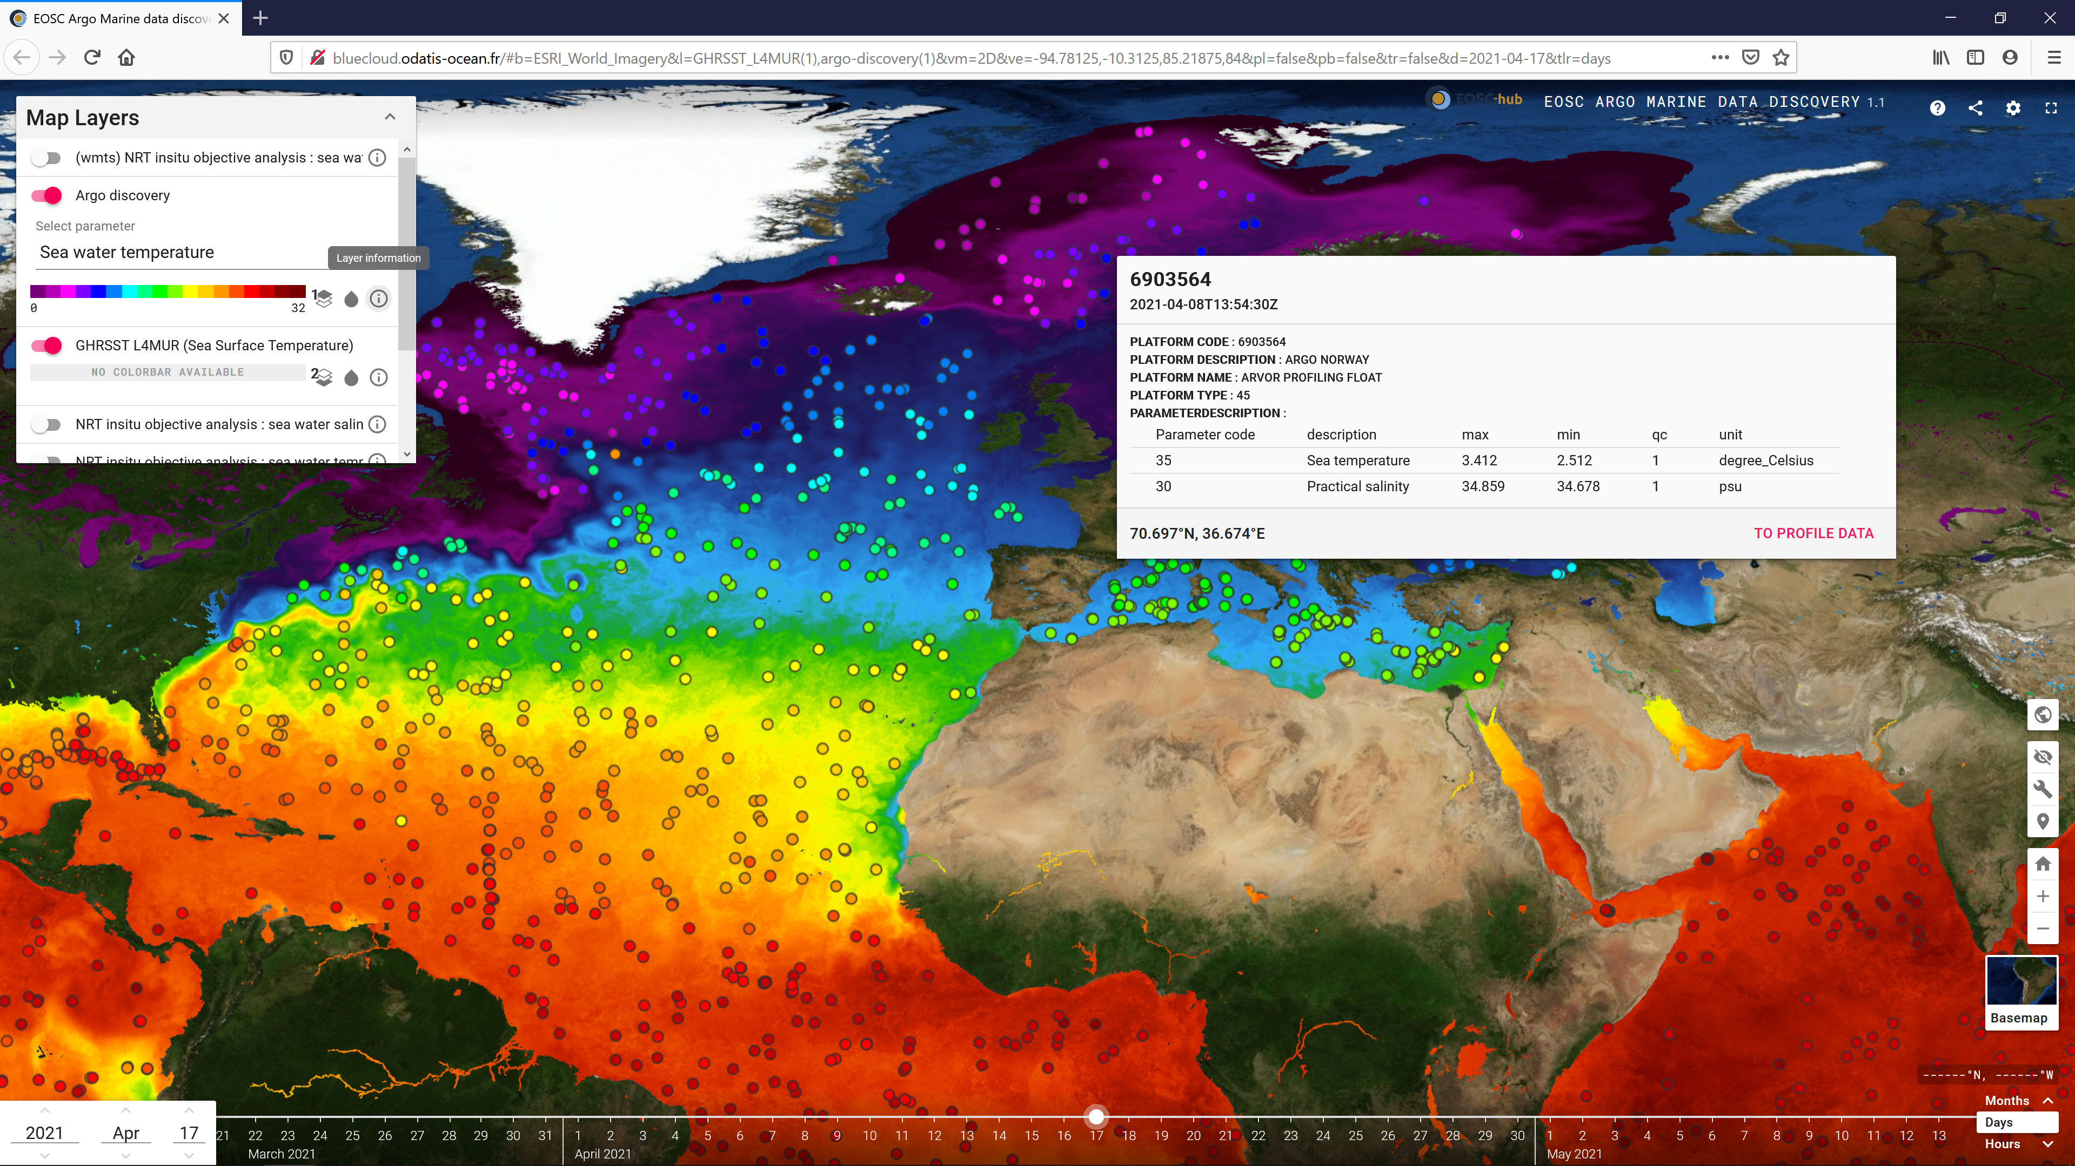
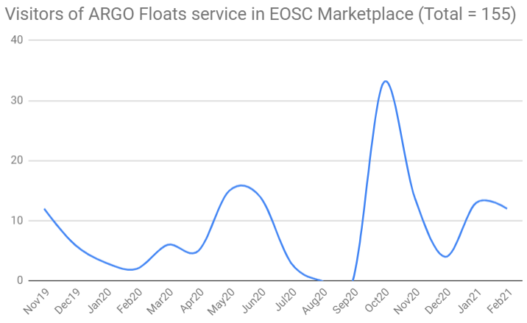
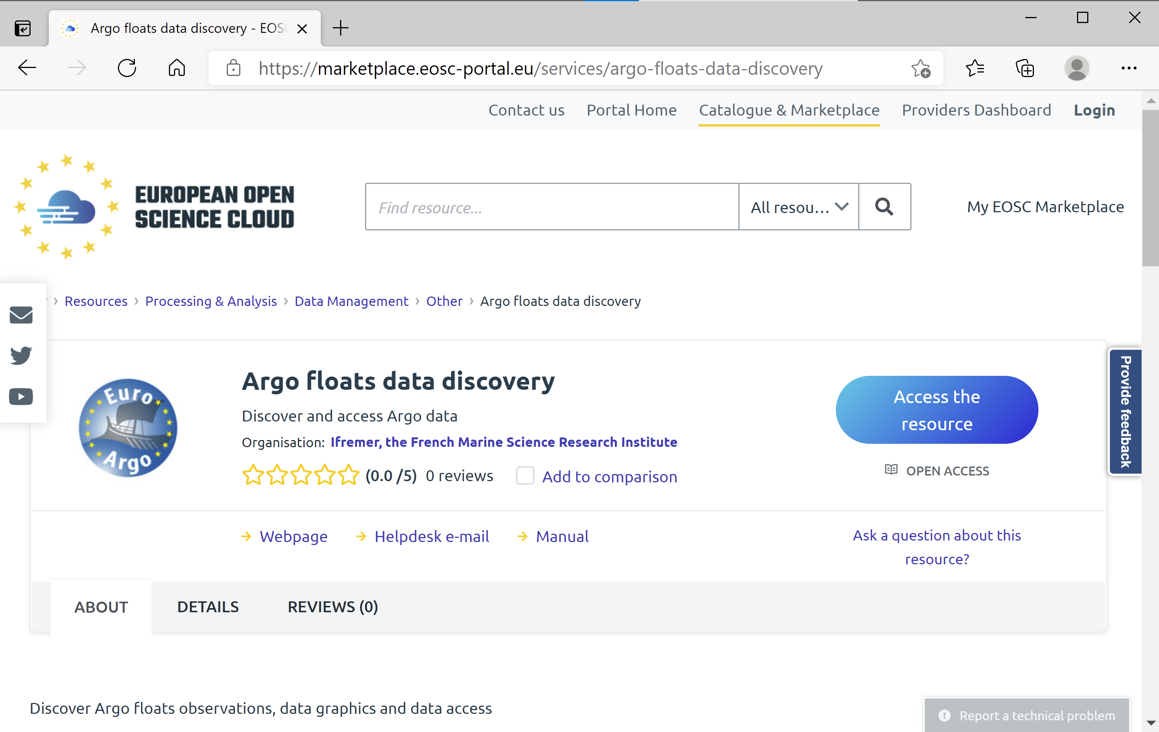
An example – Euro-Argo CC
Argo floats temperatures on April 17th 2021 along GHRSST satellite temperature analysis

Slide 9
Most popular topics: IaaS cloud, AAI proxy
Also confirmed by EOSC service orders:
https://opsportal.eosc-portal.eu/metricsEOSC/ServiceOrder
Compute
“The EAP pilot has boosted our confidence that a European federated Open Science Cloud provides the essential compute needs of the European Earth Observation community, both in the science domain and in the public use domain.” (Guido Lemoine, EC JRC, Agriculture monitoring with Sentinel EaP)
Data mgm.
Auth.-Auth.
Notes:
Talking points:
IaaS Cloud dominates, and EaPs were very compute-focused
AAI was relevant for everyone where non fully open services are offered
Data management is an effort/time intensive area therefore the scoping limited to CCs

Slide 10
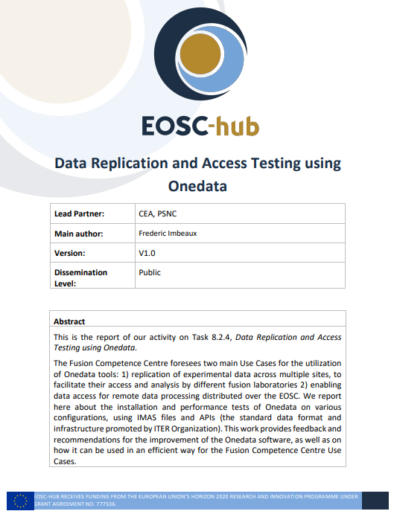
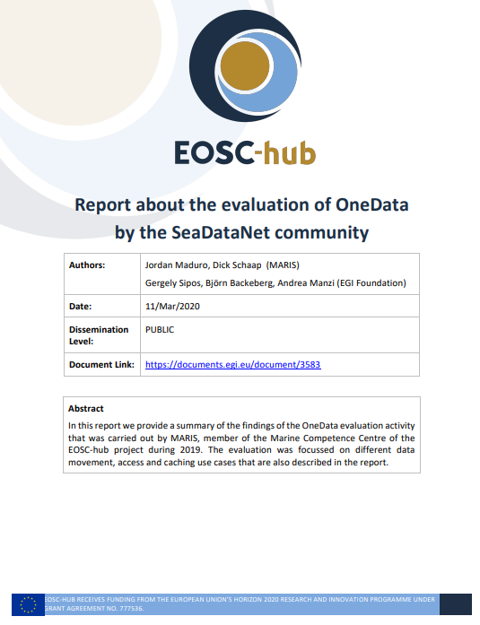
Data management and meta-data management
Data management – Was in focus for most CCs in different ways
On-demand access to datasets from IaaS clouds (Marine, Fusion)
Data replication (EPOS-ORFEUS, ELIXIR)
FAIR sharing of science-level data (LOFAR)
Meta-data management
Several CCs and EaPs worked on data catalogues (e.g. EISCAT, ECRIN, EMSO, …)
Community standards due to the lack of EOSC schemas
“Pre-caching of datasets at compute clouds, and downloading of chunks of data into clouds only when and where they are needed is the preferred way of data distribution” (Justin Clark-Casey, EMBL-EBI, ELIXIR CC)
“We need metadata interoperability between the different EOSC services, at least on the level of a core-set that includes basic discovery via geo-spatial parameters” (Esteban Gonzalez, STARS4ALL Foundation and EaP)

Slide 11
Services should be simpler to use (to attract the 1.8 million researchers)
“Discovering the enormous potential of the EOSC requires significant time investment. If I hadn’t gotten into the EaP program, I probably wouldn’t have spent that much time understanding the whole system and understanding some services.” (Miklós Bán, Uni. Of Debrecen, OpenBioMaps EaP)
Service provider’s viewpoint
“The registration time in the EOSC AAI for an experienced user is currently about 4 minutes and should be lowered as much as possible (desirably, by a factor of 2 or even more). It also takes users through a significant amount of different pages that appear redundant and might be even skipped.” (Aliaksandr Yakutovich, EPFL, Stars4All EaP)
End users’ viewpoint
https://jira.eosc-hub.eu/browse/EOSCWP10-10 → EOSC-hub AAI team

Slide 12
Good practices are key to success
“In a scientific environment of active development and high complexity, it’s important to have code that is modular and highly adaptable. […] For example, the indexing will be Kubernetes native and not-tied to any particular software cluster environment..” (Justin Clark-Casey, EMBL-EBI, ELIXIR CC)
Staff turnover, COVID, changing requirements over long period of time
The technology landscape is complex, cutting edge tools emerge in both the academic and commercial/open source domains.
“EaP actually had a larger impact than expected by defining a sustainability strategy for OpenRiskNet with much lower maintenance costs as achievable with solutions operated by partners from the scientific community. This helped to convince at least two projects to base their infrastructure developments on the solutions provided by OpenRiskNet and with that on EOSC services.” (Thomas Exner, Edelweiss Connect, OpenRiskNet EaP)
Notes:
Talking points:
A few of the CCs/EaPs were affected by staff turnover.
Their services can be handled over only if modular, and flexible
Requirements are constantly changing, for RIs over long period of time

Slide 13
Exploitation, uptake, (EOSC-)future
11 communities (7 CCs and 4 EaPs) onboarded services in EOSC, 5 more to continue in 2021
20+ Research Infrastructures and community projects build on the output of the CC-EaP programme
6+ communities continue integration and then thematic service delivery in EGI-ACE and DICE (INFRAEOSC07)
CCs and EaPs do not continue to operate as support entities. However, the framework continues in EOSC-Future, EGI-ACE, DICE, …
<MORE CONCISE MESSAGES, ALSO MENTION SLAs, SUSTAINABILITY OF THEMATIC SERVICES>
(main sustainability talk is by WP2)

