Slide 1
Project Overview
Final review, 10-11/05/2021
Tiziana Ferrari EOSC-hub Project Coordinator

Slide 2
Outline
Mission, vision and objectives
Key exploitable results and contribution to EOSC Phase 1
Sustainability strategies
EOSC-hub final review agenda

Slide 3
A project overview
20 digital research infrastructures,
EGI, EUDAT CDI and INDIGO-DataCloud
jointly offering services, software and data
for advanced, data-driven research & innovation

Slide 4
Vision
Researchers from all disciplines
have easy, integrated and open access to the advanced digital services, scientific instruments, data, knowledge and expertise they need
to collaborate to achieve excellence
in science, research and innovation
100 partners
36 months
33 million Euro

Slide 5
Mission
The EOSC-hub project mobilises providers of European relevance offering services, software and data for advanced data-driven research and innovation.
These resources are offered via the Hub – the integration and management system of the European Open Science Cloud, acting as a European-level entry point for all stakeholders.
EGI Federation
EUDAT
INDIGO-DataCloud
Research Infrastructures

Slide 6
About the European Open Science Cloud
The federated infrastructure and supporting initiative providing
all researchers, innovators, companies and citizens
with seamless access to an open-by-default, efficient and cross-disciplinary environment
for storing, accessing, reusing data, tools, publications and other scientific outputs for research, innovation and educational purposes
Credits: EOSCpilot (https://eoscpilot.eu/)

Slide 7
EOSC-hub response to EOSC objectives ➔ SRIA
EOSC Objectives | Actions
Increase the ability to exploit research data across scientific disciplines and between the public & private sector | > Publish, discover, access services and resources for all scientific disciplines > Open to national, regional, pan-European providers, and supports different exploitation models (e.g. free at point of use, commercial)
Increase interoperability, interconnect the existing and the new research digital infrastructures across Europe | > Provide thematic services integrated with European compute/data platforms for data exploitation > Single sign on, integrated access and order
Support open science | > Services to share and discover research artefacts (publications, datasets, software, workflows etc.), research artefacts data sources (publication repositories, publishers, data archives, software archives, etc.)

Slide 8
Objectives
O1
O2
O3
O4
O5
O6
Increase innovation capacity of Research e-Infrastructures
Provide a knowledge hub.
Widen the access to services to all user groups including researchers, high-education, business organizations and expand the user base.
Consolidate e-Infrastructures by expanding capacity and capabilities and improving service quality.
Remove fragmentation of service provisioning and access to high-quality digital services in Europe and beyond through the technical integration and adoption of standards for interoperability of compute, storage, data and software platforms.
Simplify access to a broad portfolio of products, resources and service provided by the major pan-European and international organizations through an open and integrated service catalogue.

Slide 9
Project Structure
100 Partners, 76 beneficiaries (75 funded)
3830 PMs, 106 FTEs, +150 technical and scientific staff involved
€33,287,542 of which the European Commission funds €30,000,000
36 months: Jan 2018 – Dec 2020

Slide 10
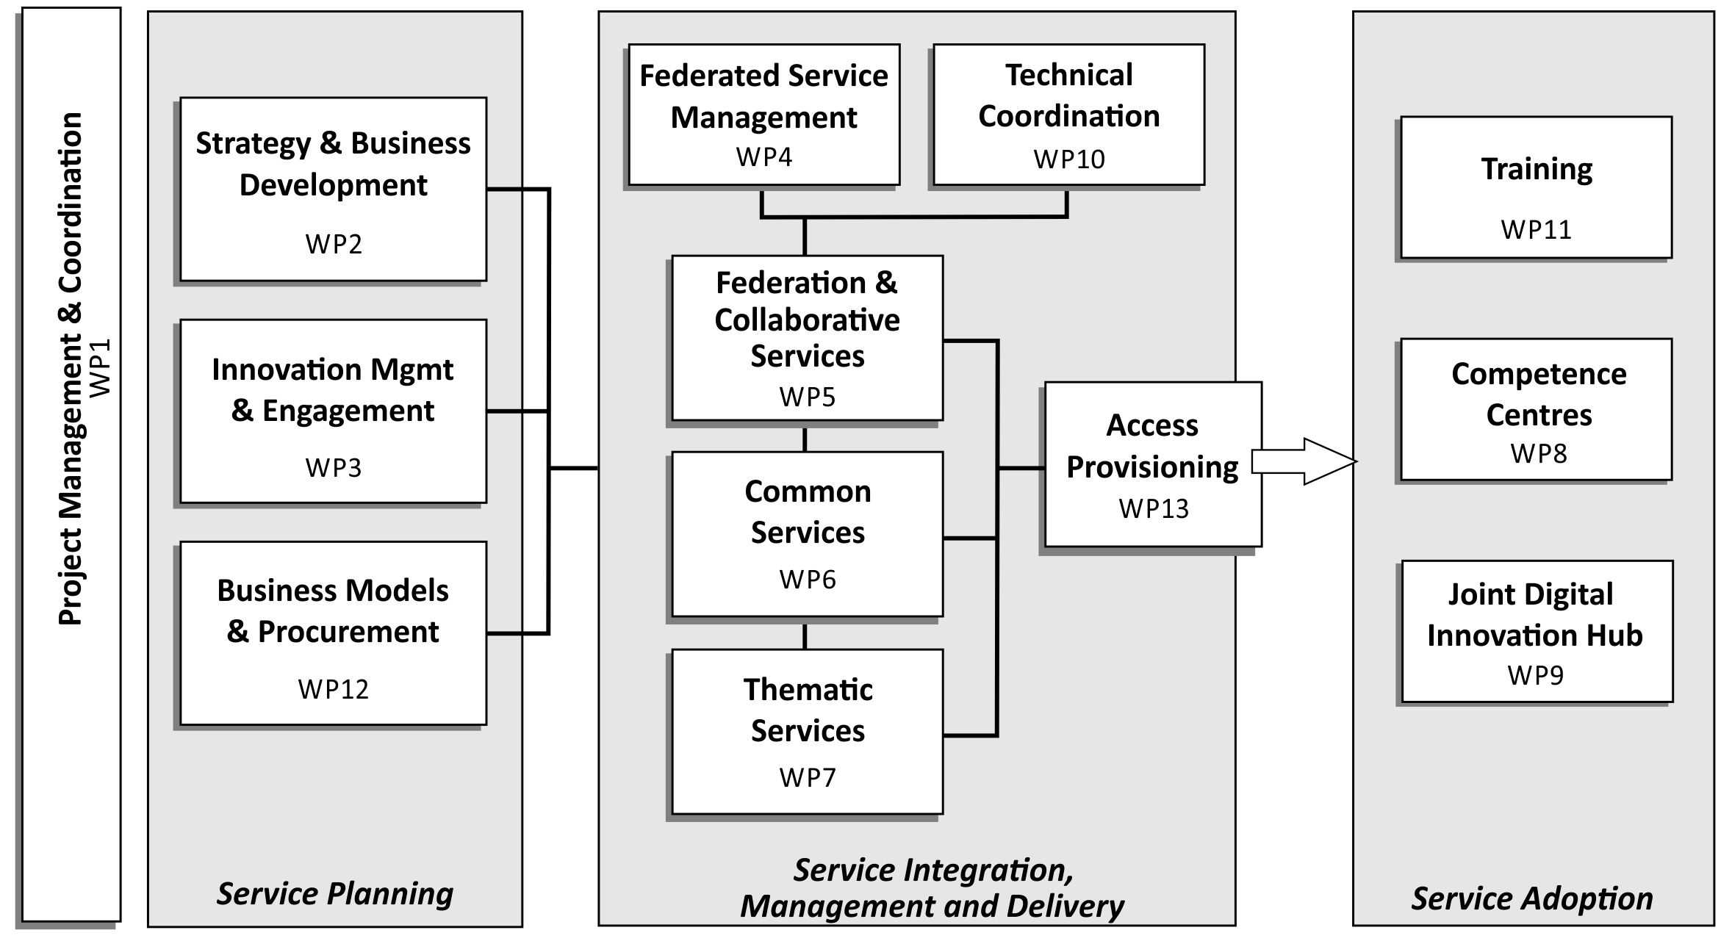
Work Package Structure

Slide 11
Innovation cycle
Maintain enabling technologies
Provide → support → access → consume
Engage with external user communities and providers
Integrate new services
Overview and Key Exploitable Results

Slide 12
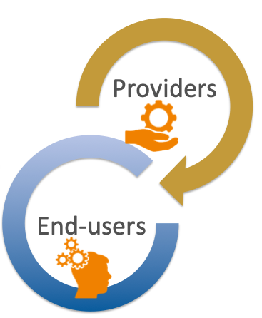
Value proposition of Users and Providers
Users
Discover services through a secure online catalogue with a central access point.
Access services via harmonised access policies and Service Level Agreements. Depending on the customer’s needs, access will be provided through a centrally managed credit-based allocation system and/or through long-term resource allocation.
Leverage a large portfolio of generic and thematic services via standard interfaces
Providers
Contribute to EOSC with services based on a harmonised corpus of access, security and provisioning policies.
Federate services by relying on harmonised processes and tools for service integration and management.
Scale-up in-house capacity by procuring services via a centrally run procurement and purchase framework.
Overview and Key Exploitable Results

Slide 13
EOSC stakeholder roles in the project
Service/Product providers
Contribute to the portfolio & Integrate
Promote, Train, Exploit
Manage the Hub
Consumers
Credit allocation & exploit
Support
Improve with feedback
technical support, exploit
Early adopters
Pilot
Use
Co-develop
Overview and Key Exploitable Results

Slide 14
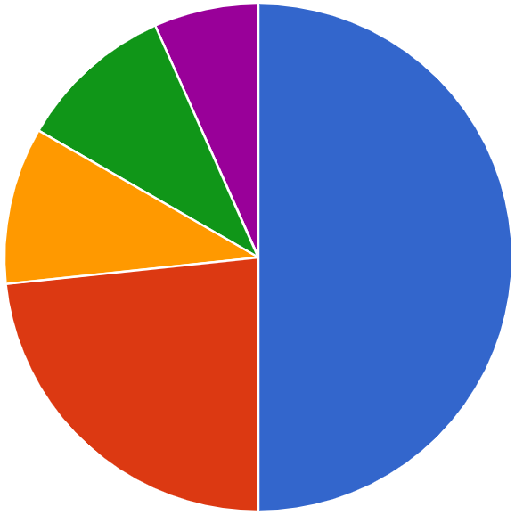
Support by discipline
9 Thematic Service providers
8 Competence Centres
xx Early Adopter pilots
SSH (2)
Inter/multi- disciplinary (3)
Life sciences (3)
Earth and environmental sciences (15)
Physics
(7)
EO Pillar

Slide 15
Project KERs and Innovation Roles
Key Exploitable Results (KER)
9 Outputs which can be taken up, exploited and reused to support the future mature EOSC
Innovation
Roles
5 EOSC stakeholders taking up and benefiting from the KER

Slide 16
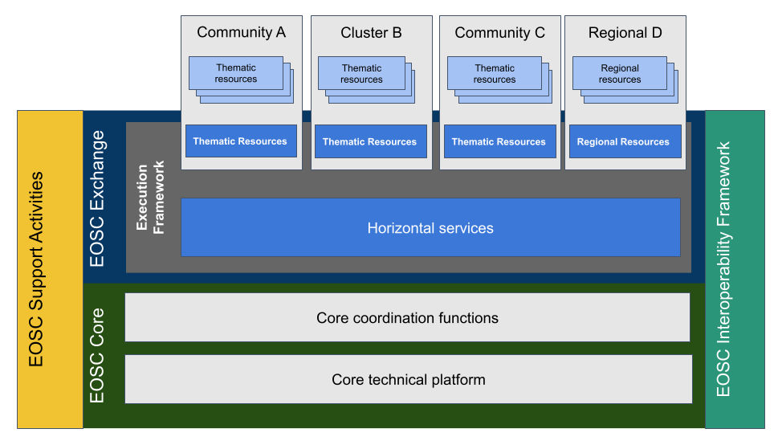
Contribution to the EOSC Implementation

Slide 17
EOSC-hub Service Portfolio
EOSC Exchange
EOSC Core
Thematic services (TS)
Simulation tools, data provisioning and analytics services
Marketplace,
Federated AAI Accounting Monitoring
Helpdesk
General purpose “horizontal services” (HS)
Adding value services
Compute platforms, data & software management, curation & preservation
Portal & Marketplace
Federated HTC/Cloud and storage facilities

Slide 18
EOSC Exchange: Horizontal services
DATA DISCOVERY AND ACCESS
Providing a common data discovery and access layer for EOSC
Off-the-shelf services to support FAIR data
FEDERATED COMPUTE
Provide a multi purpose, federated compute environment
Cloud Compute
Container compute
High Throughput Compute
PROCESSING AND ORCHESTRATION
Provide orchestration services to provision & configure virtual infrastructures across multiple cloud sites, and support deployment onto EOSC compute resources as well as commercial providers (AWS, Azure...)
DATA AND METADATA MANAGEMENT
FAIR data resources with seamless access from EOSC-hub computational resources
DATA PRESERVATION
Provide a Certified Trusted Digital Repository.
Fully integrated with EOSC FAIR data service
SENSITIVE DATA SERVICES
Off the shelf sensitive data services.
EOSC Integration: Exposing sensitive data services via EOSC FAIR data services.
18

Slide 19
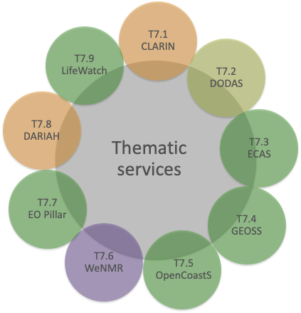
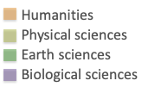
EOSC Exchange: Thematic services

Slide 20
Sustainability strategies

Slide 21
Sustainability strategies
Different paths for governance and sustainability depending on the result and its role in the EOSC implementation
Proper licensing of project foreground is key for exploitation in EOSC beyond the project lifetime
Intellectual property ownership important for proper attribution of results
EOSC-Hub choice wrt branding
EOSC brand for candidate EOSC Core components
For other results the owners retain their brand

Slide 22
1. EOSC Portal and Marketplace
Enterprise
Educate, inform and support
EOSC Portal
and
Marketplace
EOSC-hub Operators
Service Providers
Researchers and research communities

Slide 23
EOSC Portal and Marketplace - Overview
EOSC Portal is the result of EOSC Portal collaboration
Agreement between EOSC-hub, OpenAIRE-Advance and EOSC Enhance (previously eInfraCentral)
Registry of EOSC Exchange services
Providers and resources onboard via the EOSC Provider Portal while users explore, compare, access and order them via the Marketplace (connect the demand and supply side)
Platform being expanded to cover data and other research products under EOSC Enhance
A delivery channel connecting the demand-side and the supply-side which showcases the potential of integrated and coordinated access to European services, data and other scientific outputs
For more information, visit: eosc-hub.eu/eosc-hub-key-exploitable-results#KER1

Slide 24
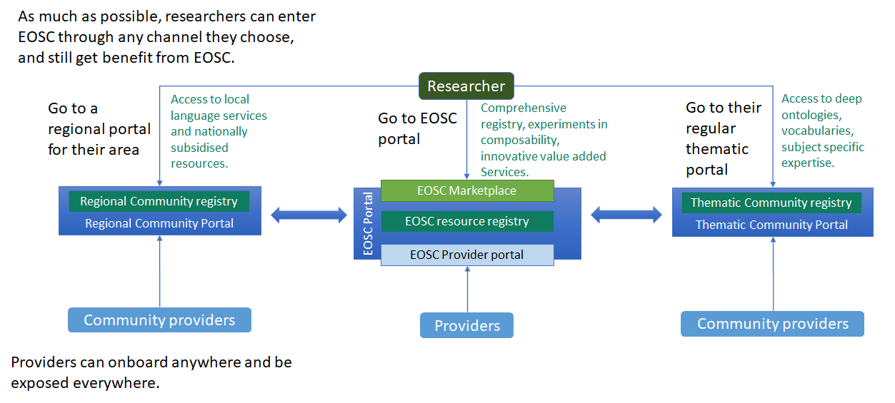
Marketplace and portal ecosystem

Slide 25
Marketplace: Governance and Sustainability Strategies
Running service
Service provisioning: Service provisioning by the EGI Federation governed by a Service Level Agreement
Software: Technical developments by consortium members of EOSC-hub and EOSC Future ⇒ Source code licenses: different OSI licenses
Brand: Use of EOSC brand
Continuity of support and development in EOSC-Future
The long term vision: the service will be part of the EOSC Core

Slide 26
2. EOSC Service Management System
Enterprise
Educate, inform and support
EOSC-hub Operators
Service Providers
Service Management System
Researchers and research communities

Slide 27
Service Management System (SMS) - Overview
EOSC-hub defined and implemented the EOSC IT service management system (ITSM): plan, deliver, operate and control services offered to customers
Directed by policies and are structured and organised by processes and procedures
Maintain customer focus while sharing the load and responsibilities dynamically across providers
Shared awareness across organisations – e.g. coordinate updates, Manage personal data in a GDPR Compliant manner, EOSC trust and identity framework, etc.
People
Responsibilities
Skills
Awareness
Technology
Support people
In their roles
Increase process effectiveness and efficiency
Processes
Defined activities
Effectiveness and repeatability

Slide 28
SMS: Governance and Sustainability Strategies
Governance
Intellectual Property of SMS specifications (processes/procedures/policies)
IP co-owned by specific organizations/authors of EOSC-hub
Access rights will ensure re-use and evolution in the context of follow-up projects. Default project license: Creative Commons Attribution 4.0 International
Sustainability
Follow-on projects, EOSC AISBL

Slide 29
EOSC-hub contributions to the EOSC Exchange
Enterprise
Educate, inform and support
EOSC-hub Operators
Service Providers
Researchers and research communities
Services in the EOSC Service Portfolio

Slide 30
Value proposition
These services and solutions are “onboarded” to EOSC Portal and Marketplace and also often integrated with each other ⇒ Contribution to the EOSC Exchange portfolio
Research outputs including services have different application areas and sustainability models.
They speed up the research process and enable cross-disciplinary collaboration and reuse of tools and results.
EOSC Service Portfolio will support them by making the discovery of the services easier and reducing the effort needed to adopt them.
More information: https://www.eosc-hub.eu/eosc-hub-key-exploitable-results#KER5

Slide 31
Governance and sustainability of thematic services of the EOSC Exchange
Sustainability/Technical integration
Currently: Incremental improvement to existing software code for integration and interoperability merged back in the related software package
After EOSC-hub: bilateral agreements between the provider of the thematic service provider and the providers of horizontal services/solutions
Governance/Access policies
EOSC-hub: transnational access with EC funded support
After EOSC-hub: to be defined by each thematic service provider according to their specific business model

Slide 32
EOSC-hub review agenda 10-11 May

Slide 33
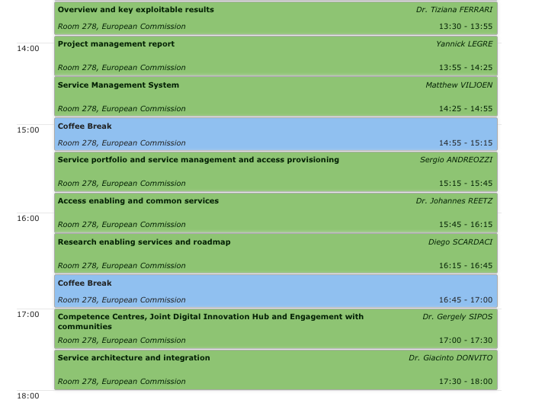
Agenda and WPs
WP2, WP12
WP1
WP3
WP4
WP2, WP4, WP5, WP12
WP5, WP6, WP13
WP7, WP13
WP8, WP9, WP3
WP10
Overview and Key Exploitable Results

Slide 35
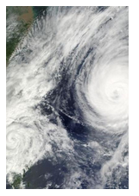
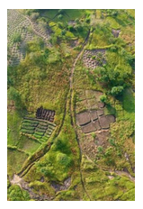
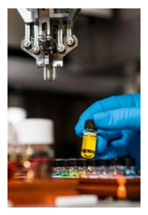
Research communities and impact (updated) https://www.eosc-hub.eu/research-communities
> 22,000 users
+5000 People trained
+200 training events
+80 providers supported to register in the EOSC Portal
328 EOSC-hub service orders
18 Interoperability guidelines
30 Thematic services
+100% EGI Cloud annual utilization
Notes:
+ 5200 people attending the f2f and webinar trainings
+ 200 training events.
Onboarded services: There are 283 services in the EOSC MP today. These were onboarded from the ‘Join as provider’ channel, but also from existing services in eInfraCentral.
126 services from 82 providers have been onboarded through the online form on the EOSC Portal.

Slide 36
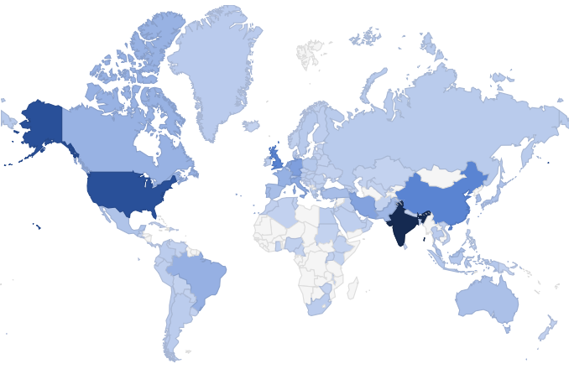
Project impact on COVID-19 research
Steady increase in number of users over the duration of the project
Worldwide impact
Relevance of the WeNMR services for COVID-related research made clear by the huge increase in usage over the last period
~80% of submissions run on EGI HTC resources
From 96 to 123 countries reached
https://wenmr.science.uu.nl/user_map

