Slide 1
EGI overview
Gergely Sipos
Head of Services, Solutions, Support
EGI Foundation

Slide 2
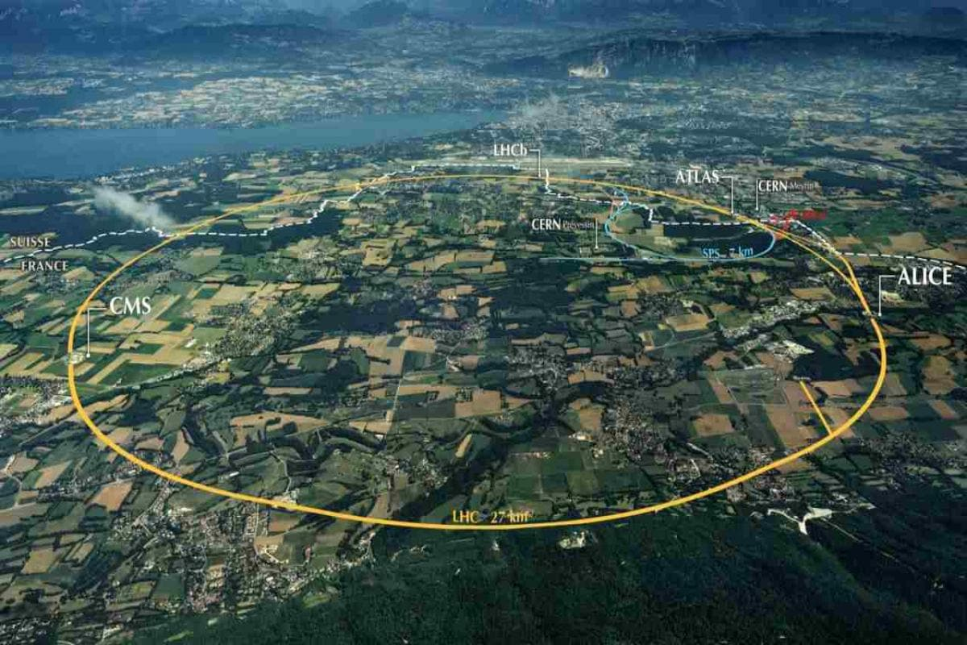
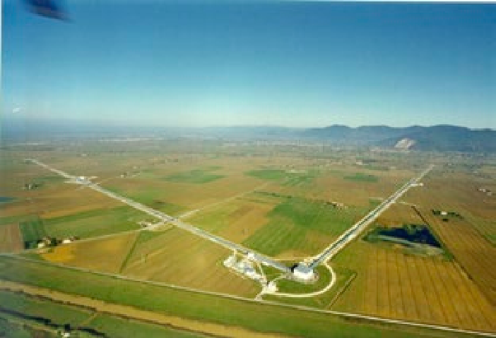
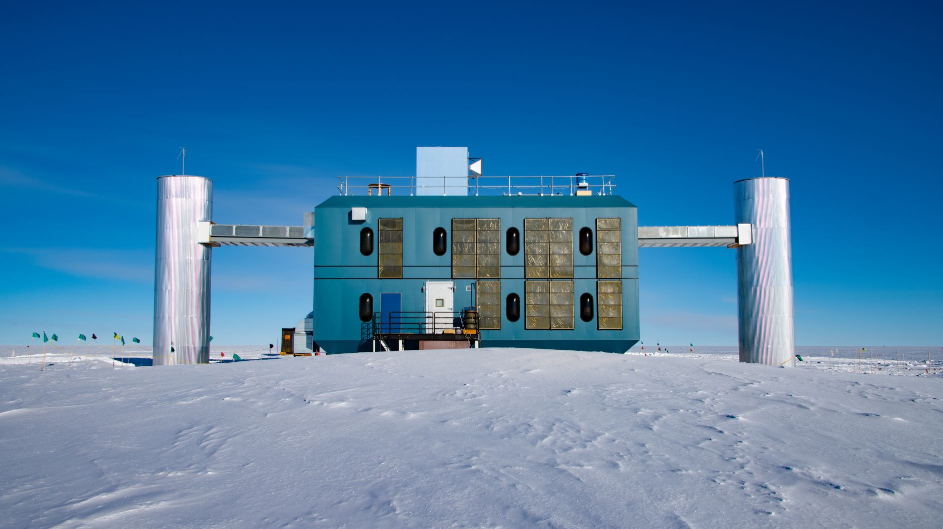
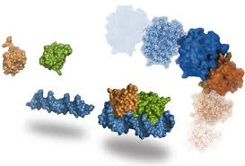
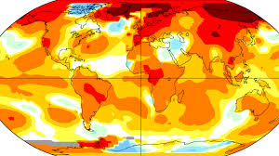
The EGI Federation is an international e-infrastructure that provides advanced data analytics services for research and innovation.
VIRGO
IceCube
WeNMR
2010
LSST
EMSO
ENES
…
250+
From the high-energy physics compute grid (WLCG)
To a multi-disciplinary, multi-technology infrastructure

Slide 3
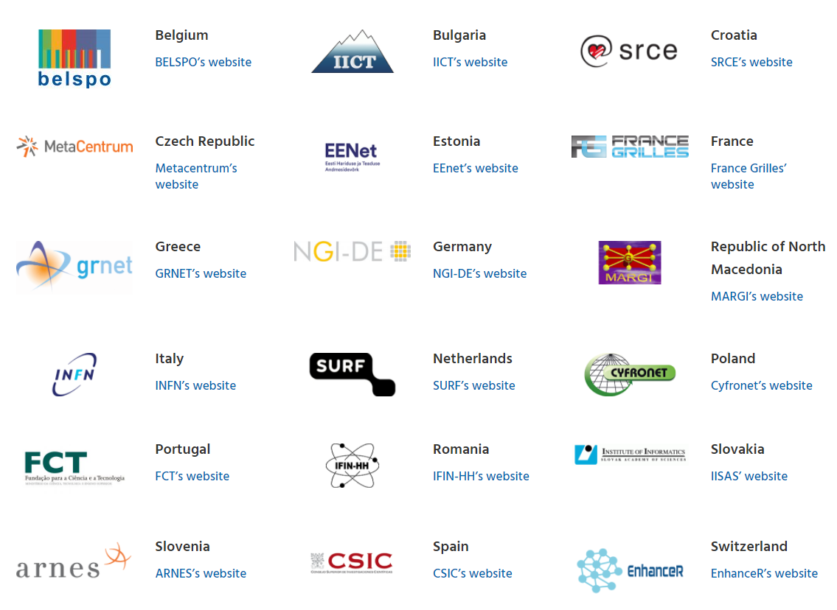
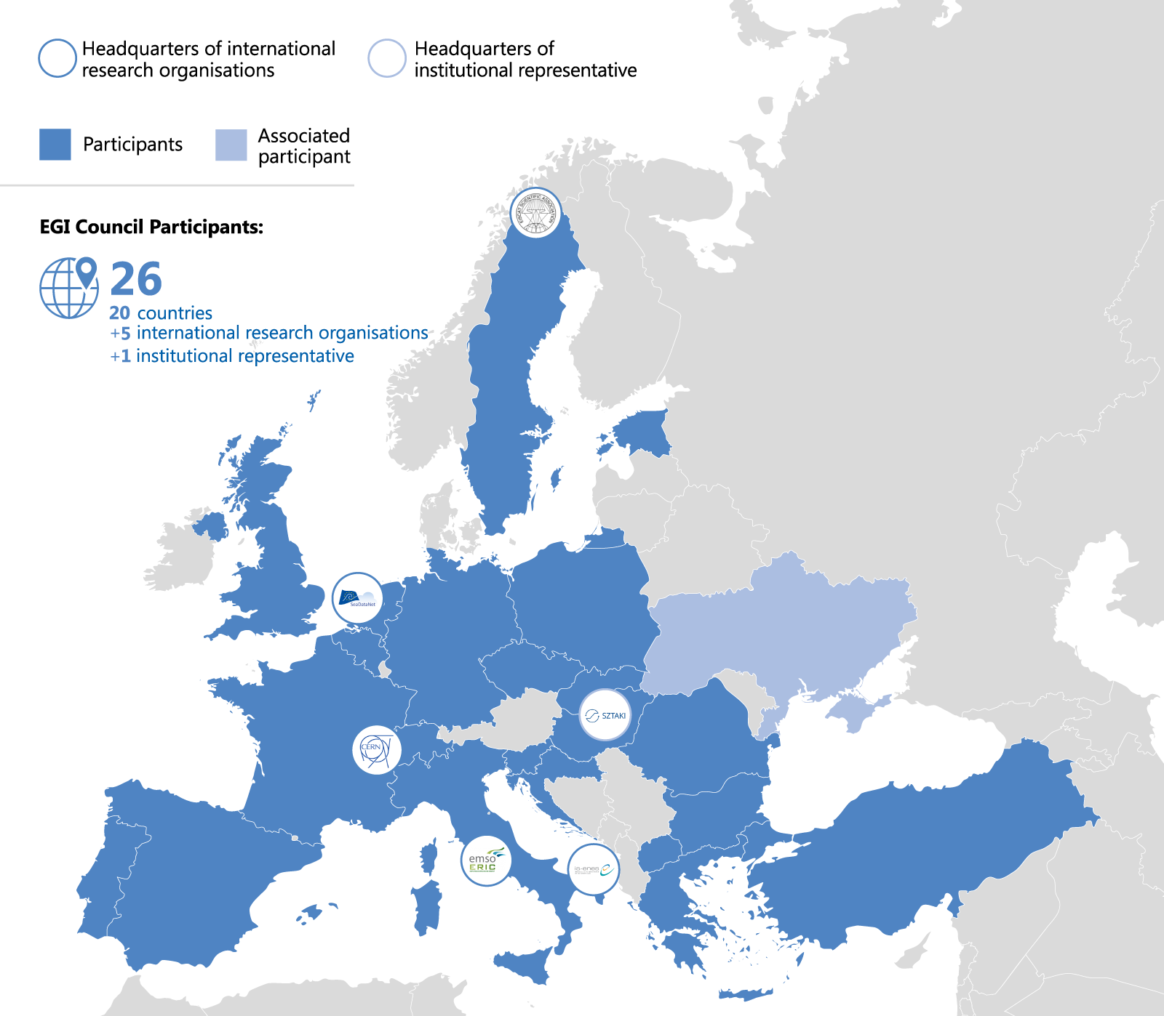
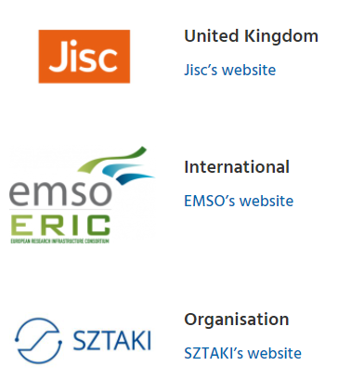
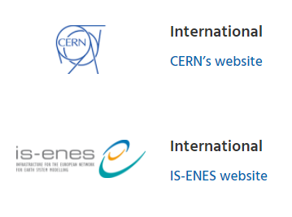
EGI Council participants
www.egi.eu/about/egi-council

Slide 4
EGI: Advanced computing for research
Mission
To deliver open solutions for advanced computing and data analytics in research and innovation, by coordinating and provisioning an international federated infrastructure from both the public and private sector in Europe. As an open initiative with a global outlook, the EGI Federation also connects service providers beyond Europe following the collaboration needs of the served communities.
Vision
The EGI Federation believes that all researchers should have seamless access to services, resources and expertise to collaborate and conduct world-class research and innovation.

Slide 5
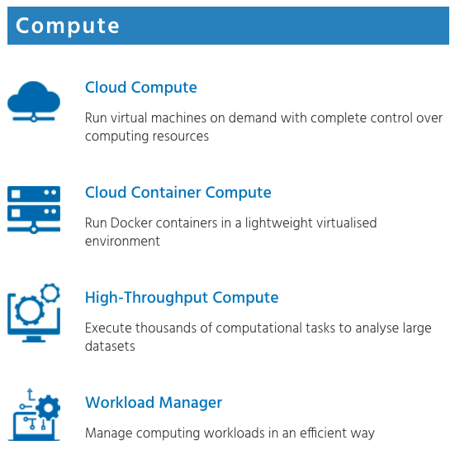
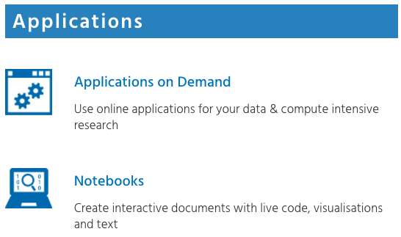
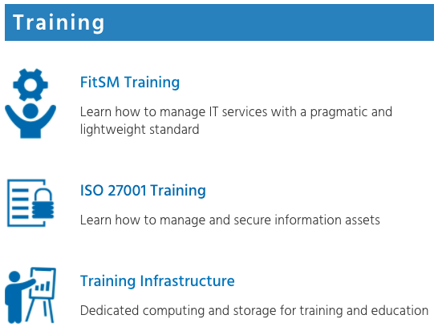
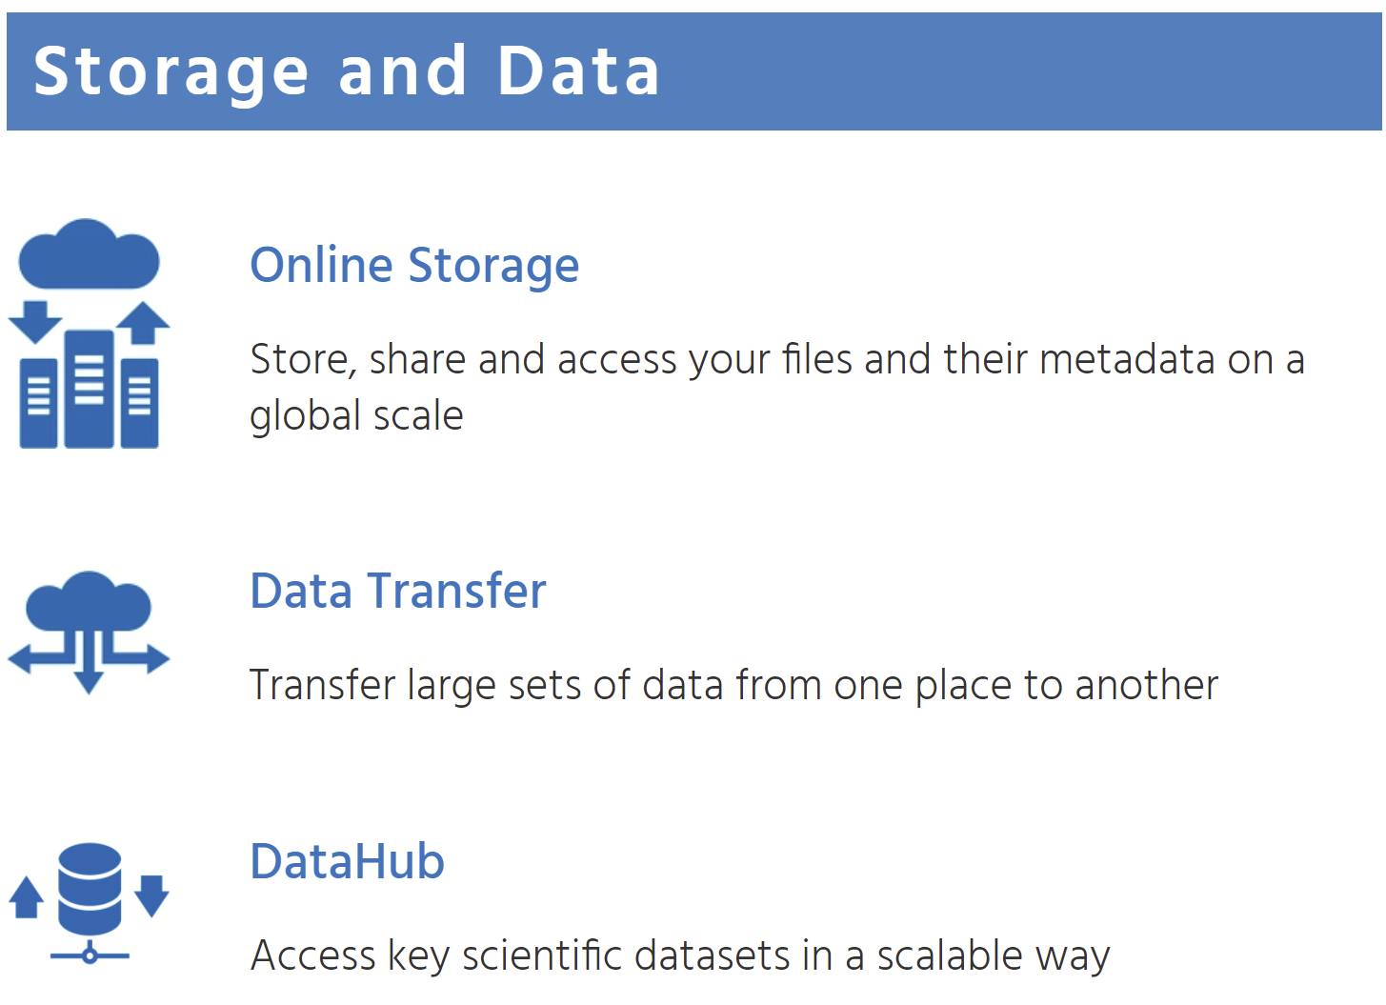
EGI Service Catalogue – Value proposition 1
https://www.egi.eu/services/
CHIPSTER, NAMD, ECAS
VMOps, EC3, FGSG
https://docs.egi.eu 🡪 Service documentations

Slide 6
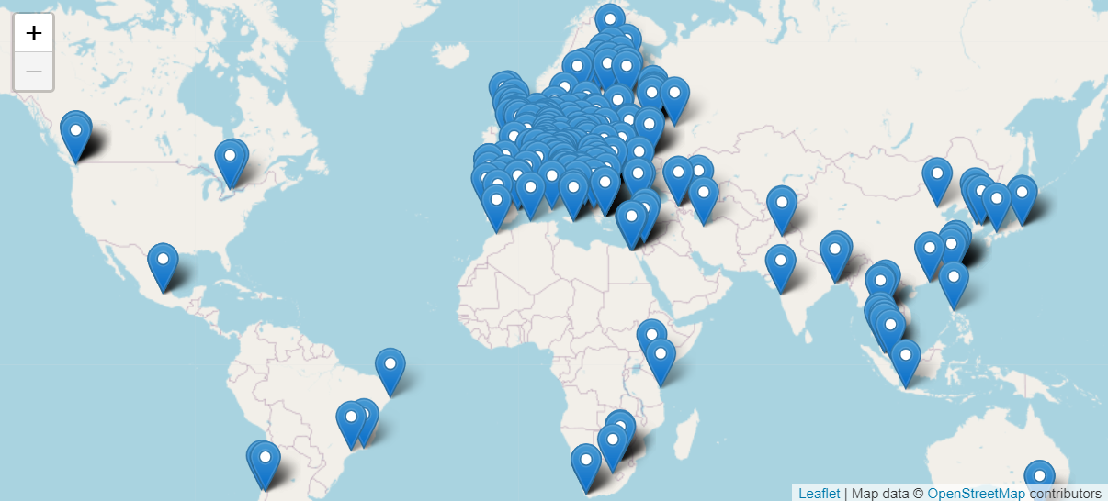
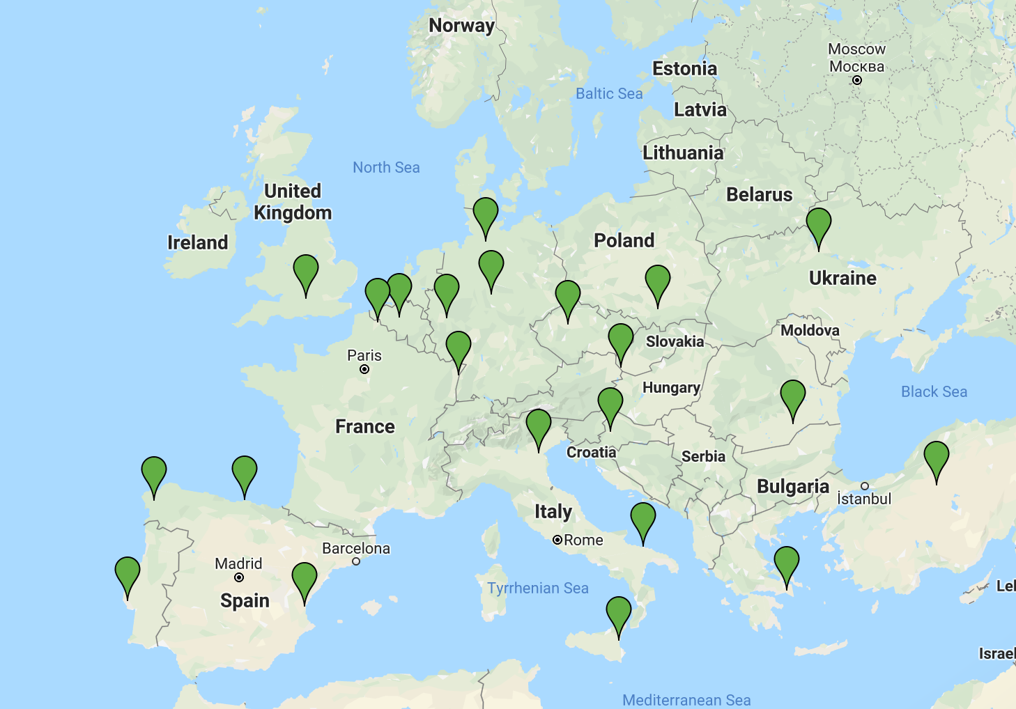
EGI HTC Federation & Cloud federation
>1 Million computing cores
> 900 PB disk & tape
HTC providers
2,915 service end-points
Cloud providers

Slide 7
Access policies
Wide access
Users can freely access scientific data and digital services provided by EGI resource providers
Policy-based
Users are granted access based on policies defined by the EGI resource providers or by the EGI Foundation
Market-driven
Users can negotiate a fee to access services either directly with EGI resource providers or indirectly with the EGI Foundation
For example:
EGI Cloud for application piloting
EGI Notebooks open instance
Science discipline-specific HTC pools
Chipster NGS toolkit (App. on demand)
For example:
Biomed international HTC pool for life sciences
SZTAKI provides Cloud for Hungarian researchers
INFN-Bari (IT) provides Cloud for the National Bioinformatics Infrastructure of Sweden
EGI Foundation negotiates services for projects
For example:
FitSM training
4 EGI Cloud providers deliver to Exprivia (ESA Data and Information Access Services)
T-Systems cloud via EGI MoU

Slide 8
Who do we serve
Size of individual groups
WLCG (CMS, …)
ELI
CTA
CLARIN
EISCAT_3D
LIGO
LOFAR
ELIXIR
INSTRUCT
DARIAH
LifeWatch
EPOS
EMSO
eLTER
SeaDataNet
…
Primarily directing them to national providers
WeNMR
LSGC
BioExcel
NextGEOSS
SoBigData
PolicyCloud
TRIPLE
AgINFRA
OpenRiskNet
OpenDreamKit
DRIHM
VERCE
PhenoMeNal
Multiscale Genomics
…
100% IT
Exprivia
CFD Support
CloudEO
CloudSME
Ecohydros
EOproc
IBM Research
mITSM
Numeca
Peachnote
RHEA
SixSq
Terradue
UberCloud
…
PeachNote
CEBA Galaxy eLab
Semiconductor design
Main-belt comets
Quantum pysics studies
Virtual imaging (LS)
Bovine tuberculosis spread
Convergent evol. in genomes
Geography evolution
Seafloor seismic waves
3D liver maps with MRI
Metabolic rate modelling
Genome alignment
Tapeworms infection on fish
…
Research infrastructures
Multinational communities (often H2020 projects)
Industry, SMEs
‘Long tail of science’

Slide 9
Allocating services for international use cases
Negotiate access to resources
Taking into consideration user requirements (type, number, size, cost, availability, ++)
Type, number, size, cost, availability, etc.
Applic. provider
Instance requirements
Conditions
Storage provider
Cloud provider
Negotiator
HTC provider
Project/Community representative
Service Level Agreement
Operation Level Agreement
Training
Support
Regular satisfaction interviews
Regular service delivery reports
Ensure that customer is happy
Ensuring that agreed targets are met
Notes:
Motivations of providers – National mission vs. pay for use
Regular satisfaction interviews

Slide 10
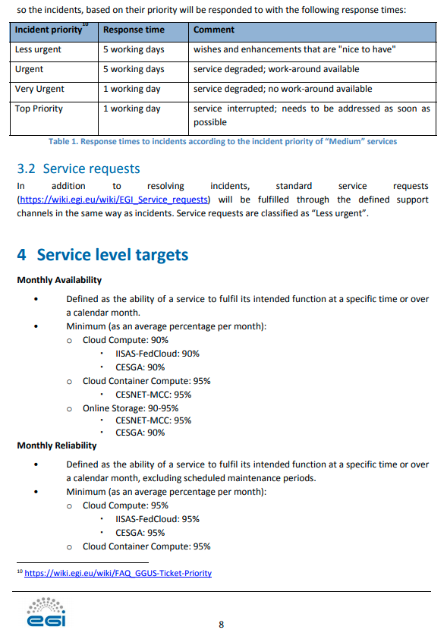
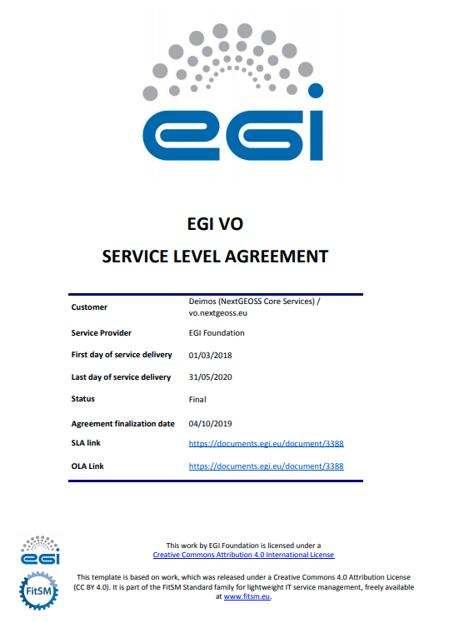
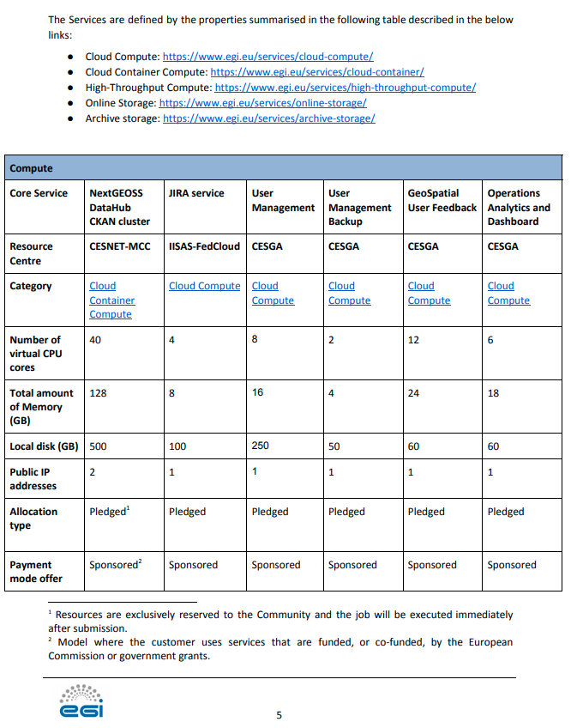
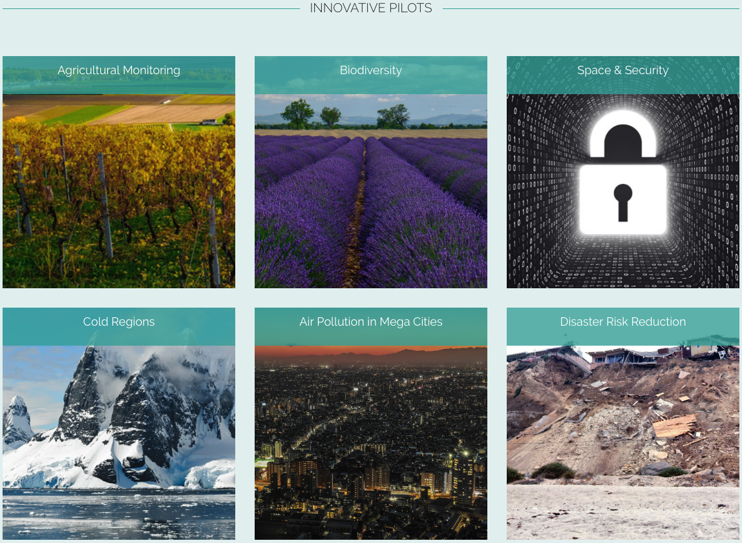
An SLA example
https://documents.egi.eu/document/3388
A centralised European Earth observation data hub and platform.
Project Core services
Innovative & Business Pilots

Slide 11
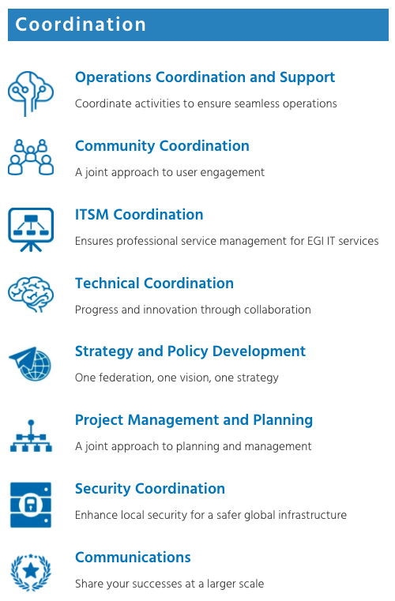
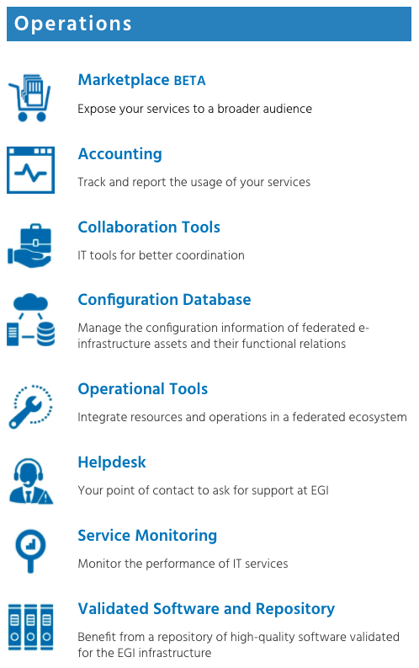
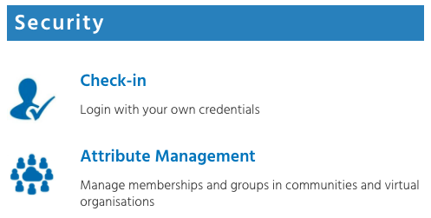
EGI Internal Service Catalogue – Value proposition 2
https://www.egi.eu/internal-services/
Offered by the EGI Foundation for the members of the federation

Slide 12
Federating with EGI
Infrastructure federation - Cloud, HTC, HPC, storage. (See next topic in Agenda)
Support federation (Delegate contacts)
NGI Operation Manager: Service operation, availability matters
NGI International Liaison: User support, outreach, training
NGI Communication contact: News, Articles, Events
NGI Council representative: Policy, Strategy, Funding
Project federation
Running projects: 17, with EGI-ACE as flagship: https://www.egi.eu/projects/
Future proposals

Slide 13
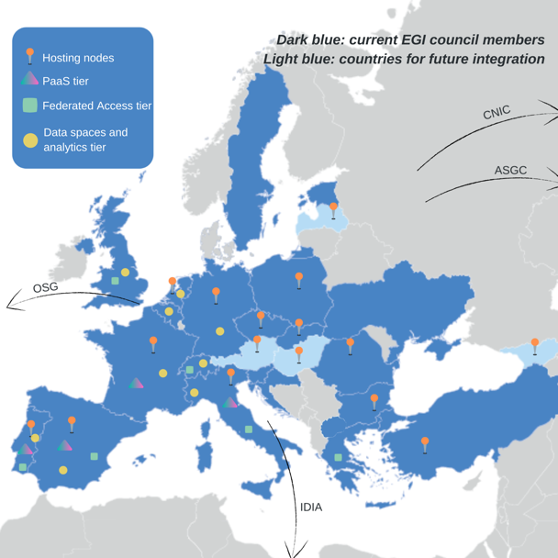
EGI-ACE Overview
H2020 project between Jan 2021 - July 2023
Objectives:
Deliver the EOSC Compute Platform
Support scientific data spaces
Grow demand and supply
Consortium at a glance
16 partners to deliver cloud, HTC and HPC resources
12 user access and platform solution providers
21 providers from 13 communities to deliver data spaces
12 federation service providers
Supplier participation
Virtual Access payment after international users
Policy-based access with MoUs
HPC pilots

