Slide 1
SeaDataNet activities in EGI
Andrea Manzi
(EGI Foundation)

Slide 2
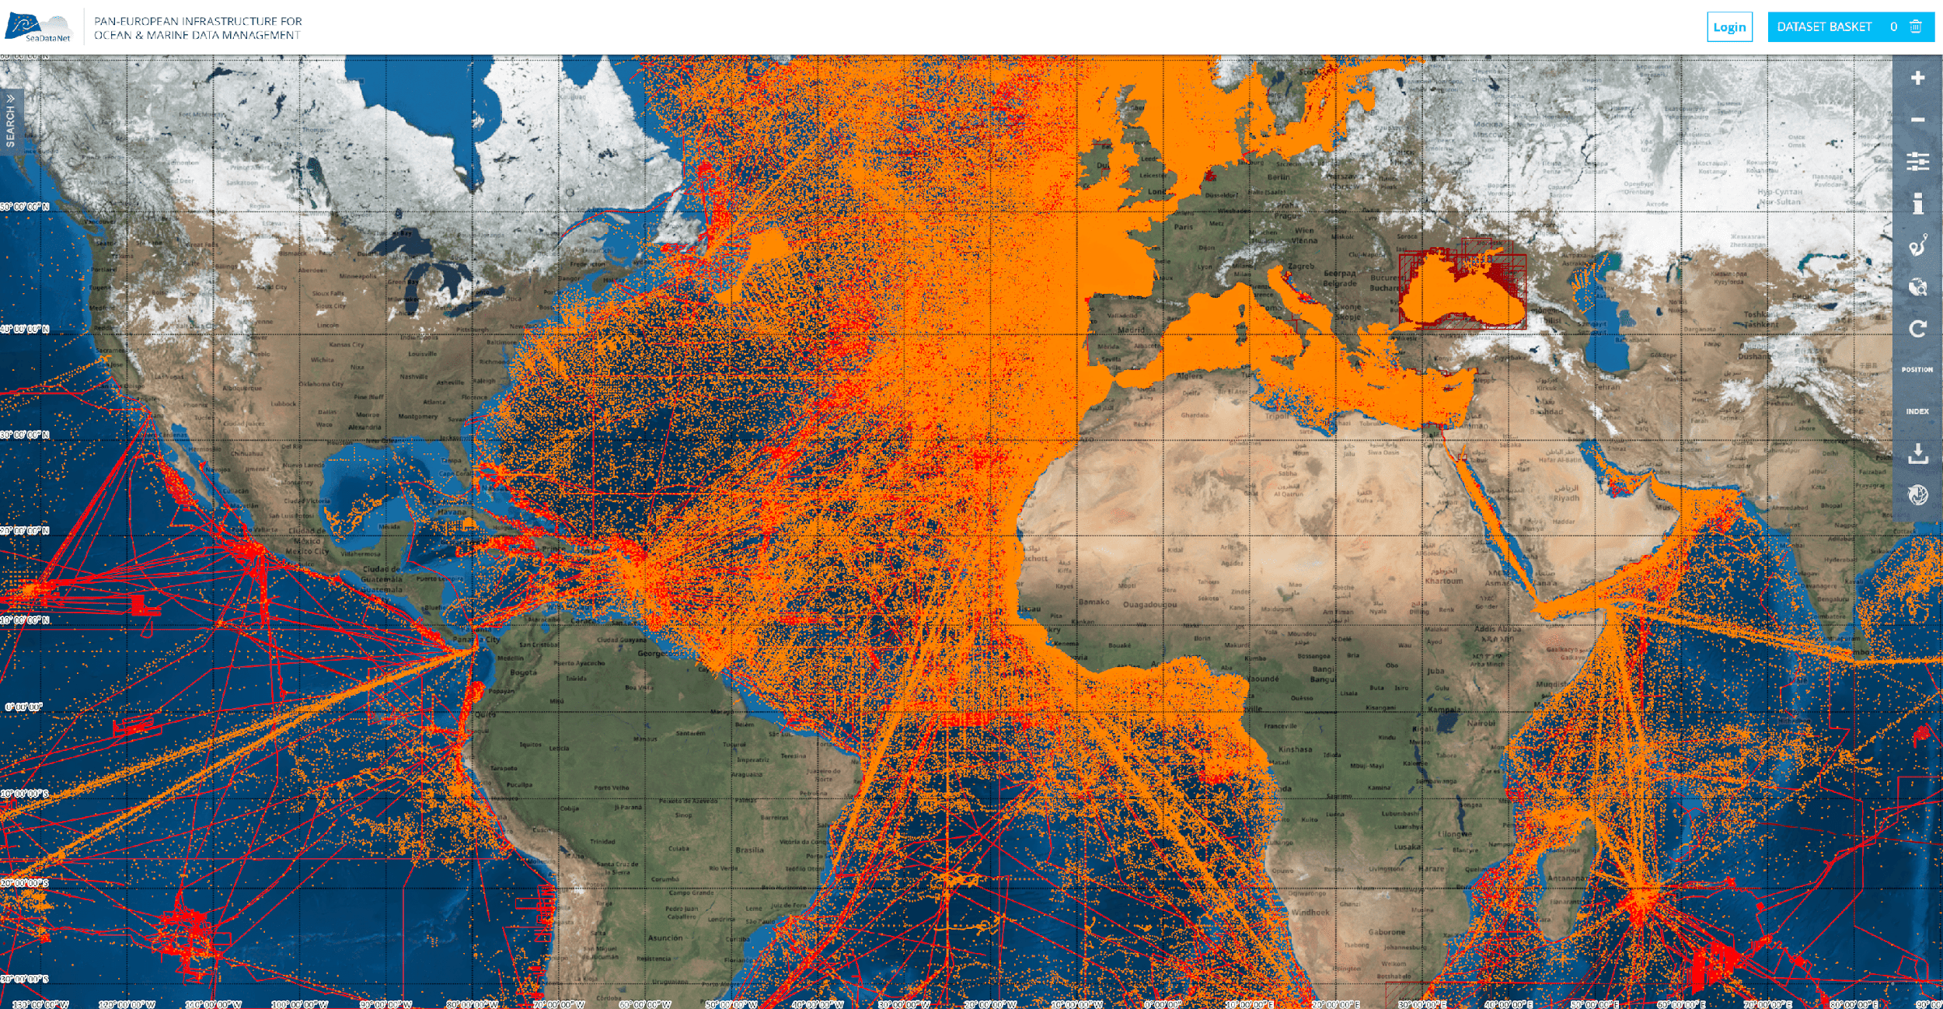
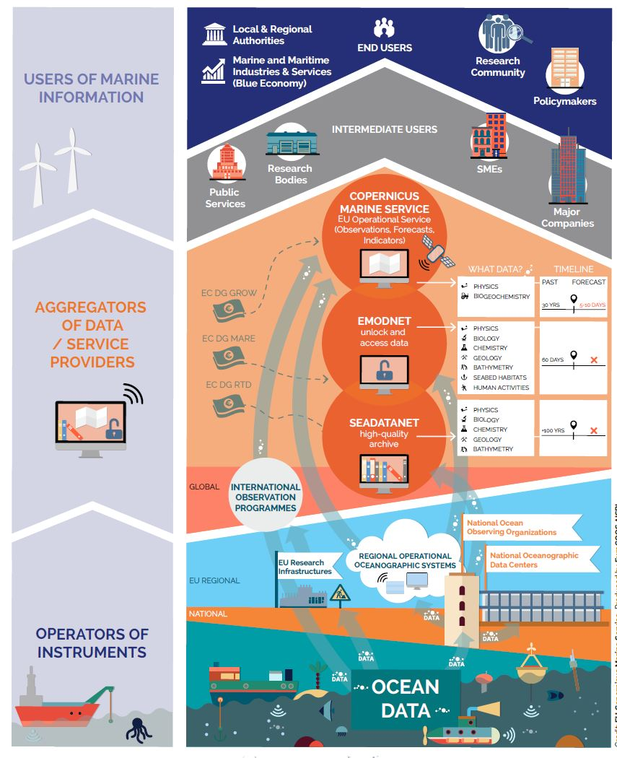
SeaDataNet - pan-European infrastructure for marine data management
Connecting > 110 data centres from 34 countries for discovery and access to marine data for physics, chemistry, geology, bathymetry, and biology from scientific and monitoring activities
Developing and promoting FAIR data management standards, services, and tools
Major contributor to EMODnet, Copernicus CMEMS, and Blue-Cloud
European marine data landscape

Slide 3
The activities in EGI: EOSC-Hub Marine CC
The focus of the SeaDataNet work in the Marine CC has been on access to the data and sharing, with exploration in performance increase in data viewing of discovered data.
The basis for the services on SeaDataNet is the so-called CDI system. It provides a highly detailed insight and unified access to the large volumes of marine and oceanographic data sets managed by the distributed data centres.
Current content is 2.5M metadata records which are describing and are linked to observation datasets. The datasets come from more than 110 data centers connected using Replication Manager to publish data.
The challenges of this system are:
Managing the access to the distributed data published via the CDI nodes. Providing access to this “data lake” of metadata and datasets toward the SeaDataNet Virtual Research Environment and to applications from other communities and EOSC .
Performance of visualisation of datasets and dataset collections directly from the nodes, because the files are small but many, and have many values (e.g. a time-series or depth profile)

Slide 4
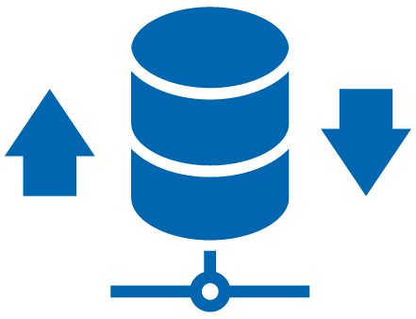
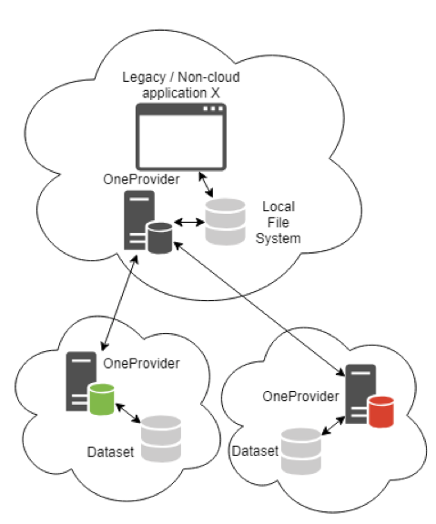
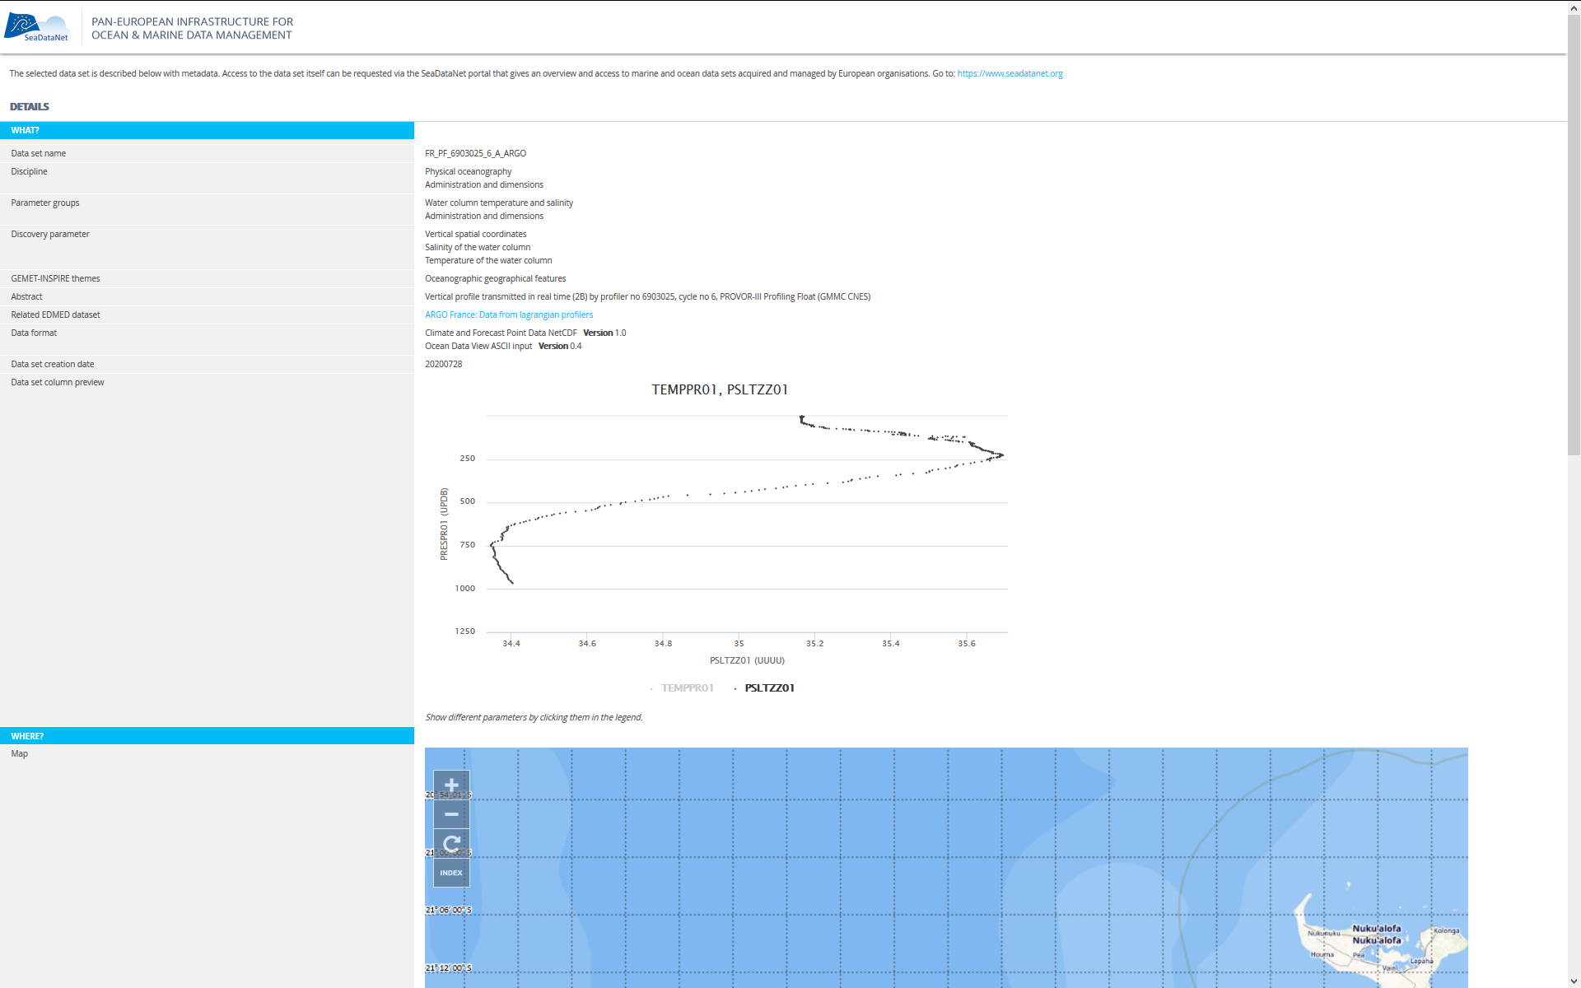
Pilot Activities
Work has focused on an alternative way to share and provide access to the data by publishing the datafiles on EGI DataHub. Files been loaded on two different nodes to explore the concept at INCD/LIP in Portugal and IFCA in Spain.
EGI DataHub worked smoothly and it was eventually possible to get from a central location a virtual overview of data on the distributed nodes as if they were centrally available.
Cassandra database has been configured that can handle, store and query the incoming datasets for visualisation.
Load the datafile values directly from the OneProvider nodes into the Cassandra database with convincing very high performance

Slide 5
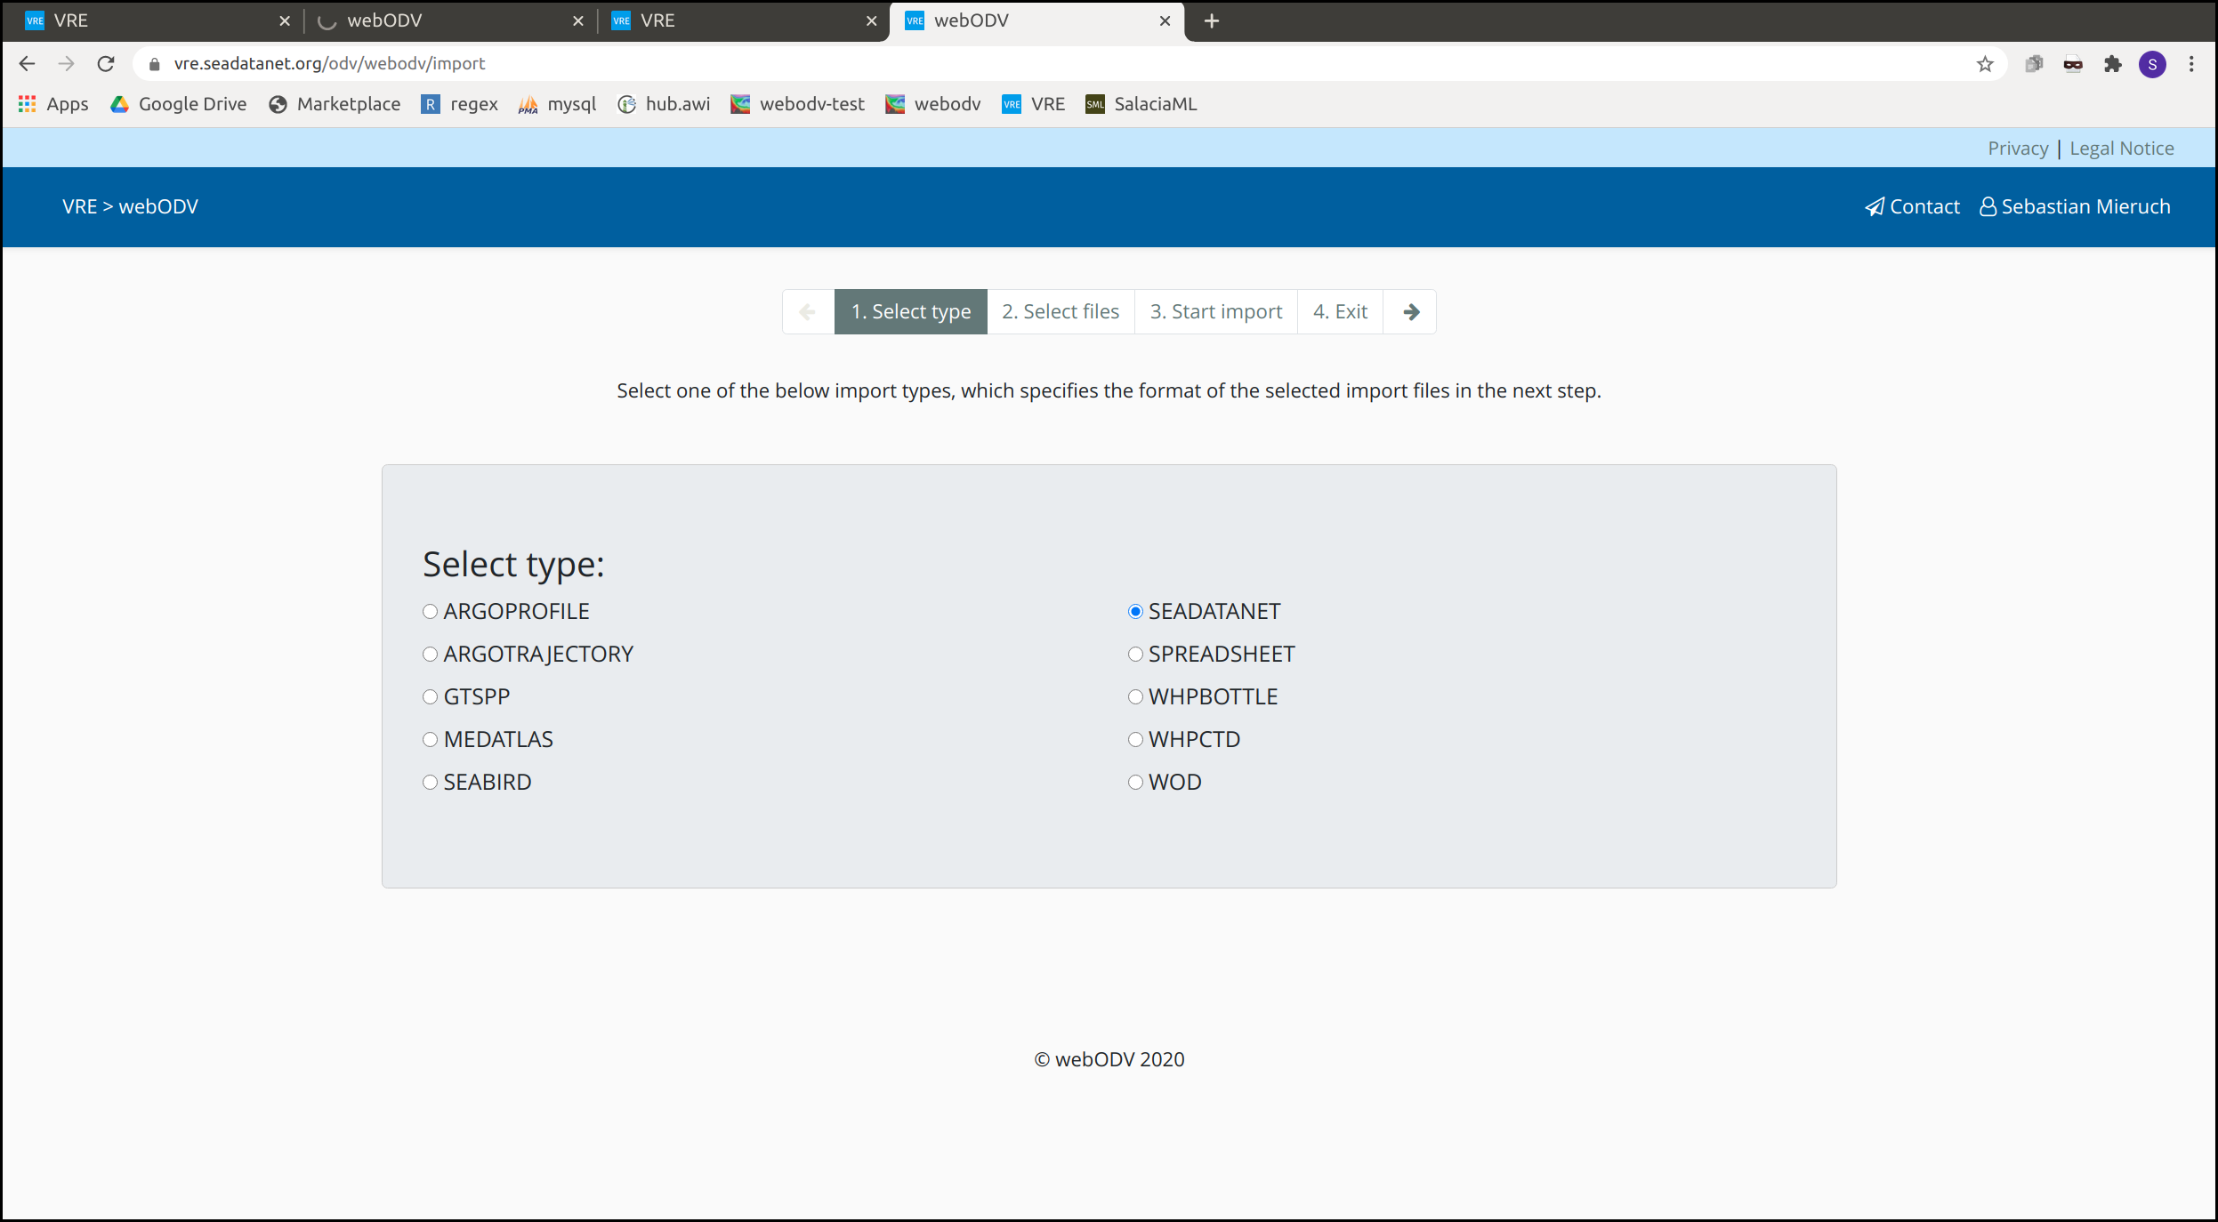
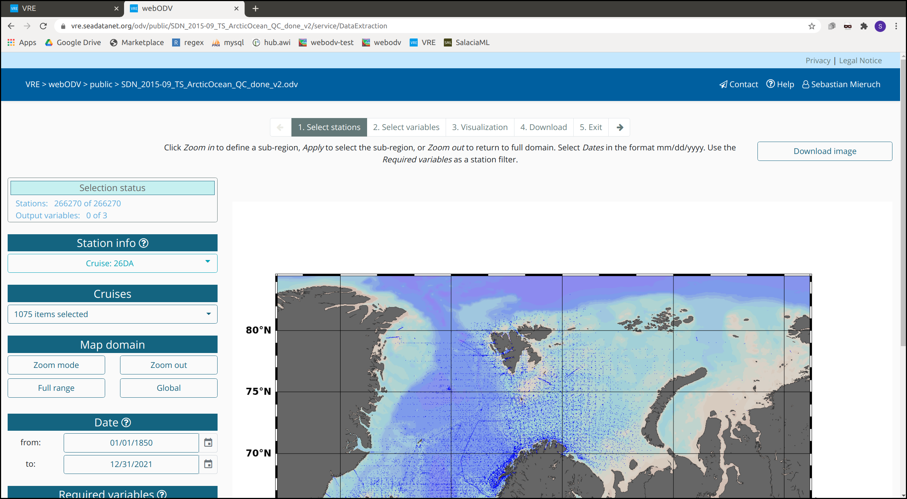
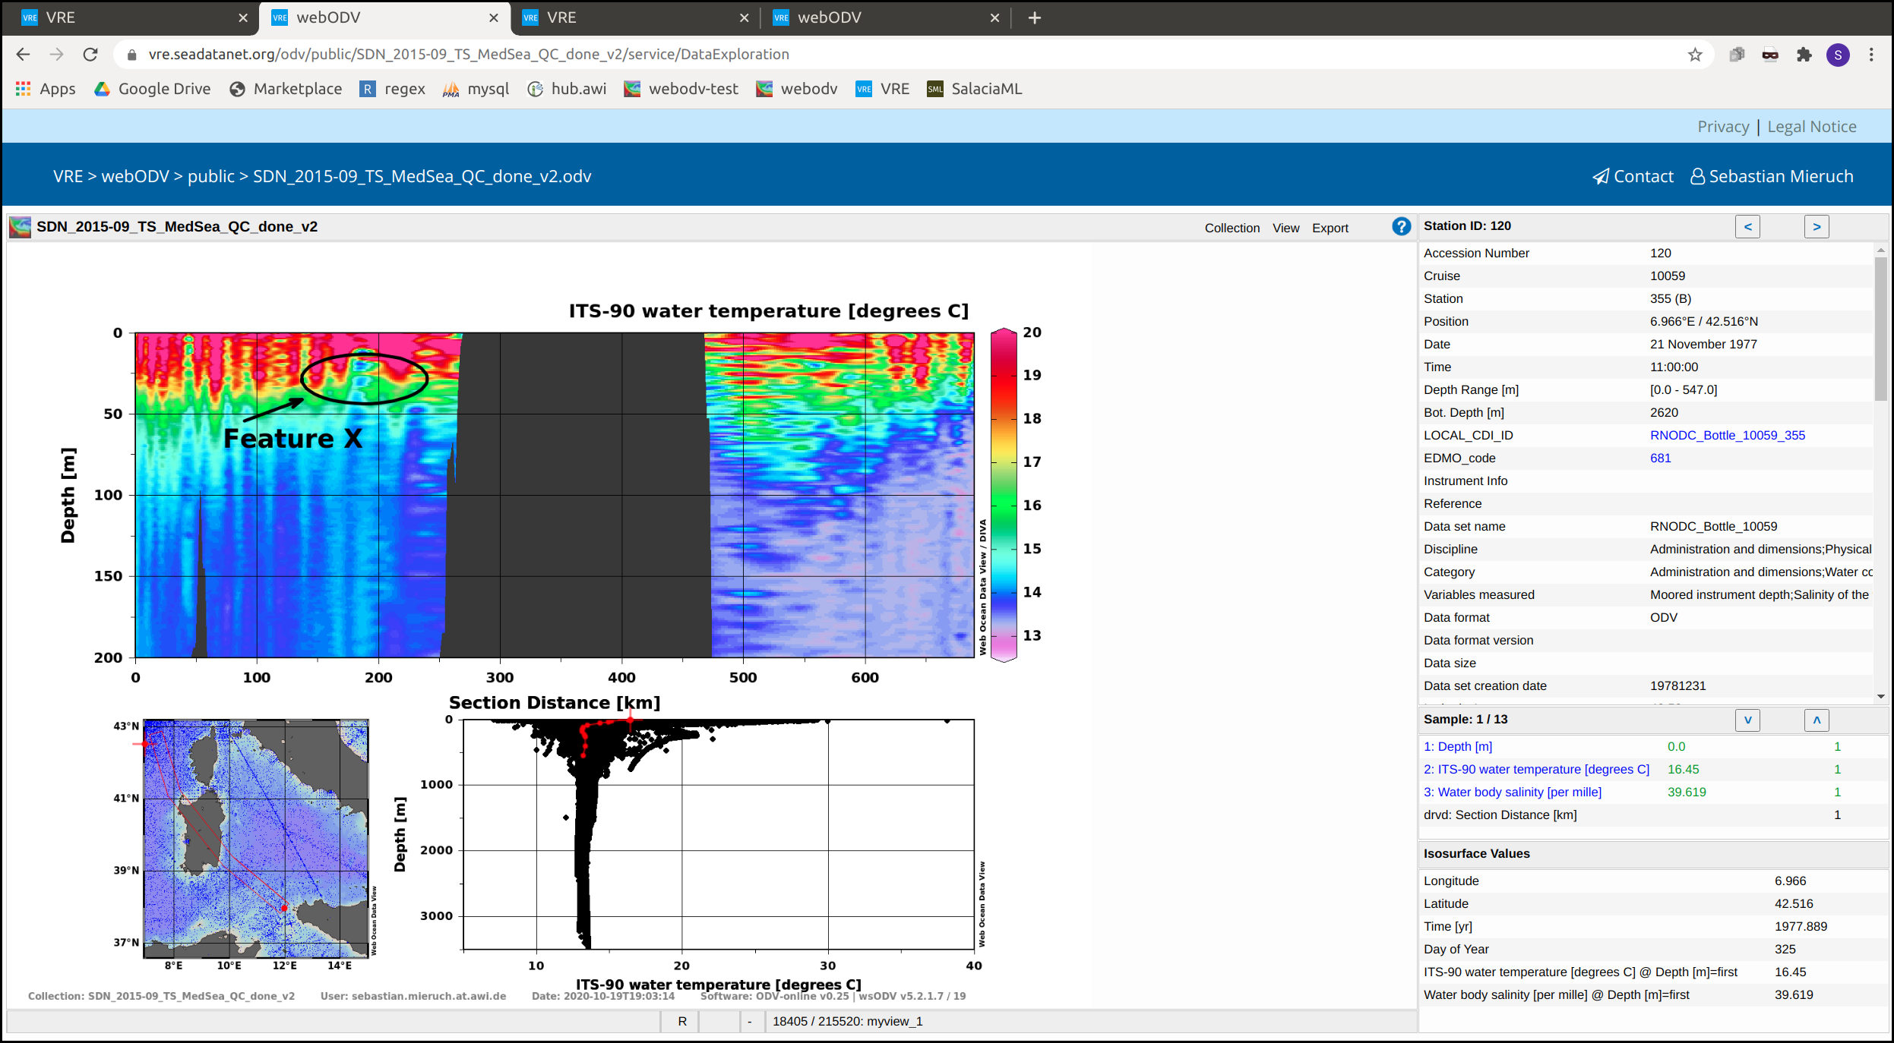
The activities in EGI: EGI-ACE SeaDataNet Data Space
SeaDataNet webODV for QA-QC, visualisation, subsetting, and export of large data collections
Deploying the webODV application at the EGI cloud infrastructure and mobilising its large scientific user basis, consisting of its existing offline users and new users, for trying out and adopting the webODV cloud version for their science.

Slide 6
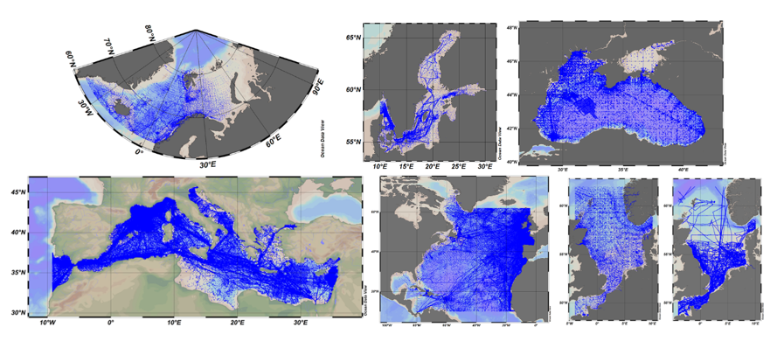
Ambition and challenges
Potential users of webODV are oceanographers, working at all major marine research institutes and universities, in Europe and beyond as oceanographic research has a global dimension
webODV facilitates them to import large amounts of marine observations and to explore and analyse these as a group interactively, performing quality control and giving quality flags, generating specific visualisations, and finally prepare output as ODV data collections, which can be shared for other webODV sessions.
Partners
Maris and AWI
Datasets
SeaDataNet regional temperature and salinity compilations
EMODnet Chemistry eutrophication compilations
Argo profiles compilations for SeaDataNet regions

Slide 7
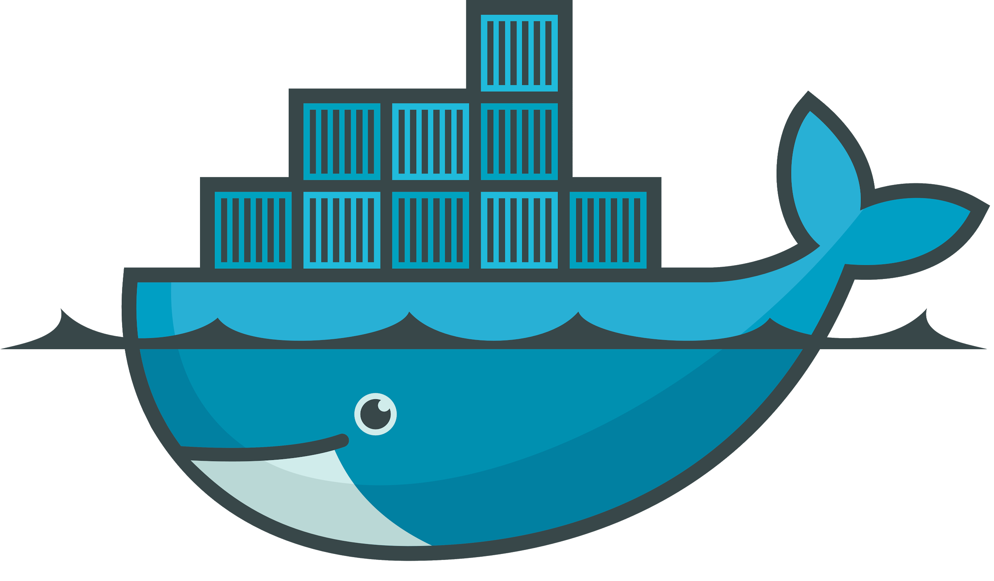
High-level architecture
Fast access to the datasets
Data Collections
SeaDataNet
EMODnet
ARGO
Virtual Machine
webODV
Fast access
mount
Private Workspace

Slide 8
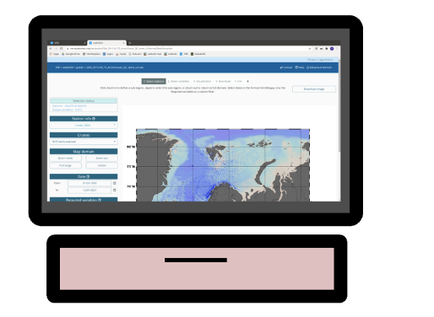
Architecture - Scalability
PaaS orchestrator
CVMFS
WS
WS
SeaDataNet
EMODnet
ARGO
...
Site A
WS
Site B
WS
Notes:
Indicate where and which EGI services are used.

