Slide 1
The European Grid Infrastructure collaboration
Overview and requirements

Slide 2

EGI
Collaboration
Research
Community
N
G
I
N
G
I
N
G
I
E
I
R
O
Research
Community
E
I
R
O
Research
Community
N
G
I
NGI: National Grid Initiative
EIRO: European Intergovernmental Research Organisation (e.g. CERN, EMBL, ESA, …)
EGI.eu

Slide 3
EGI Resource Infrastructure
National Grid Initiative
Network
Peer Resource Infrastructure Provider
Resource Infrastructure
EGI.eu
Resource Infrastructure
Resource Centres
MoUs
Resource Centres
Integrated Resource Infrastructure Provider
Resource Infrastructure
Resource Centres
Resource Centres
Resource Centres
Resource Centres
Integrated: infrastructure operated by a non-EGI-InSPIRE partner but relying on EGI operational services (MoU)
Peer: infrastructure accessible to EGI users, but relying on own operational services

Slide 4
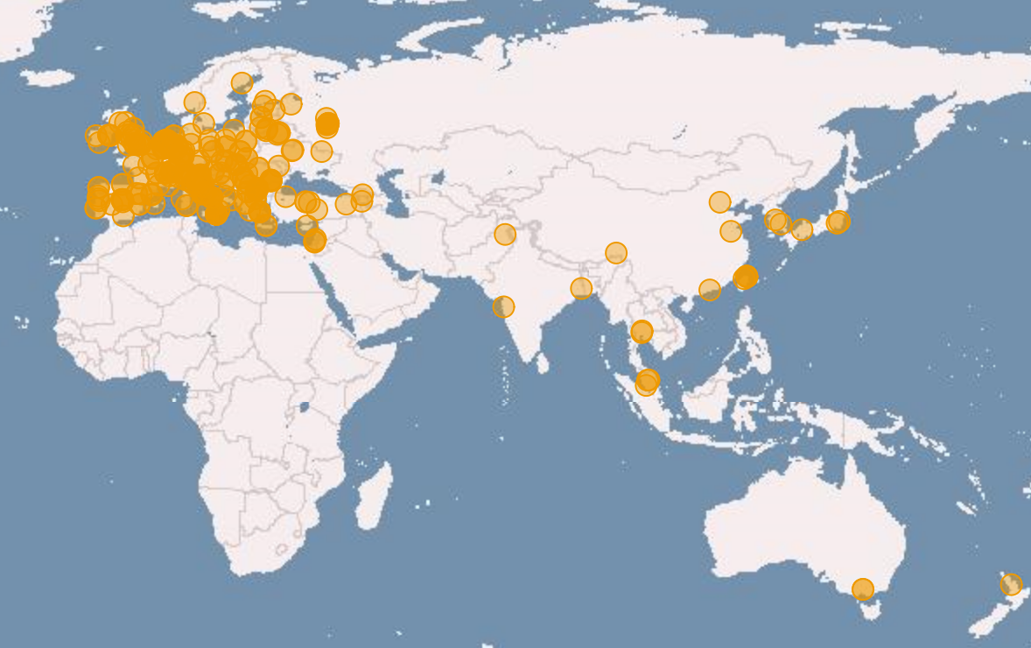
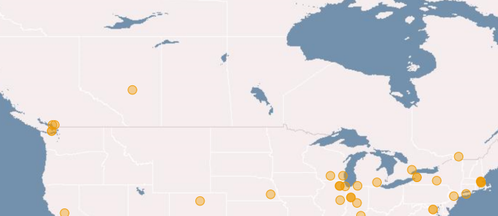
Resource Infrastructure
(Showing yearly increase)
338 Resource Centres → +6.8%
Europe, Asia Pacific, North and South America
96 supporting MPI → +31.5%
51 Countries (57 with integrated RPs) →+18.75%
Capacity
240,000 CPU cores
(339,00 with integrated and peer RPs) → 24.9%
1.89 Million HEP-SPEC 06*
102 PB disk, 89 PB tape
* Million HEP-SPEC 06 Normalised CPU time to a reference value of Mega HEP-SPEC 06

Slide 5
EGI.eu
Coordination for European Grid resources
  Established February 8th 2010
  Central policy & services needed to run a grid
  Sustainable small coordinating organisation
Based in Amsterdam
  Coordinating core (~20 people) in Amsterdam (www.egi.eu/staff)
    User Community Support Team (5 people, including Steve Brewer, Gergely Sipos)
    Operations (2 people)
    Technology (2 people)
    Policy development (3 people)
    Dissemination (3 people)
    Management and office secretary (5 people)
  Technical services from partners (~20 people)
  EGI and EGI.eu supported by EGI-InSPIRE project

Slide 6
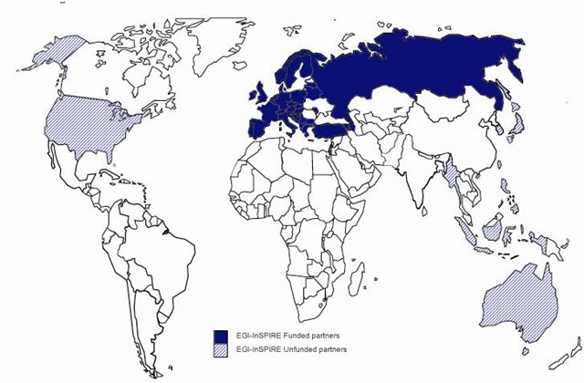
EGI-InSPIRE Project
Integrated Sustainable Pan-European Infrastructure for Researchers in Europe
A 4 year project with €25M EC contribution
  Project cost €72M
  Total Effort ~€330M
  Effort: 9261PMs
Project Partners (50)
EGI.eu, 38 NGIs, 2 EIROs
Asia Pacific (9 partners)
Un-Funded
Funded

Slide 7
EGI-Inspire project objectives
A sustainable production infrastructure
  Resource providers in Europe and worldwide
  With new technologies as they mature, as users require
Support structured international research
  Sustain current domain specific services
  Attract new user communities (e.g. ESFRI)

Slide 8
A Virtuous Service Cycle
National
Resource Providers
European Grid Infrastructure
Ecosystem
Used by Researchers
Gathering New Requirements
New Technology Assessed
Deployed Infrastructure Services
Current User Communities
MoUs & OLAs
MoUs
EGI.eu
MoUs & SLAs
New User Communities
Technology Providers

Slide 9
User Support & Services
User Communities:
  Researchers in International Collaborations (VRCs)
  National Research Collaborations through the NGI
  Scale up from the single VO to a community
Support processes:
  VRC accreditation, User Community Board, Requirements processing, Training Working Group
Support services:
  VO services, AppDB, Training Services, Requirements tracker
Support teams:
  EGI.eu User Community Support Team
  NGI User Support Teams
  NGI Operations Teams
  Experts within user communities or projects

Slide 10
User Community Board
Develops the strategy and defines the priorities for the human and technical user community support services provided by EGI
Monthly meetings (https://www.egi.eu/indico/categoryDisplay.py?categId=21)
Representatives of EGI VRCs and Heavy User Communities http://www.egi.eu/user-support/vrc_gateways:
  Structural Biology and NMR
  High Energy Physics
  Digital Research Infrastructure for the Arts and Humanities
  Research Infrastructure for Language Resources
  Life Sciences
  Earth Science
  Computational Chemistry and Material Science
  Fusion
  The study of e-Science
  Astronomy and Astrophysics
  Hydrometeorology

Slide 11
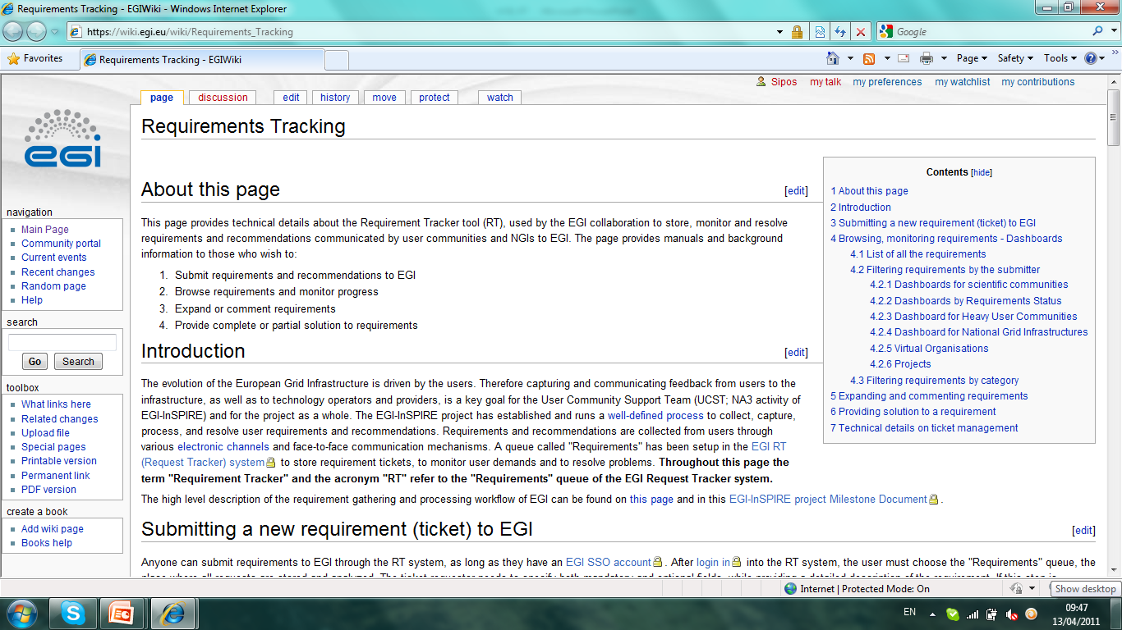
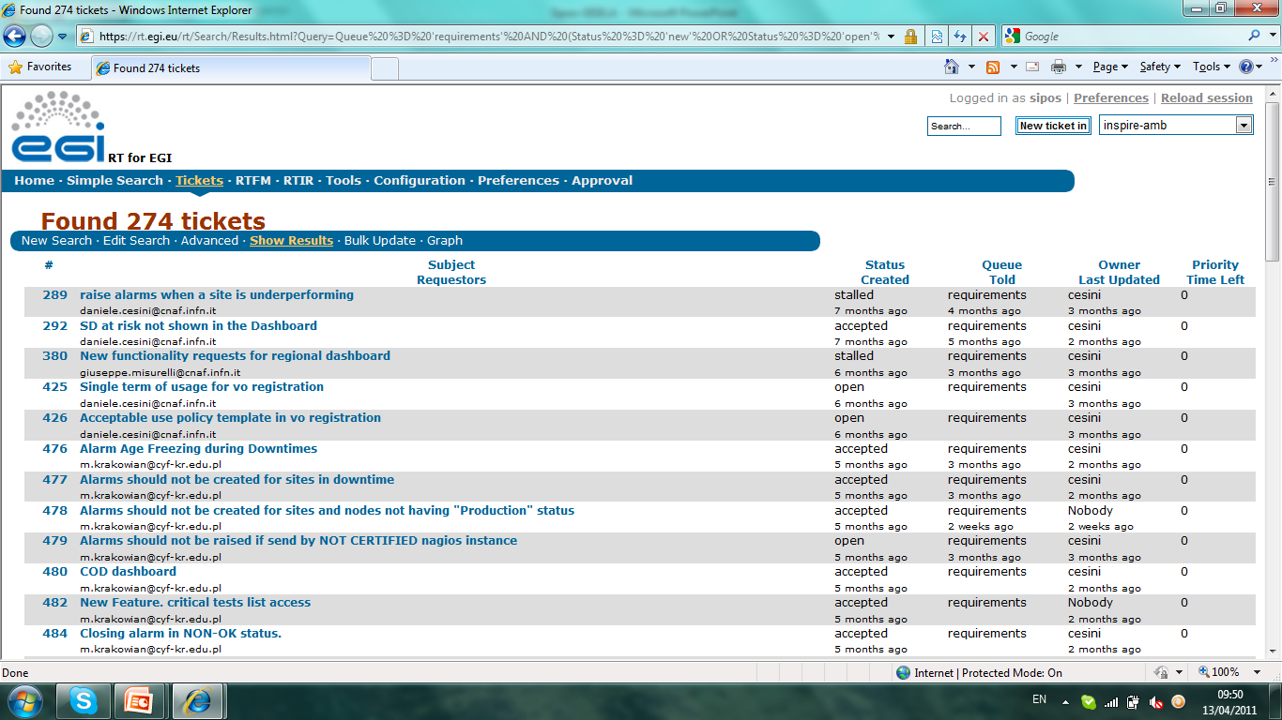
Requirements Tracker (RT)
Permanent storage for EGI requirements
  User
  Operational
Complete transparency
  For user communities
  For NGIs
  For technology providers
Requirement submission interface
Query interfaces
Manuals available

Slide 12
Processing EGI requirements, implementing solutions
External partners
UCST and EGI-InSPIRE developers
NGIs and VRCs
User Services Advisory Group
HUCs
1) 2) 3)
EIROs
VRCs
EEF
Input Channels for User requirements
EGI
Requirements Tracker
TCB
External technology providers
UCB
4) 5)
VOs
NGIs
Input Channels for Operation requirements
EMI
IGE
SAGA,
...
ESFRIs
EGI Heldpesk
(GGUS system)

Slide 13
Certification – current status
Access to EGI resources is controlled through VOs and e-Science certificates
  Most of the users have personal certificatets from National CAs (www.igtf.net)
  A growing number of users and communities access EGI through portals with Robot certificates
  Terena CS is relatively unknown at the moment

Slide 14
Certification - requirements
Wider adoption of robot certificates (particular need for robot certificates in Germany for WeNMR VRC, in France for Life Sciences Grid Community VRC)
We would like to know more about our users (needs, success, difficulties)
  How to know who requested, who received e-Science certificates for EGI access?
  How to know who has robot certificates and how many people are using these to access EGI?
Promotion of more uniform certification services, new tools across counties in order to simplify user support mechanisms in multi-national VRCs
  Graphical tools; reliable documentations; email reminders about expiring certificates, ...
Wider and better documented support of Terena Certificates. Promote to VRCs
Training certificates trusted by production sites from multiple countries
  With lightweight authentication mechanism
  Usable on production resources – not necessarily just EGI. Also e.g. PRACE
  Establishing an "EGI Training CA“?? NGIs acting as RAs??
Trusted certificates across EGI and Earth System Grid (ESG)
  A user currently needs to have two certificates to process some ESG data on EGI
  Harmonising the authentication mechanisms of EGI and ESG Federation?
  (ESGF currently expects an OpenID as unique user identifier)
Shibboleth or other federated authentication mechanism

Slide 15
EGI – ESGF authentication
The climate and related communities would be interested in using EGI with CMIP5 data stored in Earth System Grid (ESG) for regional, impact or parametric studies.
An application is carried out at IPSL in EGI-Inspire in the framework of task SA3.6 (Service for Earth Science). It consists of a fortran code and a set of CMIP5 data. To run it one needs two certificates (that are not interoperable): one for EGI, another one with role for ESGF.
It is a blocking point for a large usage of EGI by scientists using CMIP5 data in ESG.
PCMDI, established at the Lawrence Livermore National Laboratory in San Francisco, is leading ESG Federation (ESGF). ESGF currently expects an OpenID as unique user identifier.
Long term solution may be based ongoing developments of the ESG community, who is developing mechanisms to manage automatic mapping of credentials, provide data access adapters and call heterogeneous security protocols. it will be also important to have discussion between IGTF and ESGF to facilitate the use of ESGF climate data with EGI.
ESGF contact point is Phillip Kershaw (STFC, UK). P. Kershaw and J. Raciazek discussed this problem with David Groep from IGTF at CERN in May.

Slide 16
Extra slides

Slide 17

Support coordination: cultivating sustainable communities
Success stories, user requirements, application details and training information
User communities consist of:
Sustainable
EGI Virtual Research Communities (VRCs)
Scientific end users
National and specialist support units deliver services, tools & training
EGI
support services and dissemination activity
Software and technology experts
System administrators
Lessons learnt
Community representatives
Sustainability of user communities is the key
to achieve a sustainable e-Infrastructure.

Slide 18
Coordinating support: developing and deploying sustainable services
Design
Deliver
Discover
Feedback through VRCs in the User Community Board
User Services Advisory Group to drive detailed design
Where is the community?
How can I contribute?
- VRCs
Mailing lists
Workshops
Forums
Blogs
Projects
Sharing stories
Collaborating
Applications
Data collections
Requirements
Proposals
Projects
Success stories
How do I use these resources?
Integrated Services
Human
Technical
Infrastructure
Attend training courses
Utilise training material
Access data
Run applications on the grid

Slide 19
User Support structure
Support teams
  NGI User Support Teams
  Experts within established user communities
  Site administrators
  Projects with focus on specific areas. E.g.EDGI; MAPPER; StratusLab
User Support Coordination
  User Community Support (UCS) team of EGI.eu (ucst@egi.eu)
    Ensures the flow of information , knowledge and solutions among stakeholders
User Support
Teams
Processes
Services
Technical services
  Application Database
  Training Marketplace
  VO services
  Requirements Tracker
Processes
  User Community Board
  VRC accreditation
  Requirements processing
  Training Working Group

Slide 20
NGI User Support Teams
NGI User Support Teams provide:
Consultancy & training
Access to grid services
Application porting
Developing and operating software services
Collecting feedback
Documentation & helpdesk
NGIs receive:
Web & wiki resources
Requirements process
Applications and services
VRC coordination support
NGI
User Support Teams
Consultancy
Training
Porting applications
Providing access to grid and software services
Developing and operating software services
Collecting Feedback
Documen-tation
Helpdesk
Support teams are available across 50 partners – they are all different… as are their support skills.

Slide 21
Support services
Provided by a few NGIs for the whole community
  To facilitate the work of NGI support teams
  To improve communication among NGIs, among users and with users
Tools and services:
  EGI Application Database (GRNET)
    Domain specific application – for scientific end users
    Reusable toolkits and services – for NGI support teams
  Services for VOs (CSIC; LIP)
    Tools, manuals, assistance for VO setup and management
  Training Marketplace (STFC, UK)
    Repository of events and materials
    Place to request and provide NGI training services
  Requirement Tracker (EGI.eu with CESNET)
    To capture needs from the whole community
    To offer solutions from NGIs

Slide 22
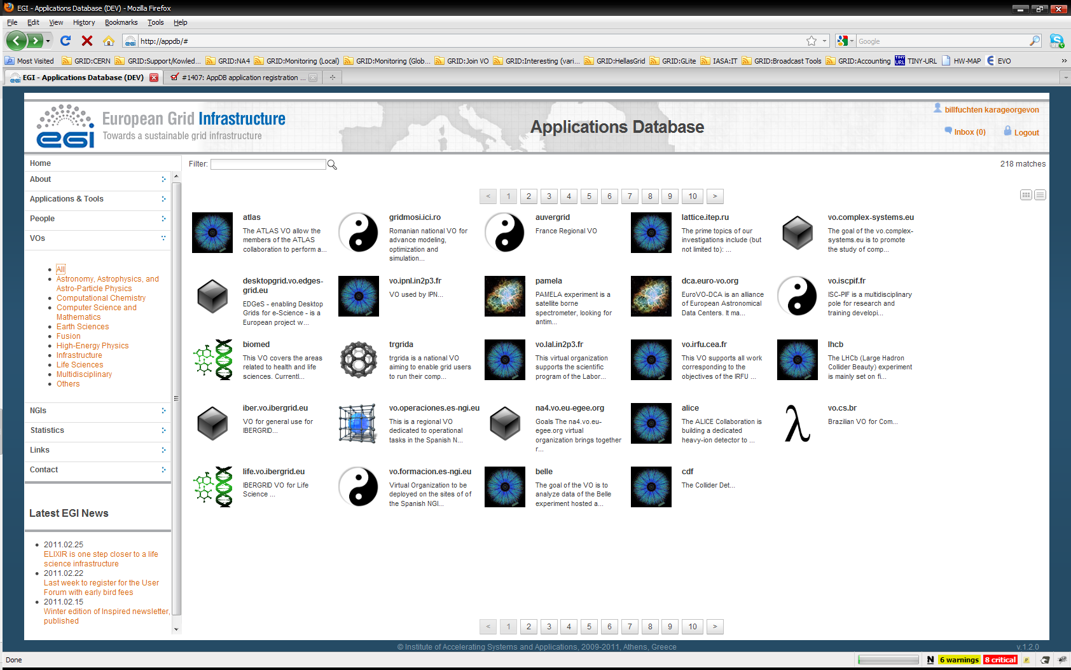
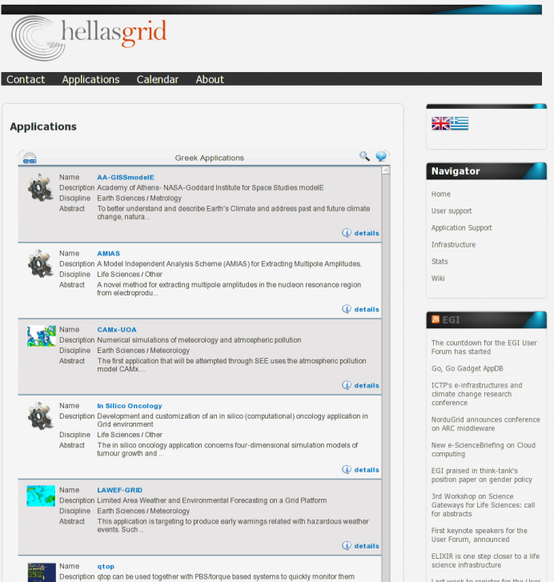
EGI Application Database
Benefits of AppDB:
gives recognition to reusable applications
gives recognition to application developers
How to get involved?
  Register applications
  Reuse applications
  Integrate AppDB through its gadget into any Webpage!

Slide 23
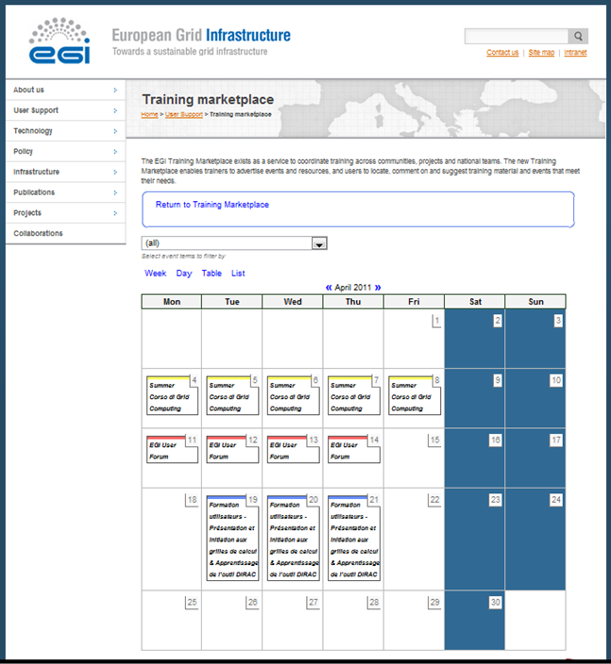
Training marketplace
Integration of:
  training event calendar
  Digital library (of training materials)
  Service offering & requesting form
How to get involved?
  Register training events
  Use, reuse and share training materials
  Offer training-related services (infrastructure, VO, CA, ...)
  Feed training-requirements
  Delegate representative to EGI Training Working Group
You can offer and request ANY type of training-related service, tool, expertise through the new Training Marketplace

Slide 24
Services for VOs
Activities:
  Consultancy and helpdesk for VO managers
  Evaluation of VO management, monitor and accounting tools
  Provision of VO support software for VRCs
VO-specific monitoring:
  Monitor only those sites that support you
  Create and plug-in VO-specific probes
How to get involved?
  Request support
    vo-services@mailman.egi.eu
  Prepare and share reviews of VO tools
  Offer local solutions for VOs through the group
NGI
NGI
VO
monitor
NGI
NGI

Slide 25
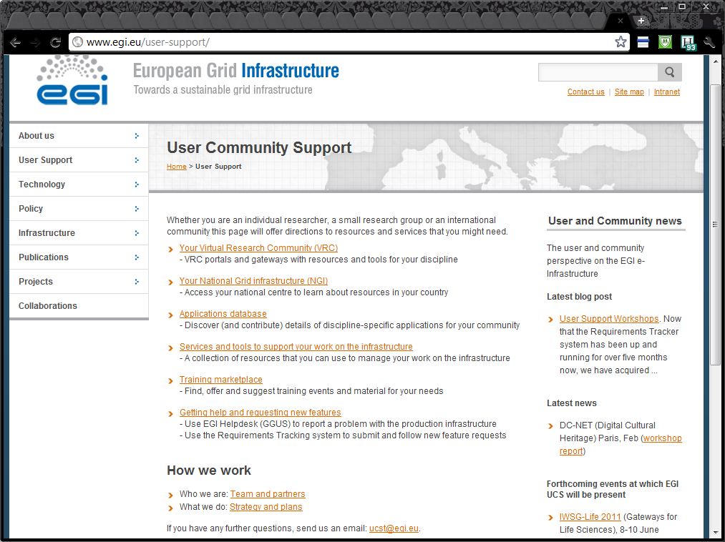
www.egi.eu/user-support

Slide 26
Virtual Research Community
What is a VRC?
  Community of researchers
  Shared technology or research interests
  Technical implementation: Group of VOs
Why be a VRC?
  Effective coordination & integration with EGI
  Build support structures within your community
Constraints to being a VRC
  Have supporting resources, i.e., supporting NGIs
  Involve significant VOs, i.e., represent users

