Slide 1
EGI-ACE Open Call no.1
Checkpoint meeting with Shepherds
eHoney
Stefano Nicotri
INFN

Slide 2
Outline
Background about the scientific use case
Ambition, Impact and Challenges
Integration Support
Capacity Requirements
Timeline

Slide 3
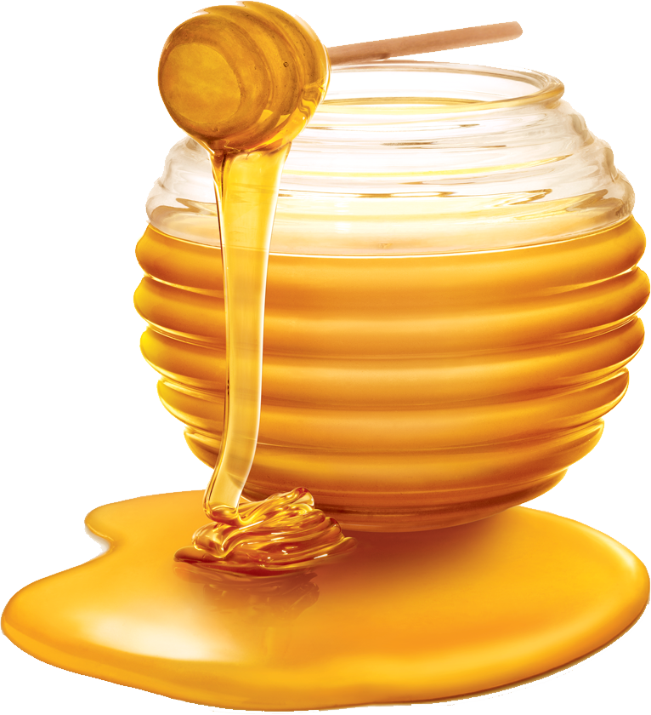
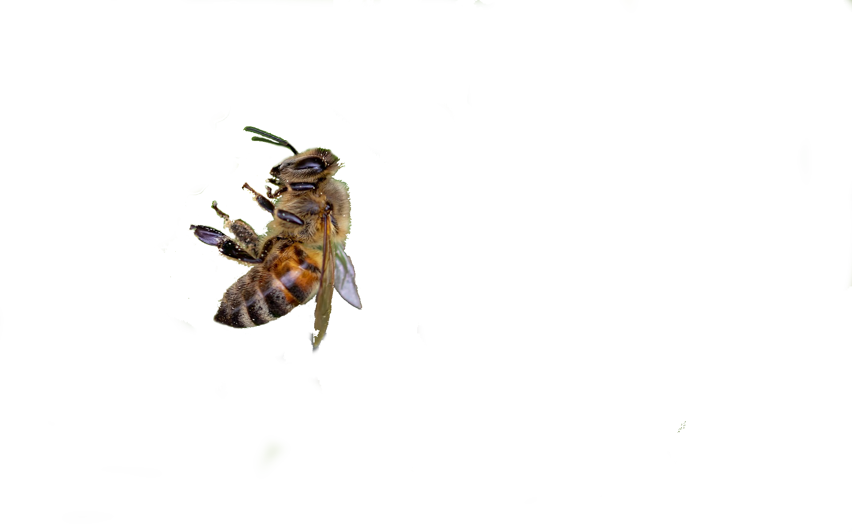
Background about the scientific use case
Objective of the use case
eHoney aims at setting up a new avenue to analyse the effect of climate change on the biodiversity using retrospectively archived honey samples.
Approach
eHoney relies on the bioinformatics analysis of environmental DNA (eDNA) information derived from more than 500 honey samples produced over the last decade.
Adopter
The Animal and Food Genomics Group of the Department of Agricultural and Food Sciences of the University of Bologna (Bologna, Italy).
The scientific community (through Open Access and FAIR data)
eHoney use-case

Slide 4






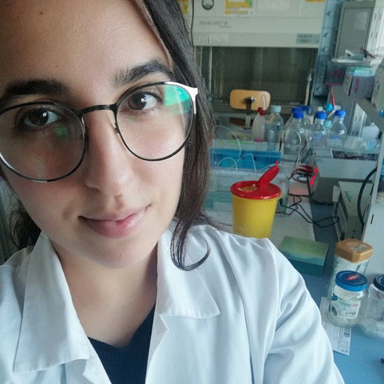
Background about the scientific use case
Team members
Located at the University of Bologna, Bologna, Italy (IT)
Scientists are specialized in apiculture genomics and eDNA analyses
Scientists have different backgrounds, including Bioinformatics (dry-lab) and Molecular Biology/Genetics (wet-lab)
L. Fontanesi
Professor
Group leader
G. Schiavo
Researcher
Dry lab
S. Bovo
Researcher
Dry lab
M. Ballan
PhD student
Dry lab
A. Ribani
PostDoc
Wet lab
V.J. Utzeri
PostDoc
Wet lab
V. Taurisano
PhD student
Wet lab
eHoney use-case

Slide 5
Ambition, Impact, Challenge(s)
Ambition: analyse the effect of climate change on the biodiversity via an efficient process of eDNA sequence annotation from honey sample (i.e. big data processing), including algorithm redefinition and pipeline scaling up.
Impact: it would be possible to rapidly process eDNA sequences from honey and monitor, in real time, the level of biodiversity and the effect of climate change .
Challenge: computational analyses of the eDNA sequencing datasets represent the major bottleneck of the project (DNA sequencer produces up to billions of DNA sequences that need to be processed in order to determine the source organism) in a process called sequence annotation. The Implementation of an efficient and scalable bioinformatics pipeline represent for a rapid data processing represent a challenge.
eHoney use-case

Slide 6
Integration Support
Simple eDNA sequencing of one single honey sample can produce raw data for up to 2.7 million of DNA sequences. Data storage requires up to 1.6GB of physical space. Deep metagenomic sequencing can produce 10× the listed amount of data.
Available data: 1000 and 500 sequencing datasets coming from a simple and deep metagenomic sequencing, respectively. The raw datasets include a total 8-10 TB of data that will be processed
The analysis of eDNA sequencing data, currently relies on two small machines, each one equipped with a dual 6-core processor, around 42 GB of RAM and 18TB of storage;
Based on this setting (using 4 threads), analyses of one eDNA sample can take up to 6 days and needs between 4 to 40 GB of physical space for data/results storage
Importance of computing performance → bare-metal HPC is to be preferred over cloud resources, at least in the initial stage
eHoney use-case

Slide 7
Capacity Requirements
The datasets locally available include about 8-10TB of metagenomics raw data that will be processed. An estimated total of 30TB will be required by the project, including the output of the analyses.
8 slots of memory (currently 4 are used), up to 20Gb of RAM for the analysis of each eDNA (honey) sample. This, together with the re-definition of the currently used pipeline used for data analysis, is expected to scale-up the process of DNA annotation.
eHoney use-case

Slide 8
Timeline
Months
 | 1 | 2 | 3 | 4 | 5 | 6 | 7 | 8 | 9 | 10 | 11 | 12 | 13 | 14 | 15 | 16
Q1.0
Q2.0
Q3.0
Q4.0
Q4.1
Activities
The use case will last 16 months and it will have the following activities:
Q1.0: set up the pipelines for eDNA read annotation. Two approaches will be tested;
Q2.0: analysis of the whole datasets;
Q3.0: interpretation of the data;
Q4.0: comparisons of results from the two approaches and re-definition of algorithms;
Q4.1: construction of Open and FAIR based databases and preparation of Open Access publications
eHoney use-case

