Slide 1
H2020 Projects – Status Update
EGI Community Meeting
21-07-2021
Tiziana Ferrari / EGI Foundation

Slide 2
Outline
Participated projects
Overview of Call for participations for service providers
EGI-ACE
Calendar of open calls, applications received so far
Project proposals Horizon Europe 2021-2022 (short overview)

Slide 3
https://digitbrain.eu/
DIGITbrain is an EU innovation program to give SMEs easy access to digital twins.
Duration: 4 years
Coordinator: PNO Consultants
EGI Contribution: Offer technical advice and consultancy to identify the best solutions to get industrial applications up and running on an integrated HPC and cloud platform
Current status:
7 industrial applications successfully integrated
A call for selecting new industrial applications closed on June 2021
Selection of the industrial applications in progress.
A dedicated budget is available for resources providers interested to extend the pledged resources.
Notes:
A Digital Twin is the virtual representation of a product, system or process that simulates its physical attributes in the real-world in real time.

Slide 4
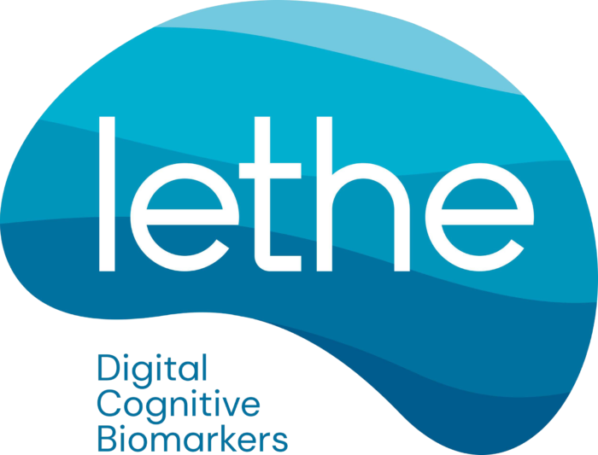
https://www.lethe-project.eu/
LETHE will establish novel digital biomarkers, for early detection of risk factors, based on unobtrusive ICT-based passive and active monitoring.
Coordinator: FH Joanneum Gesellschaft MBH
Duration: 4 years
EGI Contribution: Leading the design of the LETHE system architecture including the set-up of the LETHE big data infrastructure, set-up the authentication scheme for the project and registration of the LETHE infrastructure and services in EOSC.
Current status:
A call for supporting the project with resources is being prepared.
A dedicated budget is available for providers interested to extend the pledged resources.

Slide 5
PITHIA-NRF
https://pithia-nrf.eu/
Facilities:
NOA Node
EISCAT Node
LOFAR Node
CBK/PAS Node
SGO Node
UPS-IRAP Node
ROB-GNSS Node
UPC-IonSAT Node
OE Node
IAP Node
INGV Node
DLR-SO Node
PITHIA-NRF aligns, connects and provides easy access to European research facilities in upper atmosphere and near-Earth space studies.
Coordinator: National Observatory of Athens
Duration: 4 years (Apr ‘21 - Mar ‘25)
EGI Contribution:
Lead interoperability definition and requirement collection for the ‘PITHIA e-science centre’ (= a science data exploitation space)
Operate components for the e-science centre, expected: cloud, Notebooks, DataHub, Check-in, Monitoring & testing
Current status:
Status assessment and requirements collection from PITHIA-NRF facilities (models, datasets, access, allocations)
Set up cloud based testbed for PITHIA-NRA e-Science center (VRE) and integrate with ARGO monitoring service (register to GOCDB, setup probs etc.)
Call for cloud (and other?) resources: Later in 2021

Slide 6
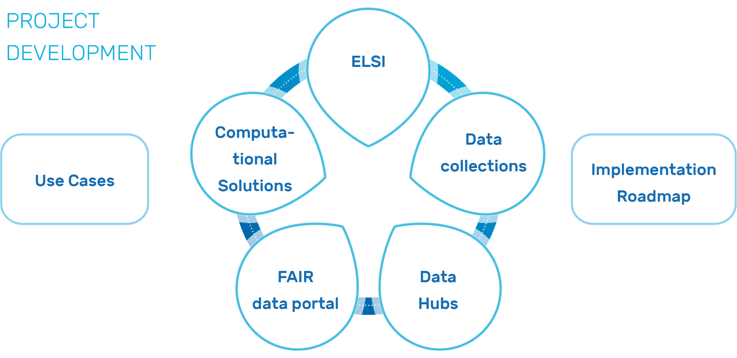
https://healthycloud.eu/
Marc ‘21 - Aug ‘23
The objective of HealthyCloud is to generate a number of guidelines, recommendations and specifications that will enable distributed health research across Europe in the form of a Ready-to-implement Roadmap. This roadmap together with the feedback gathered from a broad range of stakeholders will be the basis to produce the final HealthyCloud Strategic Agenda for the European Health Research and Innovation Cloud (HRIC).
EGI leads Task 5.1: Analysis of existing computational infrastructures for data-centric health research:
MS6: List of data-centric health research computational infrastructures (Responsible: EGI) (M6) - Aug 2021
D5.1. Analysis of existing computational infrastructures models including ELSI (Responsible: EGI) (M15) - May 2022
Coordinator:
INSTITUTO ARAGONES DE CIENCIAS DE LA SALUD
RIs in the consortium:
ELIXIR, devoted to life sciences;
ECRIN, in charge of clinical trials;
EATRIS, focused in translational medicine;
BBMRI-ERIC, which coordinates the national networks of biobanks across Europe;
Euro-BioImaging, dedicated to the management of clinical and biomedical imaging.
PLS SEND INPUT TO GERGELY.SIPOS@EGI.EU

