Slide 1
Multi-VO Rucio for EGI
Timothy Noble
Service owner and developer for Multi-VO Rucio

Slide 2
What is data management
Data management is the practice of keeping and using data securely, efficiently, and cost-effectively.
A robust data management solution becomes more necessary as the number of people accessing, generating, and sharing data increases across a number of sites.

Slide 3
Rucio
Overview
Data management tool
Integrates with many storage solutions
Data can be stored across multiple sites, with different setups and protocols
Data can be anything, images, text….
Designed with more than a decade of operational experience in very large-scale data management (Several billion files, approaching an Exabyte of data)
Developed by ATLAS, now used and developed by other communities
Open source
Community-driven development

Slide 4
Rucio
Terms
Rule – relates to and protects a file and allow for replication
Dataset – A collection of files
Container – A collection of datasets
RSEs – Rucio Storage Endpoint
Daemons – A program that performs a specific task, there are many kinds

Slide 5
Rucio
Files, Datasets and Containers
Single files can be replicated using rules
Files are grouped together in datasets
Can belong to multiple datasets
Containers are collections of datasets
Containers and datasets can have properties to protect datasets
E.g. Open/closed – can have data added
Container 1
Dataset1
Dataset2
1
2
3
4
5
2
4
5
6
8
Container 2
Dataset1
Dataset3
1
2
3
4
5
1
5
6

Slide 6
Moving Data
Replication Rules
A file from a data source may be uploaded to Rucio to an RSE
This may not be where it is needed
Add a replication rule
This would add the two datasets to the RSEs in the UK, and have 2 copies of this dataset within the UK
This would add the same two copies across the UK but excludes RAL as one of the potential sites to keep this data
RSE expressions
$ rucio upload -- rse storageendpoint scope:first_file scope:second_file
$ rucio add-rule scope:first_dataset scope:second_dataset 2 ‘country=uk'
$ rucio add-rule scope:first_dataset scope:second_dataset 2 'country=uk\site=RAL-LCG2

Slide 7
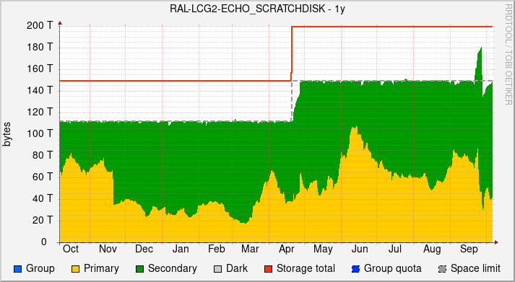
Multi-VO Rucio at RAL
Accounting and Quotas
Each account is given a quota of space
Rules that account has count towards their quota, but this does not mean that space is taken up at an end point
If two users have a rule on the same file, each has that space allocated to their quota but only one physical copy is present
If there is a rule on a file, the file will not be deleted
Primary and secondary data

Slide 8
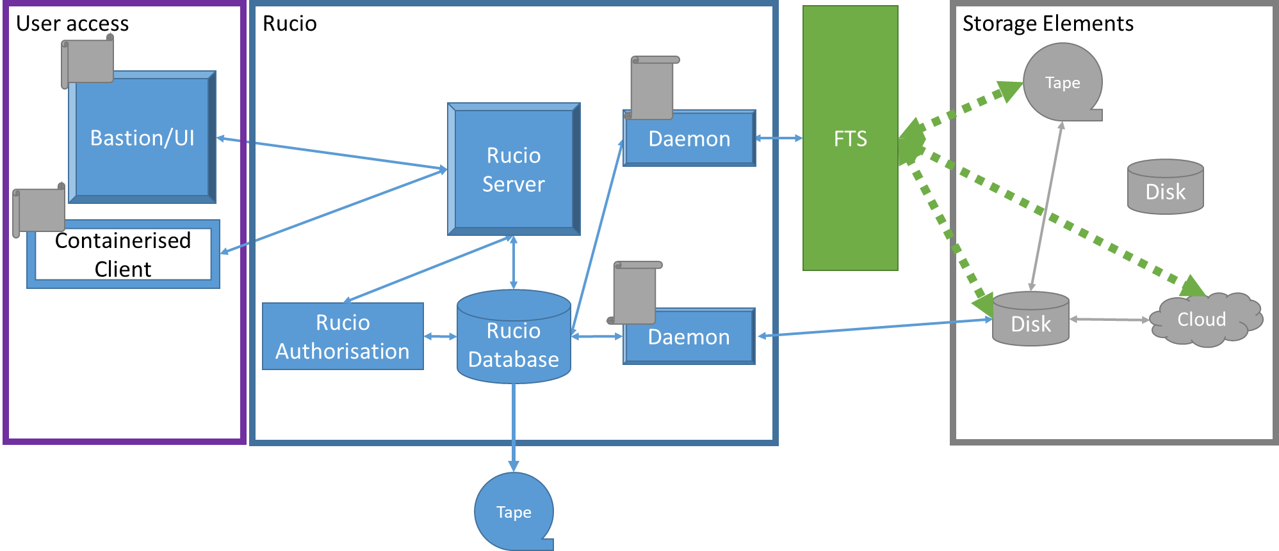
Rucio
Architecture

Slide 9
Multi-VO Rucio at RAL
Setup and maintenance
Rucio was initially setup in April 2018 at RAL to support SKA development
Evolved to supporting Multi-VO
Developers have worked with core dev team to develop Multi-VO functionality
Contact point for new users and provide tutorials
Timothy.Noble@stfc.ac.uk
Test transfers between sites to ensure endpoint functionality
Working on documentation to help User and VO-Admin use:
https://www.gridpp.ac.uk/wiki/Rucio
To be made available to EGI when complete
Rucio-Support@stfc365.onmicrosoft.com for support

Slide 10
Multi-VO Rucio at RAL
Advantages
Running a Rucio instance that supports multiple VOs is beneficial for small experiments:
Maintained by RAL not by smaller experiments
Low levels of load from smaller experiments.
One instance to support and maintain.
Shared RSE configuration
New VOs are quick to add – work with VO admin to setup their environment
More contact with Developers and larger communities using Rucio to know how best to utilise

Slide 11
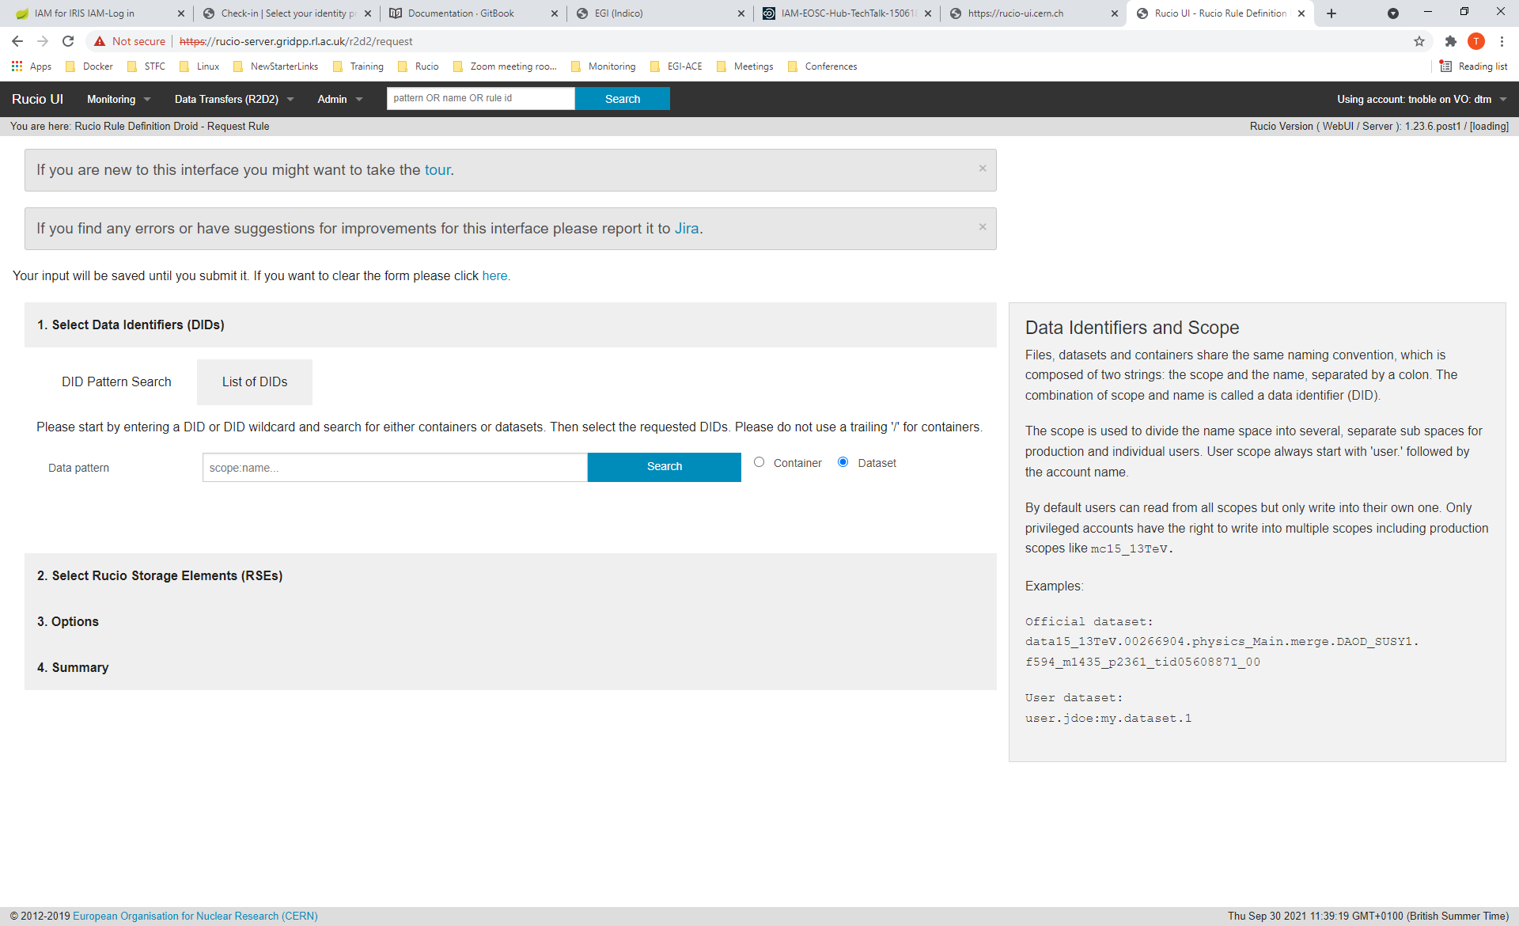
Accessing Rucio
WebUI and EGI Check-in / IAM
Work in progress
Next 3-6 months

Slide 12
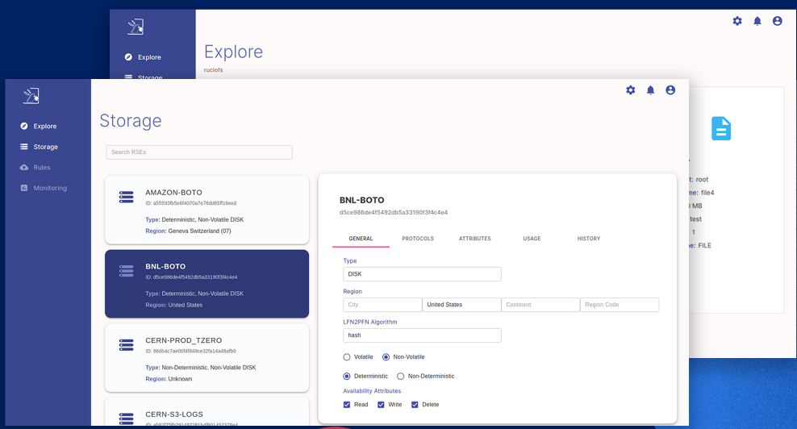
Accessing Rucio
Clients
Containerised Client
Installed using docker
Easy to install & setup
Lightweight Client
Easy to install & setup
Fewer dependencies
Run without a config file
Rucio Desktop
Graphical User interface for Rucio
Developed as a summer of code project
Work in progress
https://github.com/rucio/desktop

Slide 13
Multi-VO Rucio at RAL
RAL Plans
EGI-ACE Developments
WebUI for Multi-VO
Integration with IAM and EGI check-in
Invite new experiments to use Multi-VO Rucio
Improve documentation
Internal Developments
Multi-VO selection of certificates for daemons
Containerisation
Improve monitoring
Gain experience with on boarding a variety of communities and requirements

Slide 14
Multi-VO Rucio at RAL
Conclusions
Multi-VO Rucio at RAL is available to anyone who wishes to use it
RAL Multi-VO Rucio is working with EGI to offer an opportunity for communities to use the powerful data management software of Rucio without needing to invest in the setup and maintenance.
RAL Multi-VO Rucio at RAL is being viewed as a long term service to support any community that wishes to use it.
RAL Multi-VO Rucio is being deployed and developed with new users in mind to make it easier for communities who have no experience with Rucio or the grid environment.

