Slide 1
EGI-ACE Open Call no.1
Checkpoint meeting with Shepherds
Large sample testing of high-resolution distributed hydrological model
Miguel Caballer/UPV
Albrecht Weerts/Deltares & Wageningen University

Slide 2
Outline
Background about the scientific use case
Ambition, Impact and Challenges
Integration Support
Capacity Requirements
Timeline

Slide 3
Background about the scientific use case
The objective is to perform large sample testing of high-resolution distributed hydrological model to identify where process description or used datasets (forcing, geofabric, etc) fall short and need improvement. At the same time, we hope to be able to identify where changes in discharge regimes occur around the globe either from changes in climate, the environment or society.
The starting point of this work is to focus on locations where we have long enough observational records (i.e. discharge, volume estimates) like CAMELS (USA, Brazil, Chile, UK), EWA/GRDC databases, locally available discharge networks (Poland, Norway, Sweden, Australia) and the GRanD database for upstream reservoirs (~5000).
We will make use of available datasets (ERA5 reanalysis or locally available high-resolution gridded rainfall datasets) to force the distributed hydrological model. Given the impact of model parameter uncertainty, for each location models will be run multiple parameter sets to allow for uncertainty analysis.
TEAM: WUR (The Netherlands) , Deltares (The Netherlands)

Slide 4
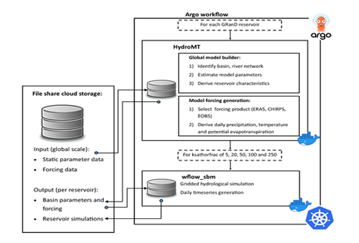
Ambition, Impact, Challenge(s)
The benefit of the cloud in comparison to traditional HPC environments is that it allows to run the hydrological models in parallel on hundreds to thousands of CPUs (depending on resources available). Specifically, the Argo workflow manager, using different Dockerized containers on a Kubernetes cluster, allows for effective scheduling, creation, simulation and evaluation of hydrological model data.
For the current project, we will use this approach for the datasets described in the previous slide to:
Generate model forcing and parameters,
run the model,
perform uncertainty analyses,
evaluate results for 40-50 years of historical data simulation (1970-present),
if available and time allows, cover the future period to assess the impact of future climate change
Resource providers:
CESGA: Already contacted.

Slide 5
Integration Support
We want to deploy our ARGO workflow (previous slide) using the EGI Cloud Compute resources. This workflow was tested on Azure Kubernetes cluster before.
We need:
Experts to deploy Kubernetes clusters.
Optionally check cluster elasticity with EC3.
Experts to integrate EGI-Datahub for external data access.

Slide 6
Capacity Requirements
Per application we would need a CPU with about 8 Gb of memory and 25-200 Gb of temporary storage to enable running of the workflow and generate results.
Total capacity needed:1000 CPU (will be reduced to 200) with 8GB memory / CPU and with 25-100 TB disk in total.The amount of storage per CPU will vary depending on the size of the catchments and the amount and form (grids/timerseries) of output that is being saved (therefore the suggested reduction of 200Tb to 100Tb if this is a problem).
In addition we would need a storage bucket or file share where static data is being stored for generating the models and model forcing: 1 fileshare / bucket 15Tb.

Slide 7
Timeline
Current Status:
Orders created in EOSC Marketplace
K8s cluster with 4 WNs (4 CPUs, 32 GB of RAM) and 5 TB of block storage created at CESGA
Deployed using IM.
ARGO Workflow manually installed.
Input data manually ingested.
Next planned actions:
Automate the deployment of the full application using TOSCA and Ansible recipes.
Test K8s elasticity with EC3.

