Slide 1
WP8 Deep Dive
Dave Heyns (GÉANT)
EOSC Future PMB - 2 November, 2021

Slide 2
WP8 - Commercial Services
WP8
Why Commercial Services?
Task 8.1 – Commercial Services Procurement (GÉANT)
Understanding OCRE (EOSC commercial cloud project)
Identifying other commercial services (not yet catalogued)
Expanding portfolio (new procurement vehicles)
European Research Dataspaces – Commercial datasets
Distribution of funded services
Task 8.2 – Digital Innovation Hub (EGI)
Activity 8.2.1 – EOSC DIH Expansion and Operation
Activity 8.2.2 – EOSC DIH Business Pilot support and co-creation
Activity 8.2.3 – EOSC DIH Impact Assessment and Exploitation

Slide 3
Why Commercial Services?
Bespoke, enhanced Compute and Storage solutions
WP8
European Commission promotes
Digital Economy for Research
Consume not Build (where possible)
IaaS/PaaS underpins e-Infra services
Sustainable EOSC (Core)
Develop Startups and SMEs
Green Compute Europe
Fewer Data Centers (resource consumption)
Rate of Innovation (accelerating in Cloud)
HPC supplementation (hyperscale compute)
FAIR data (metadata creation and cold storage)
EOSC White Labeled Commercial Services
Everything
consumable
NREN
SD-WAN
Commercial
5G
6G
2028

Slide 4
Understanding OCRE
T8.1
Cloud Framework for Research
IaaS/PaaS/SaaS
Supported by local NREN
Catalogue of Services
€4Million in adoption funding
Earth Observation services
Dynamic Procurement System
Stimulate EO service development
€4Million in adoption funding
EOSC Service Distribution model
Market response to tender – 1100 bids
Outcome - 473 cloud contracts across 40 lots
37 cloud platforms represented
Minimum of 9 platforms per country
Maximum 17 platforms per country
GÉANT WP4/CMG contract management
Platforms connected to Research Networks
Research Trust and Identity federations
Platform tested using HNSciCloud workload
Data ingress/egress waviers in place
Researcher enablement negotiated
Platform competitions complete
EXTERNAL ADVISORY BOARD in place
https://www.ocre-project.eu/services/cloud-suppliers

Slide 5
Identifying other necessary services
T8.1
D8.1 - (OCRE Catalogue) provides basis
Survey exploring need for –
Commercial services not yet identified
Datasets requiring subscription
Co-innovation opportunities
Engagement supported by WP10
D8.3 – Procurement plan for additional resources
Publication of survey results
Procurement/distribution mechanisms
Catalogues
https://www.ocre-project.eu/services/cloud-suppliers

Slide 6
European Research Dataspace
T8.1
Facilitate access to different types of data -
Required by researchers
Compliant in terms of data standards and governance
Possibly from vetted commercial providers
Consumed by means of subscription
Used in parallel with ‘open’ data
33% of funding to be allocated to commercially consumed data
https://www.ocre-project.eu/services/cloud-suppliers

Slide 7
Distribution of Funded Services
T8.1
Funding to be used to build and test service delivery chains from supplier to end user
EOSC as underwriter (direct delivery model)
service consumption through service aggregators like GÉANT, EGI, EUDAT etc.
easier access to commodity services (1 million compute hours, 1 PB long term storage etc.) and subscription -based datasets
EOSC as referrer (indirect delivery model, institution contracts with supplier for service procured by EOSC)
Funding made available using vouchers
Funding allocation based on value for testing service delivery chain and impact of commercial services on research
Calls for project proposals from both research projects and suppliers (mini-competitions)
https://www.ocre-project.eu/services/cloud-suppliers

Slide 8
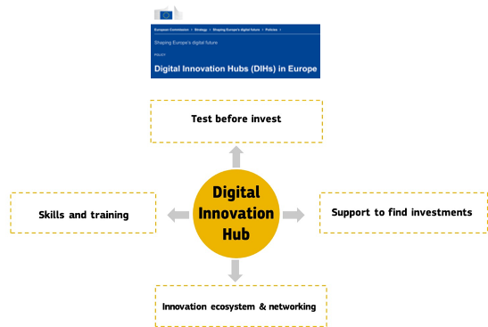
DIHs - Background
T8.2
What is a Digital Innovation Hub?
Joint partnerships between private and public organisations to stimulate innovation
Community offering added value in addition to technical services

Slide 9
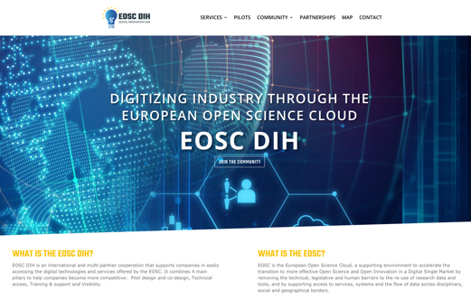
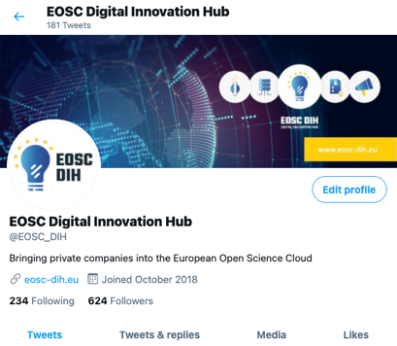
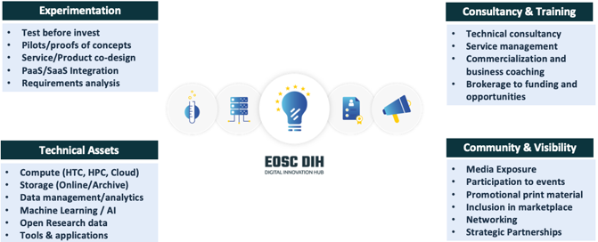
EOSC DIH – Creation to Expansion
T8.2
Created
Expanding

Slide 10
EOSC DIH – Mission, Target Groups, Objectives
T8.2
Mission
Stimulate joint innovation with private enterprise leveraging EOSC services, data and expertise
Objectives
Coordinate the operation and expansion of the EOSC DIH community
Manage the full lifecycle of business pilots
Identify services/solutions required by the EOSC to be developed by industry
Develop a more mature impact monitoring and evaluation system
Establish corridors other DIHs to support the pan-European network and connect at the regional level
Serve as an industrial engagement channel for other EC projects and initiatives for engaging the EOSC
Target Groups
Spin-outs; Start-ups; SMEs
EOSC support/regional projects
Multiplier networks
Other DIHs/EDIHs

Slide 11
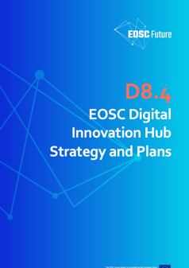
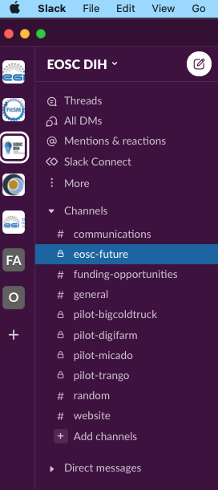
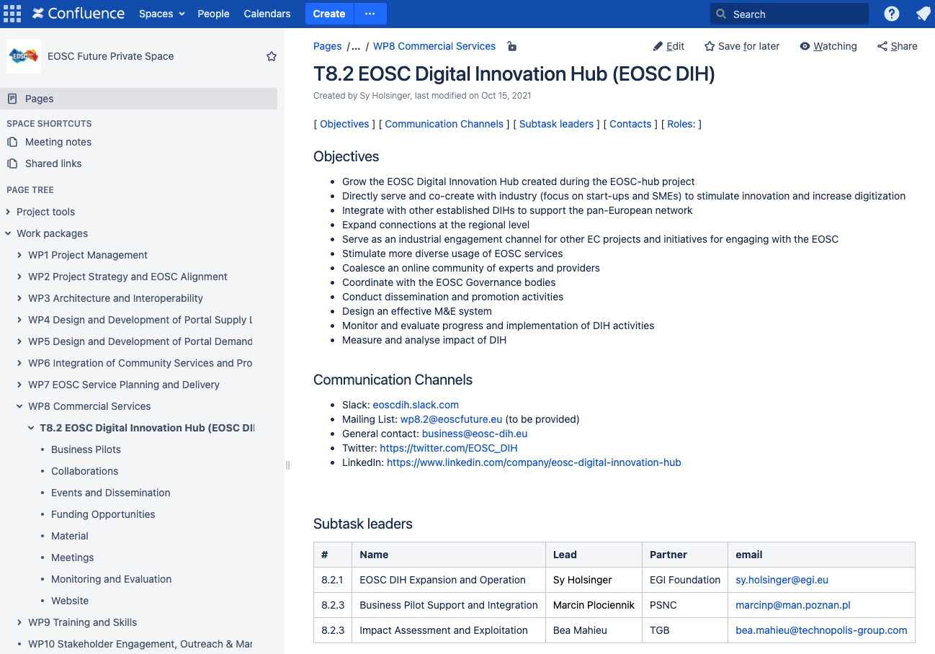
EOSC DIH - Expansion and Operation
T8.2
Management and Planning
D8.4: EOSC DIH Strategy and Plans
Submitted (M6)
Regular bi-weekly task meetings
Project Confluence
Hosting all task related info
Slack workspace
Opening to community
Private channels e.g. project task; each pilot
Community-wide meeting (every 3 weeks)
Opportunity to discuss EOSC DIH wide activities
Share updates from partnerships and pilots
Service providers to present details of offer

Slide 12
EOSC DIH - Expansion and Operation
T8.2
Collaborations and Events
Working with other WPs
T1.5: Grant committee and funding platform
WP5: Include the DIH and it’s offerings into the EOSC platform/portal
WP6: Onboarding procedure inclusion and closer integration with EOSC portal
WP7: SMS inclusion
WP8.1: Support for purchasing services; joint survey/outreach
WP10: Interfacing industry dissemination and communications
Collaborations
All INFRAEOSC-07 projects
Multipliers
Regional DIHs
Other DIH and industry support projects
Events
EOSC Symposium (June 2021)
ITM Industry Europe Fairs (Aug 2021)
EGI Conference (Oct 2021)
DIHnet Final Event (Oct 2021)
…many others being tracked and planned

Slide 13
EOSC DIH - Business Pilot support and co-creation
T8.2
Business pilots
Purchasing services
Mutual value exchange (no direct funding); mainly for start-ups/SMEs
Provide technical services
Offer expertise and support
Promote results
Periodic campaigns to entice new pilots
€600k budget (Art. 10)
Value for EOSC
Services, solutions, data not currently available but could be developed by industry for the use/benefit of EOSC
Coordination with T8.1
Joint survey in progress
Publication in EOSC Funding Platform

Slide 14
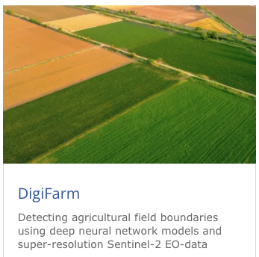
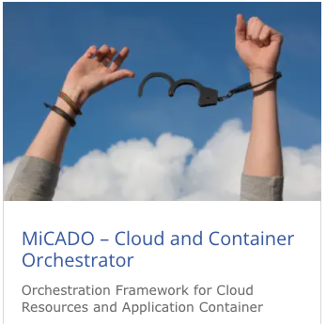
EOSC DIH - Business Pilot support and co-creation
T8.2
New pilots onboarded during EOSC Future
Intro from T8.1 partner contact
Brought by
Wanted to continuing working together – developed new workplan
From partnership to pilot

Slide 15
EOSC DIH - Impact Assessment and Exploitation
T8.2
Challenge
No common approach to impact assessment across DIH landscape and available metrics were a moving target during the life of EOSC-hub with no final community consensus at project end to adopt.
Metrics are currently defined, but are more for scoping and monitoring the task activities and objectives
e.g. # of individual SMEs directly supported, strategic partnerships, regional DIHs connected, industry events, services offered in EOSC Marketplace.
Dedicated activity (subtask) to mature a more systematic monitoring and evaluation framework along with DIH, business pilot, and purchased service indicators and KPIs.

Slide 16
Summary
WP8
…

