Slide 1
EGI-ACE
Services for Data Spaces
EGI Webinar 2021
24th November 2021

Slide 2
Outline
EGI-ACE intro
Data Exchange Approaches Characteristics mapping to EGI-ACE services
Examples of services for EGI-ACE Data spaces
EGI Check-in
EGI DataHub
Examples of EGI-ACE Data Spaces
ENES
Prominence

Slide 3
EGI-ACE objective
Implement the Compute Platform of the European Open Science Cloud and contribute to the EOSC Data Commons by delivering integrated computing, platforms, data spaces and tools as an integrated solution that is aligned with major European cloud federation projects and HPC initiatives.

Slide 4
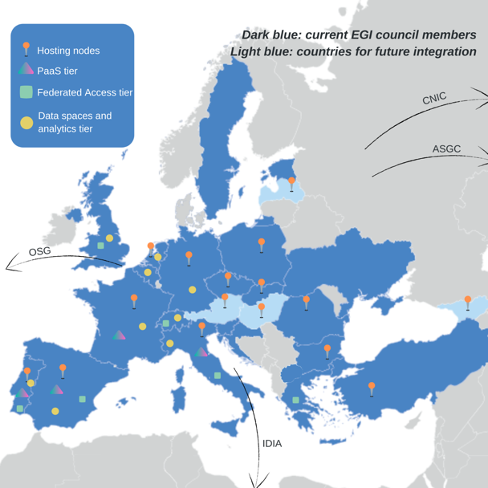
EGI-ACE Consortium Overview
EGI Foundation as coordinator
33 participating partners, 23 third-parties
Consortium at a glance
16 partners to deliver cloud, HTC and HPC resources
12 user access and platform solution providers
21 providers from 13 communities to deliver data spaces
12 federation service providers
Early adopters; Partner infrastructures
57% of the budget for service provisioning

Slide 5
EGI-ACE Tier service architecture
Data Spaces
and Analytics
Data and thematic data analytics and processing tools
EOSC portal
Early adopters
Green Deal Data Space
Health Data Space
Fundamental Science Data Space
Humanities Data Space
Platforms
generic added-value platform level services
Interactive Computing
Automated Cluster deployment
Distributed AI training
Workload Management
EOSC
users
Service Management, Tools, Processes, Policies
Federated
Access
Federation-wide management of data and computing
Federated Compute
Federated Identity
Federated Data
Federated
Resources
Compute and storage facilities
Research Clouds
Public Clouds
HTC
HPC

Slide 6
Compute services | Platform services | Data space services | Federation services (AAI, data, compute)
IM AppDB EGI HTC & Storage dCache Spider Storage Data Processing Compute EGI Cloud Compute AppDB DynDNS MetaCentrumCloud - CPU MetaCentrumCloud - GPU MetaCentrumCloud - Storage SCAI FedCloud v2 EGI - GSIOS IN2P3-IRES-CPU IN2P3-IRES-Storage TR-FC1-ULAKBIM - CPU TR-FC1-ULAKBIM - Storage INFN-BARI-CPU INFN-BARI-Storage INFN-CNAF-CPU INFN-CNAF-GPU INFN-CNAF-Storage INCD-Lisbon (NCG)-CPU INCD-Lisbon (NCG)-Storage EGI – IISAS DESY-FedCloud CESGA-CPU CESGA-Storage IFCA-LCG2-CPU IFCA-LCG2-Storage INCD-LIP-CPU INCD-LIP-Storage CYFRONET-CLOUD-CPU CYFRONET-CLOUD-Storage IICT-BAS-CPU IICT-BAS-Storage CLOUDIFIN-CPU CLOUDIFIN-Storage | EGI Notebooks & Binder EGI Workload Manager DIRAC DEEP training facility CSIC DEEP training facility LIP DEEP training facility DODAS | WeNMR portals UU WeNMR Portals UseGalaxy.eu Virtual Imaging Platform OpenRiskNet/NanoCommons Virtual Env. ENES Data Space OpenCoastS Prominence SURFSARA LOFAR Science Products NWO-I LOFAR Science Products Disaster mitigation and agriculture SeaDataNet WebOcean Data Analysis Iberian GBIF data space CSIC GBIF Cloud data space LIP GBIF Cloud data space EMSO ERIC data service OPERAS Metrics service OPERAS Certification service iop | EGI Check-in PERUN MasterPortal EC3 Indigo PaaS Orchestrator Rucio CVMFS OpenRDM EGI content distribution CVFMS EGI Data Transfer FTS EGI DataHub Onedata
31 different services from
61 providers

Slide 7
Mapping DEA Characteristics to EGI-ACE Services
DEA Characteristic | Service(s)
Visibility & Security | EGI Check-in (including Perun and MasterPortal)
Findability | EGI DataHub, Rucio, openRDM
Accessibility | EGI DataHub, Rucio, openRDM
Interoperability | EGI DataHub, Rucio, openRDM
Reusability | EGI DataHub, Rucio, openRDM
Quality | Specific to the Community building the Data Space
Community | EGI Check-in ( including Perun and MasterPortal)
Purpose | Specific to the Community building the Data Space
Governance | Specific to the Community building the Data Space + Accounting (partial) + EGI Check-in

Slide 8
EGI Check-in
Proxy service that operates as a central hub to connect federated Identity Providers (IdPs) with EGI service providers
Main characteristics:
Enables multiple federated authentication sources using different technologies
Federated in eduGAIN as a service provider
User registration portal to allow accounts-linking
Combines user attributes originating from various authoritative sources (IdPs and attribute provider services)
Integrated with PERUN
Compliant with the AARC Blueprint
Support non-web use cases & delegated access
Integrated with RCAuth.eu and Master Portal
RCAuth.eu & Master Portal
Valeria Ardizzone,EGI.eu
Nicolas Lampiotis, GRNET
Andreas Kozadinos, GRNET
Nicolas Evangeliu, GRNET
EGI Webinar 2021

Slide 9
Use Case Group Management as a Service
eduGAIN
Communities that do not operate their own group management service can leverage the group management capabilities of the Check-In platform
Avoid overhead of deploying a dedicated group management service
Authorised VO (Data space) admins will manage the information about their users independently
Can be used with EGI and non-EGI services
Institutional IdP
Social IDPs
EGI CheckIn
Service
Virtual Organization
Service
EGI Infrastructure
Service
Supported technologies:
CΟmanage
Perun

Slide 10
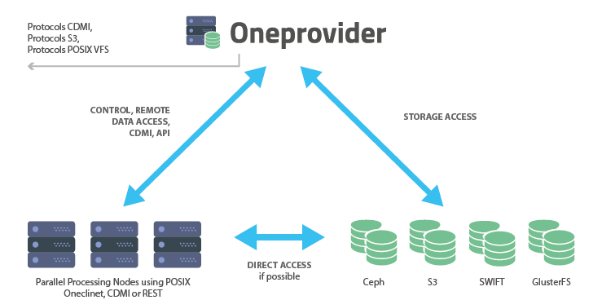
DataHub: Main functionalities
Lukasz Dutka, Cyfronet
EGI Conference 2021
Data-collections aggregation service
Aggregates Data providers (based on Oneproviders)
Opendata Repository
Easy sharing data for anonymous access
OAI-PMH for metadata harvesting
PID/DOI minting
Metadata indexing service
Webportal for data discovery
Pluggable portals for data discovery
Platform for hybrid cloud data management and processing environment

Slide 11
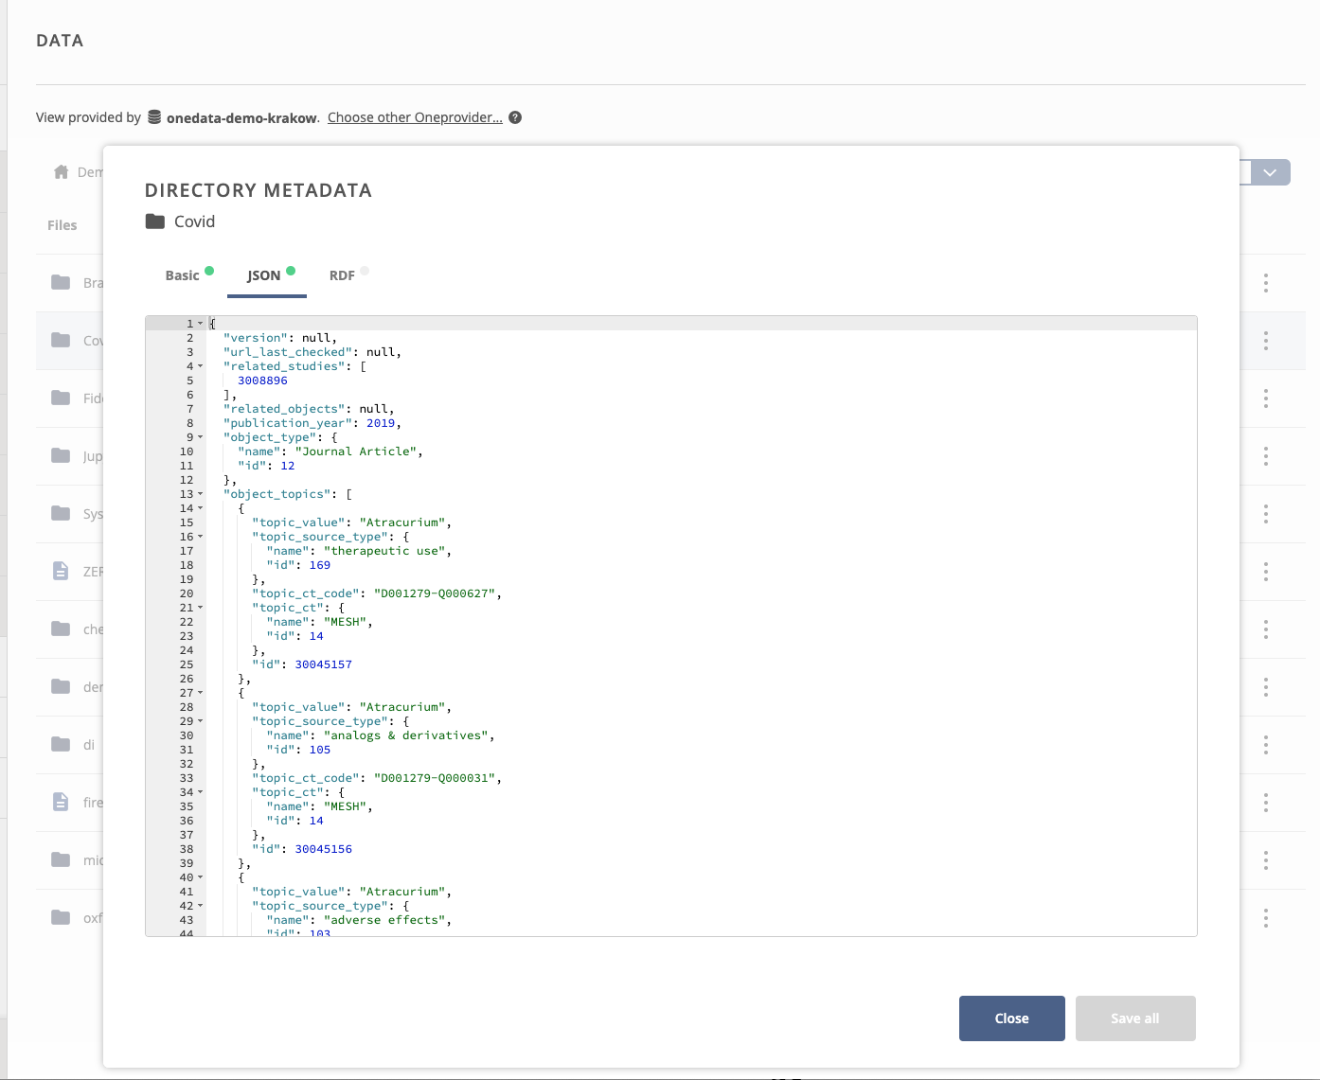
INTEGRATED METADATA MANAGEMENT
All files and directories could have a custom user metadata
API for metadata management
API for data discovery based on metadata
Virtual Folders based on metadata tags

Slide 12
SAMPLE DATA DISCOVERY PLUGIN

Slide 13
Humanities
OPERAS metrics and certification service
Disaster mitigation and agriculture
WeNMR (structural biology)
Health and medicine
EISCAT_3D Data Portal
(atmospheric physics)
GEOSS Portal and GEO DAB
Earthquake response and landslide analysis
Environmental sciences
GBIF Cloud data space
Virtual Imaging Platform (medical imaging)
13 Data spaces
EMSO ERIC data services
OpenRiskNet NanoCommons
VIRGO (gravitational waves)
MeerKAT workflows (astronomy)
E-RIHS (heritage object analytics)
SeaDataNet WebOcean Data Analysis
UseGalaxy.eu (bioinformatics)
PHIRI (population health)
LOFAR science products (astronomy)
OPENCoastS (circulation forecast)
PROMINENCE (fusion physics)
ENES (climate analytics)
7 Early adopters
Climate research
Energy and physical sciences

Slide 14
Sandro Fiore, University of Trento,
Christian Pagé, CERFACS
Sylvie Joussaume, CNRS/IPSL
Fabrizio Antonio, CMCC
EGI Conference 2021
ENES Data Space: goal and use cases
Goal: Deliver an entry point to an open, operational, scalable and cloud-enabled data science environment for climate data analysis (ENES Data Space) on top of the EOSC Compute Platform
Use cases: Data analysis on CMIP6(Coupled Model Intercomparison Project Phase 6) data
The “ENES data space” aims at providing an entry point to:
Datasets (e.g. CMIP6) -> Driven by users; Wide spectrum; Pre-staged; Open
Storage & Compute resources -> Provided by EGI-ACE
Data Science Software Stack -> To address a wide spectrum of analysis needs;
IDE and Applications -> To devel/share/(re-)use apps, etc. FAIR principles
Cloud-Enabled -> SaaS for end-users applications; PaaS paradigm for data analysis service

Slide 15
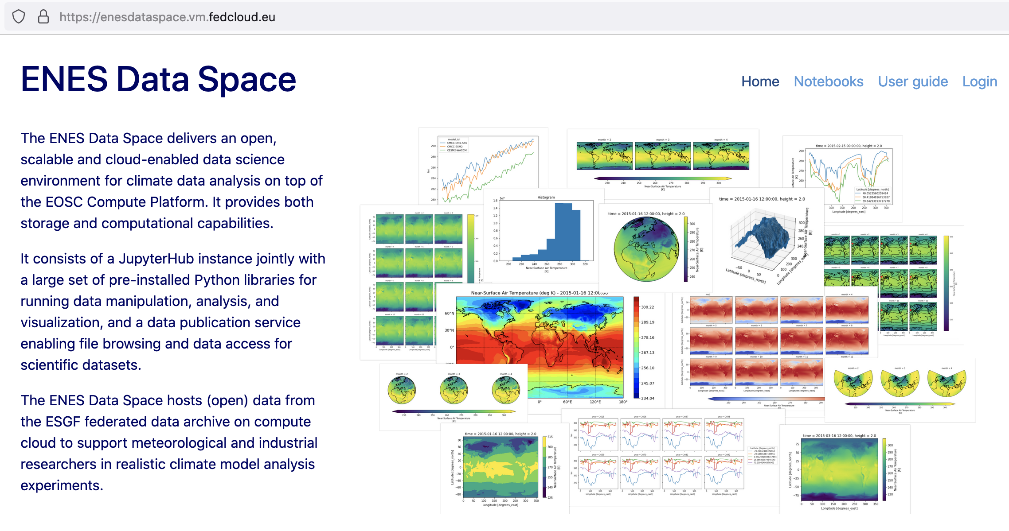
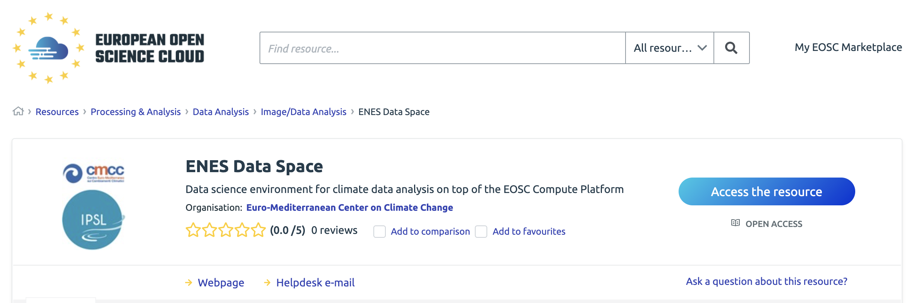
Atef Ben Nasser, CNRS/IPSL
Fabrizio Antonio, CMCC
Upcoming EGI Webinar on Dec 15th
ENES Data Space
Data Space
environment
AAI & Monitoring
EOSC Data Access Service (DataHub)
Cache Manager
Collection DB
Data Transfer tools (clients)
Data Access & Compute Service
Data Access & Compute Service
Data Access & Compute Service
Community Database (SiteA)
Community Database (SiteB)
Community Database (Siten)

Slide 16
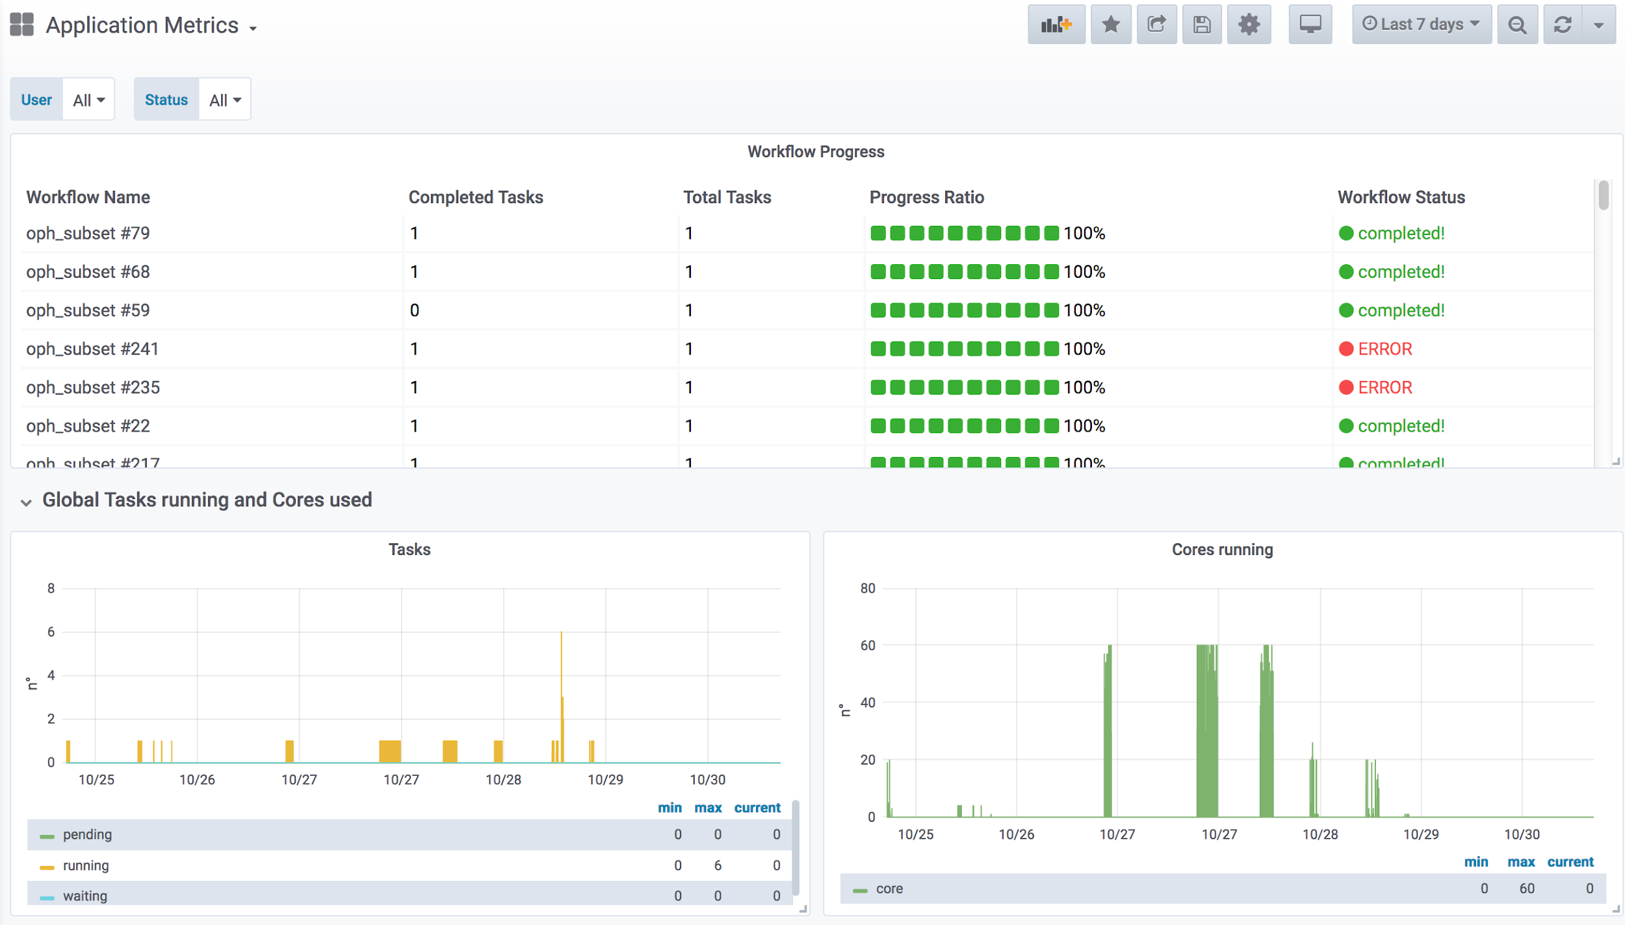
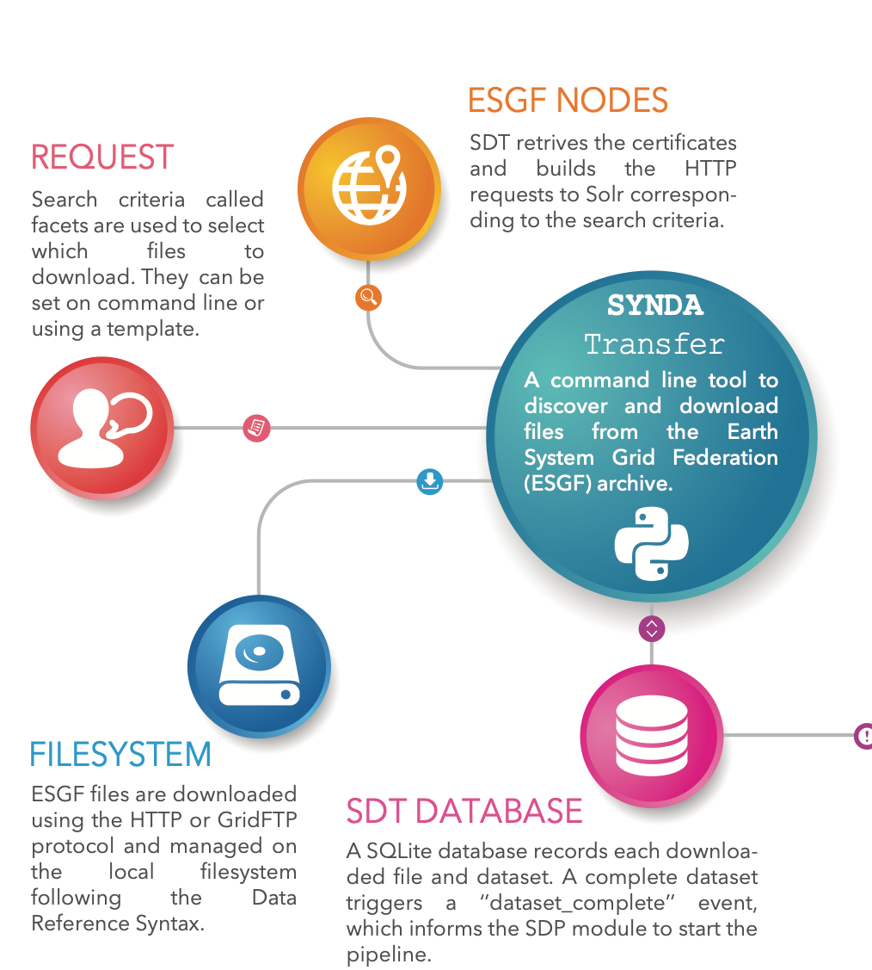
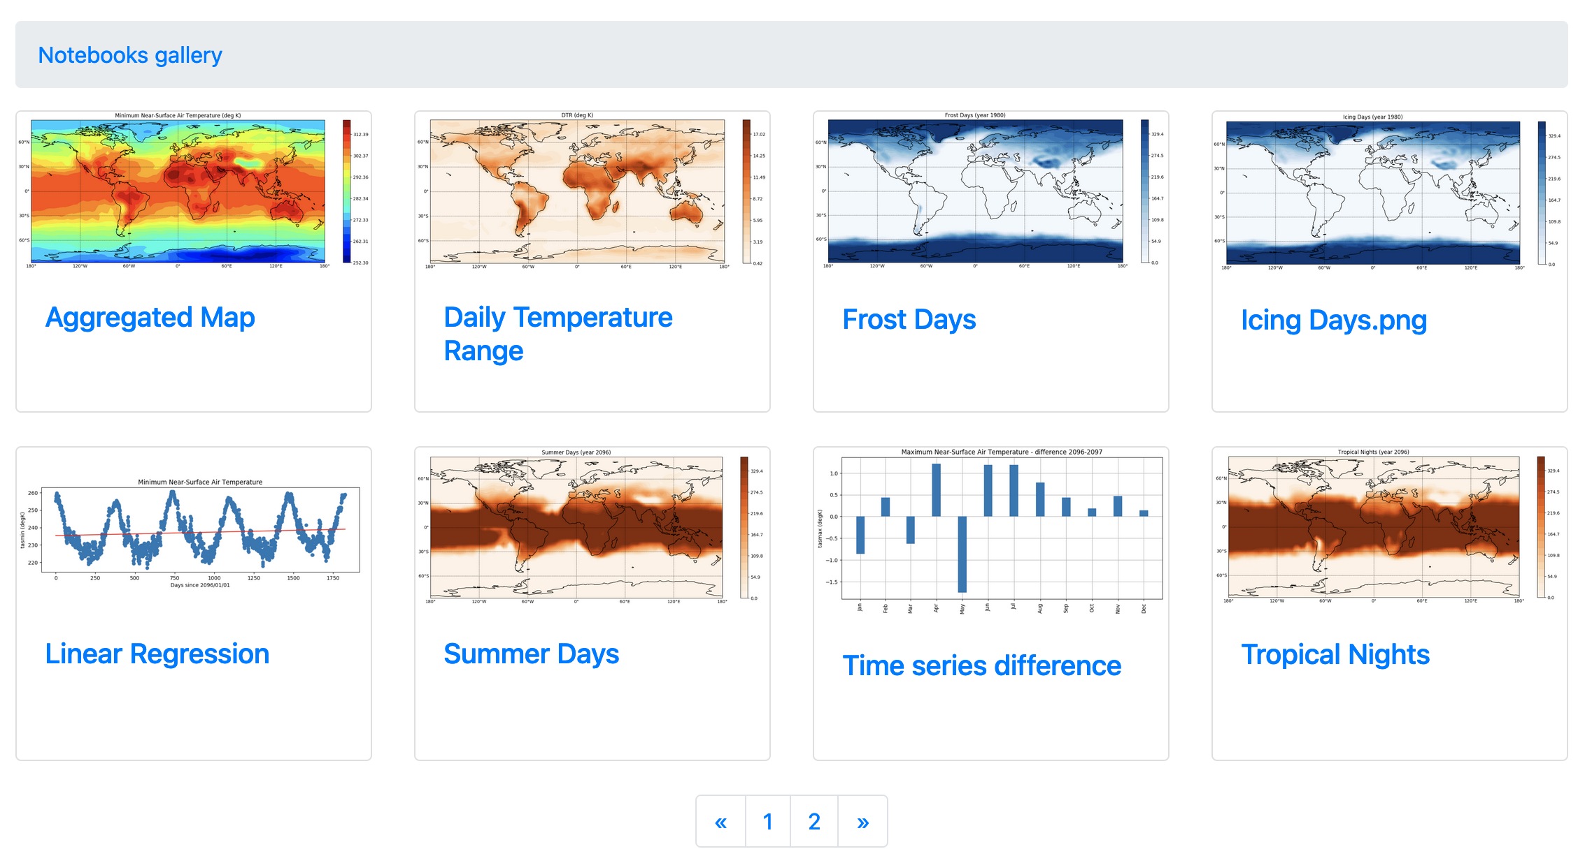
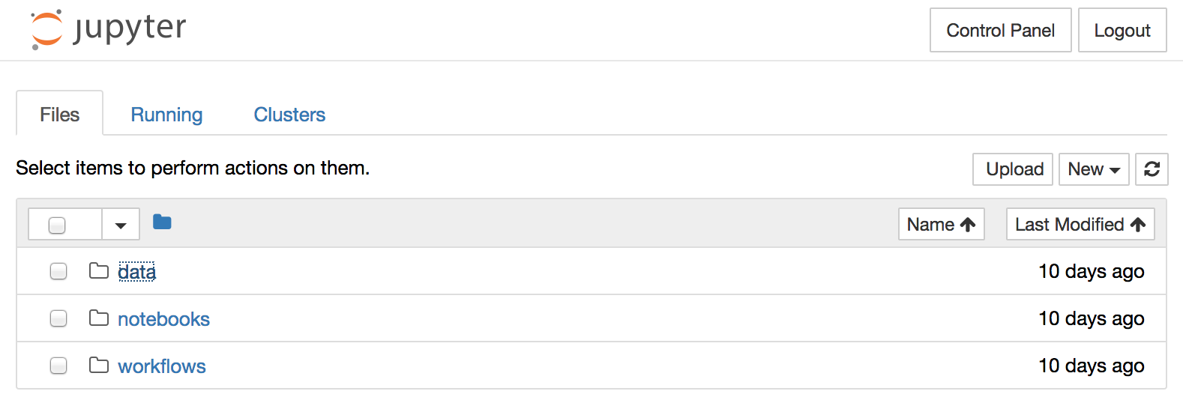
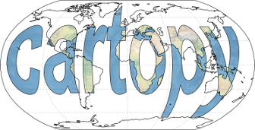
Services & Tools
System deployment, setup and monitoring
ECAS
Synda
EC3/IM
UDocker
EGI DataHub
Grafana
End-users experience and support
JupyterLab
A rich set of open source scientific Python libraries
Notebook Gallery
Data Request form

Slide 17
Andrew Lahiff, UK Atomic Energy Authority
EGI Conference 2021
Prominence Data Space

Slide 18
Prominence Data Space: Goals

Slide 19
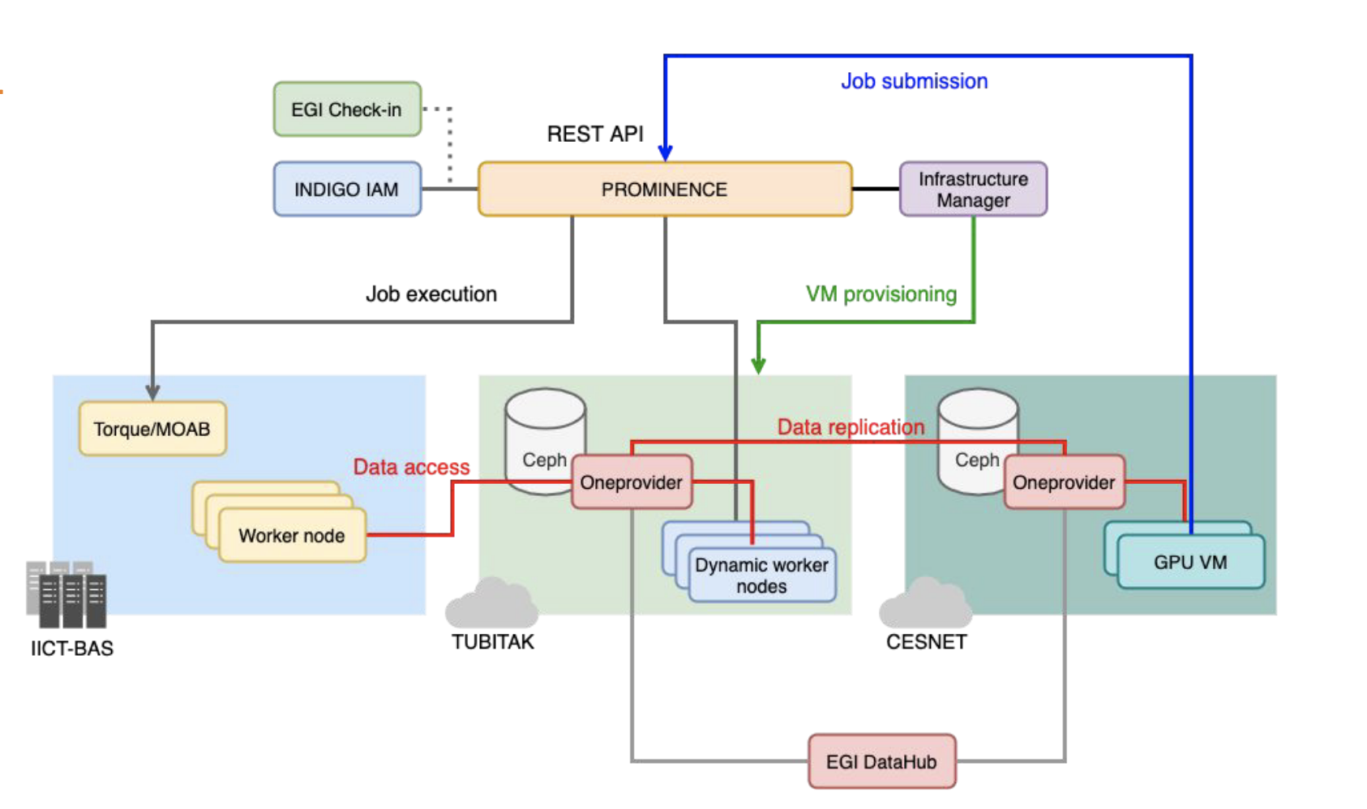
Prominence Data Space: Architecture

Slide 20
Prominence Data Space: Data Access

Slide 21
Prominence Data Space: Data distribution

Slide 22
More Links
Data Spaces
EGI conference 2021 EGI powered thematic services in EOSC session
Services
Data Management in EGI with Rucio and FTS Webinar
OpenRDM Webinar on 12th Jan 2022
EGI Conference 2021 EGI-ACE Federated Data Access service session

Slide 23
Questions?

