Slide 1
The Role of Research in Data Spaces and Data Ecosystems
Mark Dietrich, Senior Advisor
EGI Foundation
mark.dietrich@egi.eu
EGI Webinar: 24 November 2021

Slide 2
Overview
"Data ecosystem" and "Data space" being used more and more in business and by policymakers.
Relevance to the research world?
Data sharing and exchange, creating open data, are common objectives in research.
Define data ecosystems and data spaces by their key characteristics.
Explore the data exchange approaches being used in several international research communities.

Slide 3
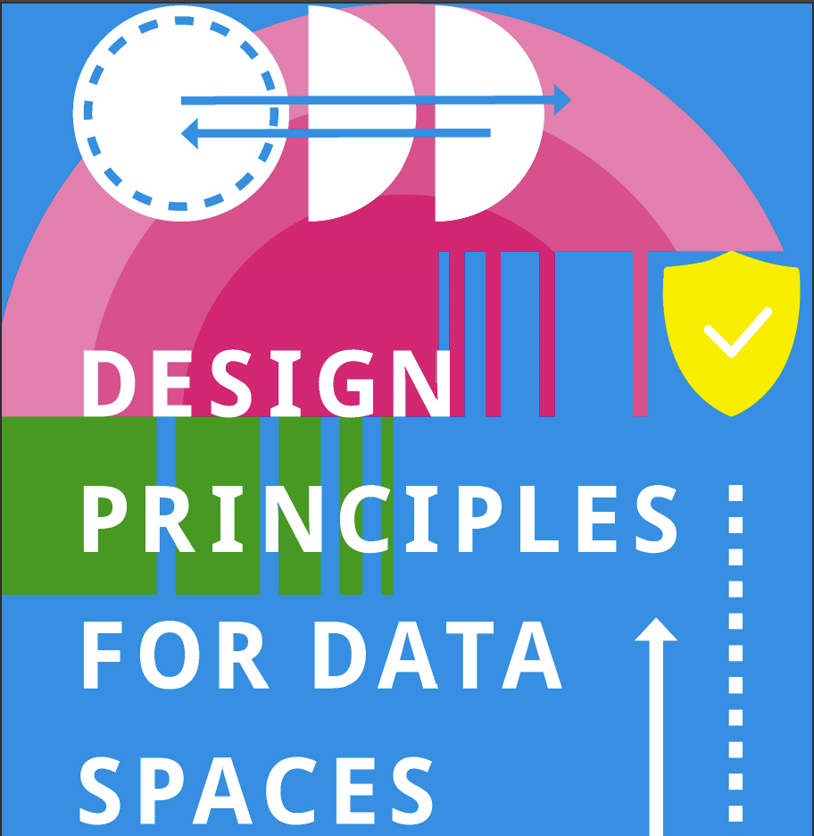
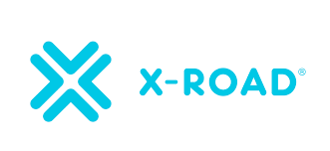
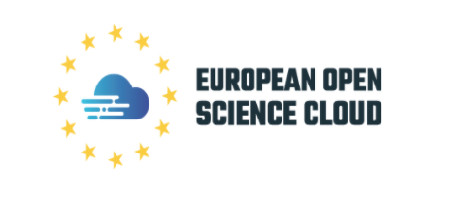
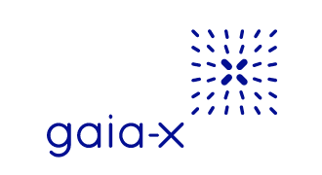
Swirling Terms and Technologies
Can we make sense of them all?
data sharing space
Data Sharing Domain
IHAN
Open Data Ecosystem

Slide 4
Defining Data Ecosystem, Data Spaces...
...and their relationship
Data Ecosystem: a purposeful collaboration or partnership consuming, producing and providing interoperable data and related resources.
Multiple data ecosystems possible -- they already exist:
E.g. in agriculture: Djust Connect, API-Agro, DKE Agrirouter, JoinData, Agrimetrics, Aladin.farm, DataConnect
These may NOT be FAIR
“Science communities” in different areas of research
These are FAIR -- or getting there!
Data Space: a collection of FAIR*, quality data and related resources consumed, produced and provided by identified participants, each respecting societal values and operating within an explicit framework of trust and governance.
EC refers to Public Data Space
Does not identify any collaborating actors or a community
Is not “purposeful”
EC aspires to a “single common European data space”
Domain Data Spaces, collecting data and data-services relevant to a domain or sector.
Data Ecosystem = Private Data Space + Community + Purpose
Notes:
* FAIR requires public metadata -- so in a Public Data Space, the metadata needs to be public. In a PRIVATE Data Space, the metadata might need to be private, so it would not be FORMALLY FAIR, but almost FAIR.

Slide 5
Data Exchange Approach (DEA)
A Unifying Concept
Data Exchange Approach: defined as
a set of (1) organizational policies and roles and
(2) technical specifications,
required to enable the trustworthy exchange of data between two parties.
Data Ecosystems and Data Spaces are types of DEA.
DEAs can flexibly describe different characteristics of exchange structures.
E.g. the visibility of data, which can be limited or controlled:
exposure to only one other party
exposure of metadata to a community, but data only upon approval
exposure of both metadata and data to a community
public exposure of both data and metadata

Slide 6
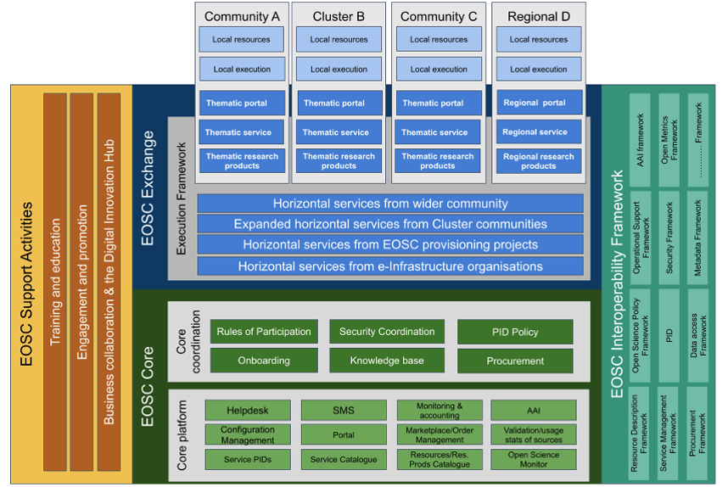
Data Exchange Approaches in EOSC
Data Exchange Approach
Data Exchange Approach
Data Exchange Approach
Data Exchange Approach
Data Exchange Approach
Data Exchange Approach
Data Exchange Approach
Data Exchange Approach
Data Exchange Approach
Data Exchange Approaches

Slide 7
Key Characteristics of a DEA
Dimensions for Comparison
Visibility and Security
Findability
Accessibility
Interoperability
Reusability
Quality and Fitness for Use
Community
Purpose
Governance

Slide 8
Spectrum of DEAs
Between Data Ecosystems
Federated Data Ecosystem
Exchange Agreement
Public Data Space
Data Ecosystem
Open Data
Increasing Data Visibility

Slide 9
With an Exchange Agreement
Data Exchange between Parties C and D
Agreement for each Exchange
C
D
Data Transfer

Slide 10
In a Data Ecosystem
Between Community Members A to F
Data Ecosystem
Agree Once to Ecosystem Policies, Rules, Specs
Metadata Catalogue
(Private)
Exchange- Specific Use Conditions
A
C
D
F
Data Transfer

Slide 11
Across 2 Different Ecosystems
Several questions must be answered
Data
Ecosystem 1
Data
Ecosystem 2
Agree Once to Ecosystem 1 Policies, Rules, Specs
Agree Once to Ecosystem 2 Policies, Rules, Specs
Harmonize 2 sets of Policies, Rules, Specs?
Metadata Catalogue 1
(Private)
Agree to expose metadata?
Metadata Catalogue 2
(Private)
Exchange- Specific Use Conditions
Align Use Conditions?
Exchange- Specific Use Conditions
A
C
D
F
Data Transfer?

Slide 12
In a Federated Data Ecosystem
Systematic Agreement to those Questions
Federated Data Ecosystem
Data
Eco-
system 1
Data
Eco-
system 2
Agree Once to Ecosystem 1 Policies, Rules, Specs
Agree Once to FDE Policies, Rules, Specs
Agree Once to Ecosystem 2 Policies, Rules, Specs
Metadata Catalogue 1
(Private)
FDE Metadata Catalogue
(Private)
Metadata Catalogue 2
(Private)
Exchange- Specific Use Conditions
Exchange- Specific Use Conditions
Exchange- Specific Use Conditions
A
C
D
F
Data Transfer

Slide 13
In a Public Data Space
Data Consumers only identified as part of exchange
Agree Once to Data Space Policies, Rules, Specs
Public Metadata Catalogue
Exchange- Specific Use Conditions
?
C
?/D
?
Data Transfer

Slide 14
By Publishing Open Data
Metadata visible to anonymous users, Data open or paid
Public Metadata Catalogue
Public Data Repository
?
C
Data Transfer
?
?
?/D

Slide 15
Important Issues
Data Sovereignty
DEAs are separate and distinct.
Data is exchanged -- not shared, except when it is published openly.
Possible role of Data Intermediaries
Bringing compute to the data → a service ≠ not data exchange.
Notes:
Data providers keep sovereignty over their data, even when provided through a Data Ecosystem.
DEAs cannot violate this principle by exposing data in ways not agreed by the provider.
DEAs are separate and distinct.
Actors can participate in, and data/services can expose their data to, different DEAs, but each DEA has its own characteristics, including governance.
Data is exchanged -- not shared, except when it is published openly.
A data provider can provide its data to a data intermediary, but the Data Intermediary takes responsibility for data sovereignty and is accountable to the provider.
Bringing compute to the data → a service ≠ not data exchange.

Slide 16
Specific DEAs along the Spectrum
Between Data Ecosystems
Federated Data Ecosystem
Exchange Agreement
Public Data Space
Data Ecosystem
Open Data
IHAN
many examples in both research and industry -- including EGI-ACE

Slide 17
Research→
Already Provides Public Data Spaces
Between Data Ecosystems
Federated Data Ecosystem
Exchange Agreement
Public Data Space
Data Ecosystem
Open Data
many examples in both research and industry
IS-ENES / ESGF
GBIF
SeaDataNet

Slide 18
Conclusions & Next Steps
Research Communities use various Data Exchange Approaches
Some will be true Public Data Spaces
Some will be Data Ecosystems accessible primarily by their communities
Each will serve distinct communities, with their own governance
Most have been built on years/decades of work to reach agreement within those communities.
Need to respect different Data Exchange Approaches
Finding commonality between DEAs will enable interoperability
We are identifying key characteristics of DEAs to aid this process
Next Steps: Expand our collaboration
Refine the framework
Start finding commonality
Contact mark.dietrich@egi.eu to learn more or participate

Slide 19
Thank You

