Slide 1
EGI-ACE Open Call no.5
Checkpoint meeting with Shepherds
IOT-SESOD
Andrea Manzi/EGI Foundation
Levente Farkas/EGI Foundation

Slide 2
Outline
Background about the use case
Capacity Requirements, Timeline and current status

Slide 3
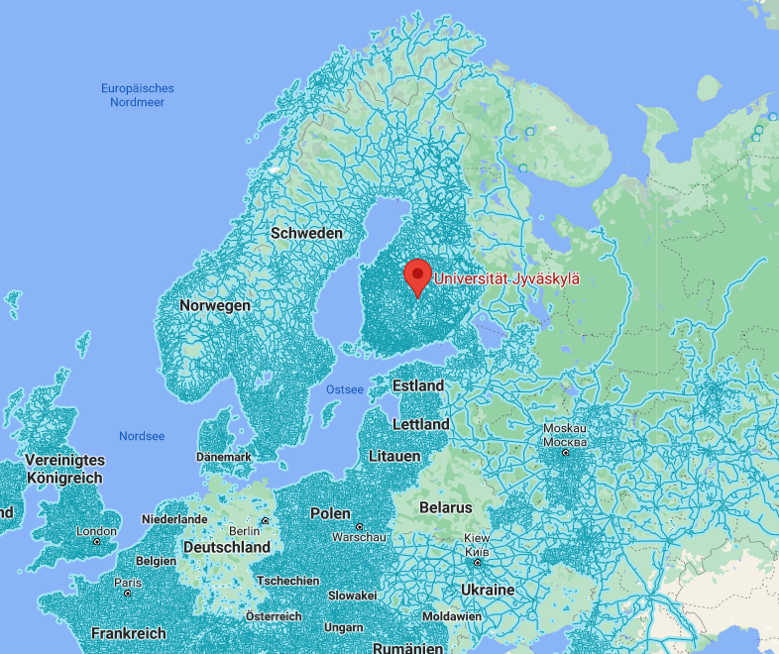
Binare is a finnish cybersecurity deep-tech spin-off from the University of Jyväskylä (JYU)
Where is Jyväskylä?

Slide 7
Capacity Requirements and timeline
Deployment of the platform already started for EUHubs4data project in May 2021
vo.binare-oy.eu VO available in Comanage
OLA in place with INFN-CLOUD-BARI till the end of February which will contine to support the project in EGI-ACE till the end of 2022
Current capacity allocated:
320 vCPU cores, 640 GB RAM, 5.5 TB storage and 10 public IPs
New requirements
640 vCPU cores, 1.2TB RAM, 10 TB storage
Meeting tomorrow to discuss the new requirements
TBD : possibility to share the datasets generated via EGI DataHub

