Slide 1
Overview of the EOSC Compute Platform
Gergely Sipos
EGI Foundation
EGI-ACE Technical Coordinator
EGI Advanced Computing for EOSC
EOSC Compute Platform User Support Workshop
5/Apr//2022

Slide 2
EGI-ACE mission
Implement the Compute Platform of the European Open Science Cloud and contribute to the EOSC Data Commons by delivering integrated computing, platforms, data spaces and tools as an integrated solution that is aligned with major European cloud federation projects and HPC initiatives.
Start: January 2021
Duration: 30 months
Consortium: 33 participating partners, 23 third-parties
Budget: 12 Million EUR (8 Million EC)

Slide 3
Objectives for EOSC Exchange capacity/capability building
Objective 1: Deliver the European Open Science Cloud Compute Platform and expand the supply-side
EOSC-Exchange
Objective 2: Contribute to the implementation of the EU Data Strategy and the EOSC Data Commons to support the Green Deal, Health and Fundamental Research
O4
O1
Federated Data
O5
O2
EGI-ACE
Objective 3: Integrate the EOSC Compute Platform with the EOSC Portal and the EOSC Core
O3
EOSC Core
Objective 4: Contribute to the realization of a global Open Science Cloud
EOSC Architecture: Solutions for a sustainable EOSC (report from the EOSC Sustainability WG)
Objective 5: Expand the demand-side of EOSC across sectors and disciplines

Slide 4
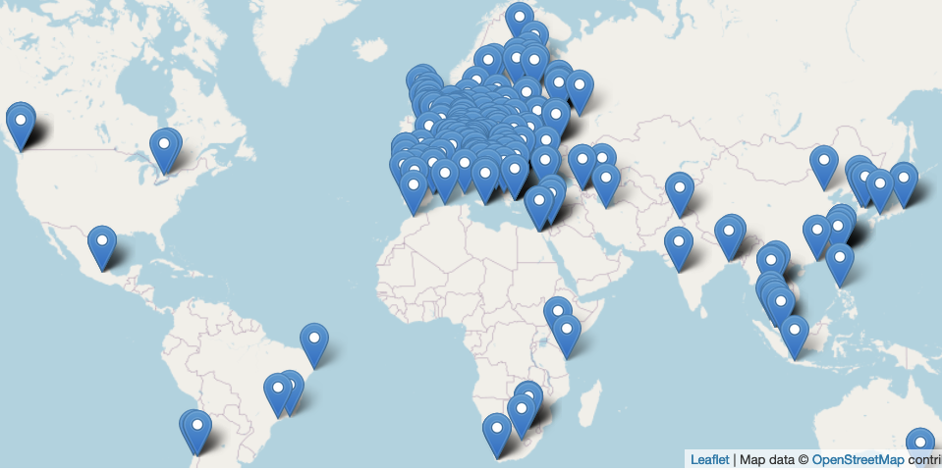
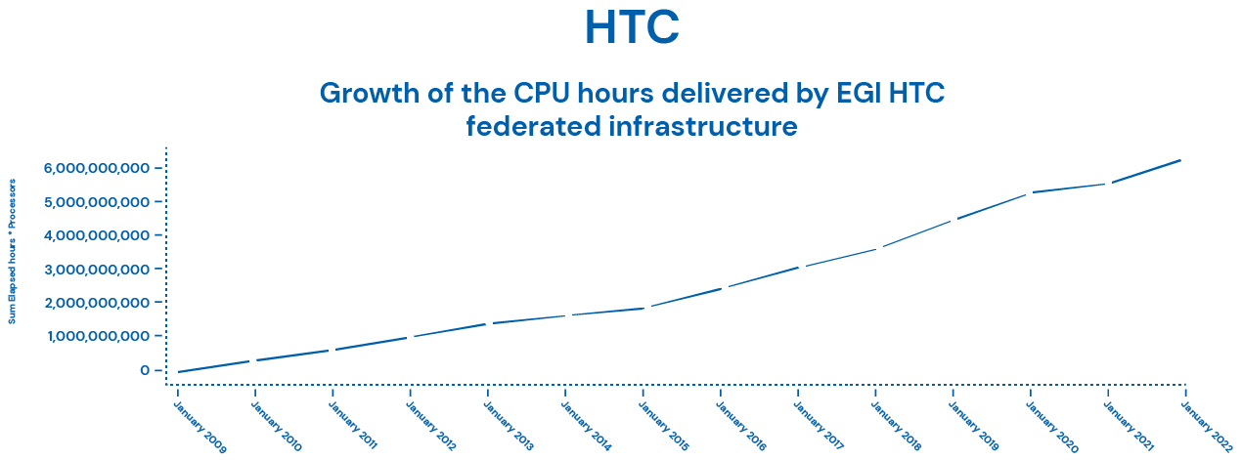
(Main) Technical Enablers of the EGI Federation
HTC, HPC and Cloud Compute facilities
Broadband network connectivity
Common Trust and Identity model and policies
Middleware
Data and scientific computing applications

Slide 5
Integrated tiered service architecture
Data Spaces
and Analytics
Data and thematic data analytics and processing tools
EOSC portal
Thematic services & applications
Green Deal Data Space
Health Data Space
Fundamental Science Data Space
Humanities Data Space
Platforms
generic added-value platform level services
Interactive Computing
Automated Cluster deployment
Distributed AI training
Workload Management
EOSC
users
Service Management, Tools, Processes, Policies
Federated
Access
Federation-wide management of data and computing
Federated Compute
Federated Identity
Federated Data
Federated
Resources
Compute and storage facilities
Research Clouds
Public Clouds
HTC
HPC
Federated resource brokering and allocation
Usage accounting across sites and communities
Service availability/reliability monitoring
User/admin response mgm via Helpdesk
Continuous improvement (feedback from users and sites)

Slide 6
EOSC Compute Platform delivery channels
International projects
Multi-national communities
RIs
Single users, small groups (Long tail)
Experimental users
EOSC USERS
Business-to-User
Business-to-Business
EOSC Portal
EGI-ACE Open Call
Ready-to-use resources/services
Self-service configuration
Short term engagement
High capacity demand
Custom configurations
Long term engagement
https://marketplace.eosc-portal.eu/
https://www.egi.eu/projects/egi-ace/call-for-use-cases
Continuously open, Cut-off dates every 2 months
Serving with the use of...
EC funds (VA, projects)
Local funds (institutional/national investments)
80million CPUh
250,000 GPUh
20 PB storage

Slide 7
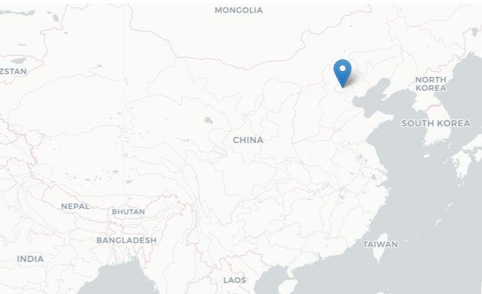
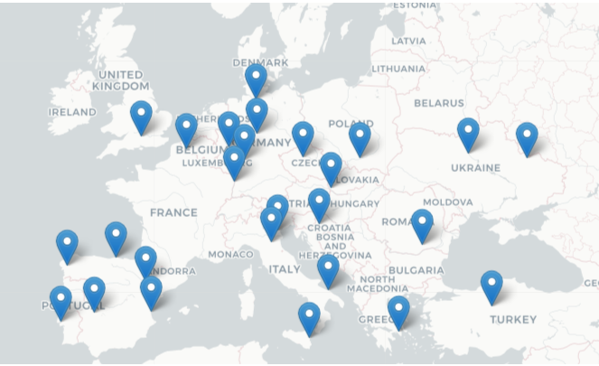
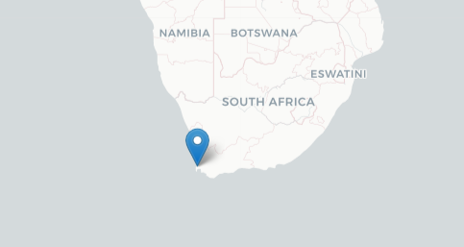
Towards a Global Open Science Cloud
New in 2021:
27 cloud providers
New in 2022

Slide 8
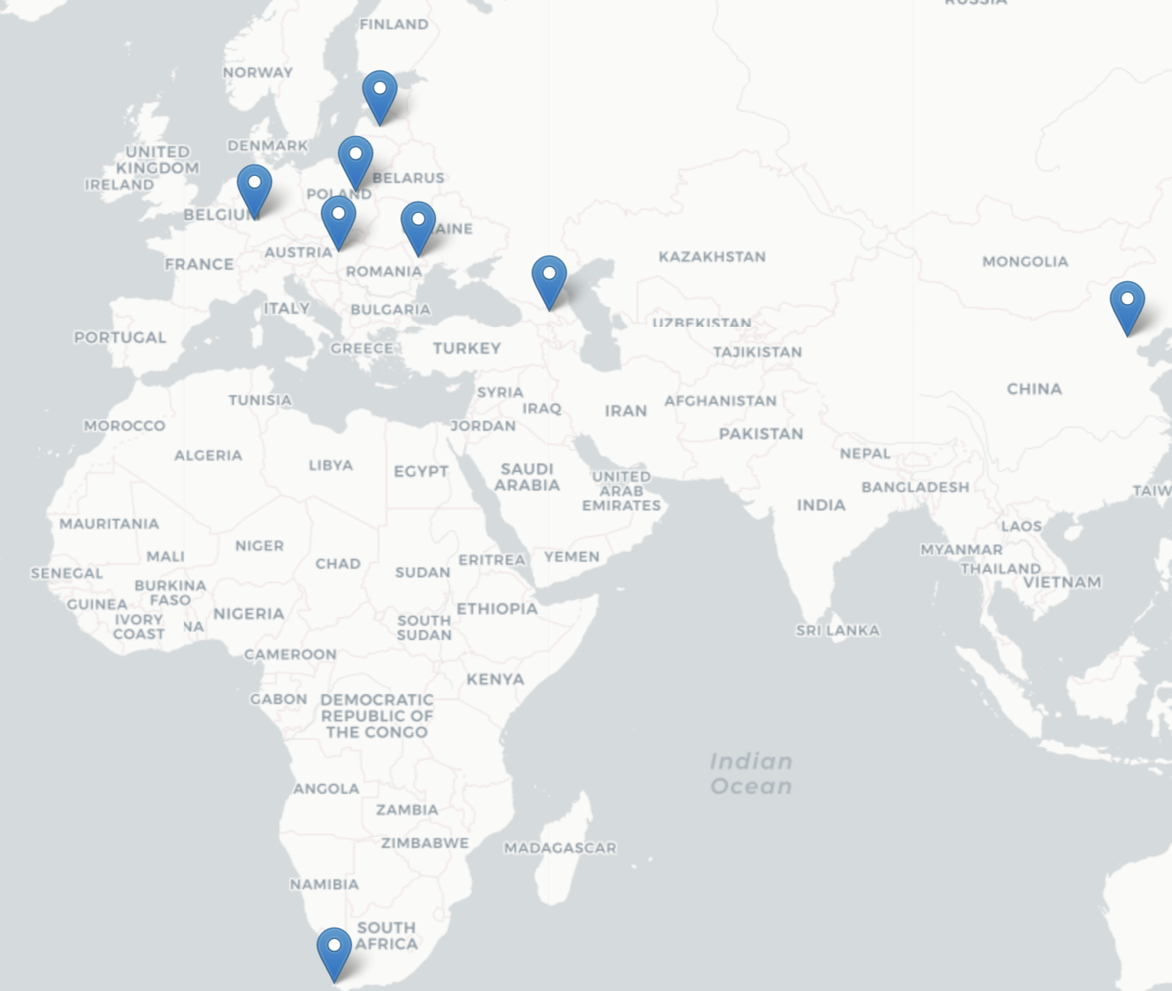
Cloud integration programme cont.
Check-in – single sign on across services and providers
DataHub – replication of scientific data to national clouds
AppDB – distribution of applications & services to national clouds
Notes:
The EGI-ACE cloud integration programme establish partnership with cloud providers to connect their clouds to 3 central services:
Check-in so national users can reuse identities across EOSC
DataHub so national clouds can pull/push scientific datasets between EOSC and their cloud
AppDB so national clouds can pull/push scientific applications and services in the form of Virtual Machines between EOSC and their cloud
Besides the technical integration the clouds also share practices of user support, resource allocation, user feedback and communication/dissemination.
The national clouds of Hungary (ELKH), Georgia (GRENA), South Africa (IDIA), China (CSTC), as well as commercial clouds from T-Systems (Open Telecom Cloud) and CloudFerro are in the programme from the start.
By reaching the 2nd phase of ELKH cloud, and then connecting the ELKH cloud to these 3 central EGI-ACE services, the users of the ELKH cloud will be ‘EOSC ready’, will benefit from the datasets and applications that are made available in EOSC for EGI-ACE.

Slide 9
Cut off every 2 months, next: 15/April/2022

Slide 10
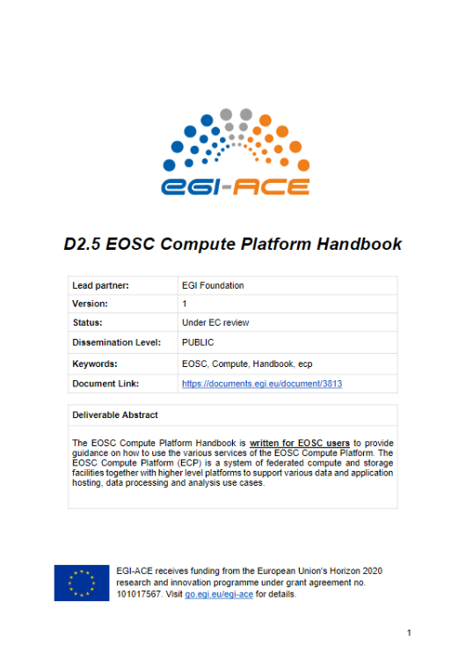
Save the date! EGI Conference: 20-22 September, Prague
Thank you!
EGI-ACE D2.5 EOSC Compute Platform Handbook
https://zenodo.org/record/6396444#.YkvqAihBxD8

