Slide 1
Working with Compute
EOSC Compute Platform User Support Workshop
Enol Fernández, EGI Foundation with the input from WP3/WP4/WP6 partners
Public
EGI Foundation
Project Consortium

Slide 2
Integrated tiered service architecture
Data Spaces
and Analytics
Data and thematic data analytics and processing tools
EOSC portal
Thematic services
Green Deal Data Space
Health Data Space
Fundamental Science Data Space
Humanities Data Space
Platforms
generic added-value platform level services
Interactive Computing
Automated Cluster deployment
Distributed AI training
Workload Management
EOSC
users
Service Management, Tools, Processes, Policies
Federated
Access
Federation-wide management of data and computing
Federated Compute
Federated Identity
Federated Data
Federated
Resources
Compute and storage facilities
Research Clouds
Public Clouds
HTC
HPC

Slide 3
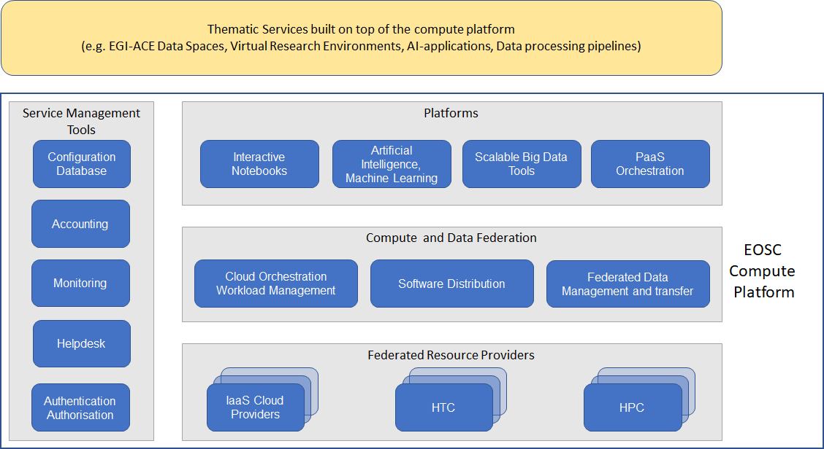
EOSC Compute Platform Working with Compute

Slide 4
EGI Compute Services
Service | Description | Use Case
Cloud Compute | Provides access to VM-based computing with associated storage. It delivers a customisable platform where users have complete control over the software and the supporting compute capacity. | The flexibility of the computing platform enables a variety of workloads: user gateways or portals, interactive computing platforms and almost any kind of data- and/or compute-intensive workloads.
Container Compute | Supports the execution of container applications on top of Cloud Compute. | It provides deployment of Kubernetes, a widely used container orchestrator, that allows users to run and manage container-based applications.
High Throughput Compute | Provides access to large, shared Grid Computing systems for running computational jobs at scale. | Analysis of large datasets in an “embarrassingly parallel” fashion, i.e. by splitting the data into small pieces, and executing thousands, or even more independent computing tasks simultaneously, each processing one piece of data.
High Performance Compute (Coming!) | Supports highly optimized applications that need massively parallel computing with low latency and high bandwidth interconnection network. | Complex computational problems using tightly coupled parallel processing: simulations, analysis of large datasets or AI/ML workloads. Typically these applications rely on MPI for supporting interprocess communication.

Slide 5
EGI Cloud Compute
Distributed Infrastructure as a Service (IaaS) powered by the EGI Federated Cloud infrastructure
Allows international collaborations to perform distributed data analysis with VM-based workloads
Features:
Execution of VMs on a distributed infrastructure
Federated identity
Common VM image catalogue
GUI and CLI/API based access
Support for IaaS orchestration
Central accounting and monitoring

Slide 6
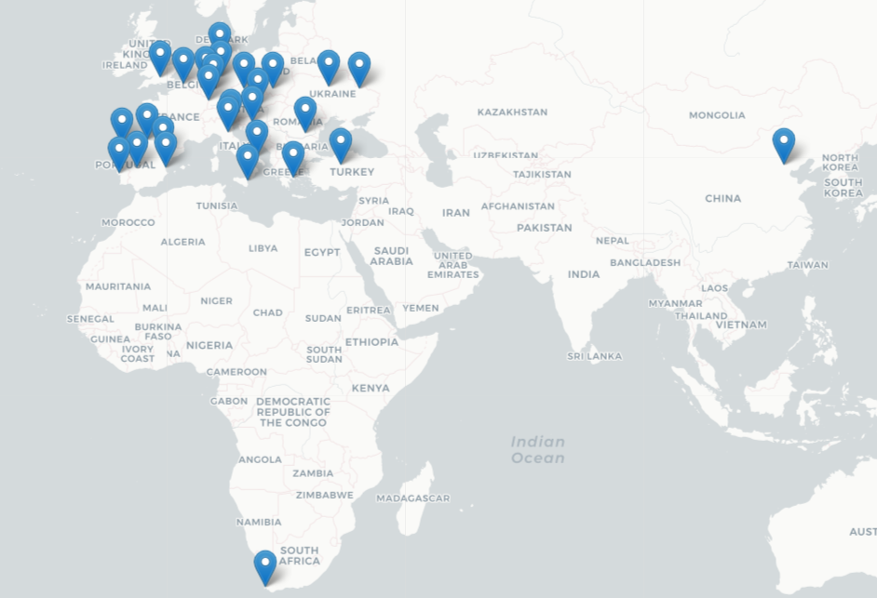
EGI Federated Cloud infrastructure
27 providers in Europe + China and South Africa
EGI-ACE is further expanding in new countries (5+ providers expected in 2022)

Slide 7
Infrastructure as a Service
IaaS gives you API-based deployment of virtual machines (VMs) on-demand:
control the hardware (CPU, memory, disk) and software (OS & any other software stacks) configuration
without managing physical servers
VM
instance
VM image
instantiate
context
Block storage

Slide 8
What can you run here?
You are the owner of the VM – you can run anything you can install ☺
You need to keep things secure
Resources are reserved as long as VM is started, try to remove unused resources as soon as possible
Use tools to help you there
Infrastructure as Code (IaC)
Orchestrators with automatic scaling
Restrict network access as much as possible – use security groups, only allocate public IPs as needed

Slide 9
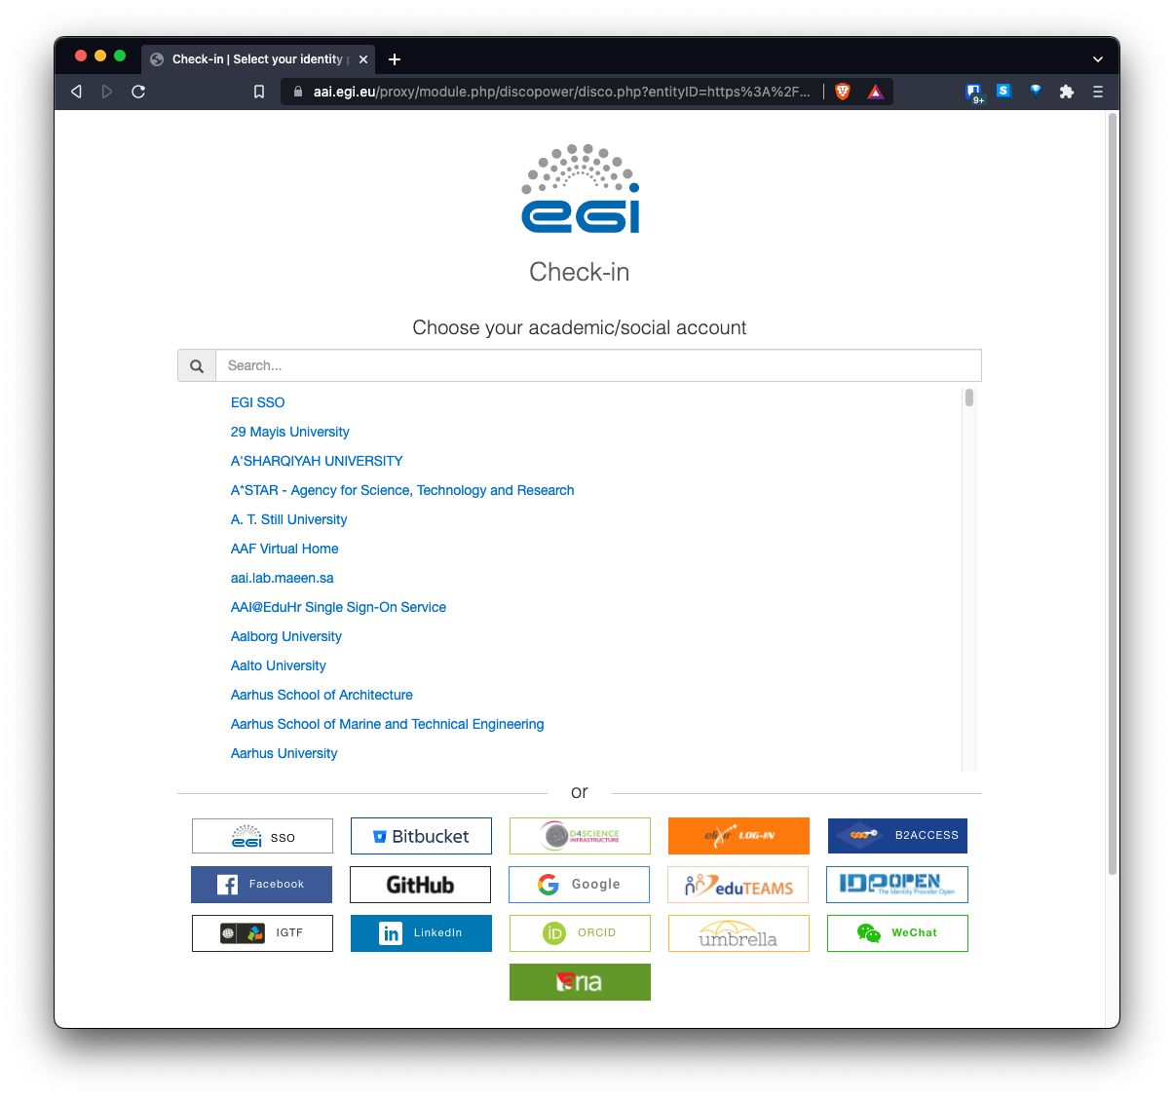
Authentication and Authorisation
Check-in: log in with your institutional account
Federated identity
Log in with eduGAIN, social media and other institutional or community-managed identity providers
Harmonised authorisation information
VO-based authorization, join a VO to get access to the providers supporting it
Industry Standard OpenID Connect technology
Allowing web and non-web access to services

Slide 10
Creating your own images
Why?
Custom OS
Complex / time consuming installation of applications – need quick start up of VMs
Reduce number of moving parts of your software stack
How?
Start from scratch: create a VM, install OS, install software, then export this image
Start from existing VM: spawn VM, reconfigure, install software then snapshot it
Learn more: https://docs.egi.eu/users/compute/cloud-compute/images/

Slide 11
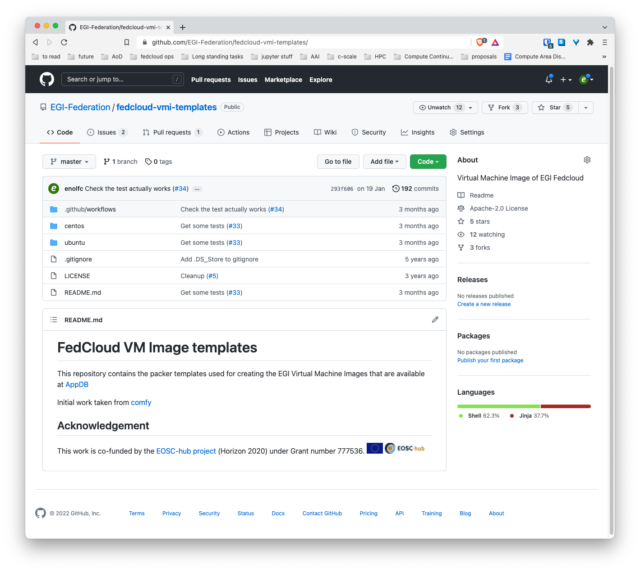
EGI Images
Set of basic OS images prepared to work with all providers
Updated regularly, at least every 6 months or earlier if security vulnerabilities are found
Automatic build with packer + ansible
https://github.com/EGI-Federation/fedcloud-vmi-templates/

Slide 12
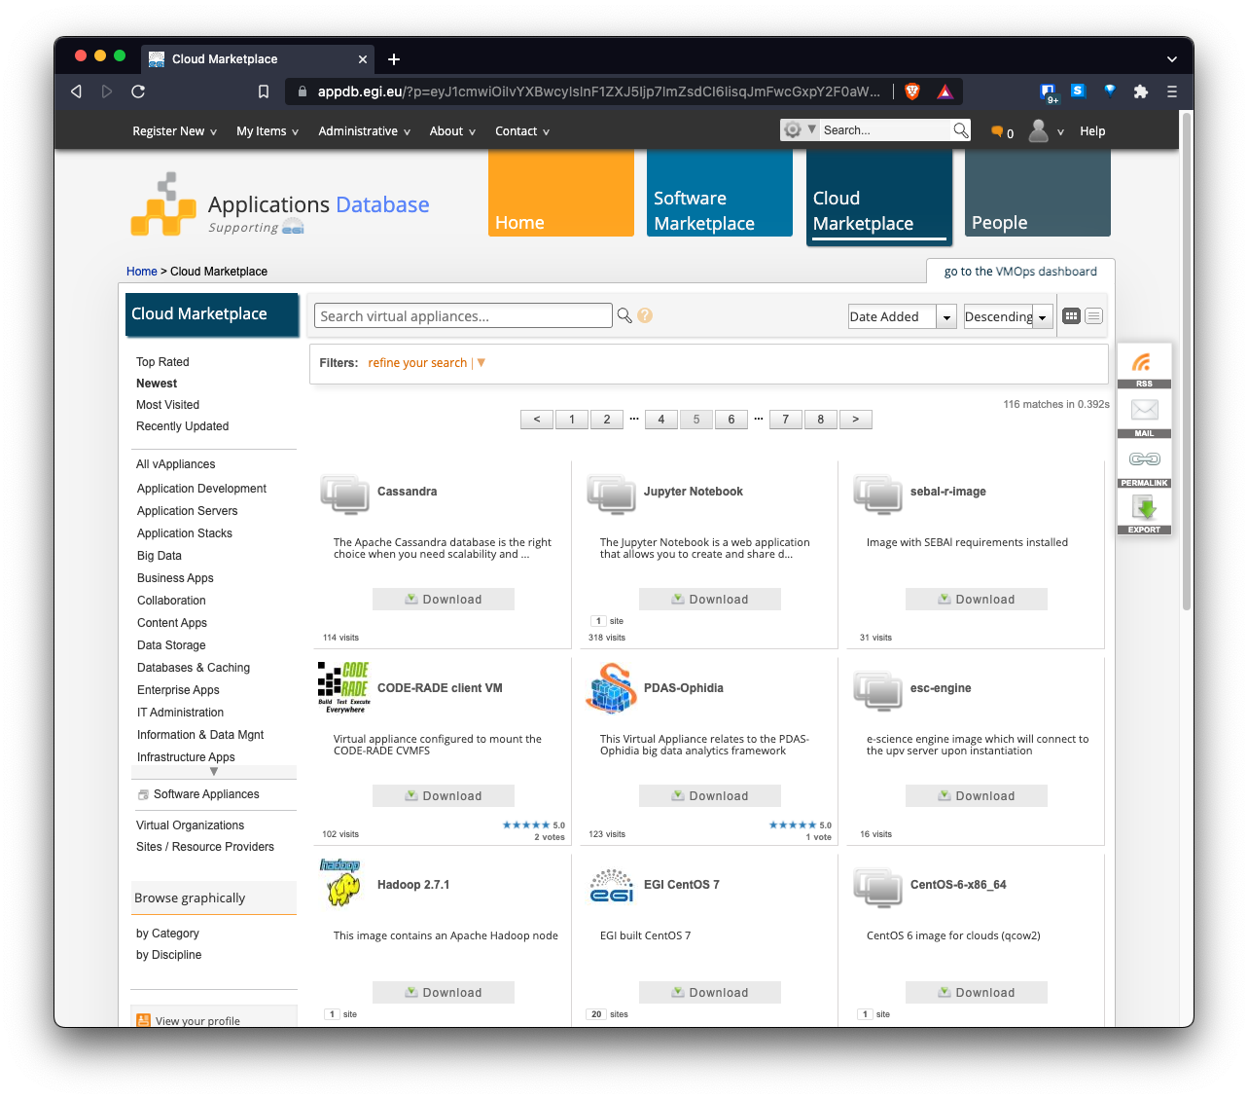
AppDB
Common registry for Virtual Appliances (VA)
VM image + metadata
Available for running at the EGI providers or on any hypervisor
Community-level management of VAs
Get the needed software on all providers automatically
Control what can be executed

Slide 13
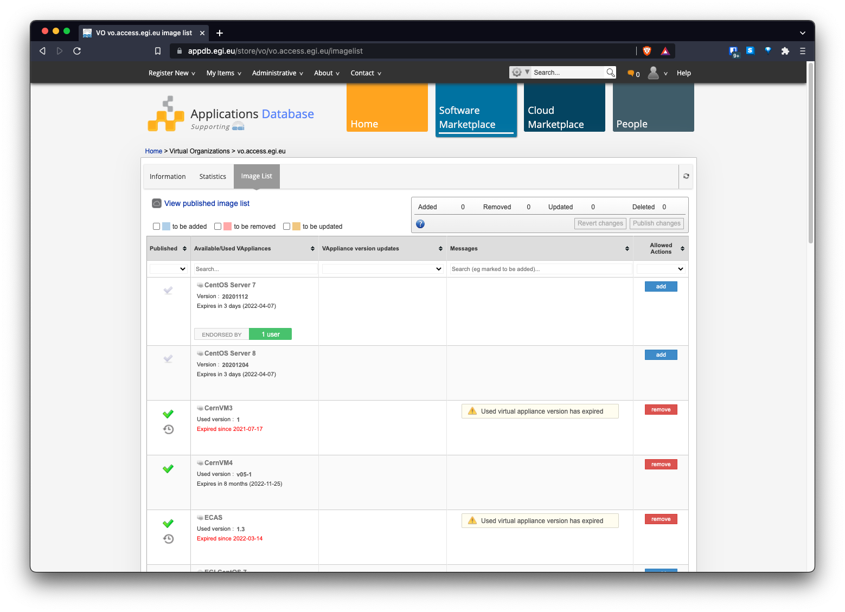
AppDB Community images

Slide 14
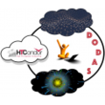
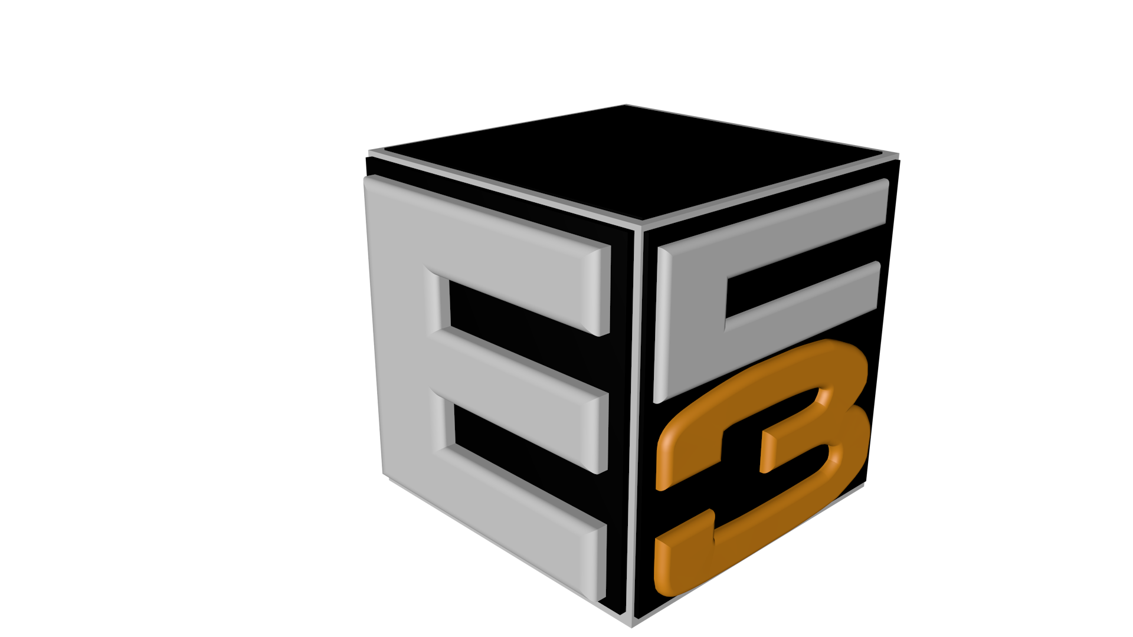
Acces layers
GUI Access
GUI Users
Federated
Access
Direct API
Access
Developers/
Advanced users

Slide 15
fedcloudclient
fedcloudclient is a simple but powerful client tool for working with OpenStack sites
in EGI Cloud infrastructure:
Simple: setup in one minute, no privileges required, intuitive syntax
Powerful: can work with all sites, all VOs, customisable, extensible, advanced Options
Federated: considers EGI Cloud infrastructure as a whole, sites and VOs are just parameters of the client
Learn more: https://indico.egi.eu/event/5694/

Slide 16
fedcloudclient

Slide 17
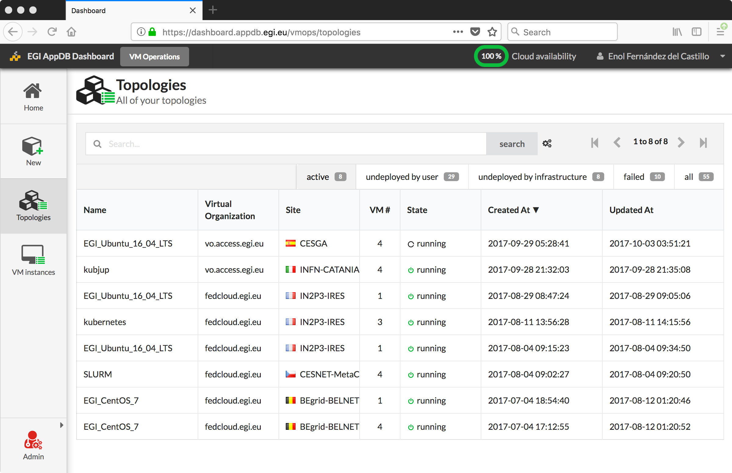
AppDB VMOps
Dashboard for the federation
A common GUI for all federated cloud providers:
Easy to use wizard to create VM topologies at any provider with associated storage and contextualisation
Integrated with the AppDB Information System: images, sites, VOs, A/R…

Slide 18
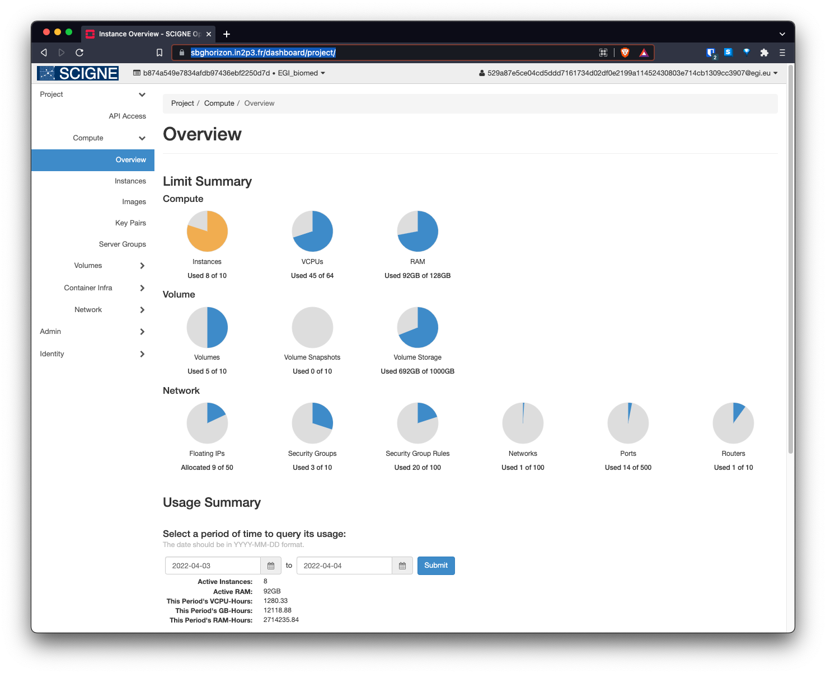
OpenStack Horizon Dashboard
Login to the OpenStack dashboard with your EGI Check-in credentials
All the OpenStack features available
Registered dashboards easily reachable from https://dashboard.cloud.egi.eu/

Slide 19
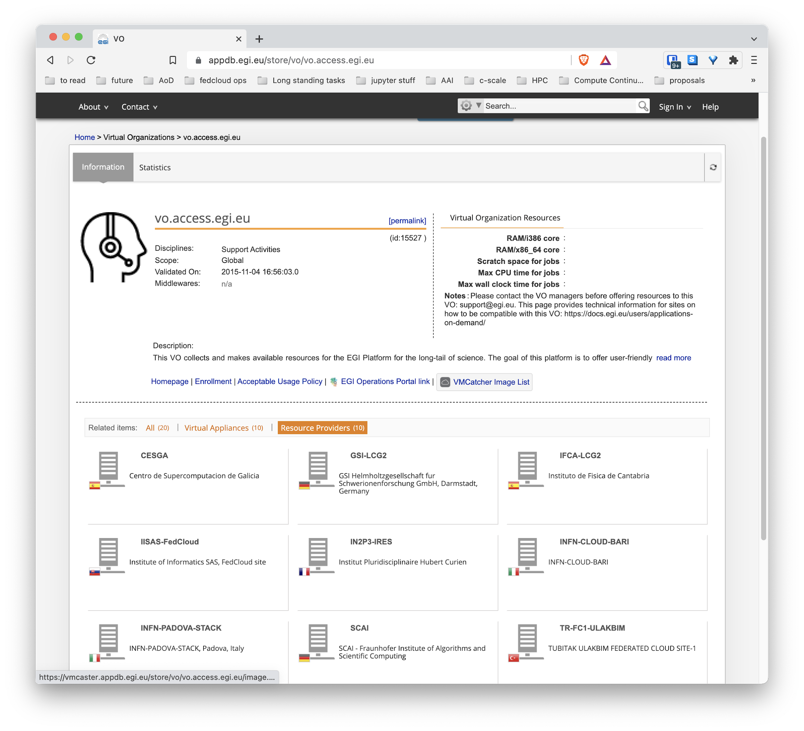
Information discovery
All providers periodically report the images, VM flavors, available resources for the VOs supported
Centrally gathered by AppDB and made available via API and the AppDB web interface

Slide 20
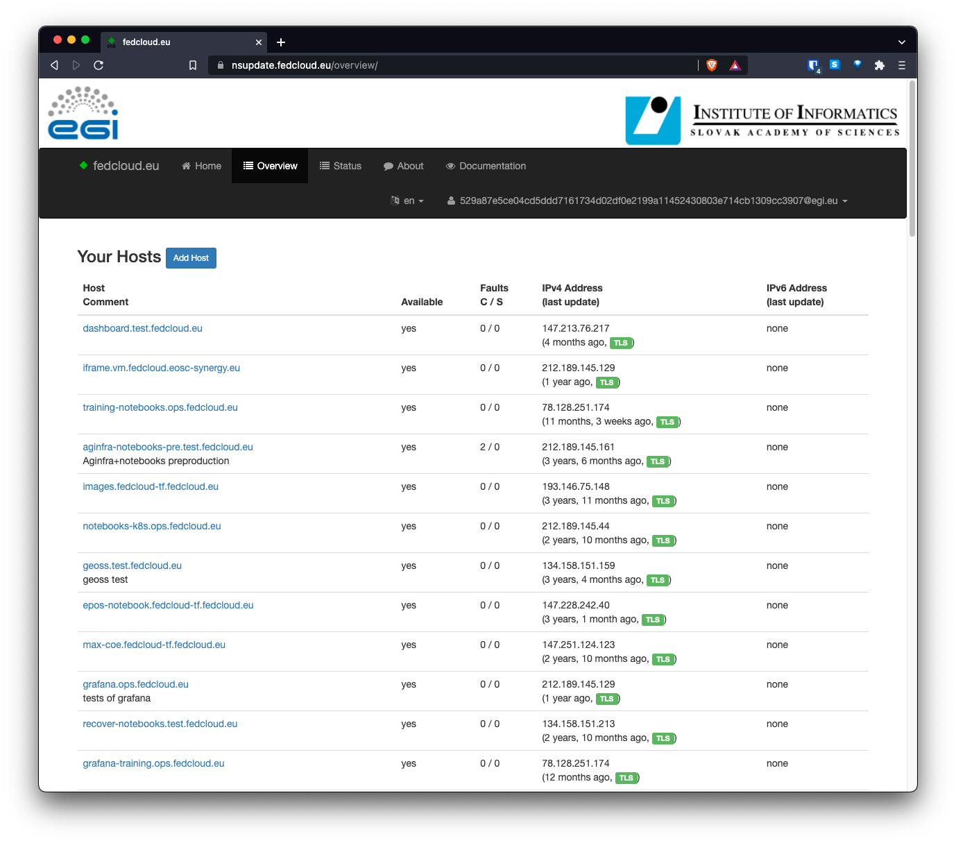
Dynamic DNS
Provides federation-wide Dynamic DNS support for VMs in EGI Cloud
Register meaningful and memorable DNS host names in given domains (e.g. fedcloud.eu) and assign to public IPs of their VMs
Avoid using IPs (subject to change) for hosting services
Facilitates moving VMs between sites
Allows requesting certificates
Learn more: https://indico.egi.eu/event/5559/

Slide 21
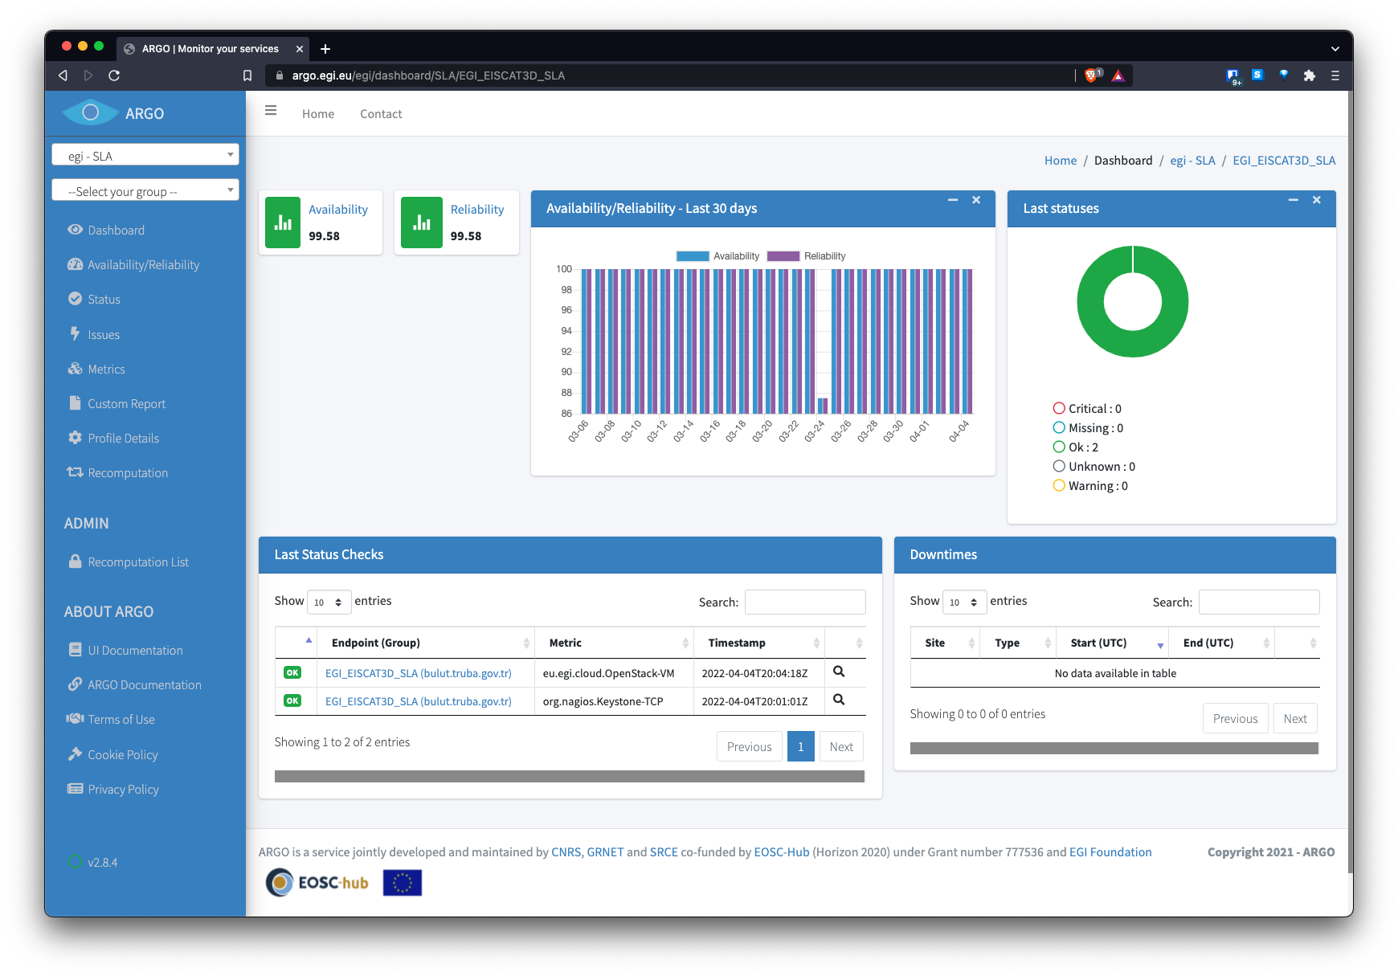
Monitoring: are providers running?
ARGO checks all providers with basic functionality probes
SLA groups available for easy check of your providers

Slide 22
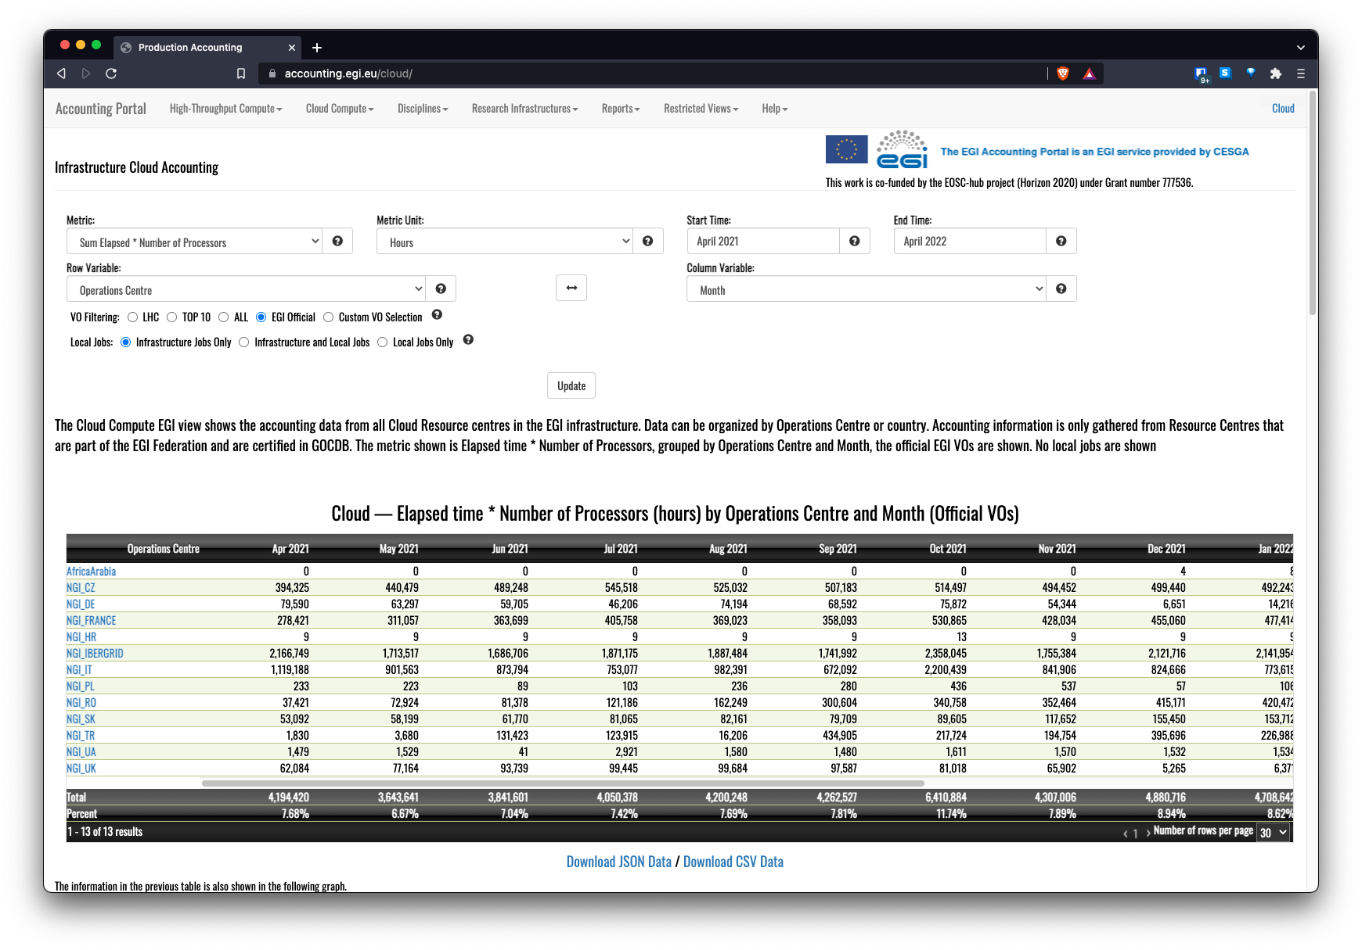
Accounting
Understand the usage of resources
Collects, aggregates and displays usage information across the federation
Standard based (OGF) usage record generated from the IaaS system
Accounting portal for visualization of metrics
https://accounting.egi.eu/

Slide 23
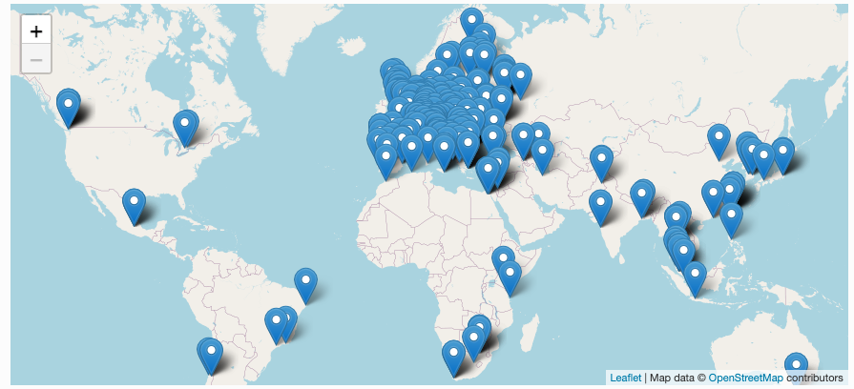
High Throughput Compute
The EGI High-Throughput compute (HTC) provides users with the capability to access large amounts of computing resources, and to submit hundreds or thousands of computational tasks.
EGI HTC is powered by a large distributed infrastructure (200+ providers) capable of running jobs at scale:
Unprivileged (no servers) and time limited (no long running services)
Capable of delivering large amounts of processing capacity over long periods of time.

Slide 24
Accessing HTC
Workload
Manager
(DIRAC)
Computing
Element
Local Scheduler
Local Scheduler
Worker Nodes
Worker Nodes
Notes:
User communities build either on top of orchestration tools that allow to deal with multiple providers in a homogeneous way or directly interact with the native APIs of the provides. Both cases they can use single sign-on thanks to Check-in.
A common GUI provided by AppDB VMOps brings a user-friendly dashboard to manage the resources at the distributed providers
The EGI federation services are integrated with the providers using their native APIs to deliver the extra features of EGI Cloud mentioned in previous slide
GUI access:
AppDB VMOps https://dashboard.appdb.egi.eu/vmops
API/CLI access:
Discovery: AppDB IS API (REST and GraphQL) https://wiki.egi.eu/wiki/Federated_Cloud_Discovery#AppDB
IaaS Federated Access Tools: https://wiki.egi.eu/wiki/Federated_Cloud_IaaS_Orchestration
Direct IaaS access, several APIs depending on the provider: https://wiki.egi.eu/wiki/Federated_Cloud_APIs_and_SDKs

Slide 25
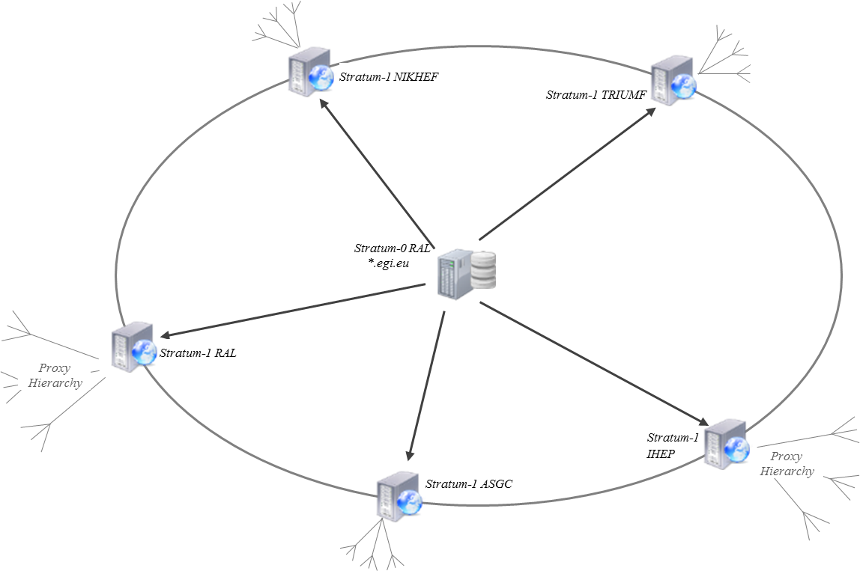
CVMFS: Software distribution at scale
https://docs.egi.eu/users/compute/content-distribution/
CernVM-File System (CVMFS) provides a POSIX read-only file system in user space
Scalable software distribution, recently extended to handle container images
Caching at providers for fast access to frequently used software
Mostly used in HTC, but useful also for IaaS
VO-scoped repositories centrally managed

Slide 26
Workload Manager
The Workload Manager helps users to exploit distributed resources in a transparent way.
Based on DIRAC, a framework shared by multiple experiments, both inside HEP, astronomy, and life sciences
Optimises workload placement
Support for massive workload and data operations
Aggregates multiple types of resources, e.g. Cloud / HTC providers, user community resources
User-friendly GUI, CLI and API access for advanced usage
Jupyter notebooks (prototype)
Services customizable for the needs of particular communities

Slide 27
Containers in EGI infrastructure
Containers in EGI
VM-based
HTC-based
Complex applications
EGI Docker image
Your own image
Singularity/
Apptainer
udocker
Kubernetes with EC3
Your own Kubernetes
Managed Kubernetes

Slide 28
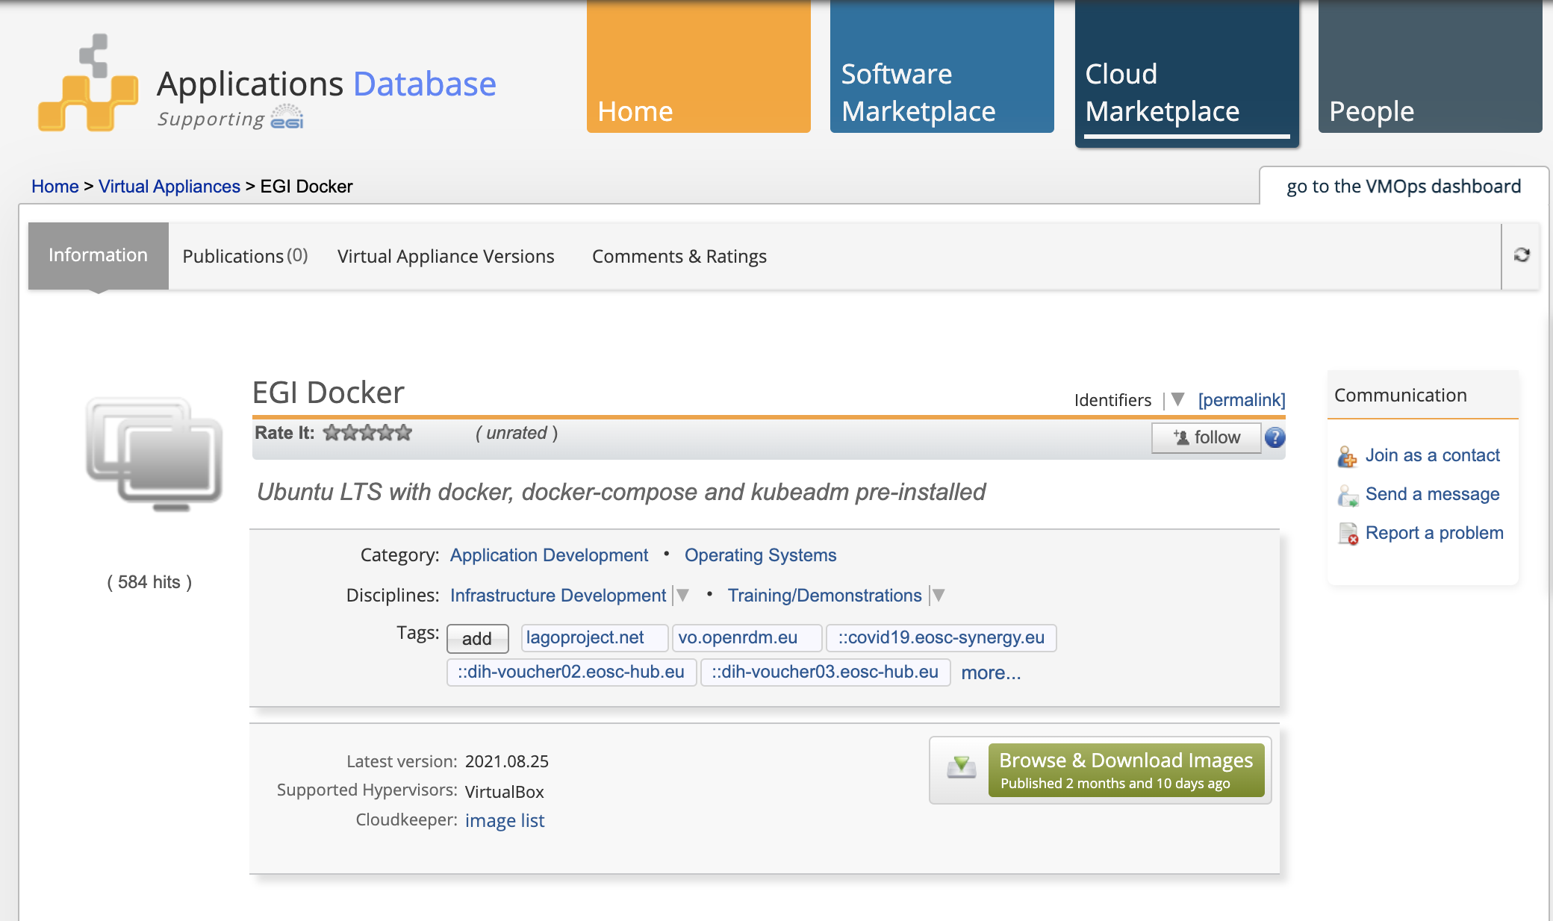
IaaS / EGI docker VM image
Just use EGI Cloud Compute to spin up a VM to install and run containers there
Your choice of OS
Your choice of container engine/runtime
Your choice of VM size
EGI docker image, ready to use ubuntu-based with Docker, docker-compose & kubeadm installed

Slide 29
But I don’t want to manage a VM!
EGI HTC/Workload Manager allows users to submit jobs without caring about the underlying infrastructure
No need to become an administrator of a VM
BUT
Docker (requires root!) won’t be allowed 🡪 Need HTC oriented container engine
Not meant to run services and limited lifetime/resources

Slide 30
Cloud Container Compute
Deployment of Kubernetes @ EGI providers
Cloud Container Compute gives you the ability to deploy and scale Docker containers on-demand using Kubernetes technology.
Relies on a EC3 (Elastic Cloud Computing Cluster) to automate the process of deploying k8s in any of the EGI Cloud Providers
GUI/CLI access
Fully integrated with Check-in (EGI’s AAI Service)
Discovery of Cloud providers features
Builds on ansible and kubeadm

Slide 31
Introducing HPC in EGI
Integration of HPC providers focusing on:
Federated access with Check-in (already achieved)
Portable code execution with containers (already achieved)
Data transfers between HPC-HTC-Cloud (in progress)
Presence in EOSC Portal (in progress)
Operational integration: accounting (already achieved) and monitoring (in progress)
Final integration manual to be available in June ‘22.
4 scientific pilots: HEP (WLCG), Fusion, ELI-NP (Lasers), Climate Change (ENES)
4 EGI and EuroCC partners as HPC Providers: IICT-BAS (BG), INCD (PT), TUBITAK (TR), CESGA (ES)

Slide 32
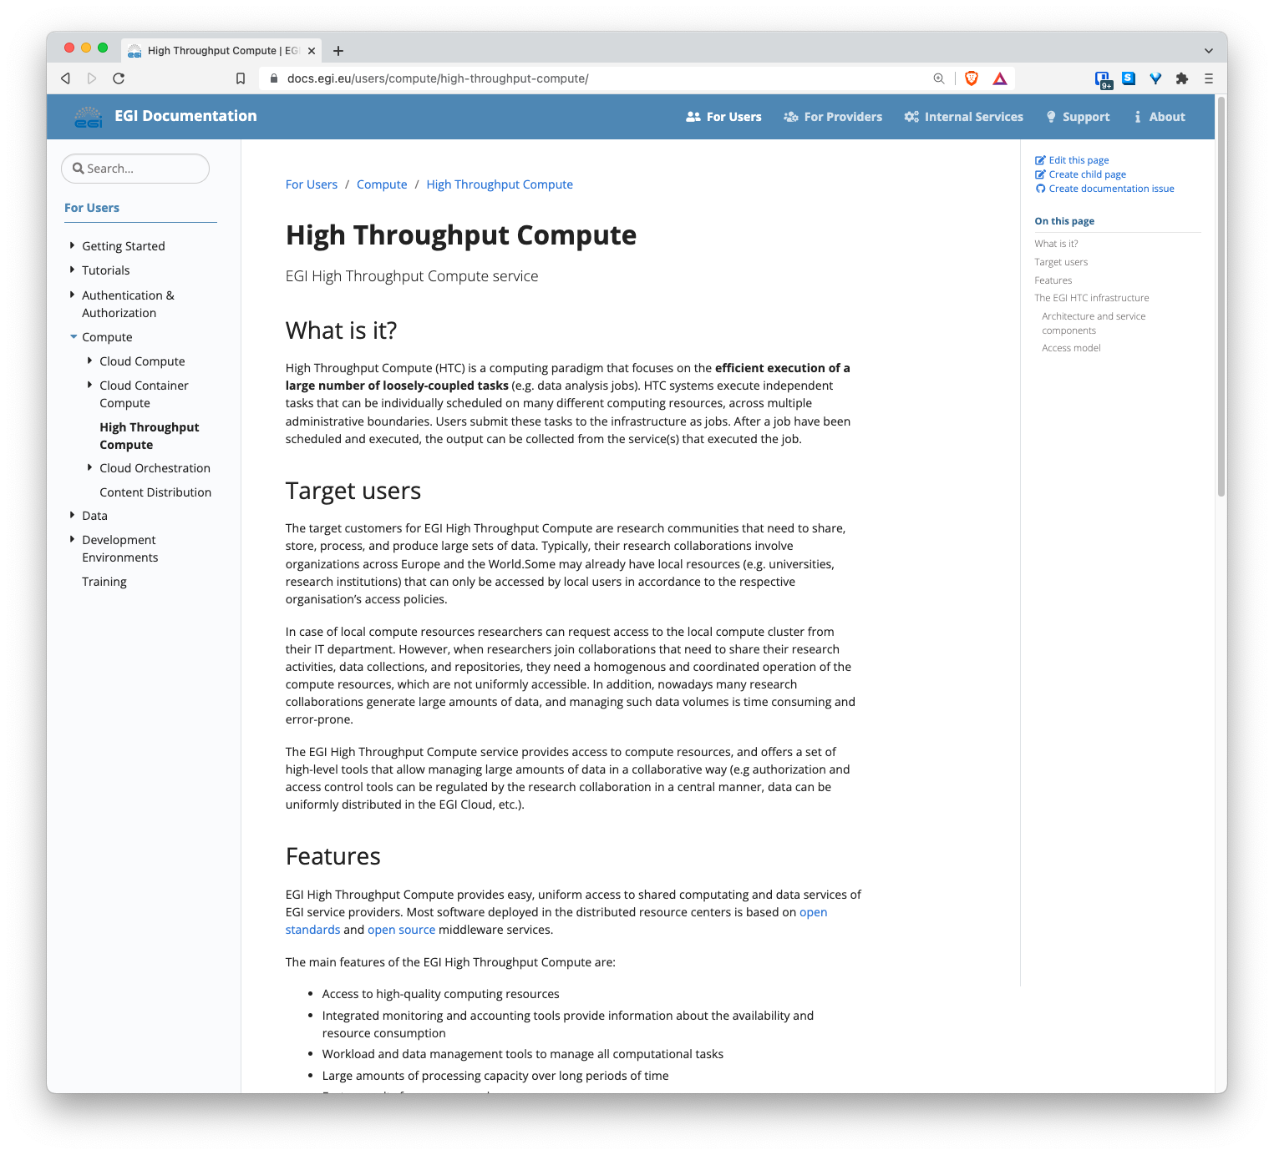
EGI documentation
https://docs.egi.eu/

