Slide 1
EGI Data Transfer Service - FTS
Service Owners:
Rose Cooper (rose.cooper@stfc.ac.uk)
Brian Davies (brian.davies@stfc.ac.uk)
05-04-2022

Slide 2
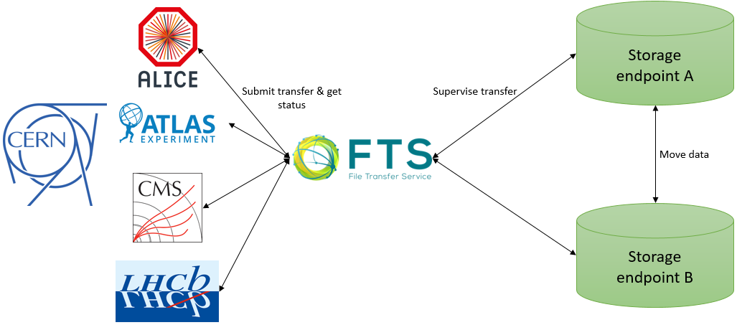
What is FTS?
Low level bulk data movement service
Responsible for moving files from one site to another efficiently
Distributes the majority of LHC data across the WLCG infrastructure
05-04-2022

Slide 3
Key features of FTS
Intelligent Scheduler
Balances transfers between many sites
Endpoint centric
Flexible service
Multiprotocol support
Interact via REST interface & WebFTS
Easy to use:
Session reuse
Web monitoring of transfers
05-04-2022

Slide 4
Types of transfers
FTS
Third party copy
GridFTP
XrootD
Webdav (HTTP)
Multihop transfers
Staging of data from tapes & archiving data to tape
Tape storage
Staging
Data Centre A
Data transfer
Data Centre B
Data transfer
Data transfer
Data Centre C
05-04-2022

Slide 5
Using FTS
Submit a transfer request via the command line:
fts-transfer-submit <url> <source> <destination>
Submit a transfer request through WebFTS:
Manage data transfer requests with Rucio
05-04-2022

Slide 6
Monitoring transfers
05-04-2022

Slide 7
Demo
05-04-2022

Slide 8
FTS Use cases
Experiments which produce large volumes of data
Need to move the data to different sites for analysis or storage
Able to move data in bulk
Can move data to tape as well as disc
Manage transfers from multiple VOs
Either Use built in FTS optimisation or can set own limits
05-04-2022

Slide 9
Current status of FTS
In the process of establishing a dedicated EGI-FTS instance
Will be able to have an instance that caters for the needs of the community
Configuration was delayed by upgrade of current production service to latest version, this is now complete!
Access to FTS via X.509 certificates or via proxy
05-04-2022

Slide 10
Future plans
Integrate FTS with EGI Check-in
Make EGI-Checkin an available authentication method for the RAL EGI-FTS instance.
Improve user accessibility & integration with the wider EGI community
Integrate with additional token authentication methods such as IAM.
05-04-2022

Slide 11
Thank you!
05-04-2022

